Slide 1
JUSTROM joint CoE-EC programme on
Roma and Traveller Women’s Access to Justice piloted in Bulgaria, Greece, Ireland, Italy, and Romania
- JUSTROM joint CoE-EC programme on Roma, Sinti and Caminanti (RSC) Women’s Access to Justice
In Italy
AD HOC COMMTTEE OF EXPERTS ON ROMA AND TRAVELLER ISSUES (CAHROM)
THEMATIC VISIT ON ROMA AND TRAVELLER’S ACCESS TO JUSTICE (WITH A FOCUS ON WOMEN)
Session 3: Lessons learnt from the implementation of the JUSTROM programme between October 2016 and March 2018
Helsinki, Finland , March 21 – 23, 2018

Slide 2
Kick-off
On October 18, 2016, UNAR (National Office against Racial Discrimination)-NRCP (National Roma Contact Point) promptly accepted to host the launch event of EU-CoE JUSTROM Programme in Italy - with the participation of national and local stakeholders, especially from Rome (Roma Capitale) and Naples where the Legal Clinics have been later established.
On February 6, 2017, UNAR presented jointly with ANCI and ISTAT the result of a two-year project, aimed at:
1. better understanding Roma’s access to basic human rights services, including housing, education, health-care, and labour;
2. monitoring all existing housing solutions of Roma and Sinti in the Italian Municipalities with over 15,000 inhabitants (i.e. private houses, social housing, settlements, and so forth).
“Gli strumenti di conoscenza e le sfide dell'informazione statistica per la strategia d'inclusione di Rom, Sinti e Caminanti”
Maja Bova, JUSTROM Italy National Coordinator
Notes:
Operationally, 606 out of the 738 Municipalities concerned replied to ANCI’s questionnaire: 55 % of Roma and Sinti are at home, mainly in North-Eastern Italy and mostly in public housing solutions. In 163 Municipalities out of 206, 79% of Roma and Sinti live in settlements. Settlements are 516, mainly in Lombardy, Emilia-Romagna, Latium, Tuscany, Piedmont.

Slide 3
Relevant Data
ANCI estimates approximately 516 settlements in Italy.
78.2% of settlements are stable.
In Latium region, 30% of settlements are precarious while in Campania they are mainly permanent.
61.9% of settlements are located in public spaces;
60.4% of RSC live in caravan, and 9.2% live in abandoned buildings.
In Latium, there are 7,260 people in settlements, while in Campania are 4,061.
- As for the origin of the settlements, about half of them dates back to 1994; and the lifespan of 30% of them ranges between 11 - 20 years.
- While basic services such as water and electricity are available in 70% of settlements and public transportation is available to nearly half of settlements, other social services remain limited.
At the end of 2014, overall figures indicate that 29,435 RSC live in settlements.
“Gli strumenti di conoscenza e le sfide dell'informazione statistica per la strategia d'inclusione di Rom, Sinti e Caminanti”
Notes:
www.cittalia.it

Slide 4
From a Human Rights Law Standpoint
JUSTROM joint CoE-EC pilot programme on
Roma, Sinti and Caminanti (RSC) Women’s Access to Justice in Italy
“29,435 RSC live in settlements”.
From a HRL standpoint, their legal status with a significant domino effect remains a matter of concern
As long as in the same family, members usually hold/may hold different legal statuses (EU citizens, Non-EU citizens, de facto statelessness, de jure statelessness, Italian citizens, refugees) with a different access to basic HR services

Slide 5
Presence of RSC in Rome and Naples
JUSTROM joint CoE-EC pilot programme on
Roma, Sinti and Caminanti (RSC) Women’s
Access to Justice in Italy
“At a municipality level, Rome is the Italian municipality with the largest number of settlements (both authorized and spontaneous) with 71 “camps”.
The Municipality of Naples counts 8 settlements”.
More recent estimates indicate the presence of about 7,500 Roma people in Rome and about 2,500 in Naples
The two Italian JUSTROM Teams conducted a re-assessment exercise of the situation on the ground (between February and March 2017)
Notes:
(this exercise is always on-going - somehow).

Slide 6
The Problems
JUSTROM joint CoE-EC pilot programme on
Roma, Sinti and Caminanti (RSC) Women’s Access to Justice in Italy
The situation and needs are very heterogeneous between Rome and Naples and within communities and among families.
It is thus not possible to provide a uniform formula and course of action.
Overall concerns mainly refer to:
- Legal status (i.e. statelessness, passport renewal, Kyenge Decree);
- Lack of access to housing, health-care, education, and employment (illiteracy);
- Discrimination;
- Domestic violence (as well as CEFM, THB, child prostitution, and so forth).
Notes:
Procedurally, confidence-building is an outstanding issue!

Slide 7
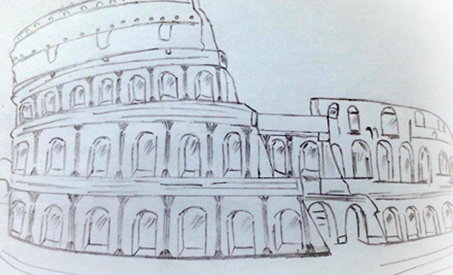
Local Situation
LOT 1 – Rome
The mobile Team has been covering the following settlements, though to a different extent: Campo Castel Romano”/Pontina: “Campo” Salviati 1, Campo Salviati 2 , Campo Gordiani, Campo Salone, Campo Monachina, Campo River, Campo Candoni, Magliana Area, La Barbuta, Finocchio-Borghesiana.
The Legal Clinic was initially located at our Lawyer’s firm. From December 2017 it has been moved at UNHCR-Rome Office in Via Caroncini 19
In Rome – LOT 1 - Following the June 2016 local elections, the new Mayor of Rome has decided to overcome the “settlements policy”.
Accordingly, in June 2017 the Municipality adopted a local plan of action for Roma Social Inclusion - which mentions and considers JUSTROM among partners.
The situation of Roma people and relevant problems greatly vary within settlements and among those living in dwellings and caravans.
Notes:
In Rome, the Office on Roma, Sinti and Caminanti and the ad hoc Office at Mayor’s Cabinet have started working on three settlements. In particular JUSTROM have provided legal advise with regard to the first settlement (Soon they will start working on the second and so forth). We plan to keep working with them, as appropriate.

Slide 8
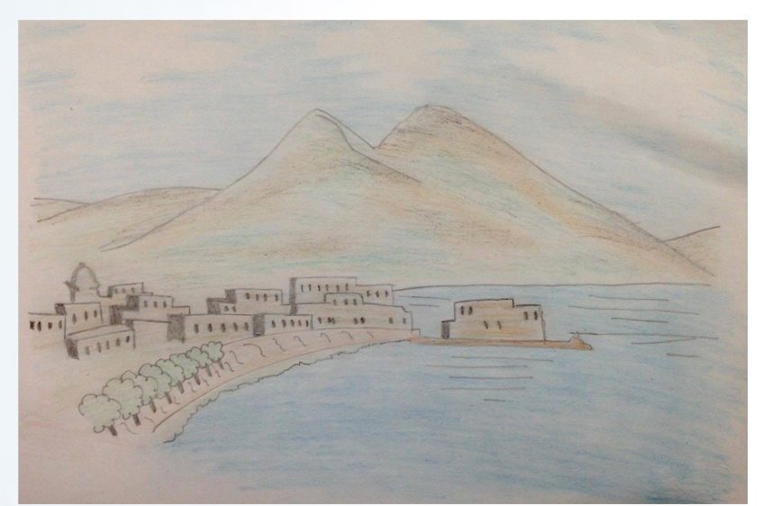
Local Situation
LOT 2- Naples
The mobile Team has been covering the following areas, though to a different extent: Gianturco area (Via delle Brecce); Grazia Deledda Former School; Via del Riposo; Scampia-Cupa Perillo; Giugliano-Ponte Riccio; Circumvallazione Esterna; Families in dwellings in Avvocata area.
The Legal Clinic, since the outset, has been established at Carlo Levi-Ilaria Alpi School in via Baku’ 4, Scampia, Naples
In Naples – LOT 2 – Following the June 2016 local elections, the Mayor of Naples was re-confirmed. Likewise Naples Town Councillor on Social Policies, who signed the associate partner form in November 2017, has been closely following JUSTROM since the outset.
The situation of Roma people and relevant related problems greatly varies within settlements and among those familiies living in housing and/or caravans.
Notes:
Between May 4 and May 12, 2017, JUSTROM got authorization both orally and in writing, to visit Grazia Deledda and Via Del Riposo settlements.

Slide 9
Awareness-raising gatherings, Visibility, and Associate Partners Forms
Partnership Agreements
Observatory on Poverty (adhered);
National Bar Council (pending);
Naples Bar Council-HR Commission (to be re-submitted following local elections held in September 2017);
Naples Municipality (signed);
Roma Capitale (signed at technical level. Pending the political ratification);
CPIA 1 – Adults school (signed);
Carlo Levi School in Scampia (signed);
UNHCR (signed);
UNAR (pending);
Rebibbia prison (pending);
Under JUSTROM 2, we do expect to extend and enhance the former ones while signing new ones, including with UNAR; and ideally, given the main problems relating to legal status, with key Embassies. Also media sector is to be better explored.
During all awareness-raising events, there has been always great interest and expectations from communities (However, approaches are totally different between Rome and Naples due to the differing different context among communities).
We also managed to organize in Rome: a Training for Teachers of the penitentiary circuit at Rebibbia prison (December 11-12, 2017) and a Training of Trainers for Legal Professionals (from December 13 through December 15, 2017) at National Bar Council.
In terms of visibility, JUSTROM has been “noted” by the UN CEDAW Committee. On various occasions, by the press too (i.e. Avvenire nation-wide distributed newspaper). JUSTROM-Italy has been also mentioned and reported on the EU EPALE Platform.
Notes:
In three out of six events, UNAR participated in.
ASL NA 2 North (supported and thanked).
Networking
In terms of contacts, confidence-building is essential and very time-consuming. Key partners remain Prefectures and Police HQs, local Authorities, and Embassies. Equally important are grass-root NGOs (and all other key local authorities).

Slide 10
Substantial Law
JUSTROM joint CoE-EC pilot programme on
Roma, Sinti and Caminanti (RSC) Women’s Access to Justice in Italy
The two Italian JUSTROM Teams have been dealing so far with a total of 184 (164+20) and 88 (85+3) cases of a JUSTROM relevance.
Most cases dealt with by Rome’s JUSTROM Team (LOT 1) are of relevance for specific JUSTROM purposes, especially when considering the under-reporting and emergence of cases of gender-based discrimination and/or violence, - as aggravated by the inner multiple and intersecting discrimination characterizing Roma women.
Please also note that women usually do not want to denounce partner of the author of violence, but just exit the circle of violence and find an alternative solution.
The Rome Team has also been dealing with a case successfully settled defined “the erased”, which about 100 people will benefit from.
As for the situation in Naples, the lack of awareness about rights by right-holders, especially women, is self-evident (illiteracy is an issue in Giugliano and Naples); and for the time being, formally, cases mainly relate to legal status (Kyenge Decree; passport/passport renewal; residence permit; and fiscal code/driving license).
Leggi una volta,
E con pazienza
Sapevate di avere tutti questi diritti?
Notes:
Cases of discrimination and violence are considered in light of relevant EU Directives, CoE Conventions, including Istanbul Convention, international HR treaties as ratified by Italy, and Italian legislation, including Legislative Decrees No. 215-216/2003 - besides considering the specific sectoral legislation to be applied to each and every case.

Slide 11
Specific Problems
When it comes to legal status, it emerges in particular, among institutional stakeholders and the communities concerned, a general lack of awareness of the so-called Kyenge Decree (this happens especially in Naples and Giugliano).
Moreover, while cases of GBV and exploitation, including child prostitution, are emerging in Rome, the code of silence in Naples remains very high (with 20 and 3 GBV cases, respectively).
More specifically, mention has to be made of the following:
1. Access to work;
2. The issue of pro bono pathway in lieu of legal aid scheme;
3. The complexity of the issues and problems;
4. The bureaucracy behind pathways and the different approaches,
which vary from one place or Municipality to another;
5. Confidence-building vis-à-vis both communities and Institutions.
With regard to legal status, in an attempt to help people getting regularized, an outstanding issue is the money necessary to renew passports: Low incomes may constitute a concrete obstacle, which merits the utmost attention.
Another issue is that people usually do not have just one issue/problem but many issues as is the case with a young mother in Naples, victim of family ill-treatment, with two children at a foster home and with a very problematic family in law.
Women exiting violence just need/want a safe shelter and to work.
Last, illiteracy is a matter of concern, in particular in Giugliano while school drop-out is very common in all localities.
Programma Congiunto
Unione Europea/Consiglio d’Europa su
L’Accesso alla Giustizia per le Donne Rom, Sinte e Camminanti - JUSTROM
In terms of JUSTROM 1 final overall data, we:
Informed 1,415 people (of which 952 with signature/initials (More specifically, 698 w.s./254 w.i.)); Assisted 875 people - for a total of 892 cases; Held 1,776 consultations; and 622 complaints (of which 254 filed
+368 (190+187) followed).
Needless to say, as a general rule, we have followed: Women; men; and entire family groups.
Notes:
Approaches change and are different between the two localities.

Slide 12
First Results and Possible Way Forward
The situation on the ground remains complex and fragmented.
As a way of examples, Roma Capitale is currently working on two of the three initial settlements to be closed within the new local strategy to overcome the settlement system.
In Naples, a big arson affected Scampia settlement (being the oldest one) in August 2017. Various options are pending on the table.
In Giugliano, last February 9, 2018, the Mayor announced that the eco-Village for Roma will not be built anymore. Other solutions for inclusion are to be clarified and indicated – hopefully in the course of next weeks.
As mentioned at the outset, there is no single common formula to be applied: approaches vary accordingly (However in general terms, activities focus on: escorting people to public Institutions; explaining pathways and rights (legal orientation, advice); supporting/re-assuring them also from a moral/psychological standpoint; setting up synergies and networking, facilitating administrative pathways in lieu of a judicial one).
Programma Congiunto
Unione Europea/Consiglio d’Europa su
L’Accesso alla Giustizia per le Donne Rom, Sinte e Camminanti - JUSTROM

Slide 13
First Results and Possible Way Forward
Programma Congiunto
Unione Europea/Consiglio d’Europa su
L’Accesso alla Giustizia per le Donne Rom, Sinte e Camminanti - JUSTROM
In terms of feedback/impact, this is something we cannot actually judge:
(provided that )People are sometimes too impatient and do not understand that bureaucracy-wise and judicial proceedings are very time-consuming, and confidence-building is an endless process as evidenced by the reluctance of some people in signing even the power of attorney,
We are increasingly known and people have expectations, look for us and do want to support us (Evidence of this emerges from last days when people keep coming to legal clinics and look for us despite this period of break. One week ago, a group of boy scouts from Scampia has contacted us because they would like to help us promoting knowledge about citizenship’s acquisition among foreigners - if feasible).
In terms of impact, Ms. Rotondo, the principal of Scampia School, has declared publicly that Scampia needs JUSTROM and she would be willing to pay the Team if necessary to continue our work, should not the Programme be extended.
Greater light shed is to be reported on the typology of cases which mainly refer to: legal status (immigration and statelessness); discrimination, including institutional discrimination; family ill-treatment; and domestic violence (and THB, CEFM, child prostitution).
Estimates indicate that in Italy Roma stateless people range between 3,000 and 10,000.
In terms of achievements, local Institutions have gotten to know us. The confidence-building process is ongoing and never stops.
In positive terms, in particular the fruitful cooperation with CPIA3 in Rome, ASL NA 2 North in Giugliano, as well as the Police HQs, and the Office of the General Public Prosecutor in Naples.
In terms of partnerships and synergies, it is necessary to add: Centro Lima; Arrevutammoce NGO; and Girasoli dell’Est, NGO in Naples, among others.
In the course of JUSTROM 2, upon Strasbourg authorization, there is a specific need to work with Embassies in a synergic way; and Rome ordinary tribunals; besides strengthening existing synergies with UNAR; National Bar Council; local Bar Councils; prison circuits (and so forth).
Potential new stakeholders include media sector.
In terms of (additional) issues, attention should be paid to, inter alia: adult (il-)literacy; school drop-out; HRE among Non-Roma; and adequate access to health-care.

Slide 14
JUSTROM joint CoE-EC pilot programme on
Roma, Sinti and Caminanti (RSC) Women’s
Access to Justice in Italy
In conclusion, this Programme is proving to have a multiplier effect
(“Access to justice does not trigger
(access to) strictu sensu justice, only”)
I do thank you for your attention!
For more information on JUSTROM-Italy, please contact
maja.bova.justrom@gmail.com
Programma Congiunto
Unione Europea/Consiglio d’Europa su
L’Accesso alla Giustizia per le Donne Rom, Sinte e Camminanti - JUSTROM
Notes:
(Abstract from Italy JUSTROM Brochure for beneficiaries)
Programma congiunto Unione Europea/Consiglio d’Europa su L’Accesso alla Giustizia per le Donne Rom, Sinte e Camminati - JUSTROM
Sapevate di avere tutti questi diritti?
Leggi una volta,
E con pazienza
Come possiamo aiutarti:
Se siete a ROMA
o a NAPOLI
e siete:
• Donna rom o sinta;
• Rom o Sinto;
• Persona di altri gruppi vulnerabili, come
per es i poveri;
• Bambini e giovani senza sostegno dei genitori;
• Da soli/e, con persone a carico.
Se sei una vittima di:
• Discriminazione e di altre violazioni dei diritti umani, tra cui:
• Mancanza di accesso ai servizi pubblici (per es. scuola e salute);
• Maltrattamenti e violenza.
Se si desidera il nostro sostegno, per
• Notificare alla magistratura e alle altre Istituzioni, richieste in materia di diritti umani;
• Ricorrere alle Istituzioni per difendere i vostri diritti.
Ti possiamo assistere se chiedi il nostro aiuto, nel corso del 2017.
Ti diamo un facilitatore, un assistente legale ed un avvocato in grado di consigliarti; e possiamo noi scrivere le domande per Te.
Telefonaci
0039 347 52 69 879
Scrivici
justromitaly@gmail.com
Ed il facilitatore ti ascolterà.
Se ti possiamo aiutare, ti daremo consigli nel presentare e seguire le tue domande, con l’aiuto anche di un assistente legale.
Se possibile, il nostro avvocato ti aiuterà nel percorso giudiziario specifico, utile per Te!
L'interessato/a ha diritto:
1. Nel rispetto della legge, di scegliere ciò che si vuole fare.
2. Essere trattato/a come le altre persone.
3. Poter presentare con faciltà le proprie richieste a tutte le Istituzioni pubbliche, compresi i Tribunali, per difendere i propri diritti (per es. richiesta di cittadinanza, rinnovo passaporto, rinnovo permesso di soggiorno, apolidia, ecc.).
4. Chiedere alle Istituzioni pubbliche, le informazioni in loro possesso e di tuo interesse; e di ricevere una risposta in base alla Legge sulla Trasparenza.
5. Ricevere le copie di tutti gli elementi del fascicolo che ti riguardano.
6. Riferire le tue esigenze agli Enti pubblici, attraverso documenti scritti, testimoni, esperti, ecc..
7. Se chiedi alle Autorità amministrative (Municipi e Prefetture ed altre Istituzioni) e non sei soddisfatto/a della risposta, si può ricorrre al Tribunale.
8. Se si ricorre al Tribunale, devi usare i rimedi giudiziari: ricorso, appello, reclamo, ecc..
9. Se spendere per un processo per difendere un tuo diritto, mette te o la tua famiglia in difficoltà,
hai diritto all’assistenza legale di un avvocato.
Sapevate di avere tutti questi diritti?
Cosa aspettarsi nel fare richieste alle Istituzioni pubbliche:
Per essere considerati/e, è meglio scrivere dei documenti ed atti, conservare la tua copia e chiedere al pubblico ufficiale di registrare la tua richiesta. In molti casi, si dovrà essere pazienti.
Nella maggior parte dei casi, la Legge prevede dei tempi specifici per le Istituzioni pubbliche per rispondere alla tua domanda.
Spesso le indagini della Polizia o comunque delle Autorità competenti richiedono mesi od anni.
E’ possibile che le domande da presentare abbiano alcuni costi: tasse, onorari degli avvocati e degli esperti, ecc..
I costi potrebbero essere molto elevati.
E solo alcuni costi possono essere coperti dal gratuito patrocinio.
Contattaci se sei a Roma
o a Napoli

