Slide 1


Best practices on promoting women and girls’ participation in sport
FROM SPARKLE TO SPORT
FROM SPARKLE TO SPORT
Nadia Bonjour · NB communication
Council of Europe · Breakfast Roundtable · 6 March 2026

Slide 2

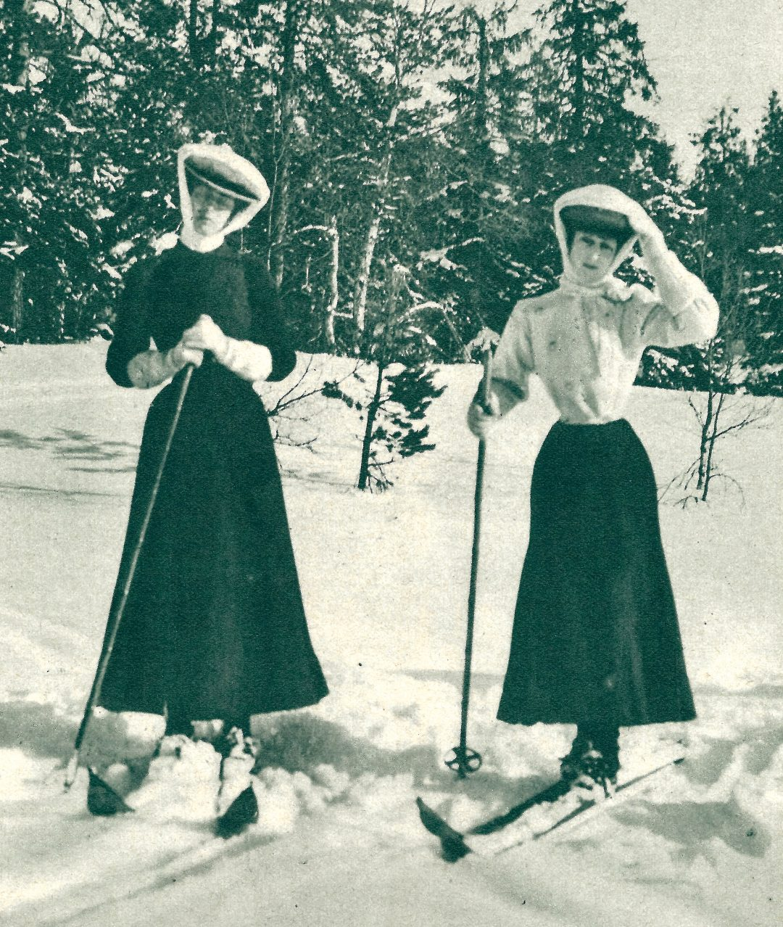
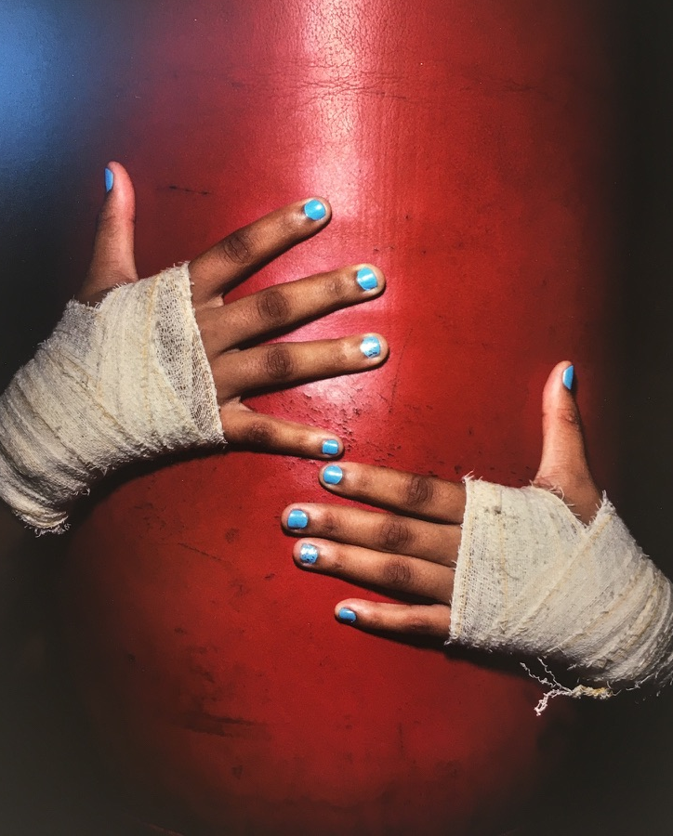
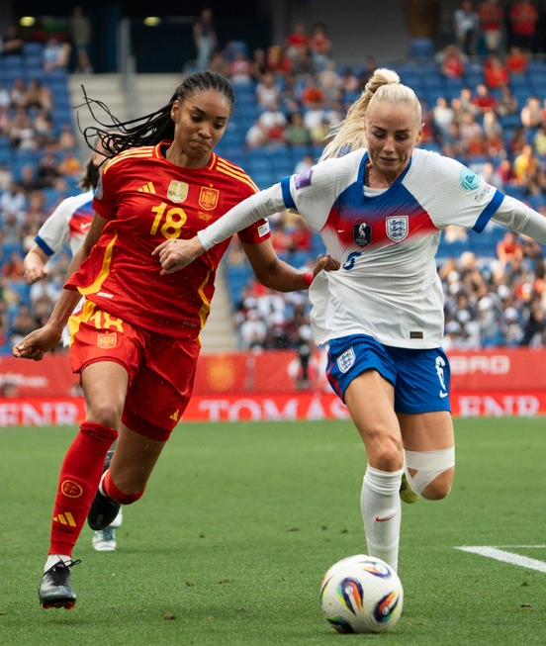


“Inspirational”
“History-makers”
“Breaking barriers”
“Extraordinary”
Credit: Vesterheim (2018)
Credit: IOC / Alex Majoli (2018)
Credit: Getty Images (2025)
Women’s sport: has it become normal, or simply more visible?
06·03·2026 | Nadia Bonjour

Slide 3
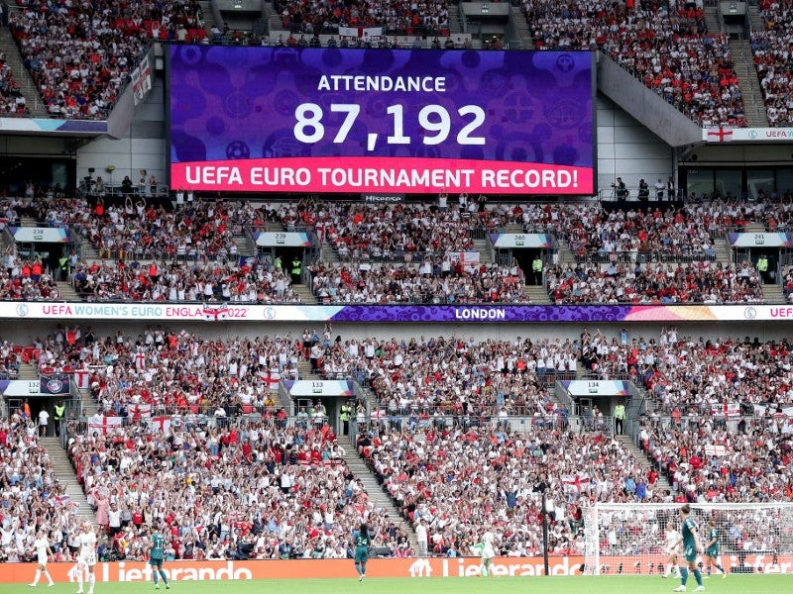
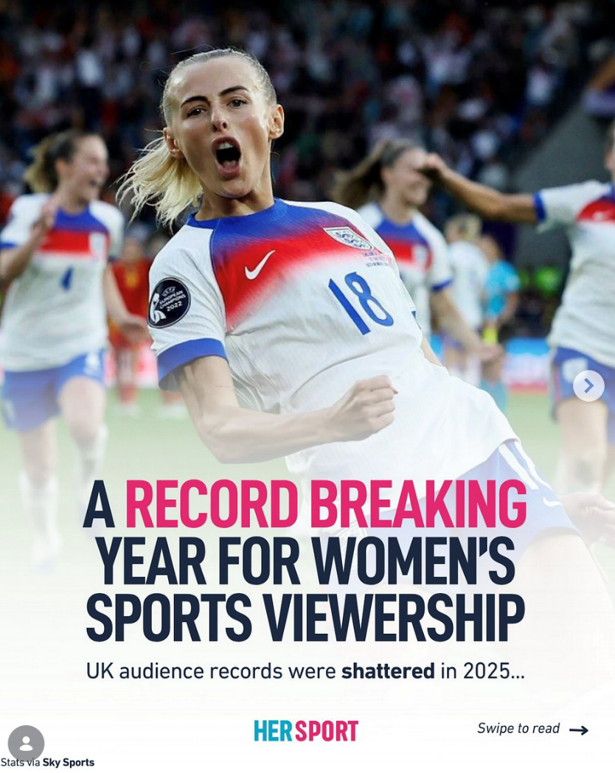

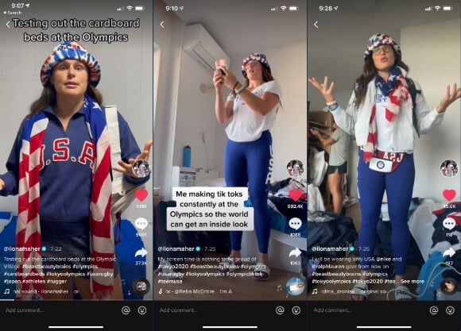
The *sparkle* trap
MOMENTUM
Record attendance
Record broadcast audiences
Record engagement
06·03·2026 | Nadia Bonjour
Notes:
Momentum :
Record audiences of women’s events: both in the stands and on television.
Record engagement on social media, driven largely by women athletes.
AND YET…
13% of coaches accredited at Tokyo 2020 were women (IOC 2022)
20% of media accredited at Tokyo 2020 were women (IOC 2022)
11% of IF Presidents in 2022 were women (IOC 2022)
No women among top 100 highest-paid athletes in the world
Image credits :
UEFA x Getty Images (2022)
TikTok @IlohnaMeier (2021)
@hersport.ie (31 Oct. 2025)

Slide 4
The *sparkle* trap
MOMENTUM
STRUCTURAL REALITY
Record attendance
10-13% women Olympic coaches
Record broadcast audiences
~15% media coverage globally
Record engagement
0 women in top 100 highest-paid athletes
06·03·2026 | Nadia Bonjour
Credit: @fjustwomenssport (2023)
Notes:
Momentum :
Record audiences of women’s events: both in the stands and on television.
Record engagement on social media, driven largely by women athletes.
AND YET…
13% of coaches accredited at Tokyo 2020 were women (IOC 2022)
20% of media accredited at Tokyo 2020 were women (IOC 2022)
11% of IF Presidents in 2022 were women (IOC 2022)
No women among top 100 highest-paid athletes in the world

Slide 5
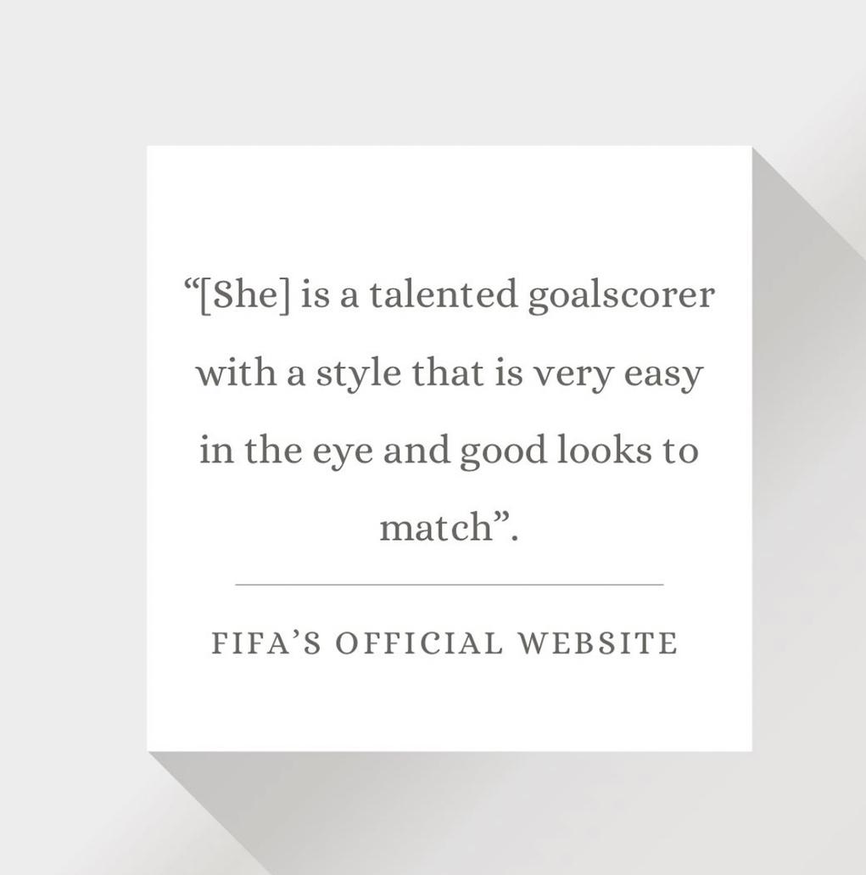
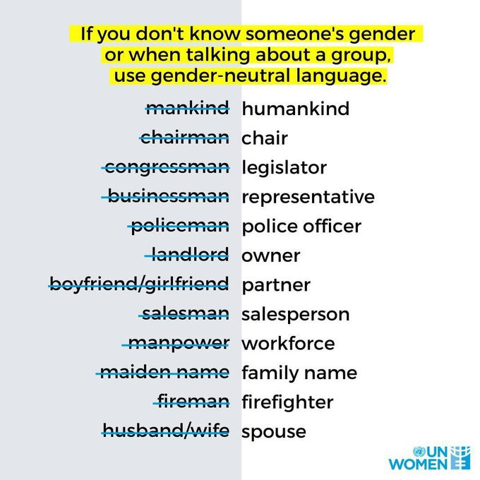
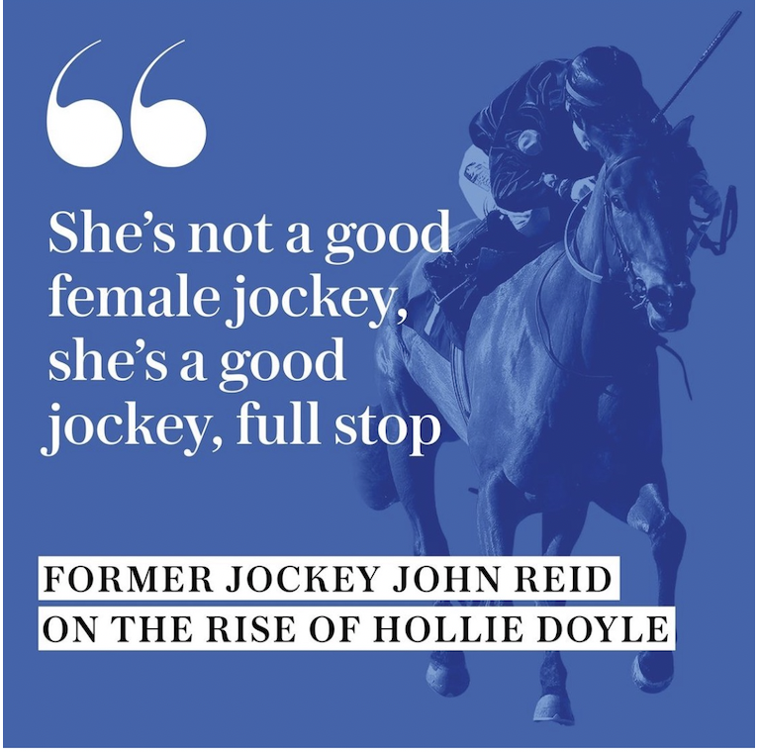
Credit: @jamilarizvi (13 August 2023)
Credit: @unwomen (2020)
Credit: @telegraphwomenssport (2020)
The power of language
06·03·2026 | Nadia Bonjour
Notes:
It's the language.
Not just the obvious stuff – the patronising commentary, the focus on appearance, the gender-marking of "female footballer" versus simply "footballer." It's the subtler architecture of words, images, framing, tone, prominence – and whose voice is doing the telling.
Just as language can reinforce stereotypes, it can also break them down.
---
Image credits:
Rizvi, Jamila [@jamilarizvi]. (2023, August 13) [Caption visual]. Instagram. https://www.instagram.com/jamilarizvi/p/Cv3PMRAhLLG/
UN Women (2020)
The Telegraph Women’s Sport [@telegraphwomenssport]. (2020, December 17) [Quotecard]. Instagram. https://www.instagram.com/p/CI47hu3g41x/?igshid=NzZhOTFlYzFmZQ%3D%3D

Slide 6
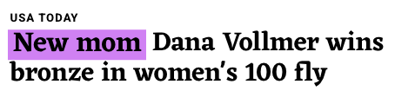
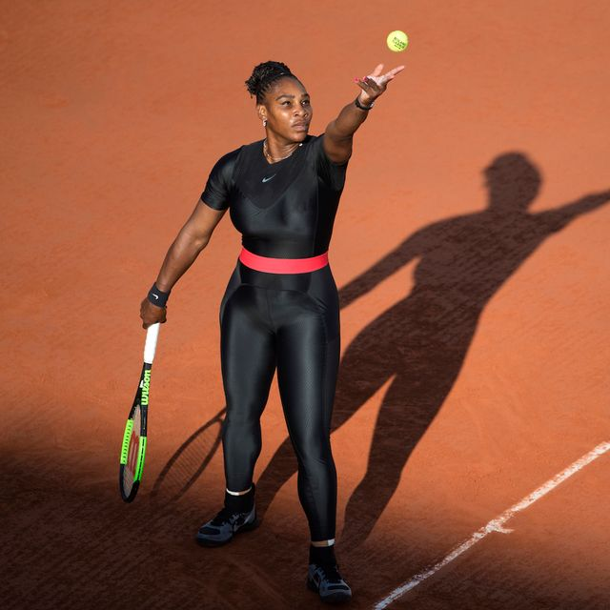
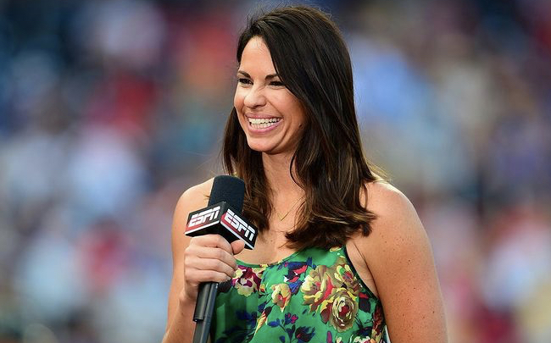

Change one word.
Change one image.
Change one voice.
Change the narrative.
The power of language
06·03·2026 | Nadia Bonjour

Slide 7
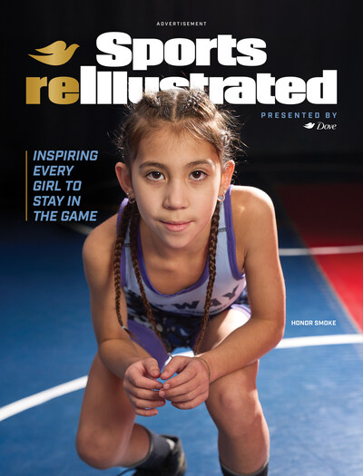
What can we do?
Change the narrative
Measure what matters
Move women’s sport from exceptional to everyday.
Track portrayal, not just participation.
Build, don’t just celebrate
Set the standard
Embed equality into funding, governance and frameworks.
Shift structures, not just headlines.
Credit: Dove x Sports Illustrated (March 2025)
Make women’s sport normal.
Not exceptional.
06·03·2026 | Nadia Bonjour

Slide 8

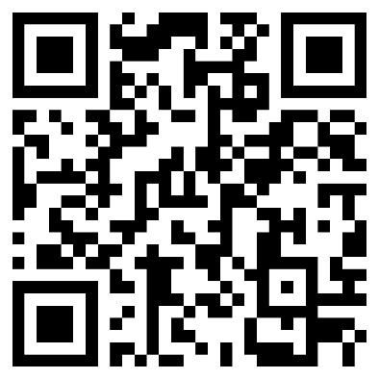
It’s not just what you say, but how you say it.

Slide 9
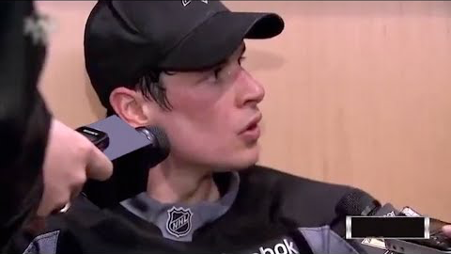

9
Notes:
A great example on the difference in treatment between men and women in sport. The moment we flip the script, mindsets change. Something that sounded normal to ask women, suddenly sounds very odd.
Demonstrates the power of language and how the language we use is (unconsciously) reinforcing discriminatory attitudes and socially constructed gender roles. Which implies, that if we pay more attention to our language and use it differently, we can then do the opposite and deconstruct these stereotypes.
World of sport plagued by many of the same gender inequalities that we see more broadly; unequal pay, gender-based harassment and abuse, lack of targeted investment, and negative stereotypes and social norms. Gender norms are the root of social inequality across the globe.
---
video #CovertheAthlete (2015): https://www.youtube.com/watch?v=Ol9VhBDKZs0

