Slide 1


BLACK GIRLS & SPORT:
A BREAKUP STORY

Slide 2

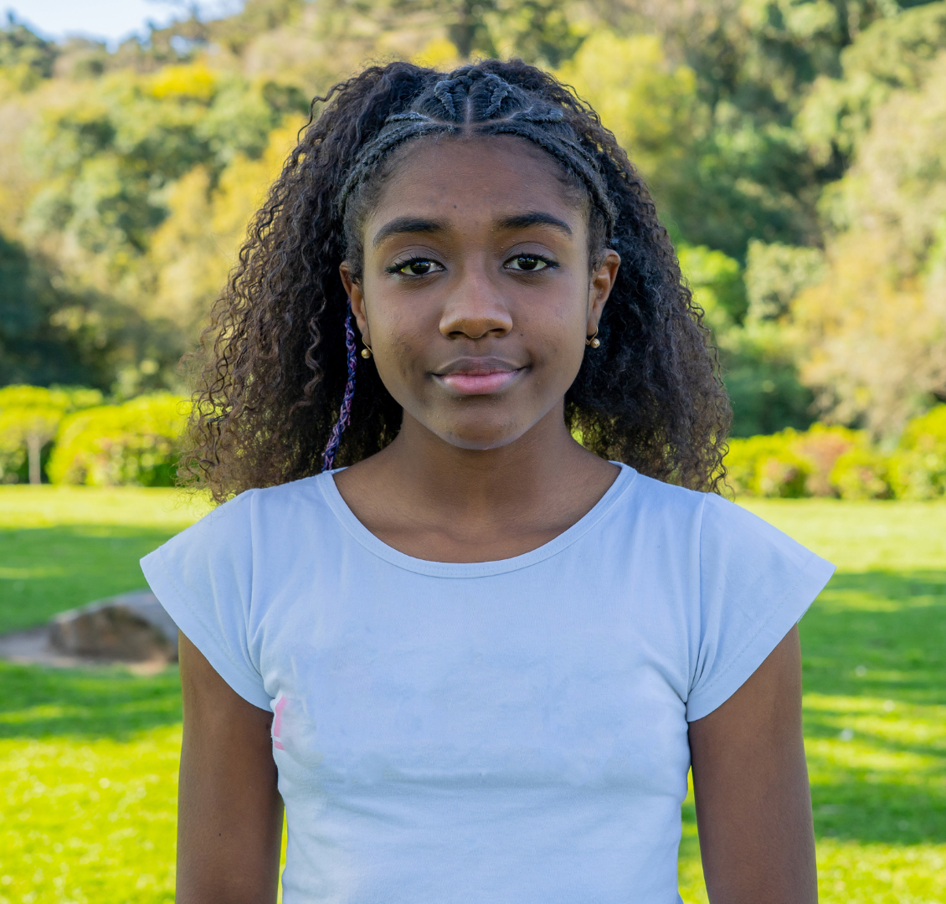
WOMEN IN SPORT
Founded in 1984, Women in Sport is the longest-standing charity in its field, advocating for the needs and rights of women and girls in sport.
WHY WE DID THIS RESEARCH
“Sport should be a sanctuary, a source of joy and a gateway to opportunity. But for too many Black girls, it becomes a source of pain, exclusion and loss, to feel like another space where they don’t belong.”
We must change this story.

Slide 3
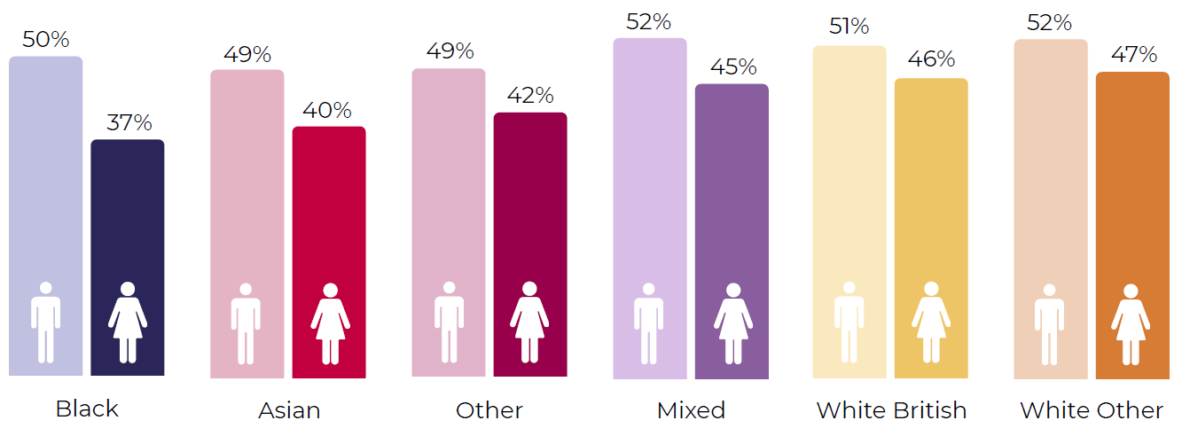
BLACK GIRLS LOVE SPORT…
60% of Black girls dream about reaching the top in sport compared to 33% of White British girls
85% of Black girls say sport makes them feel happy and carefree
68% enjoy competitive sport
…YET, BLACK GIRLS ARE THE LEAST PHYISICALLY ACTIVE OF GROUP OF GIRLS
Outside of school,
only 14%
of Black girls are active for 30 mins or more a day on average.
Significantly less than any other group of girls.
Data: Women in Sport (UK) and Sport England

Slide 4
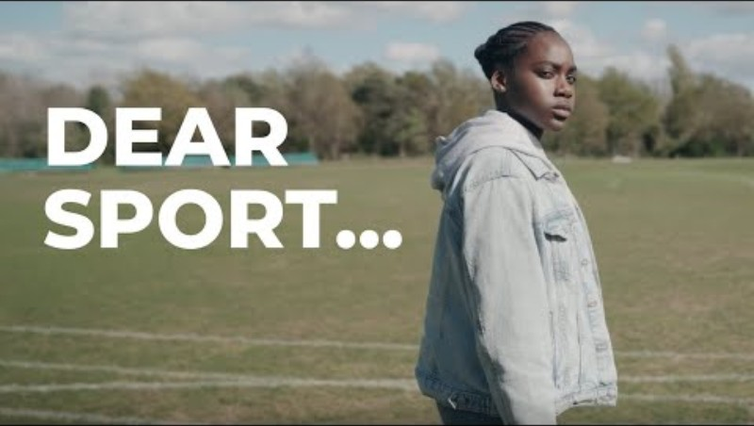

Slide 5
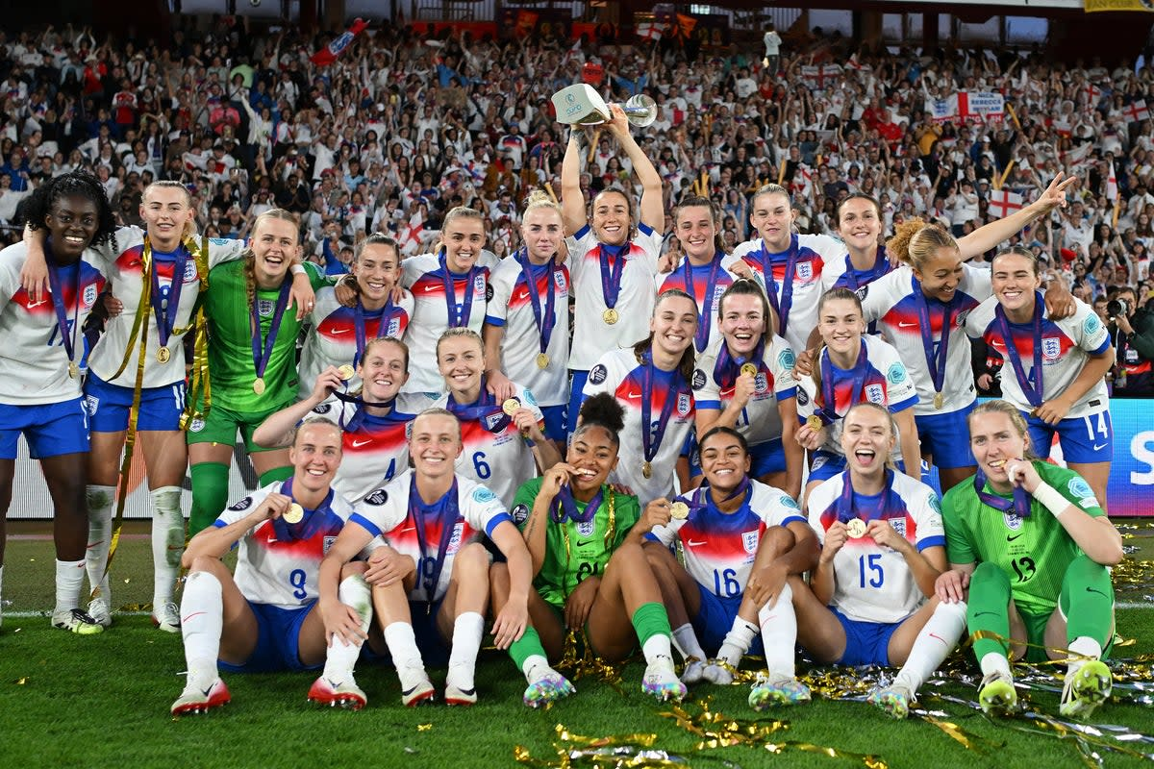
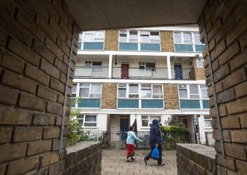
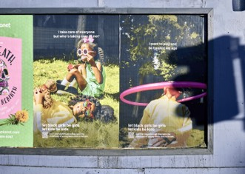


Life for teenage girls is hard, life for teenage Black girls even harder
The context that shapes her world
Minoritisation
Poverty & Economic Inequality
Responsibility & Adultification Bias
Ambition for Social Mobility
Safety & Trust

Slide 6


WHAT PUSHES BLACK GIRLS OUT OF SPORT?
Race lens
(harms felt by Black boys too but
more acute for Black girls)
Isolation
Sports typecasting
Stereotyping
Adultification
Gender lens
(harms felt by White girls too but more acute for Black girls)
5. Seriousness
6. Fewer facilities / safety
Intersectional
(unique to Black girls’ experience)
7. Her Hair
8. Masculinisation
The top 9 most common barriers and experiences

Slide 7

THE SYSTEM MUST EVOLVE TO MEET THE NEEDS OF BLACK GIRLS
“We are not going to just change because you want us to change… by doing what you want, you’re kind of lowering us to the way you want us to be… you need to find a way to change… so I don’t have to change myself.”
– Sasha, 19
“You should feel privileged whenever a Black girl walks up and knocks on your door because they are trusting you with their future, despite everything that has come before.”
– Expert stakeholder
Black Girls and Sport: A Breakup Story
www.womeninsport.org

