Slide 1
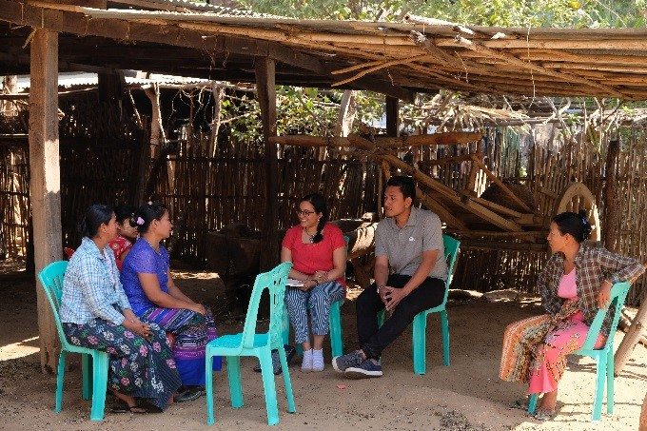
human rights impact assessmentS of private sector projects
Tulika Bansal, Senior Adviser - Human Rights and Business, Danish Institute for Human Rights

Slide 2
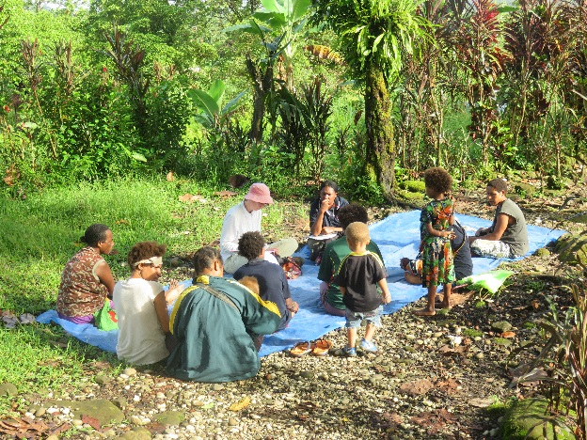
WHAT IS A HUMAN RIGHTS IMPACT ASSESSMENT?
A context specific process for identifying, understanding, assessing and addressing the adverse effects of a business project, activities or operations on the human rights enjoyment of impacted rights-holders such as workers, community members or consumers.
It is an elaborate assessment process.
Stand-alone exercise, but iterative follow up activities is essential to ensuring long term impacts.
HRIAs are on human rights, through human rights, for human rights.

Slide 3
HRIA as a discipline is inspired by ES(H)IA and SIA practices
Social Impact Assessments (SIAs): Tool to assess social impacts of a project
similarities: such as community engagement and impact mitigation
distinctions: human rights expertise / approach not guaranteed; SIAs uses a variety of benchmarks, it also looks at project benefits, and there is no explicit focus on rights-holders vs duty-bearers
Environmental, Social & (Health) IAs: Tool to assess env., social & health impacts of a project
Legally required by national law for certain types of projects
Do not explicitly apply human rights and can overlook critical elements such as:
Labour issues in the supply chain
Post-conflict or conflict-sensitive areas
Security activities related to business operations and/or activities
Gender analysis and an assessment of the gender impacts
Rights of indigenous peoples & focus on vulnerable individuals/groups
Community impacts related to business relationships or activities
In-migration associated with the development of the business project
Legacy human rights impacts associated with the activities of previous business operators
Cumulative impacts, involving human rights impacts of other businesses

Slide 4
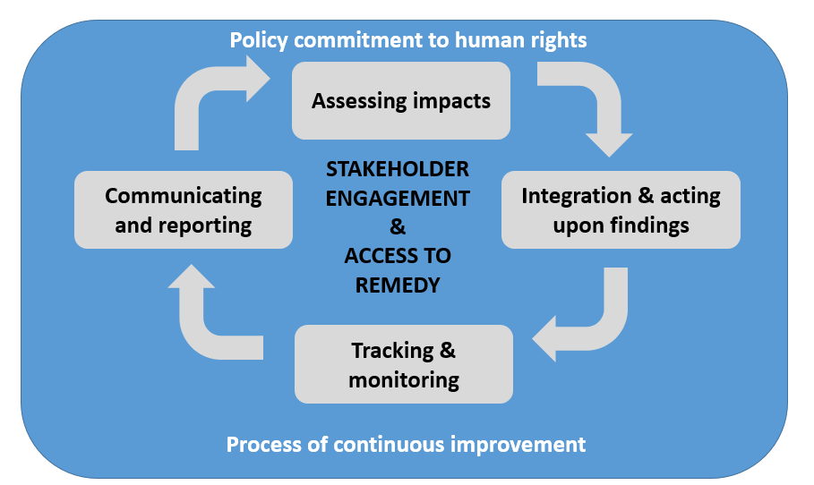
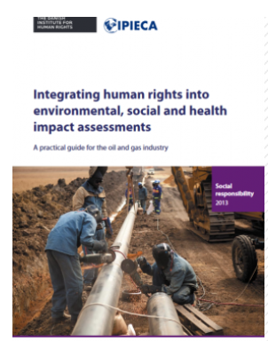
HRIA AND Human rights due diligence
The UN Guiding Principles on Business and Human Rights (UNGPs) require assessment of human rights impacts – not necessarily a ‘human rights impact assessment’.
Other types of assessments and due diligence activities are also needed to comply with UNGPs
Integrating elements of HRIA methodology into other assessments and ESG activities can improve quality thereof and enable scalability

Slide 5
Different types of Human rights impact assessments
Integrated HRIAs
Human rights integrated into Environmental, Social and/or Health Impact Assessments
Stand-alone HRIAs
Company–led HRIAs
Sector-Wide Impact Assessments
Looking at an entire business sector rather than a project
Specific topics integrated into wider HRIAs (gender/child rights)
Community-led HRIAs
Issue based HRIAs
Product based HRIAs
Collaborative HRIAs
Different ideas around collaborative HRIAs.
Do not exist yet – could this be one of the ways forward?

Slide 6
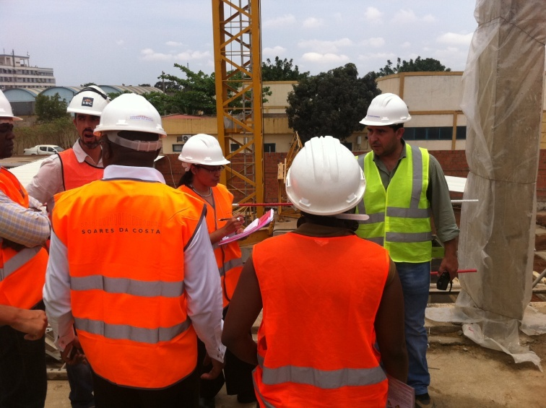
WHAT DO human rights impact assessmentS AIM TO ACHIEVE?
Identification, avoidance and addressing of adverse human rights impacts - change for people on the ground (rightsholders)
Establishment of meaningful dialogue between stakeholders in a particular context, including through developing joint ways forward
Facilitating capacity building and learning of internal and external stakeholders involved
Enhancing transparency and accountability of the business through documenting the impacts that have been identified and actions taken to address these
Empowering rights-holders to hold business to account for adverse human rights impacts

Slide 7
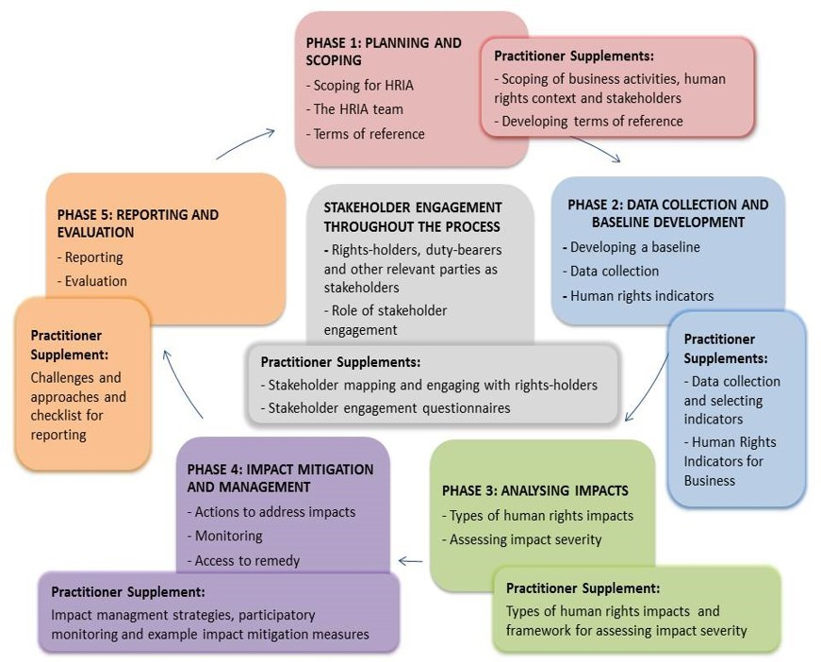

Slide 8
Key Criteria for Human rights impact assessment
Summary of 10 key criteria for human rights impact assessment
Process | Participation | Rights-holders, duty-bearers and human rights actors Throughout the process
 | Non-discrimination | Inclusive engagement and consultation Gender-sensitive Vulnerable individuals and groups
 | Empowerment | Capacity building to participate
 | Transparency | Process and outcomes
 | Accountability | Assessment team is supported by human rights expertise Responsibilities for mitigation are assigned and adequately resourced Entitlements of rights-holders and the duties of duty-bearers identified
Content | Benchmark | Human rights standards
 | Scope of impacts | Actual and potential impacts: caused by the business; to which the business contributes; and impacts linked through business relationships Cumulative impacts and legacy issues are considered
 | Assessing impact severity | Impacts addressed according to severity of human rights consequences Account for the interrelatedness of human rights, as well as the interrelatedness of environmental, social and human rights factors
 | Impact mitigation measures | Addressing follows mitigation hierarchy ‘avoid-reduce-restore-remediate’ No offsetting
 | Access to remedy | Avenues whereby rights-holders can raise concerns or complaints During and after the assessment
Source: DIHR (2016), Human Rights Impact Assessment Guidance and Toolbox

Slide 9
Human rights impact assessments: CHALLENGES & Lessons learnt frOM PRACTICE
Timing, selection of country and scope: when and where to carry out a HRIA? Can outcome of HRIA influence decision-making? How deep to go into business relationships?
Stakeholder and rights-holders engagement: requires local expertise + sufficient time to be meaningful (e.g. through a scoping mission).
Engagement with vulnerable groups: Use of proxies were needed
Time and resources: combining cost-effectiveness + sustainability vs scope and depth
Follow up: ensuring adequate follow up, e.g. through follow-up assessment in same location, needs allocation of resources
Government authorities: risks vs. value add of engaging with government actors during HRIA
Public reporting and transparency: Core requirement in this time. Better to be open than be criticized by NGOs /journalists
Making it normal: HRIA still a very embryonic practice – how to scale up?

Slide 10
Examples of HRIA reSOURCES
Introduction to HRIA: https://www.humanrights.dk/tools/human-rights-impact-assessment-guidance-toolbox/introduction-human-rights-impact-assessment
HRIA Guidance and Toolbox (DIHR): https://www.humanrights.dk/tools/human-rights-impact-assessment-guidance-toolbox
Handbook on HRIA: https://www.humanrights.dk/news/new-handbook-offers-insights-how-address-impacts-business-activities-human-rights
CDC Toolkit Guidance resource: ToR for human rights due diligence (includes HRIAs): https://toolkit.cdcgroup.com/reference-materials/
Information on integration of human rights into ESHIAs: https://www.humanrights.dk/tools/human-rights-impact-assessment-guidance-toolbox/human-rights-eshia-practitioners
Business and Human Rights Resource Centre page on HRIA: https://www.business-humanrights.org/en/un-guiding-principles/implementation-tools-examples/implementation-by-companies/type-of-step-taken/human-rights-impact-assessments
Various HRIA reports by DIHR: i.e. Nestlé, Eni, Total, other (see website)
Examples of HRIA reports by BSR: i.e. Telia, Facebook, other (see website)
Examples of HRIA reports by Nomogaia: http://nomogaia.org/work/
Sector-wide impact assessments: what are they?: https://www.humanrights.dk/sites/humanrights.dk/files/media/document/Sector-wide%20impact%20assessments%20%28EN%29.PDF

