Slide 1
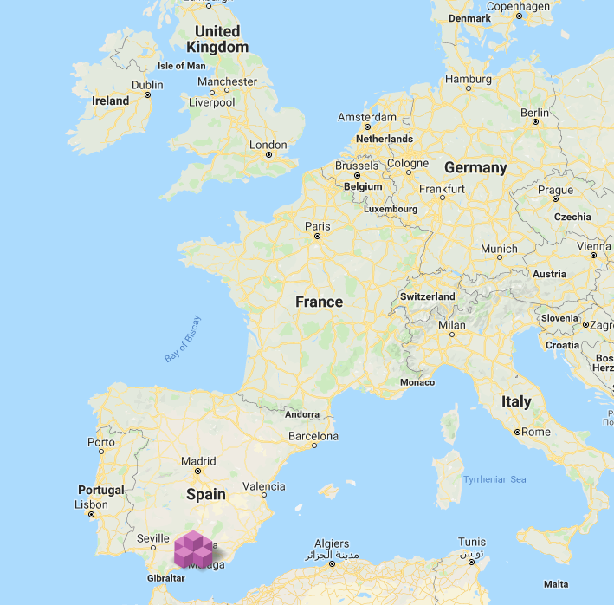
European Conference on the Local Mission of Higher Education
Strasbourg, Council of Europe. June 18 – 19, 2019
“Being a local university: The case of the University of Granada“

Slide 2
Local Mission of Higher Education. Strasbourg, June 18 – 19
“Being a local university: The case of the University of Granada“
Traditional Role of Universities: Generate and Transmit Knowledge: Research, Teaching, Service
New Role of Universities: Participate in a Learning Society, that Integrates Discovery, Learning and Engagement
Core idea..
SHIFT ON RESEARCH CULTURE MODE1: pure, disciplinary, homogeneous, expert-led, supply-driven, hierarchical, peer-reviewed, and almost exclusively university-based
SHIFT ON RESEARCH CULTURE MODE 2: applied, problem-centered, transdisciplinary, heterogeneous, hybrid, demand-driven, entrepreneurial, and network-embedded

Slide 3
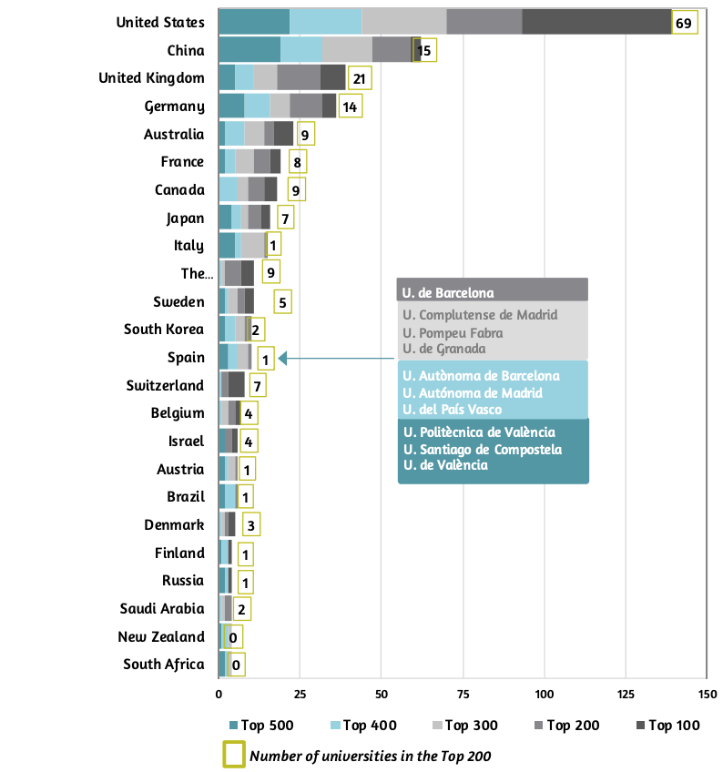
Local Mission of Higher Education. Strasbourg, June 18 – 19
“Being a local university: The case of the University of Granada“
Spanish universities in the 2018 Shanghai Ranking
Criticism (e.g., Basquet of indicators that privilege the wealthiest and long standing.., many variables beyond universities control.., number of Nobel Prizes (Severo Ochoa in 1959…), however..
Elite universities also have local impact by providing Community and Engaged Research and service like ABCS at PENN or Duke U. offering “Research service-learning” courses (many disciplines) engaging students and faculty in research on community-identified needs.
Similar programs: Brown, Cornell, Stanford, Georgetown, Harvard, Yale, Princeton, Minnesota, Penn, Michigan, Wisconsin.. Or Simon Fraser University in Canada..
Note: Ordered from the countries’ highest to lowest number of universities in the top 500
Source: Academic Ranking of World Universities (CWCU 2018).

Slide 4
Local Mission of Higher Education. Strasbourg, June 18 – 19
“Being a local university: The case of the University of Granada“
Spanish universities in the 2018 BBVA-IVIE ranking: the case of the UGR
U-Ranking, which analyzes the performance of the University System, synthesizing the universities’ achievements in teaching, research and innovation and technological development in a single index.
U-Ranking Volume, which considers the combined effect of both variables, results and size, and classifies the universities according to their total contribution to the universities’ missions.

Slide 5
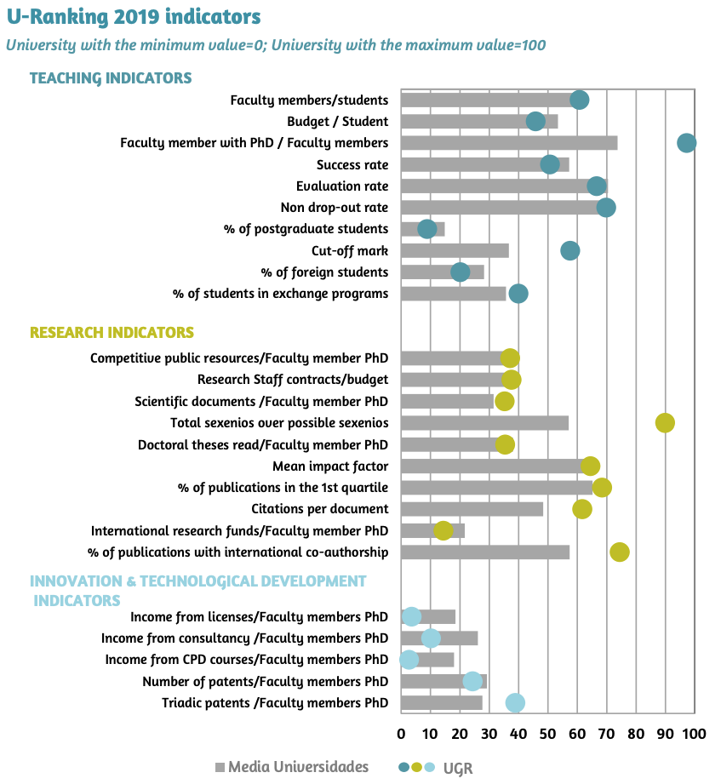
Local Mission of Higher Education. Strasbourg, June 18 – 19
“Being a local university: The case of the University of Granada“

Slide 6
Local Mission of Higher Education. Strasbourg, June 18 – 19
“Being a local university: The case of the University of Granada“
Local and regional indicators of “engagement”:
The University of Granada is the Spanish university with the greatest impact on its local environment measured in terms of provincial GDP.
The province of Granada accounts for 2.5% of Spain in surface area, almost 2% of the population and only 1.4% of the national GDP; however, the University of Granada accounts for approximately 4% of all scientific production in Spain.
The economic impact of the University, in a conservative estimate, is 4.7% of the province’s GDP. Thus, the University is one of the most productive Spanish universities in terms of research in a local environment with one of the lowest GDPs.
After only the universities of the large cities of Madrid, Barcelona and Valencia, the University is the top institution in scientific production, in a context which is very different to that of the large cities, with much fewer resources; this makes the University of Granada one of the most efficient and effective universities in Spain. This, in turn, also explains why the University is so enormously important in its local context and the huge potential it houses for the future development of the province and surrounding region.

Slide 7
Local Mission of Higher Education. Strasbourg, June 18 – 19
“Being a local university: The case of the University of Granada“
Effective partnerships in some (priority) areas:
The UGR has a longstanding commitment to partnerships of different kinds, with companies, public administrations and the third sector.
In particular, the BioTic excellence initiative is led by the University in collaboration with the National Spanish Research Council and the Health Sciences Technology Park and has 50 international partners fully engaged in the implementation of the project. These include major multinational companies such as Motorola, Fujitsu, Abbott, together with local SMEs from a range of sectors of economic activity.
Special effort is being made to ensure cooperation with our recently established doctoral schools, where leading companies are directly involved in programme committees. The Health Sciences Technology Park is an obvious example of public-private partnership that is made possible by the determination of the University in this area.

Slide 8
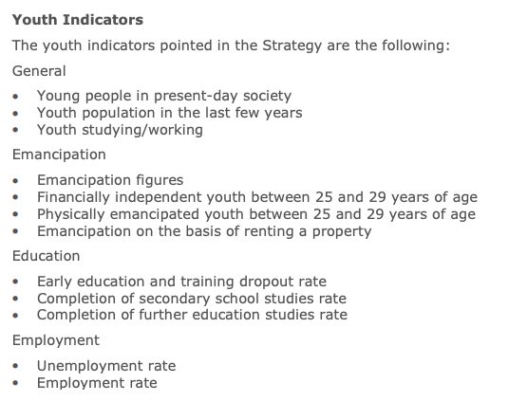
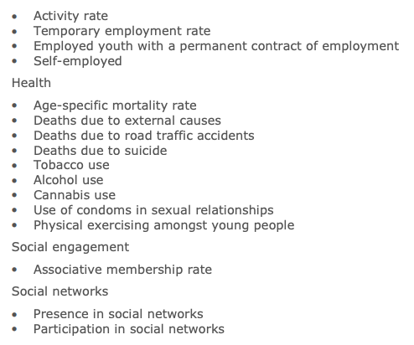
Local Mission of Higher Education. Strasbourg, June 18 – 19
“Being a local university: The case of the University of Granada“
Others key (youth) local indicators from the Spanish National Strategy 2020:

Slide 9
Local Mission of Higher Education. Strasbourg, June 18 – 19
“Being a local university: The case of the University of Granada“

Slide 10
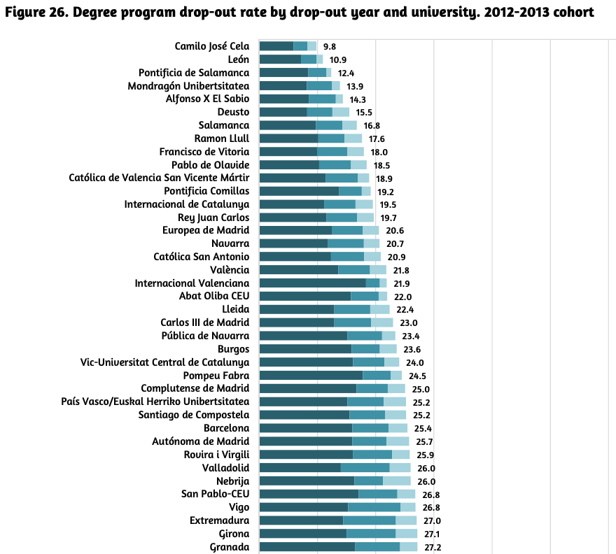
Local Mission of Higher Education. Strasbourg, June 18 – 19
“Being a local university: The case of the University of Granada“
Outcomes on completion rate…
Degree program drop-out by drop-out year and university. 2012-2013 cohort.
Overall degree program drop-out rate, which is defined as the percentage of students of a cohort first enrolled in academic year X in
Bachelor’s degree program T at university U, who, without having completed the degree, were not enrolled in that program for four consecutive academic years
Spanish University System (SUE) drop-out rate, which can be defined as the percentage of students of a cohort first enrolled in the SUE in academic year X who were not enrolled in any Bachelor’s degree program at any Spanish university for four consecutive academic years and have not completed a degree.

Slide 11
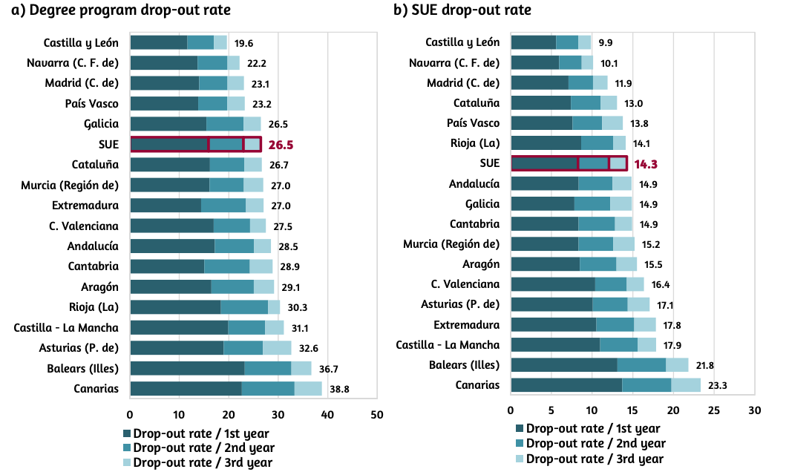
Local Mission of Higher Education. Strasbourg, June 18 – 19
“Being a local university: The case of the University of Granada“
Outcomes on completion rate by regions…
Drop-out rate by drop-out year and autonomous community. Presence-based universities. 2012-2013 cohort.

Slide 12
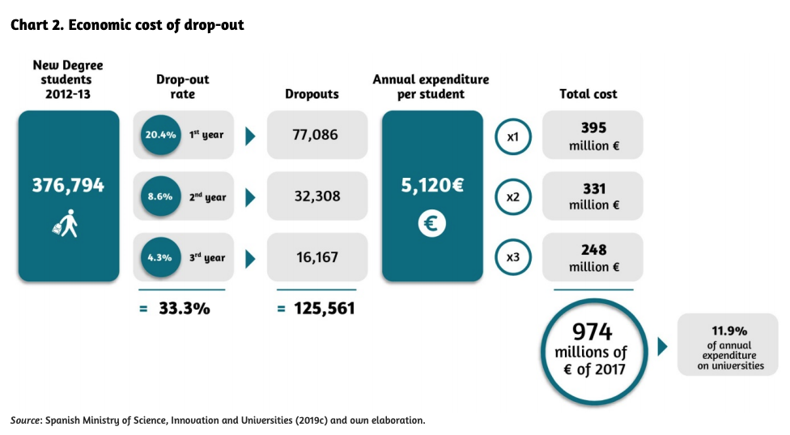
Local Mission of Higher Education. Strasbourg, June 18 – 19
“Being a local university: The case of the University of Granada“
Outcome: Economic cost of university drop-out

Slide 13
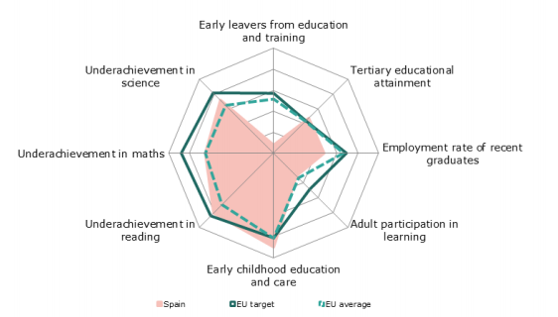
Local Mission of Higher Education. Strasbourg, June 18 – 19
“Being a local university: The case of the University of Granada“
The whole picture in Education: Position of Spain in relation to strongest (outer ring) and weakest performers (center)

Slide 14
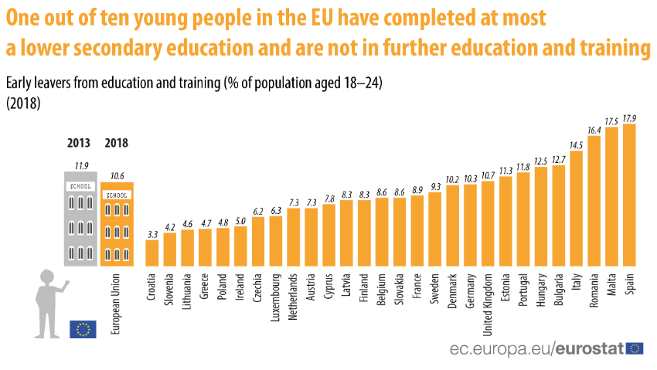

Slide 15
Local Mission of Higher Education. Strasbourg, June 18 – 19
“Being a local university: The case of the University of Granada“

Slide 16
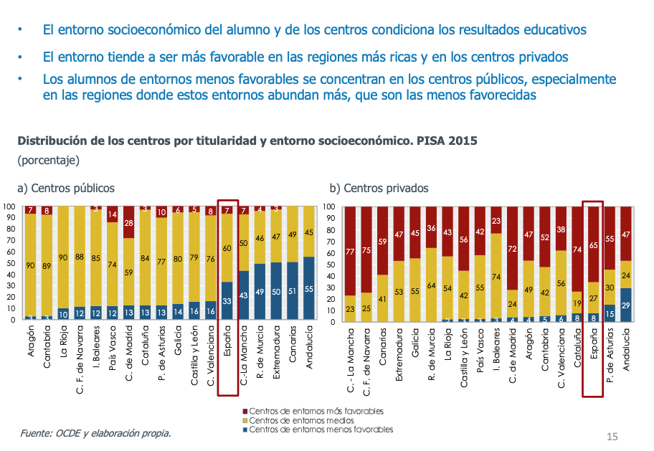
Local Mission of Higher Education. Strasbourg, June 18 – 19
“Being a local university: The case of the University of Granada“
Socioeconomic background
The socioeconomic background of the schools conditions the school results.
The socioeconomic background tend to be more favorable on rich regions and private schools.
Students from lower socioeconomic backgrounds tend to concentrate on public schools, specially on those regions with higher prevalence of those, which are those more negatively affected.
Distribution of public or private schools and socioeconomic background. PISA 2015 (%)

Slide 17
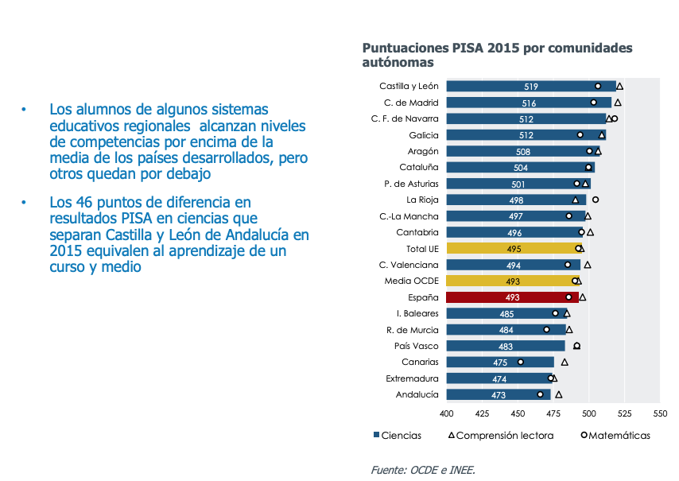
Local Mission of Higher Education. Strasbourg, June 18 – 19
“Being a local university: The case of the University of Granada“
EDUCATIONAL PERFORMANCE
2015 PISA scores by regions
Students from some of the regions reach competencies level above the average of developed countries, but other remains below.
The 46 points difference on PISA results on sciences that separate Castilla y León from Andalucía correspond to 1.5 courses of learning.

Slide 18
Local Mission of Higher Education. Strasbourg, June 18 – 19
“Being a local university: The case of the University of Granada“
Effectiveness: expenditure effect
Given the current levels of investment in education, the potential effect of additional increases is modest.
It is not about spending more, but about spent better on effective actions to solve concrete problems of equity by giving incentives to efficiency.
Estimated effect of accumulated expenditure per student on PISA score on sciences

Slide 19
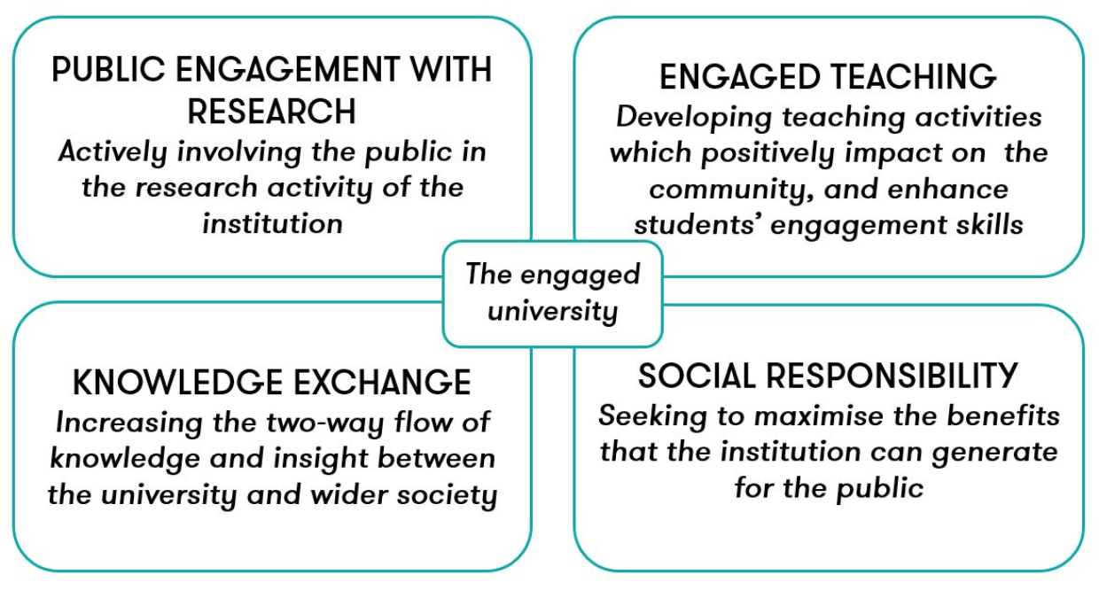
Local Mission of Higher Education. Strasbourg, June 18 – 19
“Being a local university: The case of the University of Granada“
What is missing from the array of interventions, programs, etc.?:
Source: https://www.publicengagement.ac.uk/about-engagement/what-does-engaged-university-look

Slide 20
Local Mission of Higher Education. Strasbourg, June 18 – 19
“Being a local university: The case of the University of Granada“
Challenges for Research Universities:
Incorporation of engagement into regional accreditation processes
National/regional interest in collaborative research and community impacts of research
Persistent national/regional pressure for evidence of impact
Introduction of engaged scholarship (and learning) into classifications/rankings
Student demand for engaged learning

Slide 21
Challenges for Research Universities:
Local Mission of Higher Education. Strasbourg, June 18 – 19
“Being a local university: The case of the University of Granada“
Successful reputation; investment in traditional modes of scholarship
Conservative view of innovations; resocialize new ideas to resemble current work
Large size, change is difficult
Tendency to compartmentalize in centers/institutes
Leading models for engagement are not peers
Discipline-dominated
Global ambitions; local issues less compelling

Slide 22
Confusing Engagement Rhetoric:
Local Mission of Higher Education. Strasbourg, June 18 – 19
“Being a local university: The case of the University of Granada“
Service-learning, community-based learning, academic service-learning, co-curricular service
Civic engagement, community engagement, civic education
Scholarship of Engagement
Community-based research
Participatory Action Research
Campus-Community Partnerships

Slide 23
(Effective) Service-Learning Can:
Local Mission of Higher Education. Strasbourg, June 18 – 19
“Being a local university: The case of the University of Granada“
Increase retention; diversity of local enrollment
Enhance achievement of core learning goals
Make learning relevant to more students
Influence career and major selection
Develop social, civic, leadership skills
Strengthen undergraduate research
Encourage students to be productive participants in the community

Slide 24
How can we accomplish such changes and goals:
Local Mission of Higher Education. Strasbourg, June 18 – 19
“Being a local university: The case of the University of Granada“
Greater interdependency with communities
Students come from and remain in the area-preparing future citizens and leaders
Involvement in business and workforce development at a one-on-one level
Involvement in local schools and government
More active link between research and teaching
Respect for the expertise available in community and the role of reciprocity

Slide 25
Implications for Policymakers
Local Mission of Higher Education. Strasbourg, June 18 – 19
“Being a local university: The case of the University of Granada“
Recognize the new integrated modes of knowledge generation/dissemination
Negotiate unique mission/accountability plans for each institution based on greater intentionality
Reward academic responsiveness to public context and interest in diverse forms and settings
Relax regulatory structures that encourage misguided competition and imitation
Reward innovation and collaboration across institutions and communities
Reward outcomes (e.g., impact, efficiacy, efficiency)

Slide 26
Local Mission of Higher Education. Strasbourg, June 18 – 19
“Being a local university: The case of the University of Granada“
Rubio-Alcalá, F., Arco-Tirado, J. L., Fernández-Martín, F. D., Lechuga, R., Barrios-Espinosa, E., and Pavón, V. (2019). A systematic Review on Evidences Supporting Quality Indicators of Bilingual, Plurilingual and Multilingual Programs in Higher Education. Educational Research Review. https://doi.org/10.1016/j.edurev.2019.03.003
Arco-Tirado, J. L., Fernández-Martín, F. D., and Hervás-Torres, M. (2019). Evidence-based Peer Tutoring Program to Improve Students Performance at the University. Studies in Higher Education. https://doi.org/10.1080/03075079.2019.1597038 https://www.tandfonline.com/doi/full/10.1080/03075079.2019.1597038
Arco-Tirado, J. L., Fernández-Martín, F. D., Ramos-García, A. M., Littvay, L., Villoria, J., and Naranjo, J. A. (2018). A Counterfactual Impact Evaluation of a Bilingual Program on Students’ Grade Point Average at a Spanish University. Evaluation and Program Planning, 68, 81-89. https://doi.org/10.1016/j.evalprogplan.2018.02.013. ISSN: 0149-7189.

Slide 27
THANK YOU FOR YOUR ATTENTION
jlarco@ugr.es

