Slide 1
Workshop on Artificial intelligence in the service of justice - Concrete examples of implementation
Generative AI for a practical guide to access to justice (GPJ)
CEPEJ Plenary Meeting
4 December 2023
Pedro Almeida | Ministry of Justice of Portugal Member of the CEPEJ-GT-CYBERJUST

Slide 2
Virtual assistant in development by Portuguese Ministry of Justice which aims to provide quick and simplified access to information

Slide 3
Problems addressed
Excessively dispersed legal information
Lack of uniformity in the organization of the available information
Use of “legalese”
Multiple communication channels
Overburdening of justice services personnel

Slide 4
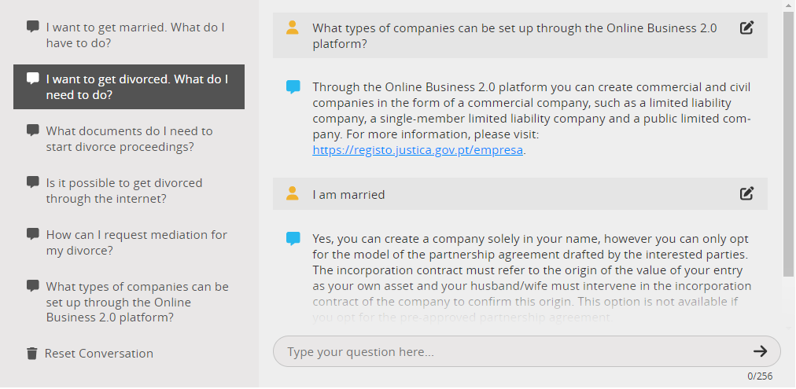
GPJ: a simple look
Aim of easily interact with the user
Focus on concrete answers and on how to really help the user

Slide 5
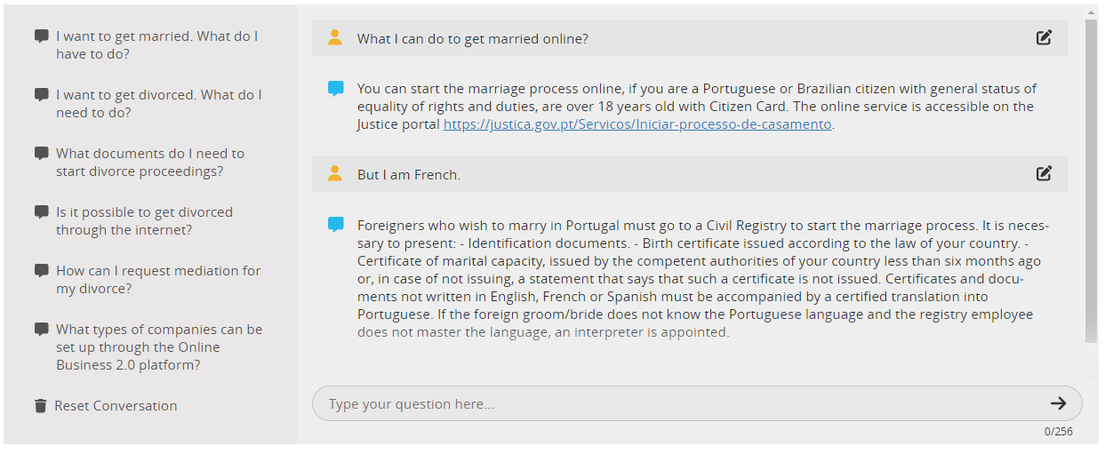
An intuitive platform

Slide 6
Benefits of use GPJ
Increased communication efficiency
Better understanding of the information: use of natural language and interaction in a conversational manner with Immediate answers
Enhanced personalized experience
Helps citizens with primary issues
Interacts in two languages (PT and EN)

Slide 7
New knowledge base
By using its “own” Database, the Ministry guarantees data validation and quick updates without increased efforts
All GPT knowledge is blocked, leaving only the narrative capacity
GPT 3.5
Narrative
Knowledge Validated by MoJ

Slide 8
Purpose and scope (1st step)
Focus on new areas of justice
It is not meant to replace any legal profession: just to inform and forward to online platforms
Ability to identify conversation context, without saving the conversation
Without suggesting or advising
Answers validated by the Ministry
Just answers on two matters: Marriage and Divorce (1st phase) and Setting up a Company (2nd phase, already completed)

Slide 9
Expand to new areas (2nd step)
Gradual expansion to new areas and services
Expand to alternative dispute resolution and Online Criminal Record
Interoperability with other source of data from public databases and other services

Slide 10
How does GPJ work?

Slide 11
Some insights for the future…
More complex tasks and better interoperability capabilities (with other databases and services)
More powerful and accurate capabilities to rapidly deploy new contexts
Improved and more sophisticated conversional skills
More intuitive type of interface with voice conversation

Slide 12
Thank you

