Slide 1
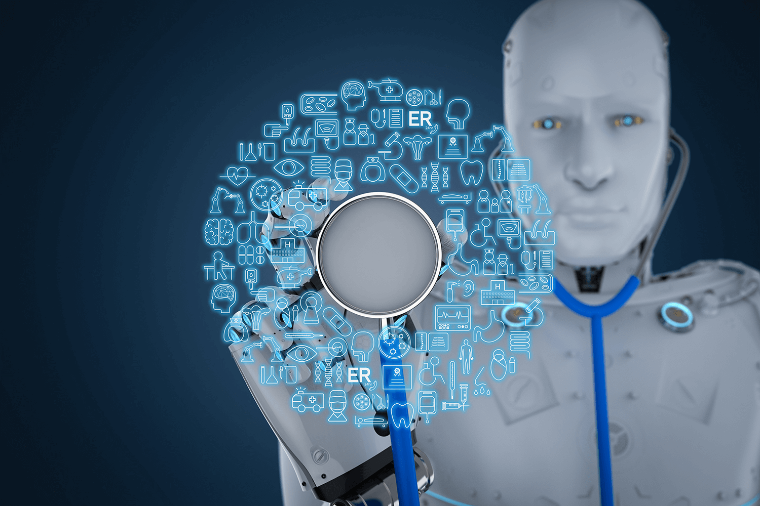
Ethical and human rights issues in the application of AI and robotics in biomedicine and health
Prof. dr. Philip Brey
University of Twente
The Netherlands

Slide 2
Major applications of AI in biomedicine and health
Diagnostics
Such as medical image analysis, precision diagnostics and stroke diagnostics for clinical decision support
Outcome prediction and prognosis evaluation
Such as predicting risk of stroke, diabetes or skin conditions and genomic analysis
Drug Discovery and Development
Identify potential drug candidates from datasets, predict their efficacy, and optimize their properties

Slide 3
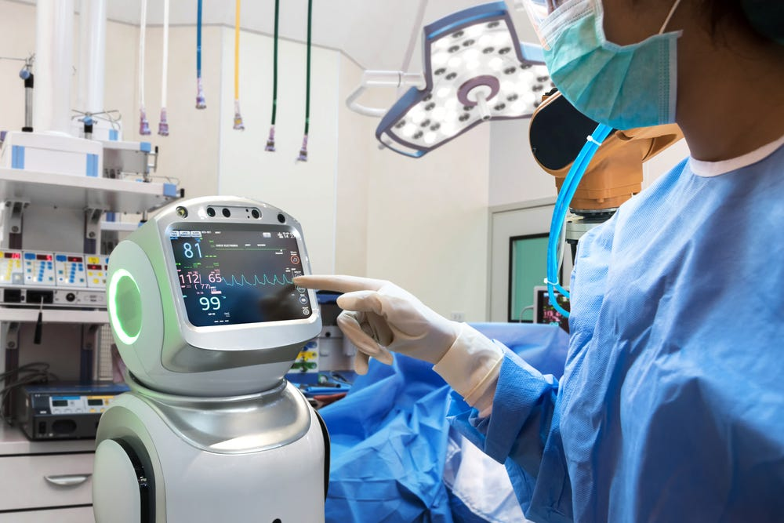
Therapeutics
Decision support systems for diagnosis and therapy
Precision therapeutics, predicting which treatment and prevention strategies for diseases will work for different groups of people
Chatbot-assisted therapy
Health education and patient self-management
Interactive learning tools and personalized education
Behavioral coaching and medication management
Remote monitoring and feedback

Slide 4
Public health
Disease Surveillance, predictive modelling and risk assessment
Health Behavior Monitoring and Intervention
Precision public health interventions
Healthcare Operations Management
Forecasting demand, improving resource allocation, and streamlining workflows

Slide 5
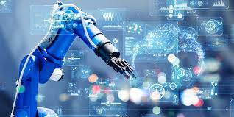
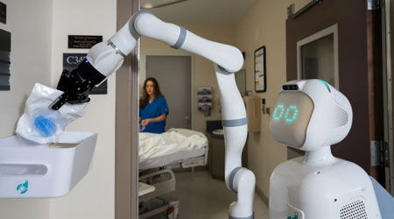
Major applications of robotics in biomedicine and health
Robot-Assisted Surgery
Rehabilitation robotics, prosthetics and exoskeletons
Laboratory Automation
Robots for physical assistance, service in the home, and companionship

Slide 6
Ethical and human rights issues with AI applications
Where do ethical issues come from? Four main sources:
Processing of vast amounts of medical data: privacy and security risks
Lack of transparency and accountability of AI systems: accountability, autonomy and informed consent
Biases in data and algorithms: fairness, equity and discrimination
Affordability, accessibility, and inclusivity of AI systems: equity and access
In addition, unintended consequences and unforeseen risks

Slide 7
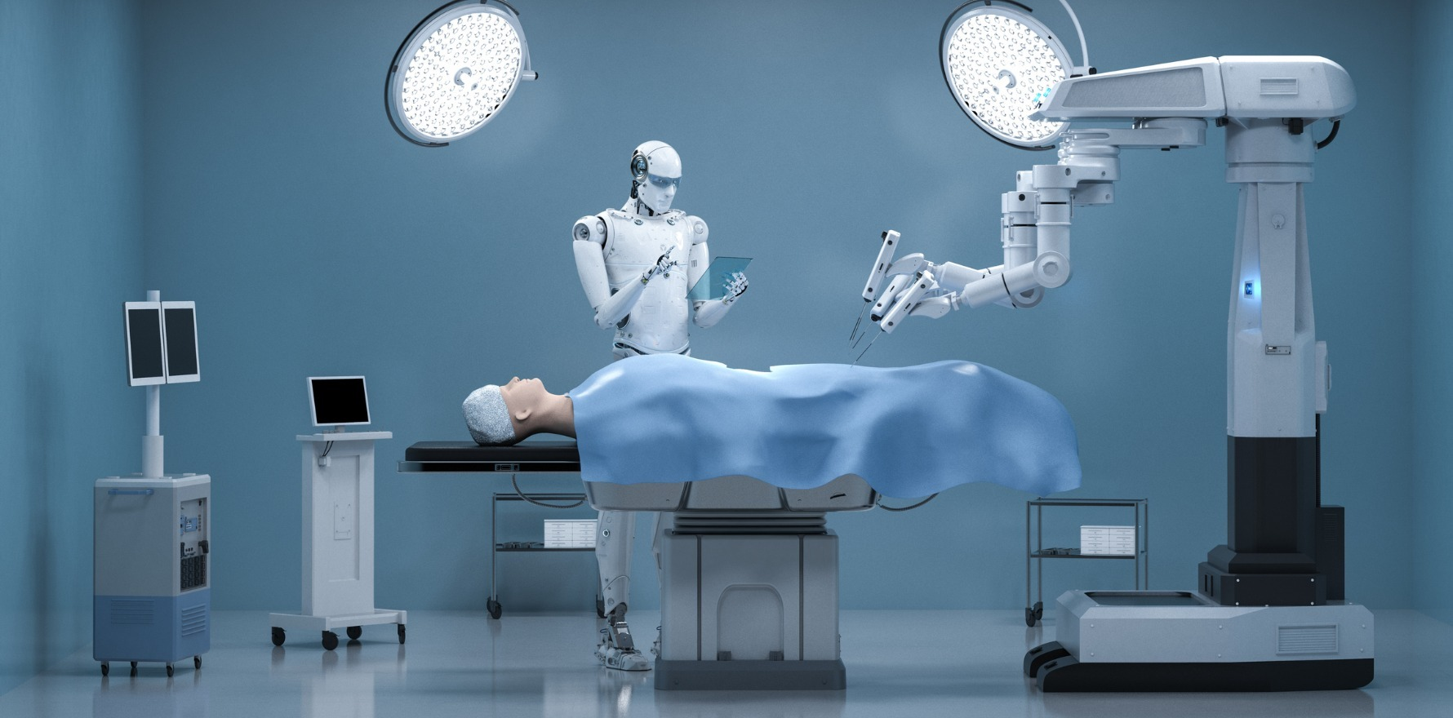
Ethical and human rights issues with robotics applications
Similar to AI, except for additional issues of physical safety and replacement of humans in patient care
Patient safety
Accountability and adequate oversight
Informed consent
Equity and access
Data privacy and security
Compassionate and dignified care

Slide 8
Ethical issues in detail

Slide 9
Privacy and security risks
Data collection by AI and robotic monitoring system
Hacking, leaks and unauthorized access to databases
Re-identification of data using AI
Commercialization and risk of third-party access

Slide 10
Transparency, accountability, and informed consent
AI systems often are black boxes. Even if opened, algorithms and learning processes may be too complex to understand or explain
-So how can AI outputs be justified?
Lack of accountability: healthcare professionals cannot control or explain these outputs
Lack of legal redress: how can one properly seek liability if the system is not understood?
Lack of informed consent: if no explanation can be given, how can there be informed consent?

Slide 11
Bias in medical AI systems
Biased training data (e.g., little data from underrepresented groups)
Biased algorithm (e.g. healthcare cost as proxy for healthcare needs: disadvantages poorer patient groups)
Drift: systems become less representative over time or are used in new contexts

Slide 12
Affordability, accessibility, and inclusivity
Will only wealthy medical centers be able to afford AI systems and robots?
Will poor, marginalized and low-educated patients have access to the benefits of AI?
Will AI systems be useful for some patients and not for others?

Slide 13
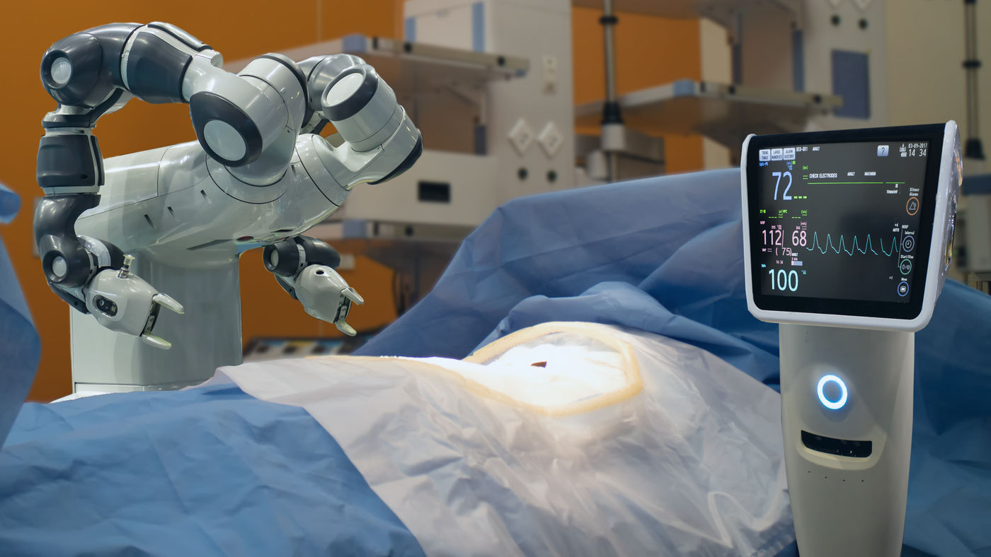
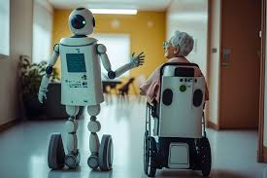
Compassionate and dignified care
Care and therapy by chatbots and robots may lack (genuine) interpersonal attention and connection

Slide 14
THANK YOU !

