Slide 1
OLGA AI support for the processing of mass trials
CoE CEPEJ – Strasbourg, 04.12.2023

Slide 2
Background: The Problem
Dieselgate + legal tech = mass trials
major car manufacturers in Stuttgart attract thousands of cases
nearly every case gets appealed
civil cases on appeal increased tenfold within five years
Digging for “data diamonds” is tedious
written submissions grow ever longer thanks to legal tech
only small but important details differ in many cases: engine type, emission standard, purchase price, mileage etc.
manual search, copy & paste is very time-consuming
OLGA: AI support for the processing of mass trials – CoE CEPEJ – Strasbourg, 04.12.2023

Slide 3
Automation: The Idea
Justice is a data billionaire
OLG Stuttgart introduced electronic filing system in 2019
nearly all Dieselgate cases on appeal are digital
Mass claims are predestined for automation
comparable cases can be grouped by parameters
parameters defined by judges can be found and extracted
copying & pasting does not require legal training
AI can complete these repetitive tasks lightning fast
OLGA: AI support for the processing of mass trials – CoE CEPEJ – Strasbourg, 04.12.2023

Slide 4
OLGA: The Solution
OLGA: Higher Regional Court Assistant
examines documents for parameters defined by judges
cases are automatically grouped as defined by judges
template decisions can be individualized with parameters
No interference with decision-making
OLGA is an intelligent research assistant
OLGA digs for data diamonds and surfaces results
each data point can be traced individually
judges decide after checking the facts
Main features achieved through OLGA
enables overview of cases and intelligent scheduling
saves time-consuming copying & pasting
OLGA: AI support for the processing of mass trials – CoE CEPEJ – Strasbourg, 04.12.2023

Slide 5
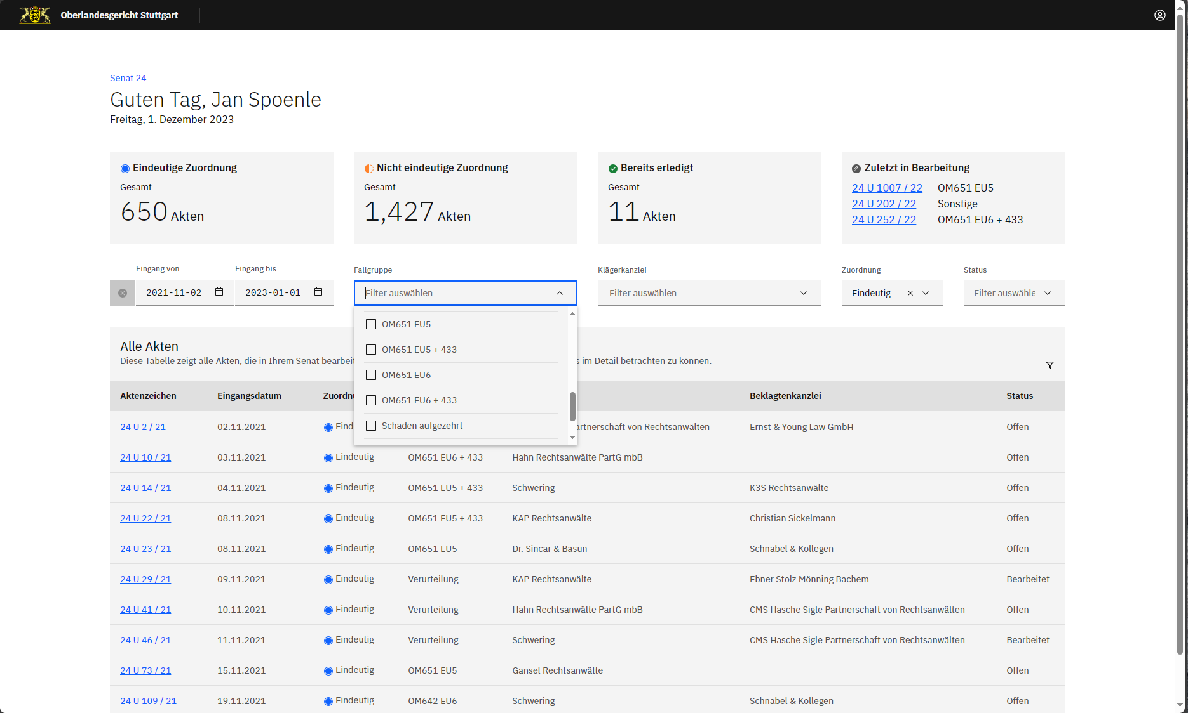
OLGA: AI support for the processing of mass trials – CoE CEPEJ – Strasbourg, 04.12.2023

Slide 6
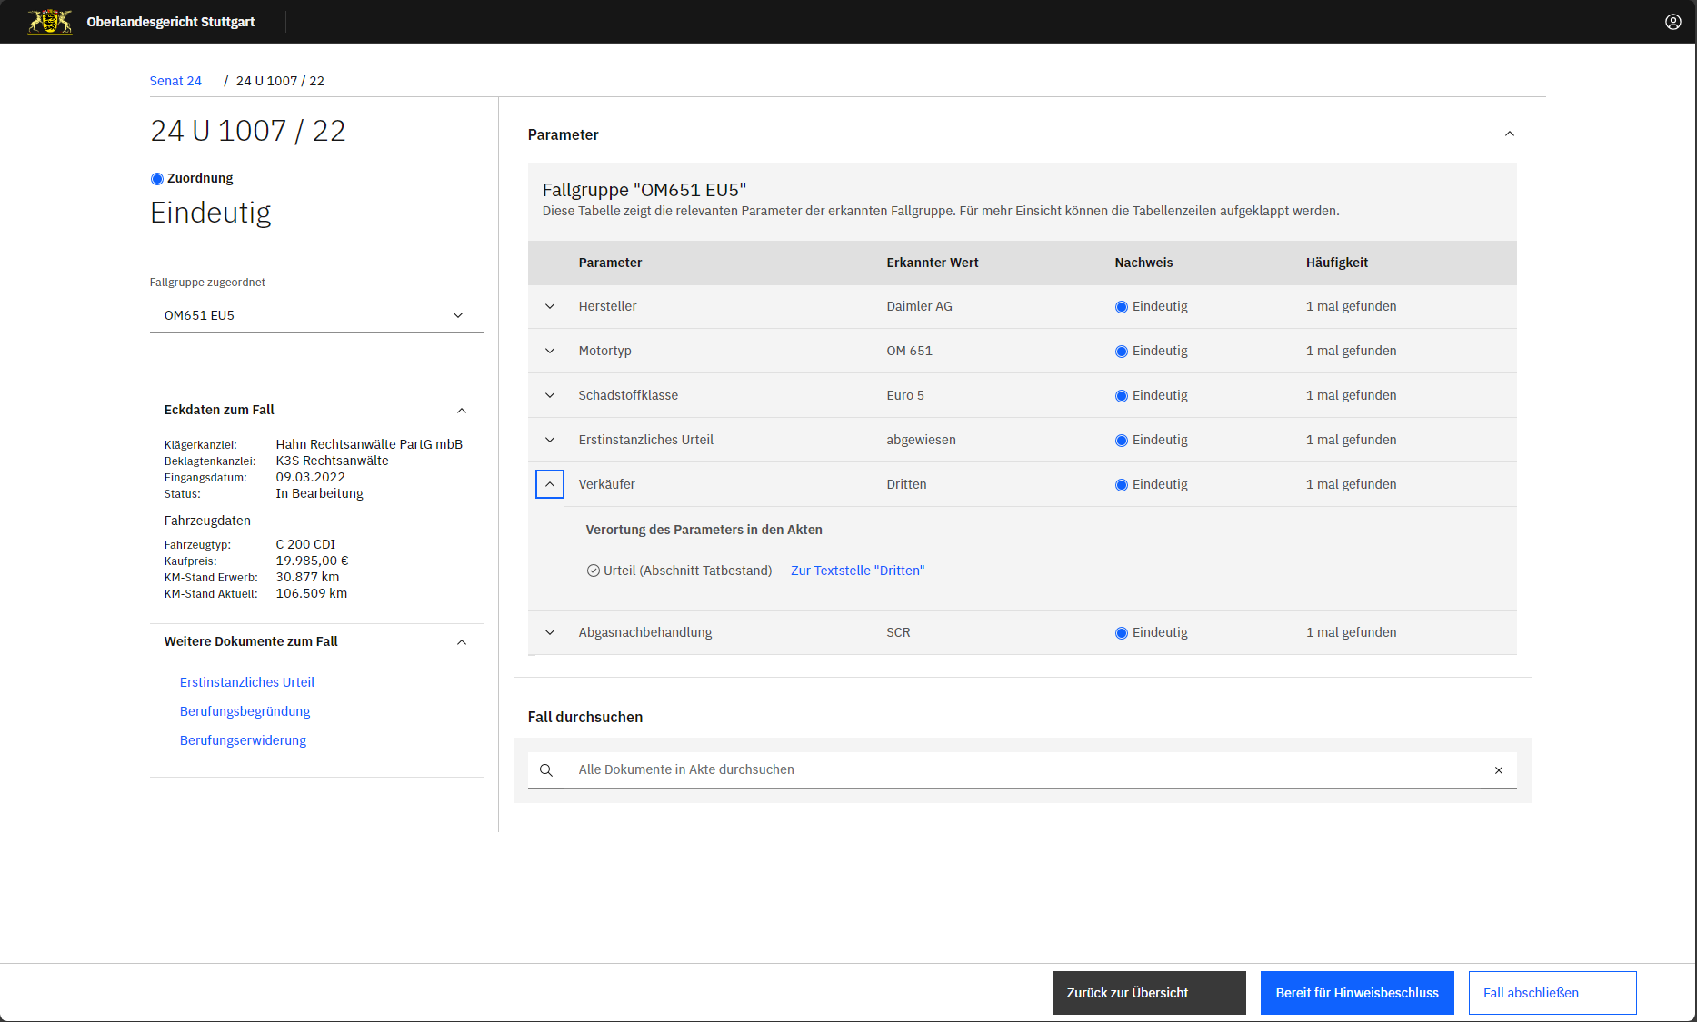
OLGA: AI support for the processing of mass trials – CoE CEPEJ – Strasbourg, 04.12.2023

Slide 7
Agile: The Process
Interdisciplinary workshops
mostly by videoconferencing during pandemic
IT experts working with Dieselgate appeal panels’ judges
mutual understanding of working methods
design thinking leads to agile development in sprints
Ready in six months
from idea to prototype to live operation
confidence for future challenges – we can build solutions
OLGA: AI support for the processing of mass trials – CoE CEPEJ – Strasbourg, 04.12.2023

Slide 8
Thanks for listening – questions?

