Slide 1


European centRe on urban risks
Activities developed in 2017
Activities planned for 2018
Paula Teves Costa
Director

Slide 2
During 2017 CERU developed the following projects:
BAYWATCH: Involving sales and tourism agents on earthquake and tsunami mitigation measures
Coordinator Centre: CERU. Partners: CEPRIS
Specific objectives:
1. Involving the municipalities on the design of evacuation routes and on the implementation of evacuation signalling on the historical centres and coastal areas.
2. Awareness of the population as well as tourism and sales agents concerning earthquake and tsunami risks.
3. Testing the questionnaire devoted to the hotel responsibles in order to check their knowledge on earthquake and tsunami risk and their availability to undertake mitigation measures.
4. Testing the tsunami signalling placed on a pilot beach in Lagos (Portugal).
LANDSLIDES: European Landslide Hazard Maps: Fostering European Harmonization of Slope Movement Hazard Assessment at various spatial scales
Coordinator Centre: CERG

Slide 3
Baywatch Activities:
Workshop to aware tourism and sales agents on earthquake and tsunami risks (in Portugal)
Tsunami friendly hotel: Questionnaire devoted to hotel managers to assess their sensitivity and support for tsunami risk awareness actions
Modulus on tsunami hazard and risk to be included in lifeguards training courses
Study / Implementation of evacuation routes on Historical Centres (Cascais and Lagos). Awareness actions, proposed paths and evacuation signalling

Slide 4
Baywatch Results:
Lagos Workshop (2-3 April 2017)
The workshop was attended by 45 participants: 4 invited from abroad (Christa von Hillebrandt-Andrade, from Puerto Rico and Chair of the Caribbean Tsunami Warning Program (CTWP), Domenico Mangione, from the Italian Civil Protection, and Anthony Micaleff, from ICoD - Euro-Mediterranean Centre on Insular Coastal Dynamics (Malta) and Jabour Nacer, Director of CEPRIS, Gianluca Silvestrini, the Executive Secretary of EUR-OPA Majors Hazards Agreement, and 40 Portuguese persons mainly from civil protection services (national and regional), hotel and tourism agents, harbour, marine and beaches responsible, Maritime Authority, IPMA and Lagos citizens.
Presented and Discussed topics:
Understanding the Hazard
Understanding the Warning
Tsunami Preparedness and Mitigation
Tsunami Ready for Beach Resorts
Waterfront preparedness & Lifeguards training
Visit to Praia da Batata tsunami signalling

Slide 5
Baywatch Results :
Lagos Workshop (2-3 April 2017)
The workshop was very interesting, for all participants, but it was ineffective to gather the target public (hotel and beach concessions staff and managers).
However, the four attendants (representing the private sector working for one marina, a beach concession, an hotel and one nautical club), were very interested, attended most of the sessions and were participative, giving significant contributions and suggestions.
As result the promoters of the workshop came out of the 2-day workshop better prepared to accomplish the ultimate goal of promoting tsunami awareness and preparedness for the hotel managers and beach concessionaires.

Slide 6
Baywatch Results :
Lagos Workshop (2-3 April 2017)
To gather the target public, hotel and beach concession staff and managers, instead of invited them to an workshop promoted by us, we have to go to their own meetings and make a short presentation on tsunami awareness and tsunami risk mitigation measures.
One way is to consider the formation and training on tsunamis as staff formation (obligatory by law). It will be only necessary to give a diploma or certificate is given at the end. The most suitable duration for this formation will be half-day or 1 day (if some training is included)
Meeting with Algarve hotel School (ESHGT)
Meeting with Algarve Touristic Council (RTA)
Meeting with Algarve hotel and tourist establishments association (AHETA)

Slide 7
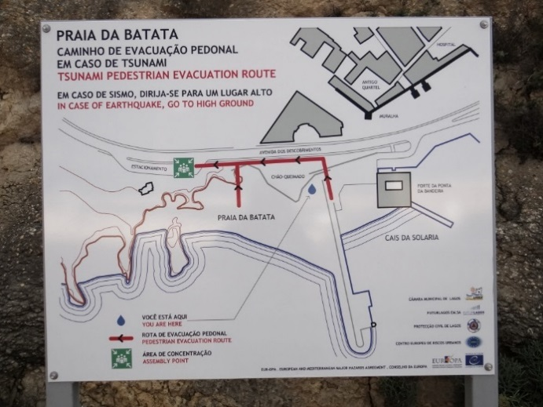
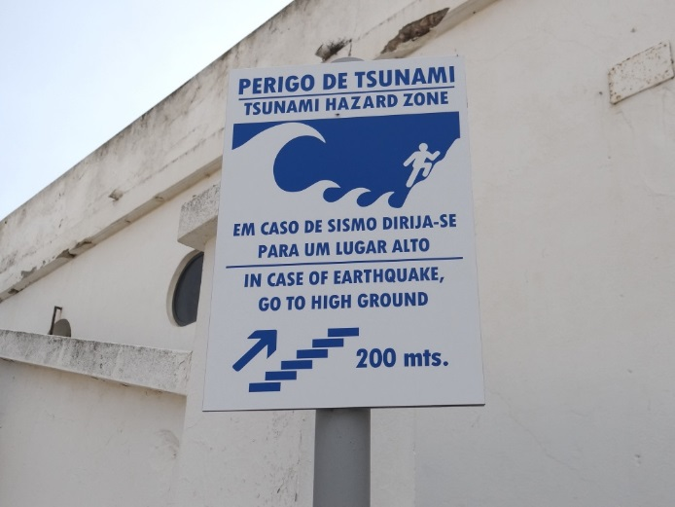
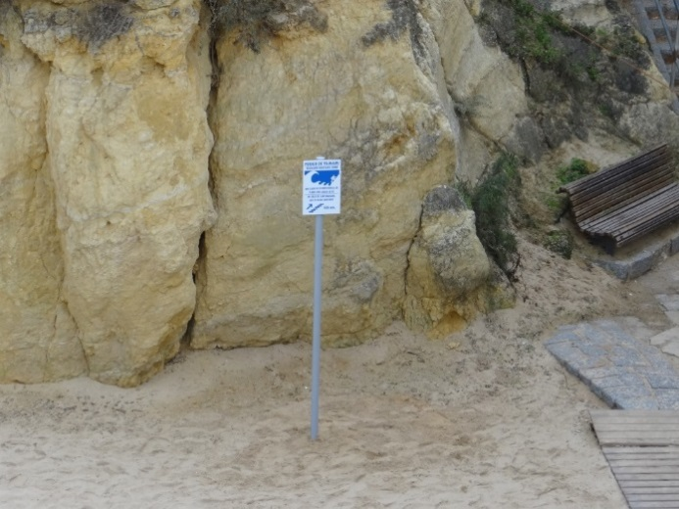
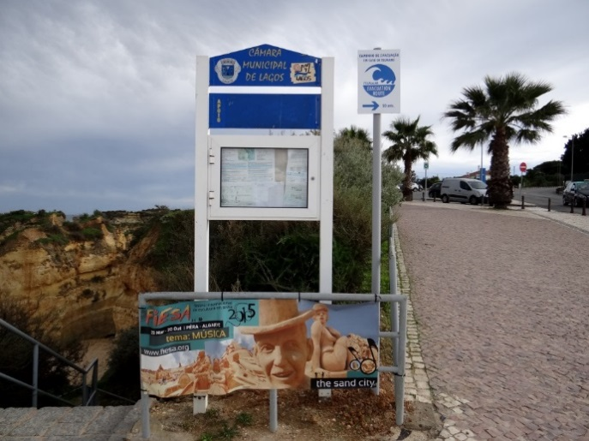
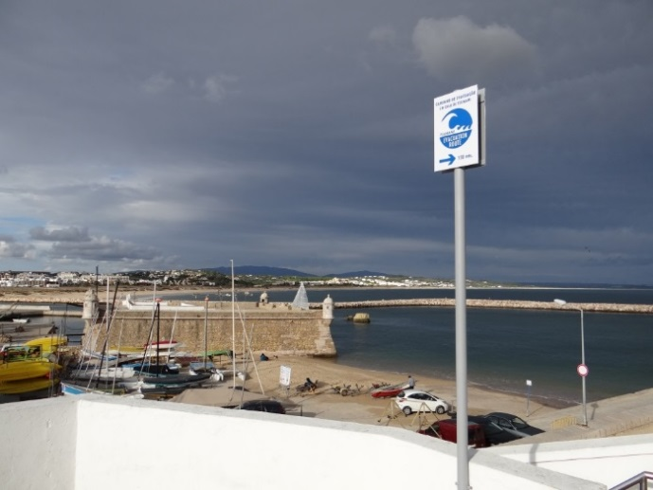
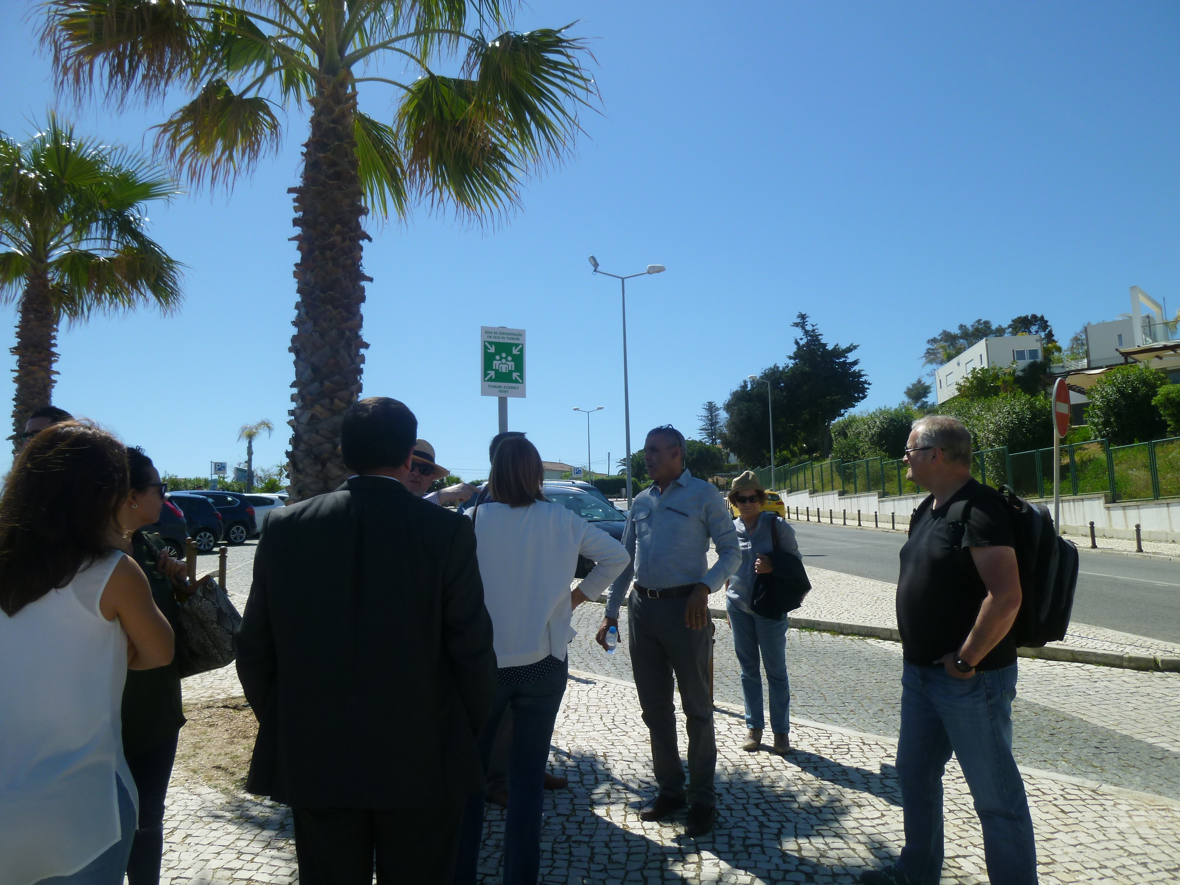
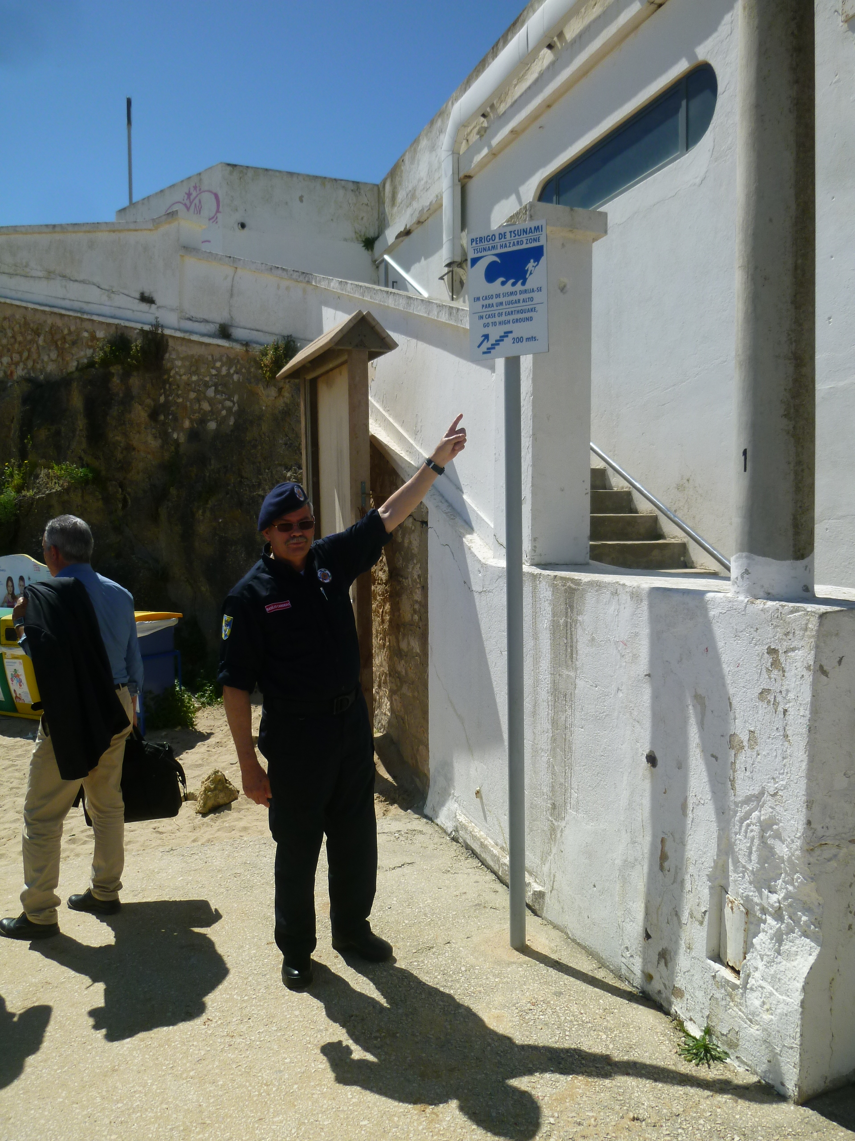
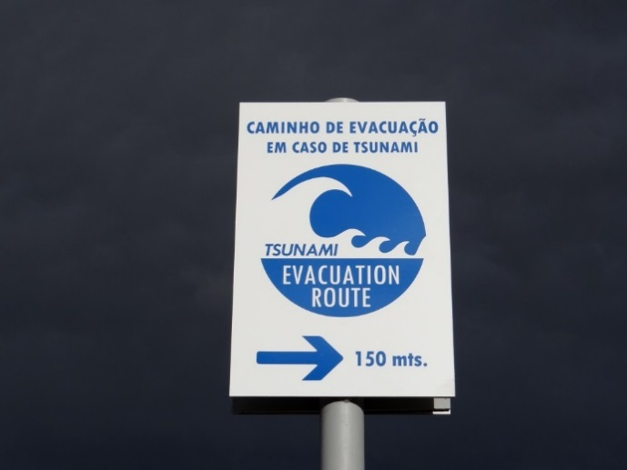
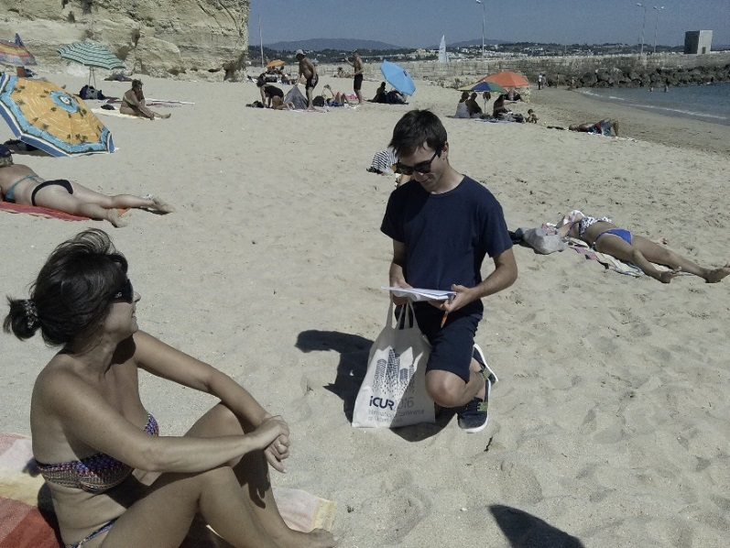
Praia da Batata
Lagos

Slide 8
Baywatch Results:
(2) Tsunami friendly hotel: Questionnaire devoted to hotel managers to assess their sensitivity and support for tsunami risk awareness actions
Up to now we have only 9 answers:
Part I: Understanding the tsunami hazard; Awareness of warning system, information, communication
Part II: Understanding the tsunami risk; Preparedness; Tsunami evacuation (4 answers)
Conclusions:
Knowledge the hazard ≈ YES (reasonable)
Awareness of warning system, information, communication = NO
Understanding the tsunami risk = LOW / VERY LOW
Availability to perform minor works to be a vertical shelter ≈ YES
Preparedness = NONE / VERY LOW
Availability to inform guest on tsunami evacuation procedures ≈ YES

Slide 9
Baywatch Results:
(3) Modulus on tsunami hazard and risk to be included in lifeguards training courses
Workshop on November 18th (Hydrographic Institute)
CERU & Relief Institute for Shipwrecks (National Maritime Authority), Portuguese Institute of the Sea and Atmosphere (IPMA), National Civil Protection Authority (ANPC)
to alert lifeguards to the need to be prepared to support bathers in case of tsunami occurrence
to discuss how to introduce new programmatic content related to this theme into the training courses for beach lifeguards.

Slide 10
Baywatch Results:
(4) Study / Implementation of evacuation routes on Historical Centres (Cascais and Lagos). Awareness actions, proposed paths and evacuation signalling
In Lagos, this point was not developed because we did not have the support of the municipality. It is not a priority activity at the moment.
Although some work on this subject was already performed some years ago, Lagos municipality prefer to improve the tsunami signalling and implement it on other beaches of the municipality, and only after that develop and implement the evacuation routes on Lagos historical centre.
However, in Cascais, some work has been developed. The Municipal Civil Protection performed some informative sessions and a leaflet, with the main evacuation routes from the historical centre, was distributed.
They also put a siren (in the Historical Centre) for tsunami warning.
We must refer that the Historical Centre includes the coast line, where more that one beaches exist.

Slide 13
Landslides Activities:
Main Task: Analysis of existing methodologies for earthquake triggered landslide assessment using available seismic parameters, selection of methods which can applied at regional scale and to test the selected methods in mainland Portugal.
Difficulties:
The extremely limited available data on earthquake triggered landslides in mainland Portugal implies severe limitations for this type of studies carried at regional or county scale of analysis.
Option:
Testing physically based approaches to landslide susceptibility assessment and mapping, considering a previous validation with inventories of rainfall triggered landslides of the input variables of the model to apply, namely soil strength parameters (cohesion and friction angle) and potentially unstable soil thickness – Application to Lisbon county

Slide 14
Landslides Activities:
Work developed: Collection of the available information and developing the processing steps required to enable the application of the proposed methods in the Lisbon County area (84.4 km²)
Applicable Methods: Due to the regional scope of the susceptibility mapping to produce, the applicable methods include the infinite slope or rigid block limit equilibrium analysis methods using pseudostatic coefficients or the rigid block displacement method proposed by Newmark (1965), with possible inclusion of recent advances on the topic (e.g. Jibson, 2011).
Results:
Application of a susceptibility model based of the infinite slope stability method with the formulation proposed by Sharma (2002) with the water table position estimated using the rainfall scenarios coupled with the hydrological model of SHALSTAB (Montgomery and Dietrich, 1994). The results of the model were validated with the landslide inventory using ROC curves, and produced an area under the curve of 0.84. This result indicates that the base information used has an acceptable level of reliability to enable the application of the seismic landslide susceptibility modeling.

Slide 15
Landslides Results:
Geological base map with the inventory of landfills (31% of county area)

Slide 16
Landslides Results:
Physically based rainfall triggered landslide susceptibility

Slide 17
Landslides Results:
Prediction curves of the safety factor models for physically based rainfall triggered landslides of Lisbon County
These results show that the base information used seems to be of adequate quality to be used to proceed to seismic landslide susceptibility assessment

Slide 18
Publications:
Leaflets on tsunami hazard and risk and evacuation routes (Cascais)
Leaflets on tsunami warning and evacuation signaling for beaches (Lagos) – under progress
1 communication presented and published on the Proceedings of the International Conference on Risks, Security and Citizenship (Setubal, Portugal, March 2017) – on the evaluation of tsunami signaling in Praia da Batata (Lagos, Portugal)
1 paper under revision submitted to an international journal (Natural Hazards) on the methodology developed for the design of evacuation routes (Cascais case study)
1 paper under preparation concerning the methodology implemented to determine the landslides susceptibility model

Slide 19
Proposed project for 2018-19:
BEACHRISKS: Beach and Coastal Resorts Risks
Coordinator Centre: CERU. Partners: CEPRIS (Morocco), ICoD (Malta)
INTRODUCTION
This project aims to develop and implement seismic, tsunami and coastal risks mitigation. In particular the project intends to contribute for a Tsunami Ready Community working on two programs: a Tsunami Ready Beach (TRB) and a Tsunami Ready Hotel (TRH). Besides, the project also intends to address other risks present on the beach (cliff rock falls, drowning, insolation, lightning, etc.).
The three involved countries have a large coastal area which beaches are a holiday destination par excellence, and tourists are one of the most vulnerable groups concerning these risks.
All the actions will to be developed in close collaboration with the local associations and authorities.

Slide 20
BEACHRISKS: Beach and Coastal Resorts Risks
Coordinator Centre: CERU. Partners: CEPRIS (Morocco), ICoD (Malta)
SPECIFIC OBJECTIVES
2018:
Awareness of tsunami and beach risks among hotels responsible and beach concessions
Awareness of local associations and responsible for safety on the beaches (Maritime Authority and lifeguards) to disseminate information among residents and floating population (tourist)
Awareness of Tourist Guides and personnel at Tourism Offices
Awareness of local and national authorities to implement preventive measures
Discuss with the Foundation for Environmental Education the integration of all coastal hazards, and particularly tsunamis, on their program for “Blue Flag” as applied to beaches.
2019:
Promoting formative seminars, short-courses or programs on disaster risk mitigation for local associations and tourism professionals.
Production and distribution of informative/educational products like posters and leaflets.

Slide 21
BEACHRISKS: Beach and Coastal Resorts Risks
Coordinator Centre: CERU. Partners: CEPRIS (Morocco), ICoD (Malta)
ACTIVITIES (2018/19)
Organization of seminars addressed to lifeguard associations, beach management entities and tourism professionals on risk culture, risk mitigation and risk dissemination OR/AND
Presentation of a module on measures to mitigate various risks that may exist on the beaches to the entities that deal with and are responsible for the tourists
Preparation and dissemination of TRB leaflets and beach signs aimed at raising beach user awareness in Malta
Implementation of tsunami warning and evacuation signs in several beaches in Portugal and Morocco
Informative sessions for general public on the interpretation of risks signs displayed on beaches. Proposal for complementary signs for risks not yet considered.
Study on informative posters and leaflets addressing different risks for different target public

Slide 22
BEACHRISKS: Beach and Coastal Resorts Risks
Coordinator Centre: CERU. Partners: CEPRIS (Morocco), ICoD (Malta)
DELIVERABLES (2018-2019)
2018
Reports on the seminars and informative sessions performed, including potential recommendations.
Report on desk study on identification of TRB local requirements and identification of relevant actors (ICoD)
Production of informative leaflets (CERU)
Guidelines to prepare the informative documentation to be produced during 2019 (CERU, CEPRIS)
2019
Published informative documentation on beach risks including mitigation measures (in English, Portuguese, Arabic and French) (CERU, CEPRIS)
TRB leaflets and beach signs aimed at raising beach user awareness (ICoD)

Slide 23
BEACHRISKS: Beach and Coastal Resorts Risks
Coordinator Centre: CERU. Partners: CEPRIS (Morocco), ICoD (Malta)
EXPECTED RESULTS
2018:
Involvement of the local population, associations and authorities on seismic, tsunami and other beach risks divulgation and on the implementation of mitigation measures.
2019:
Production of informative documentation on beach risks including mitigation measures. This information should be available on different languages (English, Portuguese, Arabic, French, Italian?)

Slide 24
BEACHRISKS: Beach and Coastal Resorts Risks
Coordinator Centre: CERU. Partners: CEPRIS (Morocco), ICoD (Malta)
ULTIMATE GOAL
You are entering on a
√
X
TSUNAMI HAZARD
ZONE
TSUNAMI READY
ZONE

Slide 25
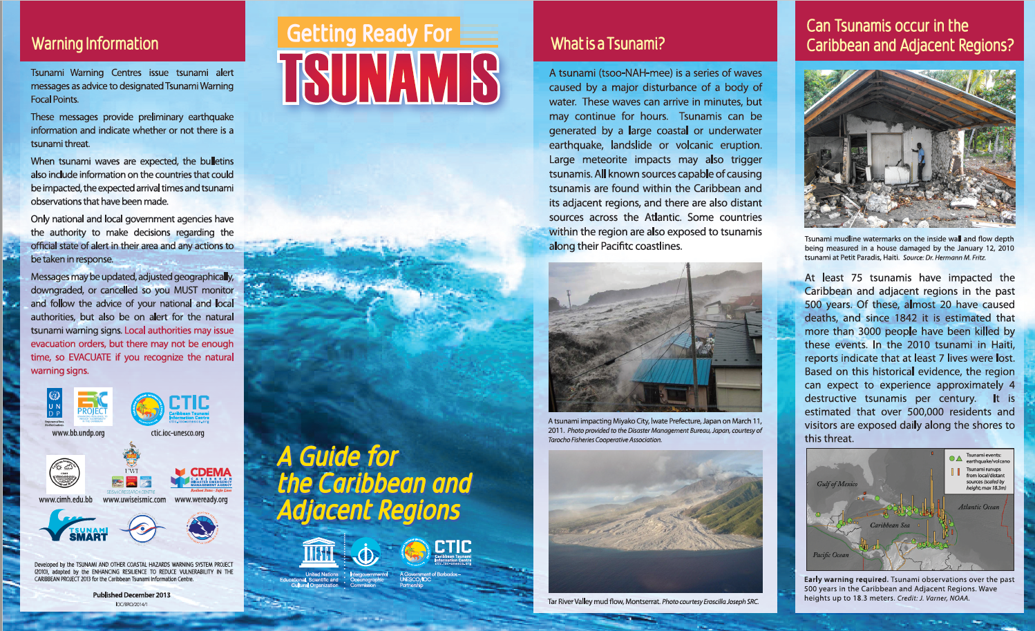
BEACHRISKS: Beach and Coastal Resorts Risks
Coordinator Centre: CERU. Partners: CEPRIS (Morocco), ICoD (Malta)
Tsunami Ready Comunity

Slide 26
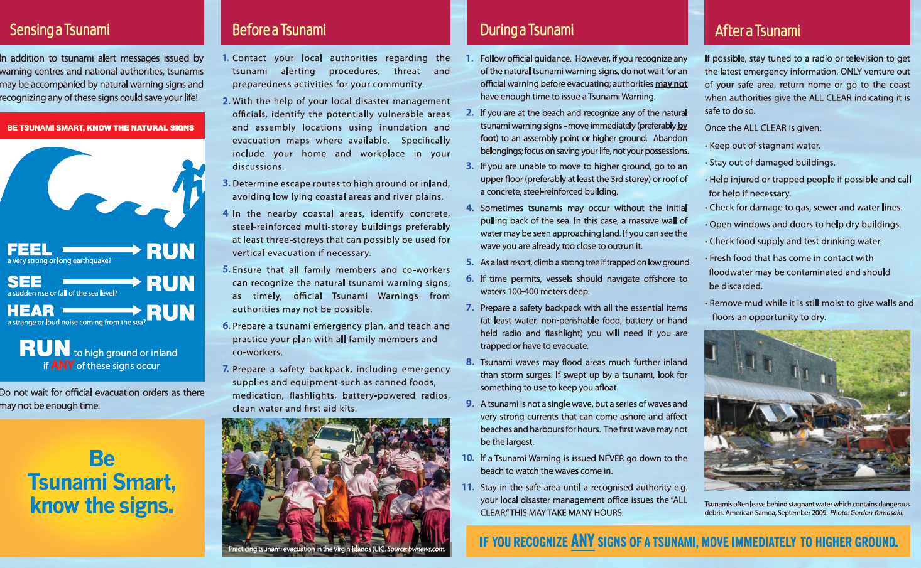
BEACHRISKS: Beach and Coastal Resorts Risks
Coordinator Centre: CERU. Partners: CEPRIS (Morocco), ICoD (Malta)
Tsunami Ready Comunity

Slide 27
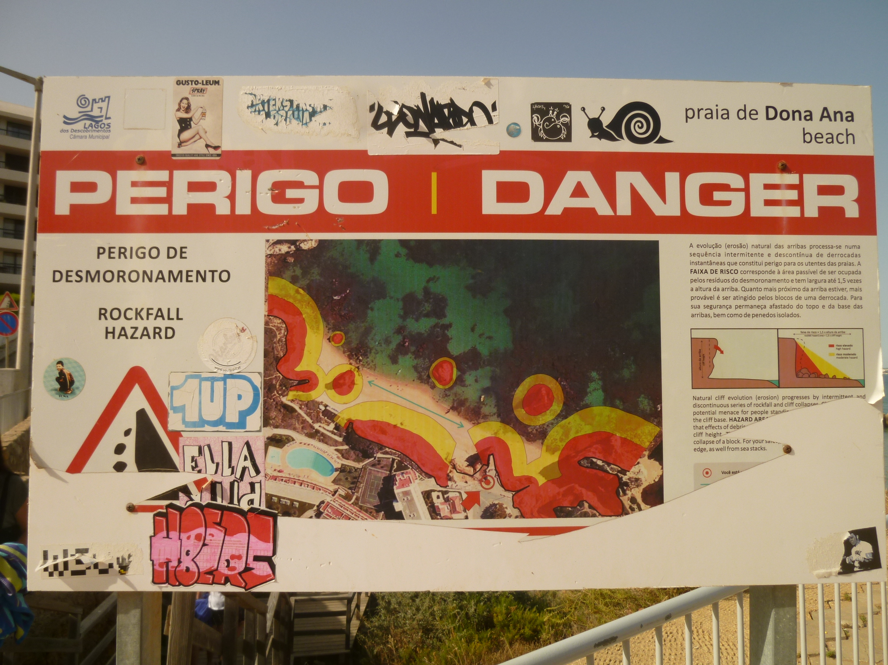
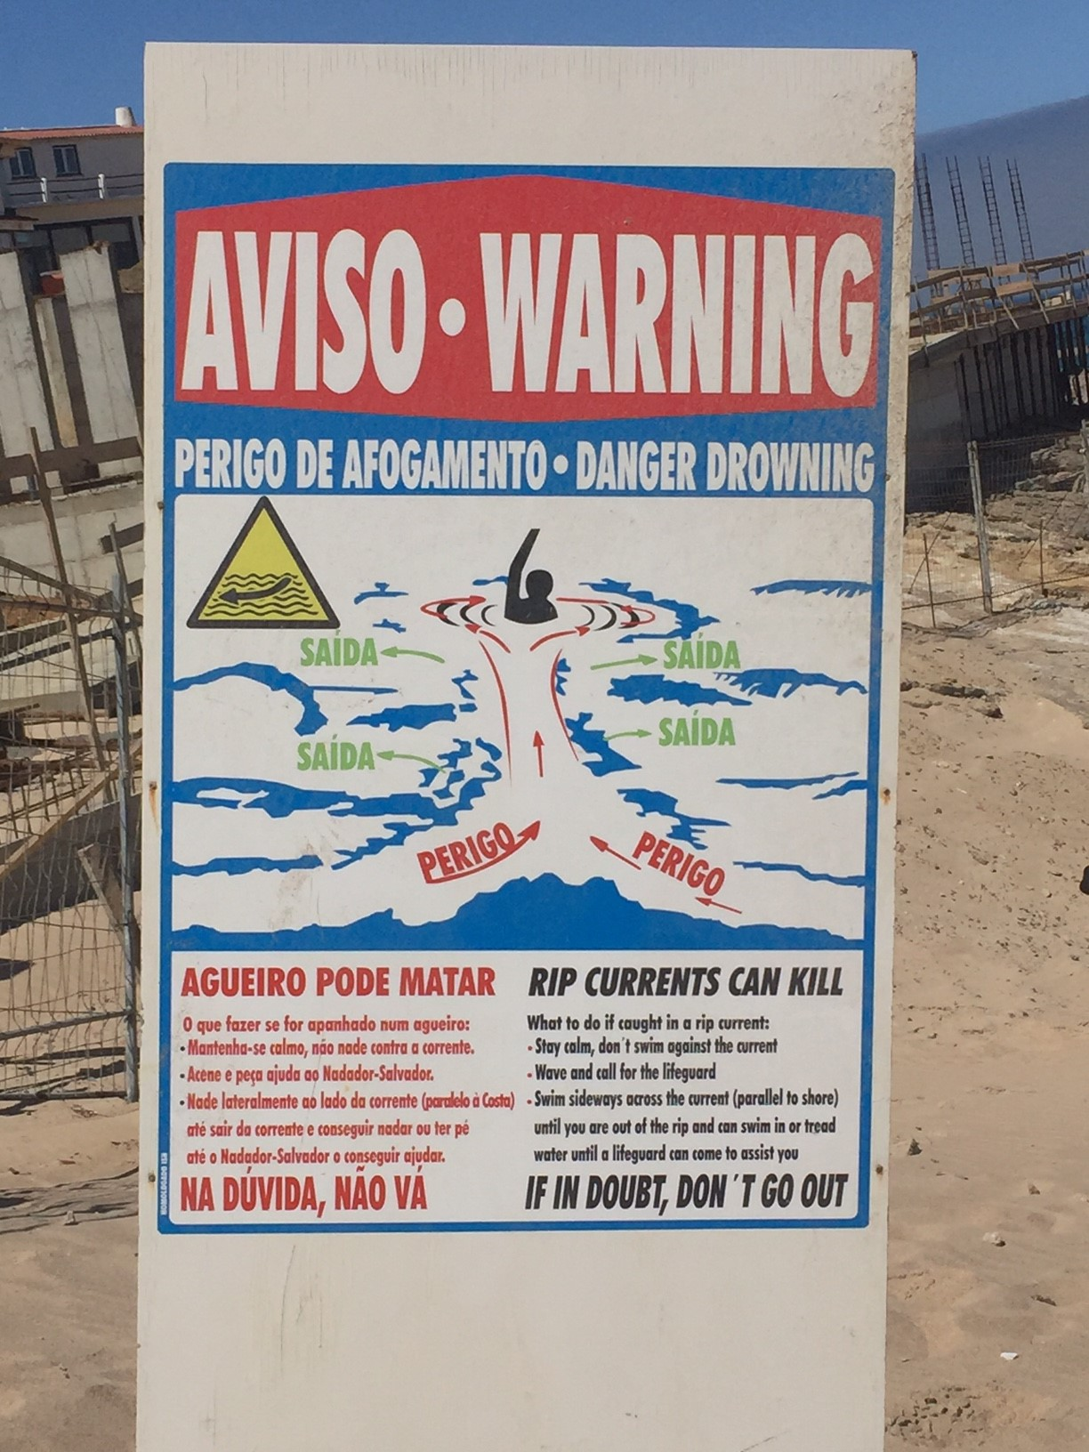
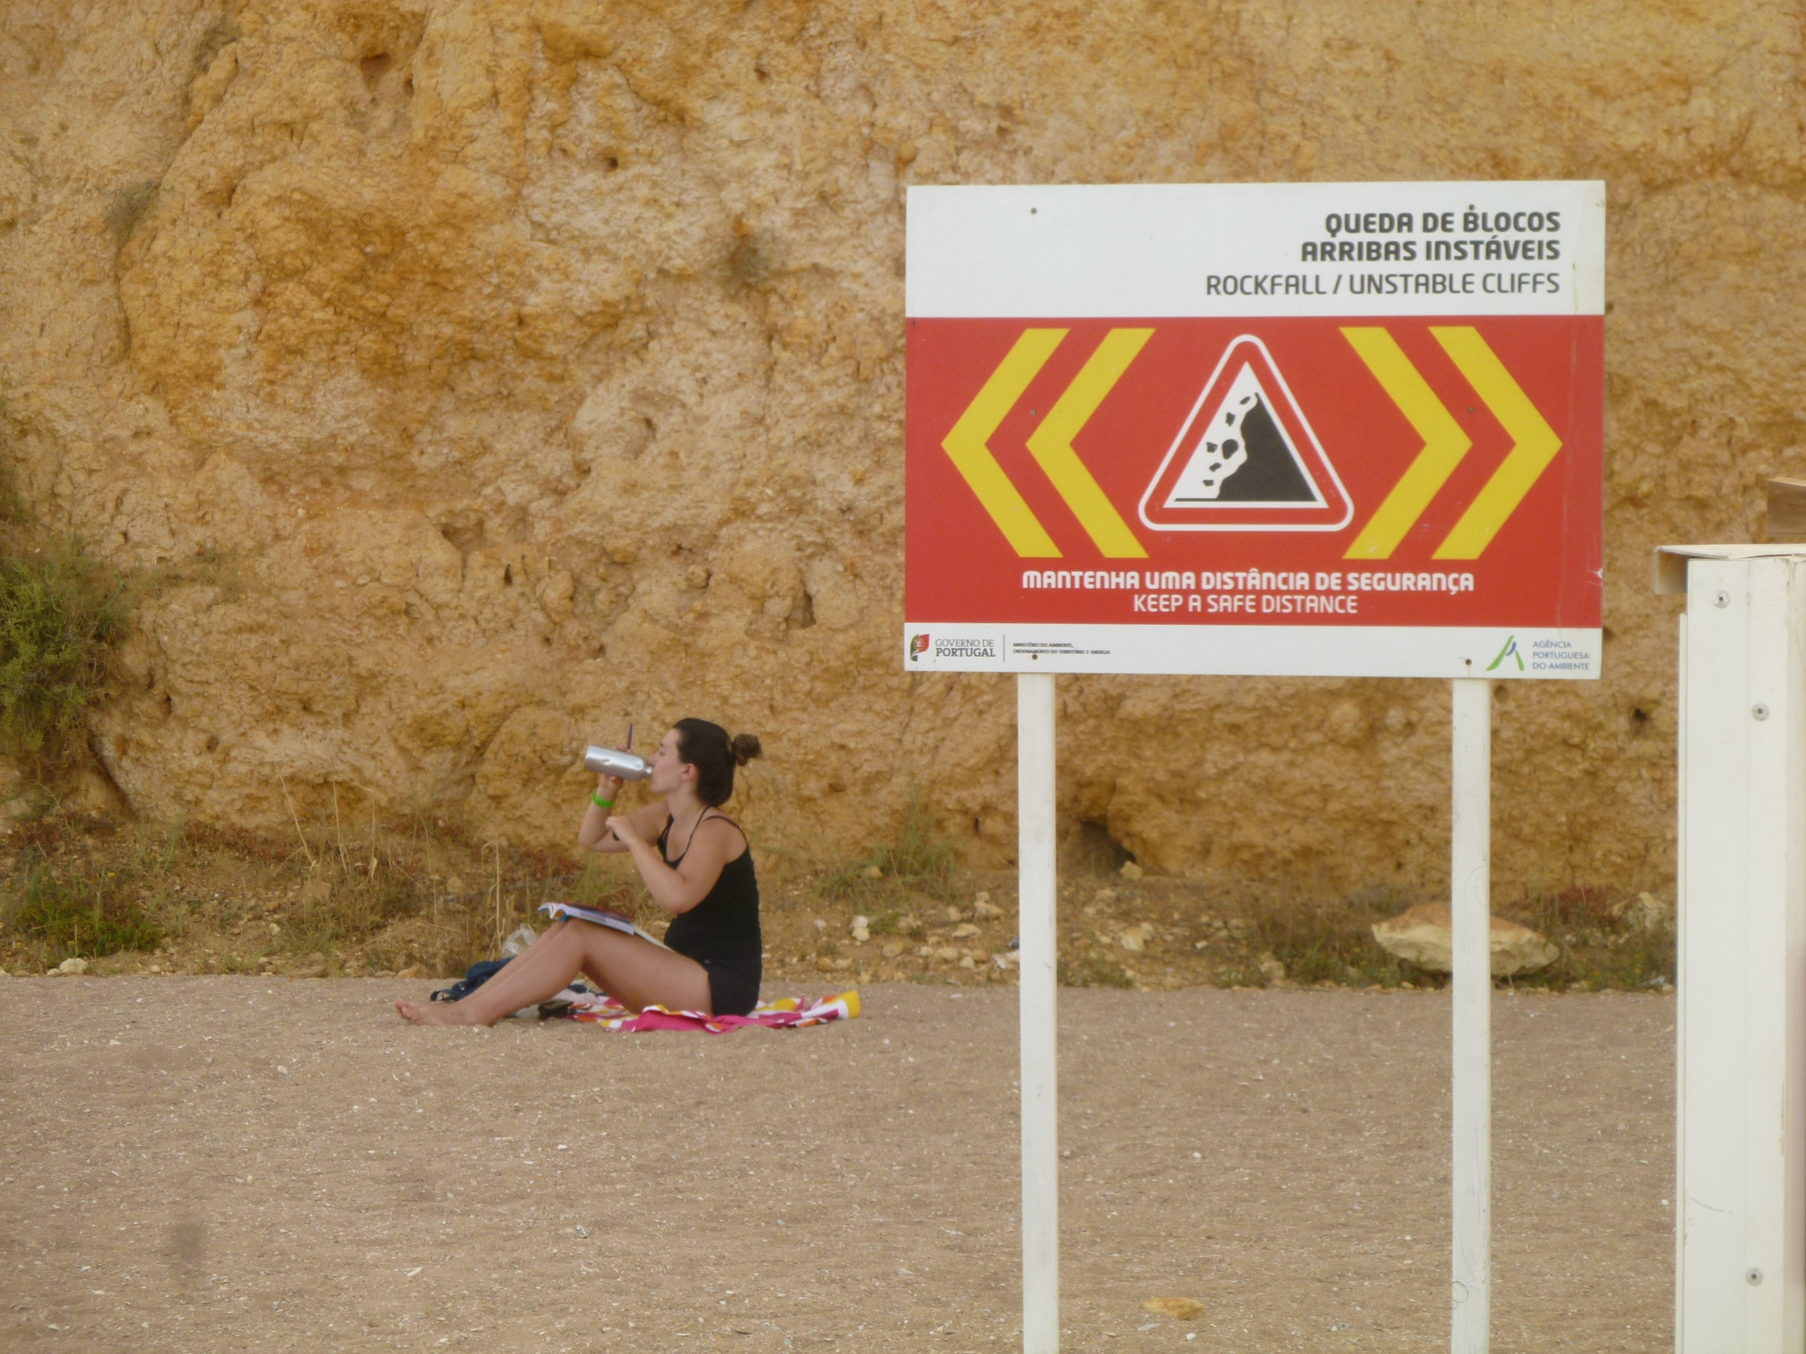
BEACHRISKS: Beach and Coastal Resorts Risks
Coordinator Centre: CERU. Partners: CEPRIS (Morocco), ICoD (Malta)
Other Risks
Rip Currents
Rockfall
Lightning

