Slide 1
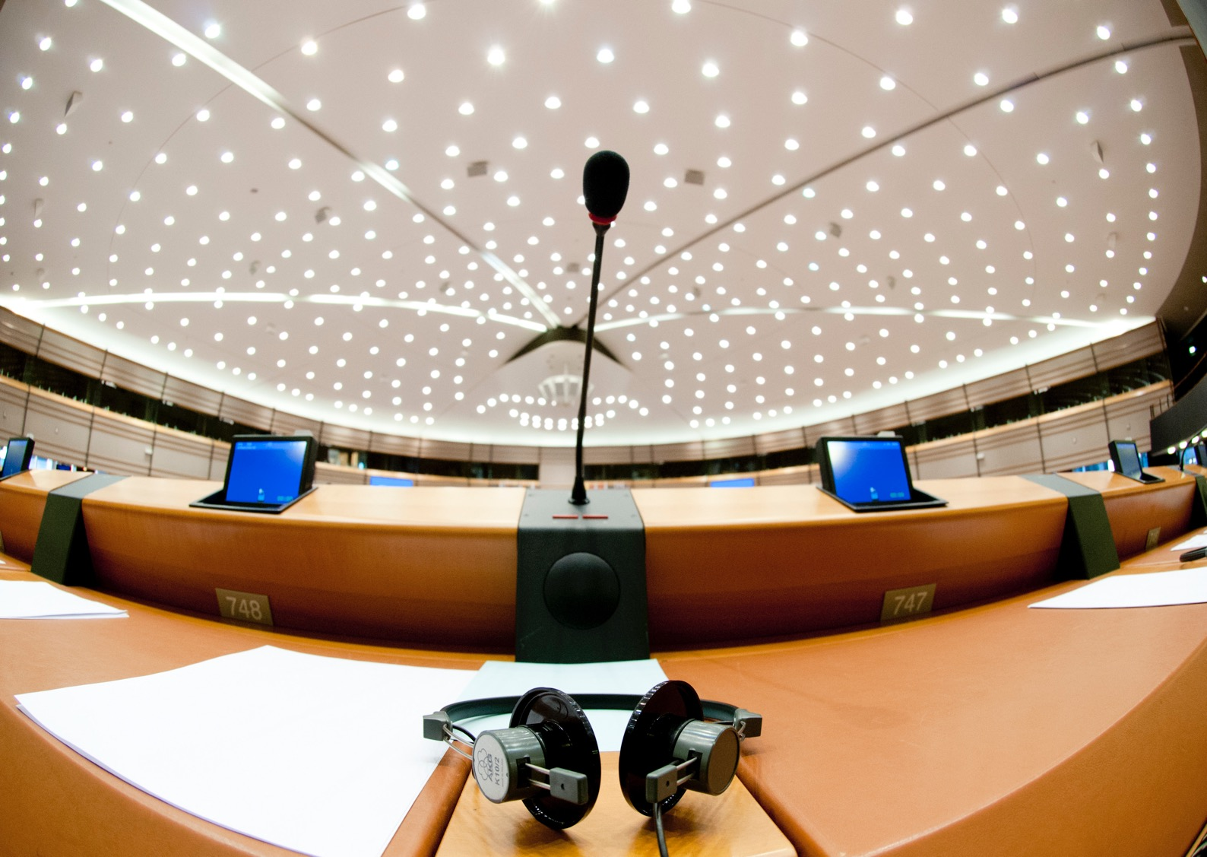
Quality and Integrity from a Students’ Perspective
The role of students, HEIs & policy makers
European Students‘ Union
Rajko Golovic
Prague, November 29. 2019

Slide 2
No Quality without Integrity
Lack of academic integrity is a threat to quality education and endangers academia as a whole.
Combating educational fraud needs to be a mission carried out by students, teachers, researchers, administrative personal and policy makers together.
We have a shared responsibility to confront corruption, plagiarism, contract cheating, nepotism, abuse of power and any other form of fraud.
ESU adopted a 0-tolerance policy towards dishonest behaviour in higher education and encourages NUSs to do the same.
Notes:
For the start some general remarks of our understanding and the understanding that 45 NUSes agreed upon when it comes to academic integrity.
We firmly believe that a lack of academic integrity is a threat to quality education and endangers academia as a whole.
When it comes to combating educational fraud we do believe that it needs to be a mission carried out by students, teachers, researchers, administrative personal and policy makers together,
united in the fight against academic misconduct.
It is not a problem that solely needs to be addressed by Policy makers or HEIs leadership. We have a shared responsibility to confront corruption, plagiarism, contract cheating, nepotism, abuse
of power and any other form of fraud. After digging very deep in our archive I found a resolution passed years ago that reflects ESU s approach towards breaches of academic integrity.
ESU adopted a 0-tolerance policy towards dishonest behaviour in higher education and encourages our National Unions to also do so. 0-tolerance applies to all members of the academic
community not only students. Especially when it comes to abuses of power by academic staff HEIs need to take immediate and decisive action,

Slide 3
The Role of Students
No integrity without students participation.
Students are an equal part of the academic community and therefor need to be involved in all decision making processes within HEI s and HE policy making.
This also means that students should to be involved in all relevant processes linked to monitoring academic integrity and the respective disciplinary measures in case of misconduct.
Student Unions need to foster a climate that promotes integrity and values academic honesty within the students body.
Student Unions need to use the given spaces and foster a quality culture that allows meaningful participation.
Notes:
Coming from an approach that is based on a concept we call modern collegiality we firmly believe that there can be no academic integrity without students participation.
Students are an equal part of the academic community and therefor need to be involved in all decision making processes within HEI s and HE policy making.
This also means that students need to be involved in all relevant processes linked to monitoring academic integrity, setting up guidelines, monitoring, investigating and respective disciplinary measures in case of misconduct.
We as student unions have an obligation to foster a climate that promotes integrity and values academic honesty within the students body. Whenever we talk about and demand students participation we also need to take into account that students participation is only meaningful if those students chosen are democratically elected and possess the necessary skills. These skills need to be taught both by the students union and HEIs .

Slide 4
The Role of HEIs
Diverse teaching methods, student centred learning, appropriate assessment forms and sanctions for unfair behaviour as the main tools to weaken environments that allow/foster academic dishonesty.
Clear information provision to students (e.g. MIT Handbook).
Education on academic integrity as part of every program.
Involving students as equal partners in processes linked to academic misconduct.
0 tolerance towards academic staff abusing their power.
Notes:
When it comes to HEIs and how they can foster academic integrity, we believe the solution is mainly prevention. Prevention through diverse teaching methods, student centred learning, appropriate assessment forms and clear sanctions for unfair behaviour are the main tools to weaken environments that allow/foster academic dishonesty.
We believe that its crucial to provide students with clear and easy accessible information on issues linked to academic integrity. I don’t know if you are familiar with the MIT Handbook. MITs Mind and Hand Book is a guide outlining MIT’s expectations of students behaviour. It contains standards, guidelines, regulations, and procedures pertaining to academic integrity and non-academic behaviour.
Provision of good informational material is a start put not enough. We believe it is crucial to have education on academic integrity as part of every program, transmitting a clear understanding of what is acceptable and what is not.
We believe that its necessary to involve students in the creation of any institutional framework that deals with academic misconduct, In case of a breach of academic integrity students need to be represented in the respective committees dealing with the issue and need to be involved in the judgement that leads to sanctions, no matter if the subsect is a fellow student or rather a member of the academic staff.
Academic staff mostly, at least to a certain extend, is in a power relation with students. Therefore it is absolutely crucial to implement 0 tolerance policies towards lecturers and professors that abuse their power. Especially when it comes to cases of sexual harassment or bullying, HEIs need to stand in solidarity with the witnesses and deliver transparent and timely investigation into the matter, leading to concrete outcomes and measure.

Slide 5
The Role of HEIs
Clear definition of learning outcomes, pedagogic and didactic competence-based teaching and learning as well as multiple types of examination would decrease the likelihood to cheat.
Professional development of teaching staff.
Implement evaluation systems for students to give feedback on teachers.
These evaluation systems need to be linked to consequences for teachers that do not fulfil minimum requirements.
Foster a culture that does not allow academic staff/lectures to claim ownership over students intellectual property.
Comparable data collection on academic misconduct
Notes:
Further measures of prevention can be introduced by providing clear definition of learning outcomes, pedagogic and didactic competence-based teaching and learning as well as multiple types of examinations that cater the students need. Every student is different and if we take this fact into account we decrease the likelihood of students to cheat. It will never be eliminated of course, since there will always be lazy people willing to cheat, within the students body, within academic staff, everywhere you will find these people. But a student centred approach will decrease the numbers heavily through taking a way the necessity to cheat.
This of course requires special training for teachers and staff. We therefor encourage you to invest in this instead of as it was brought up yesterday, surveillance cameras in examination rooms or frequenters that block earphones. Student centred learning is the key, not harsher punishment or George Orwell methods of examination from our point of view.
As much leverage a teacher has to influence a student's the standing and perspective within the academic community as little do have students means to rate the performance of academic staff and teachers. We therefor think it is necessary to implement evaluation systems that allow students to feedback the performance of a teacher both to the teacher himself and superiors within the HEI. These evaluation systems need to be linked to consequences for teachers that do not fulfil minimum requirements of quality teaching or through these evaluation systems are suspected to have breached academic integrity.
Another prominent issue we see in most of our member countries is teachers and academic staff claiming ownership of students intellectual property. There are various reported cases where students wrote and conducted the research for scientific papers that later are published under the name of the lecturer with solely a minor note of gratitude next to the footnote section.
We need to create a higher education system where this form of structural plagiarism can not flourish anymore.
In order to see what policies work HEIs need to collect comparable data on academic misconduct to measure progress and regress. This data should be reported to the national authorities in order to create an structural overview that allows the identification ob best practises and enables peer learning between institutions.

Slide 6
The Role of Policy Makers
Provide oversight for and guidance in strengthening policies and procedures that safeguard academic integrity.
Facilitate communication among institutions and encourage the exchange of best practise.
Encourage quality assurance agencies to intensify their focus on academic integrity.
Finance and support research in academic integrity.
Encourage HEIs to conduct comparable data collection on academic misconduct.
Notes:
Last but not least I want to share some thoughts on the role of Policy makers in safeguarding academic integrity. We do believe that national authorities should
provide oversight for and guidance in strengthening policies and procedures that safeguard academic integrity in order to facilitate the exchange of ideas and best practises among institutions.
Educational authorities should furthermore encourage quality assurance agencies to intensify their focus on academic integrity in countries where this is not done yet,
Another proven and effective way to take the discourse forward and to raise awareness for academic integrity is financing and supporting research in this field. If it is a priority for you make it a priority and fund projects aimed at improving the integrity culture in your higher education system.
Last but not least, Data collection is essential to evaluate the performance and effectiveness of policies that aim to foster academic integrity. We believe that national authorities should therefor encourage HEIs to conduct comparable data collection on academic misconduct in order to allow the in identification of best practises.

Slide 7
THANK YOU!
Notes:
Last but not least I want to share some thoughts on the role of Policy makers in safeguarding academic integrity. We do believe that national authorities should
provide oversight for and guidance in strengthening policies and procedures that safeguard academic integrity in order to facilitate the exchange of ideas and best practises among institutions.
Educational authorities should furthermore encourage quality assurance agencies to intensify their focus on academic integrity in countries where this is not done yet,
Another proven and effective way to take the discourse forward and to raise awareness for academic integrity is financing and supporting research in this field. If it is a priority for you make it a priority and fund projects aimed at improving the integrity culture in your higher education system.
Last but not least, Data collection is essential to evaluate the performance and effectiveness of policies that aim to foster academic integrity. We believe that national authorities should therefor encourage HEIs to conduct comparable data collection on academic misconduct in order to allow the in identification of best practises.

