Slide 1
HELP in the Western Balkans. HELP in the Eastern Partnership.
30 June 2022, Strasbourg

Slide 2
HELP (Human Rights Education for Legal Professionals)
in the Western Balkans
DURATION
30 months (1 December 2019 – 31 December 2022)
BENEFICIARIES
Judicial Training Institutions and Bar Associations from Albania, Bosnia and Herzegovina, Kosovo*, Montenegro, North Macedonia and Serbia
BUDGET
893.000 EUR
TEAM
Jasminka PERUNICIC-ALLEN
Irena KOTARSKA
*This designation is without prejudice to positions on status, and is in line with UNSCR 1244 and the ICJ Opinion on the Kosovo Declaration of Independence.
Notes:
HELP is:
the only pan-European Network of national training institutions for judges, prosecutors and lawyers in the 47 Member States;
online courses on human rights;
a human rights training methodology for legal professionals.

Slide 3
HELP online courses (domestic level)
124
124 HELP online courses
(77 directly under the action)
4300
4300 legal (and other) professionals
75%
75% average success rate
Notes:
HELP is:
the only pan-European Network of national training institutions for judges, prosecutors and lawyers in the 47 Member States;
online courses on human rights;
a human rights training methodology for legal professionals.

Slide 4
Cooperation & synergies
10 bilateral HF actions
Improved procedural safeguards in criminal proceedings in Montenegro
Preventing & combatting trafficking in human beings in Bosnia and Herzegovina, North Macedonia and Serbia
Promotion of diversity and equality in North Macedonia
Freedom of expression and freedom of media in Albania, Bosnia and Herzegovina, Serbia
Strengthening effective legal remedies to human rights violations in Serbia
Supporting enhanced access to higher quality free legal aid services in North Macedonia
1 regional HF action
Enhancing penitentiary capacities in addressing radicalisation prevention in the Western Balkans
3 CoE projects
Initiative for legal certainty and effective judiciary in Bosnia and Herzegovina
Reinforcing the fight against violence against women and domestic violence in Kosovo*
Strengthening the Kosovo* Institutions in fight against torture, ill-treatment and other degrading treatment
*This designation is without prejudice to positions on status, and is in line with UNSCR 1244 and the ICJ Opinion on the Kosovo Declaration of Independence.

Slide 5
HELP online courses (regional level)
3
3 HELP online courses launched
324
324 justice (and other) professionals

Slide 6
HELP users
July 2017 to July 2022

Slide 7
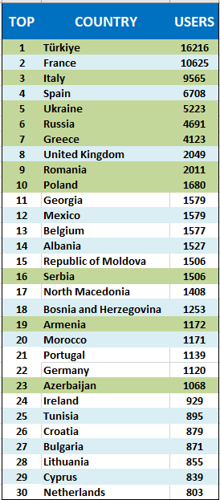
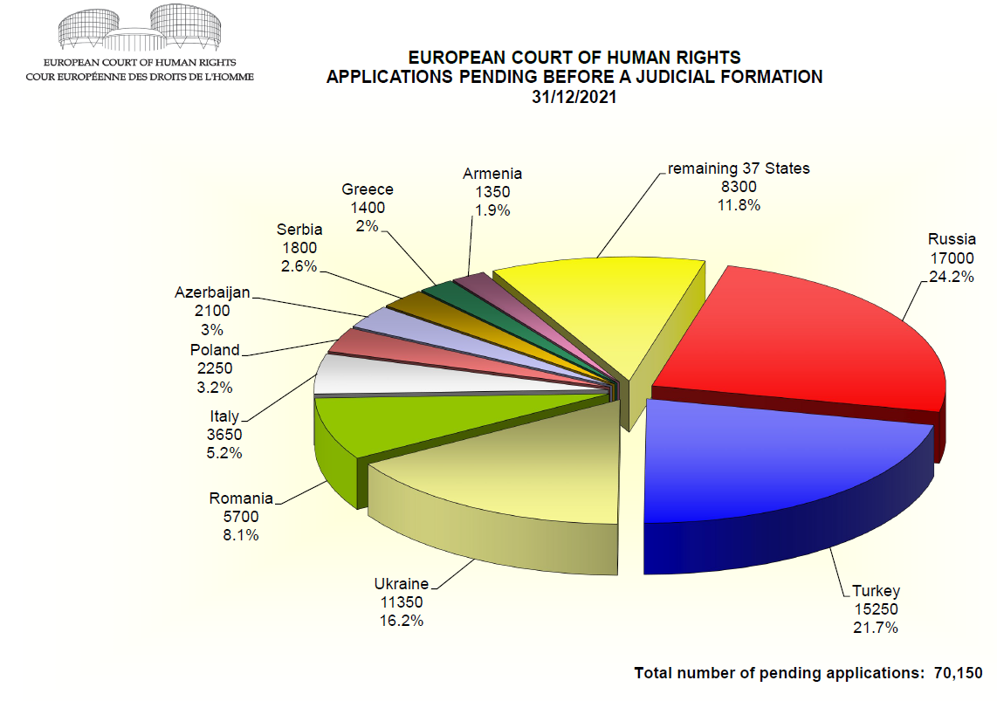
HELP Platform
Notes:
PENDING ALLOCATED CASES
Approximately 70150 62000 applications were pending before a judicial formation at 31 Dec 2021 2020. Nearly a quarter of these applications had been lodged against the Russian Federation.
The number of applications allocated to a judicial formation in 2021 exceeded the number disposed of judicially during the year.

Slide 8
Name of the presentation
Notes:
PENDING ALLOCATED CASES
Approximately 70150 62000 applications were pending before a judicial formation at 31 Dec 2021 2020. Nearly a quarter of these applications had been lodged against the Russian Federation.
The number of applications allocated to a judicial formation in 2021 exceeded the number disposed of judicially during the year.

Slide 9
HELP in Türkiye
14
145 HELP online courses launched
16
18 HELP courses translated into Turkish
7
17 HELP courses publicly available in the self-learning

Slide 10
HELP in Eastern Partnership countries

Slide 11
HELP implementing the ECHR
in Eastern Partnership countries
Armenia
Azerbaijan
Georgia
Republic of Moldova
January – March 2022: 180.000 EUR
16 HELP courses launched, 444 enrolled professionals

Slide 12
Notes:
With the support of the HF action “Strengthening the effective legal remedies to human rights violations in Serbia” and the regional action “HELP in the Western Balkans”, the Judicial Academy of Serbia has included in its compulsory training programme (for the initial training) the HELP online course “Introduction to the European Convention on Human Rights and the European Court of Human Rights”.
50 trainees of the tenth generation started and successfully completed the online course which will be followed in the upcoming months by three additional courses (on anti-discrimination, child-friendly justice and violence against women/domestic violence). These courses are intended to be systematically incorporated in the initial training programme of the Judicial Academy of the Republic of Serbia.
Training Centres of the Federation of Bosnia and Herzegovina and Republika Srpska as the course was successfully implemented for interns and young practitioners.
- The course has also been included in the initial training programme (as a compulsory course) of the Macedonian Academy for judges and public prosecutors. 60 candidates judges and prosecutors are currently attending the online course.

Slide 13
Number of users of the HELP Platform in EaP – July 2018 - July 2022

Slide 14
How many? Tutored courses and participants
HELP courses launched in EaP:
144 in total
41 since July 2021
Participants to HELP tutored courses:
1062 since July 2021

Slide 15
Which courses/topics?
Tutored courses and participants
July 2021 – July 2022

Slide 17
Join us in Facebook, Twitter:
CoEHELP
HELP
Good training for good judgments
Thank you very much for your attention!
Head of Justice and Human Rights Training Division: Eva.PASTRANA@coe.int
Deputy HoD: Ana.MEDARSKA-LAZOVA@coe.int
HELP in the Western Balkans: Jasminka.PERUNICIC-ALLEN@coe.int
HELP in the WB assistant: Irena.KOTARSKA@coe.int
HELP in Ukraine: Olga.KOSTENKO@coe.int
From 1 September: HELP in the EaP: Anna.SAHAKYAN@coe.int

