Slide 1
European Programme for Human Rights Education for Legal Professionals CoE HELP Ana Medarska, June 2022
24/06/2022
1

Slide 2
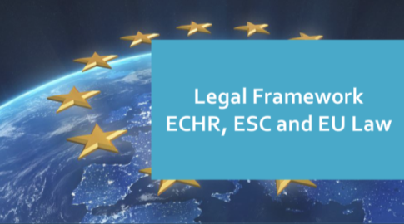
HELP’s main goal
HELP legal professionals* apply European human rights standards in their daily work, mainly by training
* and other current/future professionals
European Convention on Human Rights, (Revised) ESC, CoE Conventions
EU Charter of Fdtal. Rigths and EU Law
Notes:
ECHR + ESC + CoE legislation + EU law for EU
+ EU Charter and EU law for EU countries

Slide 3
From Reasoning of Criminal Judgements to Judicial Reasoning and Human Rights
Enlarged scope, updated content, modernised design
Notes:
HELP is:
- the only pan-European Network of national training institutions for judges, prosecutors and lawyers in the 47 Member States;
- an e-learning platform on human rights;
a human rights training methodology for legal professionals.
HELP Network
The HELP Network, the only pan-European peer-to-peer Human Rights Training Network, is composed of representatives from National Training Institutions for Judges and Prosecutors (NTIs) and Bar Associations (BAs) of the 47 member states of the Council of Europe.
The HELP Network is entrusted with the implementation of paragraph 9.vi of the 2012 Brighton Declaration and shall, in this respect:
promote the development and promotion of initial and continuous training of legal professionals on standards of the ECHR, as interpreted by the case law of the European Court of Human Rights (ECtHR);
share best practices and provide advice on curricula, training materials and training methodologies for legal professionals, identifying priority themes for future training activities.
E-learning platform
A wide range of training resources on the ECHR, developed and collected under the HELP Programme, is available on-line, translated into the national languages of the beneficiary countries. It is becoming a real challenge for legal professionals to follow the case law of the Strasbourg Court, which evolves quickly and expansively. The HELP Programme is also a platform where they will be able to keep abreast of Strasbourg case law developments through easy available updates.
There are two main types of HELP training resources:
Distance-learning courses are available for selected groups of legal professionals participating in pilot courses moderated by certified national tutors. The list of available courses (including a description) is available in the catalogue of courses.
Self-learning resources are available to any user who has an account on the platform.
They include training manuals on both ECHR Methodology and Key Concepts, as well as Handbooks, standard curricula, course outlines, presentations, case studies, and e-learning courses on the different Articles and themes of the ECHR.
Training methodology
The HELP methodology takes into account the heavy time pressure imposed on legal professionals in their daily work. Its added value is that curricula are drafted on a tailor-made basis, meeting participants’ specific training needs and learning pace, allowing flexibility.The HELP methodology and resources are systematically used in all CoE capacity building activities on the ECHR, organised in the Member States, including within the framework of EU/CoE Joint Programmes.
HELP organises training of trainers sessions, with the aim to increase ownership by national training institutions.

Slide 4
Under the joint EU/CoE action
Strengthening the effective legal remedies to human rights violations in Serbia,
within EU/CoE Horizontal Facility for the Western Balkans and Turkey 2019-2022
Update started in December 2020
Published:
February 2022
Approximately: 8 hours
Notes:
HELP is:
- the only pan-European Network of national training institutions for judges, prosecutors and lawyers in the 47 Member States;
- an e-learning platform on human rights;
a human rights training methodology for legal professionals.
HELP Network
The HELP Network, the only pan-European peer-to-peer Human Rights Training Network, is composed of representatives from National Training Institutions for Judges and Prosecutors (NTIs) and Bar Associations (BAs) of the 47 member states of the Council of Europe.
The HELP Network is entrusted with the implementation of paragraph 9.vi of the 2012 Brighton Declaration and shall, in this respect:
promote the development and promotion of initial and continuous training of legal professionals on standards of the ECHR, as interpreted by the case law of the European Court of Human Rights (ECtHR);
share best practices and provide advice on curricula, training materials and training methodologies for legal professionals, identifying priority themes for future training activities.
E-learning platform
A wide range of training resources on the ECHR, developed and collected under the HELP Programme, is available on-line, translated into the national languages of the beneficiary countries. It is becoming a real challenge for legal professionals to follow the case law of the Strasbourg Court, which evolves quickly and expansively. The HELP Programme is also a platform where they will be able to keep abreast of Strasbourg case law developments through easy available updates.
There are two main types of HELP training resources:
Distance-learning courses are available for selected groups of legal professionals participating in pilot courses moderated by certified national tutors. The list of available courses (including a description) is available in the catalogue of courses.
Self-learning resources are available to any user who has an account on the platform.
They include training manuals on both ECHR Methodology and Key Concepts, as well as Handbooks, standard curricula, course outlines, presentations, case studies, and e-learning courses on the different Articles and themes of the ECHR.
Training methodology
The HELP methodology takes into account the heavy time pressure imposed on legal professionals in their daily work. Its added value is that curricula are drafted on a tailor-made basis, meeting participants’ specific training needs and learning pace, allowing flexibility.The HELP methodology and resources are systematically used in all CoE capacity building activities on the ECHR, organised in the Member States, including within the framework of EU/CoE Joint Programmes.
HELP organises training of trainers sessions, with the aim to increase ownership by national training institutions.

Slide 5
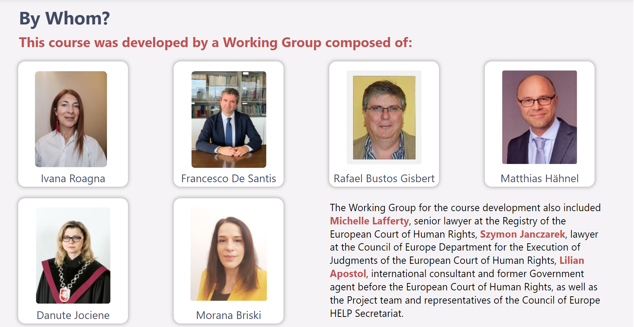

Slide 6
Aim:
to provide a practical resource for legal professionals on the material standards under European human rights law concerning the quality of judicial reasoning

Slide 7
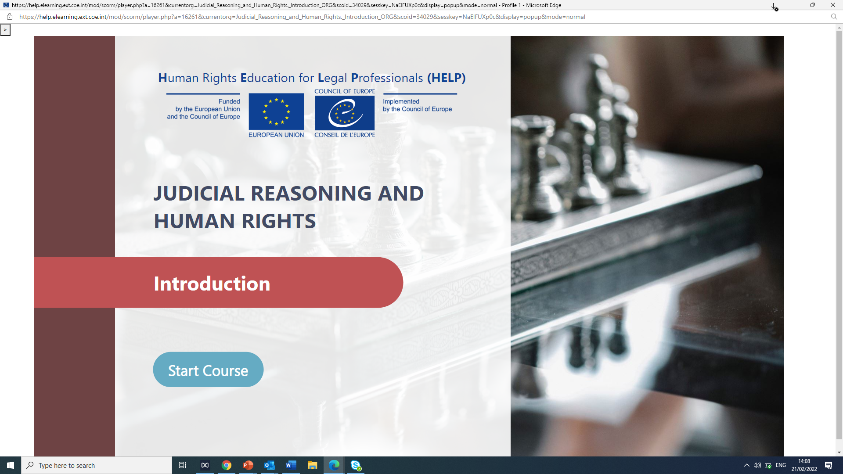
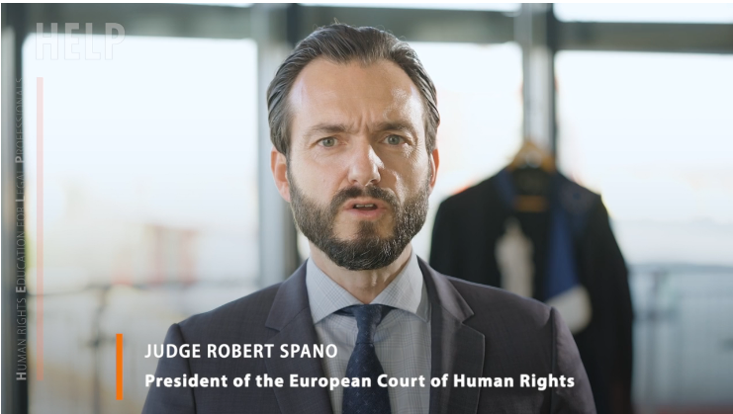
Introduction
Judicial reasoning and fair trial
Judicial reasoning in criminal proceedings: Pre-trial stage
JR in criminal proceedings: Trial, Appeal and Enforcement
Judicial reasoning in non-criminal proceedings: General concepts
JR in non-criminal proceedings: Thematic issues I
Thematic issues II
Click on the picture or here to watch a (4-min ) HELP course introductory video
Notes:
Skills & attitudes: Refer to relevant legal framework in your daily work as legal professional

Slide 9
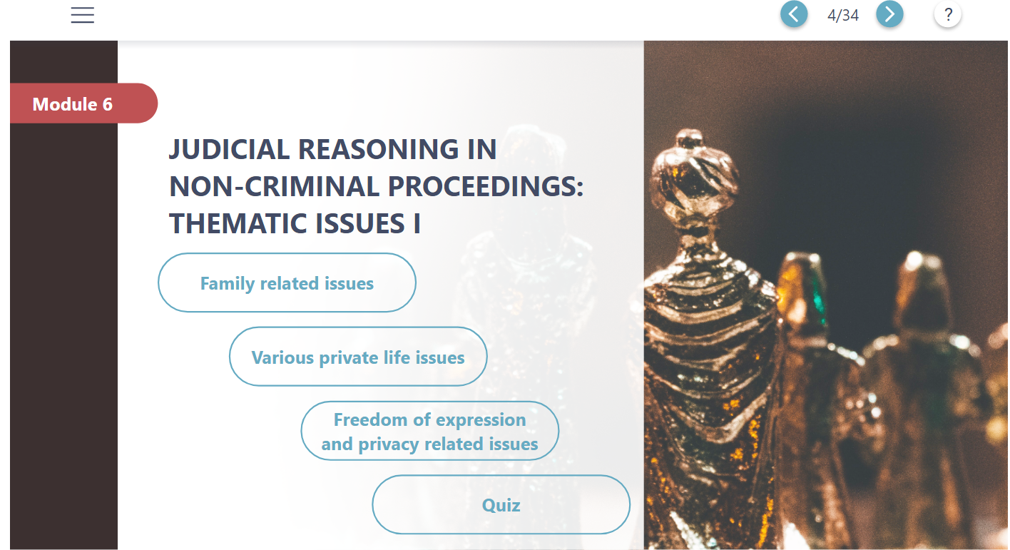
Many aspects are addressed to best tackle the challenges of this module such as Gender issues, Adoption, Parental responsibility research of personal origins, freedom of expression, privacy etc. (see full list on the next slide)

Slide 10
Family related issues
Various private life issues
Freedom of expression and privacy related issues
Establishment of parent-child relationships
Gender issues
Judicial review over interferences with freedom of expression
Regulation of parental rights
Right to a name
Freedom of expression vs. protection of reputation or privacy
Withdrawal of parental responsibility
Research of personal origins
Adoption
Home eviction and demolition
Expulsion from a member state
Issues concerning burial and deceased persons
Child abduction
Notes:
Skills & attitudes: Refer to relevant legal framework in your daily work as legal professional

Slide 11
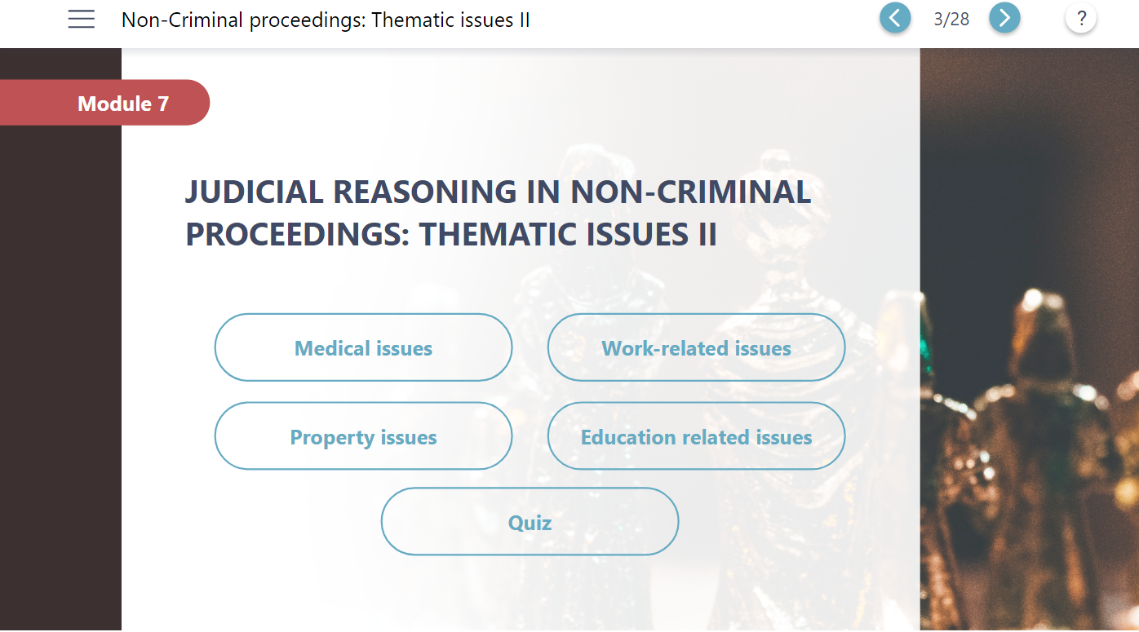
Again, several aspects are taken into account to face the challenges of this module such as medical negligence, infantile treatment against parents’ wishes, religious symbols at work, internet monitoring at work, access to university rulings etc.

Slide 12
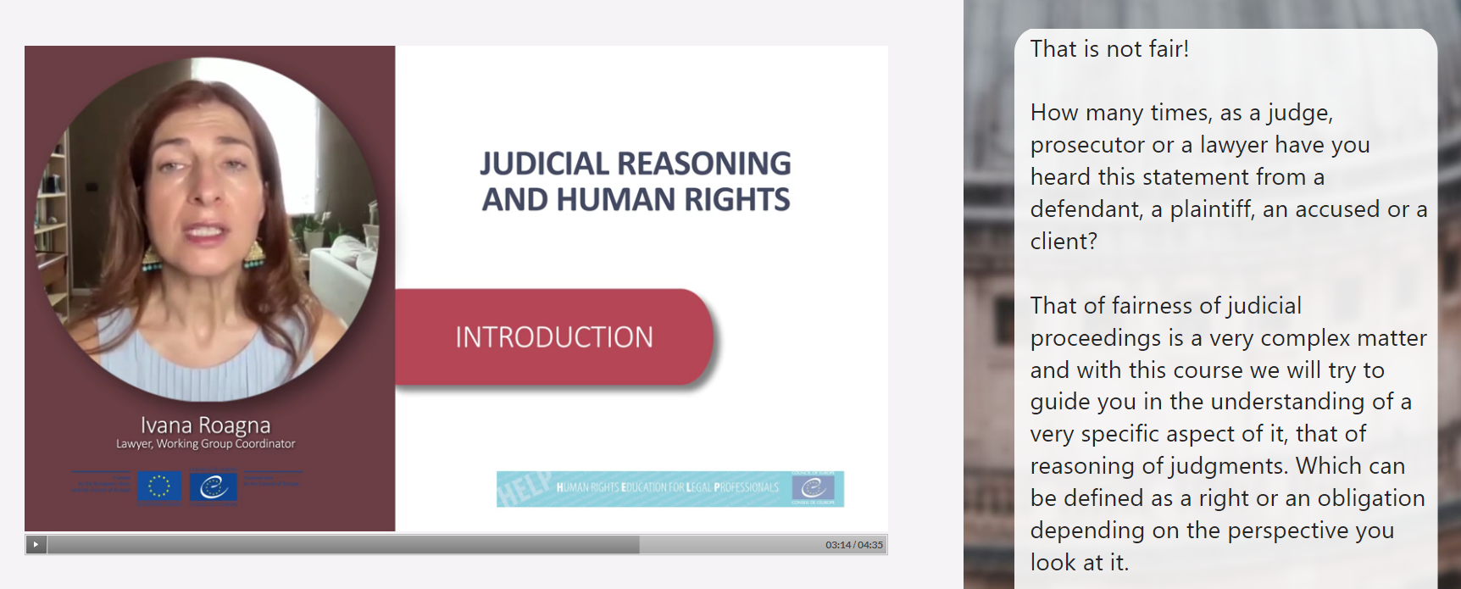
HOW?

Slide 13
Self-learning:
More than 300 people following the ENG version since its publication.
More than 70 already completed it and got the HELP statement of accomplishment
Tutored course:
Implemented already in 4 countries: Serbia:
Armenia
Azerbaijan translated
Georgia to be launched in September
Republic of Moldova inclusion in the initial training programme
115 enrolled - 75 successful participants

Slide 14
Join us in Facebook, Twitter:
CoEHELP
HELP
Good training for good judgments
Thank you very much for your attention!
Head of Justice and HR Training Division: Eva.PASTRANA@coe.int
Deputy HELP HoU–EaP: Ana.MEDARSKA-LAZOVA@coe.int
HELP assistant: Stephanie.DENTON@coe.int
HELP in the EU: Ana-Maria.TELBIS@coe.int
HELP in Western Balkans: Jasminka.PERUNICIC-ALLEN@coe.int
HELP in Turkey: Fethullah.SOYUBELLI@coe.int
HELP in Morocco: Malika.SMAALI@coe.int
HELP in Tunisia: Imene.KHALIFA@coe.int
HELP in Central Asia: Krystyna.KHOKHLOVA@coe.int

