Slide 1

7th meeting of the Ad hoc Working Group on Reporting
Reporting Manual for the Delivery of Resolution No.8 (2012) data in Reportnet 3

Slide 2
Table of contents
General reporting procedure
General resources
Extended Excel templates
National Checklists
General Report
Species tabular data
Habitats tabular data
Data submission
Data validation
Data correction
Re-submission, re-validation and re-correction
Report Delivery

Slide 3
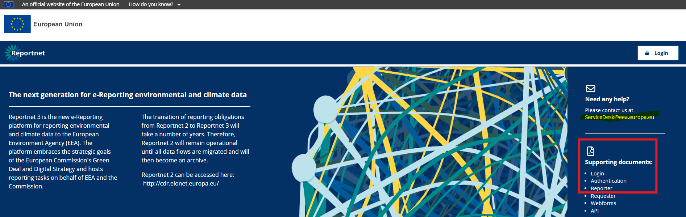
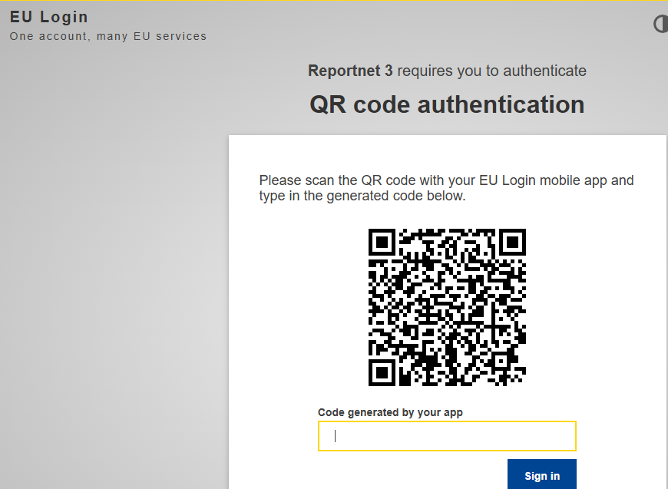
General Reporting Procedure
EU login Mobile
(Authenticator)

Slide 4
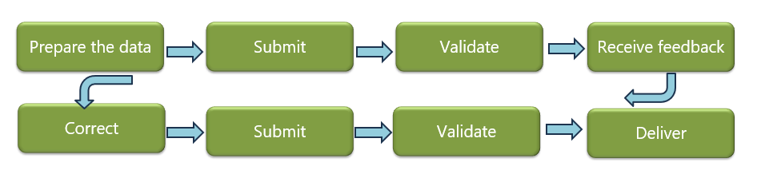
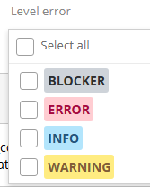
General Reporting Procedure

Slide 5

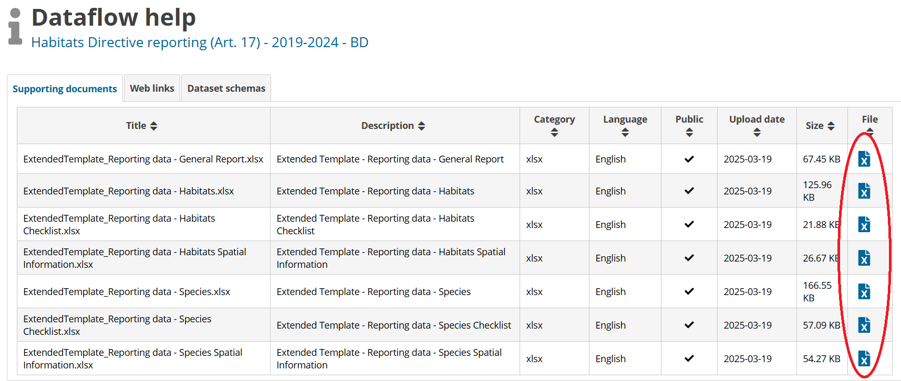
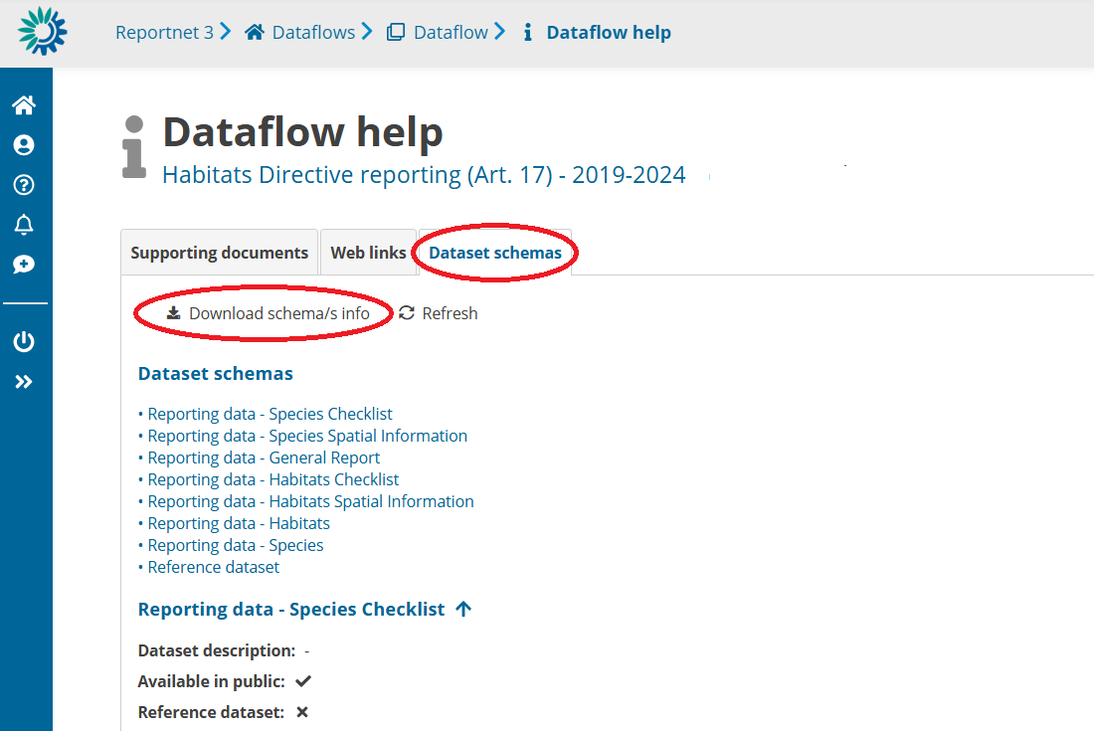
General resources

Slide 6
EET-Extended Excel Templates
WHITE | GREEN | YELLOW | BLUE | RED
Free text No drop down menu | Drop-down menu Only 1 value | Automatically prefilled. Visualize content according to the code indicated in GREEN column. | >1 value (X;Y;Z) Paste value copied in RED | Contained the code lists associated to blue column. Copy-paste into BLUE.
 |  | “_refLabel” Not imported to RN3 |  | “SameNameBLUE_MV” Not imported to RN3
Follow schemas tables, with an additional excel sheet: RefLOVs

Slide 7
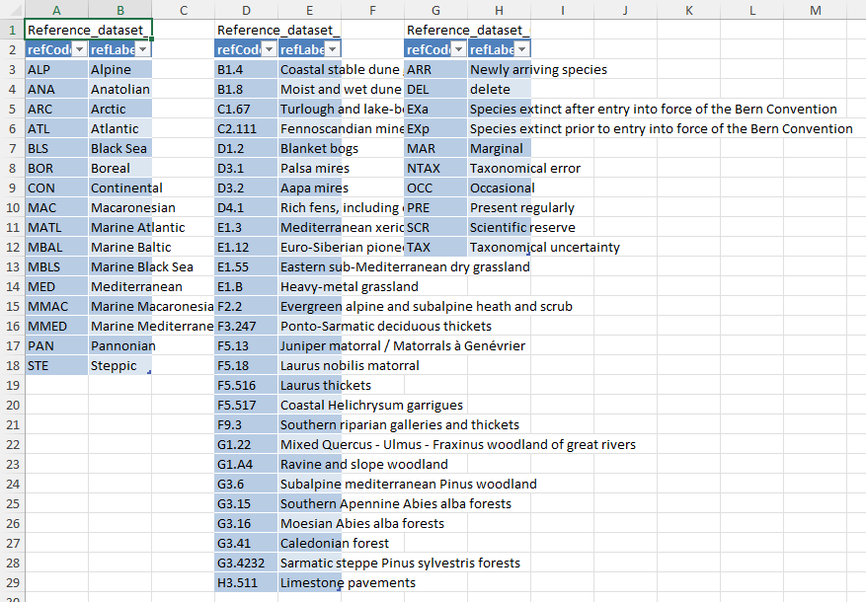
EET-Extended Excel Templates
RefLOVs

Slide 8
National checklists
First step: VALIDATE NATIONAL CHECKLIST FOR HABITATS AND SPECIES
EXTERNAL: EET_SP/HT _CHECKLIST + IMPORT
AUTOMATICALLY PRE-FILLED FROM DATA INCLUDED IN THE REFERENCE CHECKLISTS (endorsed by SC)*
CHANGES CAN BE DONE IN THE NATIONAL CHECKLISTS ->
PROPERLY JUSTIFIED (ADDITIONAL INFORMATION)
ADDITION/DELETION OF FEATURES
ADDITION OF HABITATS OR SPECIES NOT INCLUDED IN THE REFERENCES CHECKLISTS (COMPLETELY NEW) IS NOT POSSIBLE
CHANGES IN OCCURRENCE
BE CAREFUL WITH POPULATION UNITS

Slide 9
National checklists
Optional
DEL occurrence for removals

Slide 10
Part A- General Report

Slide 11
Part B_Species
2. Maps
4. Regions_GeneralInformation
5. Regions_Range
6. Regions_ Population
7. Regions_ SpeciesHabitat
8. Pressures_GeneralInformation/Pressures_List
9. Measures_GeneralInformation/Measures_List
10. Regions_Future prospects
11. Regions_ Conclusions
12. Regions_ EmeraldNetworkCoverage
13. Regions_ ComplementaryInfo (optional)
Schemas consist of tables
Mandatory vs optional tables
Mandatory vs optional fields

Slide 12
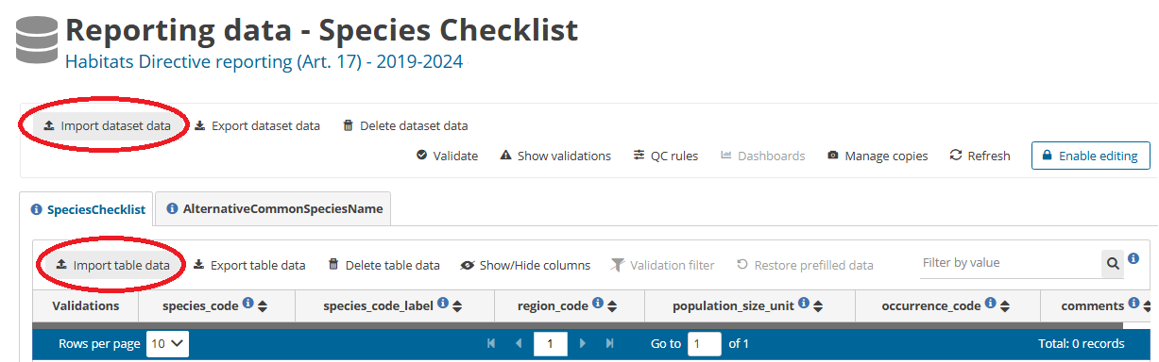
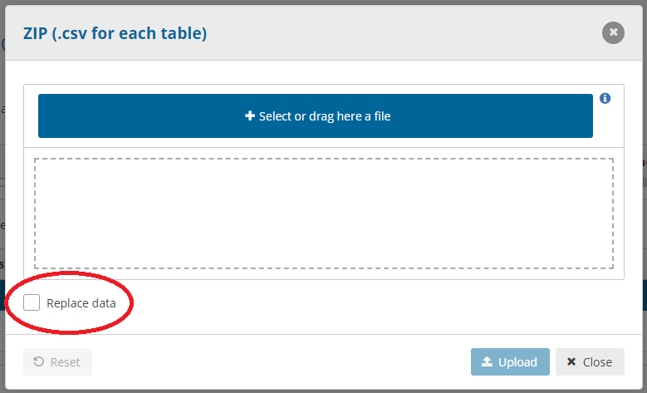
Data submission
ZIP (.csv), XLSX allowed
One file at a time

Slide 13
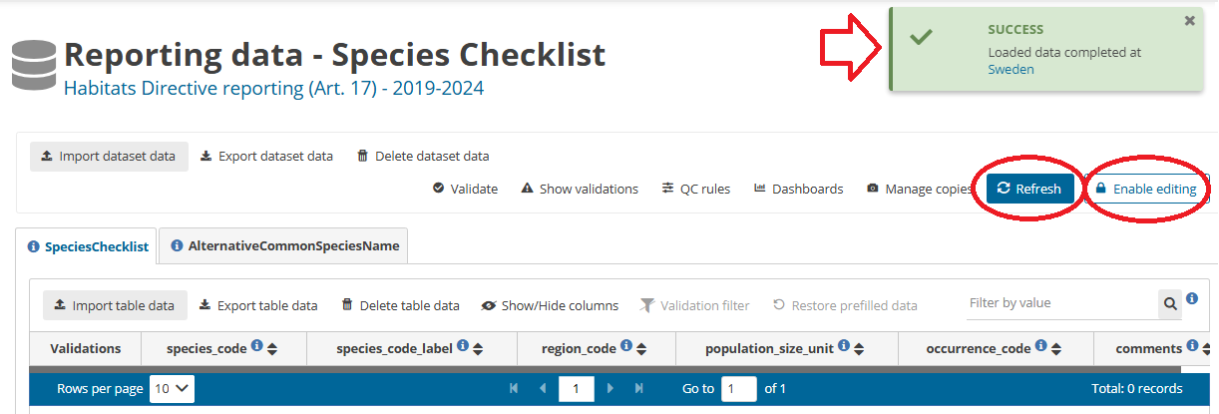
Data submission

Slide 14
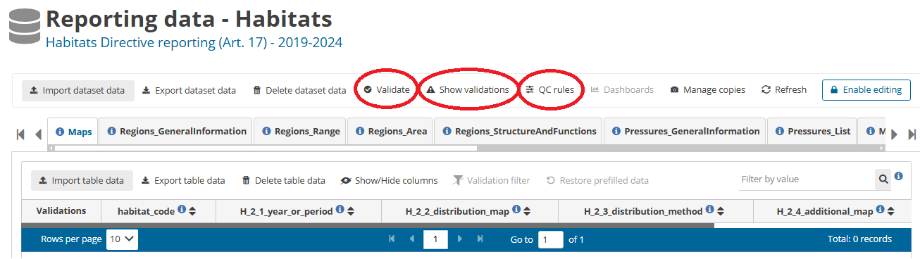
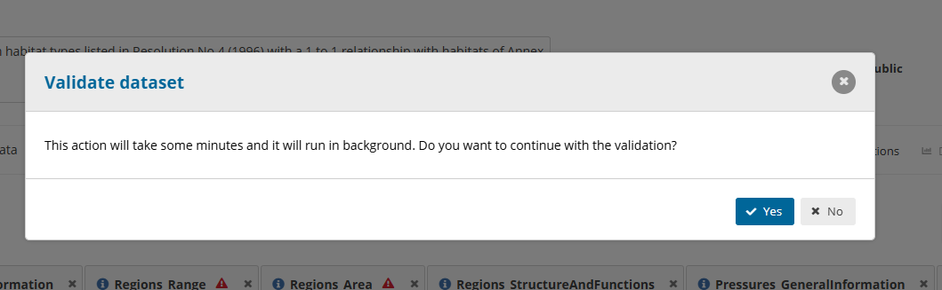
Data validation
Be careful: don’t validate two/three schemas at the same time, don’t validate and import at same time!
Ensure all data sets disabled for editing before validating

Slide 15
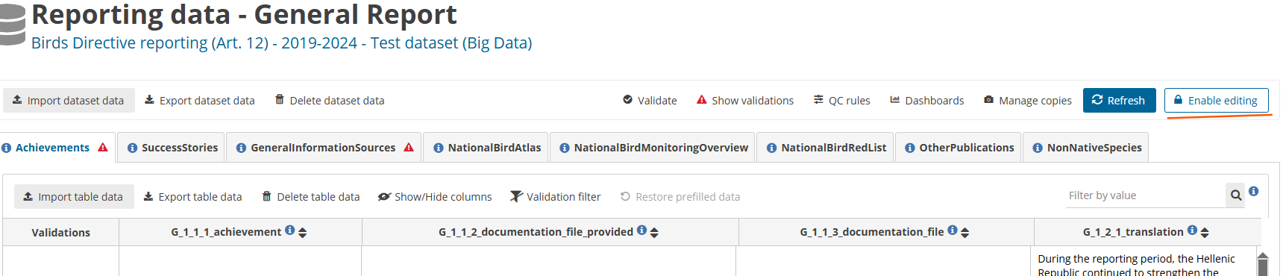
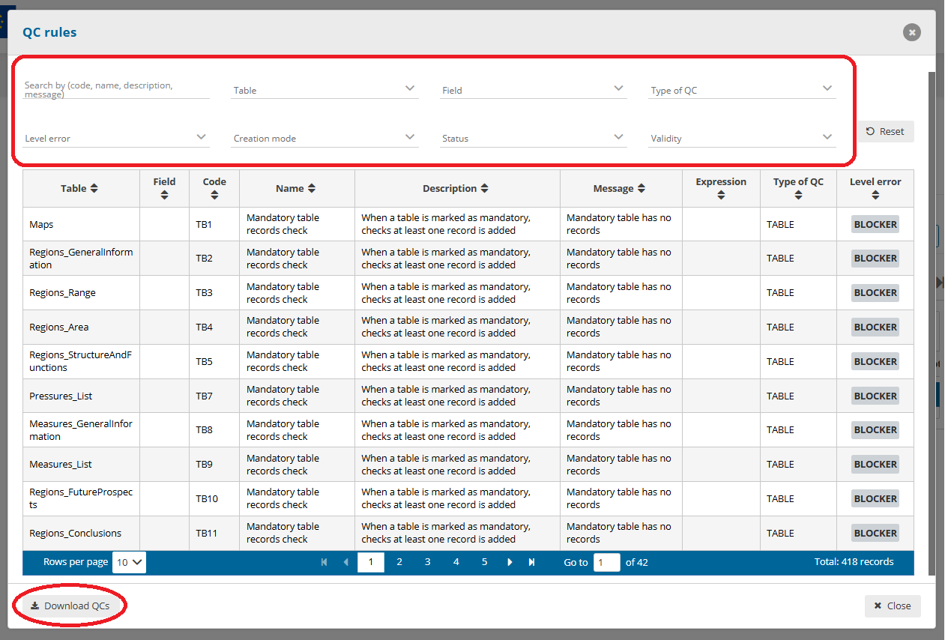
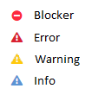
Data validation
Validate button enabled
Editing mode disabled

Slide 16
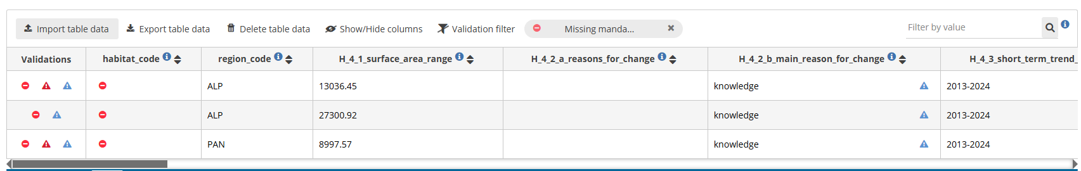
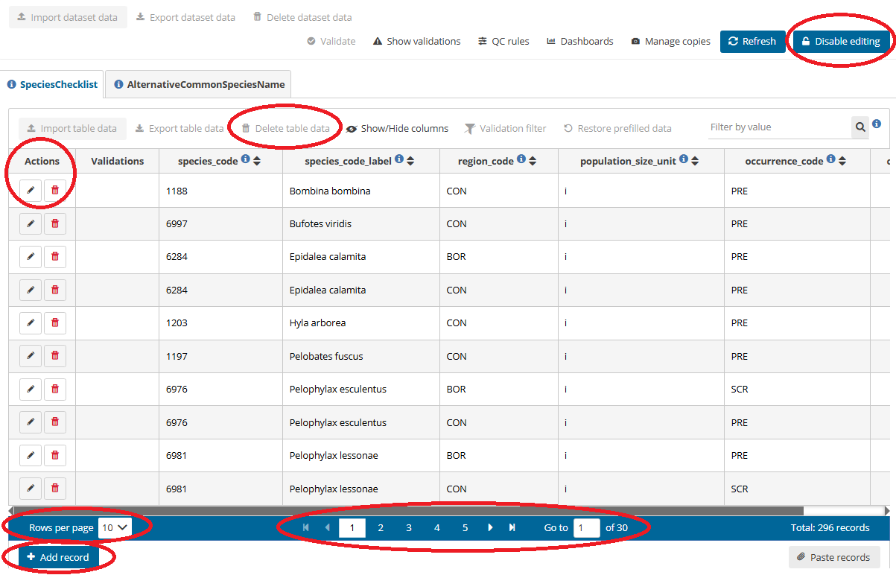
Data correction
Edit fields on-line:
Enable editing/Disable editing/
Validation
Edit off-line: correct>import (replace)

Slide 17
Re-submission, re-validation and re-correction
Submission, Validation and Correction of data may be performed as many times as needed to correct all BLOCKERS.
Recommendations:
Coordinate among multiple reporters (avoid editing/validation conflicts)
Start with checklists
Use EET templates (work on-line can be dangerous!)
Resolve BLOCKERS early

Slide 18

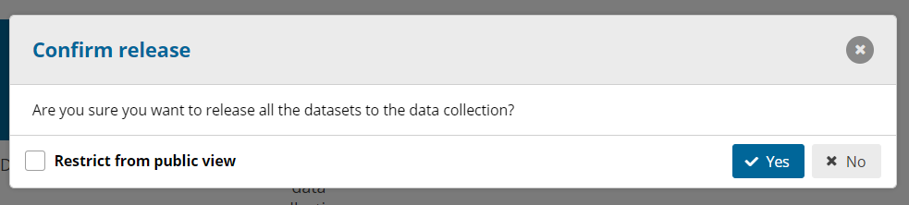


Report Delivery
Only the Lead reporter can release the dataset
Final validation runs automatically -> IF there are BLOCKERS, the release will stop
Confirmation receipt generated

Slide 19

Thank you for the attention

