Slide 1

7th meeting of the Ad hoc Working Group on Reporting
State of development of the Resolution No. 8 (2012) Portal in Reportnet 3

Slide 2
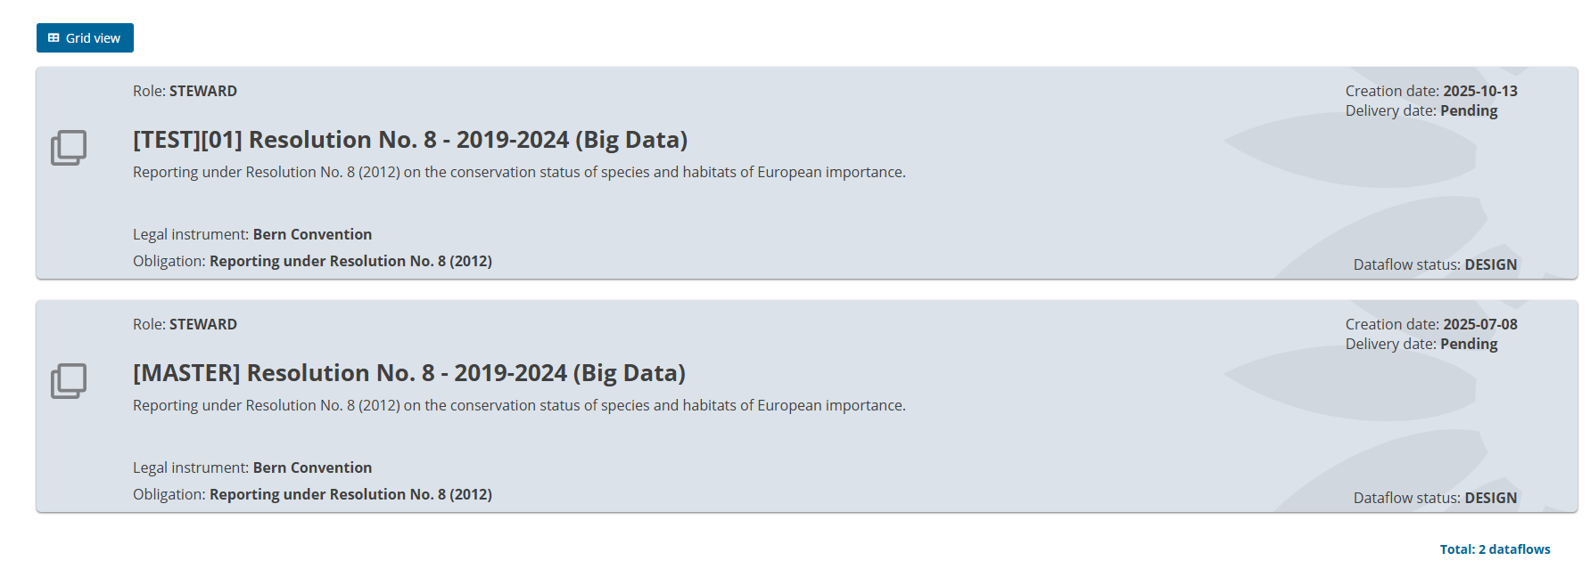
Testing phase: working on validations and double entries
Not public view yet!

Slide 3
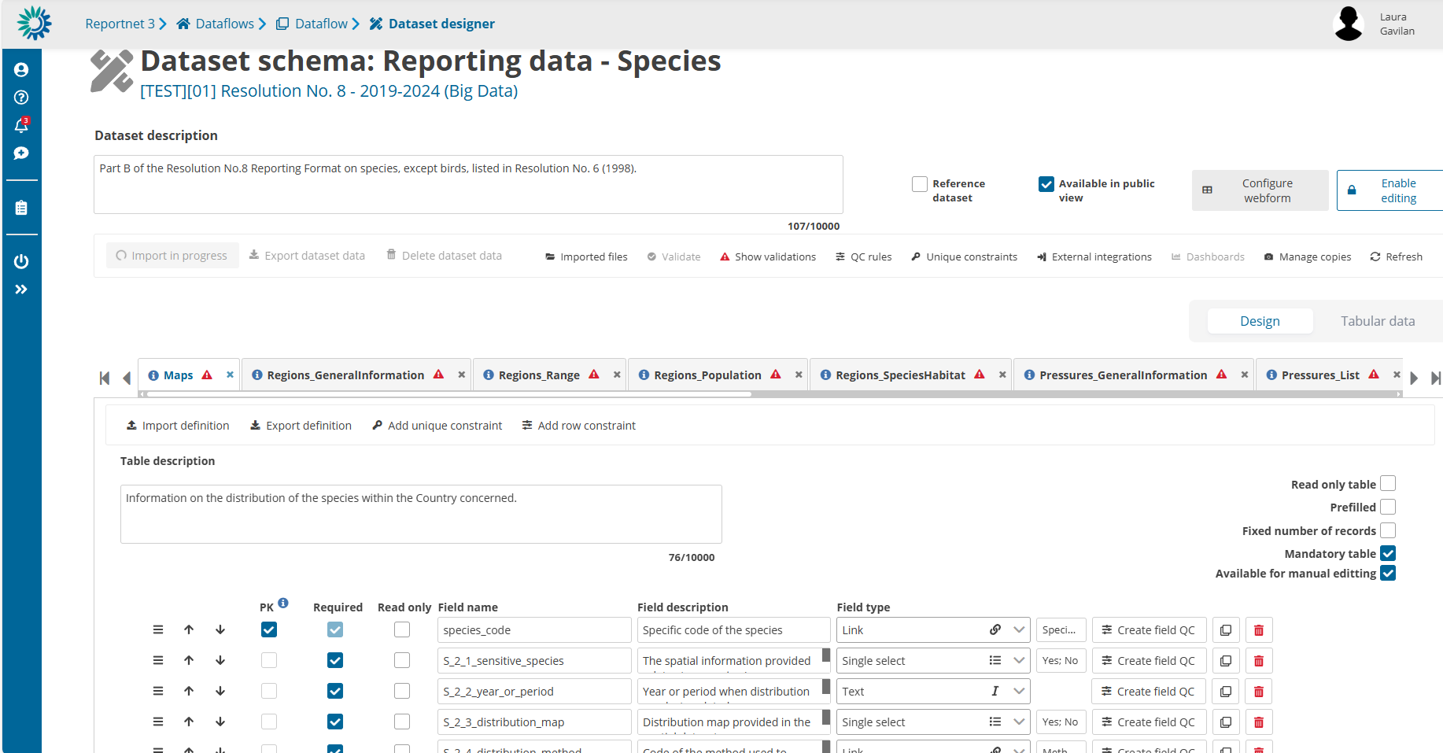

Slide 4
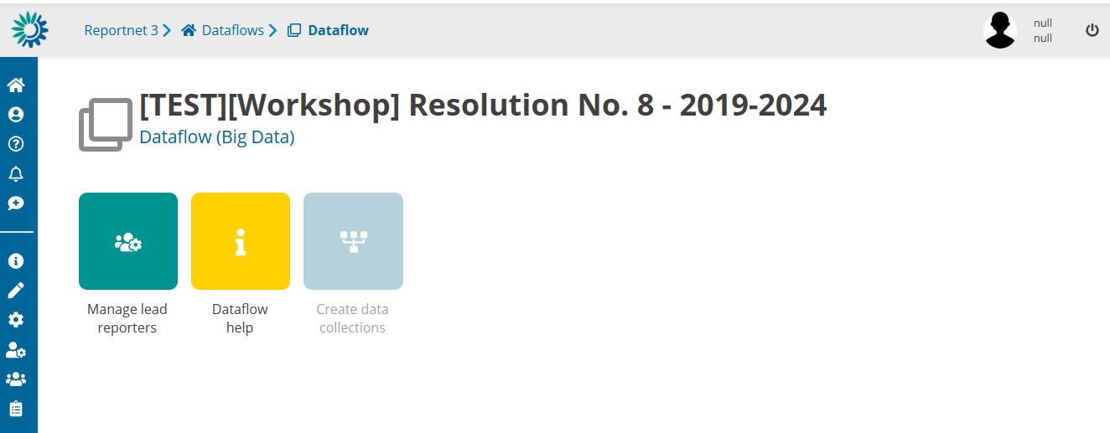
Resolution No.8 interface for the training

Slide 5

Thank you for the attention

