Slide 1

7th meeting of the Ad hoc Working Group on Reporting
Reporting Reference Portal

Slide 2
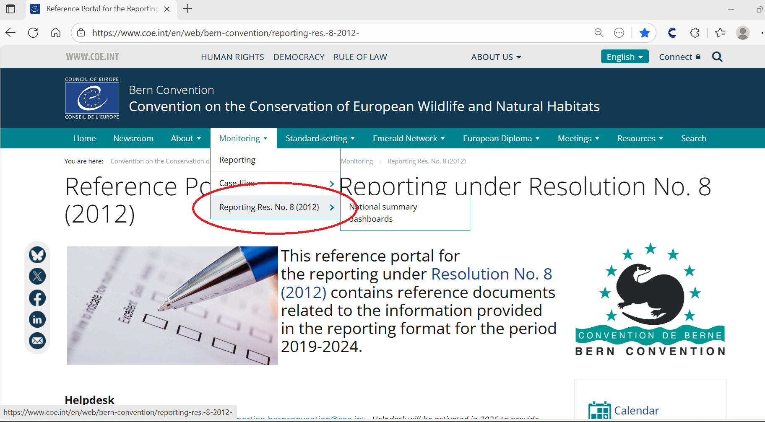

Slide 3
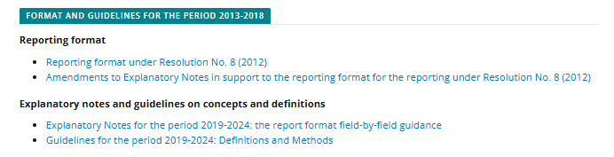
Reporting format and guidelines
Reference Portal for the Reporting under Resolution No. 8 (2012) - Convention on the Conservation of European Wildlife and Natural Habitats
Note: exploratory notes updated in August 2025 to clarify that the assessment of the trend magnitude is independent of the trend direction. However, no trend magnitude_type of estimate is required if the trend direction is “unknown” or “stable”.
I.e. Type of estimate is only expected when the trend direction is “increasing”, “decreasing” or “uncertain”.

Slide 4
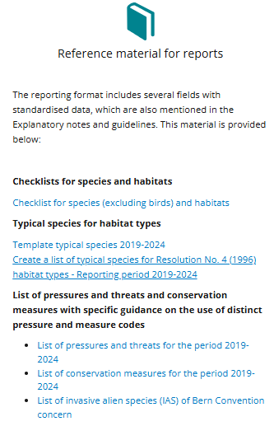
Reference tables and typical species
Please, try to provide a list of typical species for your habitat types (field H_6.6 Typical species)

Slide 5
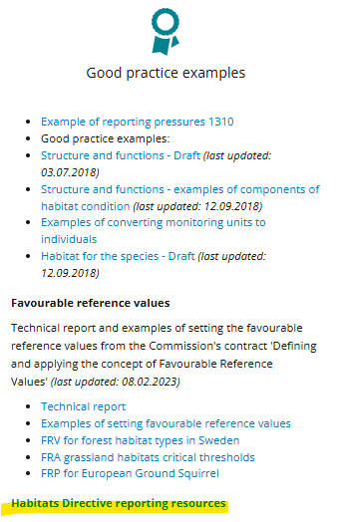
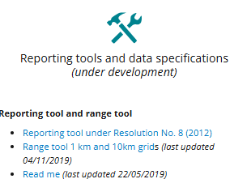
Range tool and additional information

Slide 6
Missing information
Missing information:
Updated version of the Technical Reporting Manual (replace some Art.17 figures by Resolution No.8 images)
Validation rules
Extended Excel Templates
THESE ELEMENTS WILL BE UPLOADED VERY SOON !

Slide 7
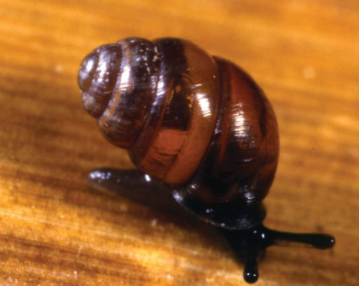
Thank you for your attention

