Slide 1

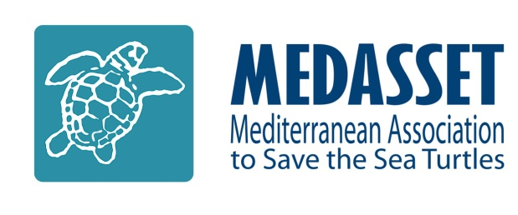
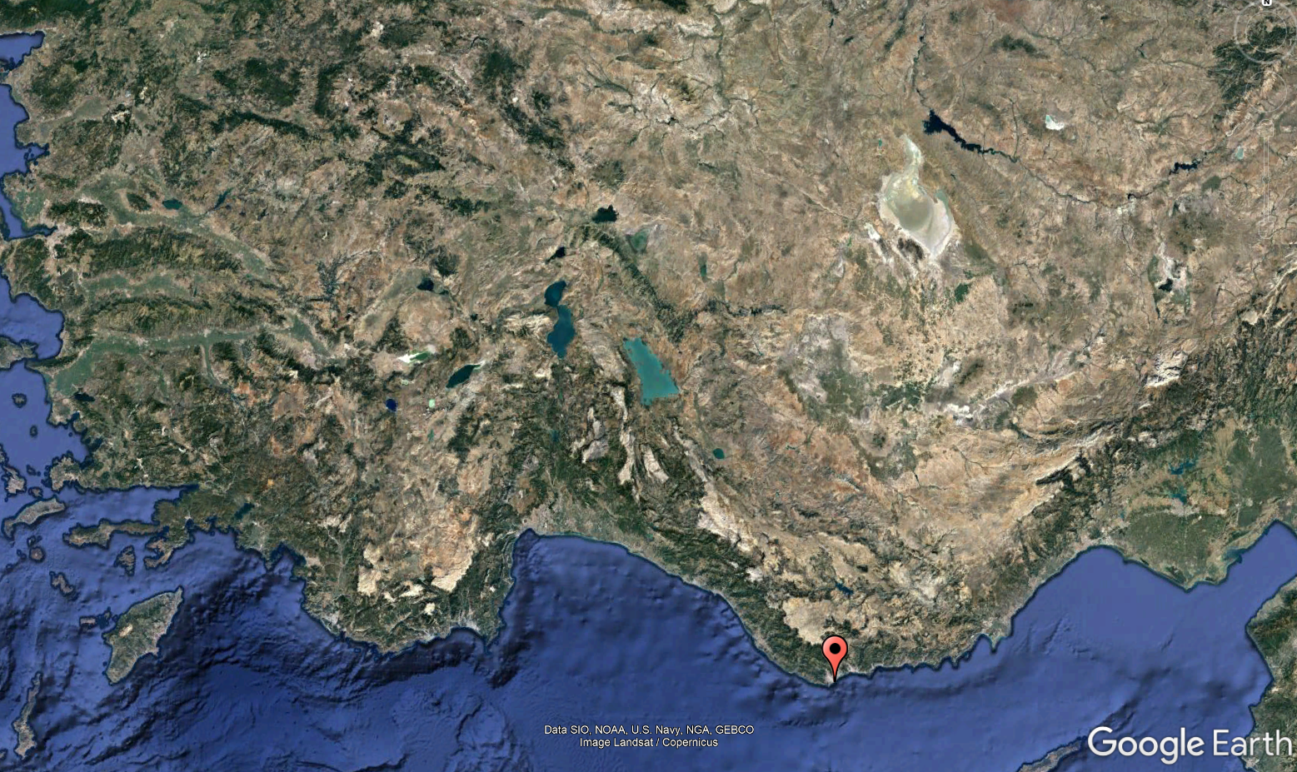
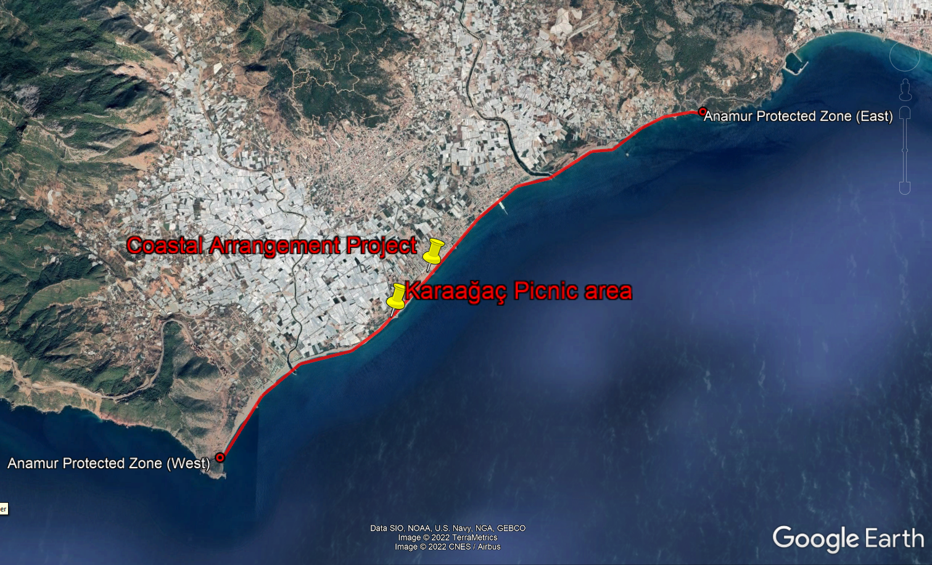
Slide 1/15
Mersin Çevre ve Doğa Derneği (MERÇED) Mersin Environment and Nature Association
Agenda Item 7.2: Possible File
Turkey: Habitat Destruction in Mersin, Anamur Beach
ANAMUR
42nd Meeting of the Standing Committee
Bern Convention
28th November – 2nd December 2022

Slide 2
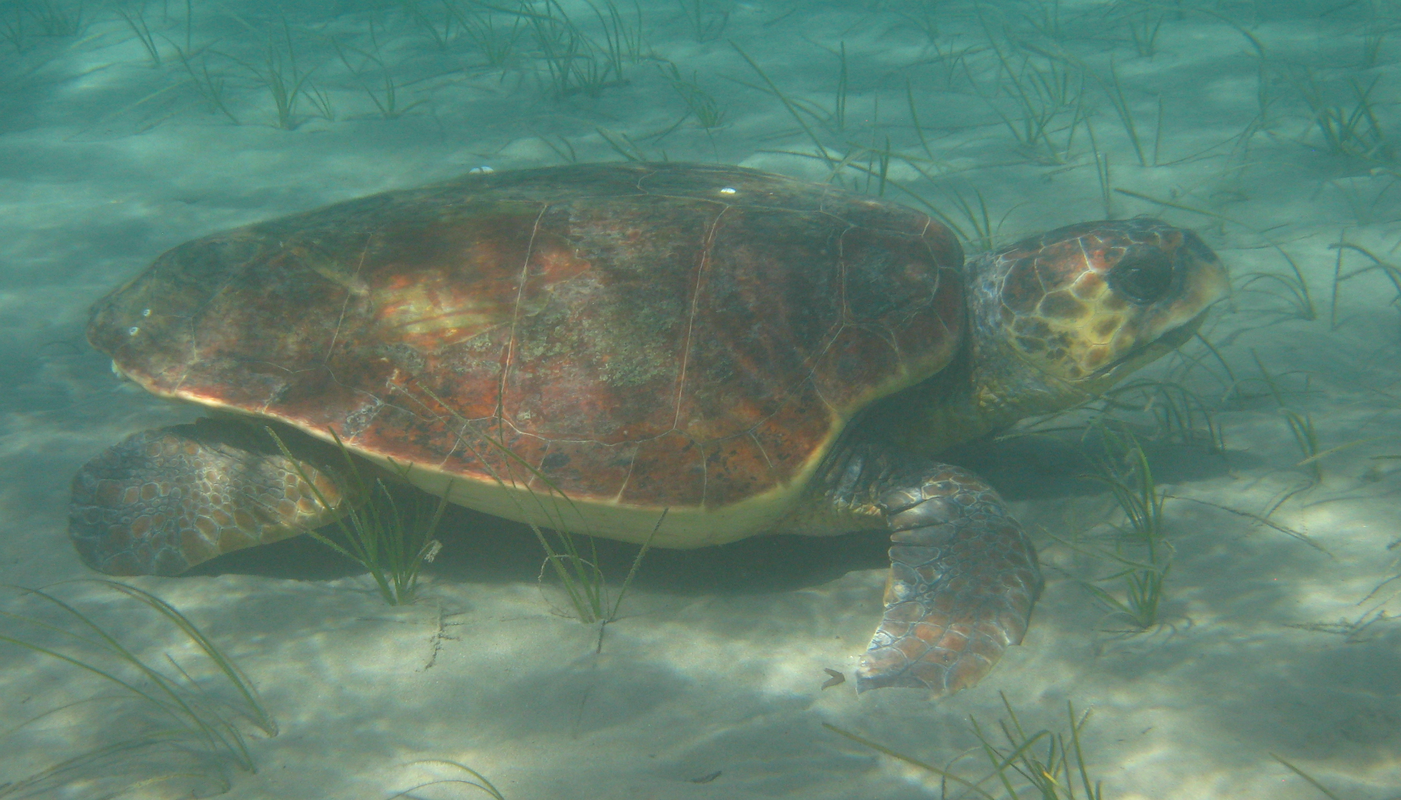
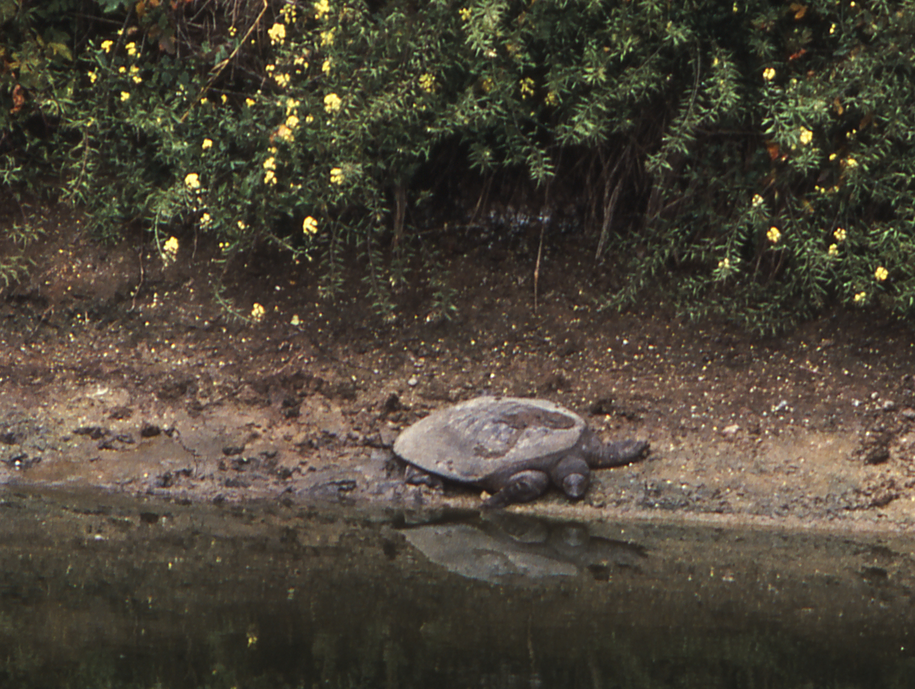
ANAMUR SEA TURTLE NESTING SITE
Slide 2/15
12.7km sea turtle nesting beach
2nd most important sea turtle nesting site in Turkey & 4th in the Mediterranean for the loggerhead turtles1
  Nests/yr Average = 7332
  Recent years have recorded 1,000+ nests
The natural habitat of the creek is also an important area for the Critically Endangered Mediterranean subpopulation of the Soft-Shelled Nile Turtles (Trionyx triunguis)
  The entire Mediterranean subpopulation of this freshwater/brackish turtles is estimated to be less than 1000 adult individuals
Caretta caretta ©2016 E.Dornhofer
Trionyx triunguis ©1999 Kasparek
1 IUCN MTSG report Sea turtles in the Mediterranean, 2010; Hochscheid et al. 2018. Sea Turtles in the Mediterranean Region: MTSG Annual Regional Report
2 Hochscheid et al. 2018. Sea Turtles in the Mediterranean Region: MTSG Annual Regional Report

Slide 3
LEGISLATIVE PROTECTION OF ANAMUR
Slide 3/15
Recommendation No.66 (1998) on the conservation status of some nesting beaches for marine turtles in Turkey on 4th December 1998.
  Measure No.1 Necessitates Environmental Impact Assessments (EIAs) to be carried out for projects.
  Measure No.4 Assure inter-ministerial compliance for marine turtle conservation
  Measure No.5 Urgent & stringent measures to enforce legislation against illegal sand extraction.
  Species Protection Anamur Beach: To Prohibit sand extraction & Secure remaining unbuilt beach plots against development.
Turkish Ministry of Environment & Forestry Circular No:B.18.0.DMP.0.01.03/831.02 Oct 2009
  1st Degree Conservation Areas. (The Protection Zone)
  (b) Prohibits alteration of the land (digging/filling)
  (c) No alterations to the sand (removal or additions)
  (f) The use of lights at night will be prevented and audited by taking necessary measures
  (g) Requirement of Ministerial permission from Environment & Forestry Ministry for projects

Slide 4
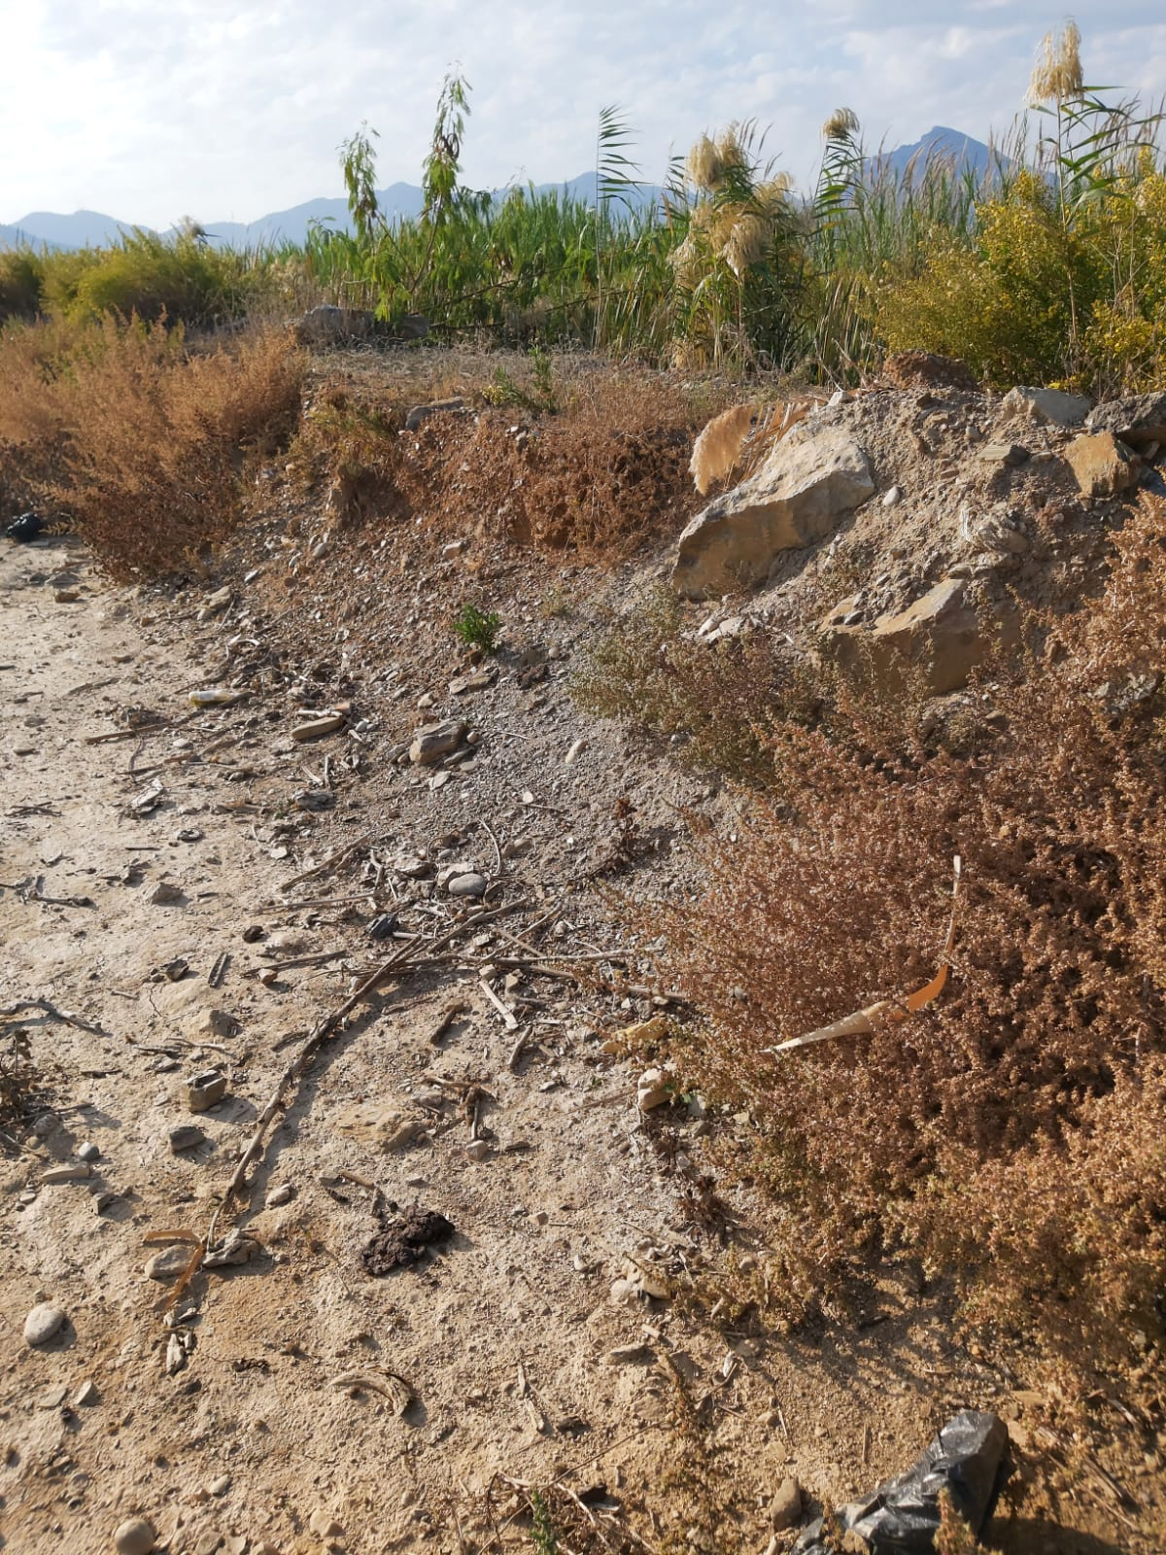
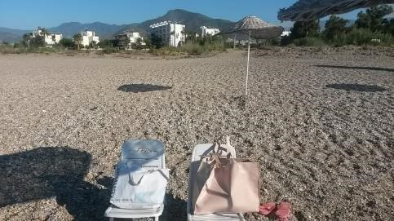
Slide 4/15
KARAAĞAÇ RESTORATION
© MERÇED – Nov 2022
After
The site has not been fully restored to its natural state.
No restoration has been attempted to remove the stone wall and reinstate the natural creek bank
Before
© 2018 MERÇED
Pre- construction
© MERÇED 2018

Slide 5
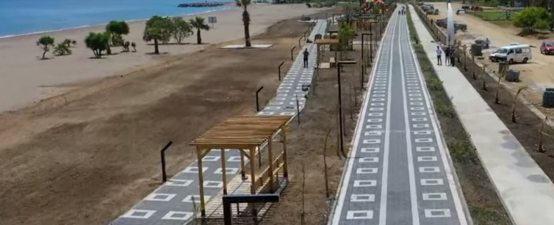
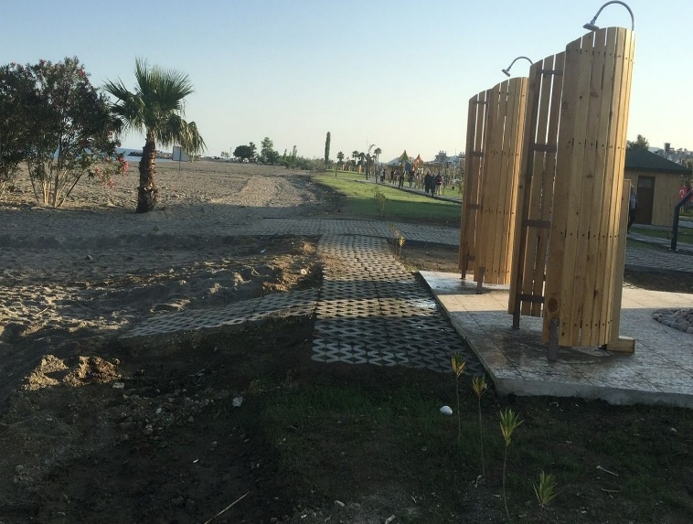
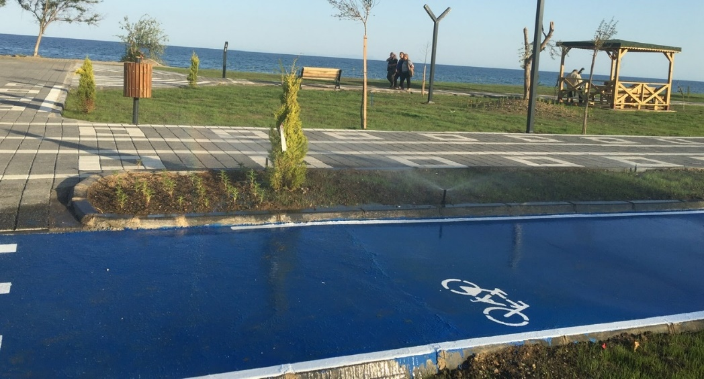
NEW COASTAL “RUINOUS” DEVELOPMENT PROJECT
Slide 5/15
The new development for tourist facilities has begun
PHASE I covers ~ 30.000m²
© MERÇED – May 2022
Showers & water runoff onto the beach
© MERÇED – May 2022
© MERÇED – May 2022

Slide 6
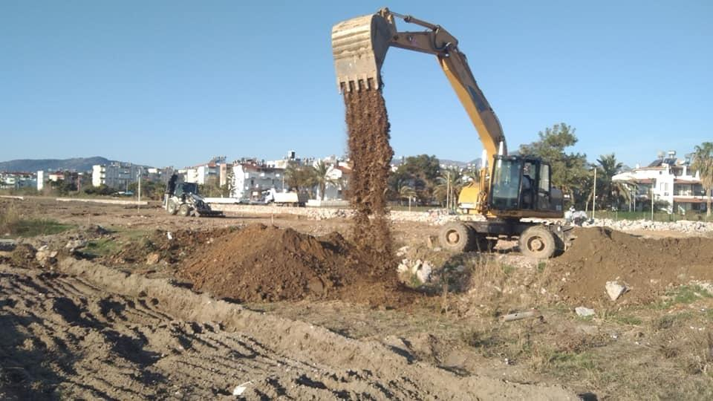
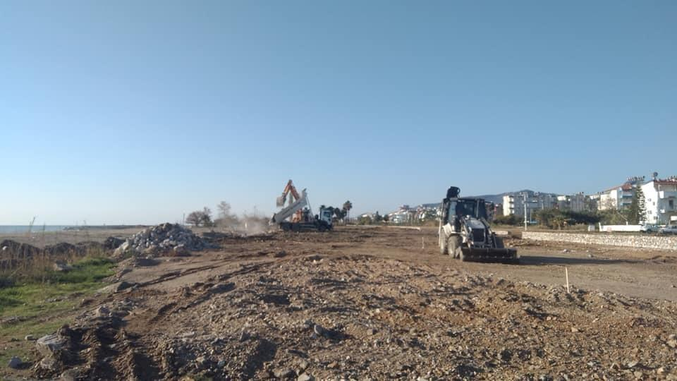
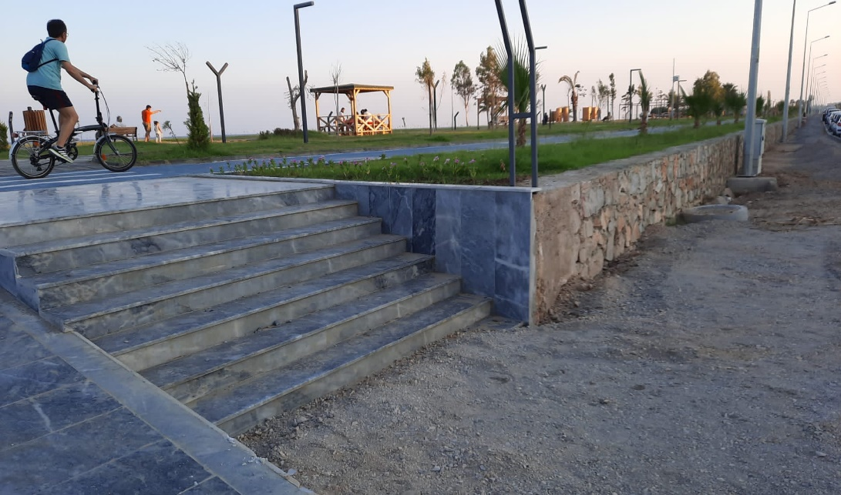
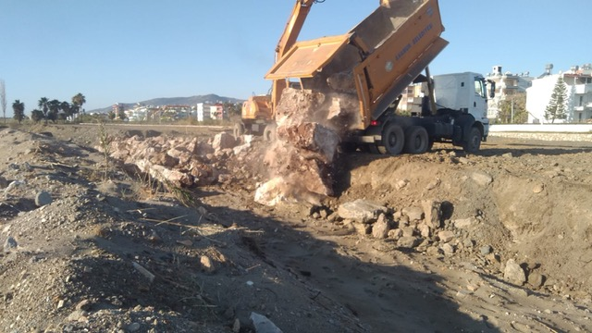
NEW “RUINOUS” DEVELOPMENT PROJECT
Slide 6/15
PHASE I covers ~ 30.000m²
© MERÇED – Oct to Dec2021
© MERÇED – Oct to Dec2021
© MERÇED – Oct to Dec2021
© MERÇED – May 2021

Slide 7
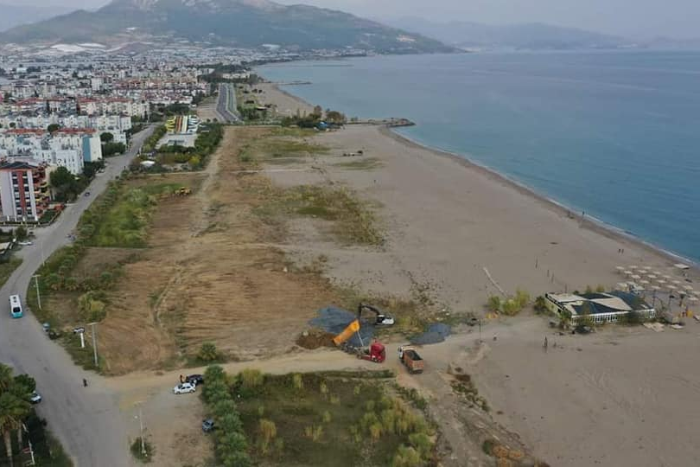
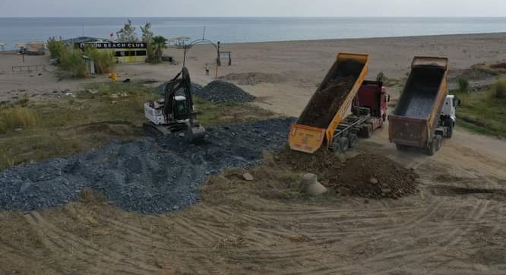
NEW “RUINOUS” DEVELOPMENT PROJECT
Slide 7/15
PHASE II Construction has begun
Image sourced from Facebook Anamur Olay
© MERÇED Nov 2022

Slide 8
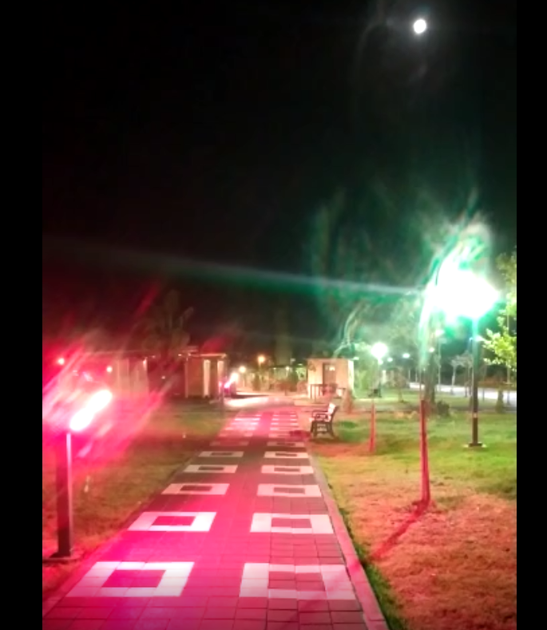
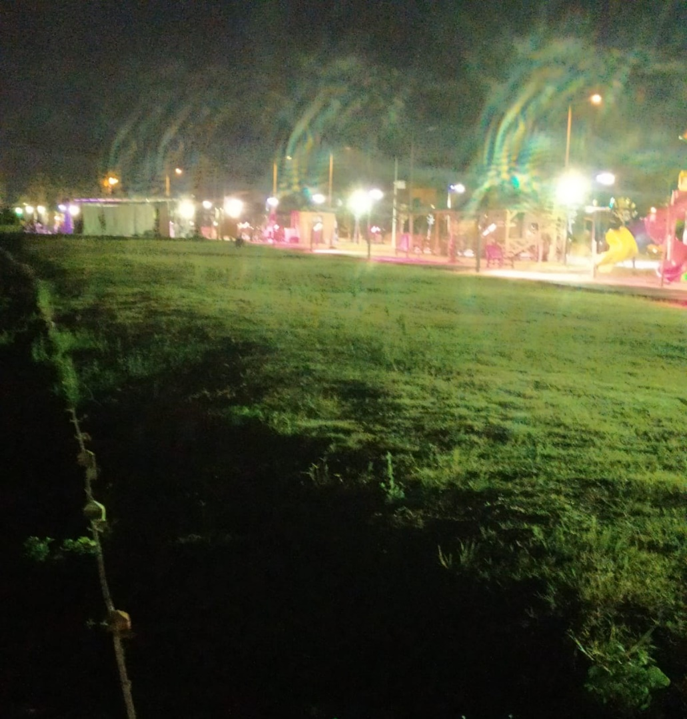
ADDITIONAL THREATS TO ANAMUR NESTING BEACH
Slide 8/15
LIGHT POLLUTION from coastal apartments and local businesses
©2020 MERÇED
©2020 MERÇED
Phase I Beach “Ruinous” Development Project
© MERÇED – May 2022
Phase I Beach “Ruinous” Development Project
© MERÇED – May 2022
©2020 MERÇED

Slide 9
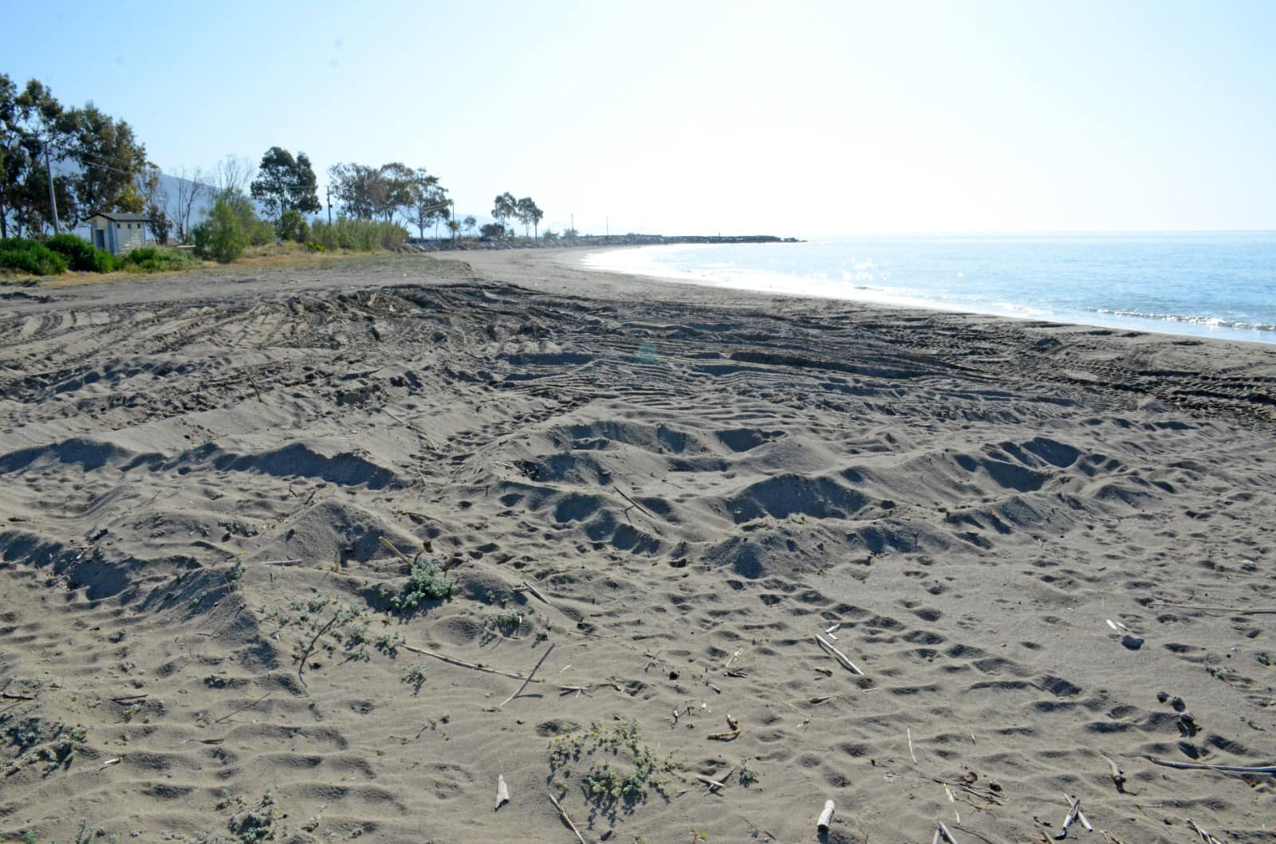
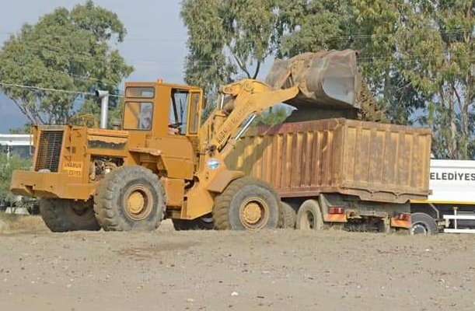
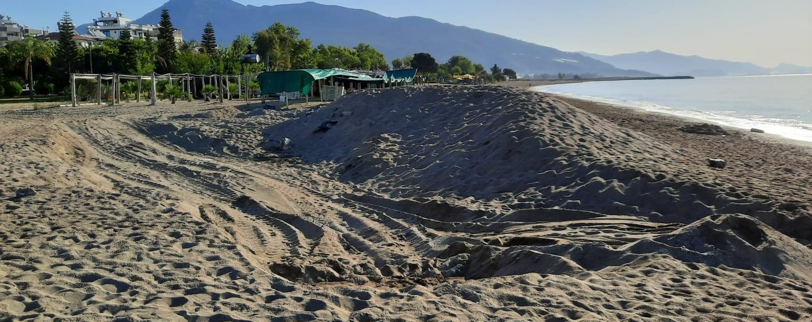
ADDITIONAL THREATS TO ANAMUR NESTING BEACH
Slide 9/15
SAND EXTRACTION. Despite National Legislation sand extraction is still evident along the protected nesting beach.
© MERÇED 2021
©2021 MERÇED
©2020 MERÇED
©2020 MERÇED
© MERÇED 2020
© MERÇED 16th May 2022
©2020 MERÇED

Slide 10
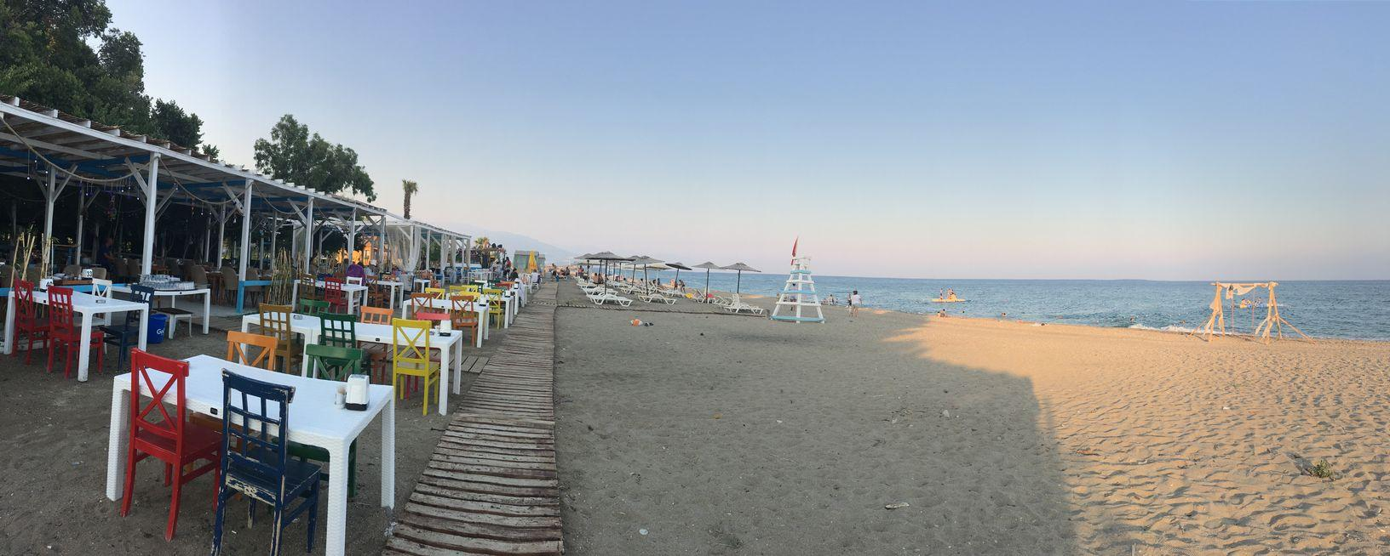
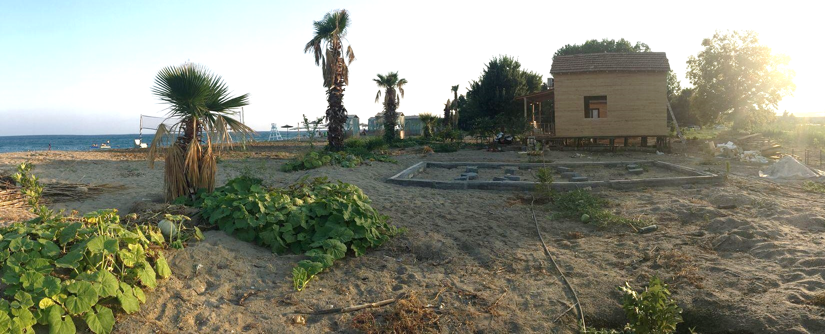
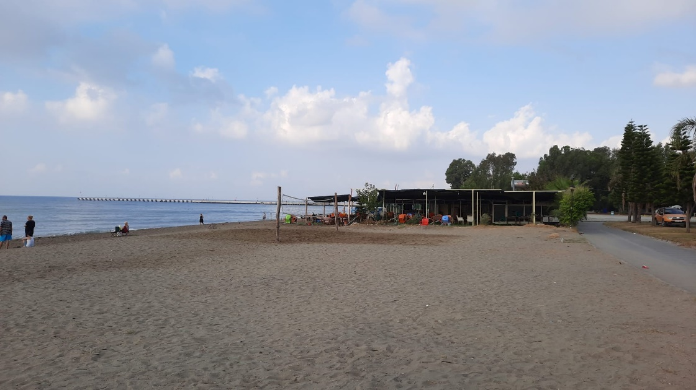
ADDITIONAL THREATS TO ANAMUR NESTING BEACH
Slide 10/15
Beach furniture
© MERÇED – June 2022
BUSINESS EXPANSIONS continue unhindered in the 1st Protection Zone; within 65m from the shoreline.
Boardwalk & Restaurant
© MERÇED – June 2022
Newly constructed Huts
©2020 MERÇED
©2021 MERÇED
©2020 MERÇED
Alien plantations
© MERÇED – August 2022

Slide 11
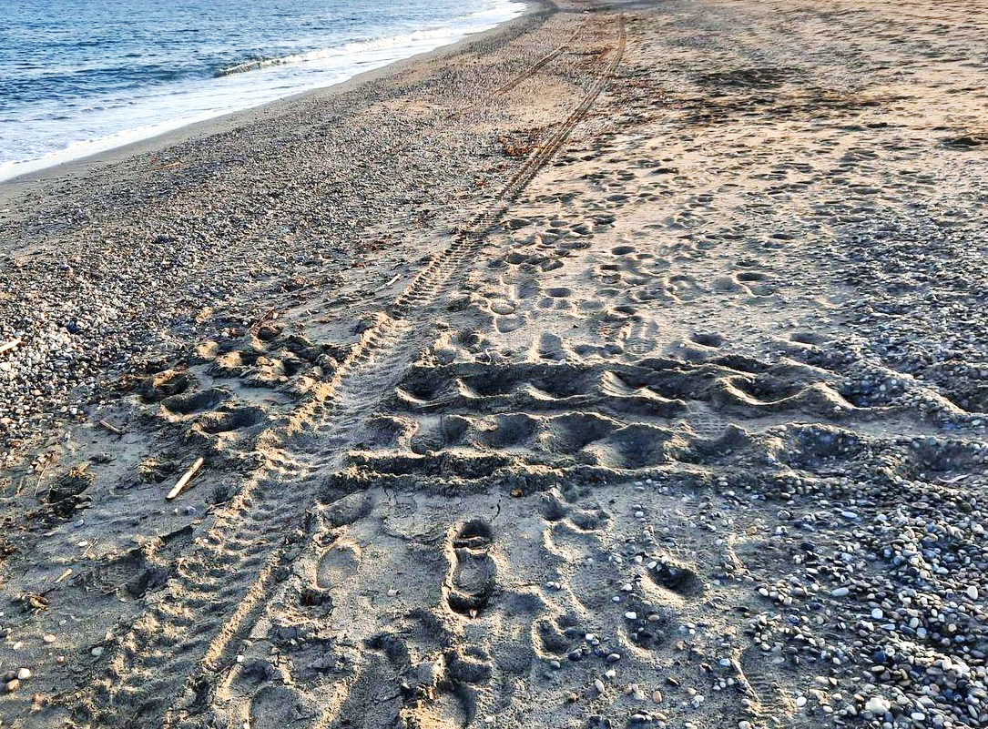
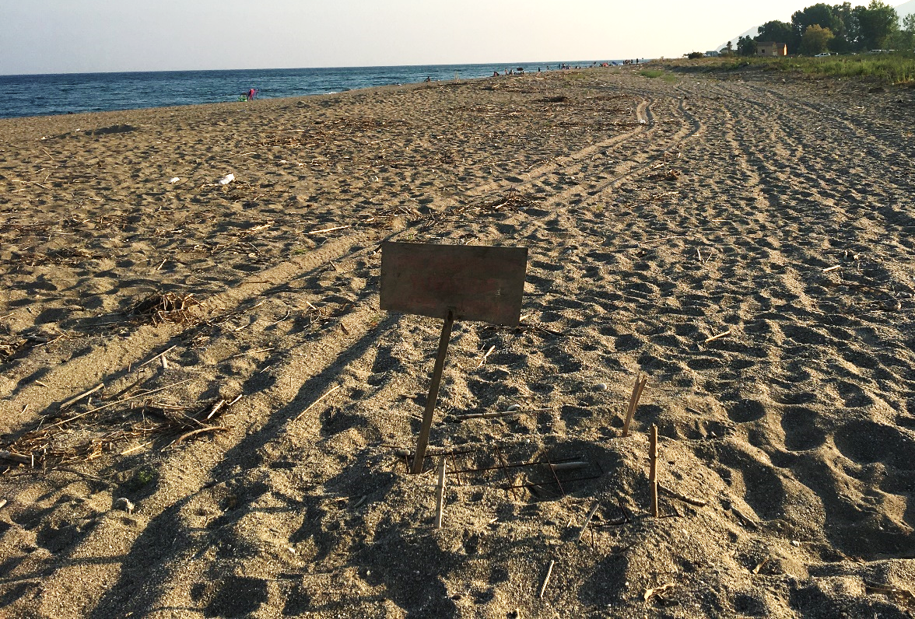
ADDITIONAL THREATS TO ANAMUR NESTING BEACH
Slide 11/15
Illegal Vehicle Access to the Beach during critical breeding period, May to September, despite being prohibited by National Legislation Circular (2009/10)
© MERÇED – May 2022
Vehicle Tracks
Vehicle Track
Green Sea Turtle Track
Marked Nest
©2020 MERÇED
©2021 MERÇED
© MERÇED – July 2022
©2020 MERÇED
Mamure Castle © MERÇED - May 2022

Slide 12
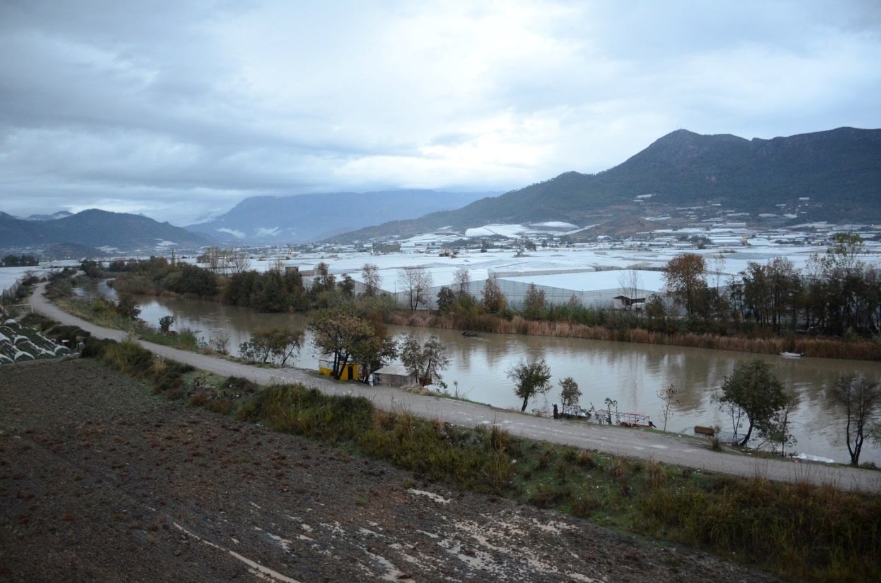
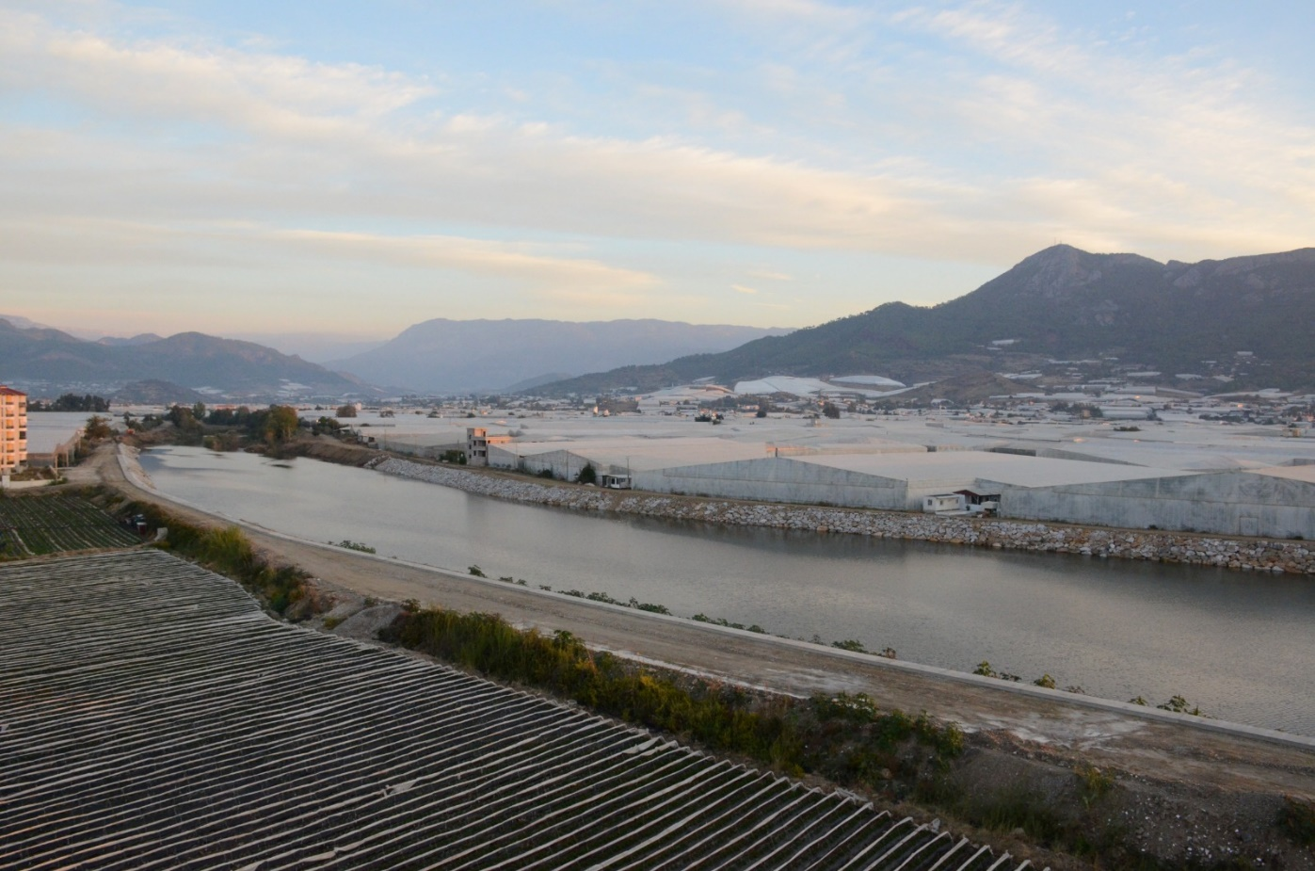
Dragon Ҫayi Rivulet
Slide 12/15
Complete alteration of the riverbank natural habitat
BEFORE – natural vegetation lining the river bank
NOW – a stone wall is lining the river bank
©2020 MERÇED
©2020 MERÇED
© MERÇED
© MERÇED

Slide 13
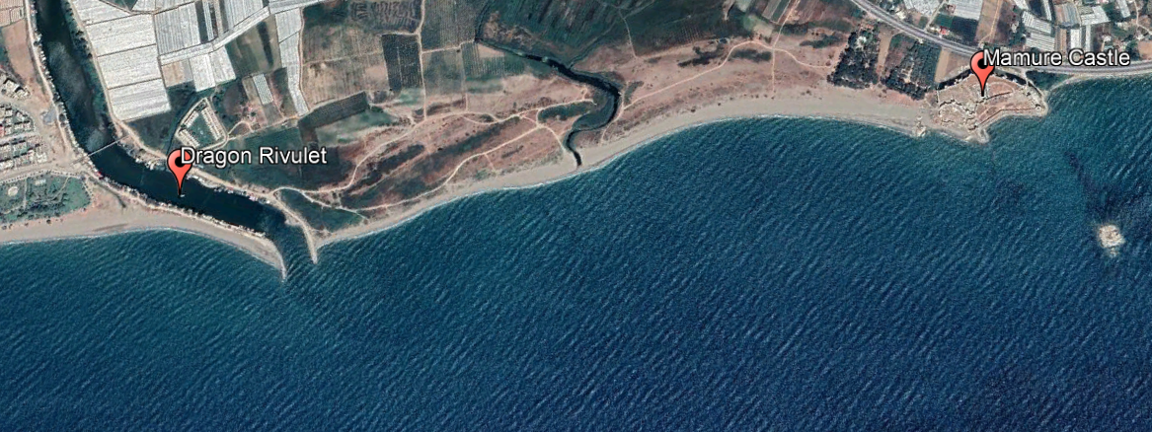
Soft Shell Nile Turtles (Trionyx triunguis)
Slide 13/15
Previous MEDASSET Reports T-PVS (99) 73 & (98) 59
No Observations of this species, were recorded in the Dragon Rivulet during 2022
3- 4 tracks were observed close to Mamure Castle, but no nests were found
No official monitoring report available
Strandings were recorded previously on Anamur Beach
http://www.haberanamur.net/15249/olu-nil-kaplumbagasi-sahile-vurdu/ : Dragon Rivulet (2012)
http://www.haberanamur.net/28191/olu-nil-kaplumbagasi-karaya-vurdu/ : Yalıevleri Region (2016)
Anamur
N
Map sourced from Taskavak E. & Akcinar S.C (2009) ‘Marine records of the Nile Soft- Shelled turtle, Trionyx triunguis from Turkey’
Map Created in Google Earth

Slide 14
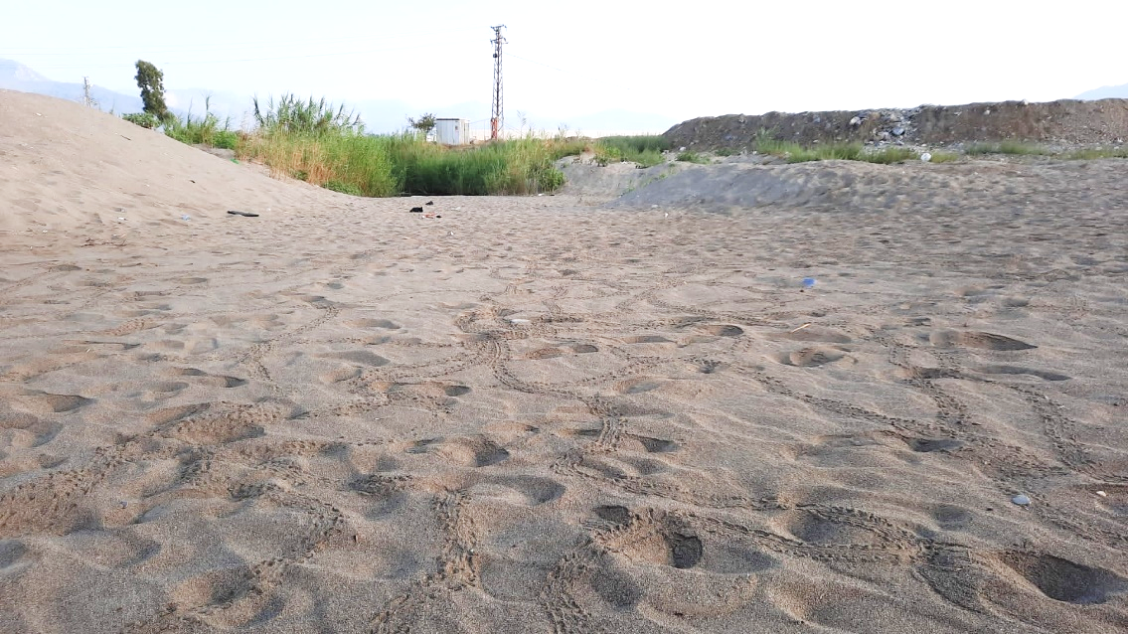
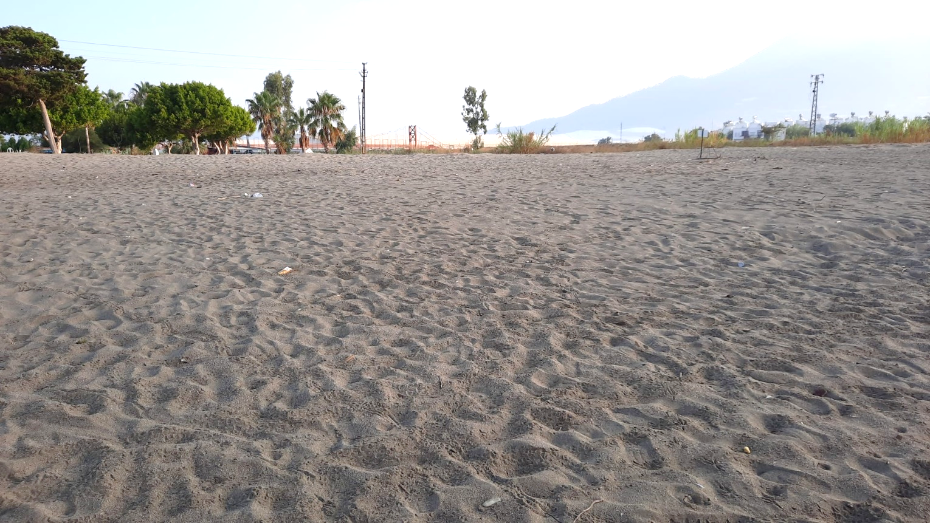
ADDITIONAL THREATS TO ANAMUR NESTING BEACH
Slide 14/15
LACK OF MONITORING & PROTECTION MEASURES
Signs of a mass emergence of hatchlings from unmarked nests
©2020 MERÇED
© MERÇED - August 2022
© MERÇED – August 2022
©2020 MERÇED

Slide 15
In Conclusion
Slide 15/15
We encourage the Turkish Government to:
Ensure Karaağac and Sarisu Creek are fully restored to their previous natural state
To provide transparency, collaborate and communicate with the local NGOs on all current projects and future proposals.
Ensure local businesses and authorities comply with Turkish National Law and the Bern Convention Recommendations and implement and enforce conservation management measures along the entire protected nesting beach.
Implement an independent study to be carried out in order to record the impacts on nesting beaches to establish a monitoring team
Call upon the Standing Committee of the Bern Convention to:
Encourage the authorities to implement all necessary actions listed above, to ensure that Anamur nesting beach is adequately protected now and in the future.
To open a case file and conduct an on-the-spot appraisal to address all issues present along this protected area

