Slide 1
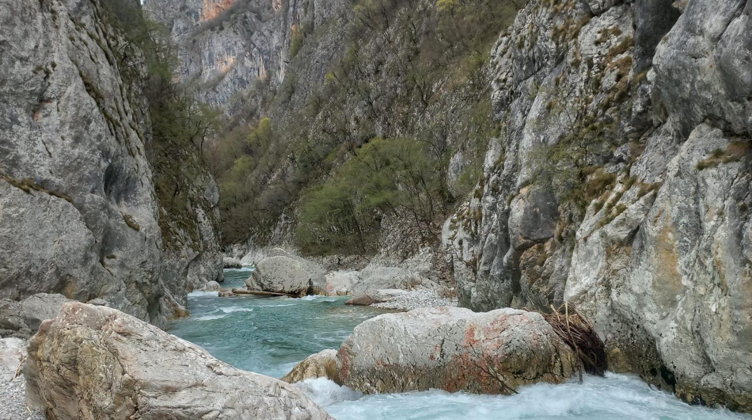


Possible negative impact of hydro-power plant development on the Neretva River (Bosnia and Herzegovina)
REPORT OF THE ON-THE-SPOT-APPRAISAL
apl Prof. Dr. Gregory Egger
©Gabriel Singer

Slide 2
Overview
Study site
Impacts of Hydro power plants
Recommendations
Notes:
Collect information on the study towards the proclamation of certain sites as protected areas at State and entity level, and on synergies between these processes and development of the Emerald Network

Slide 3
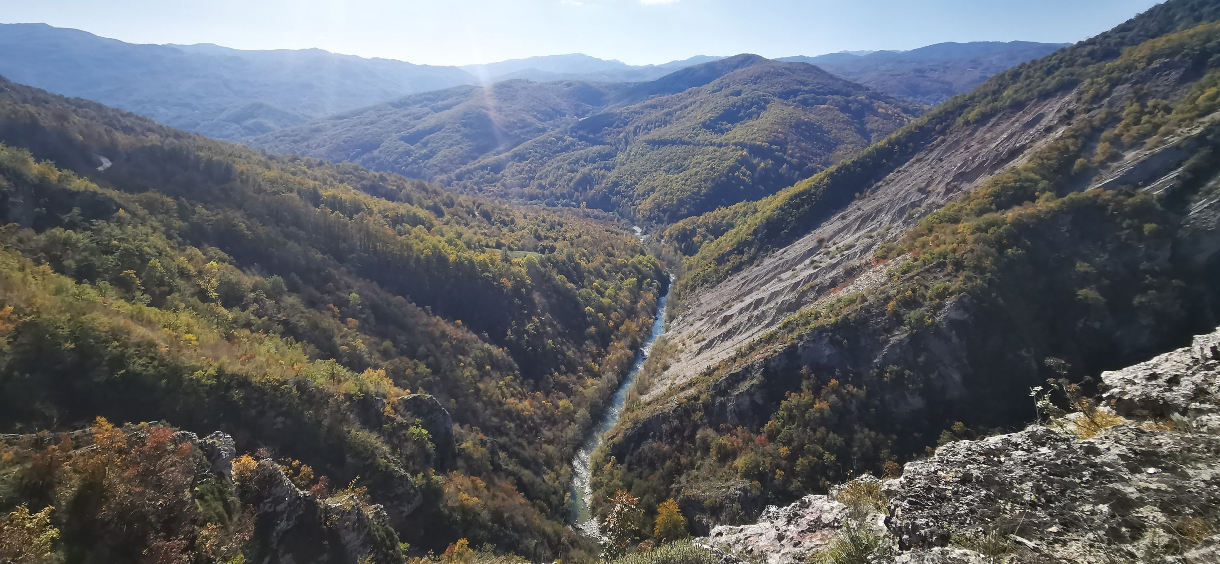
I Study Site

Slide 4
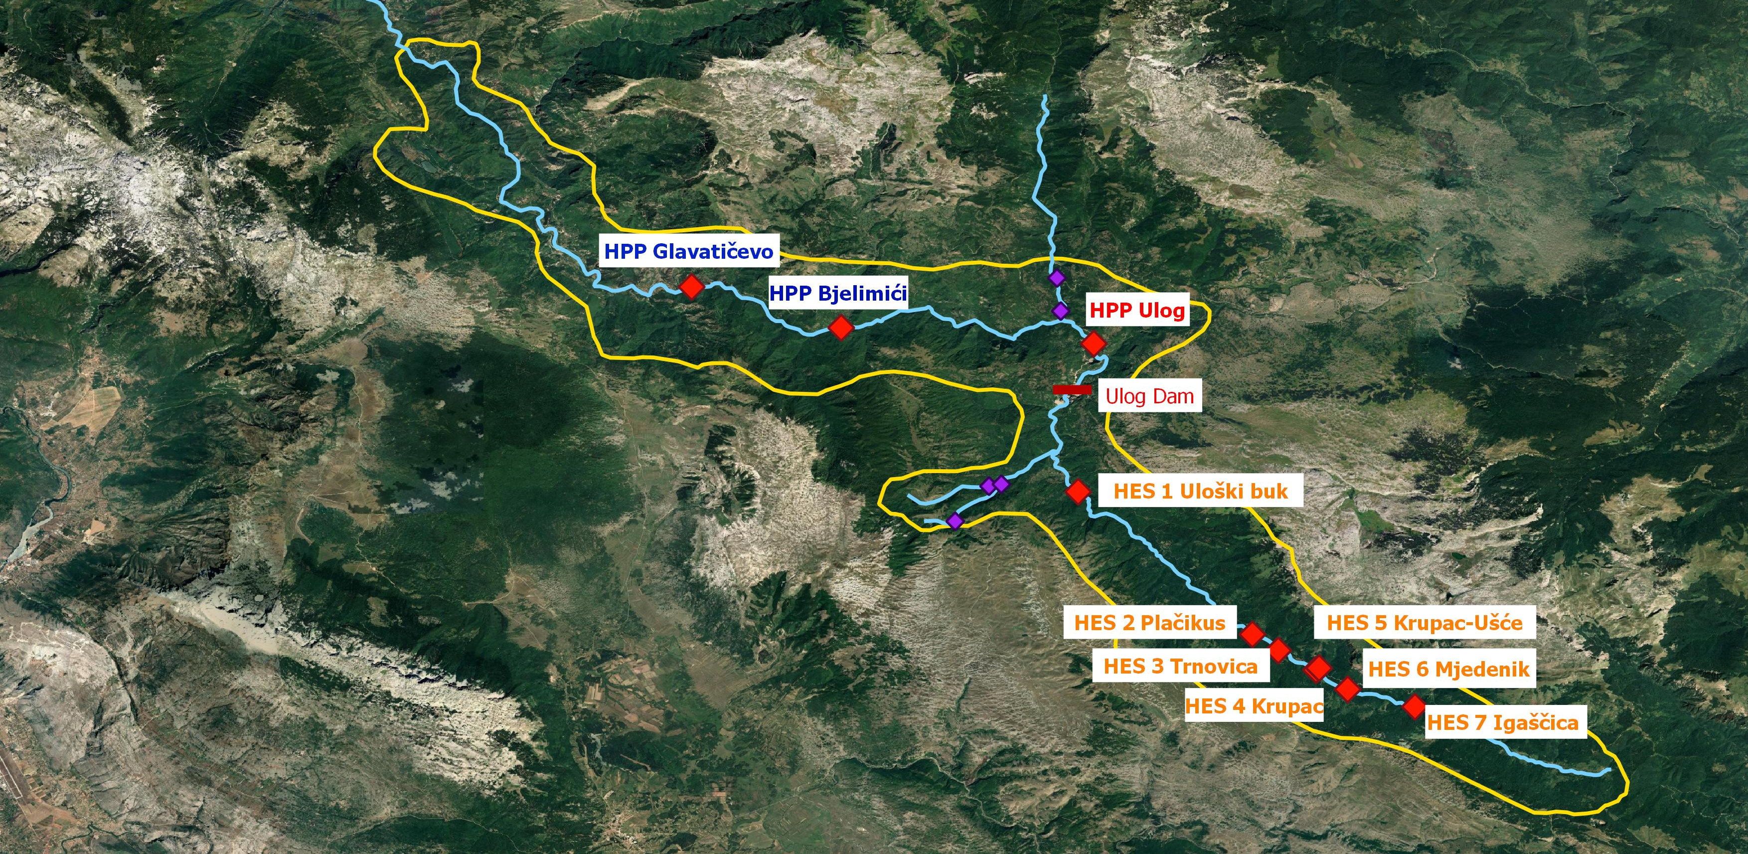
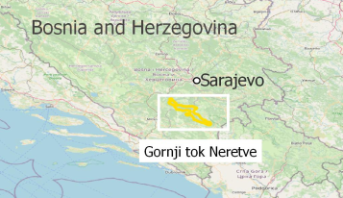
Planned HPPs in candidate Emerald site BA0000002 “Gornji tok Neretve“
Planned HPPs Ljuta tributary
Emerald site BA0000002
21 419 ha
Neretva
Planned HPPs Jezernica tributary
Notes:
Planned HPPs tributary Ljuta : all in all 10 HPPs of which 2 are within the candidate Emerald site

Slide 5
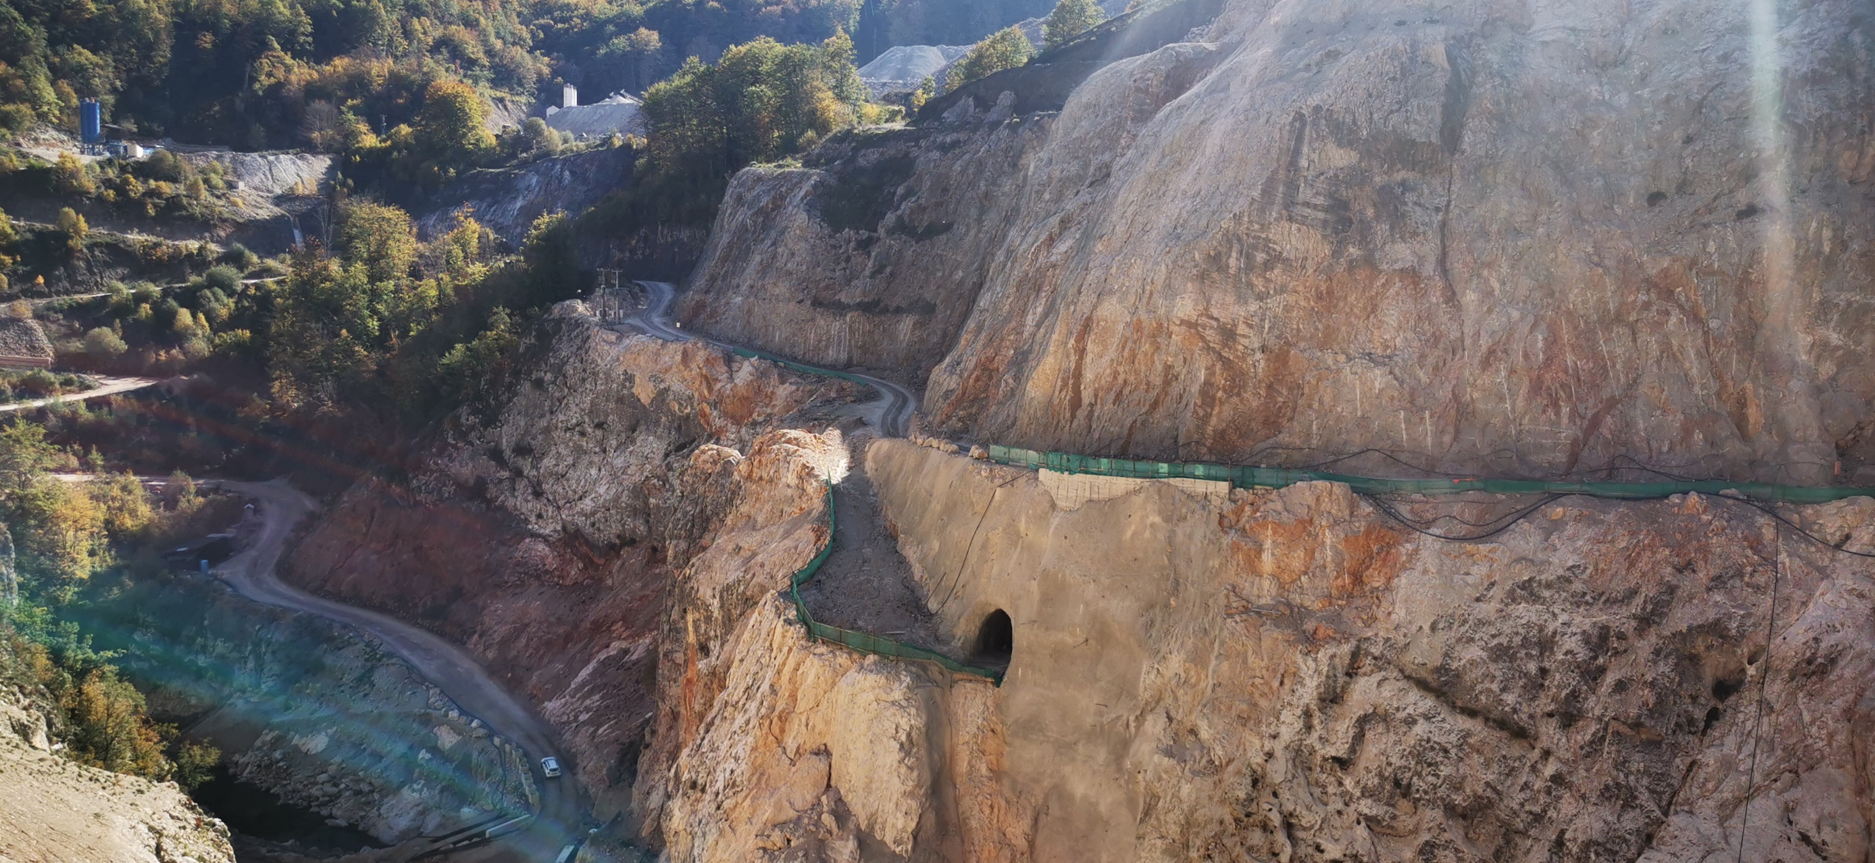
II Impacts of HPPs

Slide 6
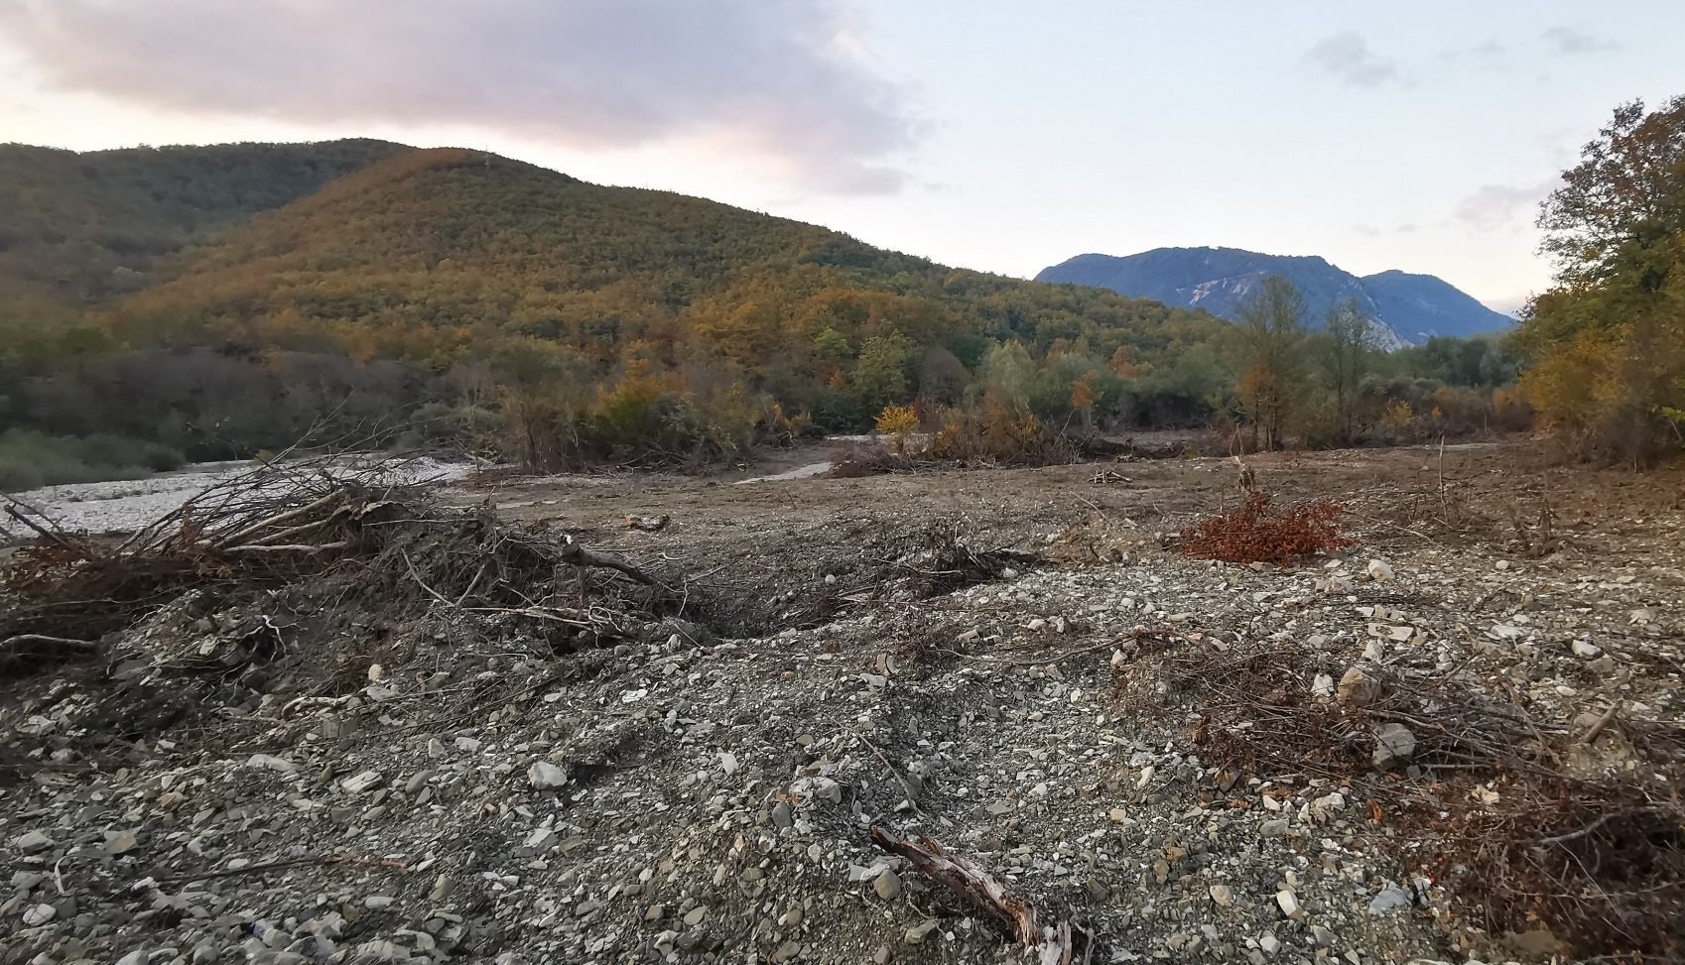
II Impacts of HPPs
Loss of natural aquatic and floodplain zones
Siltation of interstices of the riverbed
Formation of non-populatable zone
Disruption of longitudinal continuum
Disruption of bed-load transport
Retention of fine sediments
Loss of hydro- and morphodynamics
Loss of small-scale floods
Habitat loss and fragmentation of habitats
Anthropogenic disturbances
during construction

Slide 7
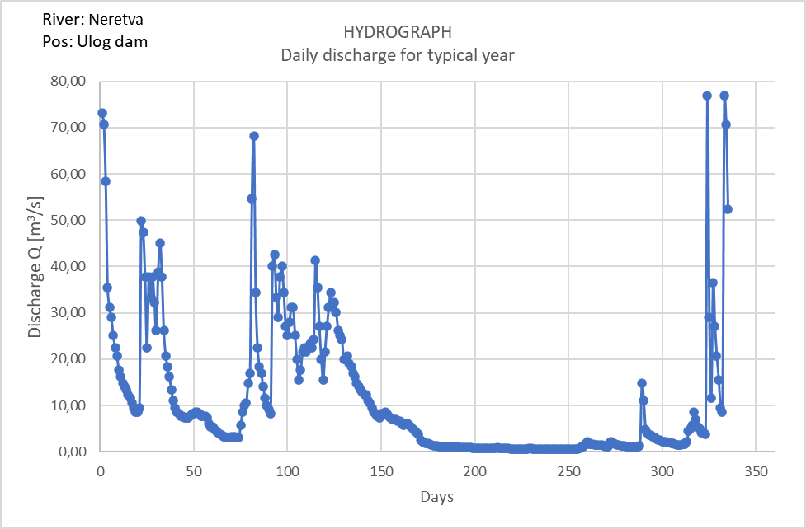
Reduced flood peak
X
X
X
X
X
X
X
35 m³/s
Notes:
35m3/s max amount of water derivated

Slide 8
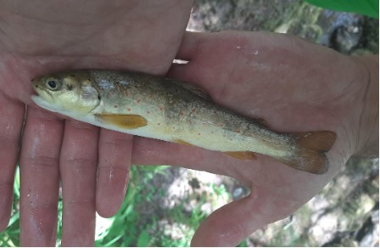
Disruption of longitudinal continuum
Disrupted bed-load transport (dam/reservoir as sediment trap)
Retention of fine sediments
Habitat fragmentation and migration barrier for aquatic species
  e.g. Adriatic brown trout (Salmo farioides)
© Study on protection of Upper Neretva river

Slide 9
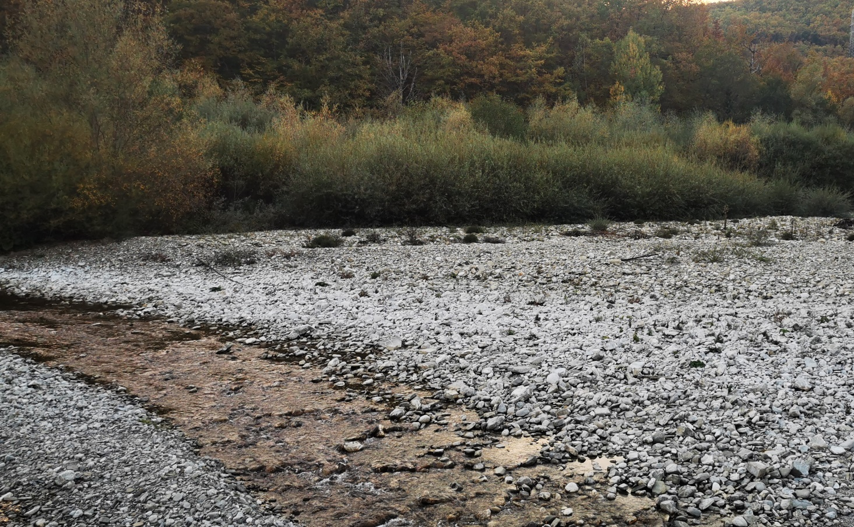
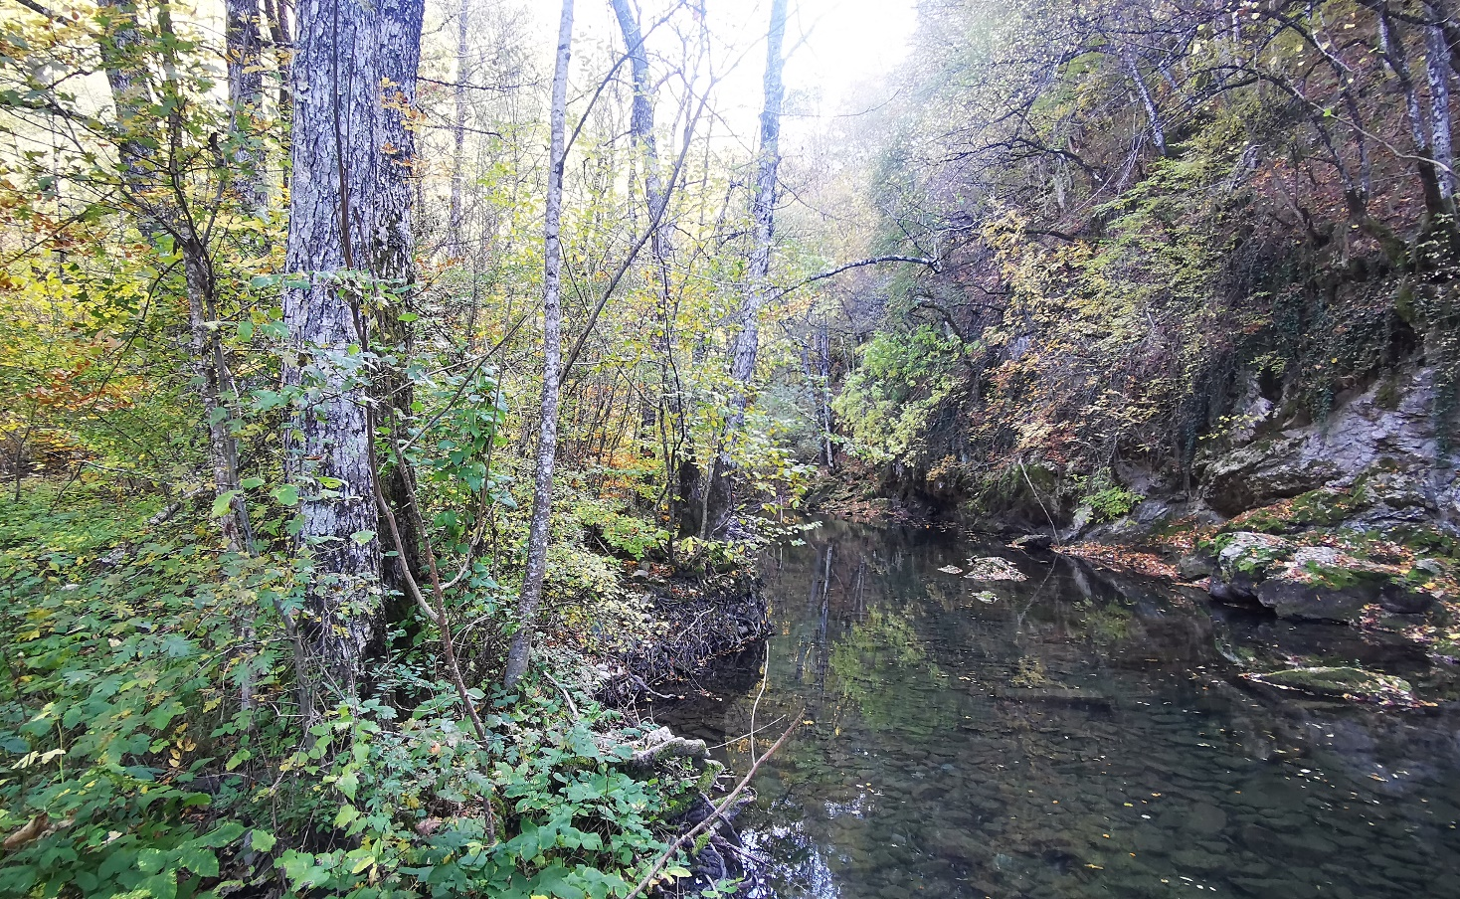
Loss of natural aquatic habitats and floodplain zones
3220 Sparsely vegetated river gravel banks
3240 Riverine shrub
91E0 Riverine Fraxinus - Alnus woodland, wet at high but not at low water
Habitat loss for rheophilic species
  white-clawed crayfish (Austropotamobius pallipes)
  Adriatic brown trout (Salmo farioides)
  sculpin (Cottus gobio)
  minnow (Phoxinus phoxinus)
  stone loach (Barbatula barbatula)

Slide 10
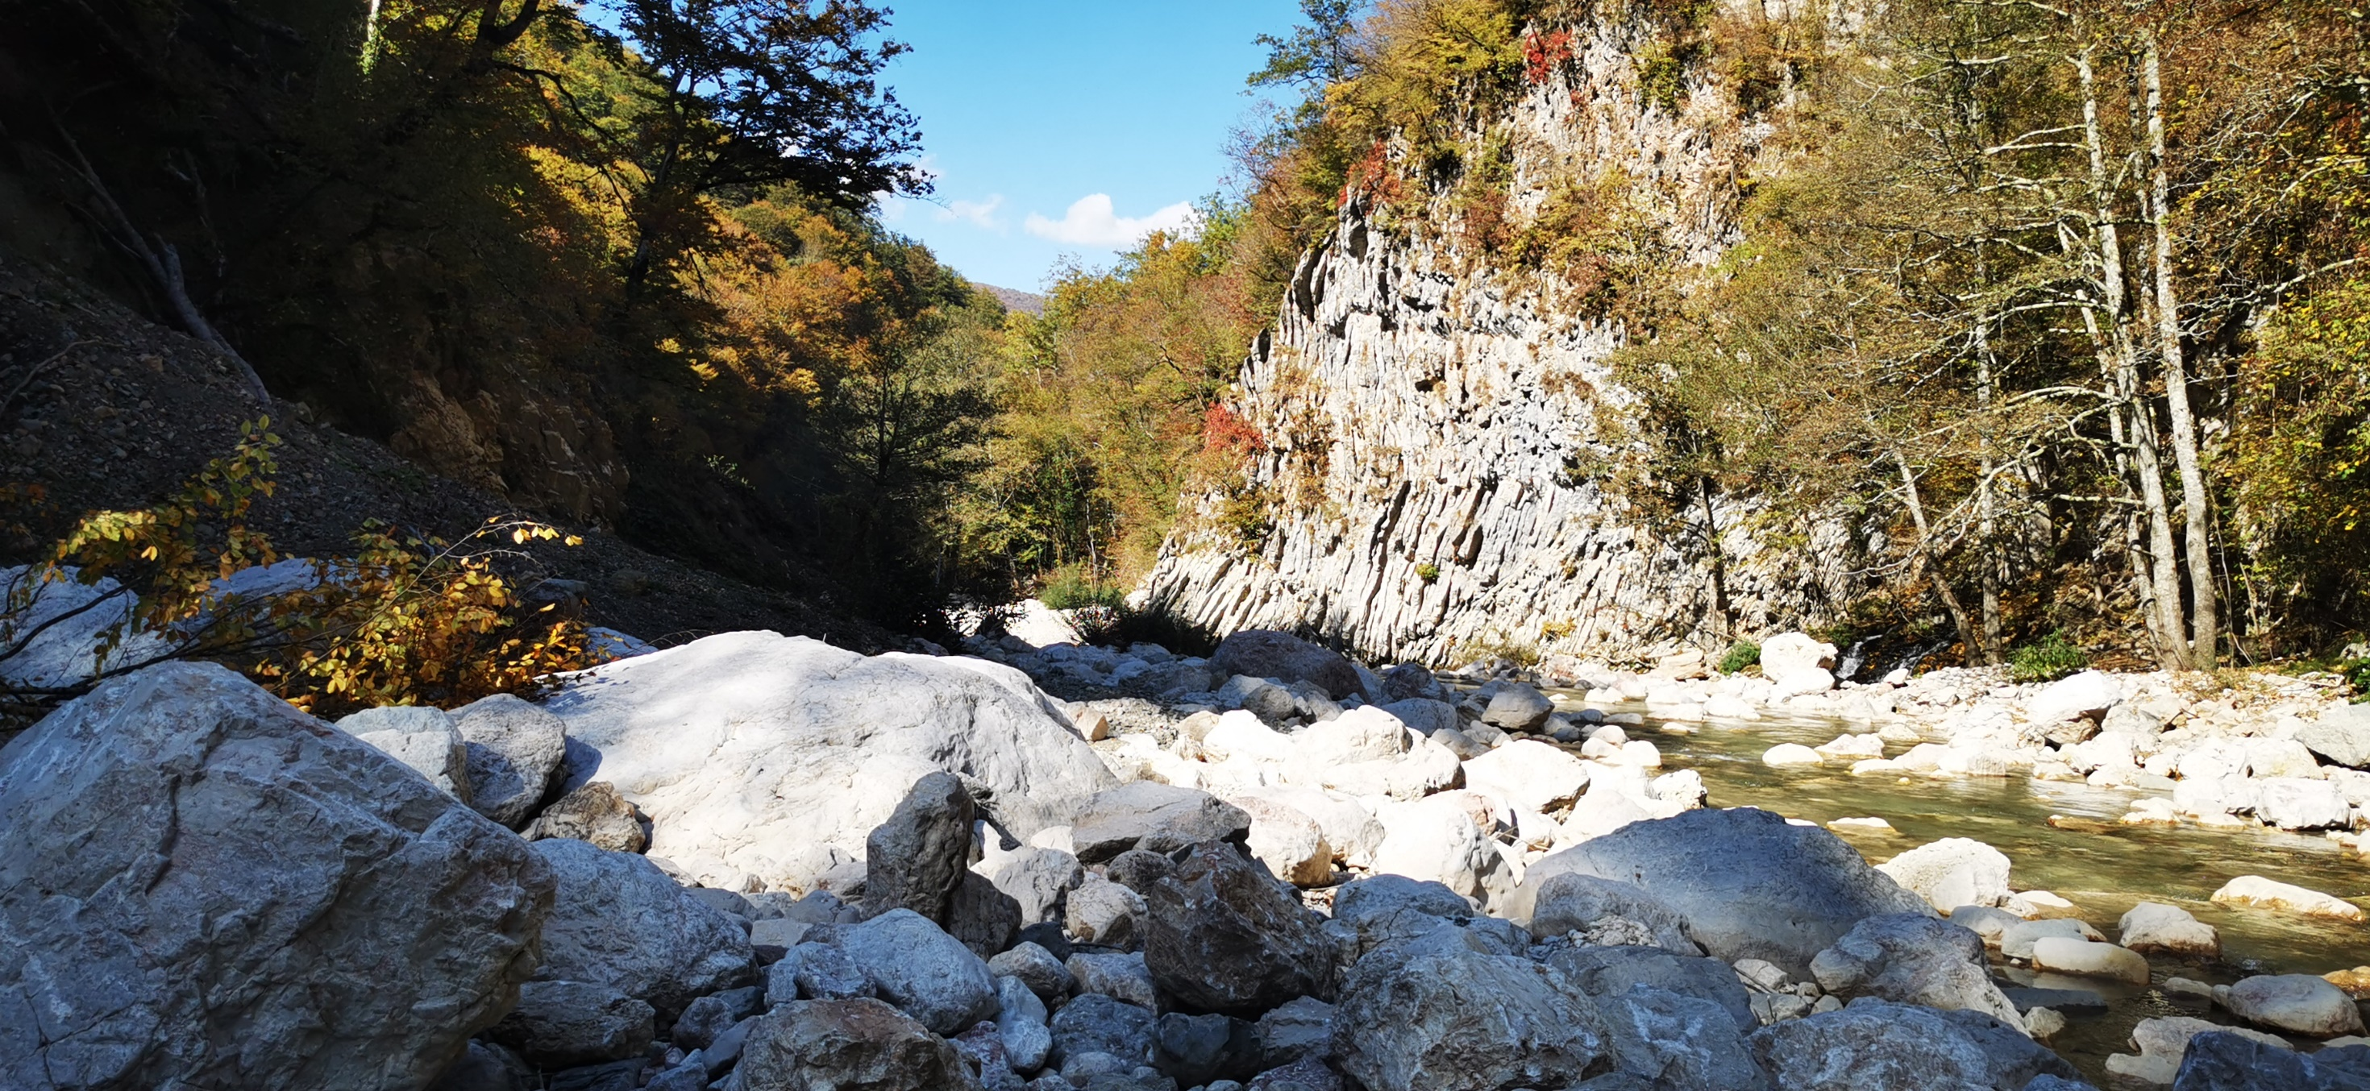
III Recommendations

Slide 11
III Recommendations
Official declaration of BA0000002 as an adopted Emerald site + Management plan
HPP Ulog → Halt construction until recommendations are implemented
  New regulation of residual flow regime in alignment with resident fish species
  No hydropeaking operations
  Mitigation measures for destroyed habitats
  Implement absolute ban on fish stocking
  Monitoring measures for affected habitats and species
HES Gornja Neretva → STOP Phase I and II
HPP Glavatičevo and Bjelimići → Prohibit implementation
Halt all planning and permitting of HPPs along the Upper Neretva tributaries
  Very long stretch of Upper Neretva affected
  Negative cumulative effects

Slide 12
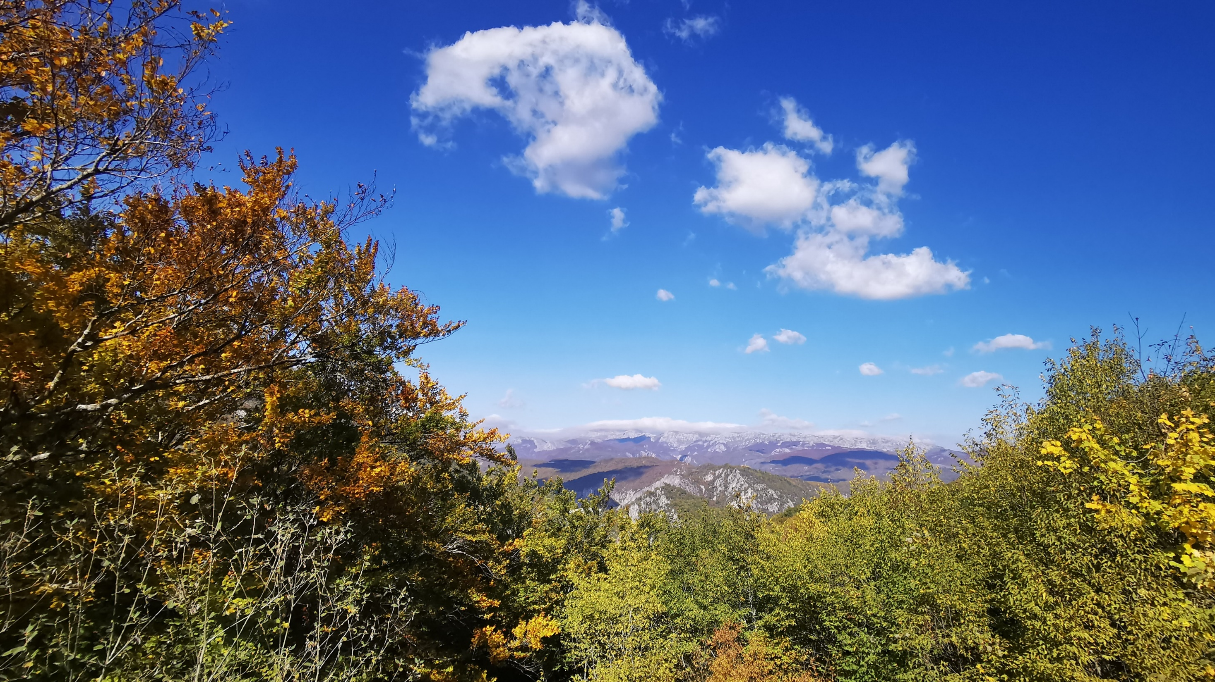
Thank you!

