Slide 1
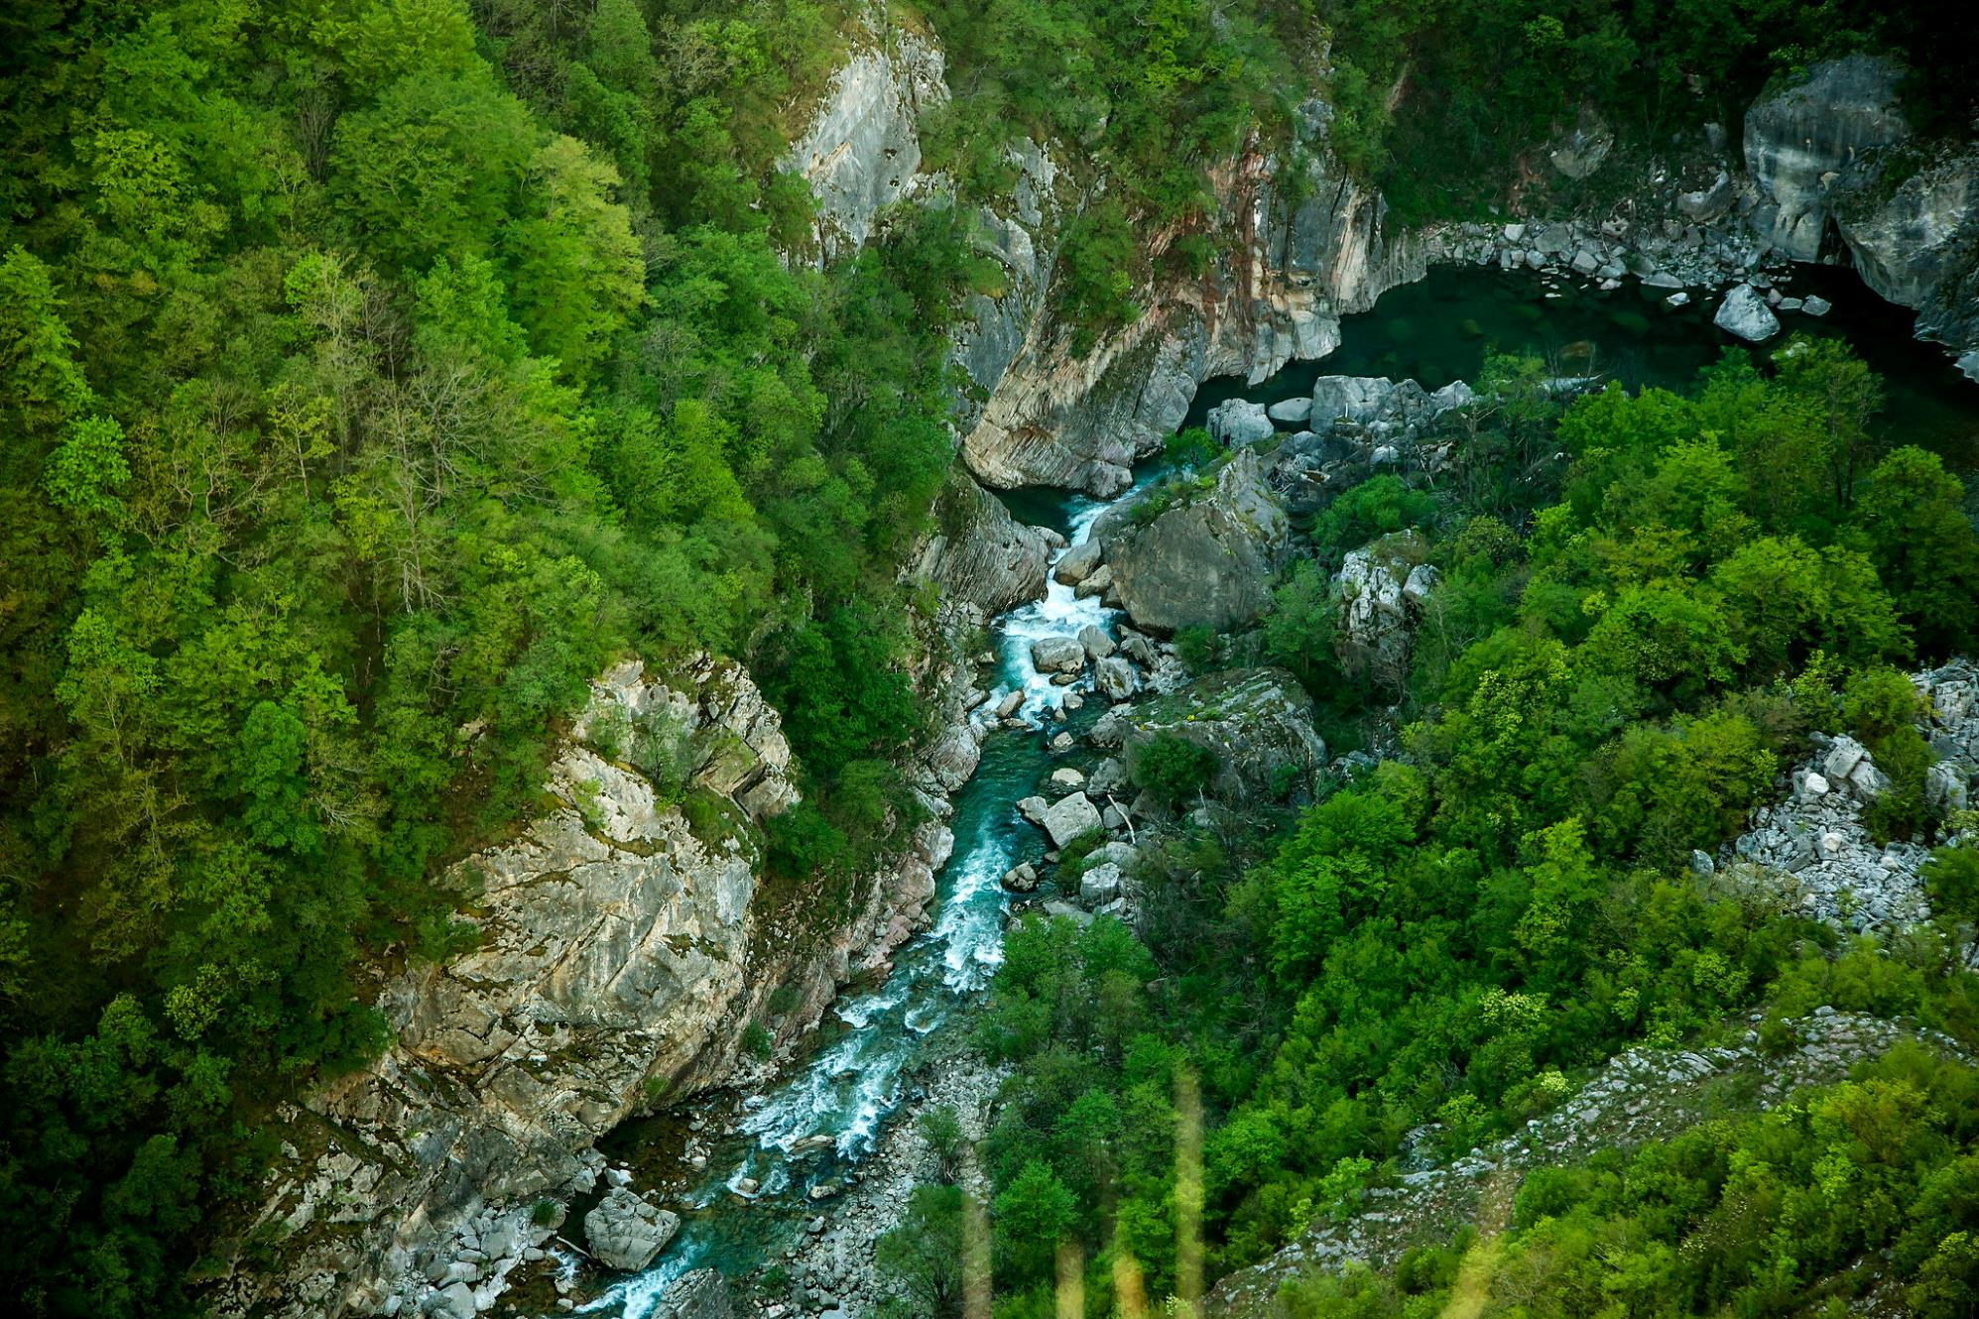
Neretva River (Bosnia and Herzegovina) 42nd meeting of the Standing Committee, November 2022, Strasbourg
On behalf of the complainants:
Emina Veljović, Aarhus Center Sarajevo Bosnia and Herzegovina

Slide 2
Upper Neretva case – iconic river and dam tsunami
Possible File no. 2020/9: Possible negative impact of hydro-power plant development on the Neretva River (Bosnia and Herzegovina)
Ulog hydropower plant (35 MW)
HES “Gornja Neretva” hydroelectric system that consists of 7 small hydropower plants (total 15 MW)
Large plans in FBIH: HPP Bjelimići, PHPP Bjelimići and HPP Glavatićevo
About 70 hydropower projects planned in the entire river basin
Almost all river stretches of Emerald Site Gornji tok Neretve still threatened - Ulog dam is built near the center of the site.

Slide 3
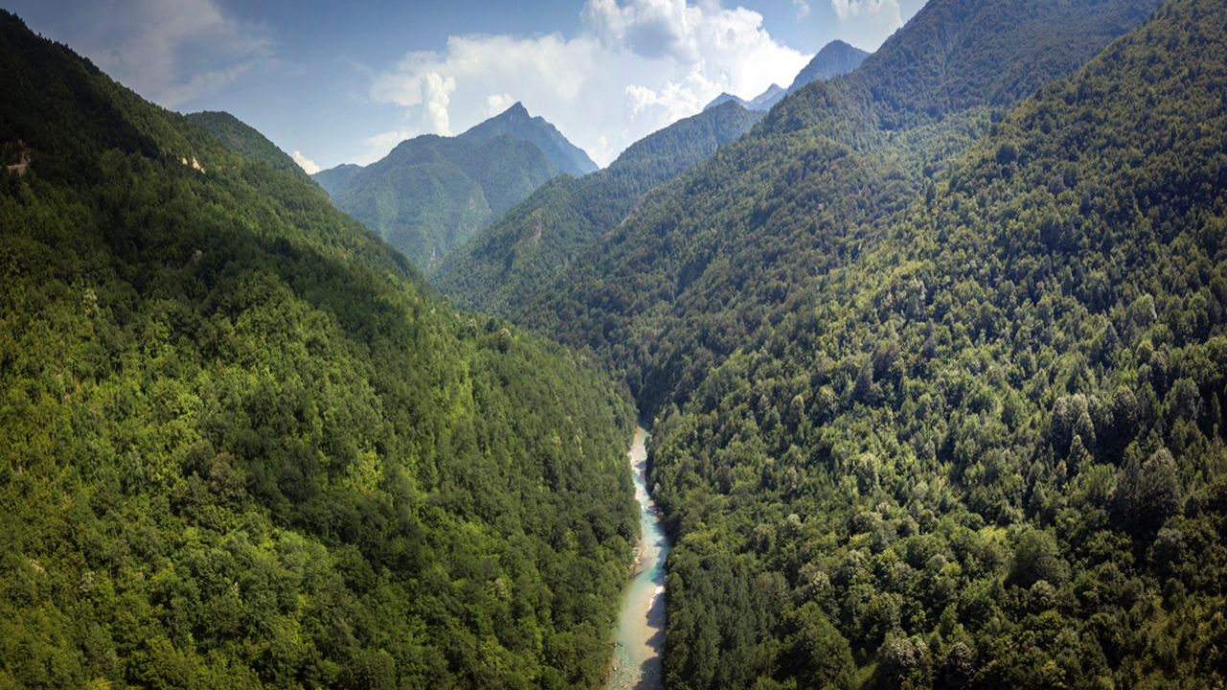

Slide 4
About 70 new HPPs foreseen in Neretva basin
Making it one of the most threatened river systems in Europe

Slide 5
Current status
Following the decision by the 41st Standing Committee of the Bern Convention in December 2021, an on-the-spot-appraisal (OSA) was carried out in October 2022 with concluding meeting with the stakeholders.
None of the previous recommendations by the Bureau (including postponement of the construction) have been taken into account by the authorities in Bosnia and Herzegovina (B&H).
B&H has no progress since 2011 to develop or protect the Emerald Network.
We support the recommendations in the OSA report.
We request opening the file because of the urgency of the case.

Slide 6
Ulog HPP construction hasn’t stopped – it has intensified!
The 2.8 km long tunnel is dug through (July 2022)

Slide 7
Ulog HPP construction hasn’t stopped – it has intensified!
Vegetation is cleared for the 5 km long reservoir (Oct 2022 / OSA)

Slide 8
Ulog HPP construction hasn’t stopped - it has intensified!
Construction of the transmission lines for Ulog HPP (Oct 2022 / OSA)

Slide 9
Ulog HPP construction hasn’t stopped – it has intensified!
The 53-meter-high dam construction is ongoing (July 2022)
… and could be finalized in 2023

Slide 10
The 53-meter-high dam construction is ongoing (July 2022)
… and could be finalized in 2023

Slide 11
Ulog HPP planned to be completed in 2023
Bern Convention Bureau request from September 2021 to: “halt any works at the site until comprehensive and legally sound environmental assessments have been carried out” completely ignored.
Reservoir volume and height of the dam point to hydro-peaking operation and downstream impacts.
The project is in Republika Srpska entity, but the Federation of B&H has failed to oppose it and to inform local communities downstream.

Slide 12
Plans for 7 small HPPs still active (RS)
Planned in the uppermost (still pristine) sections of Neretva in RS
HES “Upper Neretva” Phase I – draft EIA and valid Construction permit
HES “Upper Neretva” Phase II – EIA approved and valid Environmental permit

Slide 13
3 more large dams in the Spatial Plan (FB&H)
Downstream from HPP Ulog, on territory of FBiH
HPP Bjelimici (2x50MW), Pump-storage HPP Bjelimici (2x300MW) and HPP Glavaticevo (3x9,5MW)
All are in the FBIH Spatial Plan and declared as public interest in 2021

Slide 14
Neretva Science Week (Summer 2022)
Science camp held in Summer 2022 on Upper Neretva river
More than 50 international scientists participated in a fact-finding mission
Significant results and new data on biodiversity were obtained
New findings proved that the base-line-data was insufficient while developing the hydro projects

Slide 15
Findings from Neretva Science Week
The results of the ichthyological research confirmed presence of four fish species (Salmo farioides, Cottus gobio, Phoxinus phoxinus and Barbatula barbatula)
The species do not tolerate temperature fluctuations, reduced amount of dissolved oxygen, higher concentrations of organic substances in water, etc.
It was established that brown trout from the upper part of the Neretva river flow belongs to the Adriatic (Ad) line of brown trout and the species Salmo farioides (Karaman, 1938)
DNA analysis shows characteristic of trout from the Adriatic basin and irrefutably indicate that it is an endemic species of Adriatic brown trout.
Genetic specificity of autochthonous populations is endangered primarily by the hydro power development.

Slide 16
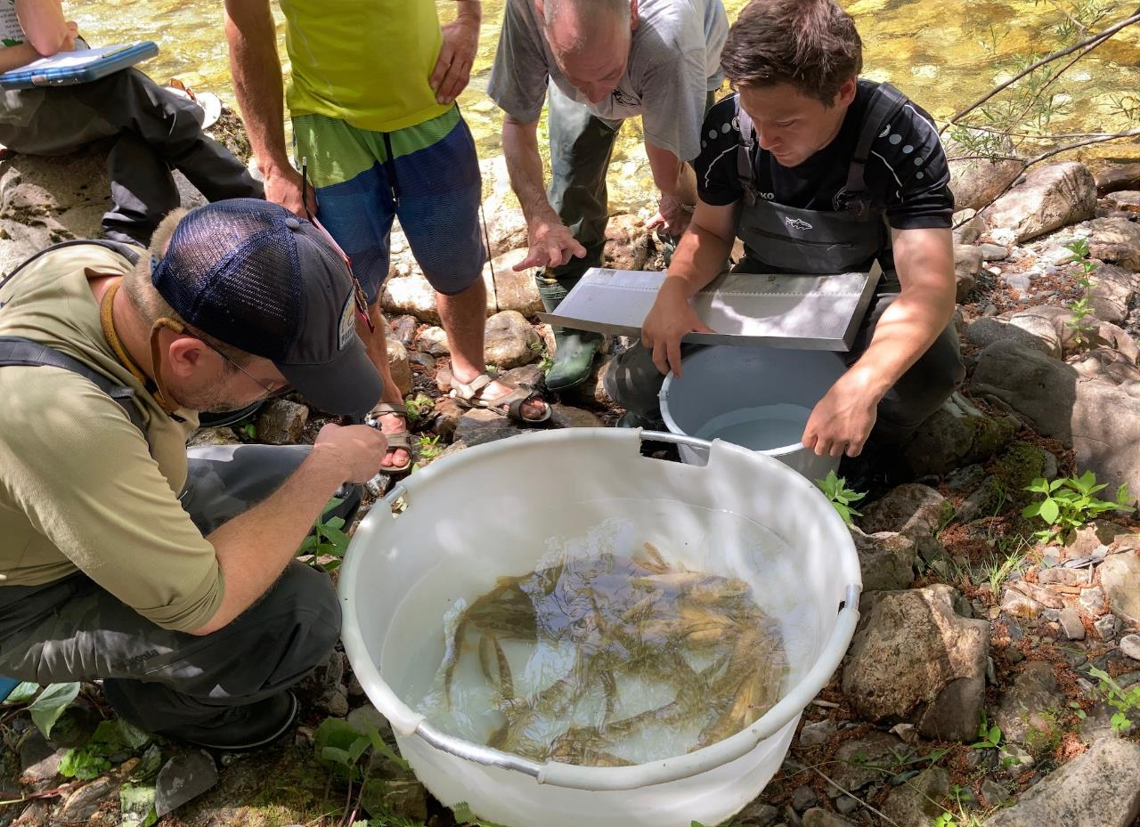

Slide 17
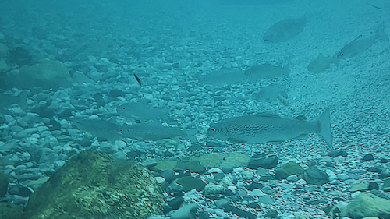
Downstream of Ulog construction site the Neretva hosts one of the last healthy population of soft-mouth trout. This population would be severly threatened by the potential flush operational mode of Ulog HPP.

Slide 18
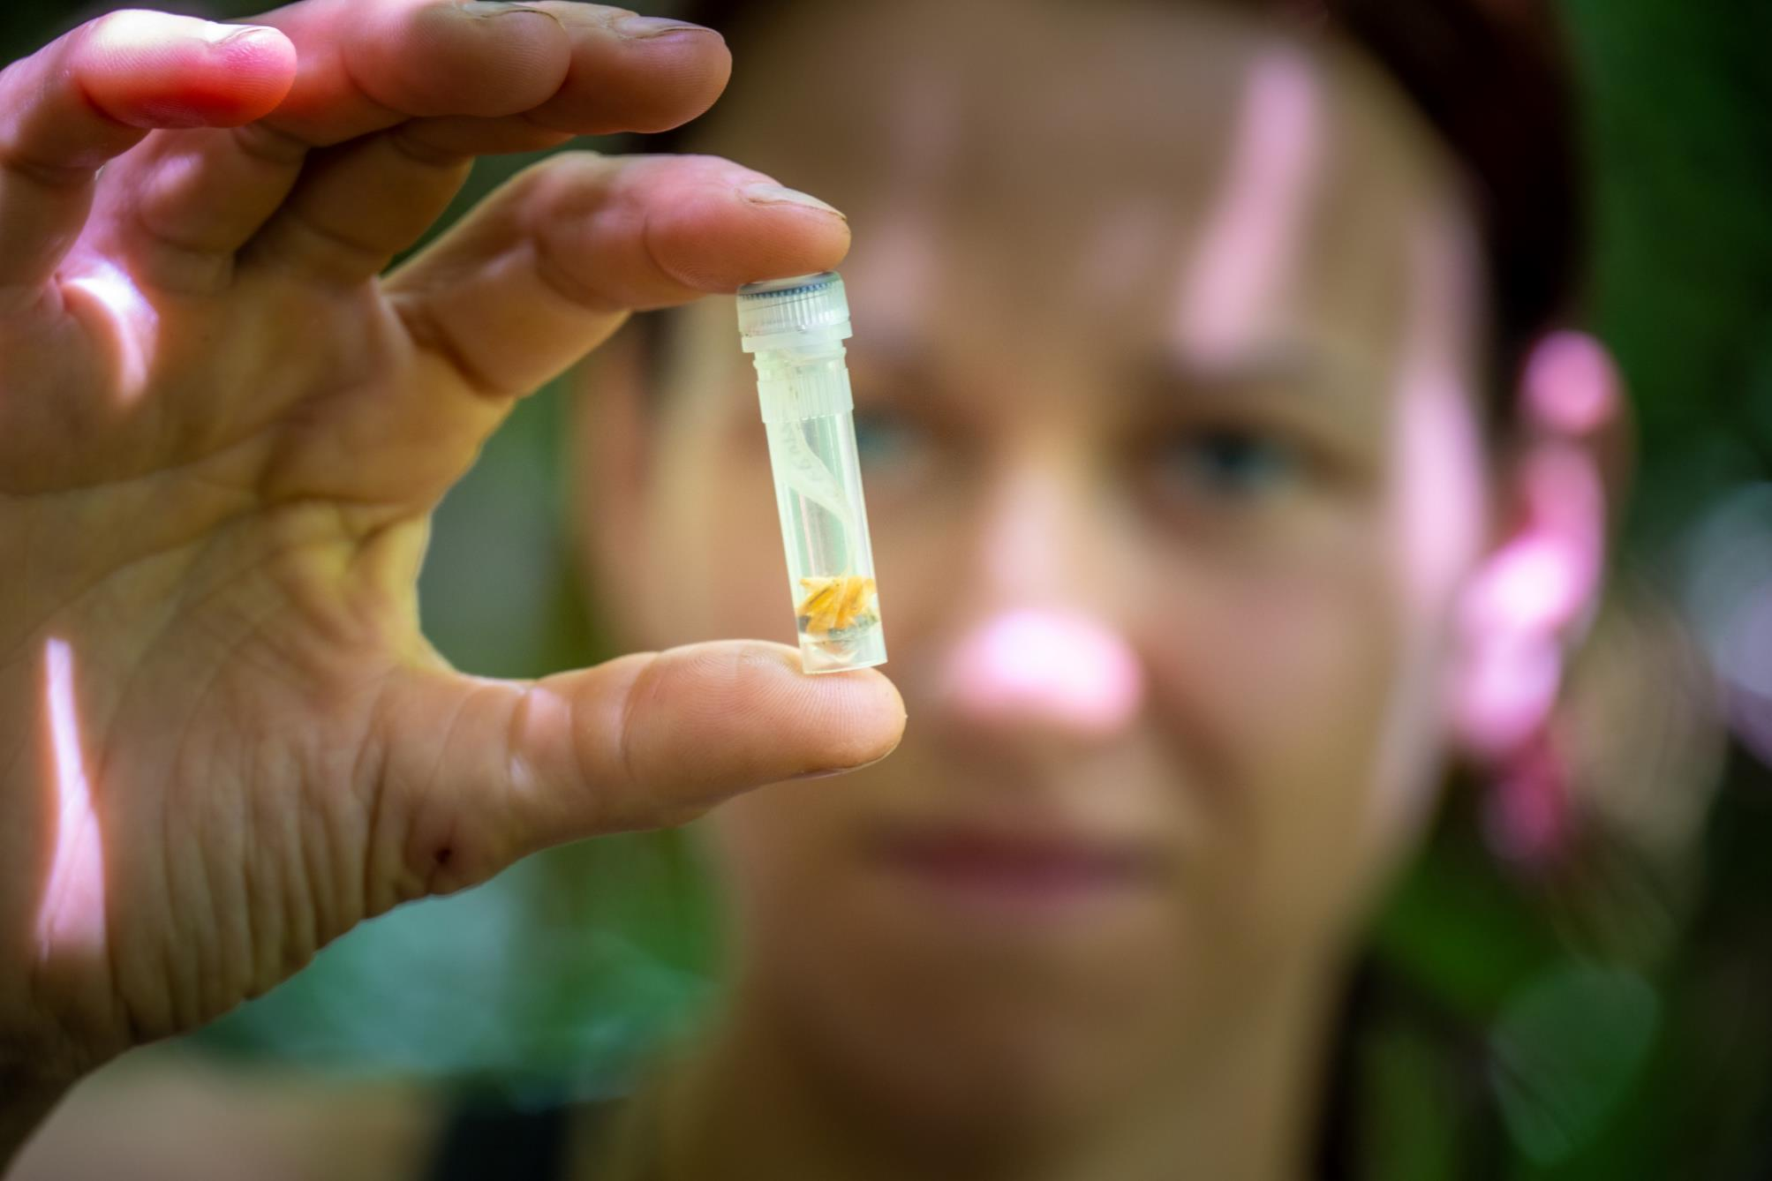

Slide 19
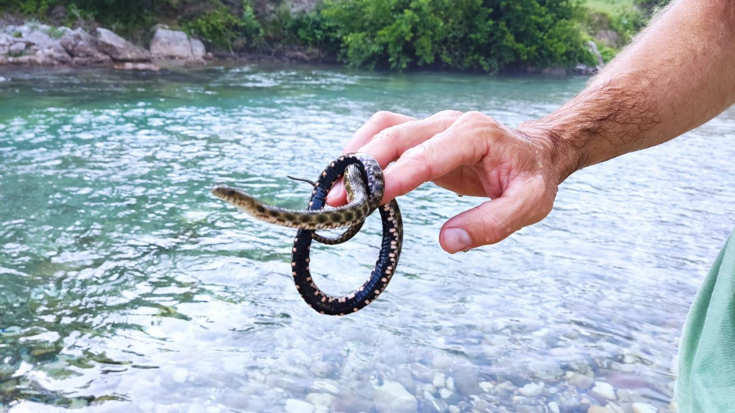

Slide 21
Proclamation as protected area
Center for Environment submited two initiatives for protecting the Upper Neretva river area in 2021 (upstream from Ulog HPP)
The initiatives were accepted by the RS Ministry
Findings from the Science Week used to additionally justify the official proclamation
Study of protection of Upper Neretva was drafted in October 2022 and forwarded to the relevant intitutions in RS
The process is ongoing, as well as hydro developments (!)

Slide 22
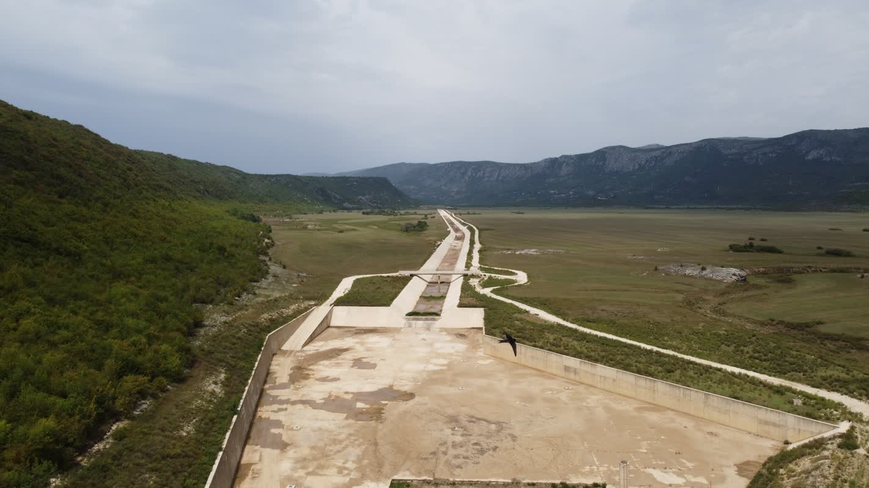
Upper Horizons project in Neretva basin
Impacts on Buna and Bunica tributaries, Neretva Delta in Croatia (Natura 2000 site), Nevesinjsko, Dabarsko, Fatnicko, Popovo poljes (Four Emerald sites).
Another huge project under construction
Water diverted away from the Lower Neretva
Cumulative impacts with projects in Upper Neretva

Slide 23
Requests from the Standing Committee:
To halt the construction of the hydropower plant Ulog.
Prohibit implementation of the hydro-electric system Gornja Neretva (both Phase I and Phase II), cancel the granted concessions and erase projects from the Spatial plan.
Prohibit implementation of the currently dormant hydropower plant projects Glavatićevo and Bjelimići due to the profound negative impact and erase them from Spatial plan.
Concerning planned hydropower plants along the Neretva and its tributaries, halt all planning projects until all Emerald Network sites are declared.

Slide 24
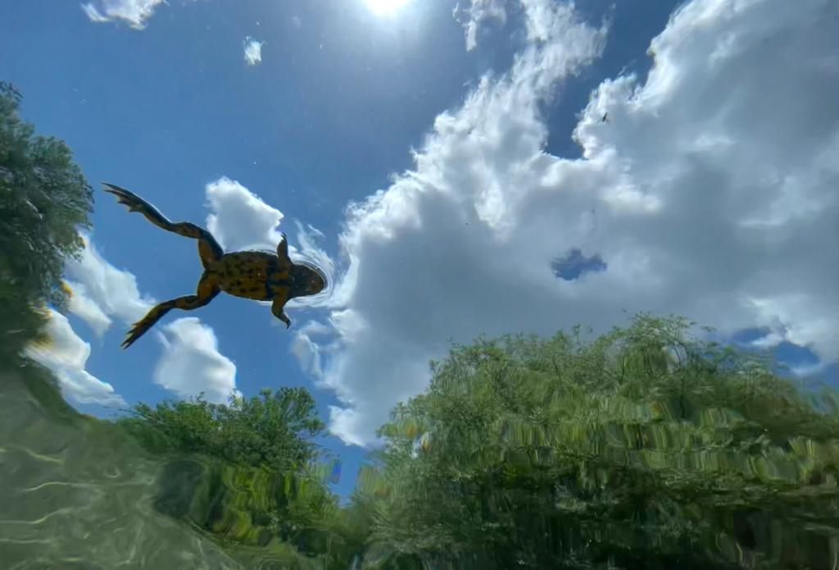
Thank you for your attention!

