Slide 1
Agenda Item 7.1: Files Opened Greece: Recommendation No. 9 (1987) on the protection of Caretta caretta in Laganas bay, Zakynthos
42nd Meeting of the Standing Committee
Bern Convention
28th November – 2nd December 2022

Slide 2
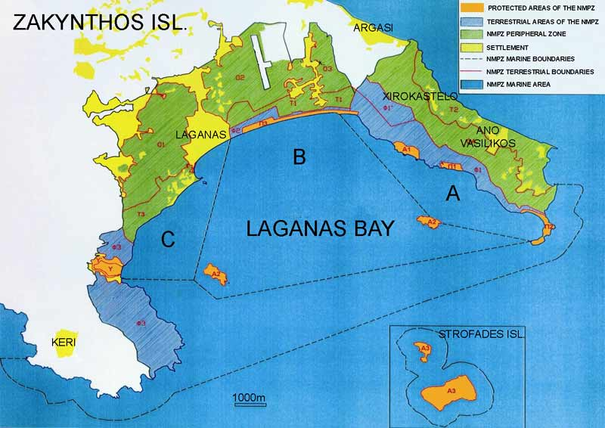
Violations of National and EU Legislation & Lack of Enforcement of Zakynthos National Marine Park (ZNMP) Protection Measures
SURVEY 2022
Zakynthos (Laganas Bay)
Hosts one of the largest Loggerhead sea turtle breeding aggregations in the Mediterranean (Av. 1200* nests/yr). During 2022 nesting season over 1100* nests were recorded
Nesting primarily occurs along six beaches, approx. 5.5km
The ZNMP was established in 1999 and the Management Agency (MA) in 2000
* Data provided by ARCHELON
Maritime zonation of the NMPZ

Slide 3
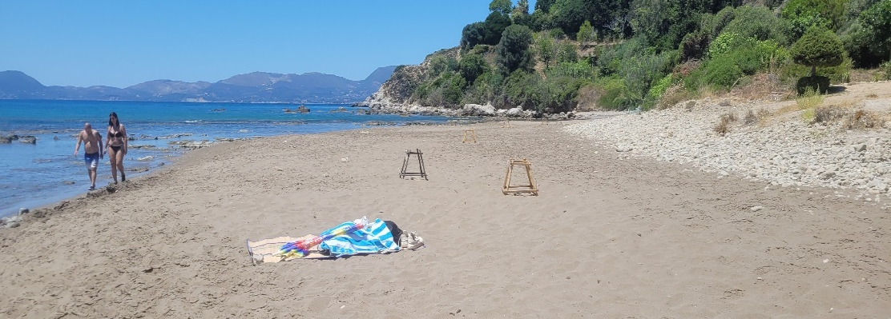
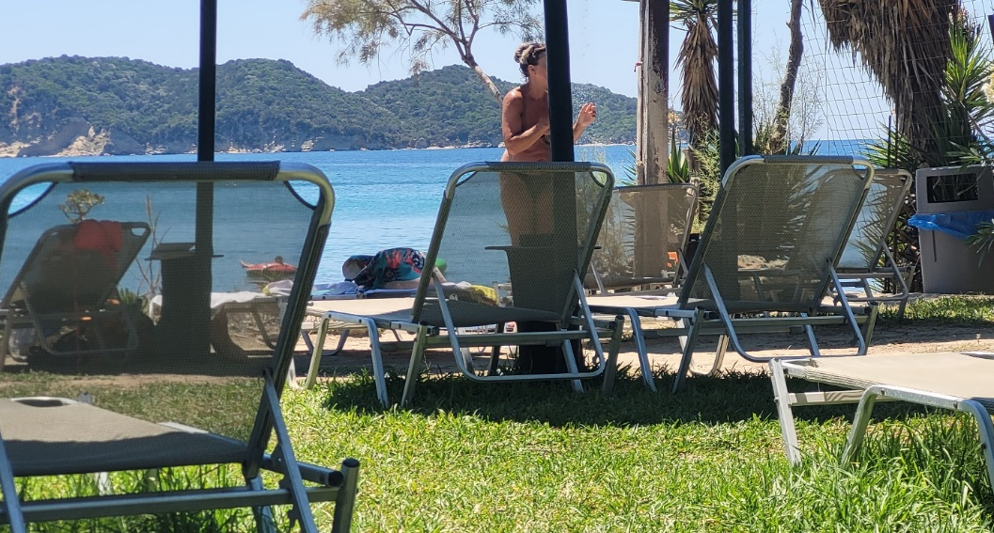
VIOLATIONS OF Recommendation. No 9 (1987)
(Measure No 1) Remove the prefabricated houses in Dafni
Illegal Constructions & lack of compliance
SURVEY 2022
Illegal construction and expansion of businesses have continued to operate unhindered on the protected sand dune system, behind Daphni nesting beach.
The sand dune system has now been completely destroyed.
Lack of zonation management on nesting beach. Visitors are able to walk in-between and in close proximity to caged nests.
530 sunbeds, an alien plant species and showers exist behind the nesting beach.
Light pollution from the illegal businesses are causing hatchling disorientation.
ARCHELON
©MEDASSET 2022: Daphni
©MEDASSET 2022: Daphni
(a)
ARCHELON
Water runoff
(b)
(c)
(a)
(b)
©MEDASSET 2022: Daphni
©ARCHELON 2022: Daphni
©ARCHELON 2022: Daphni

Slide 4
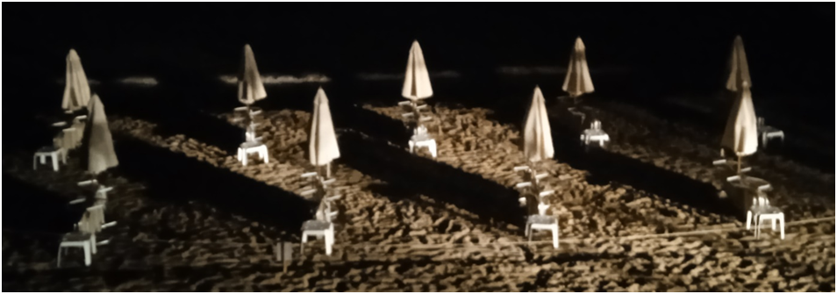
VIOLATIONS OF Recommendation. No 9 (1987)
(Measure No 5) Remove trees and ban and penalize the use of deck chairs, sunshades and pedalos on the nesting beaches of Gerakas, Kalamaki, eastern Laganas and Marathonisi
ARCHELON
©ARCHELON 2021:
(a)
ARCHELON
©MEDASSET 2022: Laganas East
©MEDASSET 2022: Laganas East
(b)
(c)
No sunbeds were observed to be removed from the front of the beaches at night; all were placed on their sides in-situ.
(a)
(b)
Maximum permitted No. of umbrellas & sunbeds was greatly exceeded :
Laganas east and Kalamaki nesting beaches: 570 on 14th July and 610 in July-August
(data by Archelon) instead of 300 permitted
Gerakas: 177 sunbeds in July-August (Archelon) instead of 120 permitted
©ARCHELON 2022: Laganas East
Increases in beach furniture and water sport equipment and failure to remove from the front of the nesting beaches, increases obstacles for both emerging females to reach the suitable beach nesting areas and emerging hatchlings reaching the sea.

Slide 5
VIOLATIONS OF Recommendation. No 9 (1987)
(Measure No 5) Remove trees and ban and penalize the use of deck chairs, sunshades and pedalos on the nesting beaches of Gerakas, Kalamaki, eastern Laganas and Marathonisi
ARCHELON
SURVEY 2022
(a)
ARCHELON
Private hire and professional boats (14 boats counted at 15:10 on 14th July 2022), as well as 4 floating canteens were observed anchored to the nesting beach of Marathonisi causing disturbance.
Number of boats anchored along the nesting beach of Marathonisi greatly exceeded the maximum limit of 10 boats at any one time.
Other private hire boats were observed anchored within Zone B of the maritime area where it is prohibited for any boat to anchor.
(b)
(c)
©MEDASSET 2022: Marathonisi
(b)
(a)
Anchor line
©MEDASSET 2022: ZNMP maritime Zone B

Slide 6
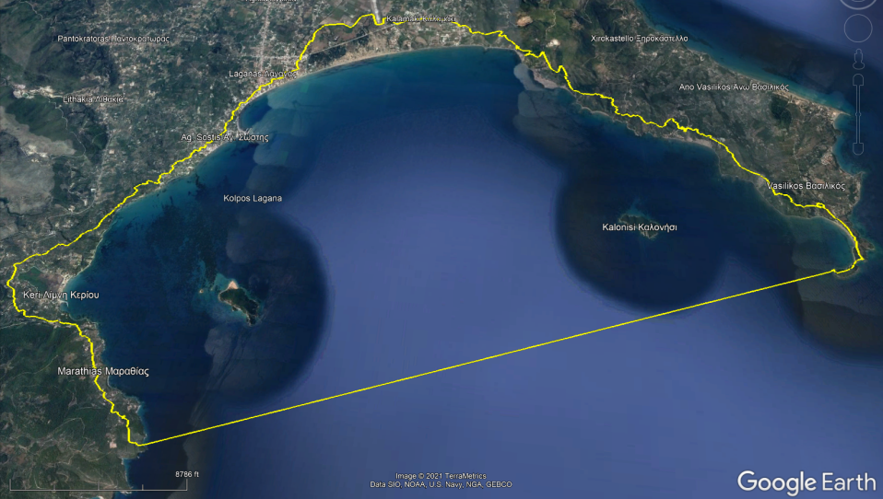
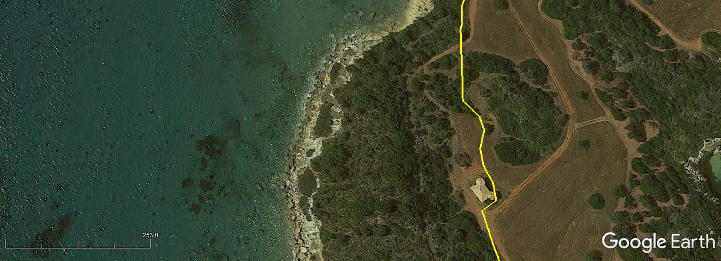
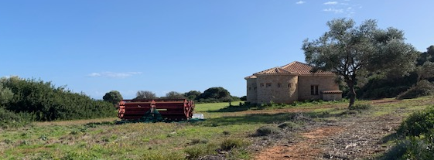
VIOLATIONS OF NATIONAL LEGISLATION – ILLEGAL DEVELOPMENTS
Gerakas - Ιllegal constructions & lack of compliance
SURVEY 2022
Google Earth Image 05/2020
Illegal building at Gerakas built in 2017 within the boundary of the Natura 2000 site has yet to be demolished.
Natura 2000 site GR2210002 is defined in Google Earth maps (top) by the yellow line. Boundary taken from https://natura2000.eea.europa.eu/ . White star on map insert shows location of illegal building.
ARCHELON
© WWF GREECE 2020

Slide 7
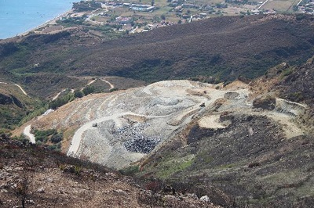
VIOLATIONS OF NATIONAL LEGISLATION- ILLEGAL DEVELOPMENTS
Illegal landfill not restored
SURVEY 2022
The saturated illegal landfill that operated within the ZNMP boundaries and the Natura 2000 site has still to be restored despite its closure since December 2017
ARCHELON
©ARCHELON 2021

Slide 8
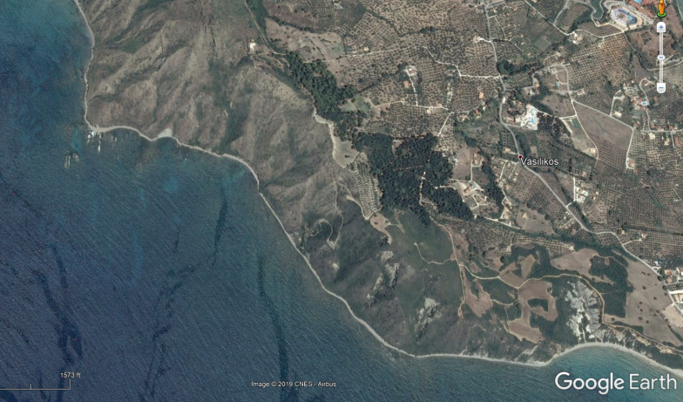
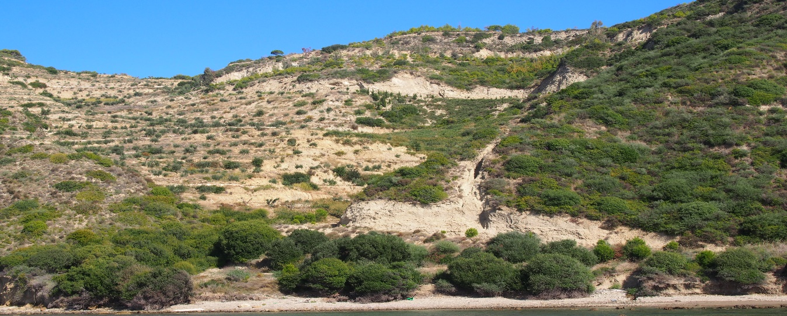
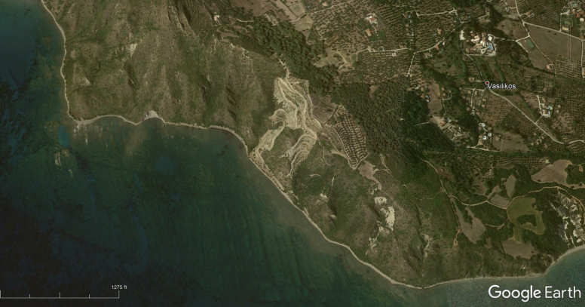
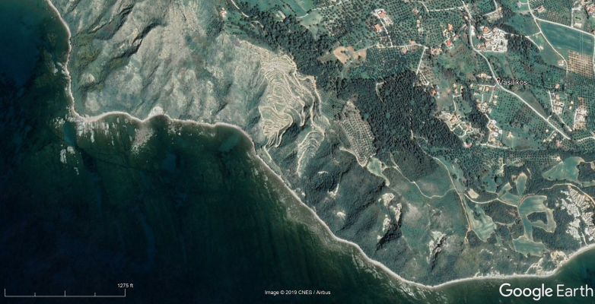
VIOLATIONS OF NATIONAL LEGISLATION – ILLEGAL DEVELOPMENTS
Ιllegal constructions & lack of compliance
SURVEY 2022
2017
The restoration of the illegally constructed road (arrowed in the photo below) between Daphne and Gerakas (Dec. 2015) has still not been carried out.
Pre illegal Construction: Google Earth Image captured: 13th April 2013
© WWF GREECE 2022
Illegal Road
2013
2019
Post illegal Construction: Google Earth Image captured: 28th June 2017
In May 2022, the large fine of 200.000 euros was reduced to 10.000 euros by the Regional Authority.
In July 2022, MEDASSET and WWF Greece lodged an administrative appeal against the validity of this decision, which was rejected by the Decentralised Authority due to lack of competence.
In October 2022, MEDASSET and WWF Greece lodged a legal action in the Administrative Court against the decision amending the fine, requesting its annulment.
Post illegal Construction: Google Earth Image captured: 24th March 2019

Slide 9
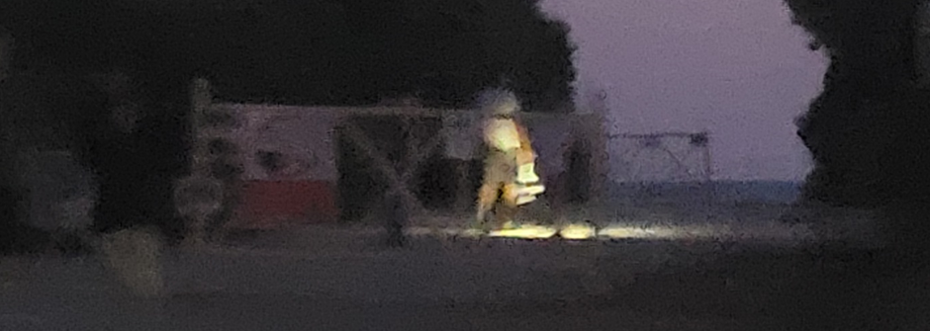
Insufficient presence of wardens resulting in a lack of enforcement
of protective management measures on nesting beaches:
Non compliance by beach users in restricted nesting areas at night
Gerakas, 14th July 2022 21:39
No warden was present to stop visitors entering the nesting beach after sunset. Visitors used a bright light to see their way.
Kalamaki 13th July
No warden presence at Kalamaki nesting beach resulted in people accessing the nesting beach after sunset (21:39) and using bright torches along the water’s edge (21:53).
The presence of humans on the nesting beaches at night presents a significant threat and risk of disturbing nesting females during this sensitive period.

Slide 10
Insufficient presence of wardens resulting in a lack of enforcement of protective management measures on nesting beaches:
Violations of restricted access to the nesting beaches during the day
SURVEY 2022
Marathonissi 14th July
Warden present, but no enforcement for maximum boat allowance was observed.
©MEDASSET 2022 Marathonisi
East Laganas 14th July 2022
Wetting of the sand on the nesting beach to cool the sand for visitors
Movement and misuse of protective nest cages
©MEDASSET 2022 Laganas
©MEDASSET 2022 Laganas

Slide 11
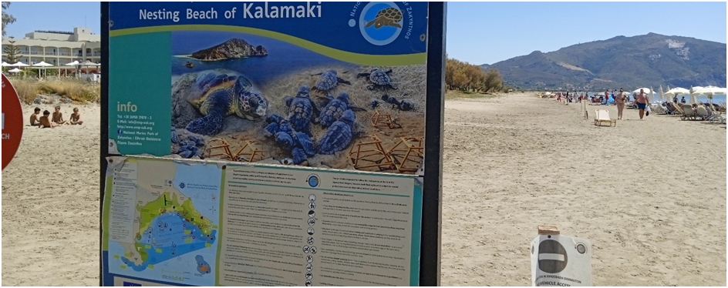
Insufficient presence of wardens resulting in a lack of enforcement of protective management measures on nesting beaches:
Violations of restricted access to the nesting beaches during the day
SURVEY 2022
East Laganas 14th July 2022
Cordoned rope detached for zonation of nesting area and a group of children playing in the nesting area.
No rope present at certain places along beach to keep visitors further to 5m from the water’s edge.
No buffer zone from visitors around the caged nests.
Detached rope on the sand

Slide 12
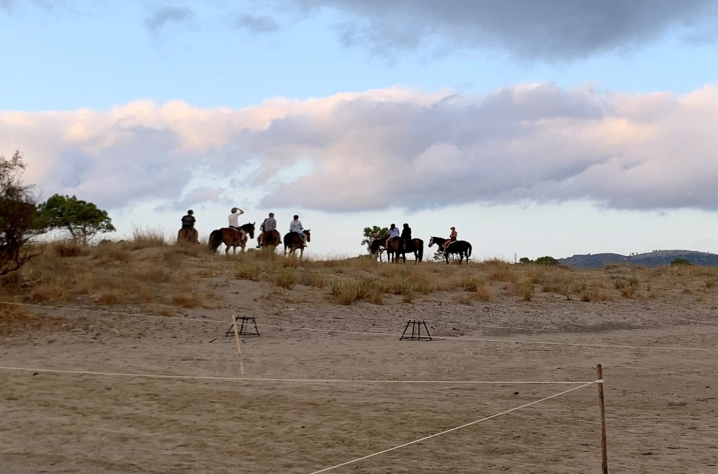
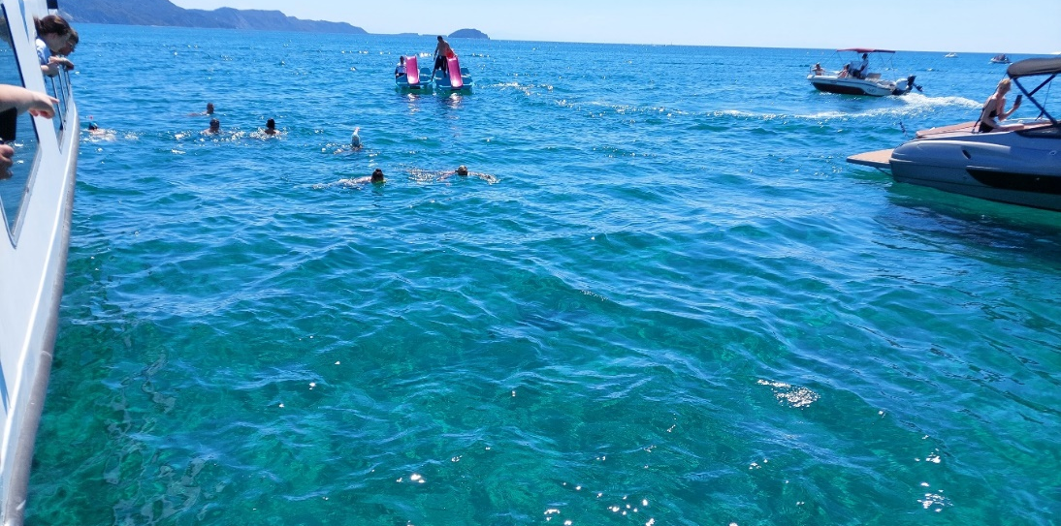
Lack of enforcement of protective management measures on nesting beaches:
SURVEY 2022
East Laganas – Kalamaki
Horse riders observed over the protected sand dunes. This activity continues to occur unhindered on a daily basis.
Cordoned roped area for nesting
©MEDASSET 2022 East Laganas
©WWF Greece 2022 Kalamaki
Agios Sostis 14th July 2022
Non-compliance to the turtle spotting regulations
resulting in turtles being harassed in the Bay.
Adult turtle
©MEDASSET 2022 Ag. Sostis

Slide 13
Insufficient presence of wardens resulting in a lack of enforcement of protective management measures in the Maritime Area:
Violations of the Bay’s Maritime speed restriction (Max. 6 knots)
SURVEY 2022
Numerous observations of boats exceeding the NMP 6 knot speed limit, up to 17 knots.
During the nesting season in 2022:
49 incidents of sea turtles strandings have been recorded in Zakynthos
13 incidences were within the protected area of Laganas Bay
9 cases with signs of interaction with fishing gear
10 cases with injuries caused by boats
2 of the turtles were still alive and transferred to ARCHELON’s Rescue centre in Athens
1 did not survive
Video: boats greatly exceeding the 6 knot speed limit in Agios Sostis, 14th July 2022 (MEDASSET).
* Data provided by ARCHELON
©ARCHELON 2022 Laganas

Slide 14
At National Level
NMPZ management issues:
Lack of human and financial resources
Bureaucracy
Direct administrative dependence of the management unit on Natural Environment & Climate Change Agency (NECCA)
Great concerns regarding the management plans and the presidential decrees for all Natura 2000 sites in Greece, especially in Zakynthos.
Seismic surveys in the area of the Ionian Sea for the exploitation of hydrocarbon resources are a big threat for the marine turtles in the area.
On November 7th 2022, the Greek Prime Minister Kiriakos Mitsotakis announced that Exxon Mobil will start conducting seismic surveys in the Peloponnese peninsula and the island of Crete.

Slide 15
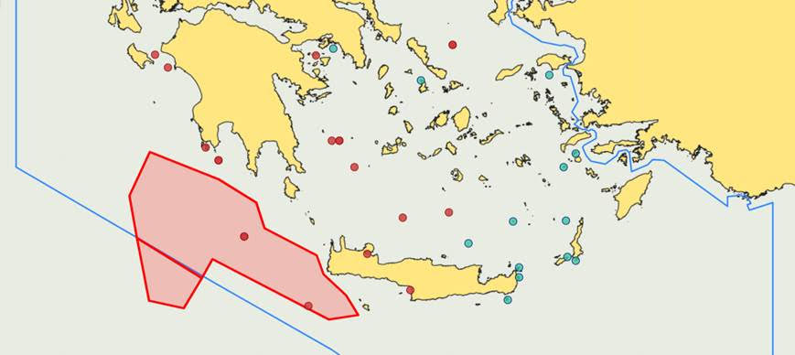
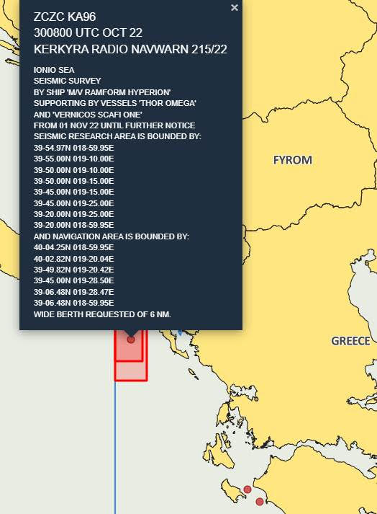
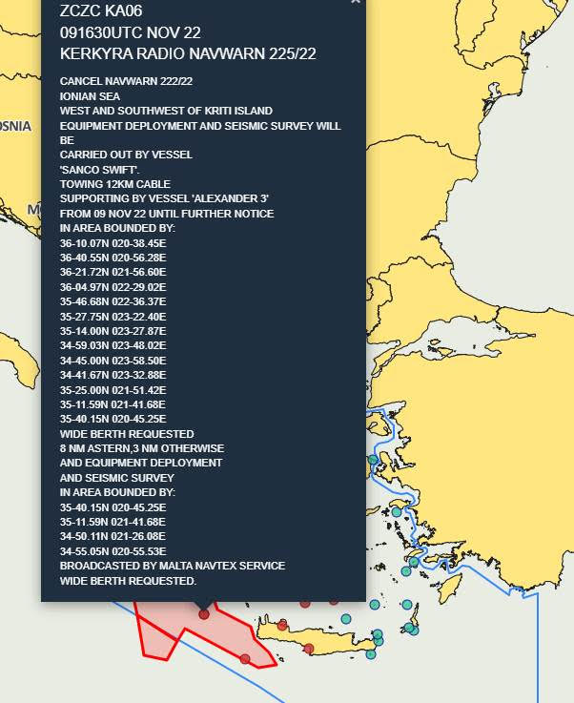
On November 9th 2022, the Minister of the Environment and Energy Kostas Skrekas confirmed that the survey vessel has already been dispatched and the survey has begun.
The map is showing the area Southwest of the Peloponnese peninsula and the island of Crete to which the two active NAVTEX for seismic surveys refer.
NAVTEX
NAVTEX
In 2019, WWF Greece, Greenpeace Hellas and Pelagos filed an application for annulment before the Supreme Administrative Court against the environmental approval of the hydrocarbon exploitation programme in areas SW and West of Crete.
The hearing of this case took place on 2nd November 2022 and the judgment of the Court is to be delivered in 2023.

Slide 16
Conclusions
SURVEY 2022
Extreme pressure in Laganas Bay due to:
Haphazard, uncontrolled, development for tourism
Poor implementation/ enforcement of EU, National Environment Legislation, PD and ZNMP Management Agency Measures
ZNMP’s Management Agency lack of financial resources and staffing.
Uncontrolled maritime activity

Slide 17
MEDASSET
Mediterranean Association to Save the Sea Turtles
SURVEY 2022
Calls on the Greek Government to:
Increase and secure funding to the ZNMP Management Unit, in particular for increased warden capacity and for the recruitment of scientific personnel. The needs of the Management Unit have increased after undertaking the responsibility of a larger area which includes the Northernwest coasts, where important habitats of other species exist.
Enforce EU, National, local and NMPZ PD regulations.
Impose, implement and enforce appropriate fines and penalties to deter further illegal activity and distraction.
Take action to stop operation of illegal businesses in Daphni & restore the habitat.
Calls on the Standing Committee of the Bern Convention to:
Keep open the case file of Zakynthos, Laganas Bay.
Follow-up through the Greek Government Recommendation No 9, and in particular Measure No 1 regarding Daphni.
Perform an on-the- spot appraisal of Laganas Bay’s nesting beaches, in order to update and amend Recommendation No 9.

