Slide 1

Agenda Item 7.1: Files opened
Turkey: Degradation of nesting beaches in Fethiye & Patara Specially Protected Areas
42nd Meeting of the Standing Committee of the Bern Convention
28 NOVEMBER – 2 DECEMBER 2022

Slide 2
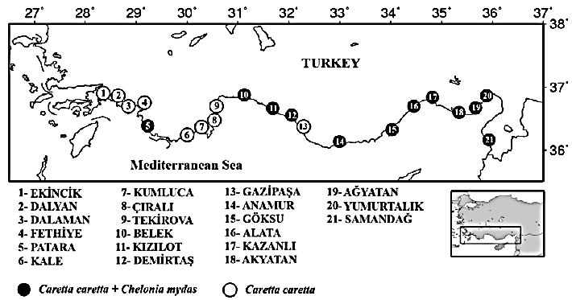
Fethiye & Patara are among the most important
sea turtle nesting beaches in Turkey
4

Slide 3
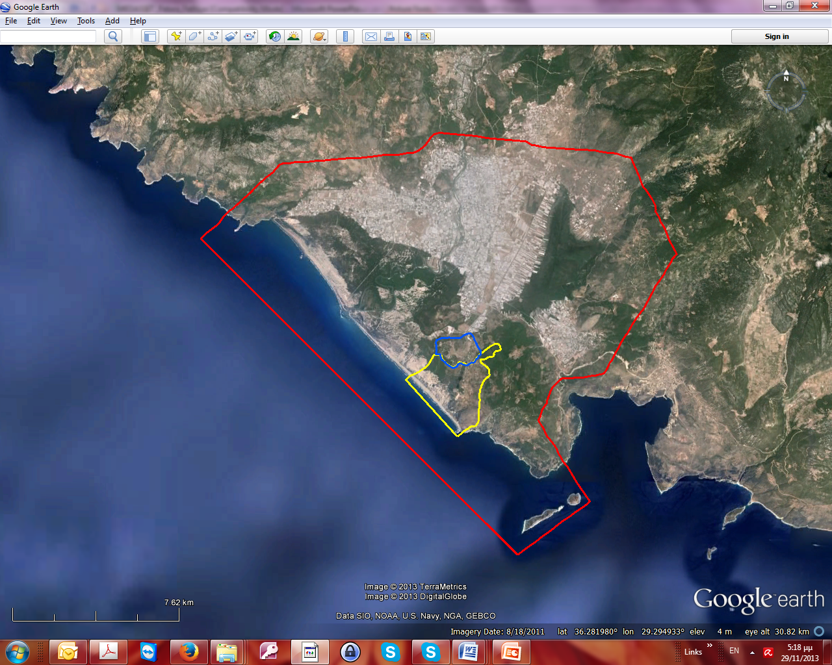
Patara Specially Protected Area
Red line: SPA borders
Blue &Yellow line: Archaeological Site
Nesting Beaches

Slide 4
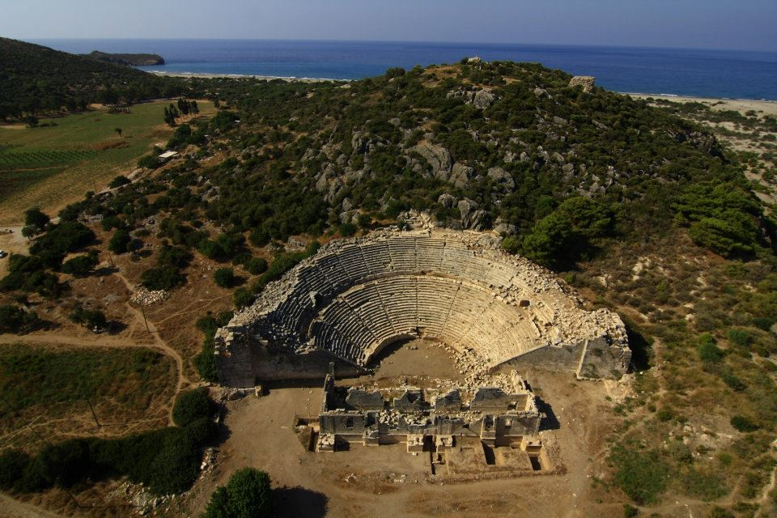
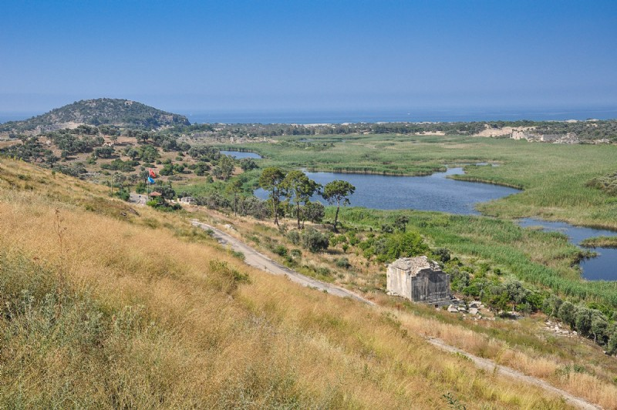
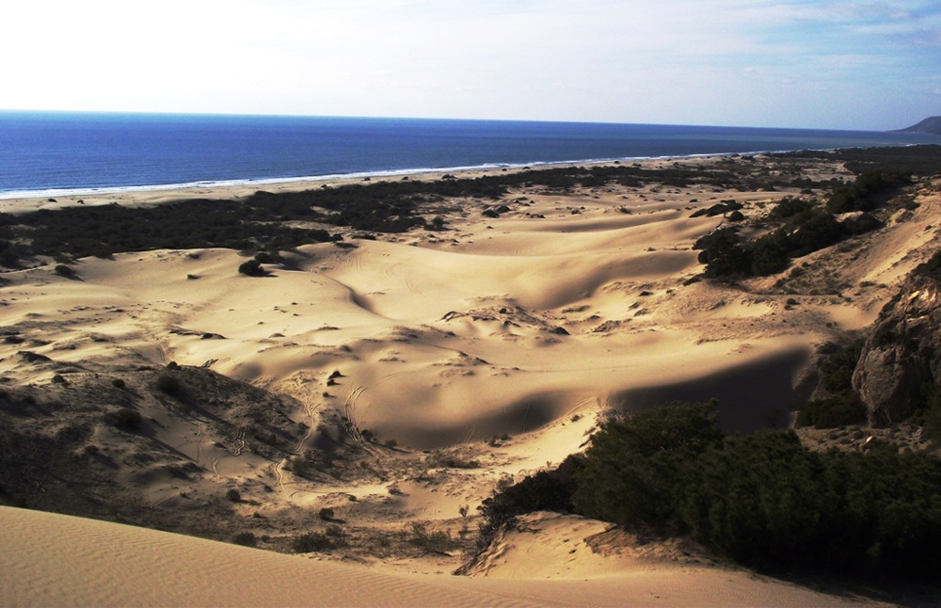
Patara Specially Protected Area
Archeological site
St. Nicholas church
Red line: SPA borders
Blue &Yellow line: Archaeological Site
Nesting Beaches
Sand dunes & nesting beach

Slide 5
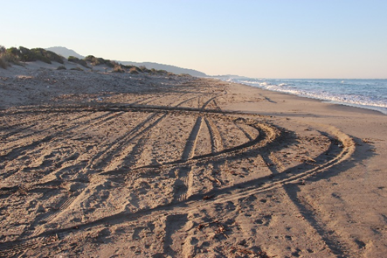
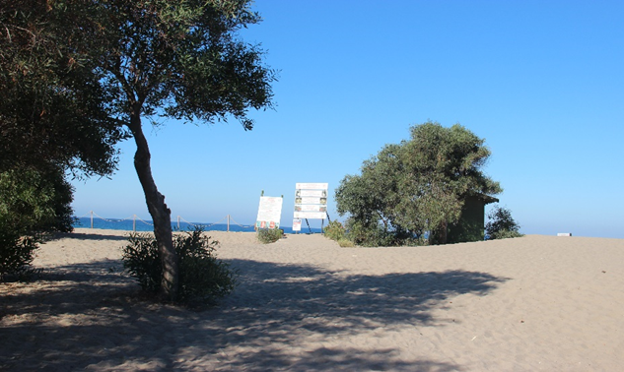
Patara Recommendation No. 182
Rec. pt. 1: Urgently ensure that Patara nesting beach receives appropriate legal protection and management, in line with its exceptional, natural and ecological value.
  No confirmation of the revised SPA borders.
  Legislation prohibiting entrance after 20:00 is not enforced.
  Poor management of vehicle entrance along the entire SPA. Personnel only at the entrance of the Main Beach.
  No personnel observed during our survey at any of the checkpoints. No rangers or gendarmerie on foot or in a vehicle.
Wooden
walkway
Tracks of heavy vehicles on the northern section of the
South beach.
Patara Main Beach. Low dunes to the right of the wooden walkway, from where it is possible to enter the beach after 20:00. Note the acacia trees on the beach.

Slide 6
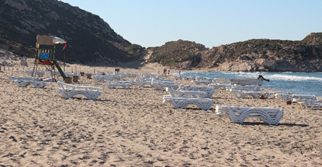
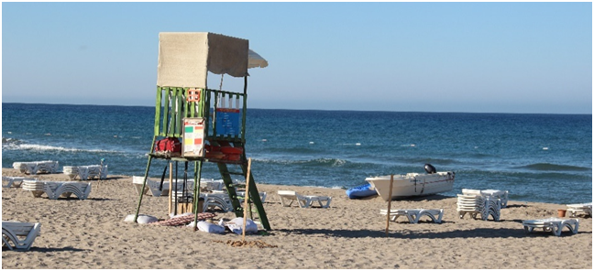

Patara Recommendation No. 182
Rec. pt. 2: Urgently set up, enforce and monitor the implementation of strict regulations.
    prohibit further development on the beach (including buildings, structures, roads) and enable the removal of abandoned illegal facilities and restoration of the dunes;
    regulate the extent and use of furniture on the beach and ensure beach furniture is removed from the nesting zone at night;
  The permanent structures on the southern end of Patara Main Beach and the Green Park directly behind the northern end of Özden Beach have not been removed was envisaged.
  No dune restoration efforts as recommended.
  Poor management of beach furniture on the Main Beach. Furniture was not removed from the nesting zone at night. Sunbeds were stacked close to the waterline.
  Visitors are free to bring their own umbrellas and insert them in the sand anywhere they want.
Multidude Bins
Patara SPA, Patara Main Beach. Sunbeds scattered all over the nesting beach at night, extending to the shoreline. A lifeguard tower, a multitude of bins, a kayak and boat (red circle) were also observed right on the water’s edge.

Slide 7
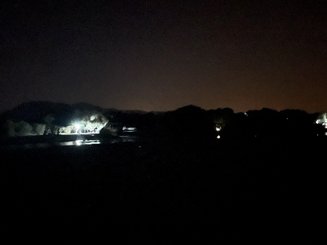
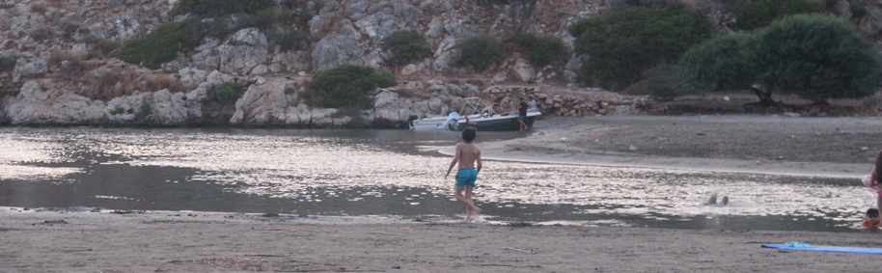
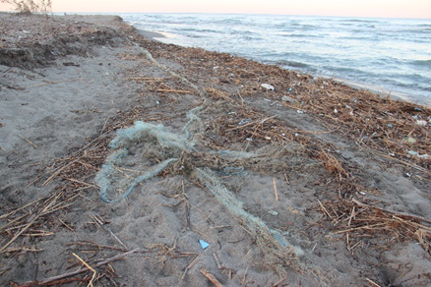
Patara Recommendation No. 182
Rec. pt. 2: Urgently set up, enforce and monitor the implementation of strict regulations.
    prohibit illumination of the beach;
    prohibit fishing with nets in front of the beach;
    prohibit camping on the beach and on riversides in view of the beach;
  Beach illuminated by the bright lights of the camping site right by Eşen River, on the Letoon Beach side, directly affect the nesting zones.
  Fishing activities were seen nearby Eşen River, with fishing rods and large nets. Remains of ghost nets and fishing ropes were encountered littering the nesting beach. Fishermen were seen with high-speed boats right after sunset.
  No camping on the beach was observed but the camping site nearby Eşen River on the Letoon Beach section continues to be a problem.
Light pollution
Fishing Activities
Ghost nets and litter

Slide 8
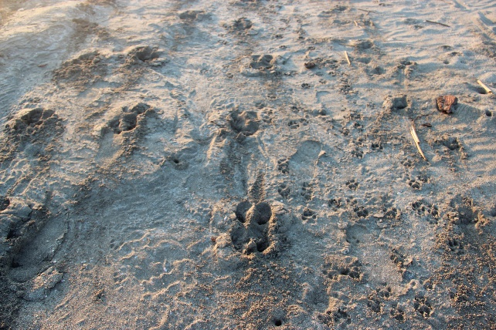
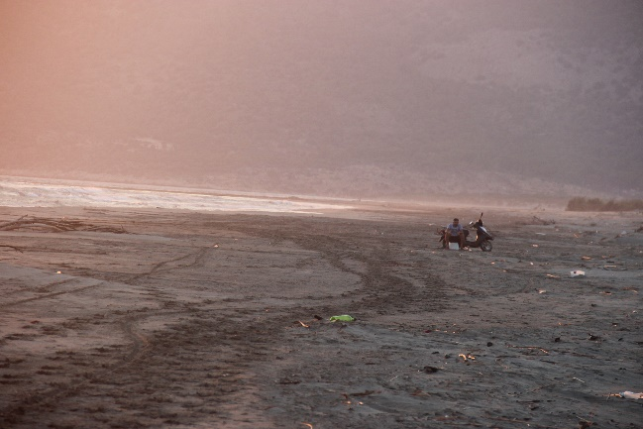
Patara Recommendation No. 182
Rec. pt. 2: Urgently set up, enforce and monitor the implementation of strict regulations.
    prohibit horse riding and 4x4 or quad safaris on the nesting beach
    (vii) define fines for non-compliance with above regulations
  Camel tracks and manure were observed on both Letoon Beach and Özden Beach.
  4x4 vehicles were seen driven inside the Patara touristic center. Locals report that tourists are allowed to rent and ride these vehicles on the nesting beach, day and night.
Camel tracks
Motorcycle and motorcycle tracks

Slide 9
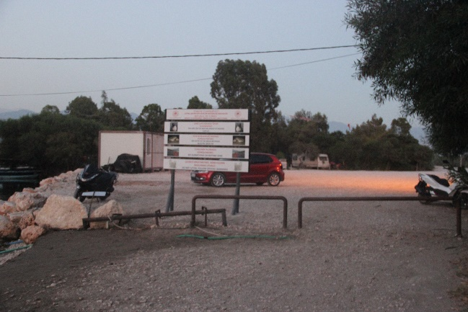
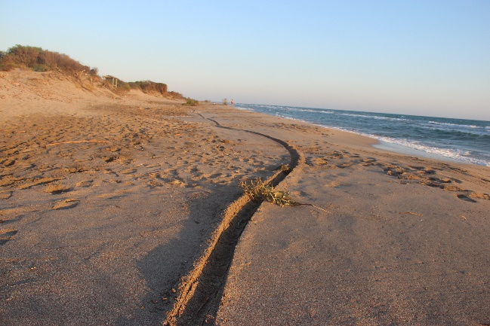
Patara Recommendation No. 182
Rec. pt. 3: Ensure that adequate financial and human resources are allocated for the control,
management and enforcement of regulations;
  Checkpoints on the way to Patara’s Main Beach were unmanned
  Entrances at the top of the Dunes and by Eşen River at Çayağzı Beach were unguarded
  No rangers or gendarmerie were seen patrolling the SPA at night, on foot or by vehicle
  The entrance point at the northern end of Özden River is now barred against vehicles, although pedestrian entrance is still possible –and no control personnel was present.
Vehicles bared but no personnel to control pedestrians
Deep motorcycle tracks along the nesting beach

Slide 10
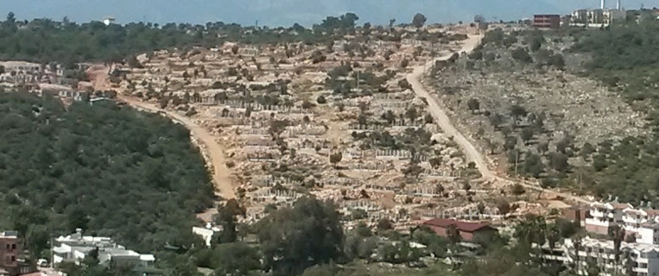
Patara Recommendation No. 182
Rec. pt. 4: Continue to prevent uncontrolled human settlement behind the beach, particularly where these may result in making the beaches unsuitable for turtle nesting;
  Construction works in Gelemiş village are largely finished, including all villas and the large building with water slides refered to last year’s report.
  Roads are being enlarged and paved.
Gelemis Village construction inside the SPA

Slide 11
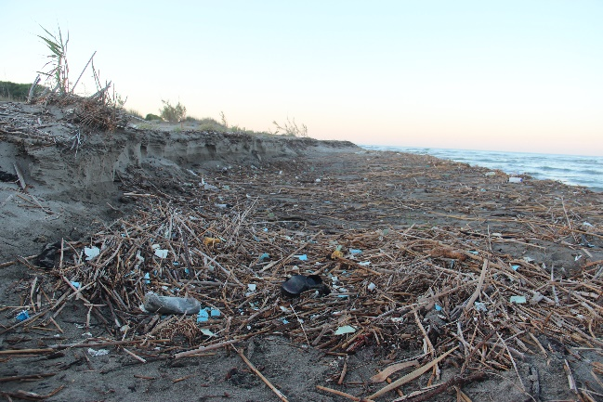
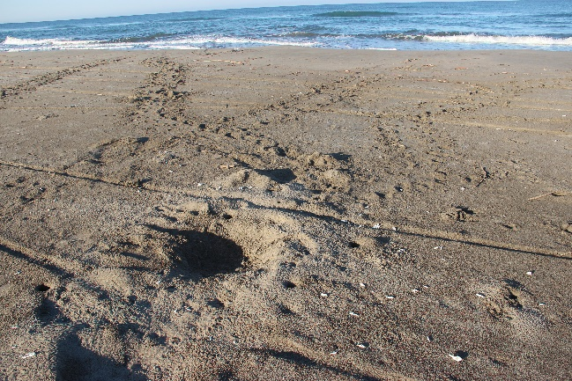
Patara Recommendation No. 182
Rec. pt. 5: Ensure that litter is periodically removed from the beach and dunes;
  The South beach was considerably more littered than in 2021. The north beach was cleaner, although there was still occasional litter at the back of the beach
  Recent media news about a stranded female C. caretta also mention the litter problem on the South Beach. Responsible SPA researchers claimed that the cause of death was plastic waste
  Rec. pt.6: Address the problem of predation, including through population control’s programs;
  The number of predated nests was higher than 2021. No protective grill cages were seen along all sections. At the southern part of the SPA, tracks of dogs and wild boars were seen.
Litter on South Beach
Predated nest inbetween vehicle tracks

Slide 12
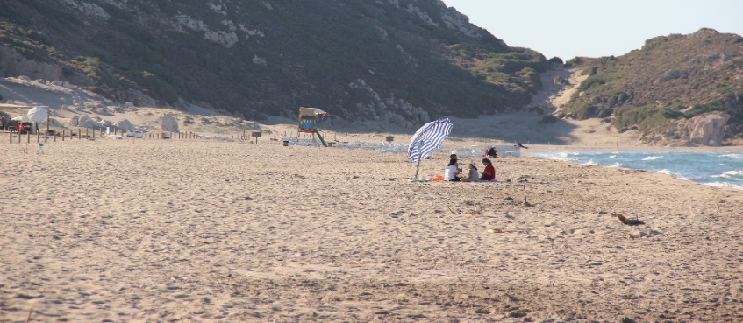
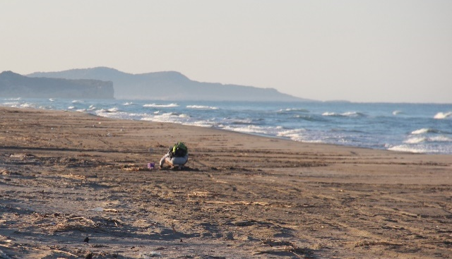
Patara Recommendation No. 182
Rec. pt.7: Ensure the proper fencing of all nests in areas with high human presence during the day, so as to protect them from trampling and from beach furniture;
  Caging of nests was not seen along the entire SPA, and no flat grills against predation. Only 20 nests near the facility on Patara Main Beach were seen caged.
  Rec. pt.8: Urgently set up long-term conservation and research programs entrusted to a permanent team;
  The volunteer group monitoring Patara SPA in 2022 was different from the one monitoring in 2021. The 2022 group was again contracted for a single nesting season.
  The work quality results of the volunteers is questionable this year due to nests destruction by the washing awaw effect, the predated nests, the absence of caging in areas with high predation, as well as some unmarked tracks and nests.
Visitors on the nesting beach. No protective cages
Çayağzı Beach. The one and only member of the monitoring team
we encountered, at 07:00.

Slide 13
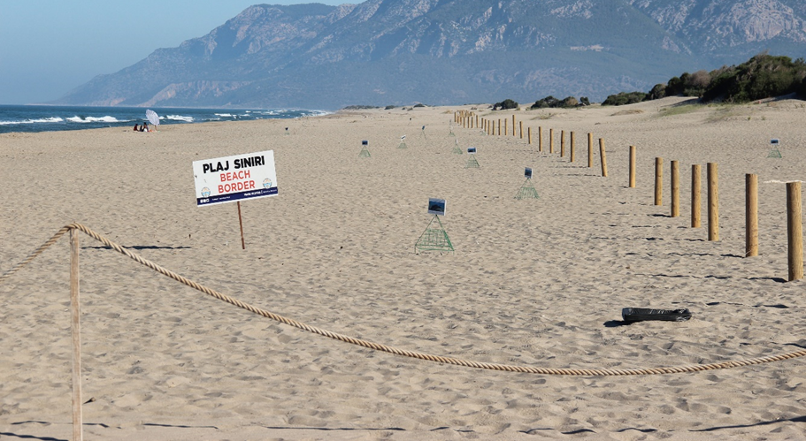
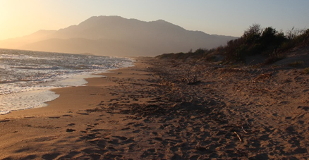

Patara Recommendation No. 182
Rec. pt.9: Improve information to and awareness of tourists about sea turtle nesting and on correct behaviour for the sustainable use of the beach and install clearer signage to indicate the nesting zone;
  New wooden posts were installed on the South beach. However the topography and characteristics of the nesting beach was not taken under account. On some sections of the beach the entire nesting zone is stretching well beyond the posts. No wooden posts were erected on the North beach.
  Information signs, including beach rules, were present at the facility entrance of Patara Main Beach, at the entrance point at Çayağzı Beach and next to the Green Park facility. No other signs were observed on the SPA.
  Rec. pt.10: Improve information and education of the local community;
  Based on our assessment, the local community is not involved in the conservation and management studies of the protected nesting area in any way.
Encircled nest laid outside the designated nesting zone
North beach. No wooden posts along the nesting zone or
designation of the nesting area.

Slide 14
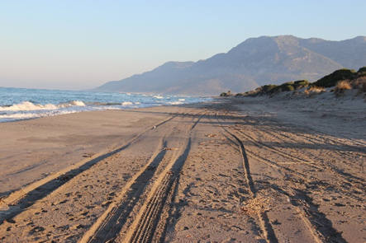
Patara Recommendation No. 182
Summary findings: Partial implementation-the main unresolved conservation problems remain!
Based on what we observed, the Patara nesting beach does not receive appropriate protection and management.
To date, Recommendation No. 182 (2015) has not been fully implemented. Patara’s nesting beaches are not adequately safeguarded against development. Improvements in the management and control for effective implementation of the Recommendation, would allow this unique natural and heritage site to become a showcase example, similar to the much renowned nearby Dalyan SPA (İztuzu beach).

Slide 15
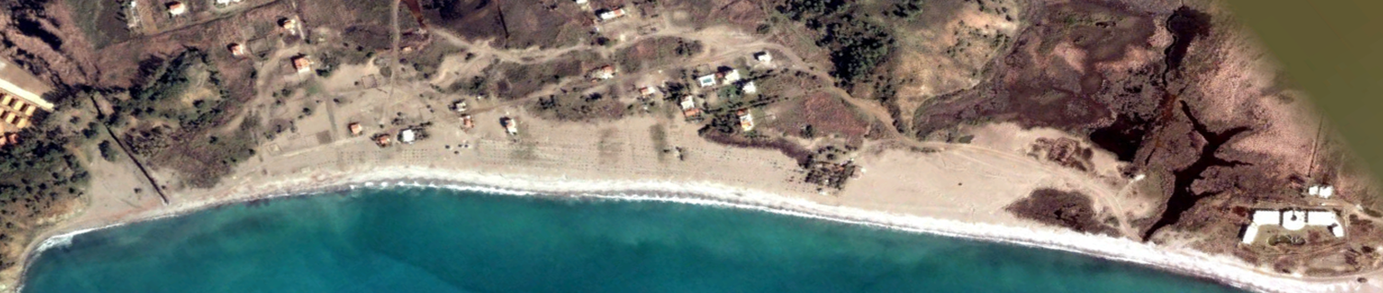
Fethiye – 2003 vs 2022 - A complete failure of efforts to protect!

Slide 16
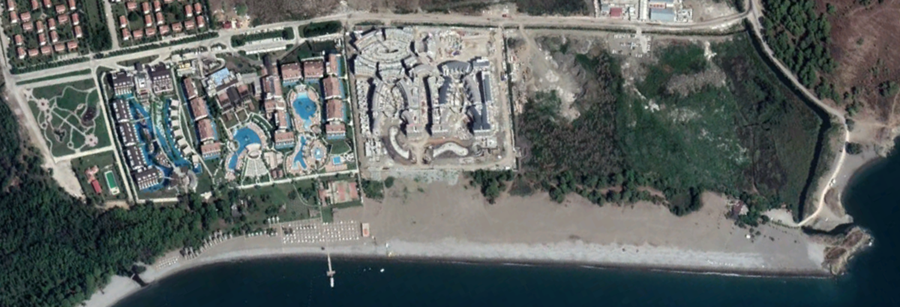


Fethiye Recommendation No. 183
Rec. pt. 1: Stop any further development of permanent structures along the entire coast of the nesting site complex, in order not to reduce further the nesting habitat.
  The site for the building of two new Hotels next to the existing Deniz İncisi hotel, before construction. The destruction of wetlands and beach continues.

Slide 17
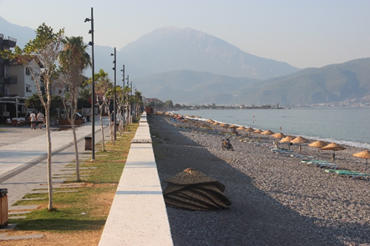
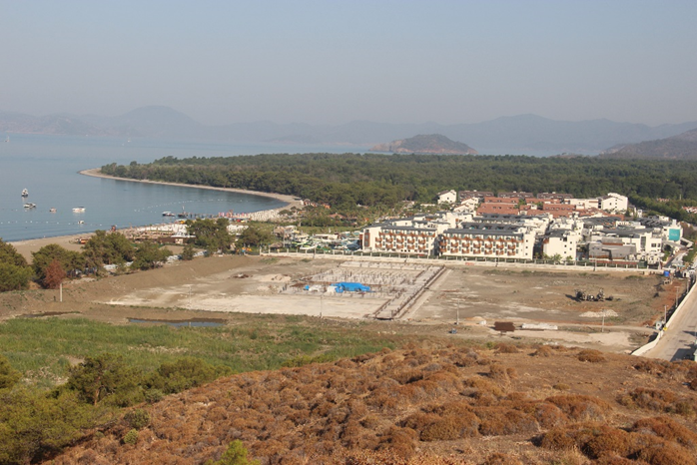
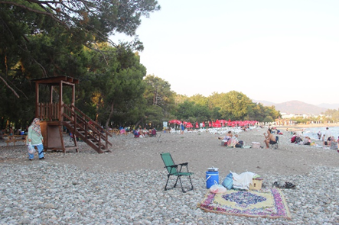


Fethiye Recommendation No. 183
Rec. pt. 1: Stop any further development of permanent structures along the entire coast of the nesting site complex, in order not to reduce further the nesting habitat.
  Construction continues and new permanent structures are built
  In Yaniklar, a new large enclosed area was observed next to the Deniz İncisi hotel. Inside this area construction work for two new hotels has started. The destruction of the wetland and of the beach has now started!
  In Çalış A and B improvements of the promenade includes a broad walking area and a new wall slightly higher from the previous one along the seaside. Tall lamp posts were placed along the wall and their light is bright white.
  A new recreation area named “Akmaz Doğa Mesire Yeri (Akmaz Natural Recreation Area)” has been established in Yaniklar.
  Only the pebbly zone near waterline is free but is unsuitable for nesting!
Çalış - a caged nest close to the wall (red circle)
Large area for the construction of 2 new hotels,
next to the Deniz İncisi hotel.
New Akmaz Natural Recreation Area
in Yaniklar

Slide 18
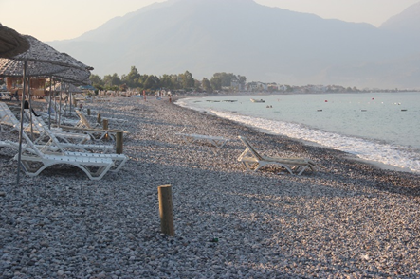
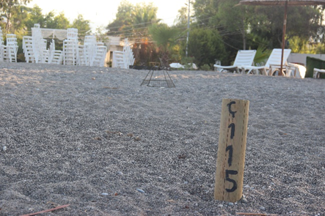
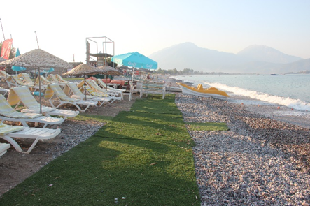

Fethiye Recommendation No. 183
Rec. pt. 2: Remove any structure from sand zones.
  New wooden posts were installed in the SPA, but in many areas the zoning is incorrect and nesting takes place behind the posts. Sensitive nesting ground is excluded from the zoning.
  Wooden posts, especially in some parts of Çalış B, are only a few meters away from the sea, thus leaving on purpose sandy nesting areas to be used for placing beach equipment.
Rec. pt. 5: Map the whole Fethiye coast using long-term data, maps and imagery to identify the past, current and potential most suitable zones for sea turtle nesting, and set a maximum percentage limit of sandy tracts where touristic structures are allowed on the nesting beach
  Most businesses have moved their bars, platforms, wooden paths, showers, pavilions, sunbeds and umbrellas behind the zoning posts. Cushions and AstroTurf carpets remain on the designated nesting zones.
Incorrect Zoning: Posts only a few meters away
from the sea.
Incorrect Zoning: Nest outside nesting zone
(encircled).
Four rows of sunbeds and AstroTurf remain

Slide 19
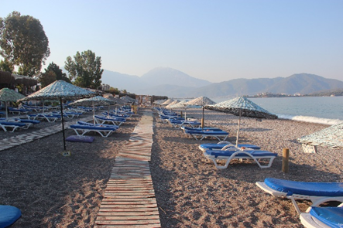
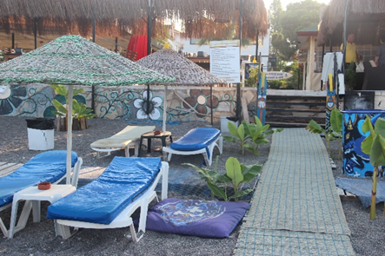
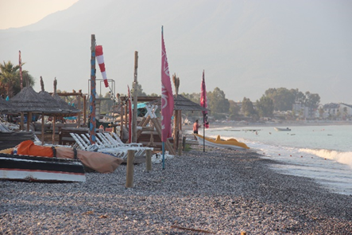
Fethiye Recommendation No. 183
Rec. pt. 2: Remove any structure from sand zones.
Rec. pt. 5: Map the whole Fethiye coast using long-term data, maps and imagery to identify the past, current and potential most suitable zones for sea turtle nesting, and set a maximum percentage limit of sandy tracts where touristic structures are allowed on the nesting beach
Vertical and horizontal walkways, carpets on walkways, cushions randomly thrown around, water sports equipment, and pavilions. Note how close to the waterline the wooden posts are.

Slide 20
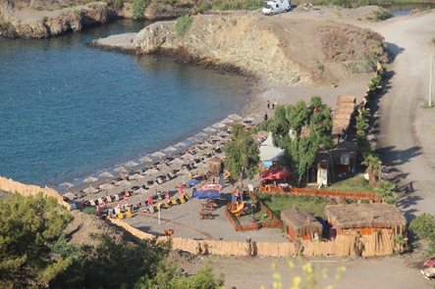
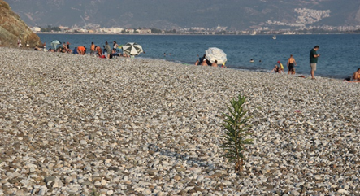


Fethiye Recommendation No. 183
Rec. pt. 3: Stop sand extraction.
No sign of sand extraction was observed during our survey.
Rec. pt. 4: Remove planted vegetation, acacia in particular.
Planted vegetation in the SPA was not removed. Acacia, agave, and palm trees remain.
Rec. pt. 6: Prohibit the use of beach furniture and other structures or facilities on the sandy zones of Akgöl beach, regulate use of the core nesting area in the sandy northern end of the beach, and carry-out the necessary controls to check enforcement
Usage of beach furniture at Akgöl beach was limited at the time of our survey. No enforcement personnel in the core nesting area, resulting in intense human presence near nests.
A pristine beach in 2020, Karataş Beach now destroyed:
No space for nesting and acacia trees.
Visitors randomly inserting umbrellas (red circles) within nesting zone.
Note the newly planted oleander

Slide 21
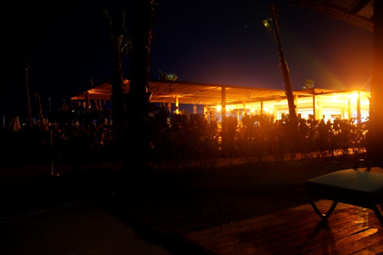
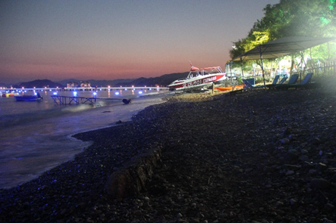

Fethiye Recommendation No. 183
Rec. pt. 7: Reduce light pollution to a minimum along the whole coast during the nesting/hatching season
  Improvements in certain areas were observed however more needs to be done:
  The northernmost part of Çalış B, from the old platform remains to Çalış Hill is used as a caravan parking and picnic area. As a result there heavy light pollution at night and no sandy beach left.
  Green and blue lights pollute Karataş Beach.
  Liberty Fabay hotel, created extreme noise with its beach bar and disco and its light shows impact the nesting beach.
  A security light between Okaliptüs and Tuana beach, next to the water sports area, created strong direct light pollution.
Hotel Liberty Fabay - heavy light pollution
Okaliptus Beach - Sports equipment left on the beach and
heavy light pollution.

Slide 22
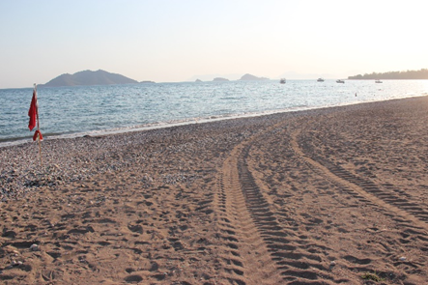
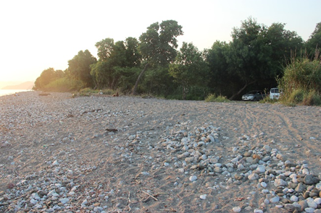
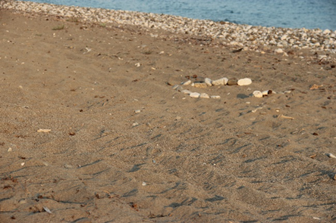

Fethiye Recommendation No. 183
Rec. pt. 8: Build permanent barriers (not ditches) on the roads to prevent vehicles from accessing the beach, designate parking spaces and official picnic areas away from the beach
  Only a few sections within the SPA have permanent barriers to prevent vehicle access to the beach.
  Vehicle tracks were observed on vehicle entrance points and in the pristine section of Yaniklar and on the beach in front of Deniz İncisi hotel.
  Designated parking spaces were away from the beach. Free picnic areas remain in the northern end of Çalış B and in the pristine area of Yanıklar.
Yaniklar Beach – Vehicle tracks
Calis B Beach – Vehicle entrance spot and tracks
Calis B Beach – Vehicle Tracks next to nest

Slide 23
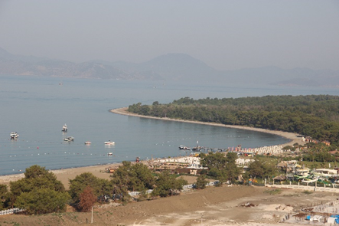
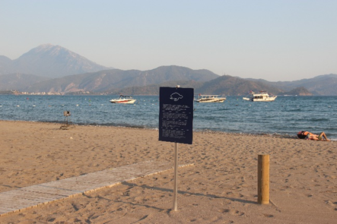
Fethiye Recommendation No. 183
Rec. pt. 9: Regulate maritime traffic during the nesting/hatching season
Fishing boats, speed boats and yachts were seen all over. A number of laws regulate marine traffic the entire nesting season, but enforcement is uncertain. Open water borders were marked with floating ropes in all sections.
Yaniklar. Fishing boats seen in the SPA
Fishing boats in front of TUI BLUE Sensatori Barut hotel.

Slide 24
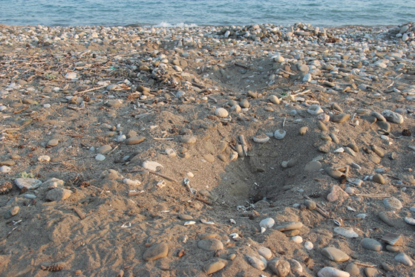
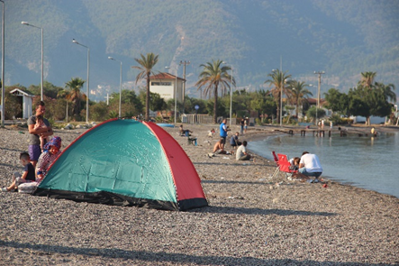
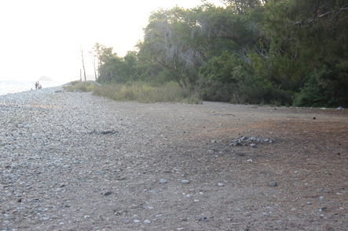
Fethiye Recommendation No. 183
Rec. pt. 10: Set up long-term research and conservation programs conducted by a permanent team recruited on a long-term perspective.
The SPA remains protected on a seasonal basis, and is not assigned to the same monitoring and research group every summer. No group member was encountered during our survey. The area though seemed to be monitored, nests were marked and predated nests were marked with large pebbles. We observed predation of several nests.
Rec. pt. 11: Prohibit camping and bonfires and set appropriate time limits for the operation of beach bars at night during the nesting and hatching season
Akmaz beach is still used as a picnic area, although controlled by the newly established business facility there. No campers were seen outside the facilities or designated areas, except for one tent.
The operation of beach bars and other facilities continues past midnight. Wood fire remains were seen in the
pristine part of Yaniklar.
Yaniklar. Predated nest.
Fethiye – beach use
Yaniklar – Remains of wood fire

Slide 25
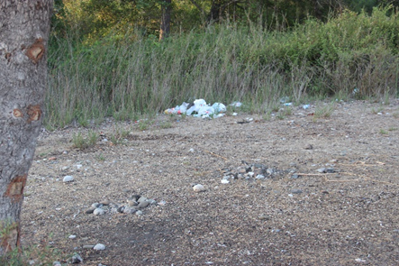
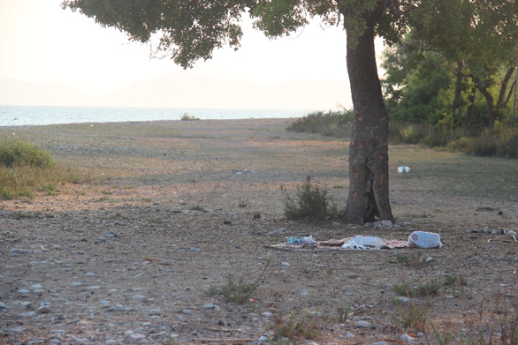
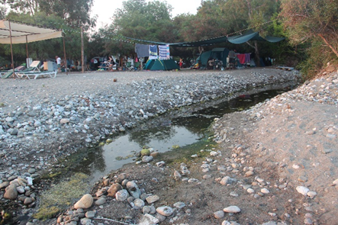
Fethiye Recommendation No. 183
Rec. pt. 12: Take measures to clean the beach and empty appropriately located bins on a daily basis, and ensure sewage is not discharged into the sea.
Beach cleaning was observed for two consecutive mornings. The beach seemed to be cleaner.
In Akmaz beach we observed plastic bags and litter.
Drainage channels reaching the sea continue to be a serious concern.
Rec. pt. 13: Set up adequate regulations and enforcement for the measures above, including regular day and night controls along the entire coast.
No compliance personnel (SPA guards, police, coast guard, etc.) were seen. No information regarding fines against noncompliance with all above regulations.
Yaniklar - Litter by vegetation.
Yaniklar – Drainage channel
Yaniklar - Litter in the pristine nesting section.

Slide 26


Fethiye Recommendation No. 183
Rec. pt. 14: Ensure that adequate financial and human resources are allocated to the control and management of the beaches.
No information exists on financial and/or human resources. However the lack of controls lead to believe that resources are not adequate.
Rec. pt. 15: Improve information to local community and tourists about sea turtle nesting and sustainable use of the beach.
A few signs installed by Ministry are not enough to cover 8km of Beach.
The sea turtle observatory next to the Municipality’s facility in Akgöl was idle and closed.
Yaniklar – New Ministry signs.

Slide 27


Fethiye Recommendation No. 183
Rec. pt. 16: Continue to protect all nests with cages, until the different conditions obtained through the other measures above will allow again a more natural process.
  Nest monitoring and awareness activities by research institutions continue and the area seemed to be monitored more efficiently
  In the pristine part of Yanıklar, about half the nests we checked by hand were covered by flat grills buried in the sand. In other sections nests were protected by prism cages.
Yaniklar – Protective grills against predation.
Fethiye – Prism cage.

Slide 28

Fethiye Recommendation No. 183
Summary findings: Partial implementation fails the purpose!
Habitat destruction due to development construction on and behind the nesting beaches, continues. New developments were observed in 2022.
Serious problems remain, imposing serious threats to the turtles and their habitat, necessitating immediate actions.
Seven years since the adoption of Recommendation No. 183 (2015), and Fethiye nesting beaches still require further protection efforts and the implementation of the measures under Recommendation No. 183. Partial implementation of the measures and the destructive development that was allowed during past years in complete disregard of the Bern Convention’s Recommendation is of great concern.
2020 vs 2022

Slide 29
Majority of measures under
Recommendations 182 & 183 (2015) NOT implemented
We call upon the Standing Committee to:
Keep the case file open for further monitoring.
Request Turkish authorities to:
  Urgently implement Recommendations No. 182 & 183 (2015) to implement all measures through a comprehensive and updated action plan as soon as possible.
  Produce SPA management plans for both sites that include zoning and that cover both the land and marine areas, including clear descriptions of permitted land uses and activities.
  In relation to Fethiye, provide an official map of the beach and adjacent land area that are under dispute, and of the areas that have been permitted for development. As per Measure 1 of the Recommendation, declare a building moratorium to prevent any further development (hotels, jetties, etc.) on or directly behind the nesting beaches and correct existing zoning errors.
  Provide the necessary resources for the effective protection of the beach (guards, vehicle barriers etc.)
  In relation to Patara, provide an update on the ongoing redetermination of Patara SPA’s zoning and ensure that the entire nesting beach (north and south sections), the nearshore areas and the entire sand dune areas are appropriately zoned and protected against any further development.
  Address the concerns raised in MEDASSET’s complaint regarding the Patara now largely completed summer house construction project, its scale, the associated impacts, the lack of an EIA and of a carrying capacity study. Provide detailed information on the additional houses constructed outside the summer house construction project.

Slide 30


Thank You
for your attention
MEDASSET
Mediterranean Association to Save the Sea Turtles
medasset@medasset.org
www.medasset.org
Photo ©2012 K. Olgun, E. Bozkurt

