Slide 1
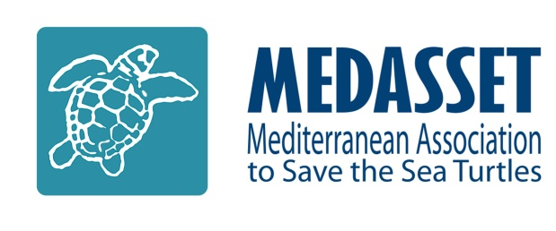

Agenda Item 7.1: Files opened
Greece: Threats to Marine Turtles in Thines Kiparissias
42nd Meeting of the Standing Committee
Bern Convention
28 November – 2 December 2022

Slide 2
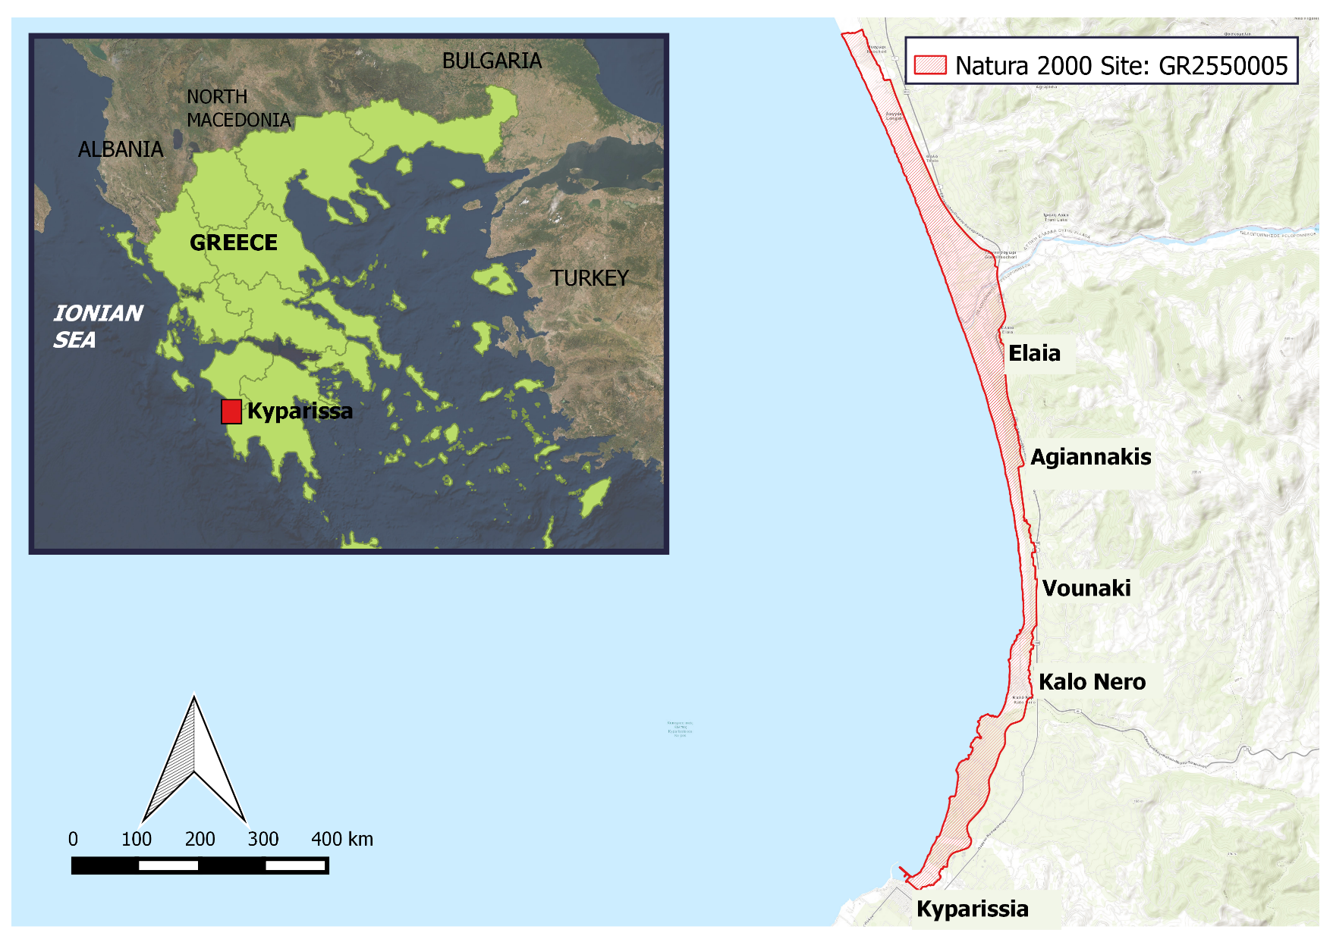
Habitat Degradation due to Uncontrolled Development in a Protected Sea Turtle Nesting Area
A NATURA 2000 site: GR2550005 “Thines Kyparissias: Neochori – Kyparissia”
Extensive sand dunes system with Juniperus spp.
The largest reproductive population across the Mediterranean for the protected loggerhead sea turtle (Caretta caretta). During the 2022 nesting season over 2.770* nests were recorded in the nesting core area (from Neda to Arkadikos River which spans 9,5 km)

Slide 3
The issuance of the Presidential Decree
Overview
Oct 2012
EC Reasoned Opinion to Greece
Nov 2012
Greece commits to taking measures
Summer 2013
Degradation continues: protective legislation delayed
Dec 2013
Case File opened at Standing Committee Meeting
Mar 2014
EC takes Greece to European Court of Justice
Aug 2010
MEDASSET Complaint to the Bern Convention
Jul 2014
On-the-spot appraisal by Bern Convention experts
Dec 2014
CoE
Appraisal Unanimously adopted
Rec. No 174
The Council of State (Supreme Administrative Court of Greece) decided that the Presidential Decree for the Protection of Kyparissia Bay (issued in October 2018) is in line with the Constitution and National legislation and rejected the seven motions for annulment on February 3rd 2021
Nov 2016
Judgment of CJEU [C-504/14]: Greece failed to fulfil obligations under Council Directive 92/43/EEC
June 2018 Approval of the draft Presidential Decree by the Council of State
October 2018
Issuance of Presidential Decree for southern Kyparissia Bay (Government Gazette D 391/03-10-2018)
7 motions for annulment requesting the repeal of the Presidential Decree led to a Court trial at national level on the 3rd of June 2020
The Presidential Decree however does not address several conservation issues. Theses are expected to be resolved by the Management Plan which is however delayed over 5 years & is yet to be developed

Slide 4
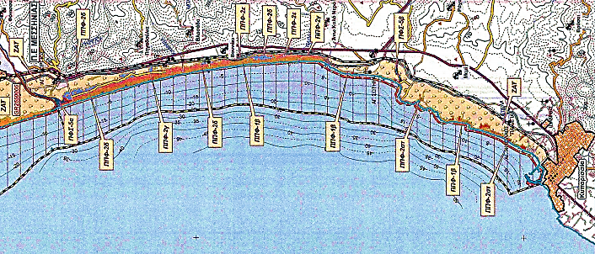
Rec. No 174. Measure No 1:
Appropriate Protection status
Presidential Decree (PD) a positive step but not ensuring adequate protection
No buffer zone between Nature Protection Area & Agricultural Landscape Zone
Presidential Decree designates Kyparissia Bay as a Nature Protected Area NOT as a National Park
Adjacent areas to the Nature Protection Areas, are designated as Agricultural Landscape Zones where construction is permitted
Part of the coastal area behind the core nesting beaches (red rectangles) is designated as Agricultural Landscape Zones, putting in extreme danger the reproduction of sea turtles and the adequate protection of the habitat

Slide 5
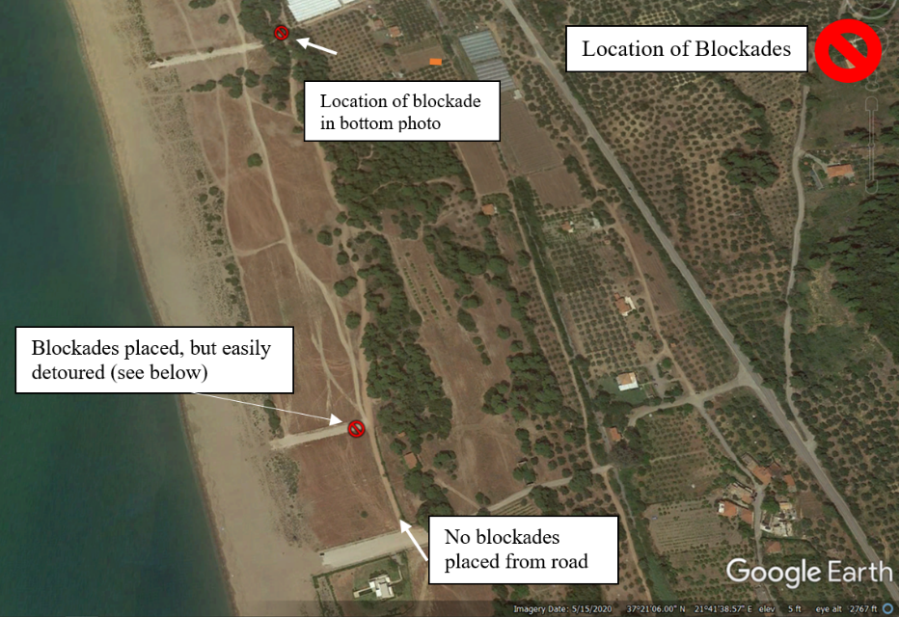
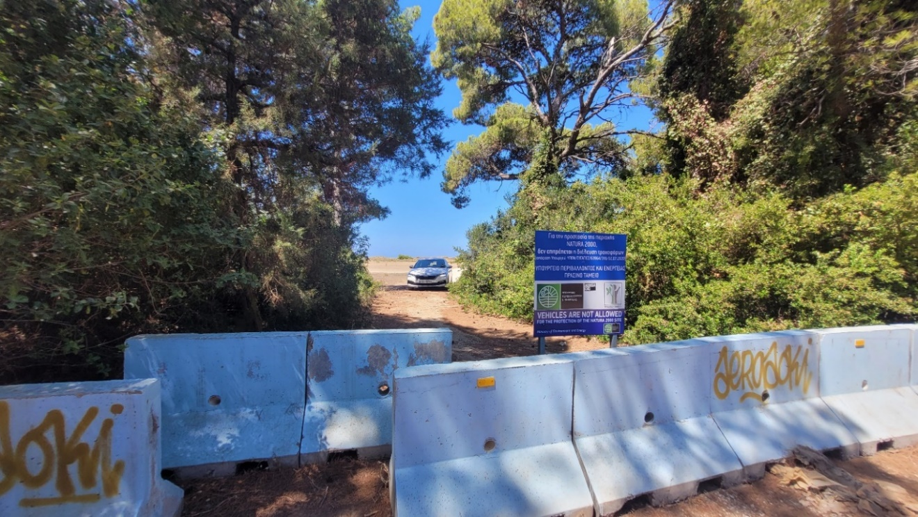
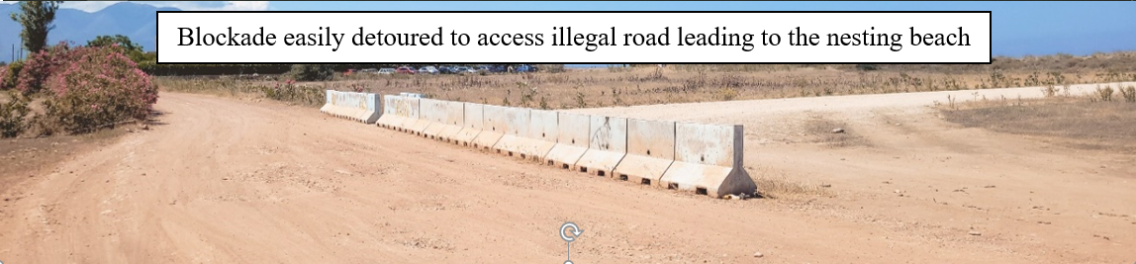
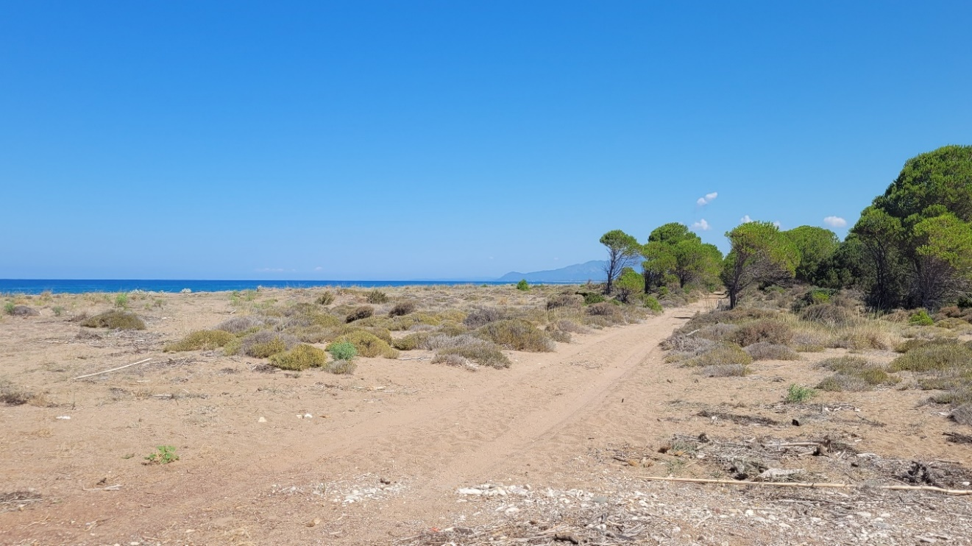
Rec. No 174. Measure No 2:
Permanent Prohibition of Construction (buildings, roads, etc.)
Presidential Decree fails to adequately protect Kyparissia Bay from constructions
Core nesting area, Agiannakis to Elaia & Vounaki, 11th July 2022. The five illegal roads are not restored yet, in violation of the PD. Blockades placed by the Ministry of Environment and Energy fail to prevent vehicles accessing the beach. See top picture, vehicle bypassing blockades.

Slide 6
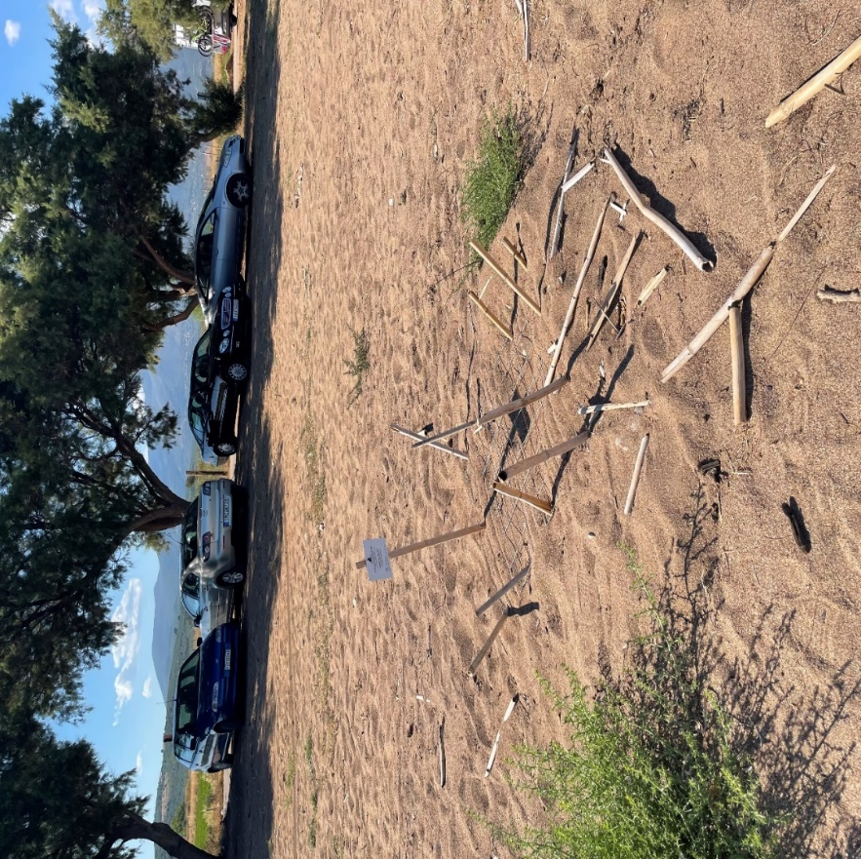
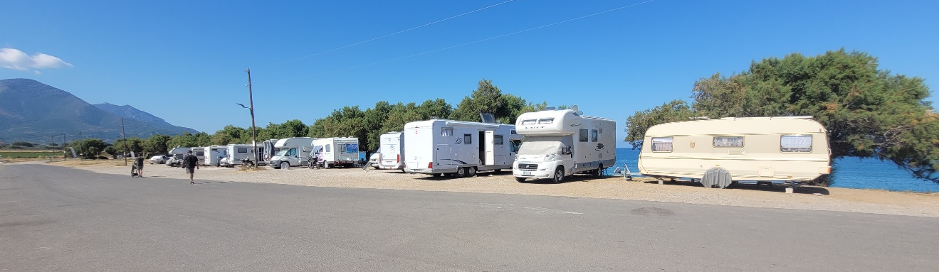
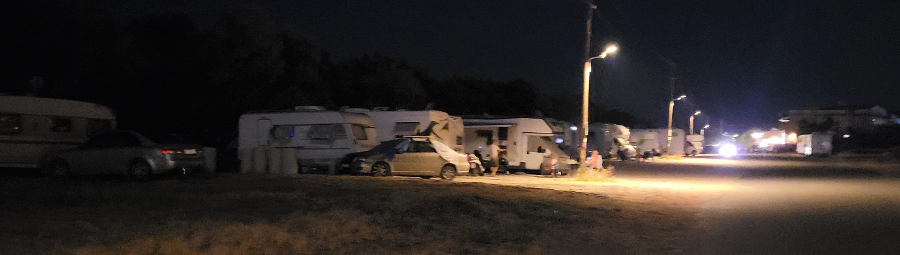
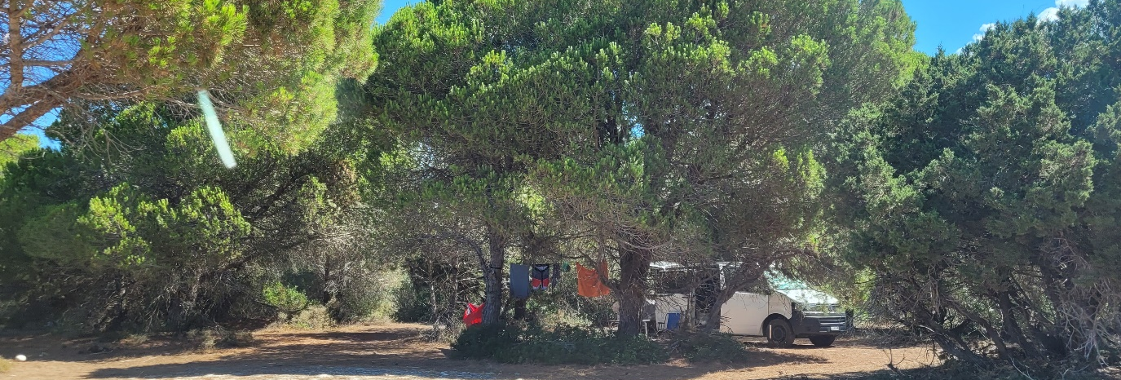
Rec. No 174. Measure No 3:
Prevent cars and caravans from reaching the proximity of the nesting beaches
Kalo Nero core nesting area. No management measures exist to prevent cars and caravans parking in close proximity to the nesting beach. Top & Middle; 32 counted Caravans during the day and overnight camping directly behind the core nesting area
ARCHELON
Vounaki core nesting area, 11th July 2022. Camping directly behind the core nesting area in the protected forestry area and illegal roads. No action is taken by the authorities to prevent this.

Slide 7
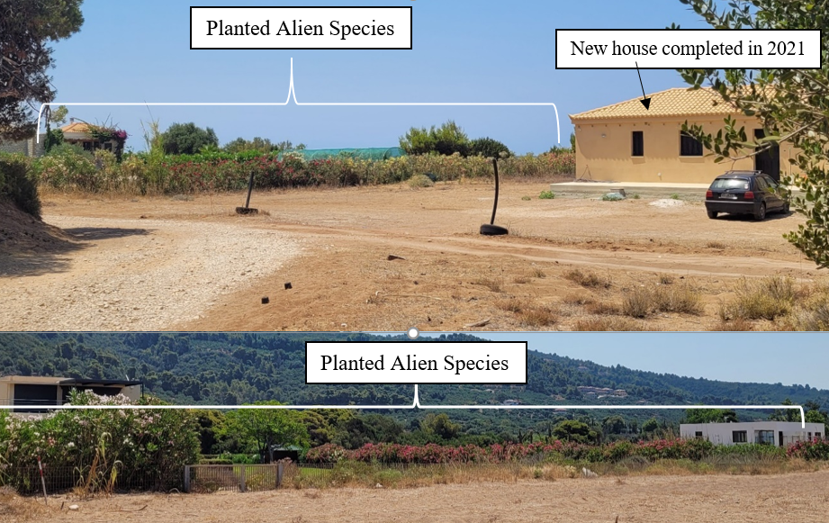
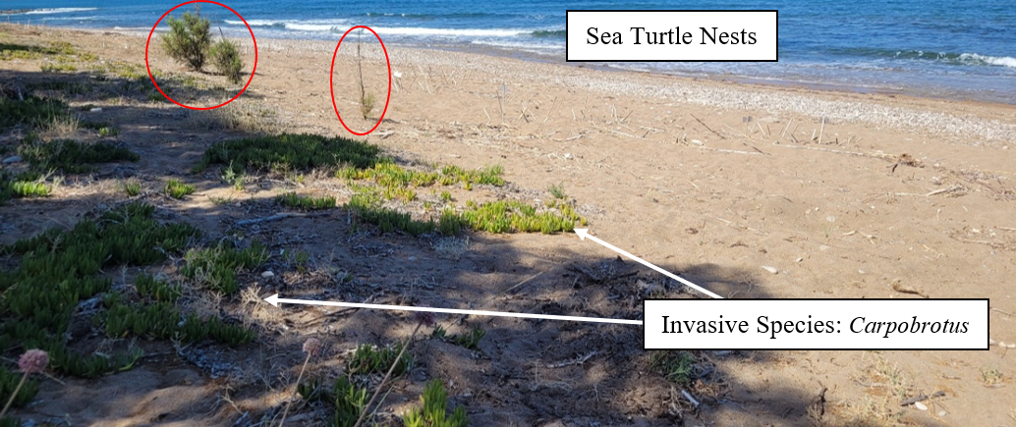
Rec. No 174. Measure No 4:
Adjustments to existing buildings &
Restoration of Original Dune and Forest Habitat
ARCHELON
ARCHELON
ARCHELON
Kalo Nero, 11th July 2022. Planted young trees (Red circles) & cultivation of invasive species. (Carpobrotus), spreading behind a high density nesting area.
Top, Vounaki & Bottom Agiannakis core nesting areas, 11th July 2022. Owners of houses constructed on the protected sand dunes, plant alien species around their properties.

Slide 8
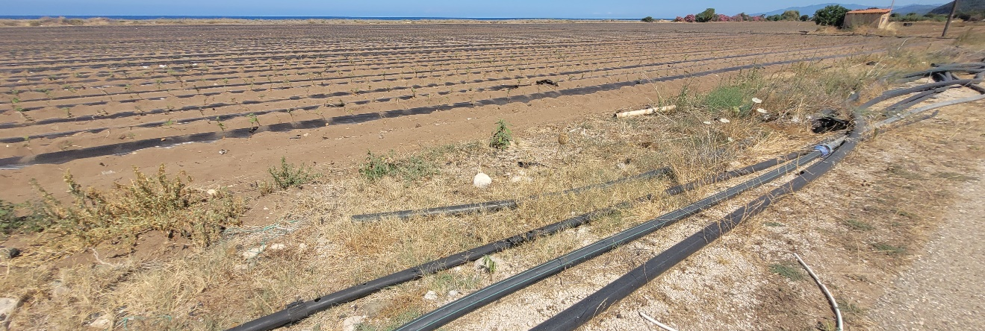
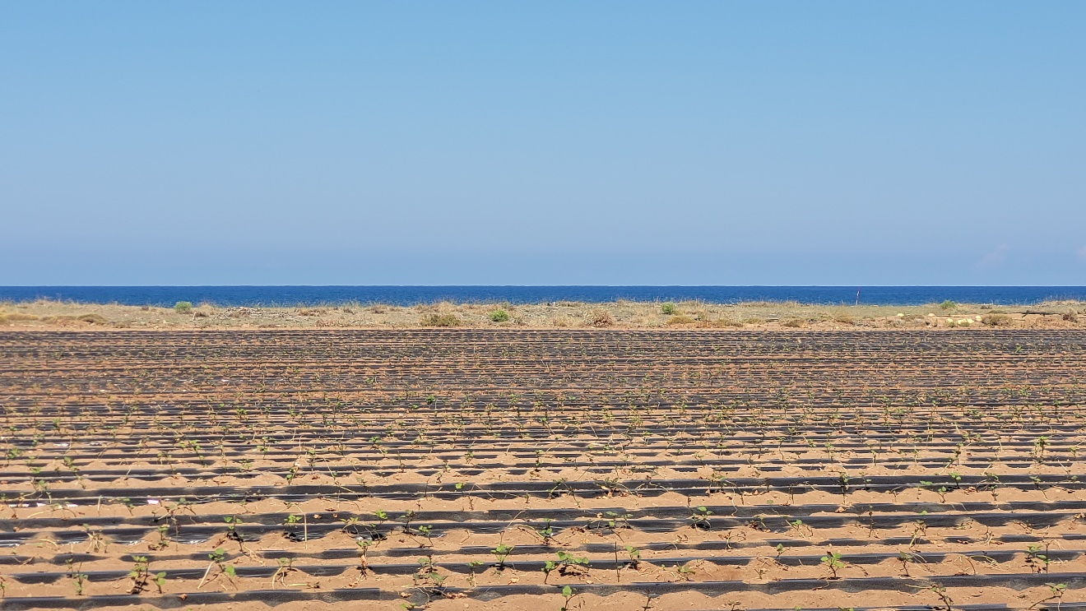
Rec. No 174. Measure No 5:
No agriculture on public land & the dune area
Exactly behind the core nesting areas of Vounaki & Agiannaki, 11th July 2022. Sand dune destruction due to agricultural use; ongoing watermelon cultivation

Slide 9
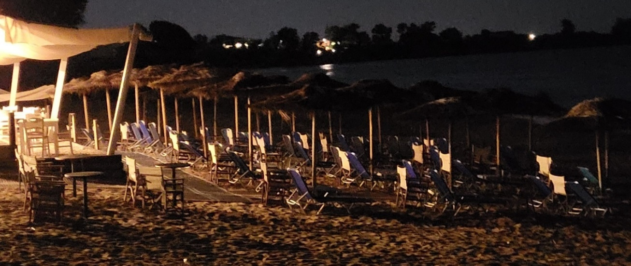
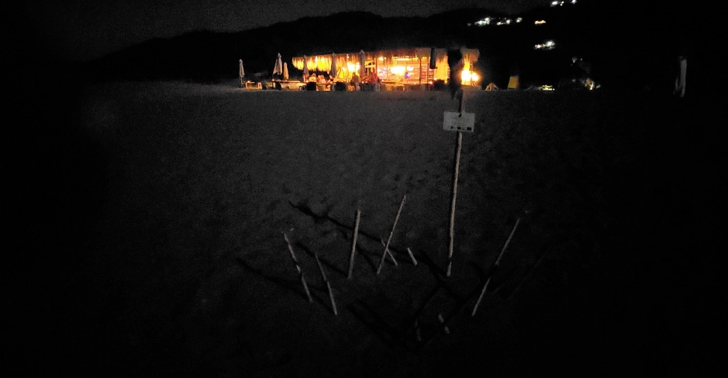
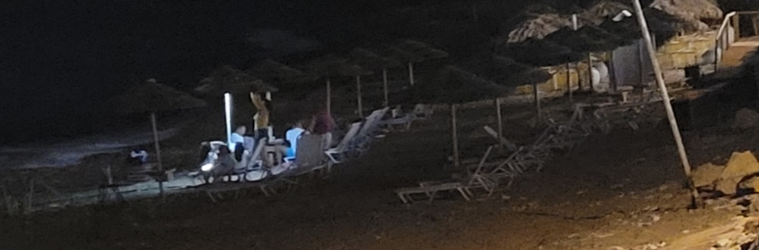
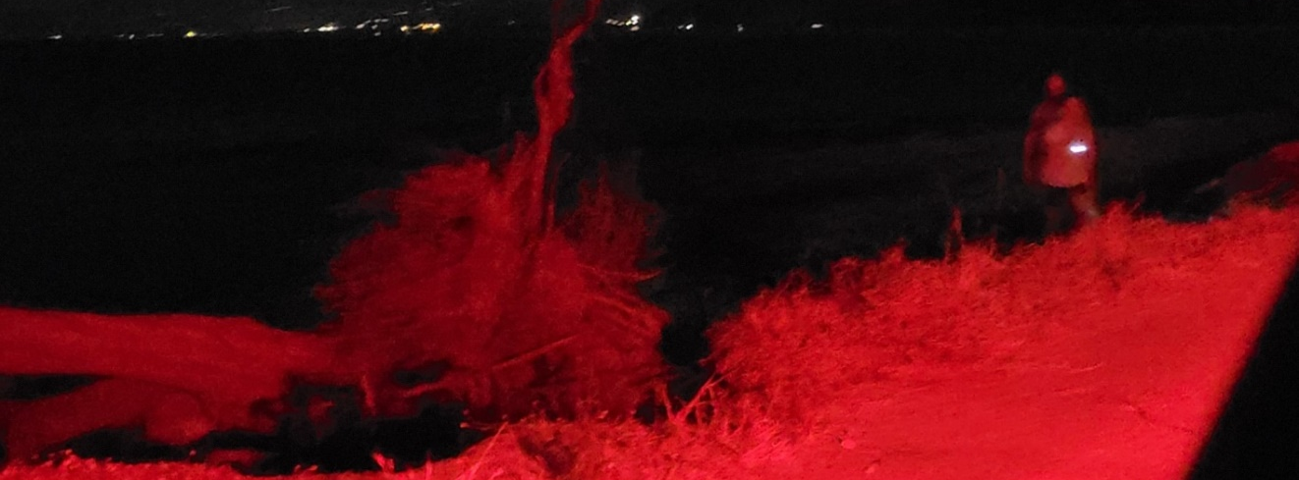
Rec. No 174. Measure No 6:
Light Pollution reduction
(a)
(b)
Agiannakis core nesting area, 10th July 2022. Light pollution from the beach bar on the nesting beach. Nest in red circle
(c)
(a)
(c)
Kalo Nero core nesting area, 10th July 2022. Light pollution emitted from all the beach bars/restaurants
Kalo Nero core nesting area, 10th July 2022. Visitors observed searching for sea turtles with flashlights across the nesting beach

Slide 10
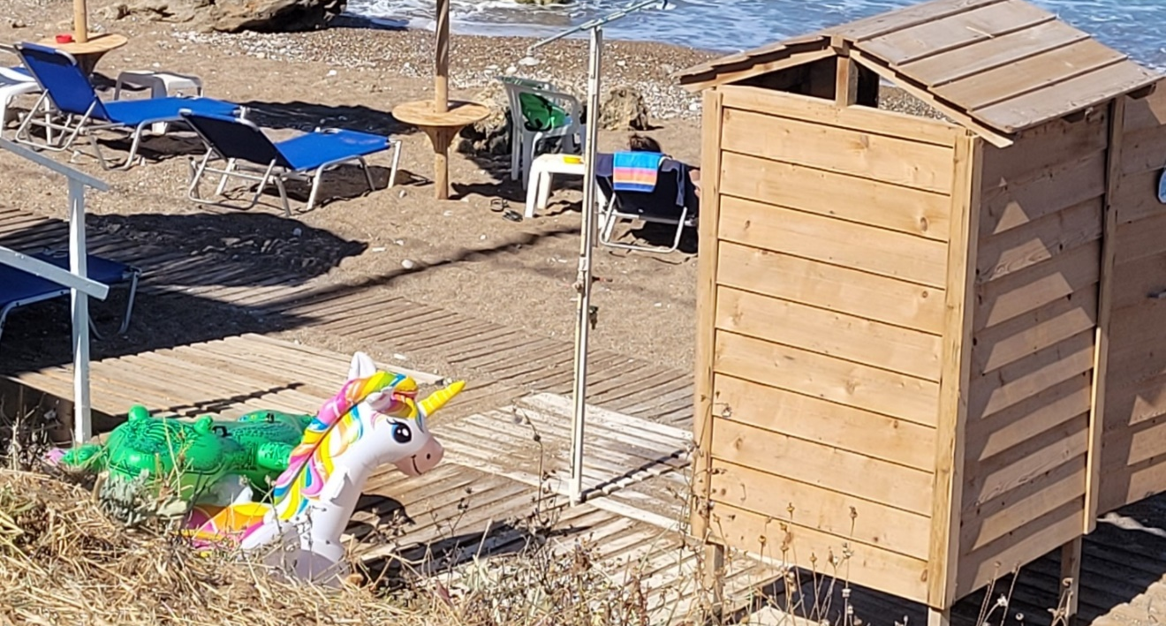
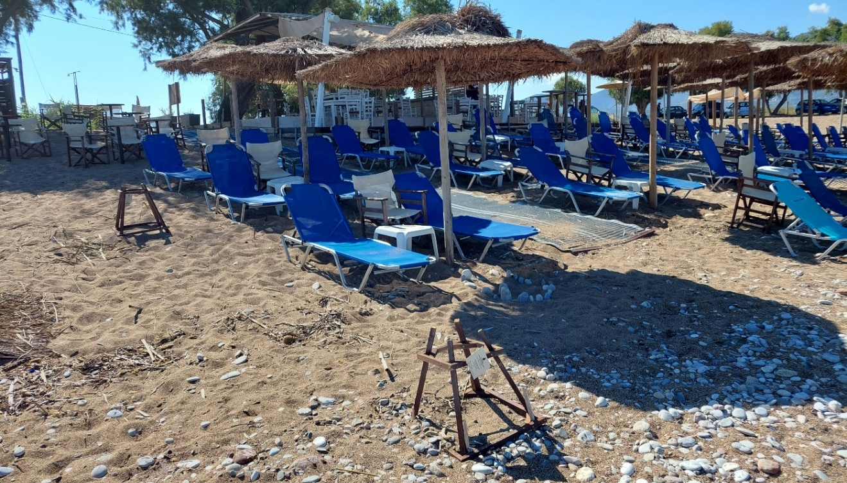
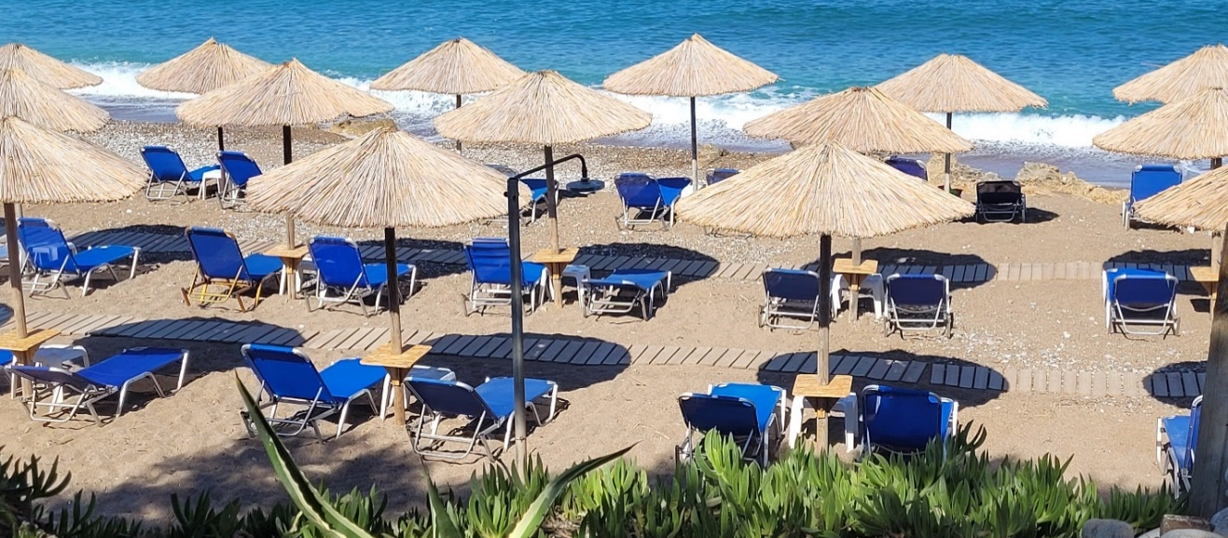
Rec. No 174. Measure No 7:
Beach Equipment management
Kalo Nero core nesting area 11th July 2022. No beach management exists to provide a safe distance between visitors and sea turtle nests (White circles)
ARCHELON
Kalo Nero core nesting area 11th July 2022. Illegal wooden platforms placed by local businesses not removed and no enforcement of demolition protocols

Slide 11
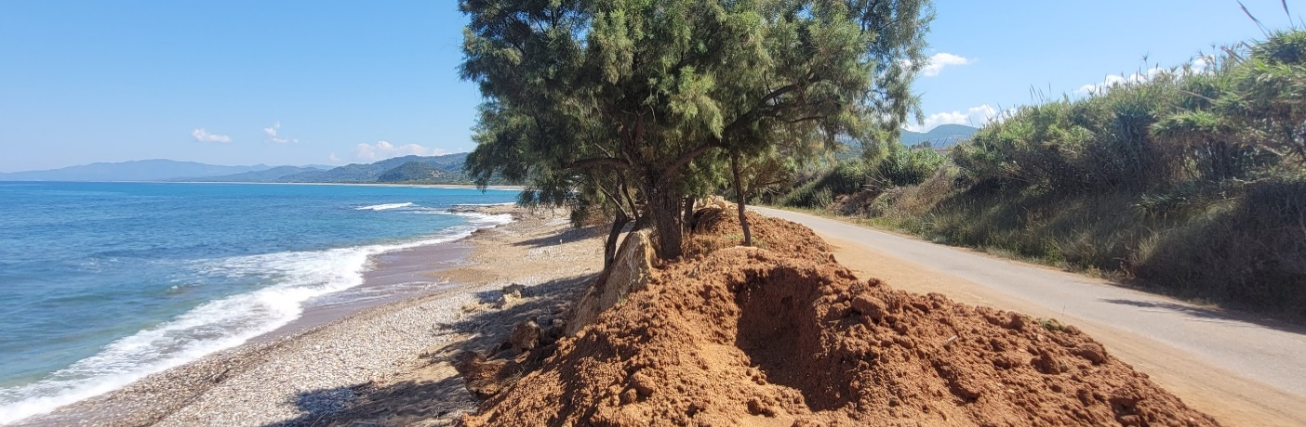
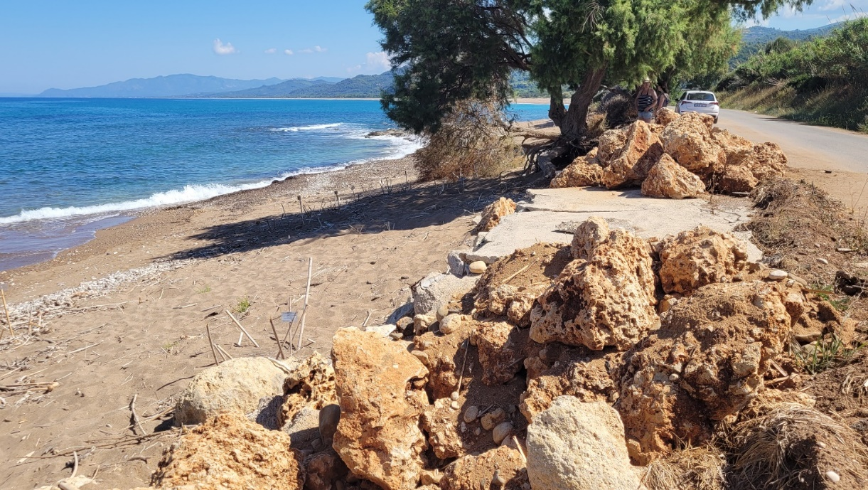
Rec. No 174. Measure No 8:
Prohibits any sand & gravel extraction or any new structures near the sea
ARCHELON
ARCHELON
Kalo Nero core nesting area, 11th July 2022. Coastal erosion & placement of local anti-erosion measures with rocks & soil mounds

Slide 12
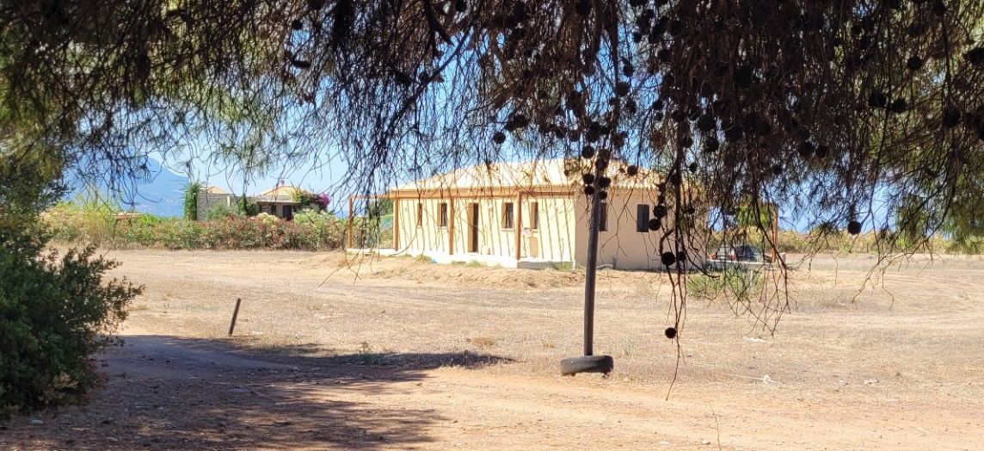
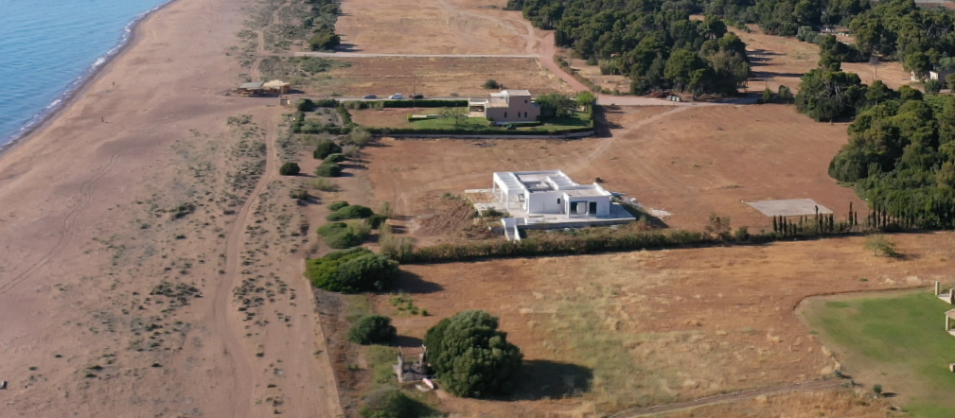
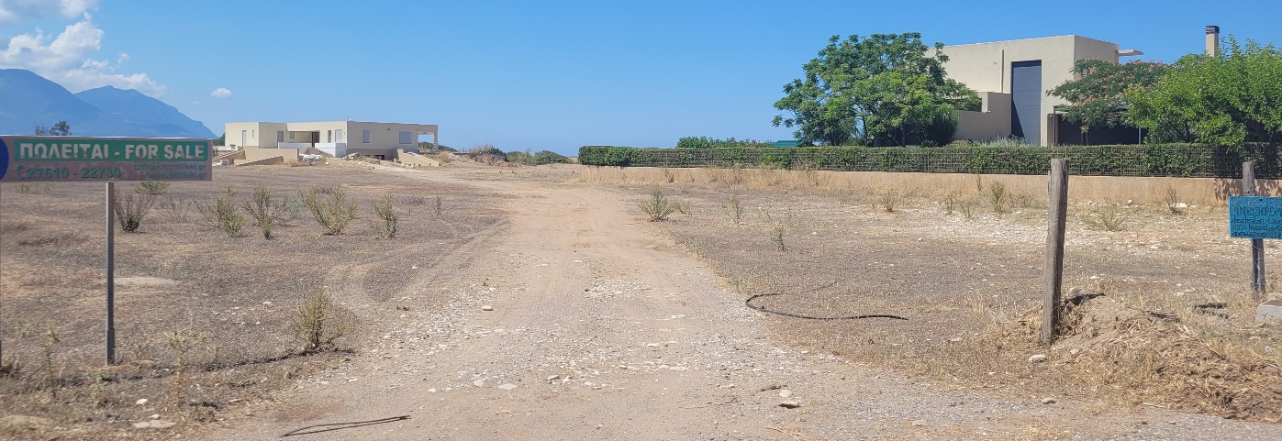
Rec. No 174. Measure No 9:
Further construction outside the urban-planning areas
Disregard to the Presidential Decree's prohibition of the expansion of settlements and buildings in the Nature Protections Areas, newly constructed house as recorded during 2022 survey
a
Agiannakis & Vounaki (a) core nesting areas, 11th July 2022. Two newly constructed house completed in 2021 (red circles)
@ARCHELON

Slide 13
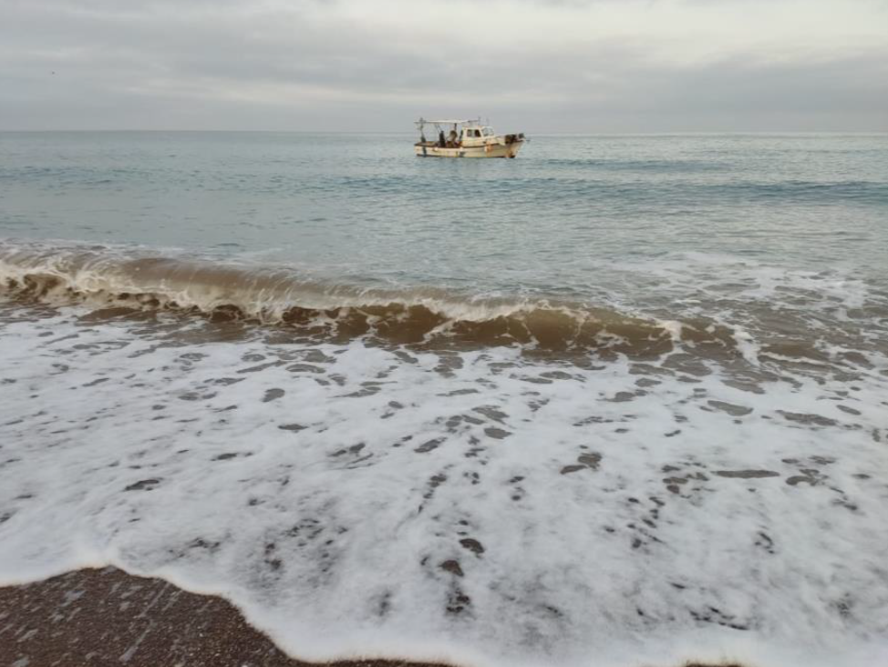
Rec. No 174. Measure No 10:
Regulation of vessel navigation & fishing practices
@ARCHELON, Galini Samlidou
Fisheries regulations are not addressed by the Presidential Decree – Urgent need of a Management Plan
The Regulation of fishing activities are not considered in the Presidential Decree. This significant threat is supposed to be addressed in the Management Plan which is yet top be developed!
Urgent action is needed to reduce/ eliminate this threat. Regarding sea turtle strandings, as recorded by the Greek Coast Guard, during the first nine months of 2022, a total of 13 dead sea turtles were reported along the entire Kyparissia Bay, of which 7 were reported by ARCHELON’s field team.
ARCHELON
@ARCHELON
Elaia, June 2022. Fishing with nets at a very close distance from the shore is a constant threat to nesting process, as sea turtles often get entangled & injured as they attempt to reach the beach.

Slide 14
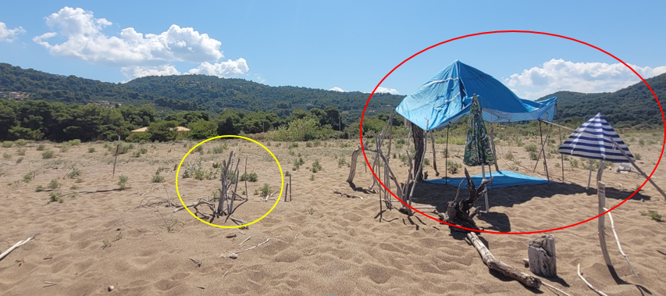
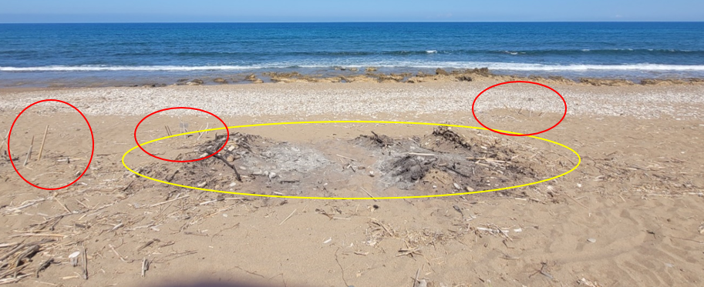
Rec. No 174. Measure No 11:
Human presence on the nesting beach
ARCHELON
Vounaki core nesting area, 11th July 2022. Temporary shelters (Red circles) mostly used by free campers, on the nesting beach in close proximity to turtle nests and bonfire pits in yellow circles.
ARCHELON
Kalo Nero core nesting area, 11th July 2022. evidence of bonfires (13 in total counted in front of camping caravans in yellow circle), in close proximity to sea turtle nests in red circles.

Slide 15
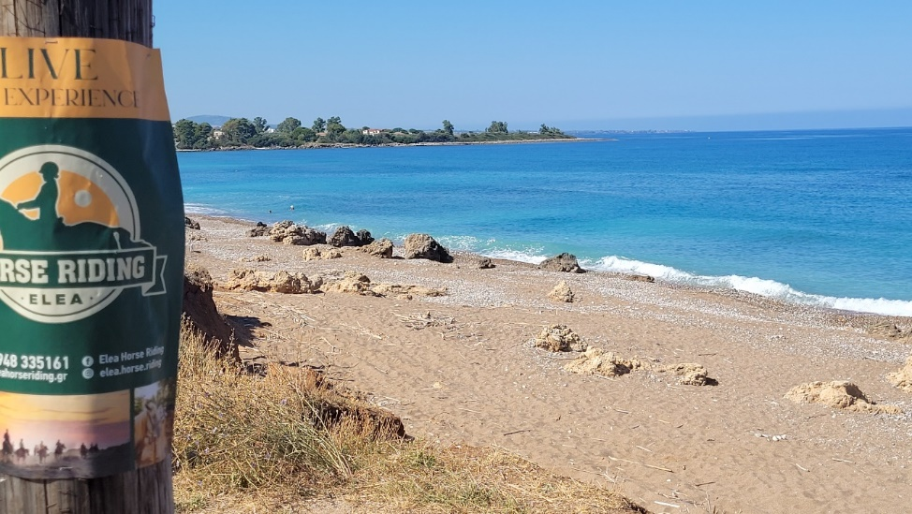

Rec. No 174. Measure No 11:
Human presence on the nesting beach
ARCHELON
@ARCHELON, Galini Samlidou
ARCHELON
@ARCHELON
Giannitsochori, 2nd August 2022. A festival, with loud music and bright headlights, was held a few meters behind the nesting beach
Kalo Nero core nesting area, a poster advertising for horse riding at Elaia nesting beach 12th July 2022 (top) and picture taken from the official Instagram account posted 1st of July 2022

Slide 16
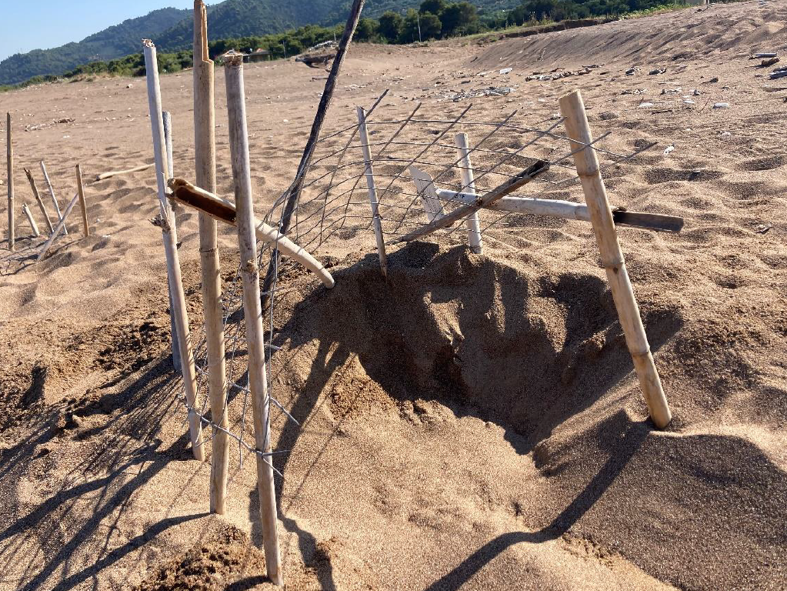
Rec. No 174. Measure No 11:
Control feral dogs as they have proved to attack and hurt many nesting sea turtles
No feral dogs attacks were recorded this year but attacks from wild boars were recorded.
ARCHELON
This year another crucial threat was recorded - predation by wild boars in the area of Vounaki. ARCHELON notes that 561 nests have been predated & 1005 showed signs of attempted predations by wild boars
ARCHELON
@ARCHELON
Vounaki, June 2022. Nest predation by wild boar

Slide 17
Conclusions
Rec. No 174 has not been fully implemented
The issuance of the Presidential Decree was a positive development however major conservation issues are not addressed and can only be solved through the elaboration and adoption of a Management Plan
Seismic surveys were carried out in the area of the Ionian Sea as part of the concessions for the exploration and exploitation of hydrocarbon resources in the area
Lack of political will to adequately safeguard the area e.g, considering the new national law (4964/2022) that allows for harmful land uses in the protection zones, excludes certain areas from the scope of the protected regime and allows for the continuation of existing projects and activities, regardless the ecological needs of protected habitats and species

Slide 18
MEDASSET
Calls upon the authorities to:
Safeguard and enforce implementation of the Presidential Decree (PD) regulations
Urgently adopt and implement a Management Plan, which will also cover unresolved issues not addressed in the PD (e.g. fishing activities and nighttime beach use and operation of beach bars)
Impose fines and penalties in order to stop illegal activities and restore the habitat especially the sand dune habitats, which are degraded year by year
Safeguard the effective management of Kyparissia Bay, as the new Legislation poses serious threats for the adequate protection of all protected areas in Greece (Observations and other impacts)
Keep the Standing Committee informed about progress in the implementation of the above Recommendations
Calls upon the Bern Convention Standing Committee to:
Encourage authorities to provide further information to the Standing Committee, as requested above
Develop a Management Plan in collaboration with the competent Management Unit and implement the urgently needed management measures and regulations that are presently lacking, with no further delay
Urge authorities to implement Recommendation No.174 (2014)

