Slide 1
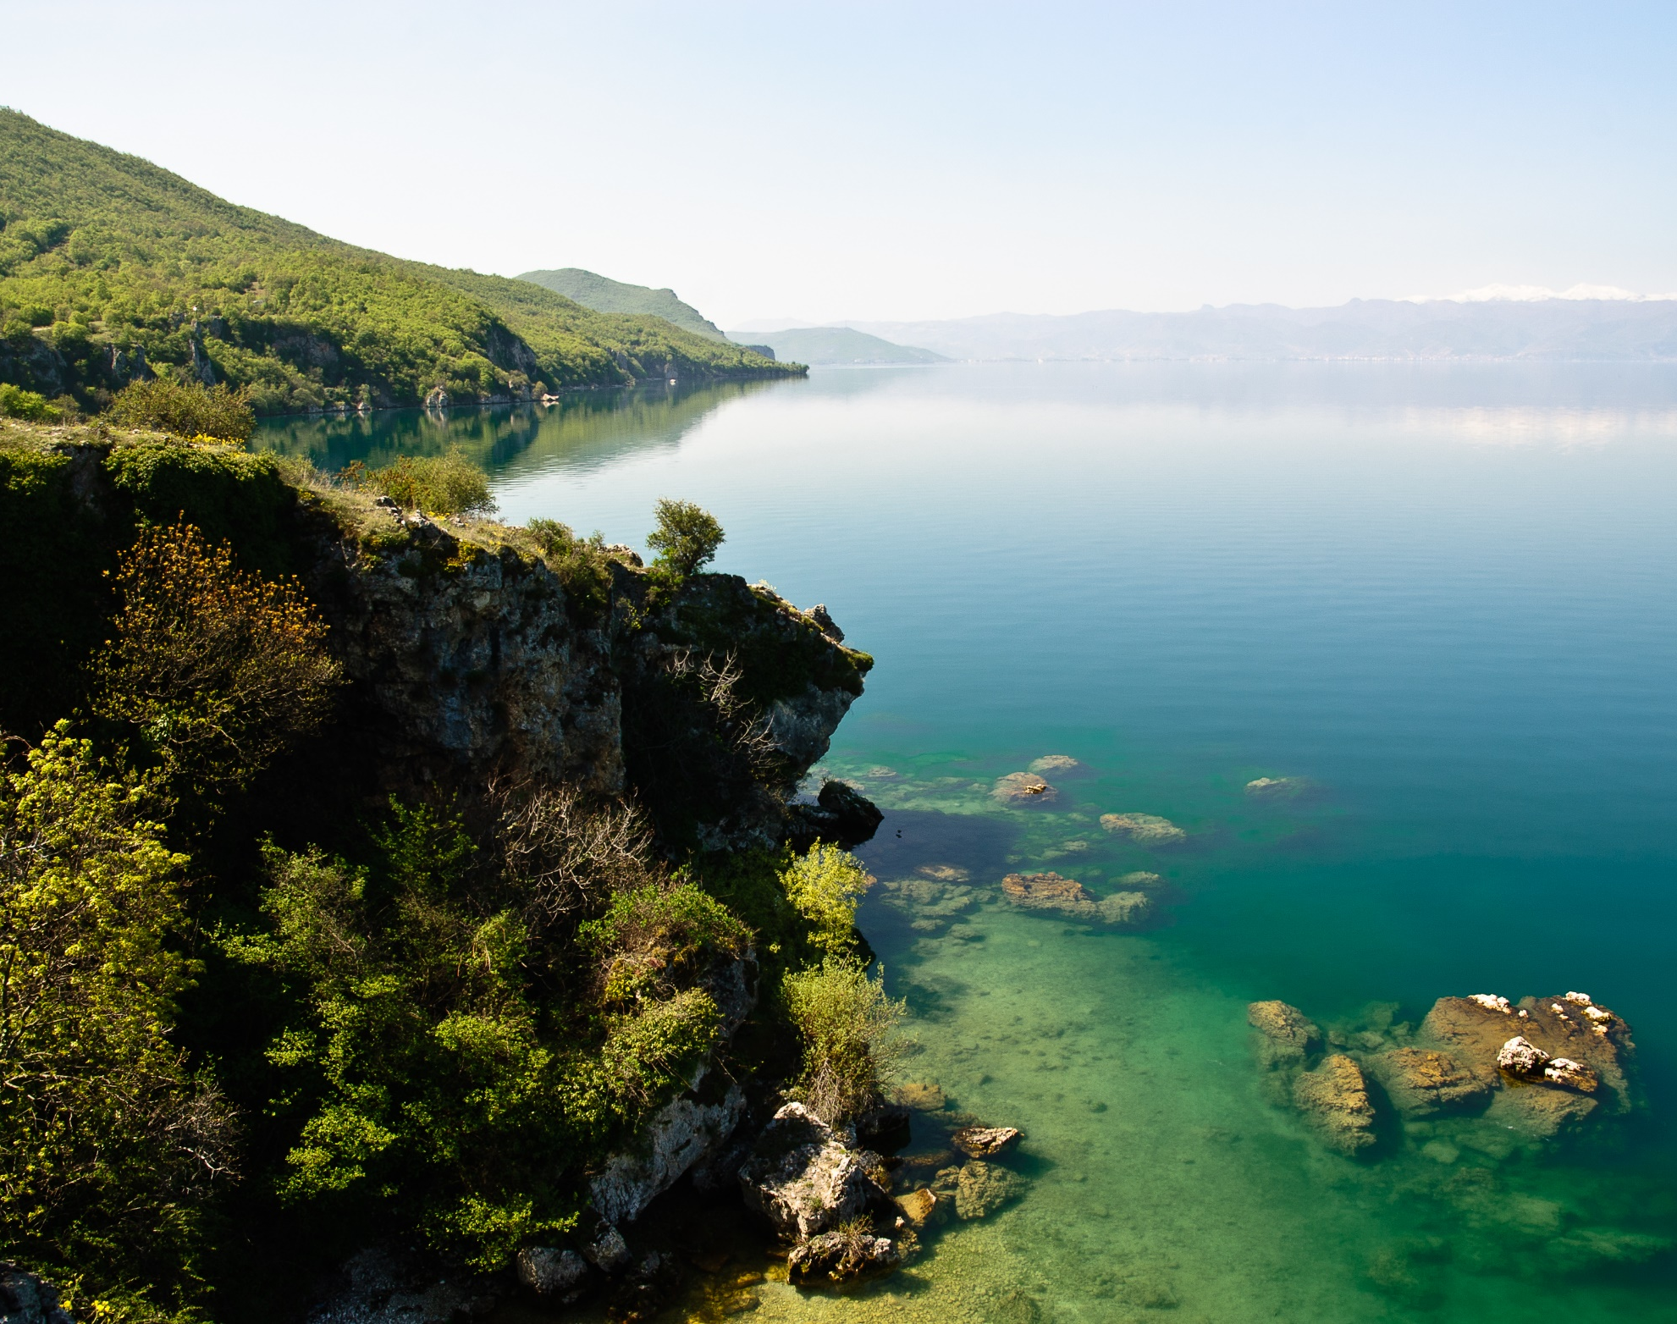
North Macedonia
Candidate Emerald sites
Lake Ohrid
and
NP Galichica
File No. 2017/2

Slide 2
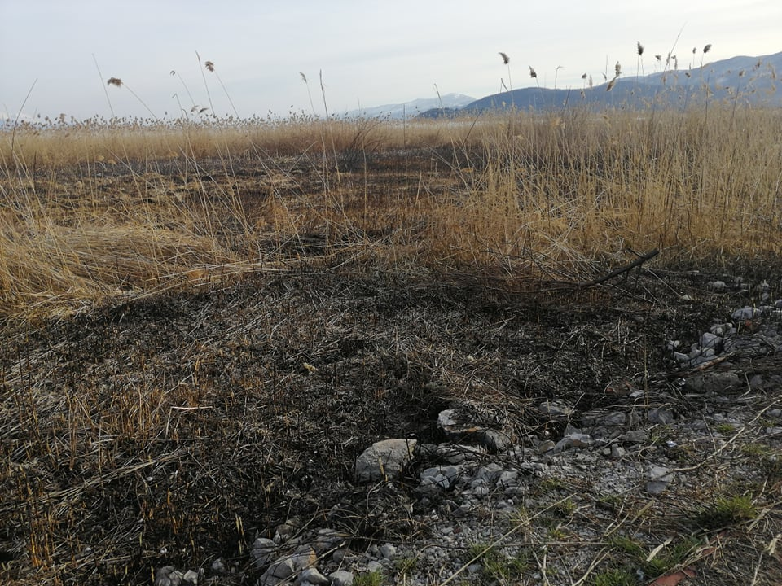
Overview of the past year (Dec.2021-Nov.2022)
Further urbanization and legalization of illegal constructions
Harmful legislation
Damaging strategic plans
Lake pollution
Burning of the reed belt
Pouching…

Slide 3
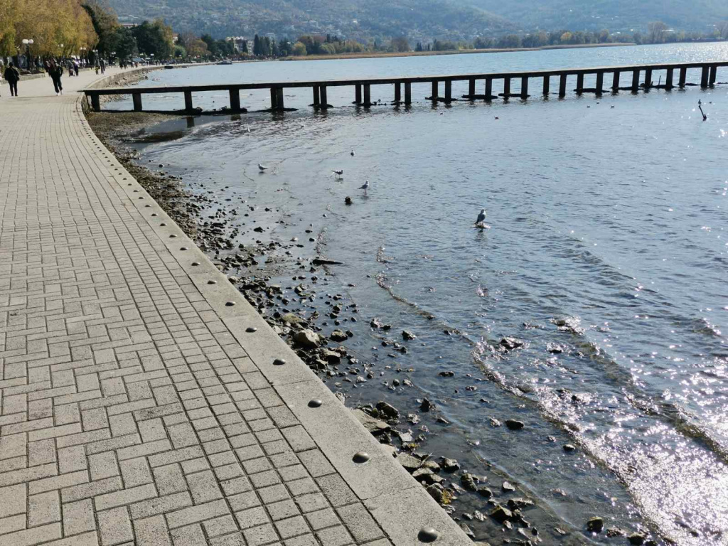
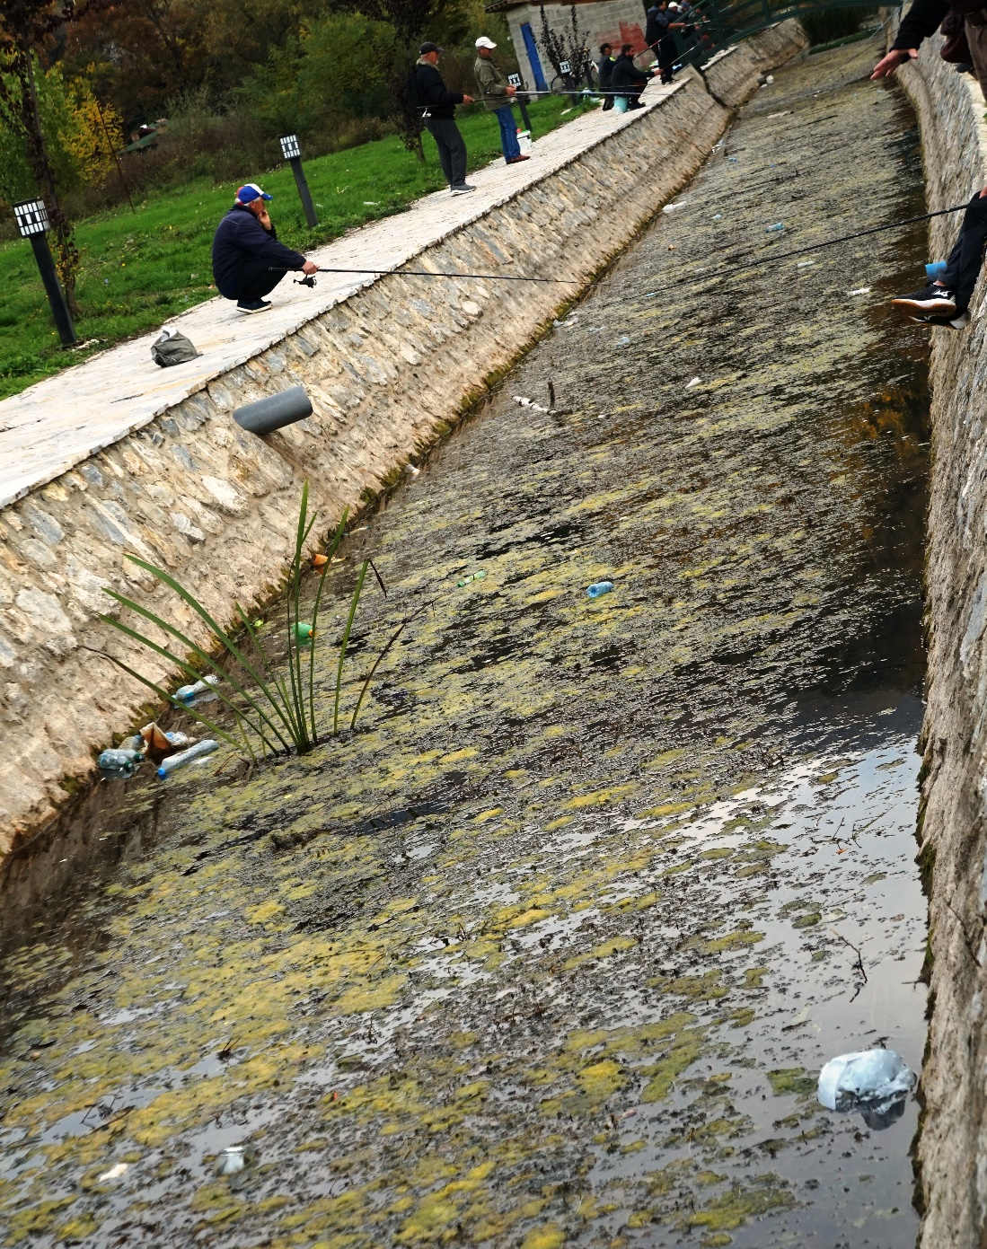
Overview of the past year (Dec.2021-Nov.2022)
11.11.2022 – below the legal minimum
… in addition to new illegal constructions, non-implementation of key activities from the WH Management Plan and status quo regarding waste water treatment, water level stabilization, invasive species, etc.;
Some (modest administrative) steps towards future (possible) closing down of the illegal landfills;
The Government wasn’t even aware that Bern Convention opened the case in 2021 until October 2022. Feedback to ToR sent in November 2022 (which disabled much needed OSA in spring of 2022)

Slide 4
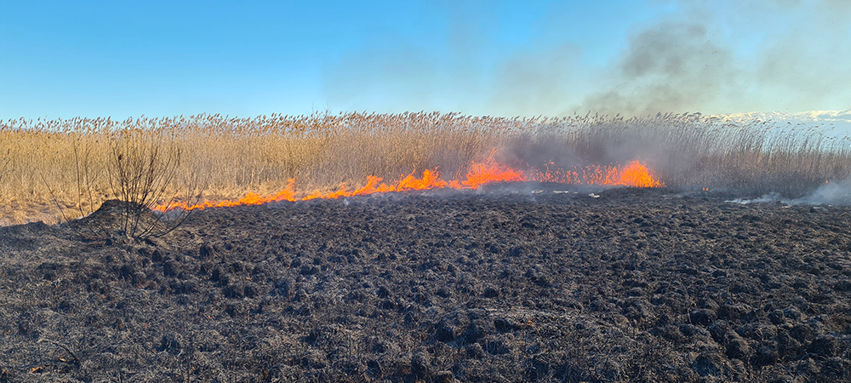
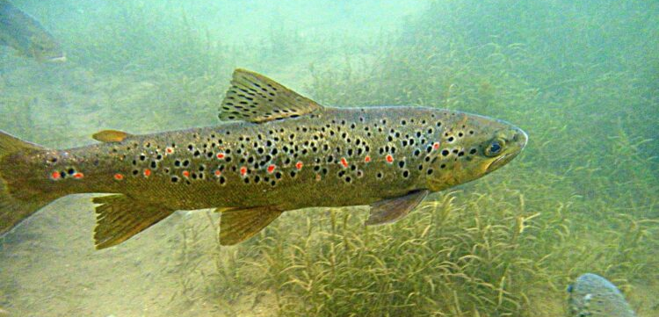
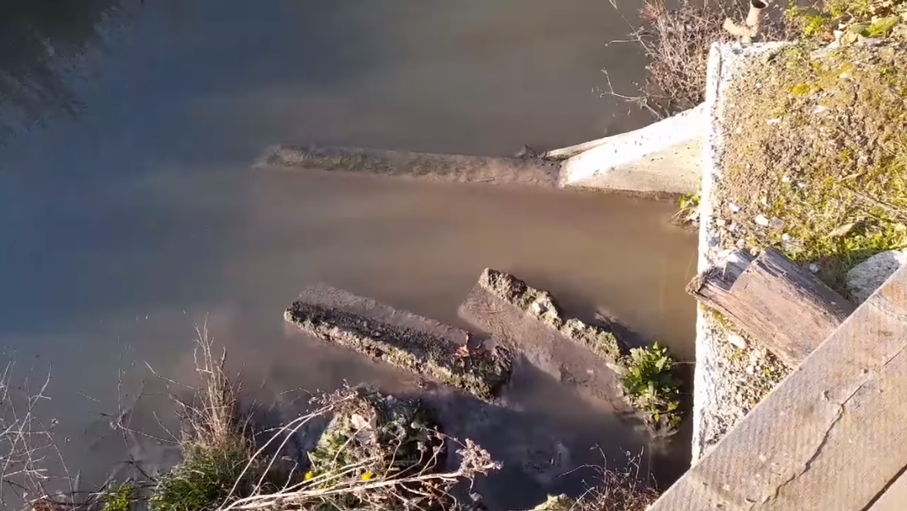
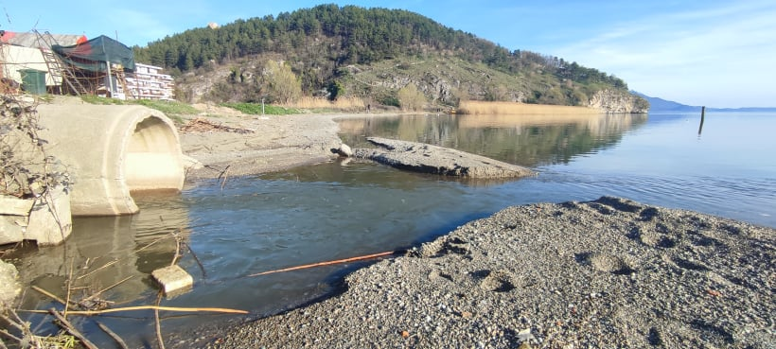
Overview of the past year (Dec.2021-Nov.2022)
There were 4 incidents of burning down the reed belt – all in Struga part of the lake, in the area of biodiversity hotspot Kalishta. At least 110.400 m2 of reedbelt was burnt in 2022
Local police in 3 actions caught pouchers with a total of 228,8 kg of endemic Ohrid trout (Salmo letnica); HBI monitoring: 20% decrease of the population in last 30 years.
Lake pollution:
Citizens Initiative Ohrid SOS sent an open letter to Ohrid Mayor for the waste water spill into the lake close to Studenchishte Canal – Jan.2022;
Local citizen contacted the media for fecal waste water spill into the lake at r. Grasnica estuary – Apr.2022;
In August 2022 the media published the results from the Public Health Centre monitoring of Lake Ohrid water quality (since Jan.2022) – category 5 in some parts (hotspot Mazija), also detected high pollution with fecal water in coastal villages (Peshtani, Trpejca, Ljubanishta – all in NPG), high concerns because of fecal water at St. Naum Springs (waste water from the restaurants/bars).

Slide 5
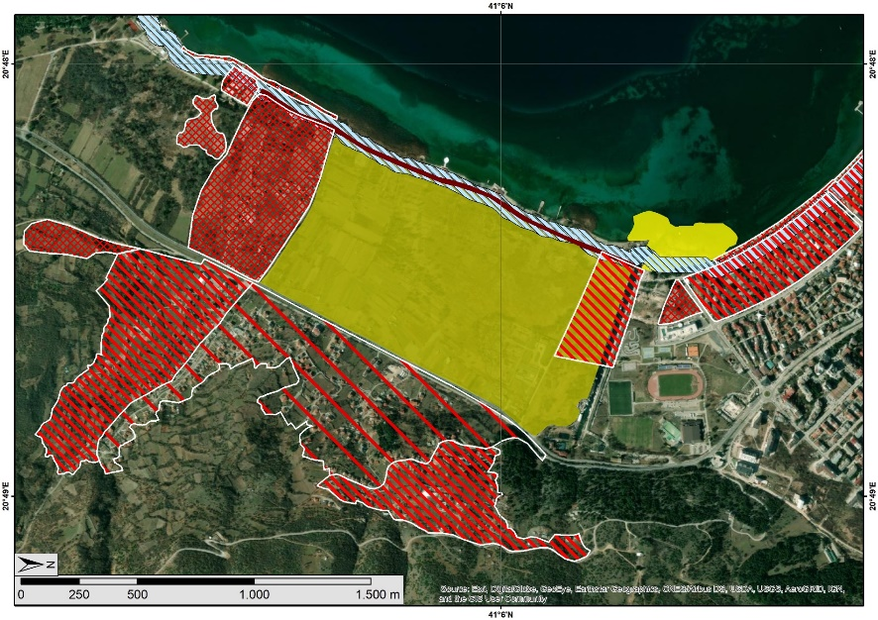
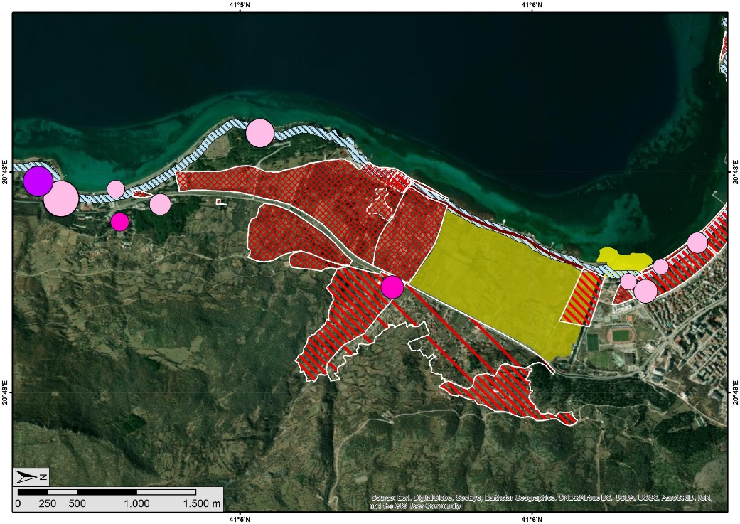
Urbanization – from bad to worse
Since December 2021:
New actions for over 40 urban plans, projects, etc. taken by Municipalities of Ohrid and Struga (“controlled urbanization”);
Both municipalities legalized at least 300 illegal constructions; at least 41 of them are within National Park Galichica.
November 2021
November 2022
Studenchishte Marsh
Urbanization around Studenchishte Marsh – updated map with new information received after 41 Session + urban plan “Gorica East, part 2” – 15.7ha (about 22 football fields)
Municipality of Ohrid – fully or partially illegally constructed hotels

Slide 6
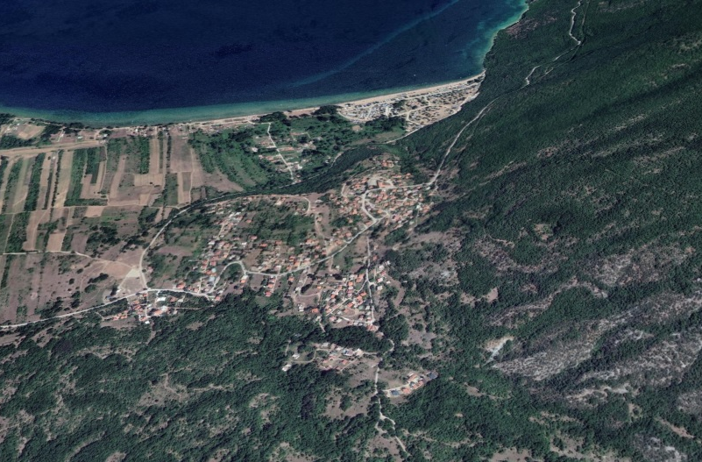
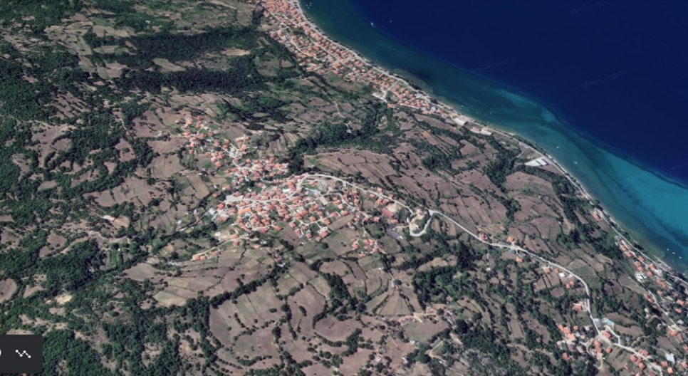
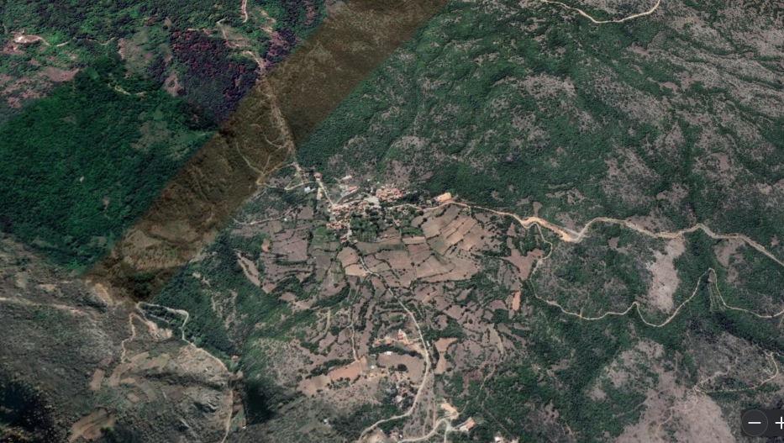
Further (controlled) urbanization
December 2021 – November 2022
Villages within NP Galichica
Further urbanization enabled by a measure for restriction of activities in WH Management Plan
(“More than 20% of urban enlargement of the villages is forbidden.” No reference point/base year).
Ljubanishta
Elshani
Konjsko
Ramne

Slide 7
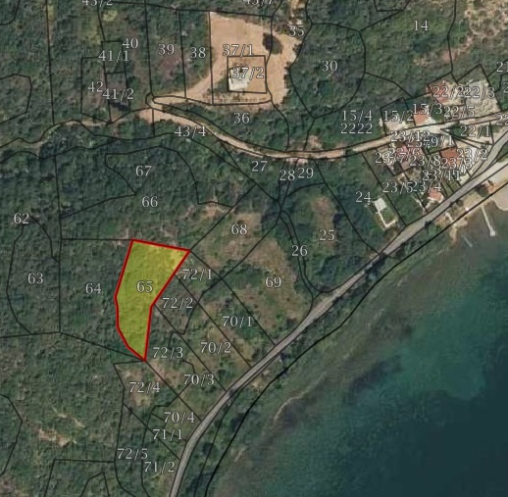
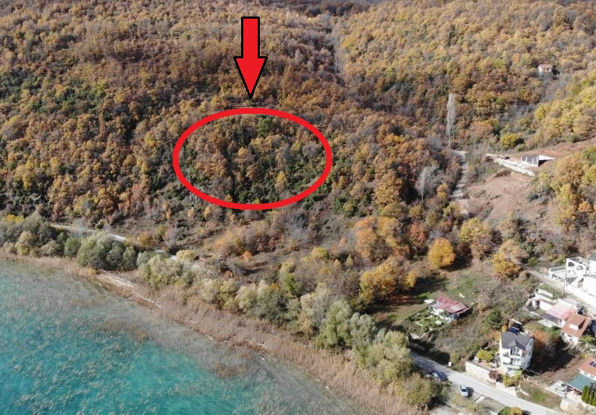
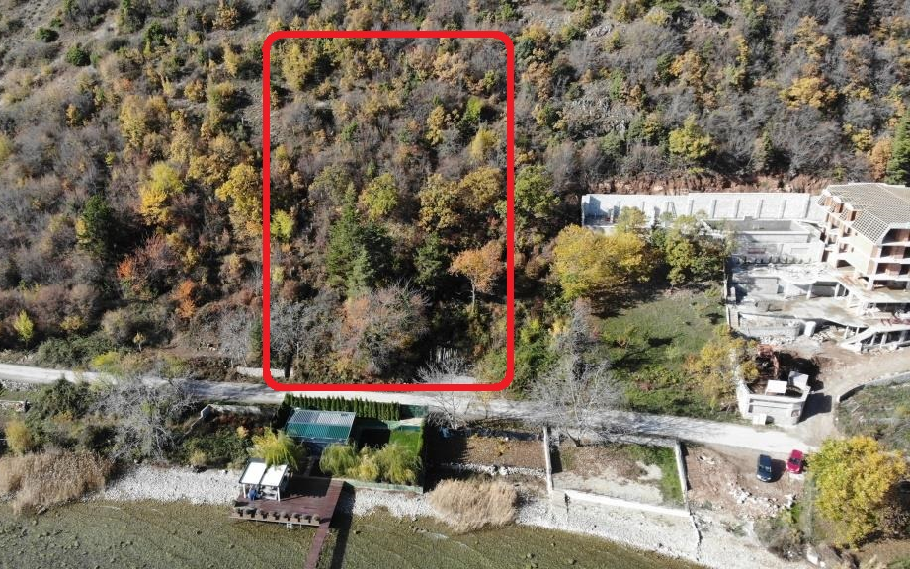
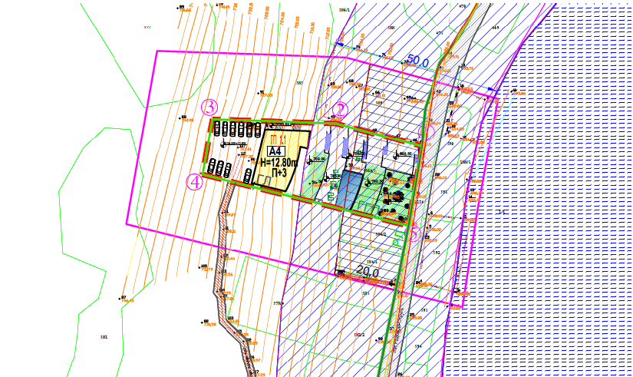
Further (controlled) urbanization
December 2021 – November 2022
Coast of Struga
The SEA Reports for these 2 plans were published for “public consultations” without the actual urban plans, without any information where to send comments and by what deadline and without any information for the legally binding public hearing
1
1
2
2

Slide 8
Municipality of Struga – recent urban development (v. Radozda)
These 3 new developments are all in a stretch of about 650 meters of previously (almost) untouched coastal area. In addition, there is a plan for extension of the village of Radozda to the left and a plan for weekend houses, bungalows and (renovated existing) camp to the right.

Slide 9
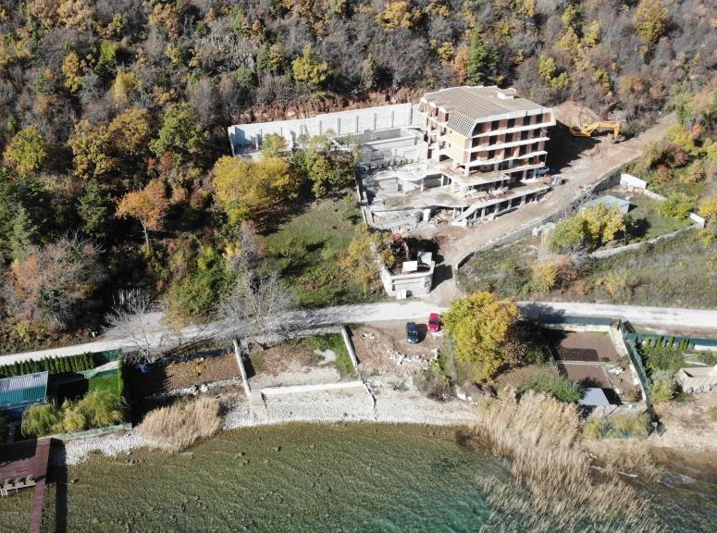
Further urbanization - Coast of Struga (December 2021 – November 2022)
November 2021
November 2022

Slide 10
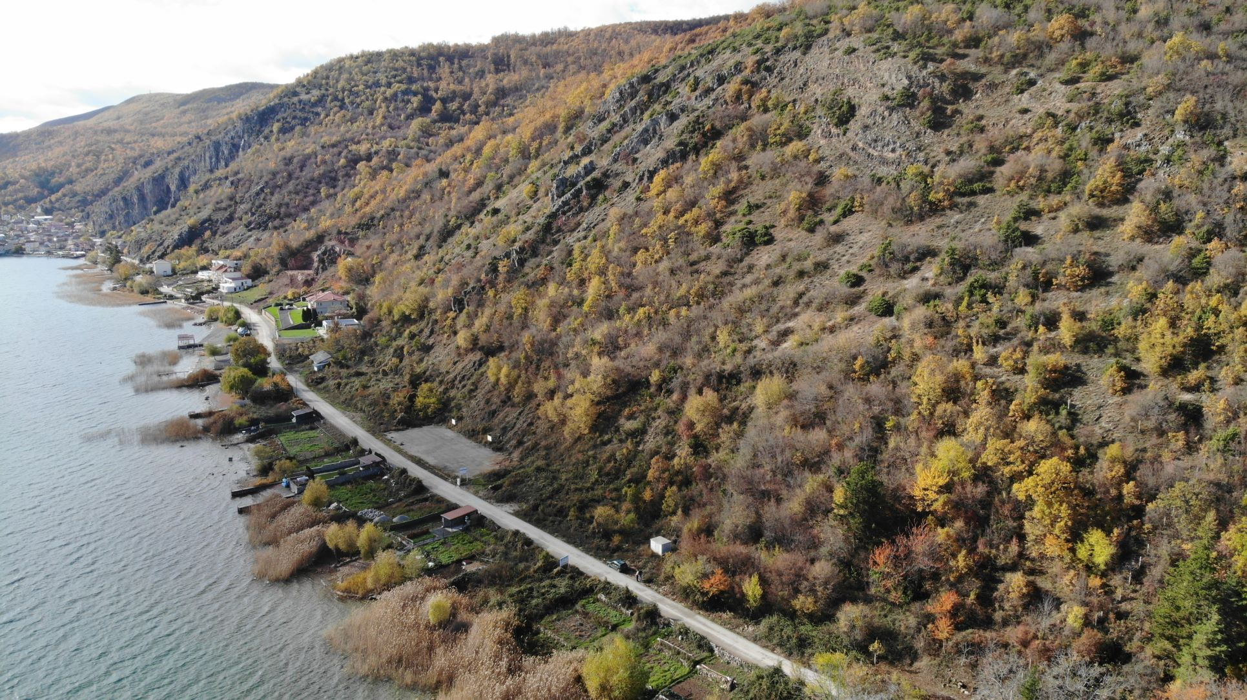
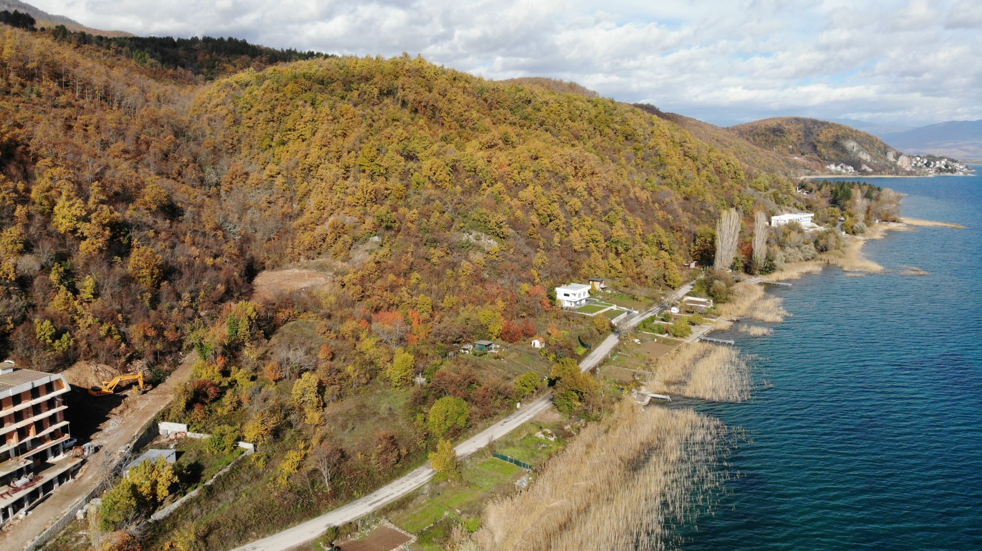
Further urbanization - Coast of Struga (focus on previously almost untouched parts)

Slide 11
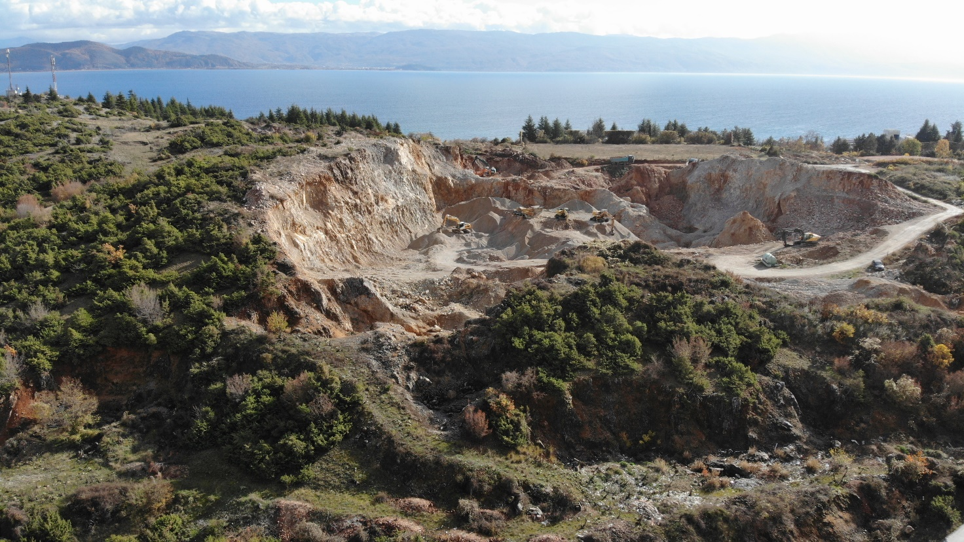
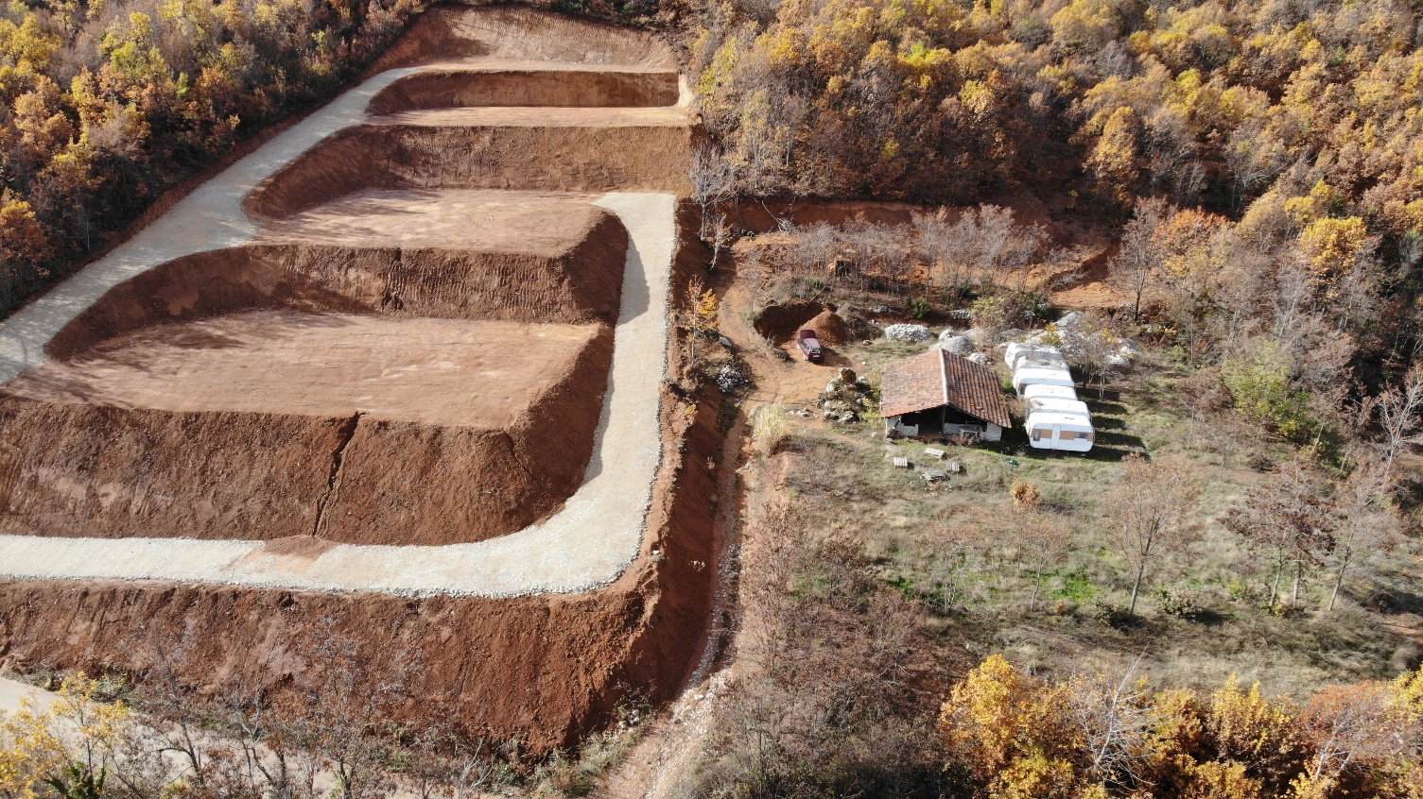
Struga part of the WH – area above the biodiversity hotspot Kalishta (sublacutric springs)
We recently found out that the huge clearance near the
hotspot Kalishta is a limestone quarry (excavation pit) –
concession was issued in 2012, it’s valid for 30 years.
New, nearby clearance of substantial size was discovered during our visit to the site in November 2022.

Slide 12
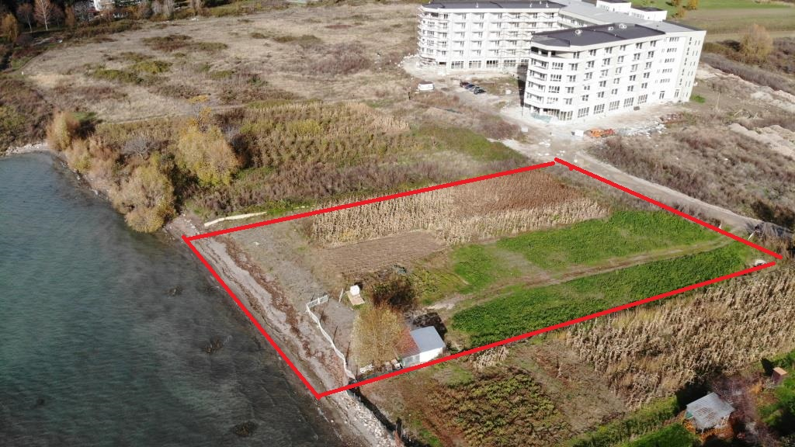
Further (controlled) urbanization
December 2021 – November 2022
We learned about many existing urban plans and/or projects (11) thanks to the Sessions of Ohrid Region Management Commission (this past year finally opened to the public, as the Law on WH implies since 2010).
This project for a new hotel complex on the shore is one of them – the WH Commission recommended putting this project on a stand by until Lake Ohrid Shore Urban Plan is adopted.
New hotel complex
Since August 2021, when WH Committee, instead of inscribing Ohrid Region on the List of WH in Danger, granted N. Macedonia 2 more years to implement the recommendations:
Procedures for at least 53 urban plans and/or projects were initiated or continued (within the WH);
At least 400 illegal constructions have been legalized;
Issued 212 construction permits; 580 new flats/apartments.
Municipality of Ohrid 2002: 55.7499 inhabitants, 28.437 flats/apartments; 2021: 4.321 less inhabitants, 5.223 more flats/apartments (than 2002)

Slide 13
New legislation (December 2021 – November 2022):
Illegal constructions and urbanization
Second Law on legalization of illegal constructions sent to the Assembly in February 2022
All legalization procedures started under the old law will be completed accordingly (over 20.000 illegal buildings within Ohrid Region can be legalized by March 2026. This includes houses, weekend houses, hotels, hotel complexes, etc. also in the 50m. shoreline zone and anywhere in NP Galichica, with MoE opinion); The scope of illegal constructions eligible for legalization is expanded (as of now, only illegal constructions built before March 2011 can be legalized, with the new law this eligibility stretches also to those built between March 2011 – January 2021; built before March 2011 for which the owners missed the deadline for submission of requests for legalization; those whose legalization was rejected and valid Decisions for demolition have been issued, but haven’t been demolished yet); etc.;
Amendments to the Law on Urban Planning initiated by the Ministry of Transport
In January 2022 (15 days for comments, with no public hearing) – urbanization defined as a public interest; implementation of annulled general acts for villages (urbanization of the villages without SEA); Automatic treatment of any kind of land (agricultural, forest, coastal, etc.) as a construction land, if it is a part of urban project outside of an existing urban plan (elimination of procedures for transformation);etc.

Slide 14
New legislation (December 2021 – November 2022):
Law on proclamation of Studenchishte Marsh as a Nature Park, currently at the Assembly
No buffer zone (no obstacles for planned urbanization);
Only 33.89% for primary protection goals;
Highly fragmented zone of strict protection (8,85%);
No reallocation of the main polluter within the marsh;
Municipality of Ohrid – managing body;
Property owners to take part in the definition of the allowed activities in the zone of sustainable use.
All our comments were rejected

Slide 15
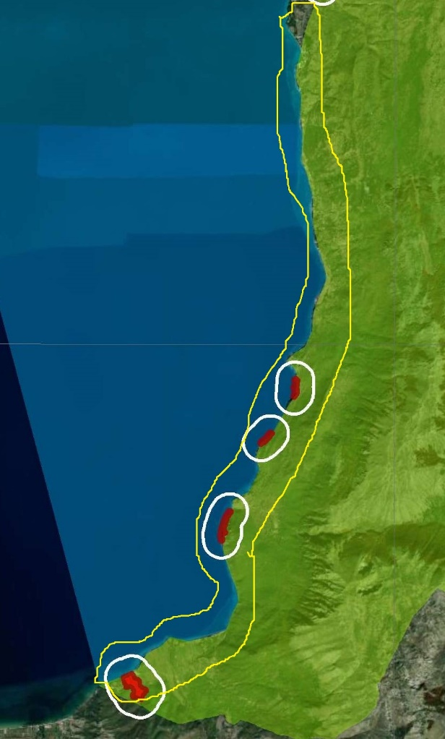
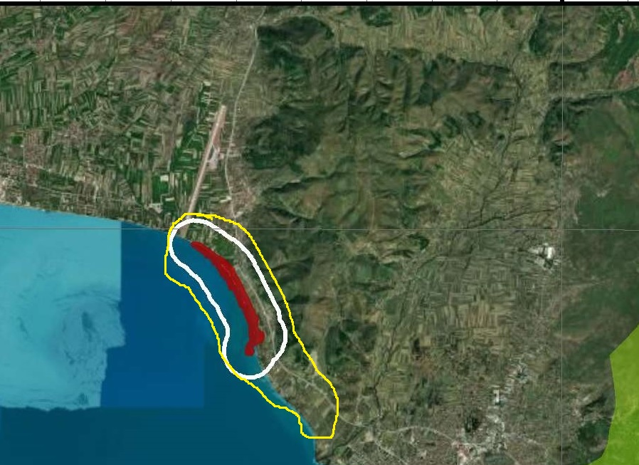
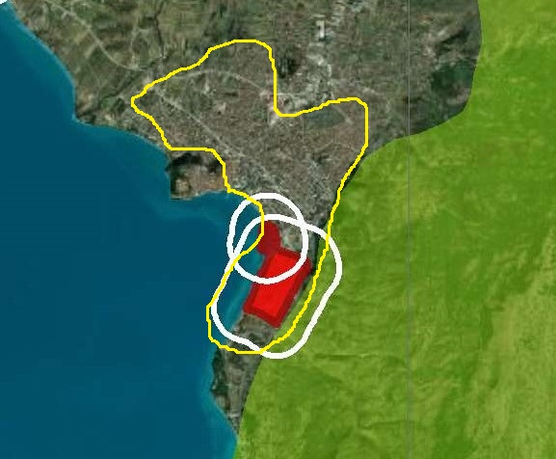
New strategies: Tourism development strategy, Municipality of Ohrid (in process, public consultations completed, MoE positive opinion for the SEA Report)
7 development zones – opportunities for investments we find worrying
Podmolje – the largest reed belt on the shore, 1 of 9 Lake Ohrid biodiversity hotspots
4 out of the 9 Lake Ohrid biodiversity hotspots (St.Naum)
Mazija and Studenchishte Marsh - 2 of 9 Lake Ohrid biodiversity hotspots
Problem: unused areas suitable for beaches. Opportunities for investment: public/private partnerships and concessions;
Problem: parking. Opportunities for investment: public/private partnership for construction of public parking garages;
Problem: docking of boats. Opportunities: investments in designing and equipping of ports.
Problem: mass tourism and specific season concentration. Opportunities: investments in new locations;
Problem: parking spots. Opportunities for investment: public/private partnership for construction of public parking garages;
Problem: boats docking. Opportunities: investing in ports and construction of a marina;
Problem: the space around the reed belt is uncultivated.
Opportunities for investment: accommodation capacities, weekend houses and villas and infrastructure

Slide 16
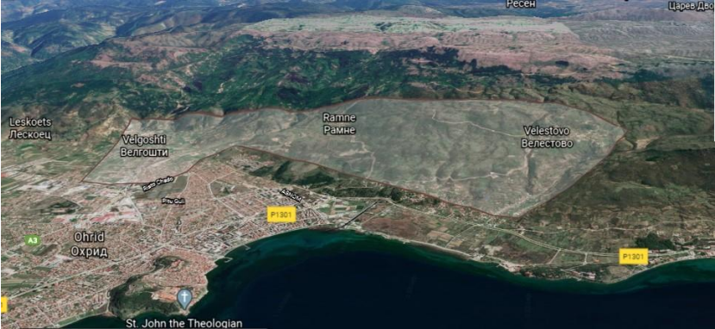
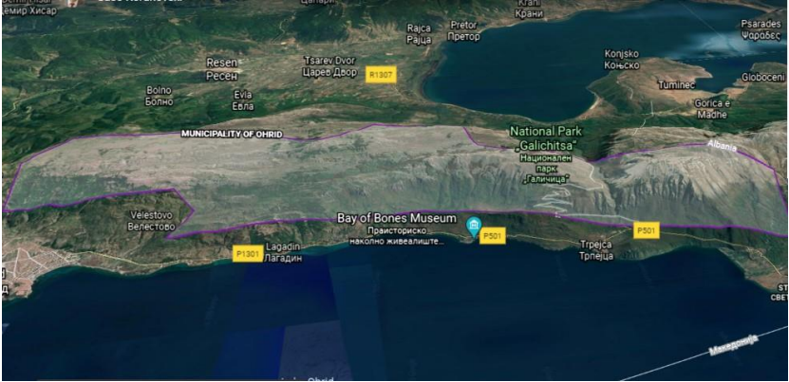
Tourism development strategy, Municipality of Ohrid – proposed development zones (Galichica)
Problems with the infrastructure and emergence of illegal constructions.
Opportunities: investments in urbanization of the villages and the infrastructure;
Peri-Galichica zone as presented in the Strategy
Galichica zone as presented in the Strategy
Problems with the infrastructure and emergence of illegal constructions.
Opportunities: investments in urbanization of the villages and the infrastructure;
Problem: lack of plateaus for presentations.
Opportunities for investment: construction of plateaus

Slide 17
Development strategies, Municipality of Ohrid (in process, SEA process finalized)
More than half of the proposed budget for all the activities in the strategy is allocated for a construction of a new marina and spatial interventions around Studenchishte Marsh, by the construction sector.
Adoption of Tourism Development Strategy for M. Ohrid in a context of non-implementation of the WH Management Plan:
Visitors Plan – should have been finished by June 2021, not yet started;
Analysis of the uncontrolled tourism development impact and Evaluation of the carrying capacity – should have been finished by February 2022, not yet started;
Sustainable Tourism Development Strategy for the World Heritage site, in a trans boundary context – should have been finished by December 2022, not yet started.
Rural Development Strategy for M. Ohrid
(at the same time with Tourism Development Strategy)
URBANIZATION of the villages (new urban plans as a way to solve the problem of illegal constructions);
New ski-centre in Plakenska Mountain – area used for migratory paths of the Balkan lynx (Lynx lynx balcanicus), we asked for a feasibility study on the presence of the lynx prior to any decision for a ski center in this area, the reply was that the request is accepted and will be incorporated in the strategy;
A new marina in the coastal village of Peshtani - we asked what is the basis of this proposal and pointed out that the SEA Report doesn’t even mention such marina, the reply we got is that this activity will be erased from the strategy;
No mention of illegal constructions in the villages – reply: that’s not the subject of this strategy.
WH Commission negative opinion for this strategy and its SEA

Slide 18
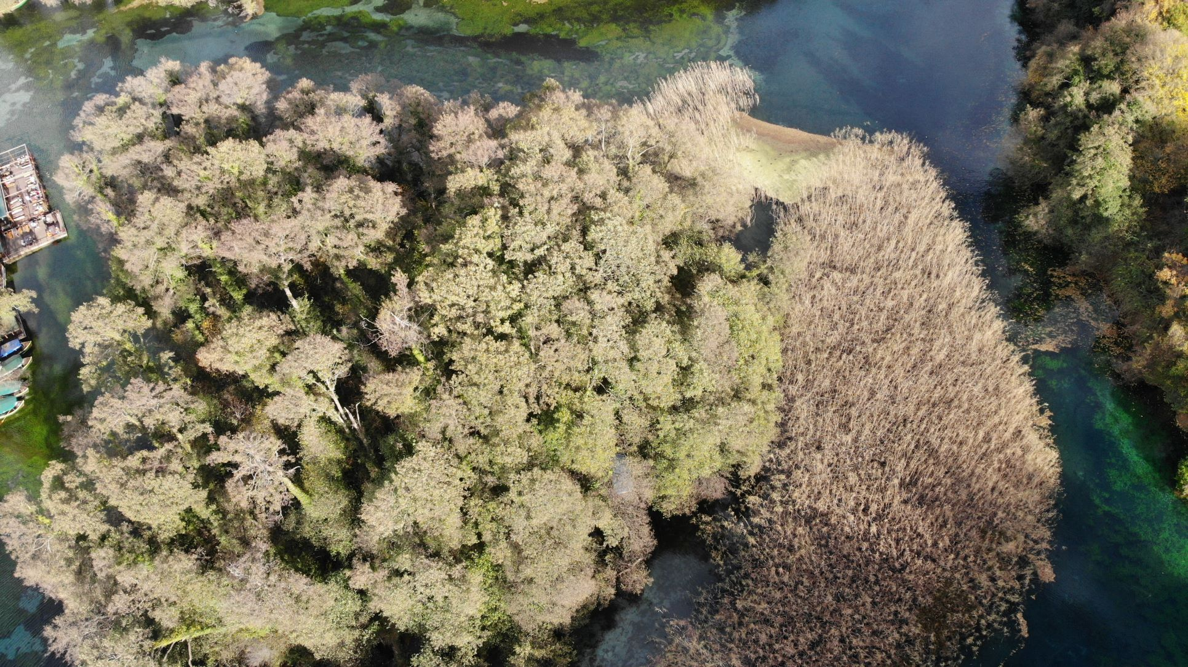
Management Plan for St. Naum Springs area (in process – early stage)
Our main concerns:
Great focus on tourism development despite tourism being identified as one of the main threats;
Recommendations from NPG Management Plan SEA not incorporated (e.g. to dismantle the restaurant platforms and restore the natural site in its authentic form, to restrict/forbid sailing tours around the springs);
Macedonian Orthodox Church, owner of a great part of the area, has a keen interest to open for tourism development highly sensitive areas that are now forbidden for tourists, also to establish a new camping site;
Urbanization defined as a major threat, but no specific actions envisaged for elimination of this threat.
Positive aspects:
Several new scientific studies proposed, as well as a programme for invasive species.
“The Big Island” – most sensitive part of the zone of strict protection, Macedonian Orthodox Church wants it opened to visitors

Slide 19
Strategic Rehabilitation Plan for WH (in process – public consultations completed )
Decision 44 COM 7B.77 - Urges the two States Parties to develop a detailed Strategic Recovery Plan with an associated phased action plan that sets out clearly defined aims and outcomes to mitigate threats to OUV with a set of agreed actions including a timeframe both in the short and longer term as well as a phased action plan, based on the full recommendations of the 2020 mission, and which would provide an overarching transboundary political and institutional framework for addressing the severe and multiple threats facing to the property; and to present the Strategic Recovery Plan to the Advisory Bodies and the World Heritage Centre in February 2023.

Slide 20
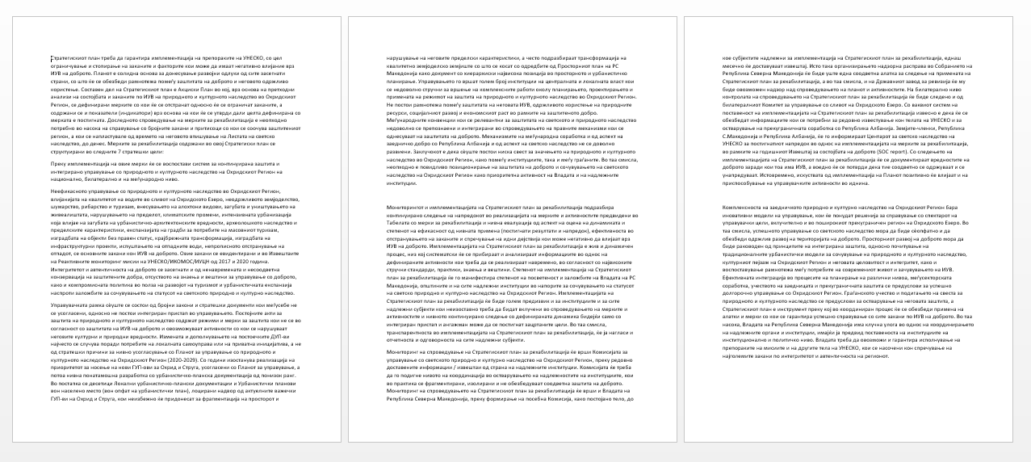
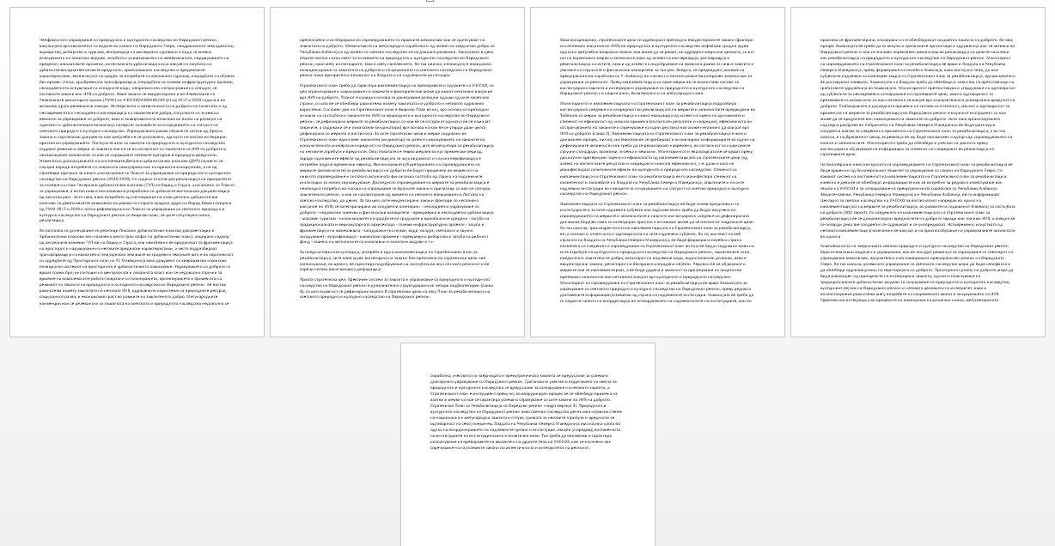
Strategic Rehabilitation Plan for WH (in process – public consultations completed )
After working for 10 months, a team of 9 experts, in consultations with 18 institutions – (without the pictures and technical parts) produced almost 3 pages of text, most of it taken from existing documents (general elements); + Action Plan with 98 activities, 38% activities from the WH Management Plan but with new deadlines.
Following the informal consultations with CSOs, the draft version for public consultations was published: little over 4 pages of text + Action Plan with 126 activities, 32.5% from the WH Management Plan with new deadlines. New addition in the main text:
“Financing/budgeting of the measures (activities) for rehabilitation of the property will be assessed in the moment of their implementation and in accordance with the actual financial situation of the institutions responsible for their implementation”

Slide 21
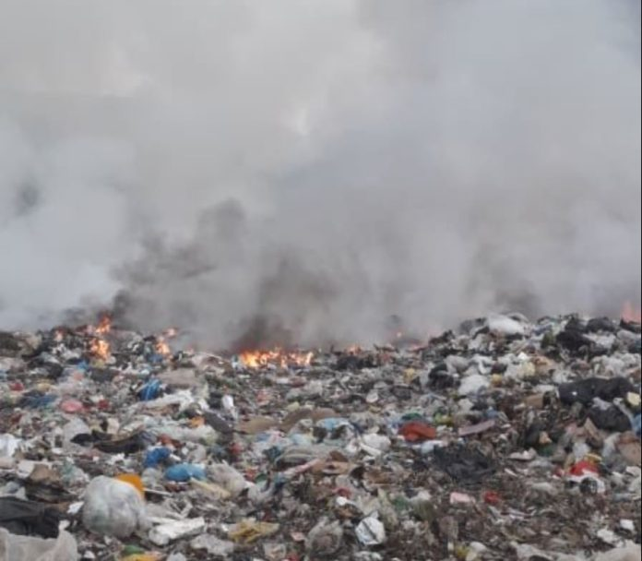
Strategic Rehabilitation Plan for WH (in process – public consultations completed )
Few of the many significant problems in this plan (in addition to the previous ones):
Not a single goal/aim for rehabilitation of the actual natural (and cultural) values of the WH; “Controlled urbanization” one of the strategic goals;
No outcomes (for the desired state of the values);
Zero analysis of the current state of the specific values and existing threats (which should be eliminated/mitigated);
No monitoring and evaluation plan for the impact/effects of the activities on the actual values, nor appropriate indicators (with few exceptions);
Monitoring of the implementation of the plan to the same, proven ineffective bodies (WH Management Commission, Governmental Commission, etc.);
Overall goal presented as “This Plan should ensure implementation of UNESCOs recommendations and decisions…” – proposed activity for implementation of the recommendation for an urgent moratorium on construction: update of currently invalid municipalities’ decisions (evaluated by RMM 2020 as “can’t be considered as implementation of the recommendation for a moratorium); Etc.
“Bukovo” illegal landfill – WH MP: closing down by Oct.2023; SRP: closing down by 2029 (maybe - if there are finances)
Main water treatment collector – WH MP: full repair and reconstruction by Dec.2020; SRP: by 2028 (maybe - if there are finances)

Slide 22
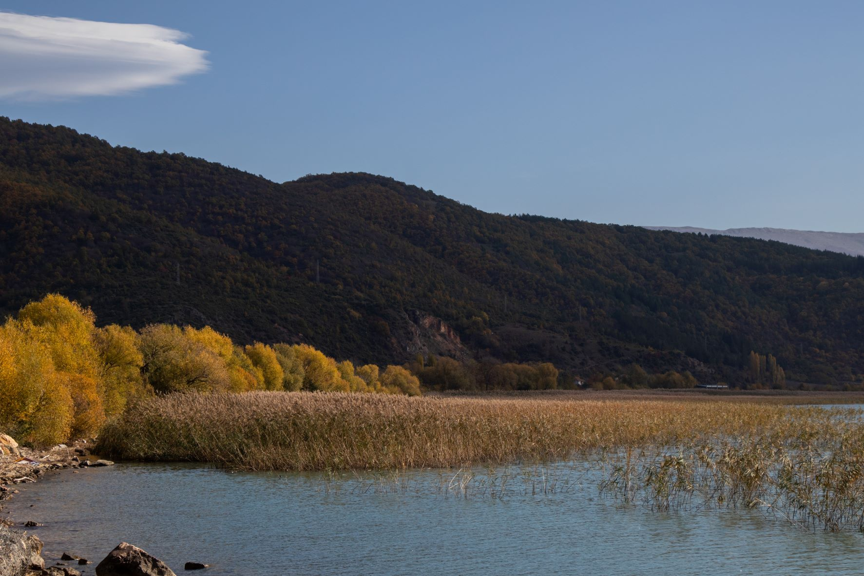
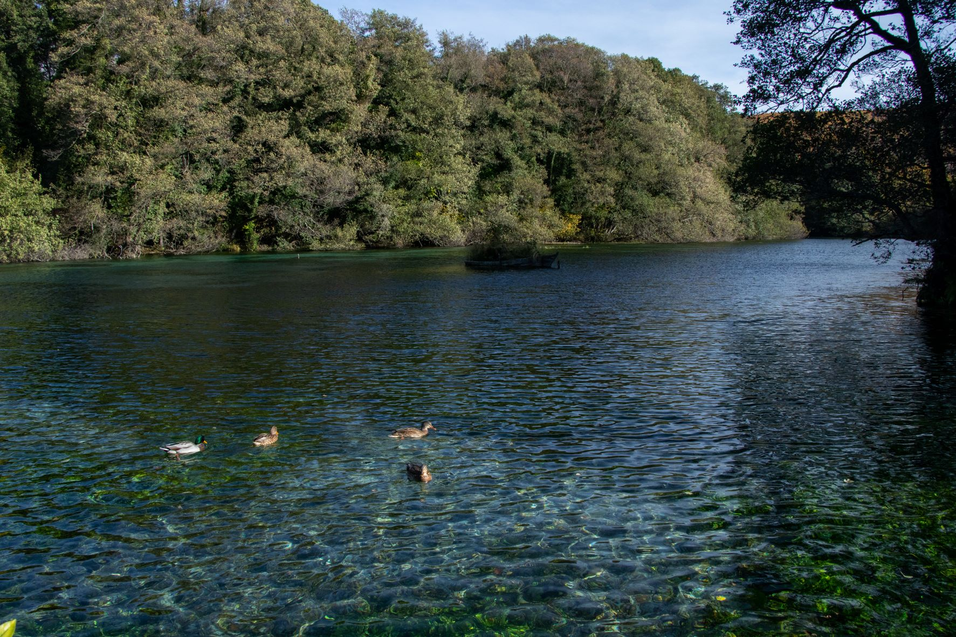
Some good news (sort of)…
According to the recently presented field research (EU funded project, implemented by UNDP MK) the surface of reed belt in the Municipality of Ohrid has increased, especially in the area Podmolje-Ohrid.
Important note: unfortunately 1 of the plans envisages urbanization of this very area.
Since August 1st 2022, NP Galichica implements a project for research and inventarization of the St. Naum Springs flora and fauna; evaluation of the species and habitats; development of educational packages; evaluation of the state of the ecosystems and ecosystem services.
According to the NPG Representative in the WHMC the initial data points to worrisome conclusions.

Slide 23
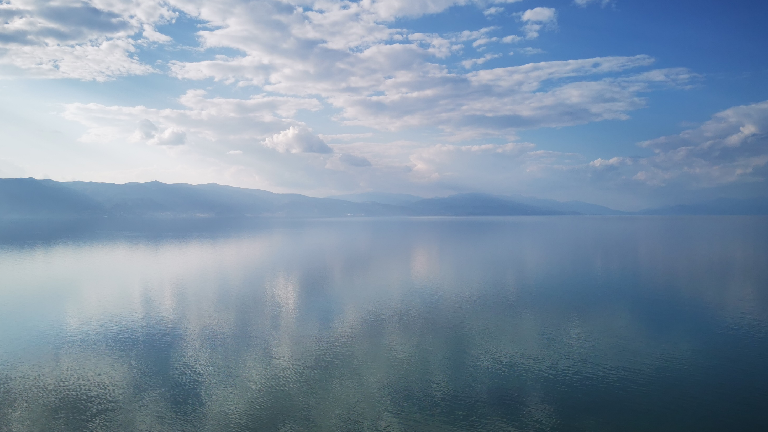
Our conclusions and proposals:
There is an obvious urgent need for OSA. We ask the Standing Committee to consider the complexity and size of the property while defining the details of the OSA.
We also ask the Standing Committee to:
Recommend temporary postponement of the adoption of key documents until the OSA, which will bring much needed consultations/recommendations from international experts from 3 conventions protecting the site (if WHC and Ramsar Convention join the OSA);
Urge the country to halt any activities for further urbanization and/or other constructions (including administrative procedures for these) and legalization of illegal constructions, on or near the Emerald sites Lake Ohrid and Galichica, until the OSA takes place and its recommendations are adopted;
To express a strong concern for the continuation of harmful activities in the past year despite the BC Bureau Decisions.

Slide 24
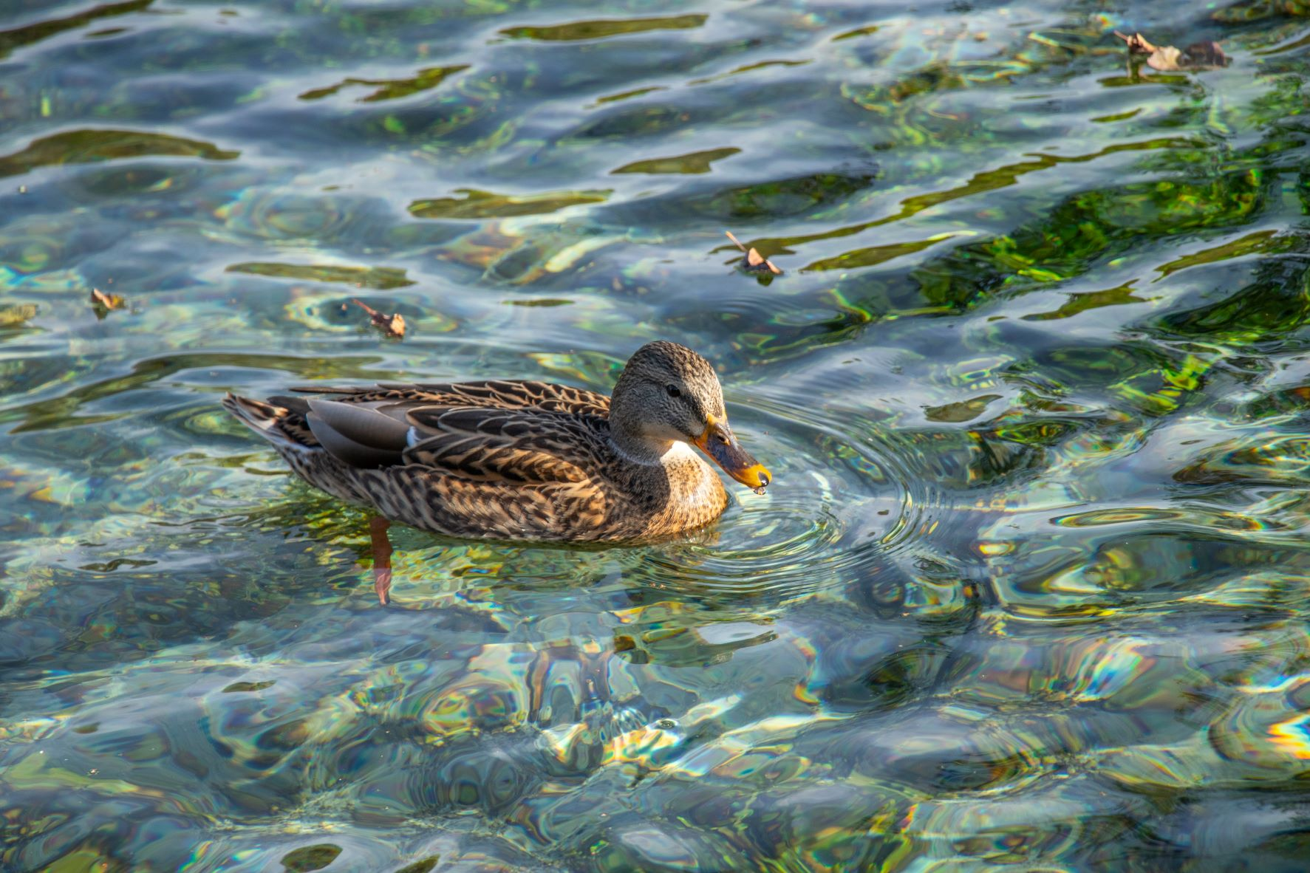
Thank you for your attention
iskra.stojkovska@gmail.com

