Slide 1
SCADAR LAKE NATIONAL PARK
MSc. Azra Vuković
NGO Green Home
Citizens Group of Virpazar
30.11.2022.

Slide 2
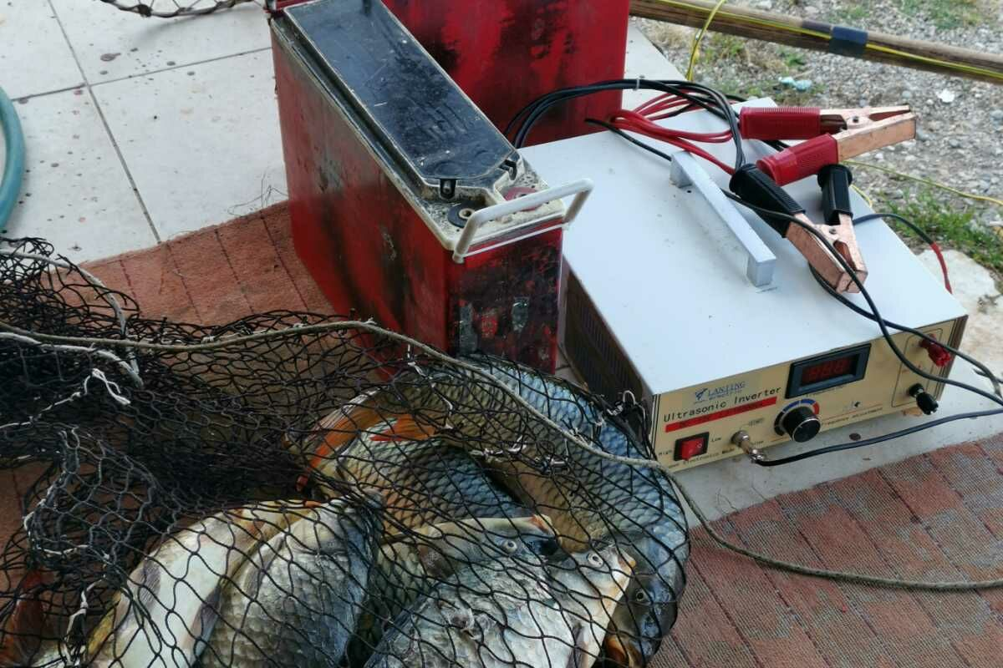
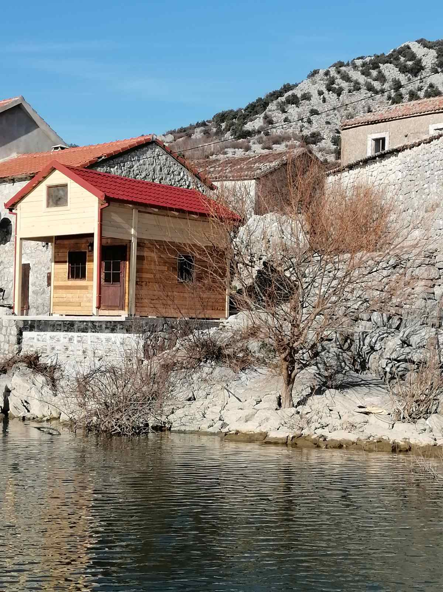
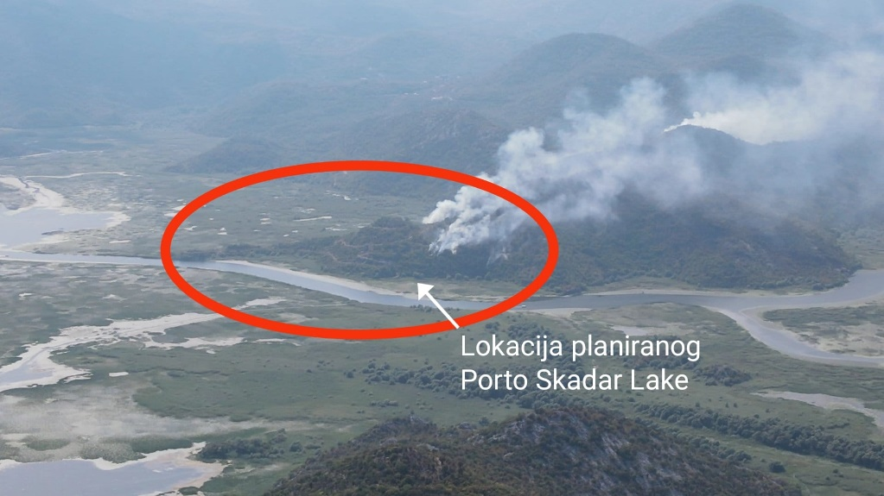
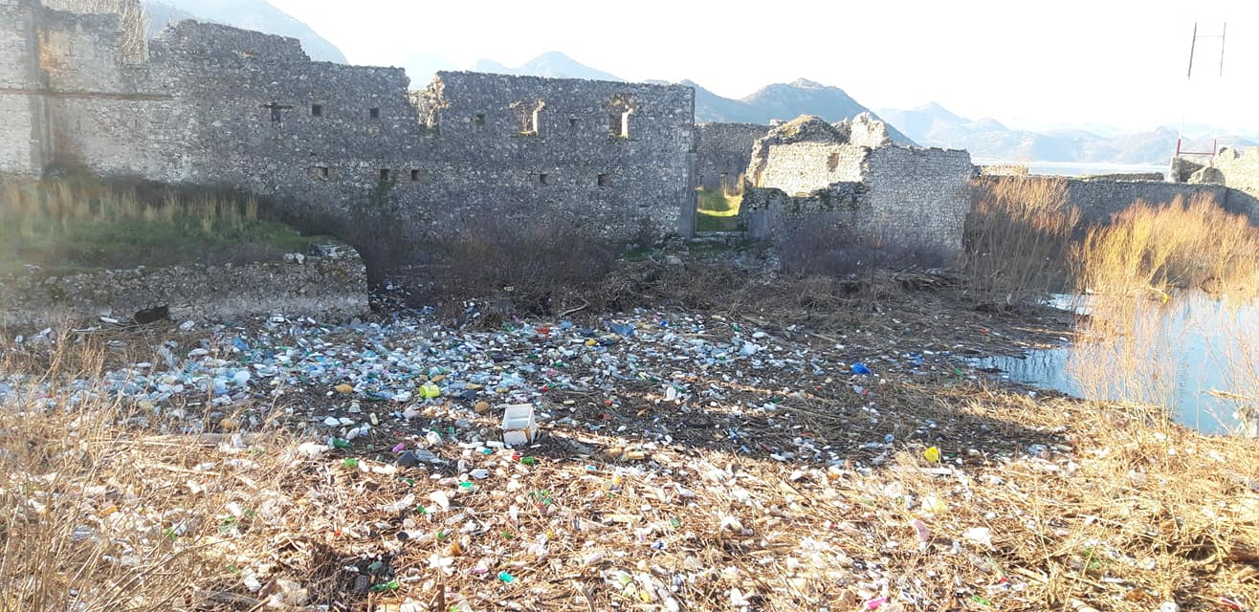
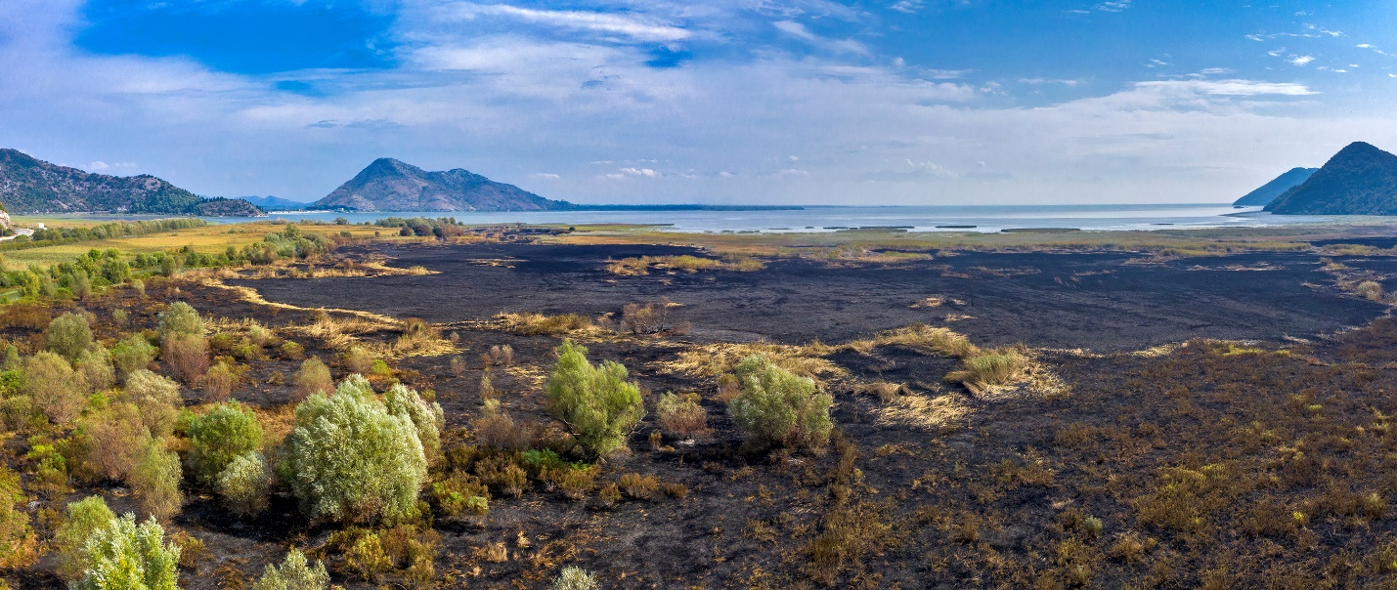
Threats
Illegal construction of buildings
Poaching
Illegal gravel extraction
Invasive species
Not effective waste management
Fires

Slide 3
Open File No. 2016/4: Montenegro: Development of a commercial project in Skadar Lake National Park and candidate Emerald site
A formal Case File was opened in 2016
Bern Convention On-the-Spot Appraisal Mission and Ramsar Advisory Mission were implemented jointly in 11-14 June 2018
In the meantime, compliant 4/2016 was passed from Informal Citizens Group of Virpazar to NGO Green Home

Slide 4
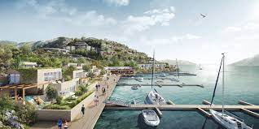
KEY FINDINGS
No meaningful progress from Montenegrin Government on recommendations 201.

Slide 5
Comment
The lack of progress in the implementation of the recomendations 201/2018 and general lack of protection in the National park are largerly due to the political crisis in Montenegro
Since 2016, in PE National parks of Montenegro there were appointed 6 directors!
Decisions regarding the case of Mihailovići and revocation of associated building permits is a political decision that will have to be made on the level of the Government.

Slide 6
Status of recomendations implementation
Conservation and management measures recommended by the Mission | Results achieved (according to the publicly available information)
Halt any further development on the mainland as well as the shore zone and water body of the Mihailovići location unless a detailed habitat map on a 1:10,000 scale for Mihailovići, Poseljanski Zaliv Bay, Biški rep, the mouth of Crnojevića river, the mouth of Bazagurska matica and the islands Liponjak and Galići has been provided. | Further development on the mainland was stopped. Detailed habitat map on 1:10,000 scale for Mihailovići, Poseljanski zaliv Bay, Biški rep, the mouth of Crnojevića river, the mouth of Bazagurska matia and the islands Liponjak and Galići was not provided until now. Habitat types pursuant to the EUNIS habitat classification and EU Habitat Directive were classified in the frame of the GIZ project “Natura 2000 Habitat Mapping of the Skadar Lake National Park” implemented in 2019. Report available here.

Slide 7
Status of recomendations implementation
Conservation and management measures recommended by the Mission | Results achieved (according to the publicly available information)
Elaborate immediately a reference list of all present EUNIS and Natura 2000 habitats with a focus on wetlands habitats, define their favorable conservation status and the necessary conservation measures to maintain or restore the favorable conservation status and include those measures in any planning document related to the conservation of Skadar Lake National Park, Skadarsko jezero Ramsar Site and Candidate Emerald Sites Skadar Lake. | Government of Montenegro did not adopt Management plan for national park Skadar lake for the period from 2021 – 2025. In July 2022 there was organized public debate for the new Management plan for the period 2021 – 2025, even though period for its implementation already passed more than year and a half.

Slide 8
Status of recomendations implementation
Conservation and management measures recommended by the Mission | Results achieved (according to the publicly available information)
Establish and run a monitoring system on species strictly protected according to Appendices I and II of the Bern Convention resp. Natura 2000 species and habitats by the National Environmental Protection Agency at first at least in the area mentioned under (1). The monitoring system must include the otter (Lutra lutra). | Government of Montenegro did not adopt Management plan for national park Skadar lake for the period from 2021 – 2025.

Slide 9
Status of recomendations implementation
Conservation and management measures recommended by the Mission | Results achieved (according to the publicly available information)
Provide the Convention’s secretariats with georeferenced and digitalized borders of and respective updated data forms on both the corresponding Candidate Emerald Site and Ramsar Site. | Not implemented according to the available information.

Slide 10
Status of recomendations implementation
Conservation and management measures recommended by the Mission | Results achieved (according to the publicly available information)
The new Special Purpose Plan for Skadar Lake National Park needs to follow the approach of the 2001 Special Plan for Skadar Lake National Park and reconfirm the designation of the broader area of the mouth of Crnojevića river and the Liponjak and Galići islands a Zone I of strict protection | In August 2018, Draft on Special Purpose Spatial Plan for Skadar Lake National Park until 2025 was presented to the public through the public discussion that lasted 20 days. This draft document did not apply the recommendation of designation of Zone I of the broader area of the mouth of Crnojevića river and the Liponjak and Galići islands. For the needs of this Special Purpose Spatial Plan, the State Study of Location (DSL) Mihailovići that was completed in 2014 was treated as a committed obligation. The adoption of the Plan was expected in October 2018. However, until now, document was not finalized and adopted.

Slide 11
Status of recomendations implementation
Conservation and management measures recommended by the Mission | Results achieved (according to the publicly available information)
The use of speedboats has to be limited to police, border police, ranger service and other authorities with competences on the lake. Those have to follow speed restrictions except in case of emergency. | Law on National parks prohibits to use vessels with an engine power over 10 horsepower (boats, speedboats, scooters, etc.) without approval, except for the needs of state administration bodies. In 2020 the application of this norm begun. However, there was a lot of pressure from the fisherman on the institutions. Local people and fisherman organized protests against this norm. Until today it is not implemented and there are no limits for speedboats on the lake.

Slide 12
Recomendations of latest EU report
In EC Montenegro report 2021 Montenegro has some level of preparation in this area. Limited progress was made in further alignment with the EU aquis, on nature protection and to develop the National Energy and Climate Plan.
However, Montenegro should in particular:
“take urgent measures to preserve and improve the ecological value of protected areas and potential Natura 2000 sites such as Ulcinj Salina, Lake Skadar, the Tara river and other river courses”.

Slide 13
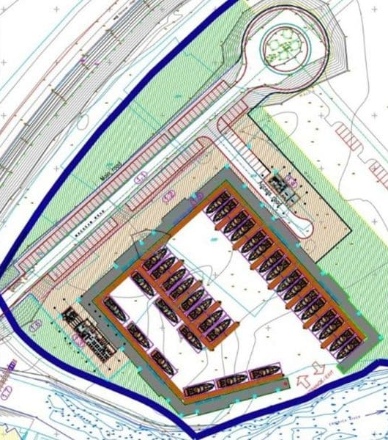
Specialized marina in Virpazar
There was actualized the project of construction of specialized marina in Virpazar.
This project’s Environment Impact Asessmet Study was not approved by Environmental Protection Agency.

Slide 14
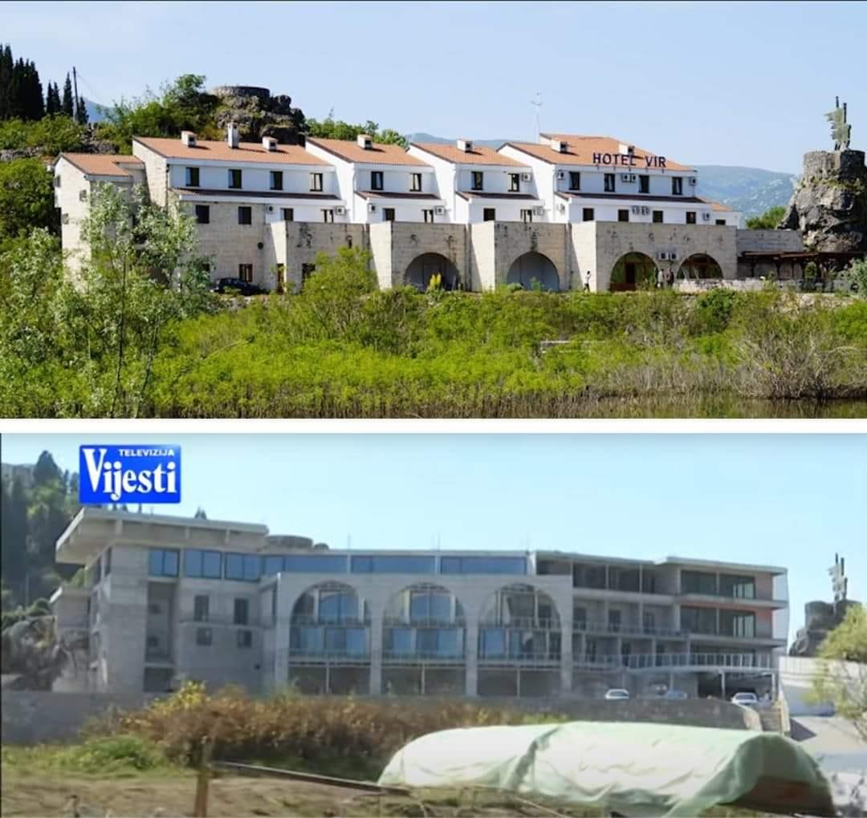
Case of hotel “Vir” in Virpazar – a negative example of building practices and lack of rule of law
Hotel Vir (previously “13 Jul”) was built in 1981, architecturally inspired by traditional house building in the region of Crmnica.
The proposal for its reconstruction has been twice rejected by the main Architect of Montenegro, only to be approved in February this year directly by Mr Ratko Mitrovic, Minister of Ecology, Spatial Planning and Urbanism.
Note that this is a Minister who has been known to be involved in illegal building practices himself.

Slide 15
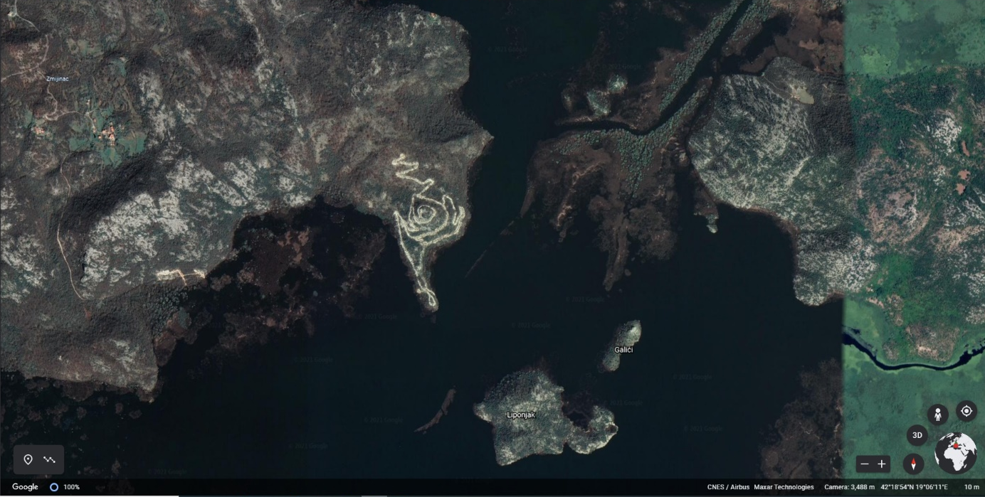
Reiterating our key positions:
1. Abandoning SLS Mihalovici entirely (validity expired in 2020) and, in the light of current evidence, revoking all building permits for Porto Skadar Lake and White Village. This will ensure that most of the Recommendations 201 are respected. It will send a strong message that sustainable development and conservation takes priority over private sector profit.
Building permits for both project are still in force.

Slide 16
2. As the highest priority, the development and delivery of a new spatial plan for the National Park, as previously committed to by the Montenegrin authorities. Ensuring that the new Spatial Plan is rezoned according to Recommendations 201, the Shore Functionality Index study and recent biodiversity mapping.
Zone I and II with their buffer zones are treated as nature reserves and fully protected from ANY AND ALL developments.
any further new tourist developments be sustainable, based in areas that are already currently occupied, be of small scale, and be eco and village tourism based. This as per 3.4.2 Recommendations for Montenegro (page 66 of SFI Study).
existing road infrastructure is maintained and not upgraded. We maintain that the new motorway route (Bar-Boljare) over Rijeka Crnojevica should be abandoned, and a more sustainable/less damaging alternative is found.
waterways follow Recommendations 201. Exceptions to the recent law limiting boat engine sizes to be abandoned and law to be enforced.

Slide 17
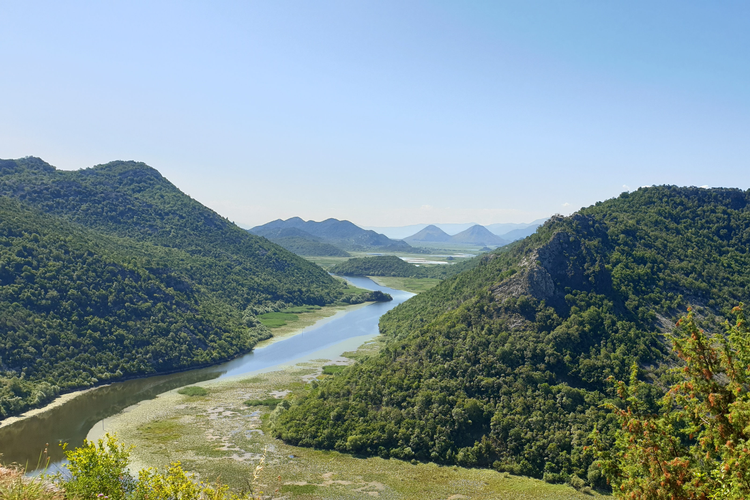
3. Protection as a priority. Management plan. Finally, initiate and establish efficient and effective methods of monitoring implementation of existing laws, executed in a manner that is visible on the lake.

Slide 18
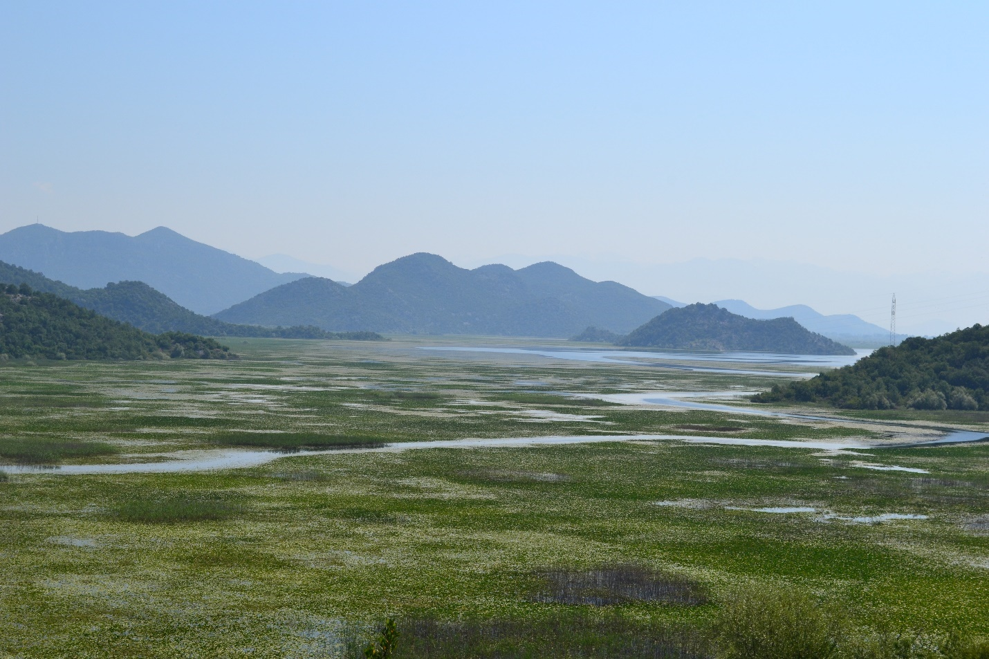
Thank you!
Azra Vuković
NGO Green Home, Citizen’s Group Virpazar
+38268526061
azra.vukovic@greenhome.co.me

