Slide 1
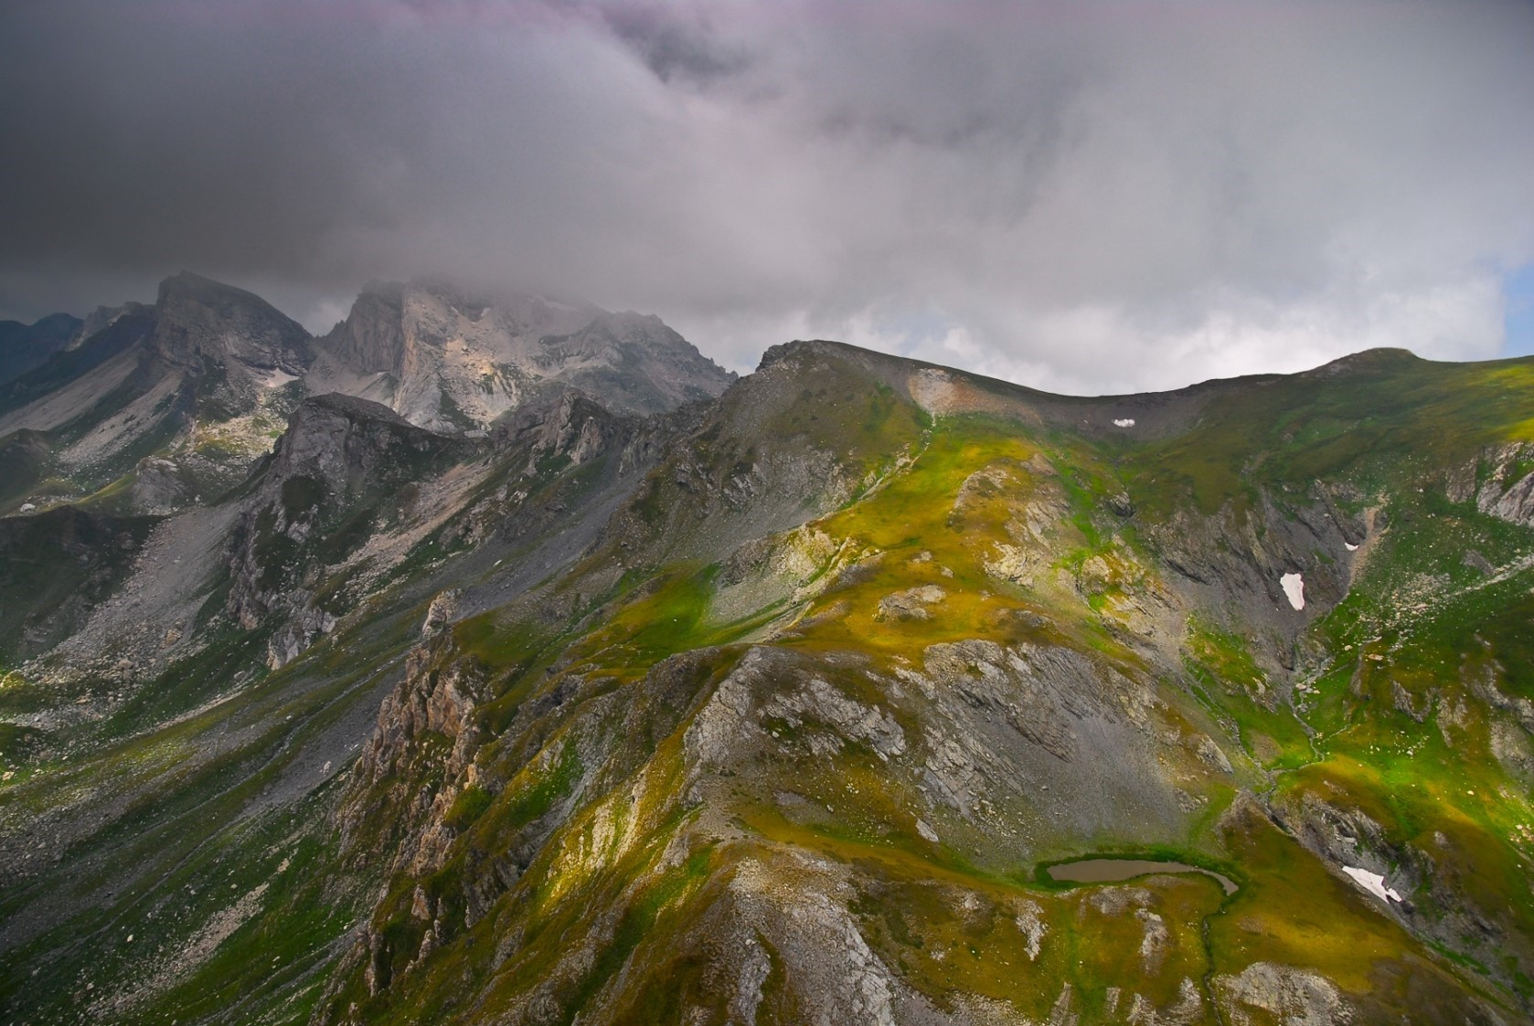
Mavrovo national park and planned hydropower projects on it’s territory
Аna Colovic Lesoska
Eko-svest
Bern Convention Standing Committee meeting,
28.11-.2.12.2022

Slide 2
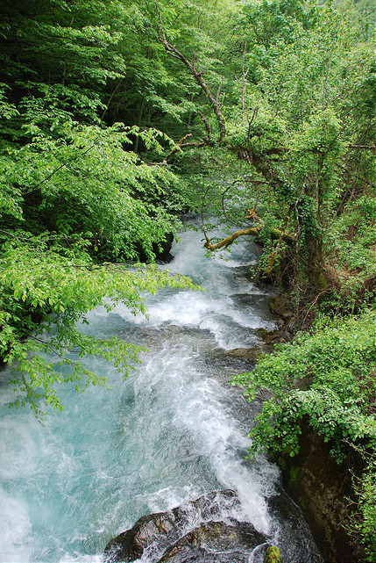
About the case
Complaint submitted in 2013
Case file opened in 2014
On the spot appraisal 2015
Recommendation 184 (35th Standing Committee meeting)
On the spot appraisal May 2021
Recommendation 211 from (41st Standing Committee Meeting)

Slide 3
Update on the case
1. Suspend and cancel approved concessions and those planned for construction and implement a ban on hydropower plants (large, medium and small) both a) in national parks, protected areas, World Heritage Sites and other candidate Emerald sites (potential future Natura 2000 sites) as their implementation will cause problems with compliance with the Bern Convention and b) that will impact on these locations if constructed outside their boundaries.
The Government of North Macedonia recently revoked 7 concessions for small hydropower plants in the newly proclaimed Shar Mountain National Park.
No new concessions have been issued. No ban on new projects has been adopted.

Slide 4
Update on the case
3. Ensure proper implementation of the EU Water Framework Directive National Law regarding environmental flow of streams and prevent excessive withdrawal of water in streams within or impacting upon Mavrovo National Park, other protected areas, World Heritage Sites and Emerald candidate areas.
The Ministry of environment organized a public hearing for the draft Law on Waters. The draft Law published has not yet been adopted.
The draft version of the Law includes a definition of the ecological flow. No bylaws have been prepared to define the methodology for determining the ecological flow.

Slide 5
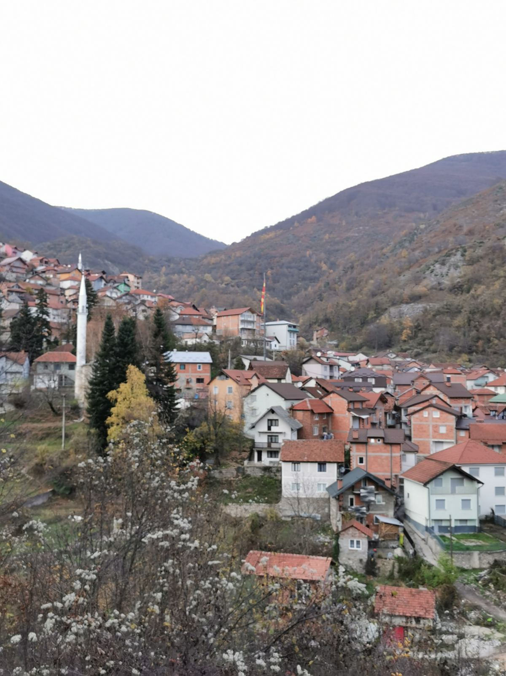
Update on the case
4. Ensure that core funding for the operation and management of national parks in North Macedonia comes from the state budget and not from the excessive harvesting of natural resources and other unsustainable sources of funding (complying with IUCN ctg. II protected area standards).
No state funding for protected areas is available, with the exception of the newly proclaimed national park Shar Mountain.

Slide 6
Update on the case
6. Accelerate the process of preparation of the valorisation study for Mavrovo National Park, taking into account all international and national standards for nature conservation and protected areas, including IUCN protected area and World Heritage Sites standards. Increase efforts to complete the process of re-proclamation and adoption of a new law for Mavrovo National Park and prepare an effective and comprehensive management plan for the park.
Eko-svest organized a coordination meeting for the Ministry of environment and the NP Mavrovo authority to discuss the details on the new/updated valorization study (July 2022).
No funding has been secured to date.

Slide 7
Update on the case
7. Ensure that there are no further extensions for applications for legalisation of objects that were built without permission in Mavrovo National Park, other protected areas and World Heritage Sites.
The draft Law on regulating the status of illegal objects has not been adopted yet, Parliament has announced that a supervisory hearing will be organized to address the gaps in data and to help them in finalizing the Law.
A change in the construction law was recently adopted with a shortened procedure, enabling non-polluting industry to receive construction permits (or legalization of objects) if they invest in renewable energy projects (solar rooftops). It is unclear if this provision is also valid for protected areas and if so if there are any additional provisions taking into consideration the Bern Convention recommendation.

Slide 8
Update on the case
8. Improve and maintain the capacity of protected area management and monitoring structures in accordance with international methodologies and IUCN standards, including the principles of implementing the primary management objective for the protected area over at least 75% of its territory. Ensure that expert staff are deployed in all management unit positions to enforce legislation, carry out proper wildlife and habitat management, and carry out inspections and monitoring.
In some protected areas there has been a visible progress with staffing, in others there has been no particular progress.
In most protected areas (except national parks) there are no certified rangers in place. Protected area managers (municipalities) have limited funding and no permission for new employments or creation of new departments responsible for nature protection and monitoring

Slide 9
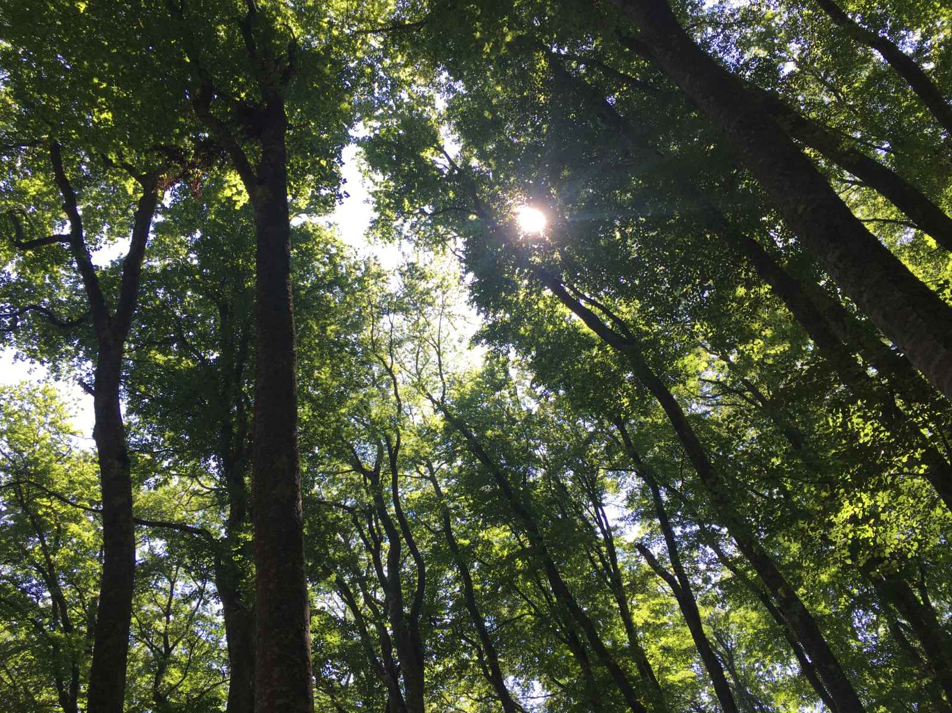
Update on the case
9. Harmonise spatial and sectoral plans, especially on tourism and urban settlements in order to prevent further urbanisation and degradation inside national parks and protected areas. Encourage sustainable, environmentally friendly forms of tourism, which are based on the IUCN standards for tourism in protected areas.
The preparation of the spatial plan is ongoing, however no public information is available on the process to date.

Slide 10
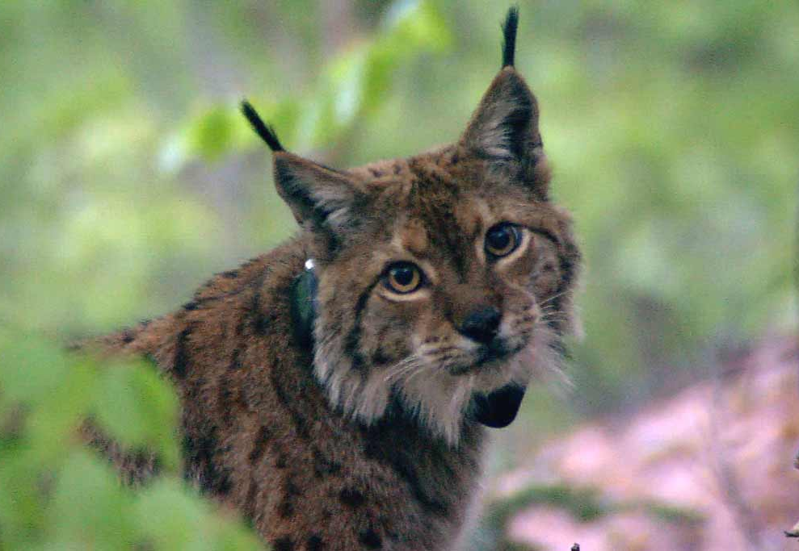
Update on the case
11. Review, endorse and re-implement the Conservation Action Plan for Balkan Lynx in National Park Mavrovo developed in cooperation with the Balkan Lynx Recovery Programme in 2013 and ensure funding for the implementation of the plan.
The Balkan Lynx Conservation Action plan has not been updated and adopted. No state funding is available.

Slide 11
Update on the case
12. Improve the cooperation between Mavrovo National Park, neighbouring national parks in North Macedonia, the adjacent communities and extant or potential lynx areas in neighbouring countries with regard to wildlife and habitat conservation and management to ensure the connectivity of these sites and the expansion of the lynx population. In this respect, consider the development and implementation of a National Lynx Action Plan.
Several ongoing CSO led projects to facilitate cross border cooperation between North Macedonia, Albania and Kosovo are contributing to the improved cooperation among protected areas.

Slide 12
Update on the case
13. Improve collaboration among government agencies, complainants, NGOs, scientists, and stakeholder groups to expedite the process of effective protection and management of Mavrovo National Park, Ohrid Lake, and Galichica National Park. This collaboration has improved greatly in recent years, but more efforts are needed to achieve protection and development goals. There is also an urgent need to involve Albanian decision makers and other relevant stakeholders and to promote transboundary cooperation between the two countries.
А meeting between the State authorities (Working group for the Bern Convention) and Complainant CSOs held on 7.11.2022 regarding both open case files for North Macedonia. However, at the meeting the progress for each of the recommendations was not discussed, nor further information was shared about the status by the State authorities.
Eko-svest proposed that regular meetings (at least once a quarter) are held to update both parties on the progress and status for each point of the recommendations.

Slide 13
Proposal to the Standing Committee
Cancel the remaining three concessions in Mavrovo NP (Zhirovnica 5 and 6 and Ribnicka sHPP).
Accelerate the adoption of the new Law on nature which will:
include the ban on new hydropower projects in protected areas,
incorporate new international standards on the prohibition of hydropower plants in World Heritage Sites (beech forests in Mavrovo National Park are part of serial Beech Forests World Heritage property) and ensure due diligence for protected areas
ensure the employment of professional staff in protected areas at all levels and structures.
guarantee state funding for protected areas and prescribe the mechanisms for funding.

Slide 14
Proposal to the Standing Committee
Immediately start the process of reproclamation of Mavrovo NP by initiating public consultations and desktop analysis of existing documentation.
Start the process of update of the Balkan Lynx Conservation Action Plan.
Start the process of preparation of the methodology for determination of ecological flow in cooperation with civil society organisations.
Establish regular coordination and consultation between State authorities and CSO Complainant.

Slide 15
Thank you for your attention

