Slide 1

7th meeting of the Ad hoc Working Group on Reporting
Reference tables, schemas and validation rules for Resolution No. 8 (2012) reporting 2019-2024

Slide 2
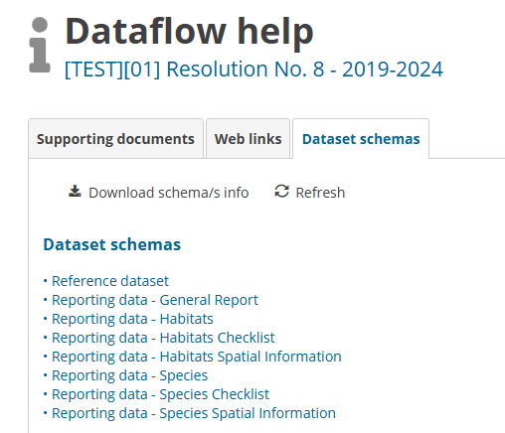
Dataset schemas
Relations among schemas and among tables and fields-> interlinks

Slide 3
Reference lists
Reference Lists are included in the refLOVs of EET

Slide 4

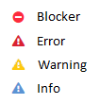
Validation rules
Complex system of validation rules among tables and schemas (more than 1000 validation rules to check your data!)
More challenging than previous reporting -> assurance of data quality
Still on-going Thank you for your data!
Validation rules have been adapted from Art.17, considering specificities of Resolution No. 8 reporting: more optional fields, fields related to changes and first-time reporting. Less BLOCKERS than in Art. 17, only those related with integrity and coherence of data.
Recommendation: when checking the result of validations rules (open the Reporting format and the Explanatory notes of the reporting format) and filter by type of ERROR
BLOCKERS NEED TO BE CORRECTED
Try to correct ERRORS too, especially those fields involved in the CS MATRIX
Complete set of VALIDATION RULES will be included in the Reporting Reference Portal

Slide 5
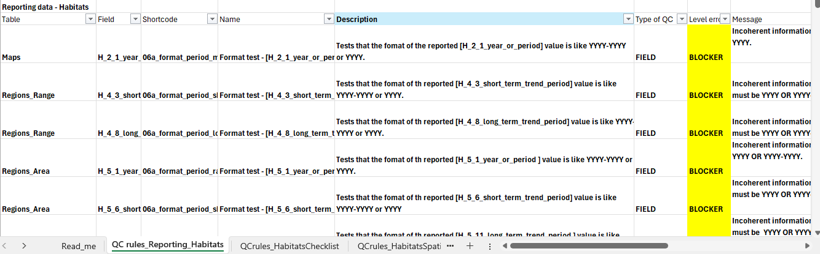
Validation rules
Revision of the validation rules schema by schema and table by table:
Be sure that you understand BLOCKERS

Slide 6
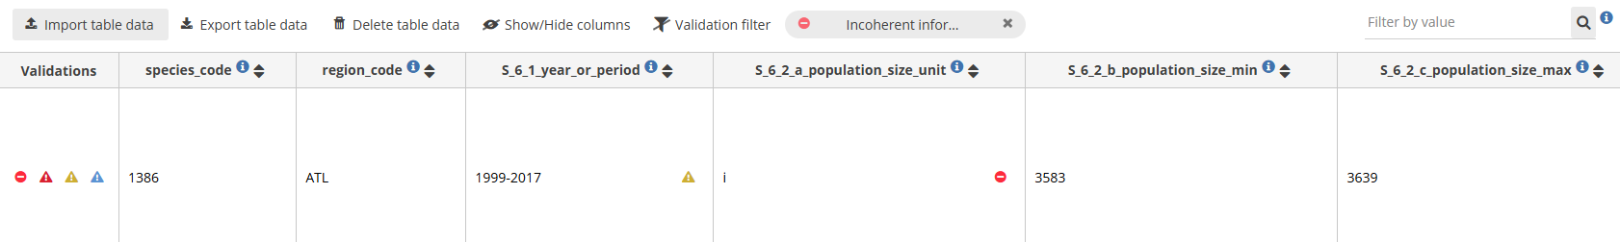
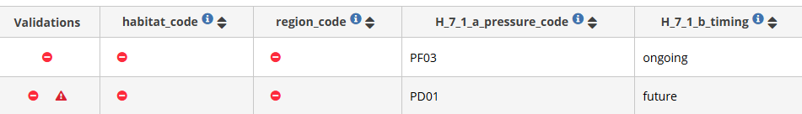



Validation rules: examples
BLOKER related to the population unit. Pop unit in S_6_2 should be the same than the pop unit included in the Reference Lists. When using different pop unit-> Use S_6_5 additional pop.
BLOCKER: missing code and BGR

Slide 7
Validation rules: examples
Please, don’t leave tables blank, use “lack of data”, “unknown” fields. All tables need to contain sp/ht code and BGR (mandatory fields)

Slide 8

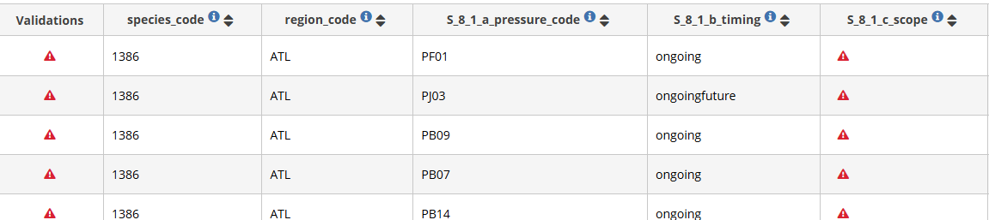

Validation rules: examples
Misuse of the EET-> copy paste the content of _mv columns, when there are a few values, they should be separated by “;”. No add additional text.
When a pressure in on-going the scope should be reported

Slide 9




Validation rules: examples
Incoherent information. The field [H_10_1_conclusion_range] should be 'U2 - Unfavourable - Bad' if the value in field [H_4_12_b_favourable_reference_range_predefined] is "between 11% and 50% smaller than FRR" or “between 51% and 100% smaller than FRR”
Incoherent information. The field [H_10_2_conclusion_area] should be 'U2 - Unfavourable - Bad' if the value in field [H_5_15_b_favourable_reference_area_predefined] is ‘11-25% smaller than the FRA’ of ‘26-50% smaller than the FRA' or '51-100 - between 51% and 100% smaller than the FRA'.
Incoherent information. The field [H_10_3_conclusion_structure_and_function] should be 'U2 - Unfavourable - Bad' if the mean of fields [H_6_1_b_condition_notgood_min] and [H_6_1_b_condition_notgood_max] is more than 25% of the mean of fields [H_5_2_a_surface_area_min] and [H_5_2_b_surface_area_max].
Area in not good condition=10 km2
25% of 13.5 =3.375 km2

Slide 10
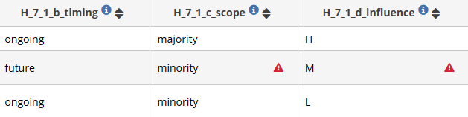


Validation rules: examples
No needed for future pressures, only for on-going
Measures needed but cannot be identified
Incoherent information. Fields [H_8_3_a_measures_purpose] and field [H_8_3_b_measures_main_purpose] should be empty if the value in field [H_8_1_b_measures_status] is 'Measures are identified, but not yet taken' or if 'Measures needed but cannot be identified' or if the field [H_8_1_b_measures_status] is empty.
Incoherent information. Field [H_8_4_measures_location] should be empty if the value in field [H_8_1_b_measures_status] is 'Measures are identified, but not yet taken' or 'Measures needed but cannot be identified' or if the field [H_8_1_b_measures_status] is empty.
Incoherent information. Field [H_8_5_measures_response] should be empty if the value in field [H_8_1_b_measures_status] is 'Measures are identified, but not yet taken' or 'Measures needed but cannot be identified' or if the field [H_8_1_b_measures_status] is empty.

Slide 11
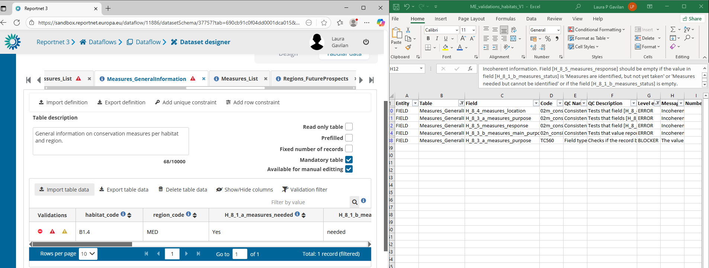
Validation rules: recommendations

Slide 12
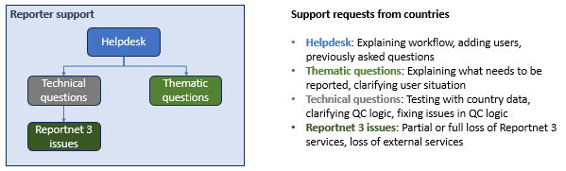
Validation rules: recommendations
All the schemas' structures and validation rules must be fully considered when preparing data
Disregarding this can result in mistakes that must be rectified before the data is delivered
The same applies to the code lists considered

Slide 13

Thank you for the attention

