Slide 1
AD-HOC WORKING GROUP ON REPORTING National summary dashboards of the first reporting under Resolution No. 8 (2012) Marc Roekaerts
Notes:
A few words on the Council of Europe and why the Convention was negotiated there.

Slide 2
1 The countries databases
1 The countries databases
National summary dashboards of the first reporting under Resolution No. 8 (2012)
• Number of habitats and species reported per country and per biogeographical region • Conservation status and trends of habitats and species • Main pressures and threats • Data completeness and quality

Slide 3
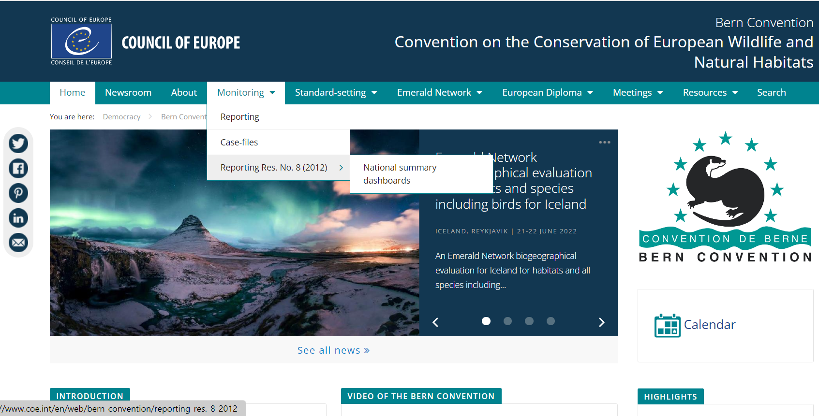
Dashboards accessible from the Bern Convention Webpage

Slide 4
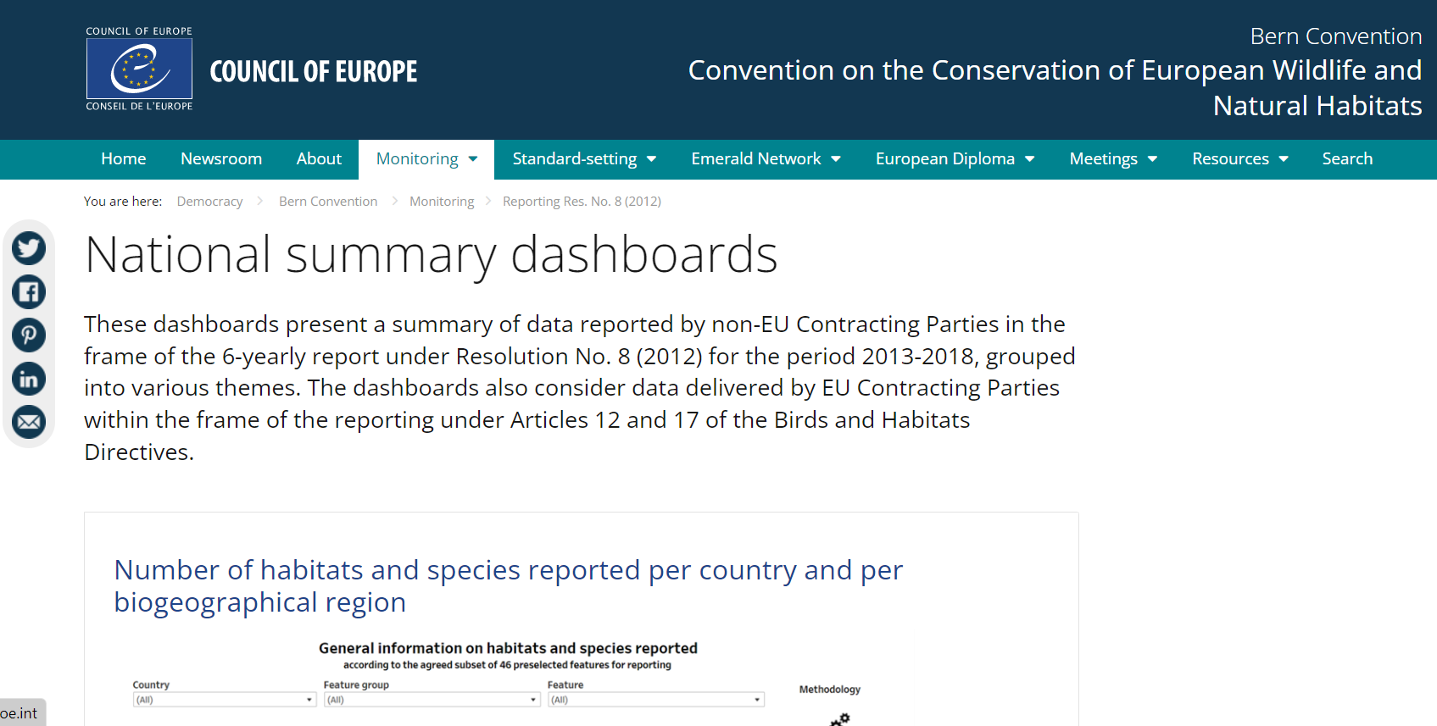
Introduction page
https://www.coe.int/en/web/bern-convention/national-summary-dashboards

Slide 5
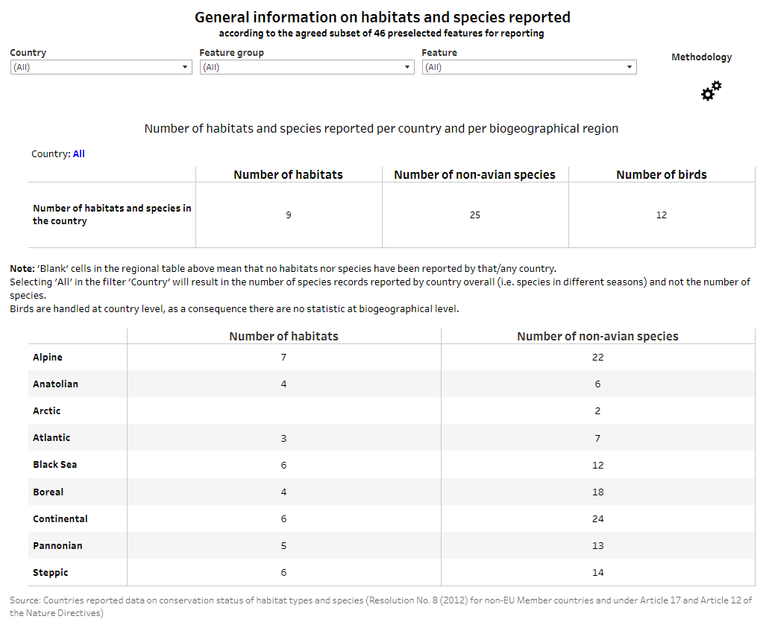

Slide 6
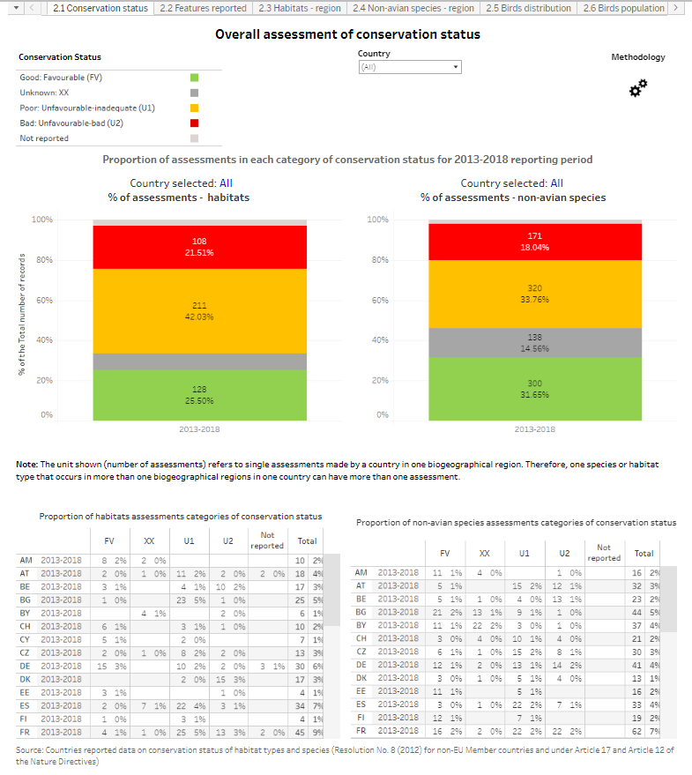

Slide 7
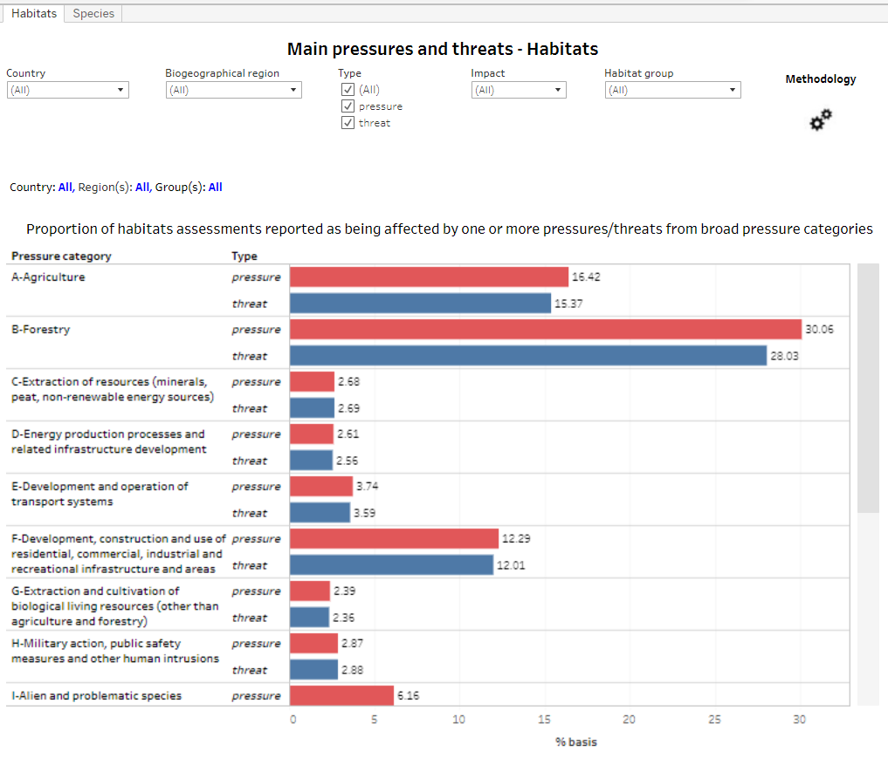

Slide 8
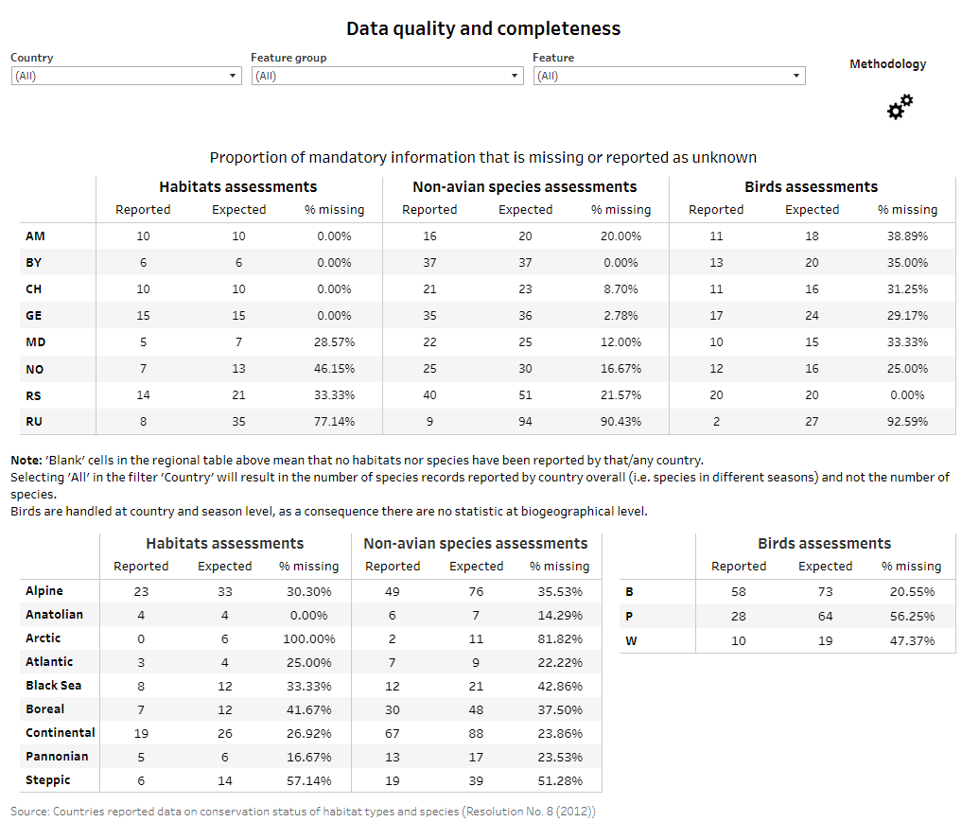

Slide 9
Concluding remarks
The National Summary Dashboards are based on the data as delivered by the countries
The data of Art. 12 and Art. 17 of the same features as reported by non-EU countries are merged with the Resolution No. 8 data
The dashboards should raise the awareness of Resolution No. 8 (2012) reporting
They should be used as a tool to browse the data and to foster ideas and plan the future reporting round(s)
....

Slide 10
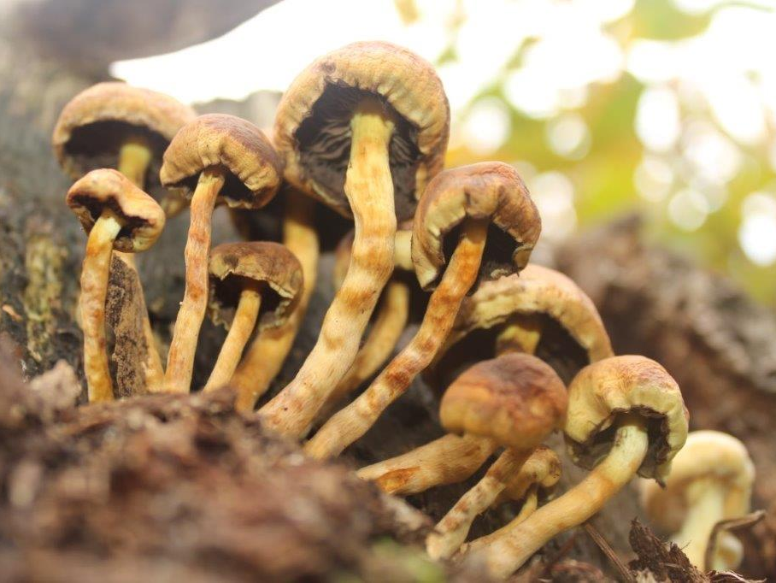
Thank you for your attention

