Slide 1
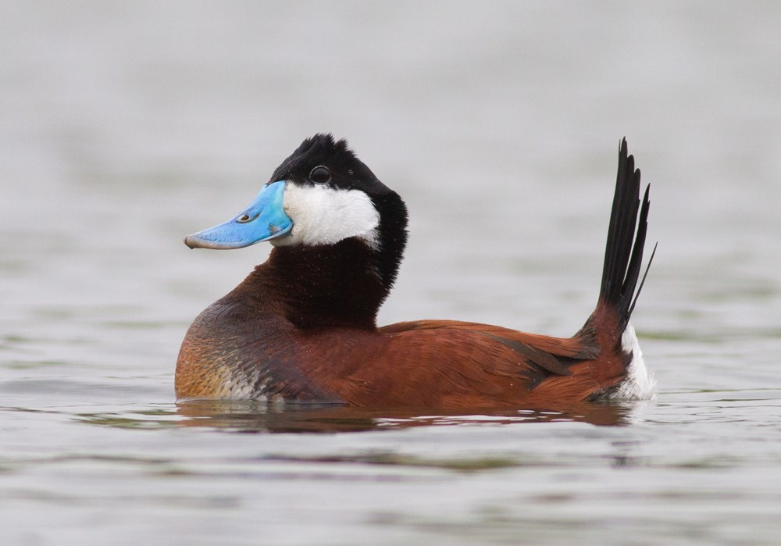
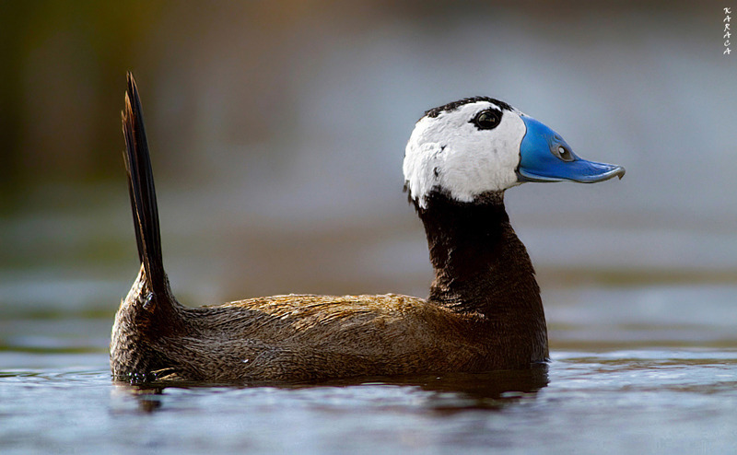
Eradicating Ruddy Ducks in the Western Palaearctic
Progress update 2022
Peter Cranswick & Colette Hall
Notes:
A very brief overview for context –
Ruddy Duck is an introduced species in Europe. A large population became established in the UK in the 1990s, and from there spread to many countries across Europe. It became the main threat to the native White-headed Duck.
The Bern Convention developed an eradication plan in the 1990s which is updated every five years, most recently in 2020.

Slide 2
Recommendation No 209 (2020) of the Standing Committee
All Contracting Parties to implement without delay the actions specified in the ‘Action Plan for the Eradication of the Ruddy Duck, 2021–2025’
Goal – Ruddy Ducks stop being a threat to the White-headed Duck
Outcomes
Ruddy Duck is functionally extinct in the wild in the Western Palaearctic by 2025
Progress is regularly assessed and adaptively managed
Contracting Parties coordinate their activities to collectively achieve the plan’s outcomes and targets
Notes:
One of the aims of the plan – eradication in the wild – is within reach.
The outcomes of the latest plan reflect that eradication in the wild is achievable in the current plan period In this final stage, we will actively track progress – each year checking that the plan remains on course, identifying problems as soon they arise, so they can be solved quickly.
This is of paramount importance as we reach the closing stages – collective actions need to be coordinated and synchronous if the plan is to succeed.

Slide 3
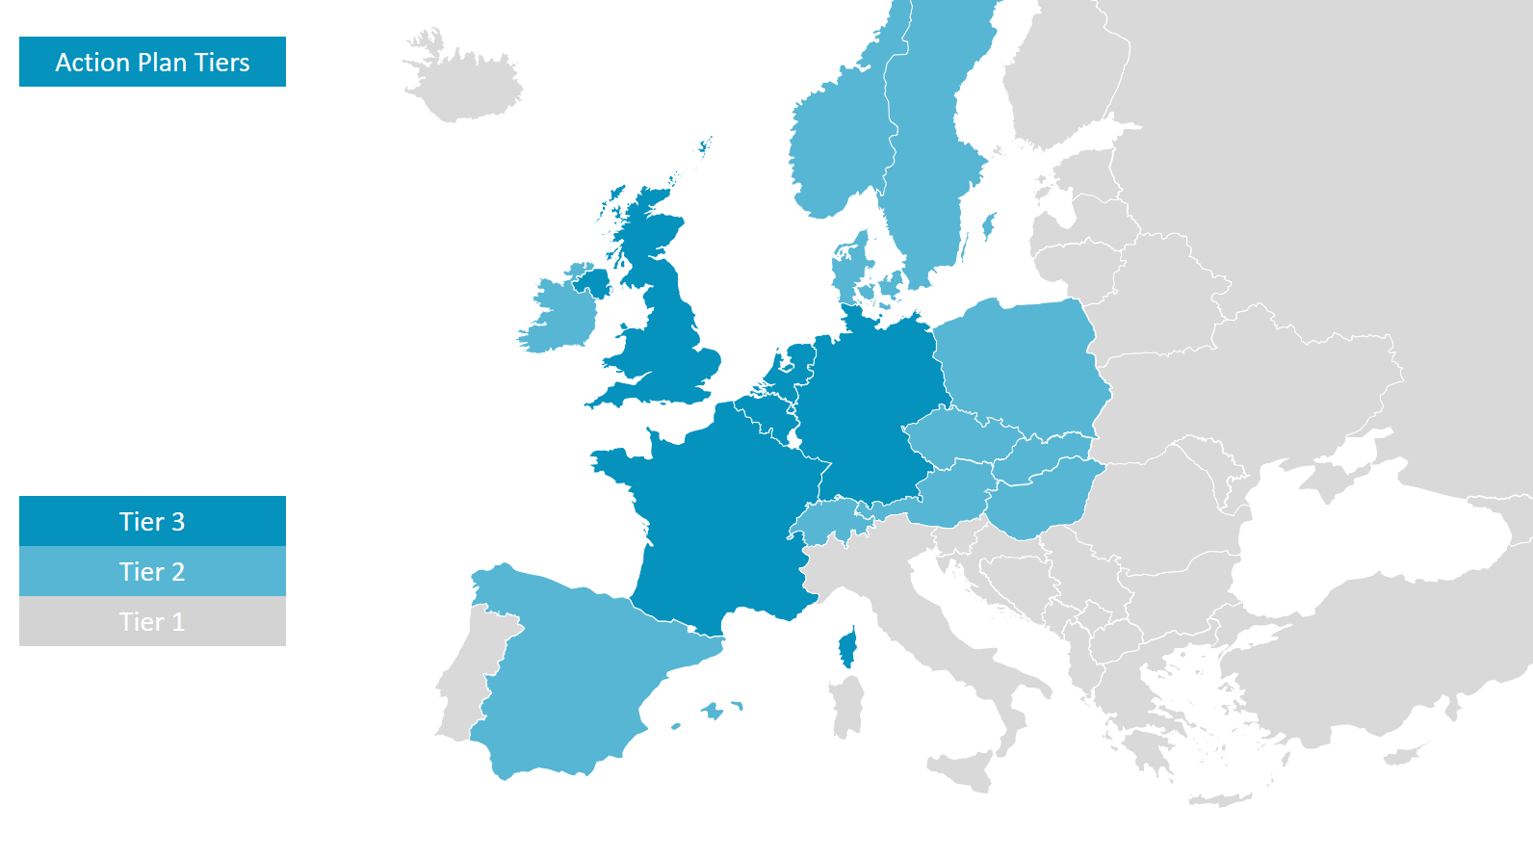
Notes:
For the plan, CPs are placed in Tiers, requiring different actions relevant to their situation –
Tier 3 – are those with breeding and/or significant numbers of Ruddy Ducks – these countries need proactive control programmes
Tier 2 – are those at significant risk of birds arriving from Tier 3 countries – requiring reactive control
Tier 1 – all other CPs – who actively monitor
Monitoring and adaptation –
A questionnaire is sent to all CPs to assess progress – responses were received from 28 (an improvement over 19 previous year)
A meeting was held of Tier 3 countries for adaptive management – technical experts from the five countries review progress and identify key issues so these can be addressed immediately to ensure the plan meets its goal

Slide 4
Numbers of individuals
Tier 3 | winter 2019/20 | summer 2020 | winter 2020/21 | summer 2021 | winter 2021/22 | summer 2022
BE | 8 | 8 | 5 | 6 | 10 | 9
FR | 57 | 13 | 14 | 13 | 59 | 19
DE | 13 | 9 | 12 | 5 | 13 | 16
NL | 100–120 | 80+ | 100–120 | 75+ | 112 | ?
UK | 12 | 12 | 14 | 14 | 14 | 14
Records in other Tiers in winter 2021/22 or summer 2022 –
Tier 2 – found in TWO CPs
Tier 1 – found in TWO CPs
Notes:
A brief overview of key results –
Results of from recent years paints a picture of relatively small numbers in most Tier 3 countries – generally fewer than 20. The main part of the population is in NL, with over 100 birds.
Notable points from the last year –
France – a notable jump, with a bigger number than in recent years. This was an influx of 50 birds in December 2021, present till February.
Germany – better coverage and better assessment in the last year. Figures in the table are the max individuals in a single month, but based on repeated observations at same sites, the estimate is of 40 birds. That’s a significant number of birds, and many more than we previously thought.
Very few are seen elsewhere – generally just single birds for short periods. These are assumed to be wanderers from Tier 3 countries.
So, the overall population may number 200, possibly 250 (cf 175 last year), but there is some uncertainty given the curious influx in France.

Slide 5
Breeding pairs
Tier 3 | 2020 | 2021 | 2022
BE | 0 | 0 | 0
FR | 10 | 2 | 5
DE | 1 | 0 | 0
NL | 20+ | 22+ | ?
UK | 2 | 1 | 1
Notes:
For breeding numbers, no significant change in picture
In some countries, individuals are widely spread and don’t meet, so breeding is rare
The key concern is the significant numbers of birds still breeding in NL – at least 20 pairs.
A breeding pair was seen in BE in 2022, but was controlled

Slide 6
Numbers controlled
Tier 3 | 19/20 | 20/21 | 21/22
BE | 2 | 2 | 2
FR | 88 | 61 | 10
DE | 1 | 0 | 2
NL | 33 | 19 | 29
UK | 1 | 0 | 1
DK – 6, 9 and 9
Notes:
The numbers controlled now are small, simply because the wild population is smaller.
A couple of points to note –
The key need for control is in NL. Based on experience in the UK and France, the number controlled each year needs to be similar to the winter count to achieve a significant reduction. So, this figure in NL needs to be around 100. This need was a focus of last year’s report, and whilst there is no obvious increase in NL yet, there is positive progress to report.
Germany – very few are controlled, which is now significant given the new estimate of around 40 birds there.
The only birds controlled elsewhere were, again, in DK – control in each of the last three years. DK to be applauded for this.

Slide 7
Meeting of Experts (Tier 3) – conclusions
Belgium
status quo maintained – numbers remain small and control is effective
possibility some are escapes
France
influx of 50 birds in December 2021 – origins unclear
trapping methods are being developed
significant reduction in captive numbers from 200 to 100 birds
Notes:
Tier 3 countries meet annually to review progress in detail, identify needs and ensure these are acted upon without delay
Key points from this summer’s meeting –
Belgium –
France –
The influx is of unknown origin. This would paints a different picture for the population if the increase were real.
Control is a challenge because birds occur on large lake where birds are often too distant to shoot. Trapping methods started to be developed, but were delayed by Covid – those efforts are being renewed
Good progress is being made under EU IAS on captive birds by working closely with private breeders – FR the only country making obvious progress on this issue

Slide 8
Meeting of Experts (Tier 3) – conclusions
Germany
population revision – approx 40 birds, widespread
little or no effective implementation of control programme
The Netherlands
positive progress to address barriers to control in Noord-Holland – access to N2000 sites, use of firearms, professional hunters, and coordination
expectation is numbers controlled will increase
controlled birds included an escape
United Kingdom
status quo maintained – population close to functionally extinct
Notes:
Germany –
The obvious issue is the much larger numbers there – notable, also, is that birds were found in 8 of 16 federal states
Allied to that, there is little control – the issue is similar to NL, with responsibility devolved to regions – the practicalities and use of firearms are given as key reasons for lack of progress
Netherlands –
Good progress to address and resolve underling issues in Noord-Holland
No difference yet in numbers controlled – but the expectation is that numbers controlled in this region will increase markedly
An escaped bird from Germany was found among those controlled
UK
Few birds, widely distributed – difficult to control, but targeted control efforts to keep birds from meeting/breeding – so will die out naturally

Slide 9
Key needs
Numbers in the wild
Clarify total population size
Control
Ensure changes in Noord-Holland have an impact on numbers
Roll out this approach to other Provinces in the Netherlands
Establish clear system and overcome barriers for control in Germany
Maintain momentum elsewhere – develop trapping in France
Coordination as numbers get smaller – share information in border areas
Captive birds
Learn from positive progress made in France
Notes:
Numbers The 50 in FR is curious. We hope this is not a genuine increase. Genetic analysis and comparison of monthly counts in NL with FR will help clarify; as will another year’s data
Control
It is important that good progress on the control issues in Noord-Holland translates into real progress on the ground. A big reduction in NL numbers is THE obvious big need for the eradication plan.
Important to roll out those new systems in N-H to other Provinces asap – to ensure they overcome the political and systematic issues; the close coordination established between Provinces should allow this
Need to explore the control systems in Germany in detail, to understand what’s not working. The issues there are not new – the practical issues have all been addressed in other countries, and the federal issue is understood from NL. Important to actively seek help from other CPs to ensure there is a clear and workable plan – 40 birds is a significant number, and we need to make inroads quickly
Elsewhere – important to maintain good control programmes in BE, UK, DK and FR – and in FR, where it’s particularly challenging, developing effective trapping will be key
Coordination – control has to happen synchronously. CPs would benefit from sharing of information, particularly in border regions where it’s likely birds move around
Captive birds
The priority is clearly wild birds – but there is a clear need to make progress with captive birds. Applaud FR for real positive progress – there must be opportunities for other CPs to benefit from that. There are suggestions from several countries – NL, BE, DE and CH – that birds seen there are escapes, so this is an important issue to address.
Closing point –
We urge CPs to maintain this momentum – we are close to the end but even small numbers can increase again to a large population, so it is essential to maintain this coordinate pressure in all CPs to achieve the goal. Thank you

