Slide 1

Agenda Item 6.5: Follow-up of previous complaints and Recommendations
Recommendation No. 95 (2002) on the conservation of marine turtles
in Kazanli beach, Turkey
41st Meeting of the Standing Committee of the Bern Convention
29 NOVEMBER – 3 DECEMBER 2021

Slide 2
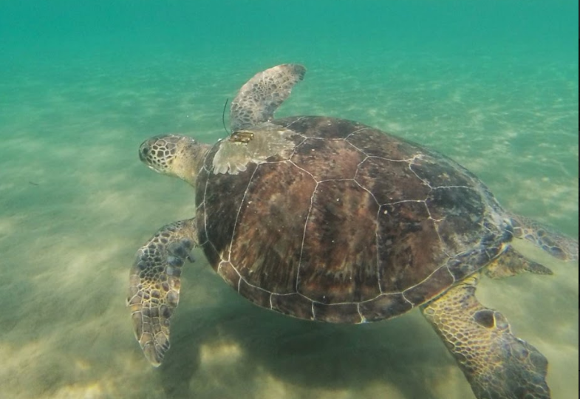
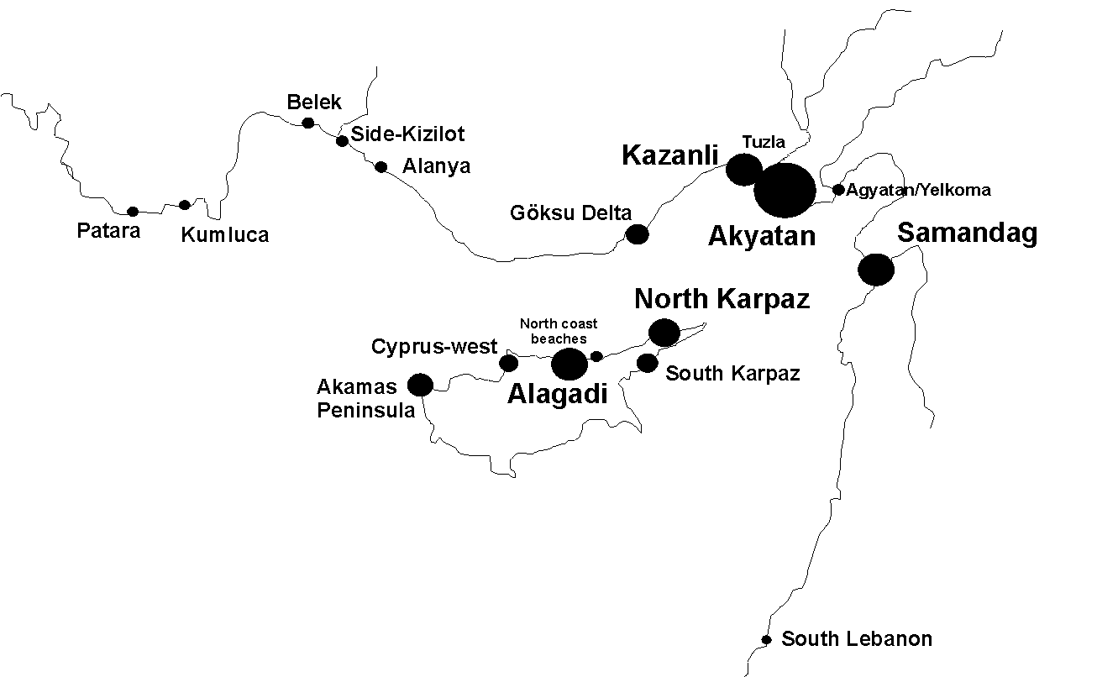
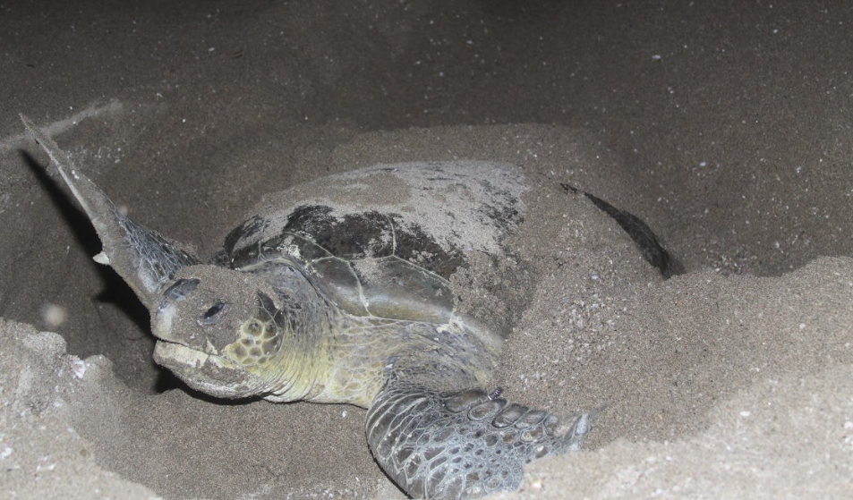
Green turtle Chelonia mydas nesting beaches in the Mediterranean
& Location of Kazanli
Lattakia
Photos: O. Turkozan | Marine Turtle Research Group, E. Duncan

Slide 3
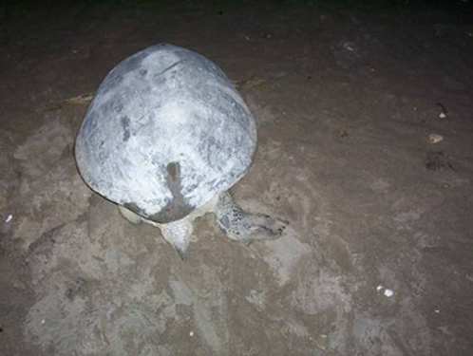
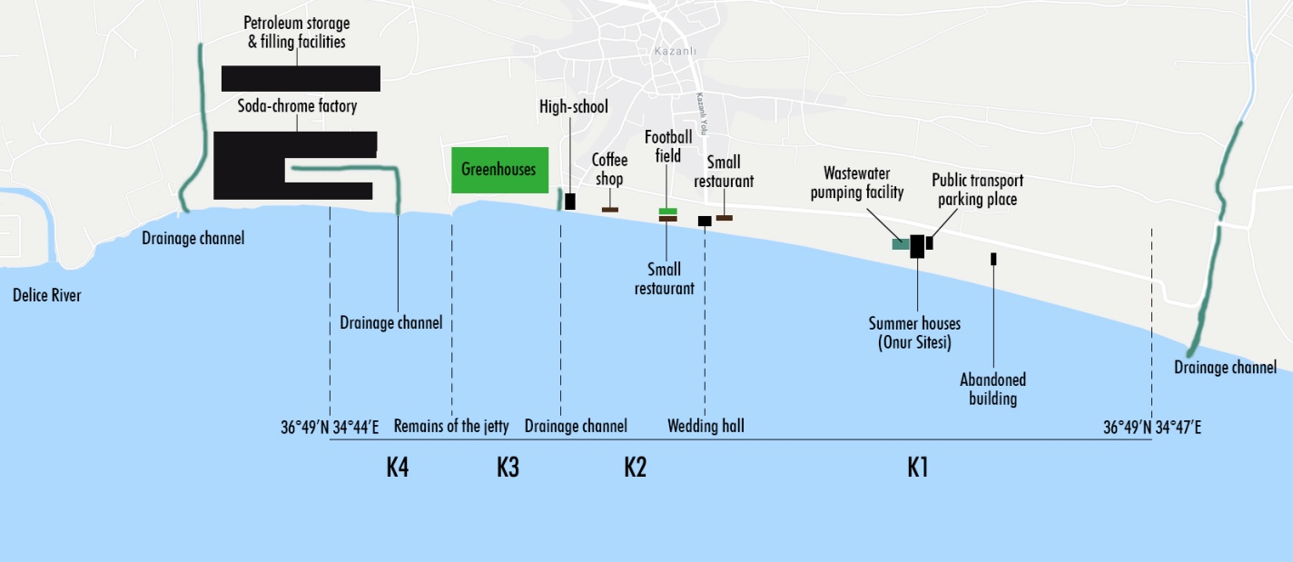
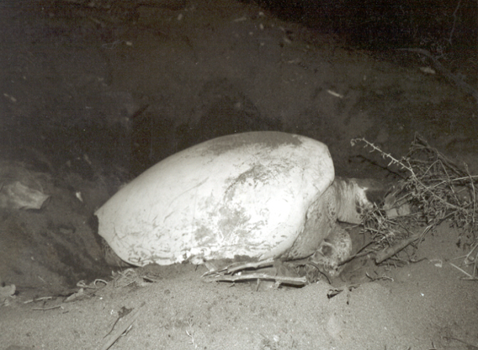
2001: Nesting green turtles encrusted with CaCO3 due to Soda Chrome Factory’s discharges into the sea.
Map of Kazanlı nesting beach sections
& coastal infrastructure

Slide 4
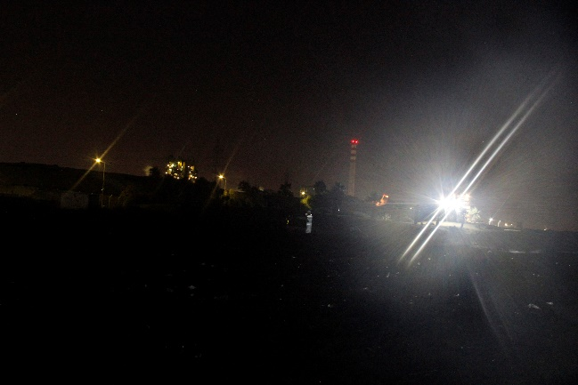
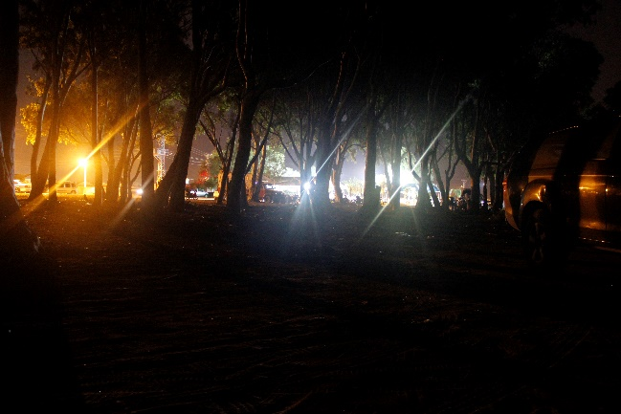
Recommendation No. 95 (2002)
    (3) remove plastic debris: insufficiently implemented → litter on all beaches
    (4) light screening: insufficiently implemented → light pollution from buildings, factory
    (5) nest monitoring: partly implemented → started July
    monitor chemical waste discharge → results not available
    (7) public awareness: insufficiently implemented → only 1 sign
    (14) reduce agrochemical impact: insufficiently implemented
    → drainage channels seem polluted
Light Pollution from Factory
Light Pollution from restaurants

Slide 5
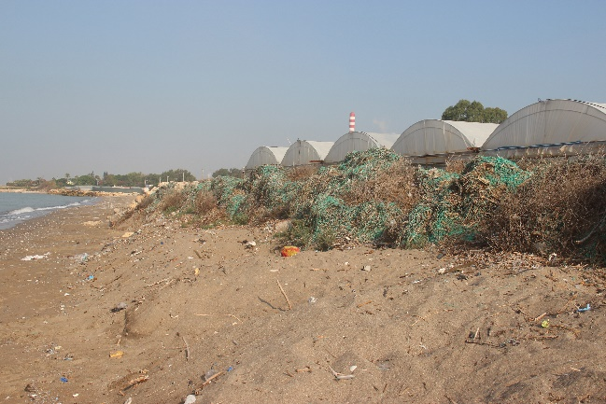
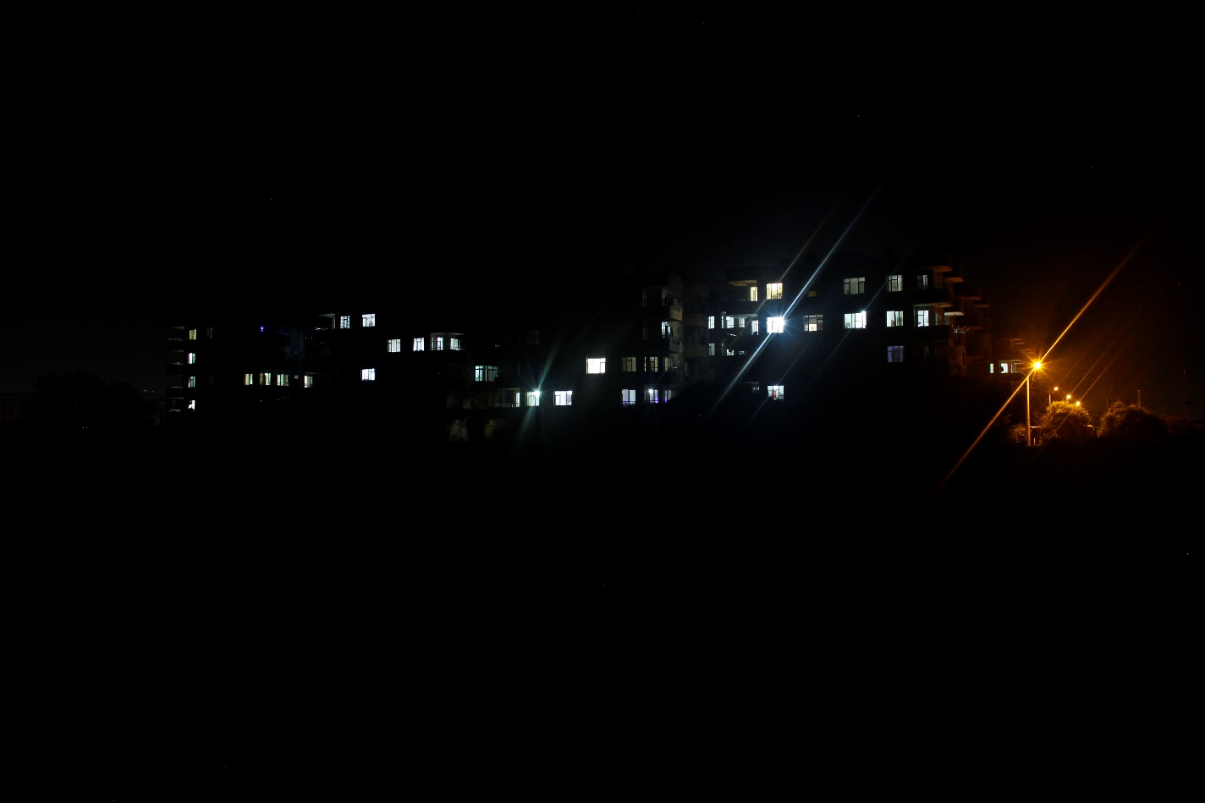
Recommendation No. 95 (2002)
    (3) remove plastic debris: insufficiently implemented
    (4) light screening: insufficiently implemented
    (5) monitor chem. waste discharge, nests: partly implemented
    (7) awareness: insufficiently implemented
    (14) reduce agrochemical impact: insufficiently implemented
    (1) remove greenhouses: not implemented, in use
    (2) move taxi parking : implemented
    (8) planning: “Beach Arrangement Project”?
    (9) remove illegal building: not implemented
    (11) remove wedding hall: not implemented
    (13) remove houses on beach:
    not implemented → legalised
    → light pollution
Light Pollution from summer house building

Slide 6
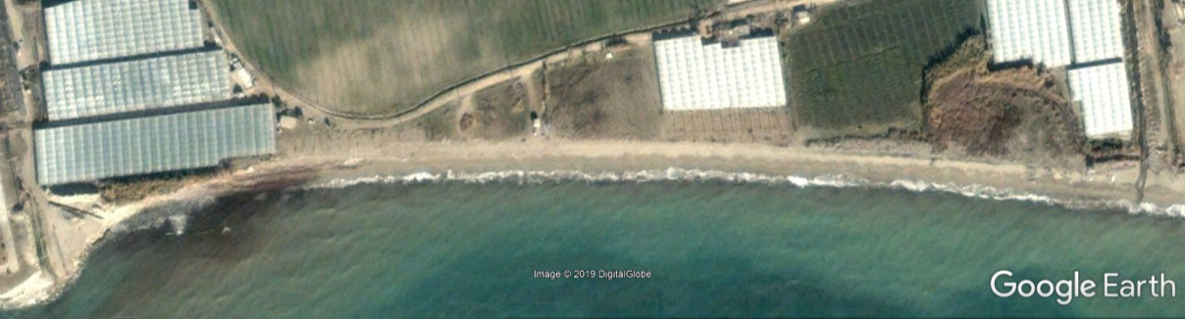
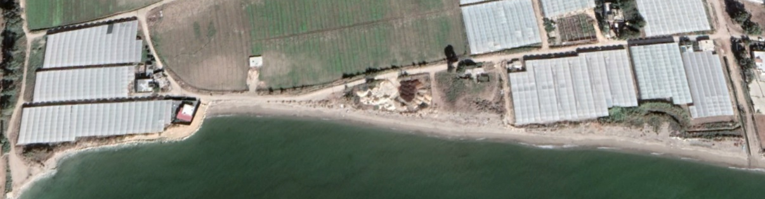
Recommendation No. 95 (2002)
    (3) remove plastic debris: insufficient
    (4) light screening: insufficiently implemented
    (5) monitor chem. waste discharge;nests: partly implemented
    (7) awareness: insufficiently implemented
    (14) reduce agrochemical impact: insufficient
    (1) remove greenhouses: not implemented
    (2) move taxi parking : implemented
    (8) planning: “Beach Arrangement Project”?
    (9) remove illegal building: not implemented
    (11) remove wedding hall: not implemented
    (13) remove houses : not implemented
  (6) monitoring beach erosion: not implemented, erosion continues
  urgent action needed
  coastal engineering studies, setback zone

Slide 7
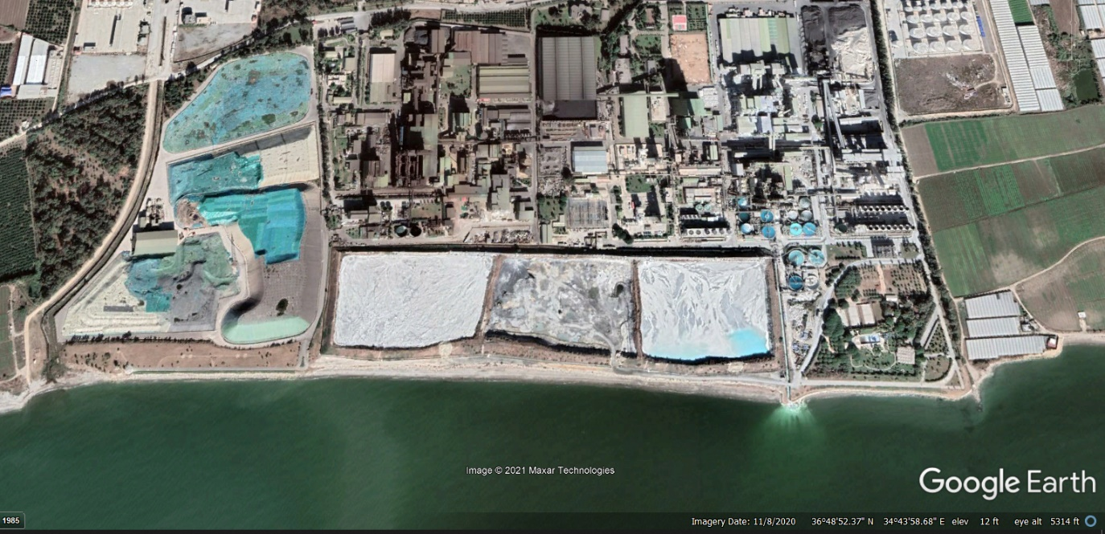
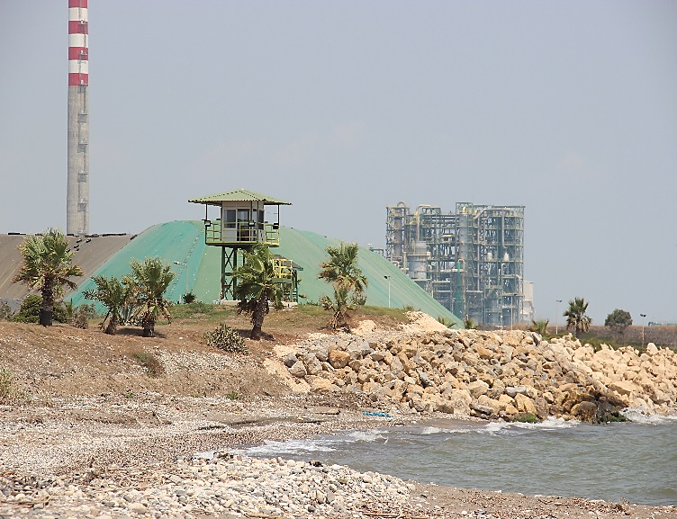
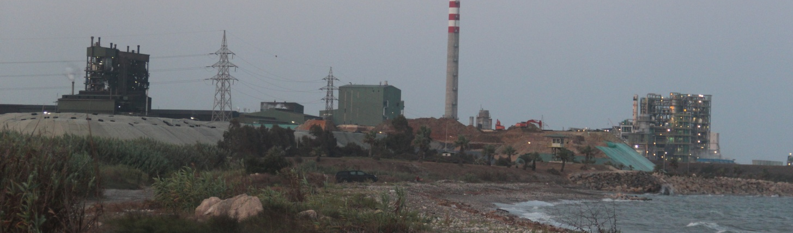
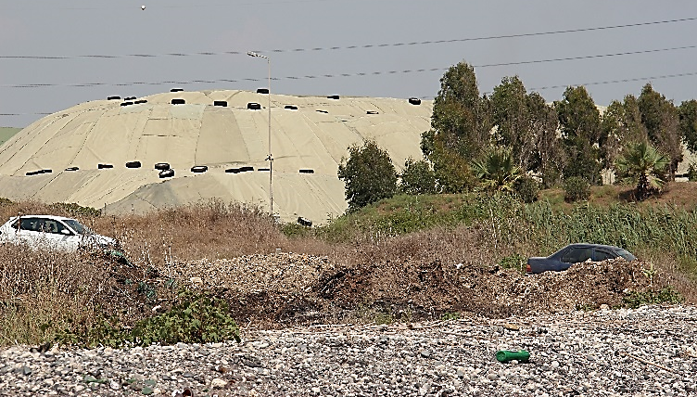
Recommendation No. 95 / Measure 10
Neutralised waste & 500.000 tn of toxic waste still remain next to nesting beaches & sea

Slide 8
Recommendation 95 (2002) NOT implemented
    (3) remove plastic debris: insufficiently implemented
    (4) light screening: insufficiently implemented
    (5) monitor chemical discharge; nests: partly implemented
    (7) public awareness: insufficiently implemented
    (14) reduce agrochemical impact: insufficiently implemented
    (1) remove greenhouses: not implemented
    (2) move taxi parking : implemented
    (8) planning: ”beach arrangement project”?
    (9) remove illegal building: not implemented
    (11) remove wedding hall: not implemented
    (13) remove houses on beach: not implemented
  (6) monitoring beach erosion: not implemented
  (10) remove hazardous waste: not completed
We call on the
Standing Committee to:
Urge Turkish authorities to implement all measures
Follow-up at the 2023 Meeting of the Standing Committee
Request full update by authorities on all measures & development plans

Slide 9
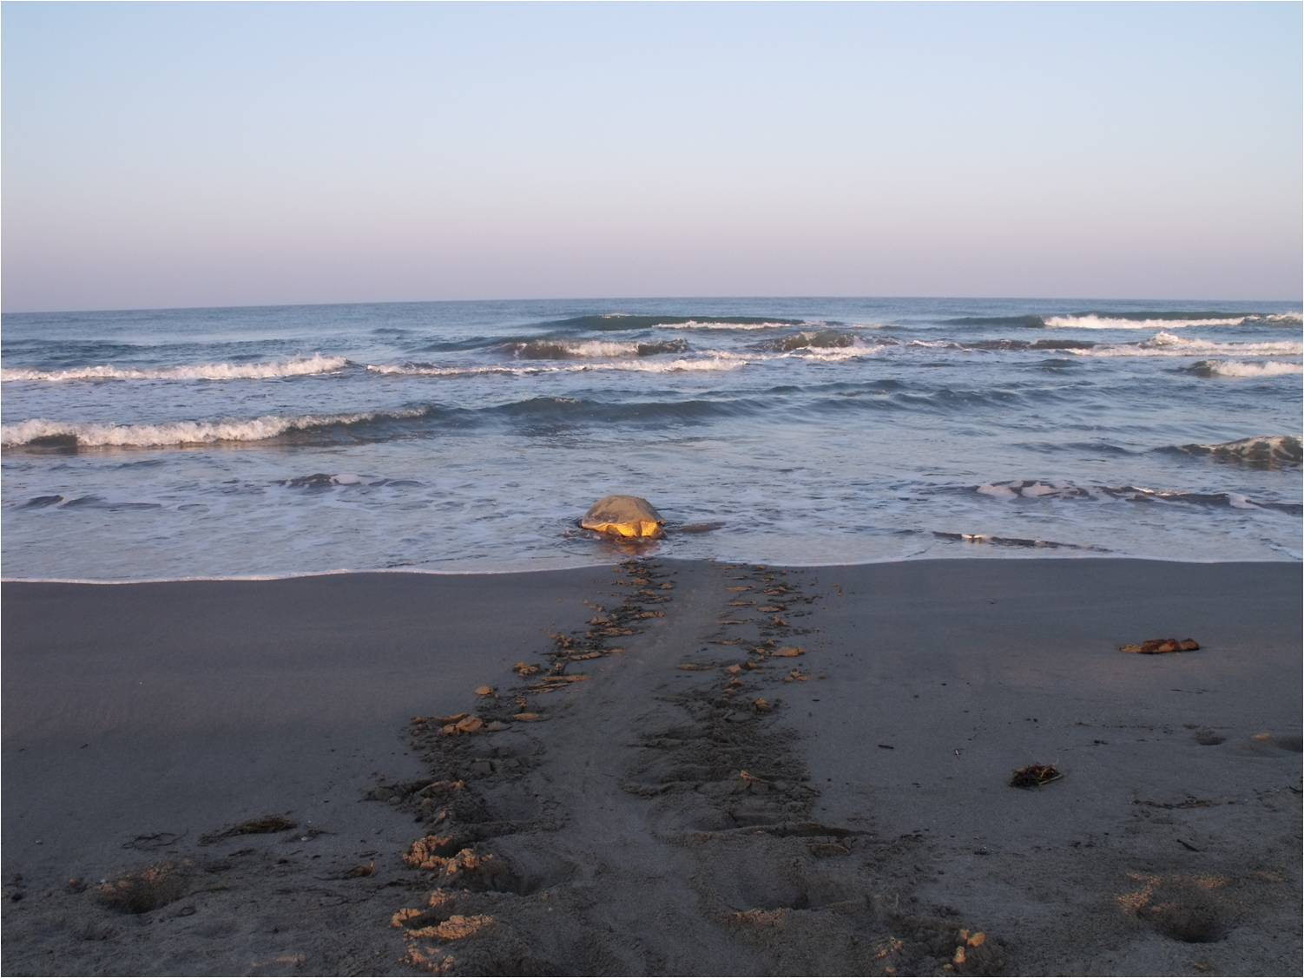
Thank You
for your attention
MEDASSET
Mediterranean Association to Save the Sea Turtles
medasset@medasset.org
www.medasset.org
Photo ©2012 K. Olgun, E. Bozkurt

