Slide 1
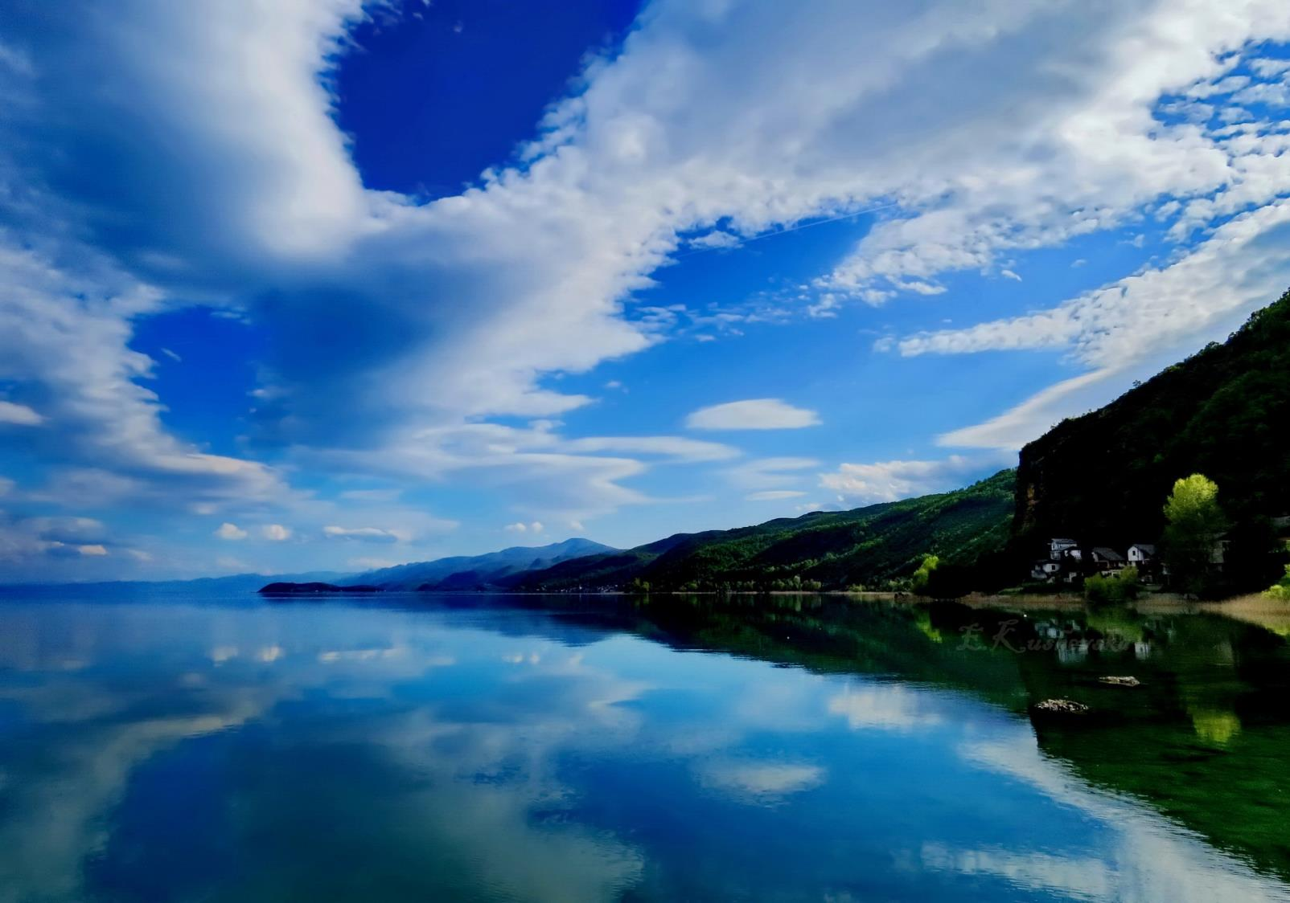
Threats to the Emerald sites
Lake Ohrid
and
Galichica
North Macedonia
Complaint No. 2017/2

Slide 2
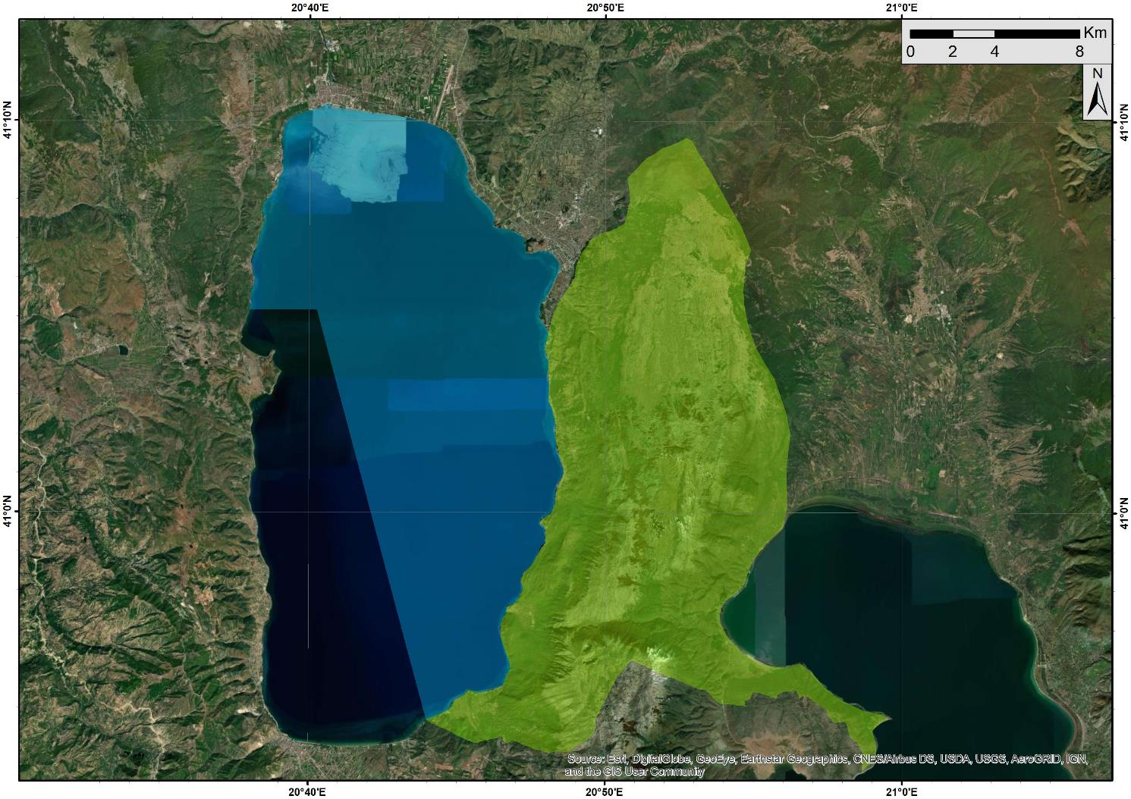
Emerald sites
Lake Ohrid and
Galichica
Type C - sites important for birds and other species and/or habitats
Location: Southwest part of North Macedonia
LAKE OHRID
Code: MK0000024
Area: 24370,00
GALICHICA
Code: MK0000001
Area: 22750,00
Potential NATURA 2000 sites
EMERALD SITE
LAKE OHRID
EMERALD SITE
GALICHICA

Slide 3
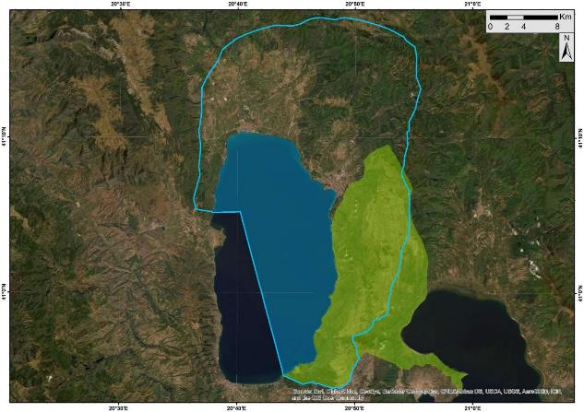
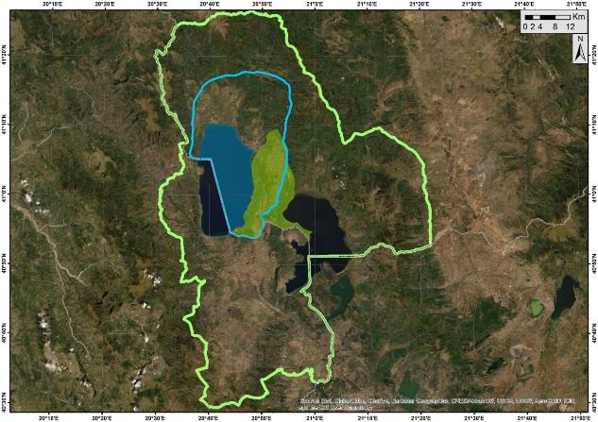
NATURAL AND CULTURAL TRANSBOUNDARY
WORLD HERITAGE OHRID REGION
(N.MACEDONIA AND ALBANIA)
Inscribed in 1979/ 2019
TRANSBOUNDARY BIOSPHERE RESERVE OHRID PRESPA
(N.MACEDONIA, ALBANIA)
Designated in 2014

Slide 4
Lake Ohrid
Deep, oligotrophic lake of tectonic origin and amongst the few ancient lakes in the world;
The oldest natural lake in Europe (2-4 million years);
Host of about 1,200 species, over 200 endemic species;
Highest biodiversity index of all the lakes in the world, taking surface area into account;
Designated Ramsar site (with Studenchishte Marsh), 2021;
Designated Important Bird Area (IBA) - over 100 bird species, 20.000-40.000 wintering waterfowls;
Key Biodiversity Area (KBA) of international significance - IUCN
Monument of Nature – national protection.

Slide 5
Galichica
Designated Prime Butterfly Area (PBA) – European priority sites for conservation - 1.644 species of butterflies, many endemic;
Designated Important Plant Area (IPA) – 40 plant communities, 1.600 taxon of vascular plants, over 480 species of fungi;
Over 35 types of habitats, extremely high biodiversity index – over 3.150 taxon, 61 endemic. Recognized as a Key Biodiversity Area (KBA) of international significance;
National Park – since 1958

Slide 6
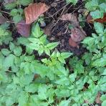
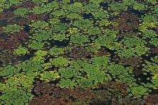
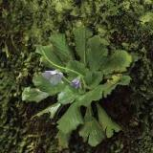
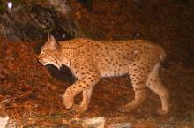
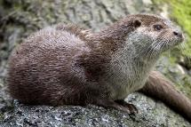
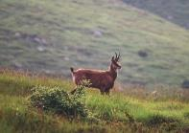
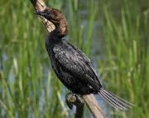
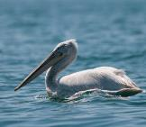
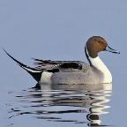
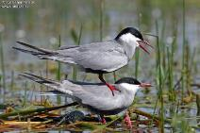
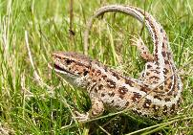
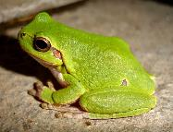
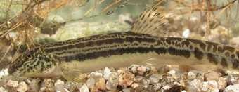
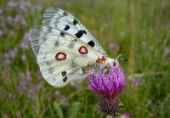
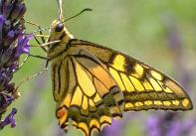
BERN CONVENTION PROTECTED SPECIES: 273
Lynx lynx balcanicus
Plants: 4 (Appendix I)
Mammals: 28 (22 Appendix II)
Birds: 191 (154 on Appendix II)
Reptiles: 25 (18 on Appendix II)
Amphibians: 10 (6 on Appendix II)
Fish: 5 (all on Appendix III)
Insects: 10 (8 on Appendix II)
Strictly protected species
(Appendix I and II): 212
Angelica
palustris
Trapa natans
Ramonda serbica
Rupicapra rupicapra
Pelecanus crispus
Microcarbo
pygmaeus
Lutra lutra
Anas acuta
Lacerta agilis
Chlidonias hybrida
Hyla arborea
Cobitis ohridana
Parnassius apollo
Papilio machaon

Slide 7
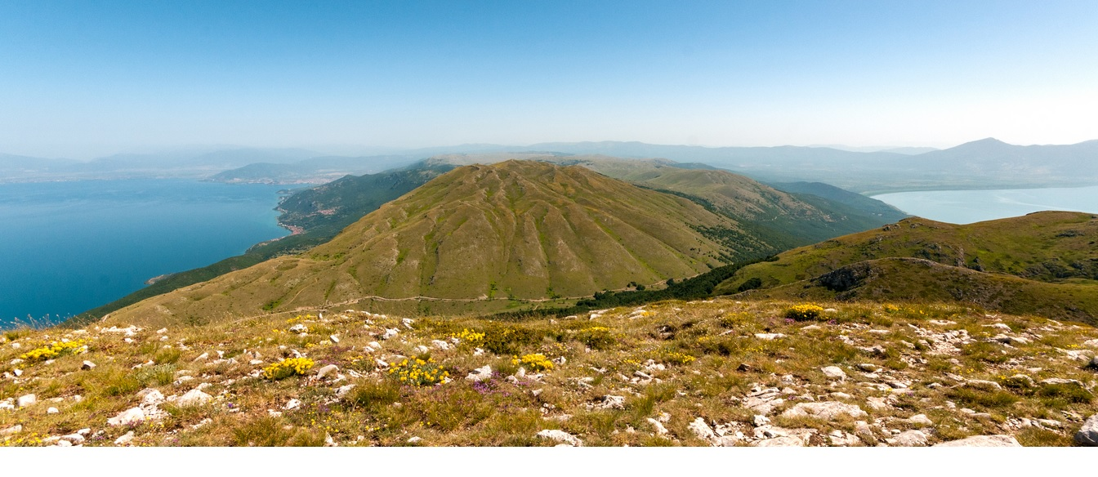
BERN CONVENTION PROTECTED HABITATS (Res.4): 21
Lake Ohrid: 4
C1.1 Permanent oligotrophic lakes, ponds and pools
C1.222 Floating Hydrocharis morsus-ranae rafts
C1.225 Floating Salvinia natans mats
C3.4 Species-poor beds of low-growing water-fringing or amphibious vegetation
Galichica: 17
C2.12 Hard water springs; E1.2 Perennial calcareous grassland and basic steppes; E3.3 Sub-mediterranean humid meadows; E4.3 Acid alpine and subalpine grassland; E5.5 Subalpine moist or wet tall-herb and fern stands; F2.2 Evergreen alpine and subalpine heath and scrub; F3.12 Buxus sempervirens thickets; F3.245 Eastern Mediterranean deciduous thickets; G1.A1 Quercus - Fraxinus - Carpinus betulus woodland on eutrophic and mesotrophic soils; G1.A4 Ravine and slope woodland; G1.11 Riverine Salix woodland; G1.6 Fagus woodland; G1.7 Thermophilous deciduous woodland; G3.9 Coniferous woodland dominated by Cupressaceae or Taxaceae; H1 Terrestrial underground caves, cave systems, passages and Waterbodies; H2.4 Temperate-montane calcareous and ultra-basic screes;
H2.6 Calcareous and ultra-basic screes of warm exposures

Slide 8
Brief history of the case and current situation
Complaint submitted in 2017 due to infrastructure projects (ski center and resort, expressway A3, marina, and several touristic development zones);
As a result of the joint WH Centre, IUCN and ICOMOS RMM in 2017, and consequently the WH Committee Decision 41 COM 7B.34, the plans for a ski center and expressway on Galichica have been cancelled. Unfortunately, these are the only 2 recommendations (out of 19) that have been implemented (fully and in a meaningful way);
In 2019 the World Heritage Committee (Decision 43 COM 7B.36) welcomed the cancelation of the construction projects of the A3 road and the Galičica ski resort, but also noted: “however, (WHC) considers that this step is not sufficient to significantly reduce the vulnerability of the property”;
The worrisome state of the world heritage found by 2017 RMM got even worse in 2020. The Report of the RMM in 2020 notes: “Not only have the identified threats not been removed, but new ones are emerging.”
Concluding that “the property is facing both actual and potential threats to its OUV…” the 2020 RMM experts, once again, confirmed that “Ohrid Region fulfills the criteria to be inscribed on the List of World Heritage in Danger”;
This was also the recommended decision by the World Heritage Centre. However, the WH Committee gave the country additional 2 years for implementation of the recommendations, as well as several other provisions, including a Strategic Recovery Plan to be created (and implemented) with Albania.

Slide 9
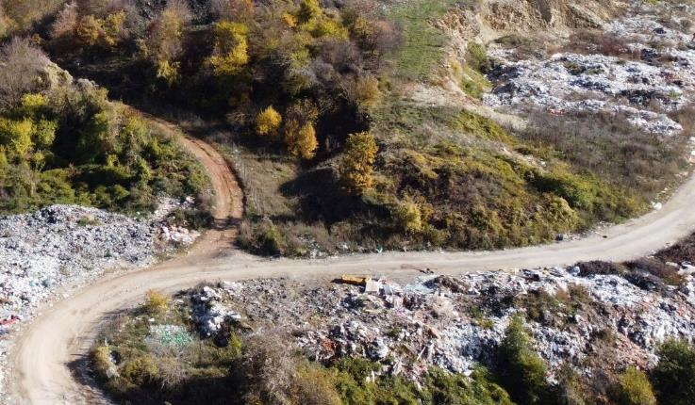
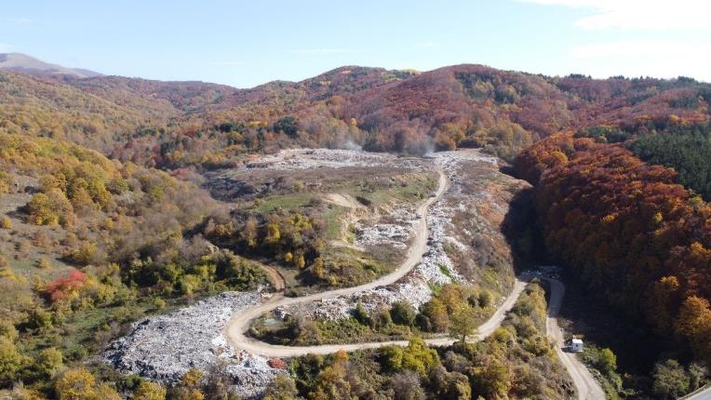
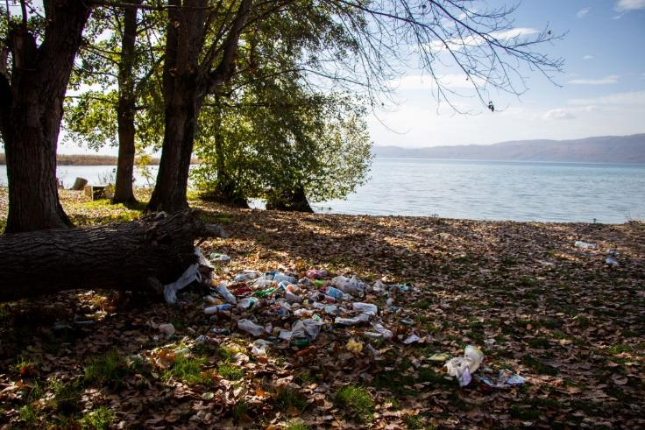
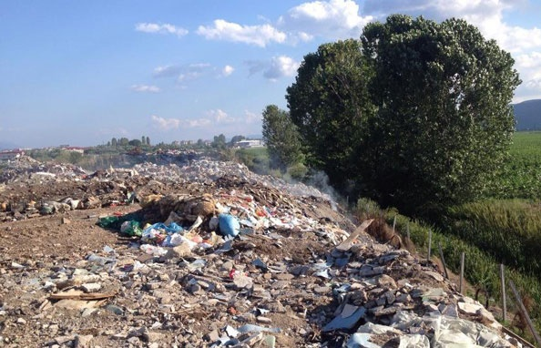
Threats and current state - solid waste (RMM 2017,2020)
“Bukovo” - largest illegal landfill in the WH, still main waste disposal site for Municipality of Ohrid
Smaller illegal dumping sites are not rare on Lake Ohrid shore;
The main landfill for Municipality of Struga

Slide 10
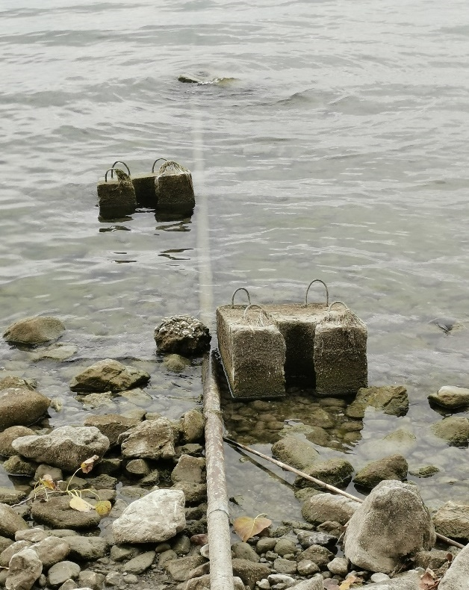
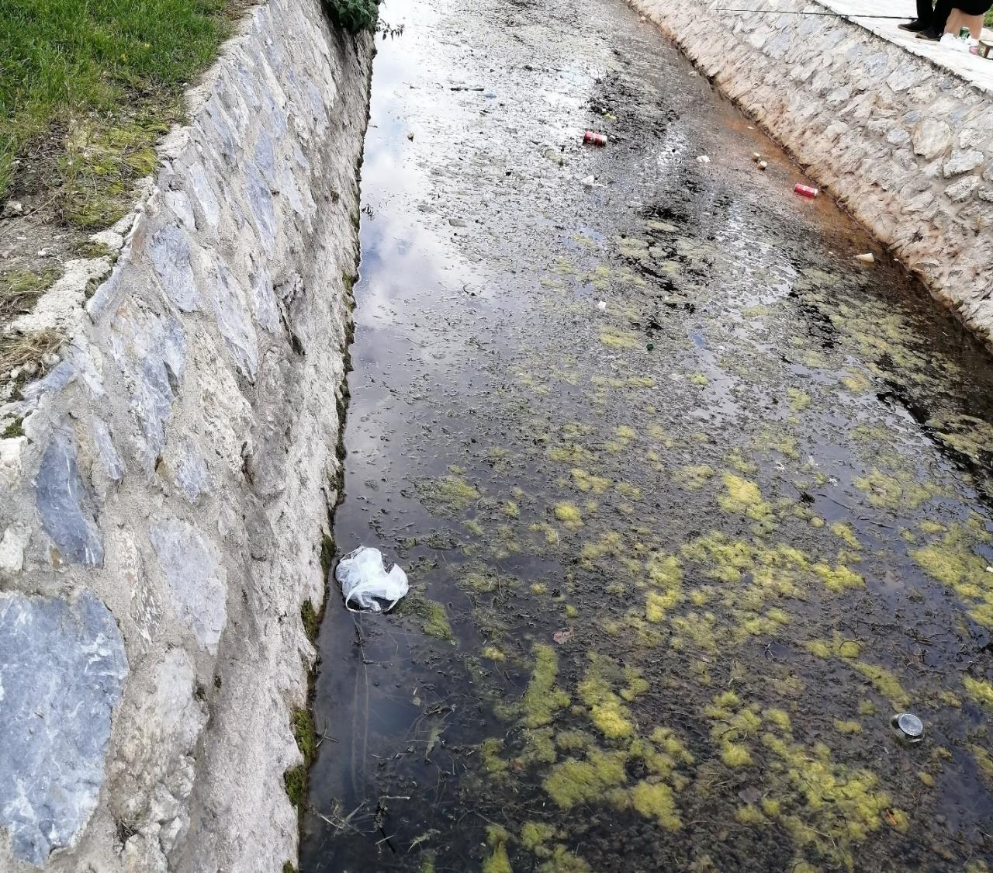
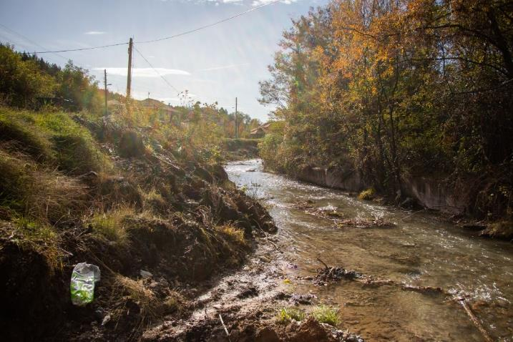
Threats and current state - lake pollution, wastewater, tributaries… (RMM2017,2020; LO Study)
Sewage wastewater is discharged directly into the lake in many areas on the shore;
River Koselska – one of the largest tributaries and together with River Sateska one of the largest polluters;
The state of the canal just few meters down from Biljanini springs.
N.B. Despite some maintenance work, the treatment facility of Ohrid collector is not capable of working anywhere close to full capacity.

Slide 11
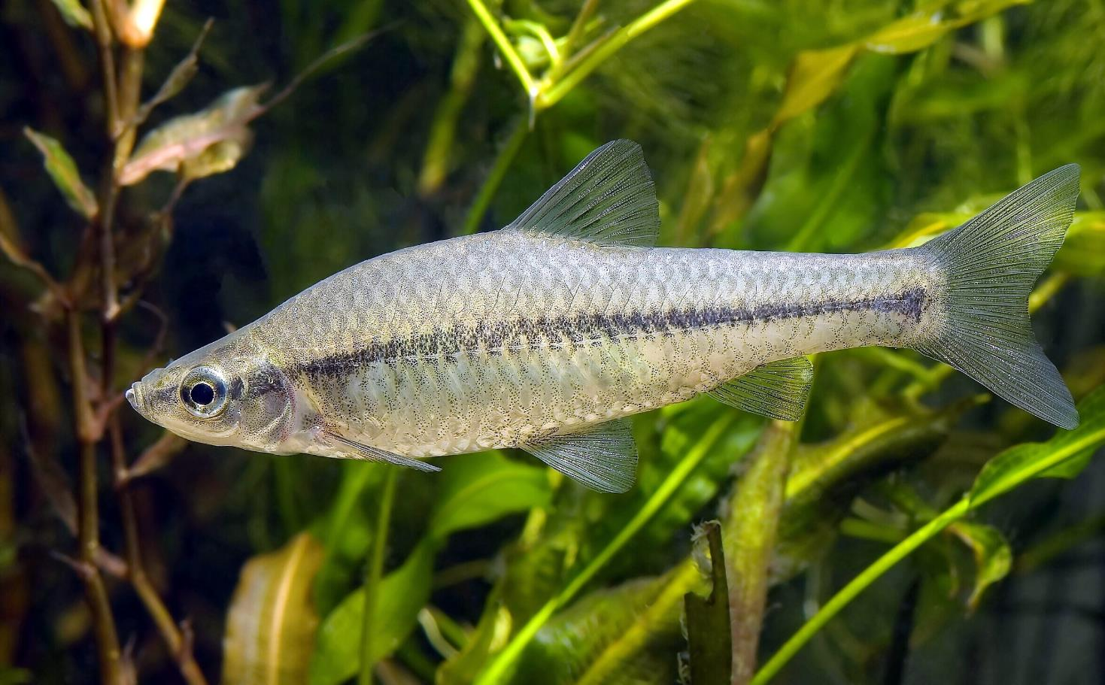
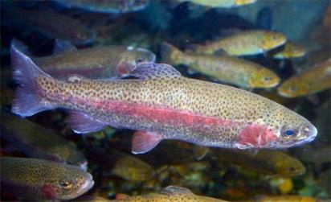
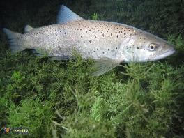
Threats and current state – invasive species, overfishing, pouching…
RMM 2020: Several invasive species have been found in Ohrid Lake such as the Canadian waterweed, Acute pond snail, amphipod Gammarus roeseli, and the fish species Rainbow trout, Silver carp, Stone moroko, Prussian carp, Eastern mosquitofish, Pumpkinseed and European bitterling. According to the European Alien Species Information Network (EASIN), the Stone moroko is part of the list of 49 invasive species of concern for the European Union, which recommends appropriate measures to be taken if the species has become widespread…. Rigorous information on the presence and impact of invasive species in Ohrid Lake, which can potentially impact the OUV of the property, is still lacking;
Lake Ohrid Re-valorization Study: The presence of exotic fishes like the rainbow trout and Chinese carp have been recorded by local fishers. The rainbow trout farms in several tributaries,…. are a particular concern, since the species might be able to displace the native Ohrid trout;
RMM 2020: Stocks of the endemic Ohrid trout (Salmo letnica) have been consistently decreasing over the last decades despite annual repopulation efforts (Jordanova et al. 2016), mainly due to overfishing and lack of enforcement of fisheries regulations.
No field work (monitoring, data gathering, analysis) done for the Study, so still no accurate and up to date information on presence, impact, etc.

Slide 12
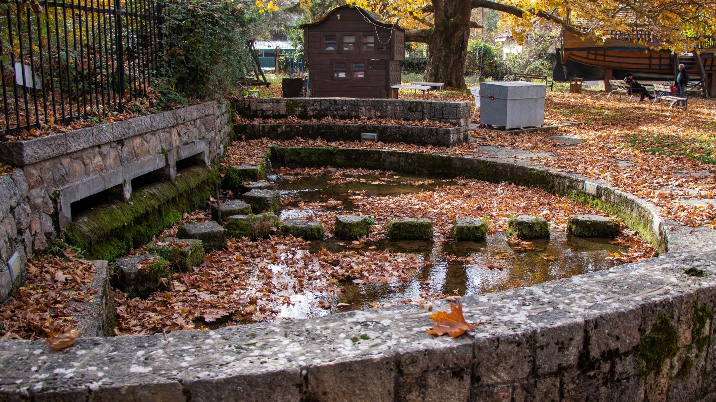
Threats and current state – hydrology, fluctuating water level
RMM 2020: Discharges (from the lake) into the Crn Drim (to produce hydroelectric power), result in the decrease of the lake’s water levels and are still heavily felt on the Albanian side.
Lake Ohrid Valorization Study: Water level fluctuations due to the inappropriate management of hydroelectric dams on the Crn Drim.
Water level in Oct. and Nov. 2021: very close to the allowed minimum (1-3 cm)
Pic. (Nov. 21): No water from Biljanini springs

Slide 13
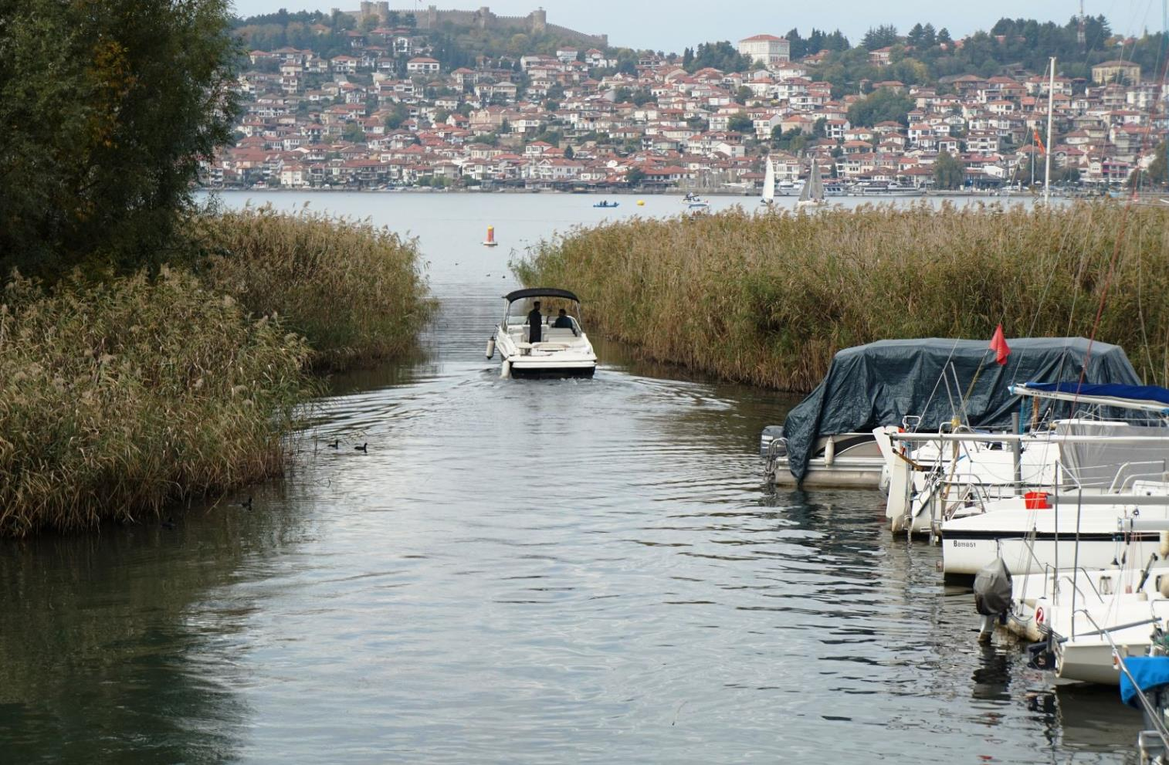
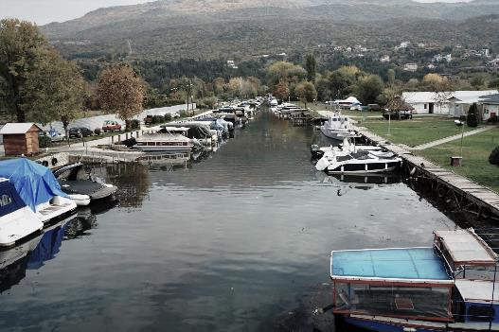
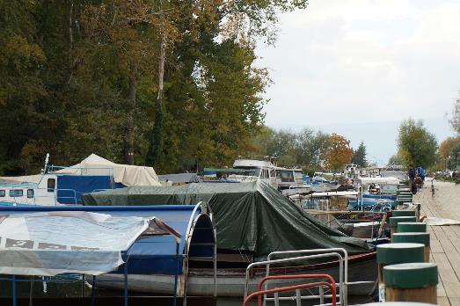
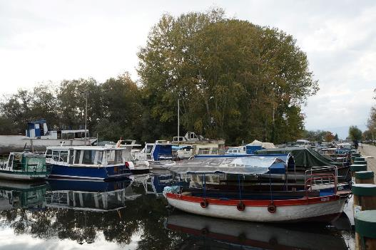
Threats and current state – boats, boat tourism…
Lake Ohrid Re-valorization Study: Use of boats of different types and sizes causing waves, noise pollution and disturbance; Pollution from oil, gasoline and other chemicals from boats and vessels (e.g. from the marina) – High threat
2,268 recreational and fishing boats registered since 1999, of which 500-600 are currently in regular use. The exact number of boats is not known, as the Port authority does not record their locations.

Slide 14
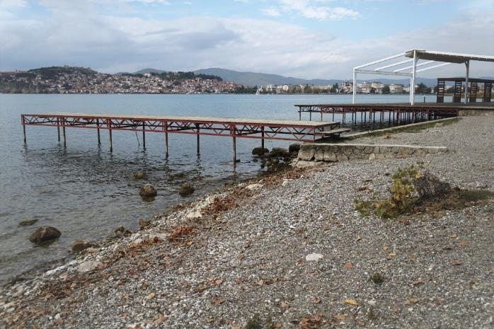
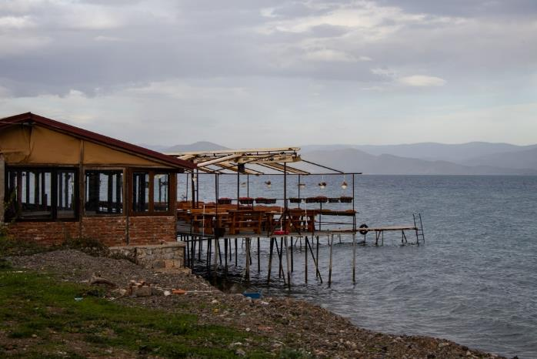
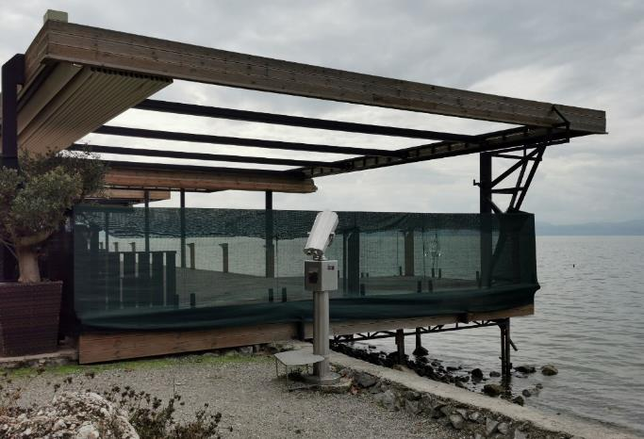
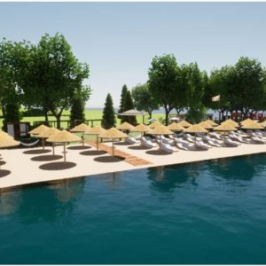
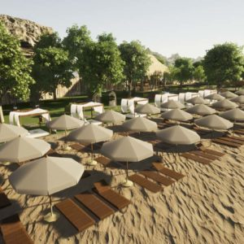
Threats and current state - tourism pressures… (RMM 2017,2020; Lake Ohrid Re-valorization Study)
Few of many temporary constructions in the lake got removed prior to the WH Sessions in 2019 and 2021. This was presented as “decisive action against the illegal constructions”, “clearing the lake shore and bringing it back to its natural state”. (pics. taken in Nov.21)
In Aug/21 Municipality of Ohrid had a public call for design ideas for the beaches (replacement for the removed platforms?). One of the conditions was use of sand. Lake Ohrid natural shore is not sandy. The call was announced and finalized while the Management Plan for the shore is still in a process of creation.
Newly elected Mayor of Ohrid (Nov. 21) stated that the constructions on the beaches are not illegal and announced bringing back private concessions.

Slide 15
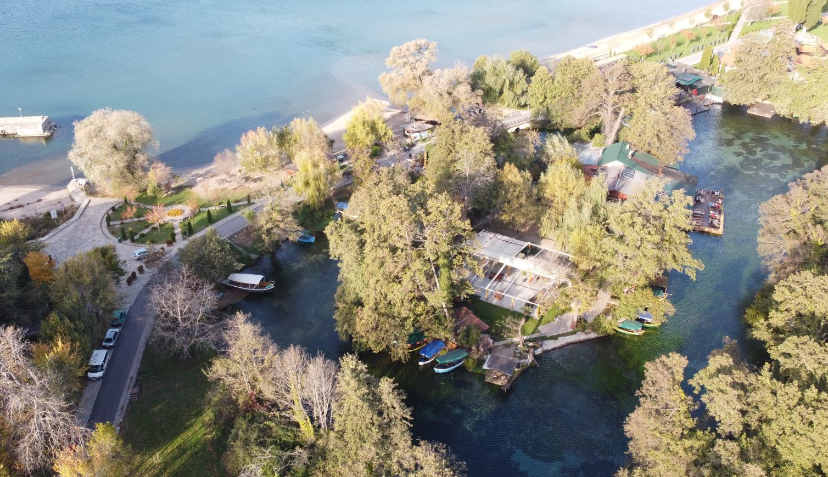
St. Naum springs – touristic complex in the zone of strict protection
Raft Floating Restaurant in the strictly protected area of St. Naum springs – 6 platforms over the springs (NP Galichica).
The Law on Nature Protection allows only scientific research in this zone.
Over 1.000 tourists visit with boats and/or cars daily, during the summer season.

Slide 16
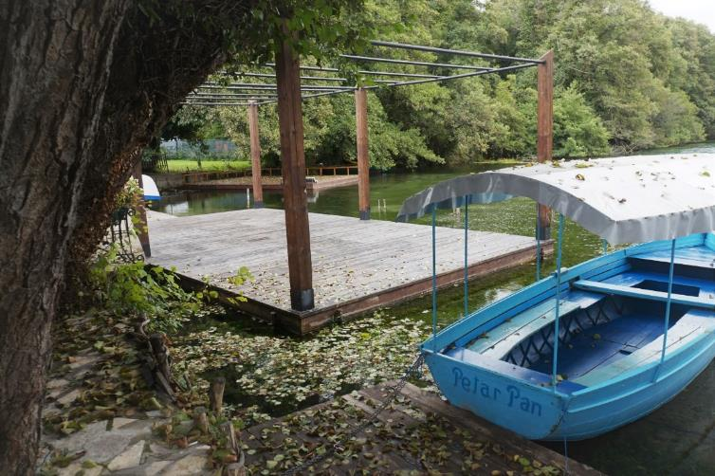
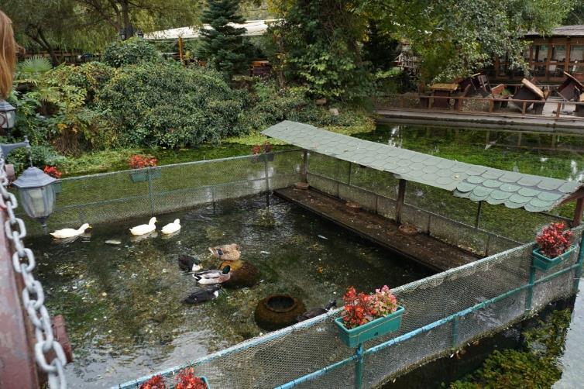
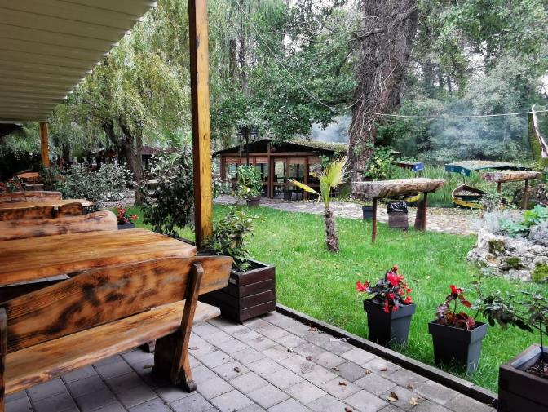
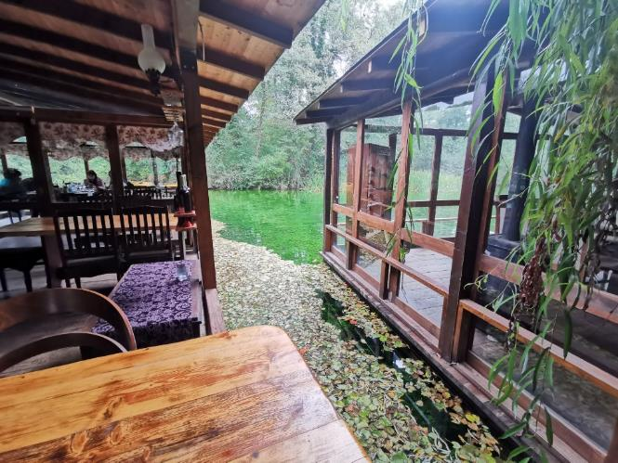
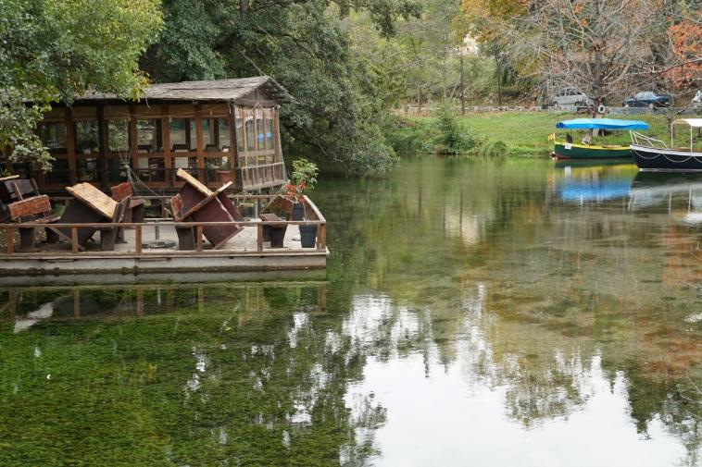
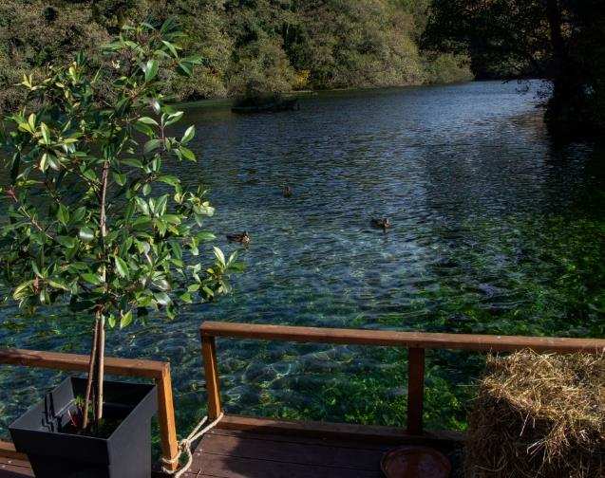

Slide 17
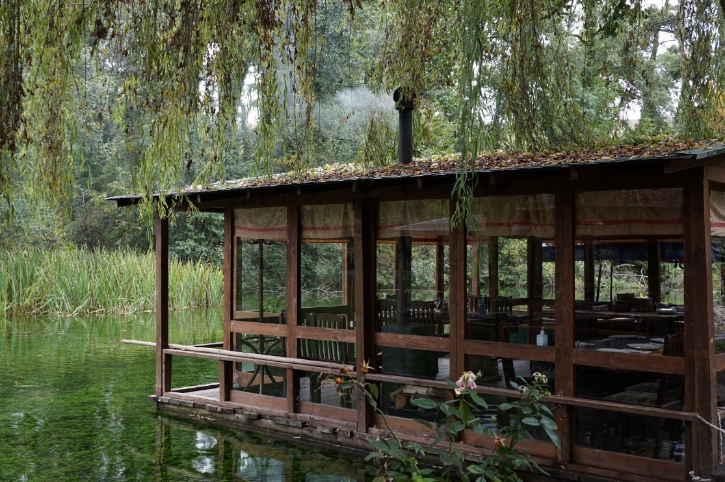
The only habitat of Angelica Palustris -National Red List, Critically Endangered; Bern Convention: Appendix I, revised Resolution No 6 (2011); Annex II of the Habitat Directive;
Contract with NP Galichica, approved in 2019 by the Government. MoE approved the Environmental Impact Elaborate and issued water economy permit (2015);
The Government didn’t approve renewal of the contract, (expired 07/21). Pictures taken in Nov. 21 – facility fully functional. Thanks to the approved elaborate and water economy permit, it can continue to work without the Government’s approval for continuation of the contract with NPG, even without the contract;
NPG dismissed our comments to include the facility as a threat to NP in the new Management Plan, recommend its removal and envisage restoration of the site.

Slide 18
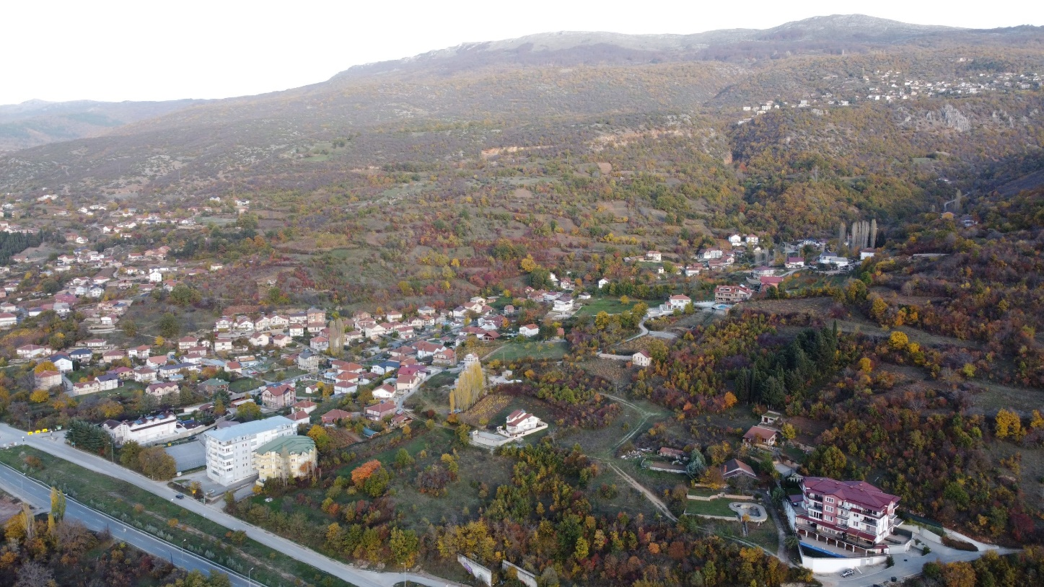
Threats and current state - illegal buildings (RMM 2017,2020)
Urbanization of NP Galichica…
Over 2.000 illegal constructions within the NP.
NPG dismissed our comments to include an Annex with inventory of illegal constructions within the NP in the new Management Plan, and envisage SEA for their impact.

Slide 19
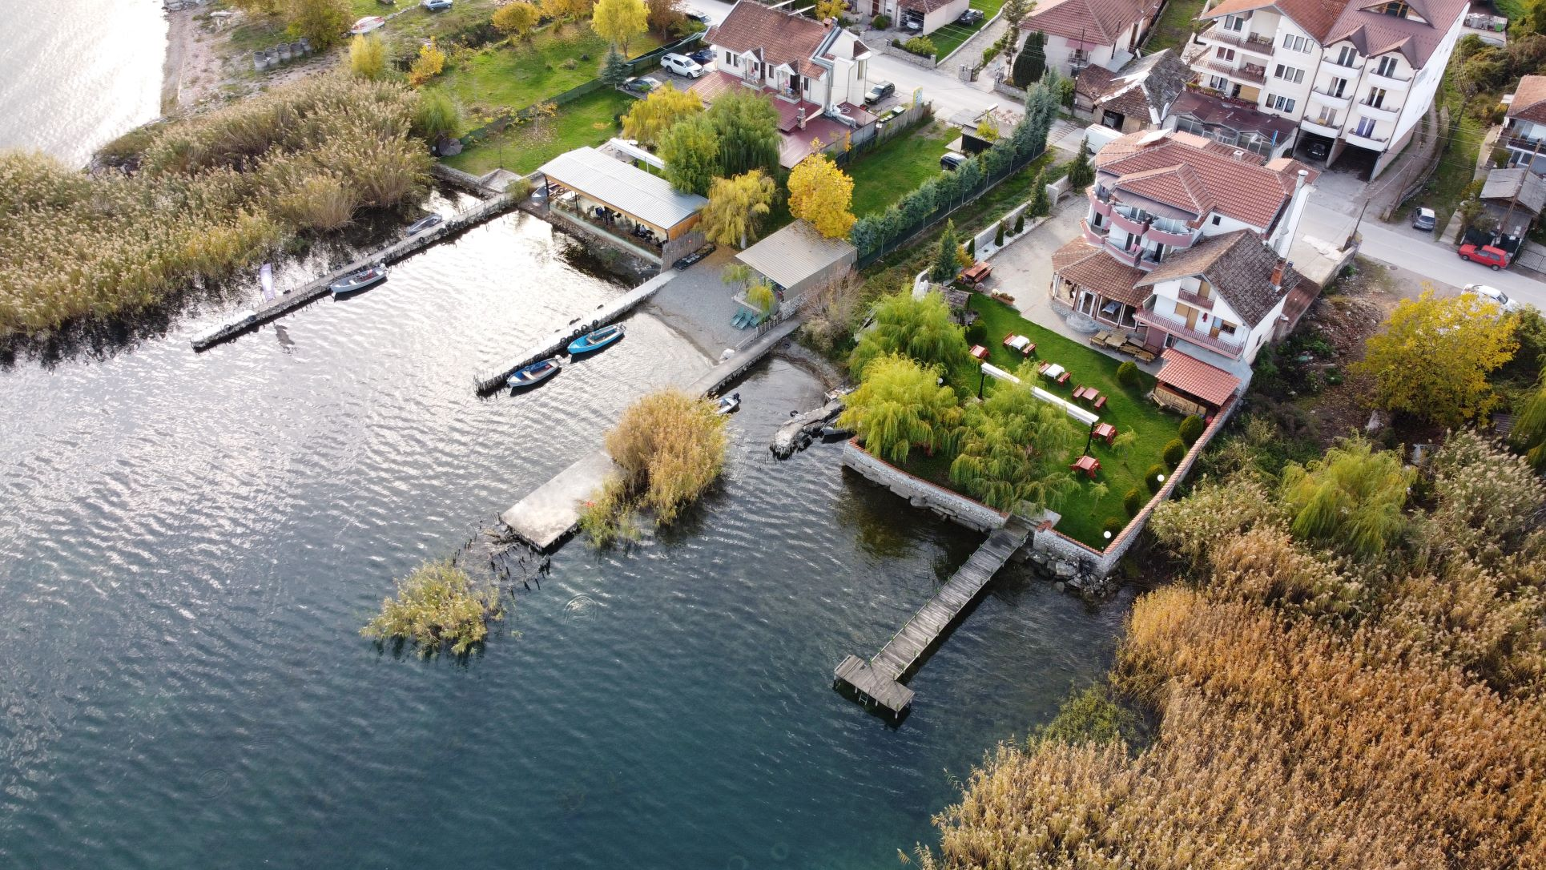
Kalishta – one of 9 biodiversity hotspots on the lake shore. The only natural habitat of Nuphar lutea in Lake Ohrid.

Slide 20
Illegal weekend houses on the shore close to village Trpejca (NP Galicica).
Around 16.000 requests for legalization of over 19.900 facilities submitted by June 2020 to Municipality of Ohrid. There are 420 illegal residential buildings; 37 illegal camping sites; 13 hotel complexes, over 20 individual hotels; etc. only in M. Ohrid. No data for Struga and Debarca

Slide 21
2017 UNESCO Recommendation 9:
Undertake a detailed inventory of all existing illegal constructions; carry out Heritage and Environmental Impact Assessments to assess their impacts on the OUV; remove all illegal constructions within the property and in particular within the Galičica National Park, which are considered to represent a threat; ensure the strict enforcement of existing laws and regulations to prevent any further illegal constructions within the property.
And the immediate measure:
“Halt the process of legalization of all illegal constructions within the property until a detailed inventory of all existing constructions is established and relevant Heritage and Environmental Impact Assessments (HIA and EIA) have been carried out”
The Government:
In 2021 proposed a law for extension of the validity of Law on legalization of illegal facilities built until 2011, until March 2026. The Assembly adopted this law in July 2021.
The Government proposed another (parallel) Law for legalization of illegal constructions built until January 2021. There is a provision that buildings in WH Ohrid Region can be legalized only with a positive opinion from MoE and Ministry of Culture, confirming they don’t have a negative impact on the OUV (based on the impact assessment studies).
The law is still in a procedure.
Once adopted, this second law stipulates a halt to all initiated procedures for removal of illegal constructions (everywhere in the country).
Local authorities :
The latest agenda of the new local council of the Municipality of Ohrid included discussion for legalization of over 100 illegal constructions. There was a consensus among the representatives of all parties to speed u and easy up the legalization of the illegal buildings.
The old Mayor of Municipality of Struga got re-elected. His position is that there are no illegal constructions in Struga.
No Inventory has been compiled, or it’s not publically available.
So far no intention to conduct EIA (SEA) and/or HIA. According to the State of Conservation Report, submitted in 2020 to the World Heritage Centre, there is no legal framework for EIA (SEA) and HIA studies.
This is not true - EIA and SEA Directives have been transposed for over a decade. Many EIA and SEA procedures have been conducted so far.

Slide 22
Threats and current state - Urban sprawl; Delay and weakness of the moratorium on any new construction (RMM 2017, 2020); Urbanization (Lake Ohrid Study); Urbanization and infrastructure (NPG MP)…
November 2021
Large area in Gorica is getting cleared for a new, unknown construction.

Slide 23
The site is fenced for a construction of a new hotel complex on the shore. Construction started in 2019. Picture taken in November 2021.

Slide 24
November 2021 – new, unknown construction near v. Radozda, Struga
2017 UNESCO Recommendation for a moratorium on any urban and coastal transformation didn’t make any difference. Nor did the municipalities’ “Decisions for a moratorium” (2019,2020), with so many exceptions that they didn’t affect new urban plans and constructions. RMM 2020 confirmed that these Decisions can not be considered implementation of the Recommendation 6 and called for immediate Moratorium on any construction.

Slide 25
WHAT ABOUT THE FUTURE?
Nine biodiversity hotspots identified
in the 2 Emerald sites (all docs)
Plans and projects for further urbanization and transformation
EMERALD Site
Lake Ohrid
EMERALD Site
Galichica

Slide 26
CLOSER LOOK – hotspots with plans and projects (St. Mother of God Kalishta and Kalishta)
1
TRANSMISSION LINE
2
RAILWAY (CORRIDOR 8)
1
3
GAS PIPELINE
3
4
HIGHWAY A2 (CORRIDOR 8)
5
NEW URBAN PLAN v. KALISHTA
(new hotels, houses, streets)
4
2
6
New Tourism Development Zone
(14.5 ha new hotels, shopping mall, restaurants, sport halls)
11
10
8
7
7
UNKNOWN CONSTRUCTION
(cca 2.8 ha)
9
5
Blue/white line – 50m. shore
(1st A zone, proposed buffer Lake Ohrid)
6
8
NEW PLAN CAMP LIVADISHTA
(weekend houses, bungalows, camp)
St. Mother of God Kalishta:
Sublacustric springs, one of the most important underwater sources for oxygen rich water, crucial for the oligotrophic character of the lake.
Kalishta: The only
natural habitat of
the yellow water
lily (Nuphar lutea)
on Lake Ohrid
9
NEW PLAN FOR WEEKEND HOUSES
10
EXTENSION OF v. RADOZDA
11
New Tourism Development Zone
(cca 3 ha, Camp Treska)

Slide 27
CLOSER LOOK – hotspots with plans and projects (Podmolje)
1
ONE OF 3 POSSIBLE LOCATIONS FOR A NEW MARINA (R. SATESKA)
1
Podmolje:
The biggest reed belt (Phragmites australis) on Lake Ohrid - natural habitat of threatened species of birds and spawning place for carp. Reed belts are defined as a key habitat in Re-valorization Study for Lake Ohrid. Macrophyte vegetation in a reed belt is a nesting and feeding area for waterfowls, among other points.
2
NEW URBAN PLAN v. PODMOLJE
3
HIGHWAY A2 (CORRIDOR 8)
4
NEW URBAN PLAN ANDON DUKOV
(cca 28.7 ha new hotels and hotel complexes, commercial facilities, restaurants, weekend houses, sport venues)
4
2
3

Slide 28
CLOSER LOOK – hotspots with plans and projects (Studenchishte Marsh, Mazija)
STUDENCHISHTE MARSH
Designated Ramsar site (2021)
The last remaining marsh from the extensive wetland on the east shore of Lake Ohrid.
Crucial part of the ecosystem and an exceptional habitat on its own. Contains 2 endangered natural habitats protected under Bern Convention:
D4.1 Rich fens, including eutrophic tall-herb fens and calcareous flushes and soaks (EU Habitats Directive Annex I 7230: Alkaline fens ); and
C1.223 Floating Stratiotes aloides rafts (EU Habitats Directive Annex I included in 3150 Natural eutrophic lakes with Magnopotamion or Hydrocharition -type vegetation).
It’s an important nesting site for birds and spawning location of fish. Harbors its own rich flora and fauna, including 79 bird species (49 on Appendix II, 23 on Appendix III); at least 9 species of amphibians and at least 8 species of reptiles (all protected by BC); 15 species of fish; 34 types of dragonflies. - 15 on IUCN global red list; 106 diatoms; etc.
Mazija:
Revitalized natural habitat of the yellow water lily (Nuphar lutea), spawning place of carp and habitat and nesting place of birds.
STUDENCHISHTE MARSH
Studenchiste Marsh is currently in a process of being proclaimed as a Nature Park (category IV) under the Law on Nature Protection.

Slide 29
CLOSER LOOK – hotspots with plans and projects (Studenchishte Marsh, Mazija)
1
New DUP (could be for legalization of illegal constructions)
10
11
Blue/white line – 50m. shore
(1st A zone, proposed buffer Lake Ohrid)
2
New hotels near Biljanini Springs
12
3
One of 3 locations proposed for a new Marina (current GUP)
9
13
4
New DUP v. Velestovo
8
5
Planned urban development (current GUP)
1
6
New DUP v. Racha
7
7
New Urban Plan Gorica East
(hotels, motels, weekend houses, etc.)
6
2
8
New Urban Plan Gorica North
5
3
9
Unknown construction activities
10
Urban Plan Complex Gorica
(new hotel complex, construction in 2019)
4
11
Beach design project – 700m
12
Recently finished concrete promenade
13
Reconstruction of Quay Macedonia

Slide 30
New promenade cutting the connection with the lake
Studenchishte Marsh
New urban plan “Gorica North” Weekend houses, motels/hostels, restaurants, shops, infrastructure, etc.
17.05 ha

Slide 31
“Gorica North” – illustration of local and national authorities’ approach and effectiveness of legislation and management plans (“it’s all legal”)
Area: 17.046 ha, bordering Studenchishte Marsh
Planned constructions: weekend houses, motels/hostels, large restaurants, shops, infrastructure, etc.
SEA Report: Recommended implementation of the proposed urban plan, in compliance with the Management Plan for WH Ohrid Region and no significant negative impact.
Note: the Management Plan states that no urbanization is envisaged outside of towns and existing settlements. However it also defines a First A zone – 50m from the lake line, in which no construction is allowed. Gorica North is 2m from this 50m. zone, hence the SEA expert, the municipality and MoE consider it “in compliance with the Management Plan”.
Process of adoption: Municipality of Ohrid organized public consultations for the SEA Report, but didn’t publish the actual urban plan (it’s still not available). SEA expert engaged and paid by the investor, not by the municipality (as the law implies). All our comments for legal breaches and non compliance with the WH Management Plan were ignored.
MoE approved the SEA Report in October 2021.
Studenchishte Marsh
Gorica North
Impact of other laws and documents:
Proposed Draft Law on Proclamation of Studenchishte Marsh for Nature Park – no buffer zone around the Marsh; proposed management body – Municipality of Ohrid;
Re-Valorization Study for Lake Ohrid (and Draft Management Plan) – 50m. buffer zone (ignores comments for revision and expansion of this zone, as well as relevant references in the WH Management Plan); proposed Executive Body of Management Body – 5 persons, 3 from the municipalities, 2 from Gov.;
Latest version of the “Moratorium Decision” – SEA expert and MoE state that the urban plan is in compliance with the WH Management Plan, so it’s in compliance with this decision.

Slide 32
OUTCOME:
None of the existing laws, plans and decisions, including recently proposed draft law on Studenchishte Marsh and Management Plan for Lake Ohrid, stops the on-going and/or prevents future destruction from urbanization and other types of construction.
Draft Law on Studenchishte Marsh:
BUFFER ZONE? NO
MANAGING BODY: MUNICIPALITY OF OHRID
Special Law for A2 Highway (Corridor 8): The highway is of a prime public interest.
OK to break other laws – actual article in the law
Draft Management Plan Lake Ohrid: Deadline to be met
BUFFER ZONE? 50m EXECUTIVE BOARD OF MB: 5 PERSONS/3 REP. MUNICIPALITIES + 2 GOVERNMENT
Consider public consultations for the base documents (Study and Law on proclamation) which didn’t take place yet? NO
Law # 1 on illegal constructions: all built by 2011 and requested legalization + opinion MoE - OK
Law # 2 on illegal constructions: If built by Jan. 2021 and get + opinion from MoE and MC - OK
Municipal “Decisions for a Moratorium on urban and coastal transformation”:
- everything OK if not 50m shore;
- infrastructure, parking lots, sport venues, Gov. build., etc. OK everywhere
Law on Re-proclamation of Lake Ohrid as a Monument of Nature – nonexistent
Management Plan NPG, Illegal constructions Annex and SEA? NPG Opinion on new urban plans in the park?
Draft Valorization Study Lake Ohrid:
Field research/data collection: 0
Evaluation of current state of species and habitats: 0
Deadline = compilation of what’s there + stakeholders’ comments
BUFFER ZONE: 50M.
EXECUTIVE BOARD OF MB:
5 PERSONS/3 REP. MUNICIPALITIES + 2 GOVERNMENT
Ohrid and Struga GUPs in function of the protection - nonexistent (plans expired in 2016/ 2017 still a base for urban planning )
Management Plan for WH – meet WHC deadline! No implementation, no monitoring, no reporting, no responsibility… Used as a tool for continuation and “legalization” of the destruction (50m zone)
Spatial plan for WH in function of the protection
02.2021 - 02.2023 (?)
New (efficient) Law on Managing WH Ohrid Region
in Government’s drawer since 2019, after public consultations, after WHC comments
(WHMP deadline: 10.2020)
Rulebook for the zones in WH (crucial tool for urban planning) - nonexistent
(WHMP deadline: 07.2021)
LOWMP: Valid? Adopted?
Public consultations? NO. SEA? NO
WH Management Plan? NO
Law on Managing WH Ohrid Region
Inefficient, not implemented

Slide 33
One of the main explanations for non-implementation of UNESCO’s recommendations, of both central and local authorities (since 2017) is that “it can’t be done overnight”, “the situation is complex and problems have been accumulating for many years” - WHILE CONTINUING TO ACCUMULATE THE PROBLEMS.
The laws and plans for nature protection at the same time enable continuation of the urbanization. Crucial laws and management plans have significant gaps and are created/adopted for a sake of meeting a deadline. The explanation is that “protection and management are urgently needed” – WHILE POSTPONING LAWS, PLANS AND DECISIONS WHICH WOULD IMPOSE EFFECTIVE PROTECTION AND STOP FURTHER DESTRUCTION.
If currently draft plans and laws are adopted as they are proposed, further urbanization (and consequently destruction of the sites, more solid waste, more untreated waste water into the lake, higher pressure from tourism, more traffic, etc.) WILL BE FULLY SUPPORTED BY FORMAL MANAGEMENT PLANS AND LAWS.
The new law on managing WH, the Rulebook for protection measures in the protective zones, spatial plan for WH, new urban plans for Ohrid and Struga, SEA on cumulative effects of all plans and projects, EIA/SEA for the illegal constructions (if any remain illegal) can then be adopted WITH ZERO MEANING.

Slide 34
RMM 2020:
Ongoing and planned modifications and developments are exacerbating this already vulnerable situation TOWARDS A POINT OF NO-RETURN

Slide 35
Thank you for your attention!
iskra.stojkovska@gmail.com

