Slide 1
Presumed threat to Emerald site
«Polonina Borzhava» (UA0000263) from wind energy development
Jan Šeffer
Ministry of Environmental Protection and Natural Resources of Ukraine,
41-th Meeting of the Standing Committee of the Bern Convention

Slide 2
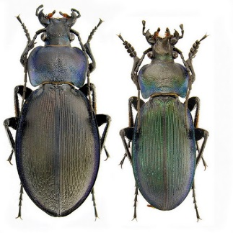
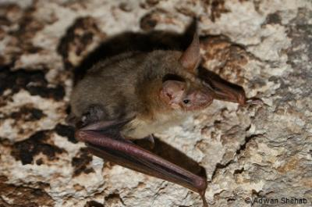
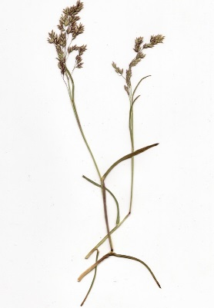
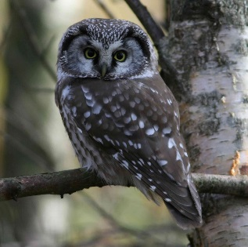
Emerald site UA0000263 «Polonina Borzhava»
was determined in 2016
an area - 4520.0 hectares
Alpine Biogeographical Region, Carpathian Mountains, Transcarpathian region
12 habitat types listed in Resolution 4
20 species listed in Resolution 6 (14 species of birds, 4 species of Mammals, including 2 species of bats and 1 species of Invertebrates - Carabus hampei)
Carabus hampei
Myotis myotis
Aegolius funereus
Poa granitica

Slide 3
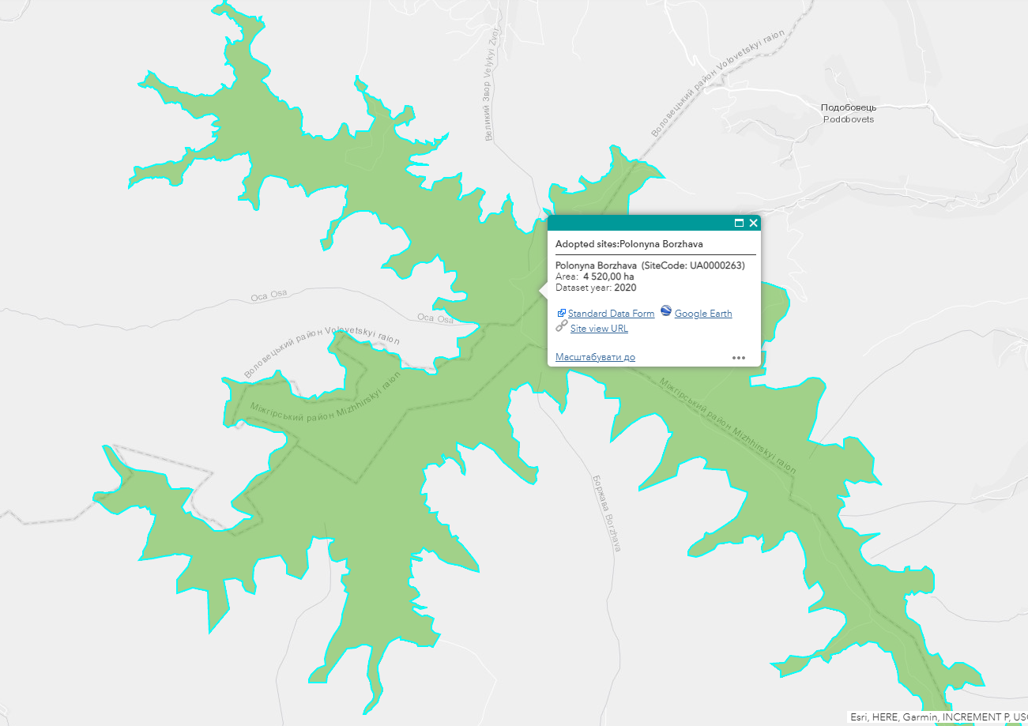
Conclusion on the EIA of the planned activities
Department of Ecology and Natural Resources of Zakarpattia Region considers it feasible to carry out the planned activity upon following condition:
If a significant negative impact will be detected during the implementation of the planned activity, and if such impact has not been assessed during the EIA and / or substantially alters the results of the EIA of the activity, the decision about such planned activity have to be cancelled by judge of court and the activity – interrupted.

Slide 4
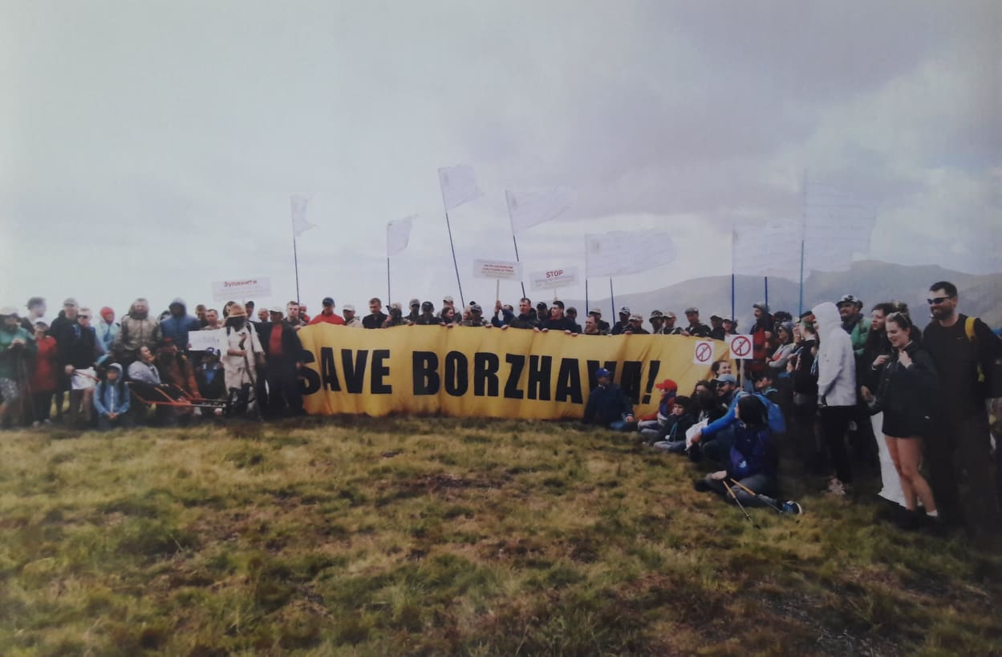
State of affairs
March 18, 2020 - the Zakarpattia County Administrative Court have been taking up in a public court the administrative case on the claim of the NGO «International Institute of Man and Global Studies «Noosphere» to declare the conclusion illegal and revoke it.
November 3, 2020 - the Eighth Administrative Court of Appeal has satisfied the appeal of the Volovets settlement council and others and reverses the ban of the EIA conclusion.
November 27, 2020 - the Zakarpattia Region Prosecutor's Office filed a lawsuit with the Commercial Court of the Zakarpattia Region to declare the actions of the Main Department of the State Geocadastre in the Zakarpattia Region and one of the enterprises of the oblast illegal. The lawsuit was filed in the interests of the state represented by Ministry of Environmental Protection and Natural Resources of Ukraine.
December 29, 2020 - cassation proceeding was open by appeal of Public organization «International Institute of Man and Global Studies «Noosphere» against the abovementioned judgement.
A decision in these cases has not yet been made.
Implementation of the project has not been started.

Slide 5
Draft Recommendation on the Presumed Threat to Emerald Network Site “Polonina Borzhava” from Wind Energy Development (Ua0000263)
the work on implementing of Recommendation is already ongoing
request - to exclude item 6 from the draft Recommendations concerning the development of an independently administered national level certification scheme for ecologists involved in commercial work such as EIA.

Slide 6
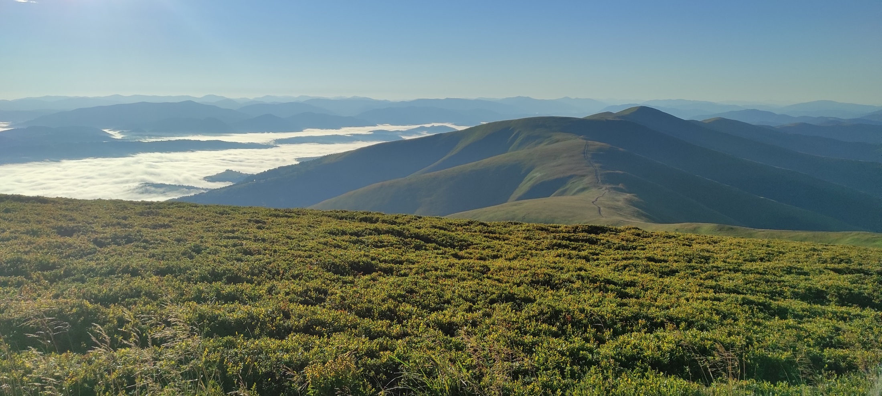

Slide 8
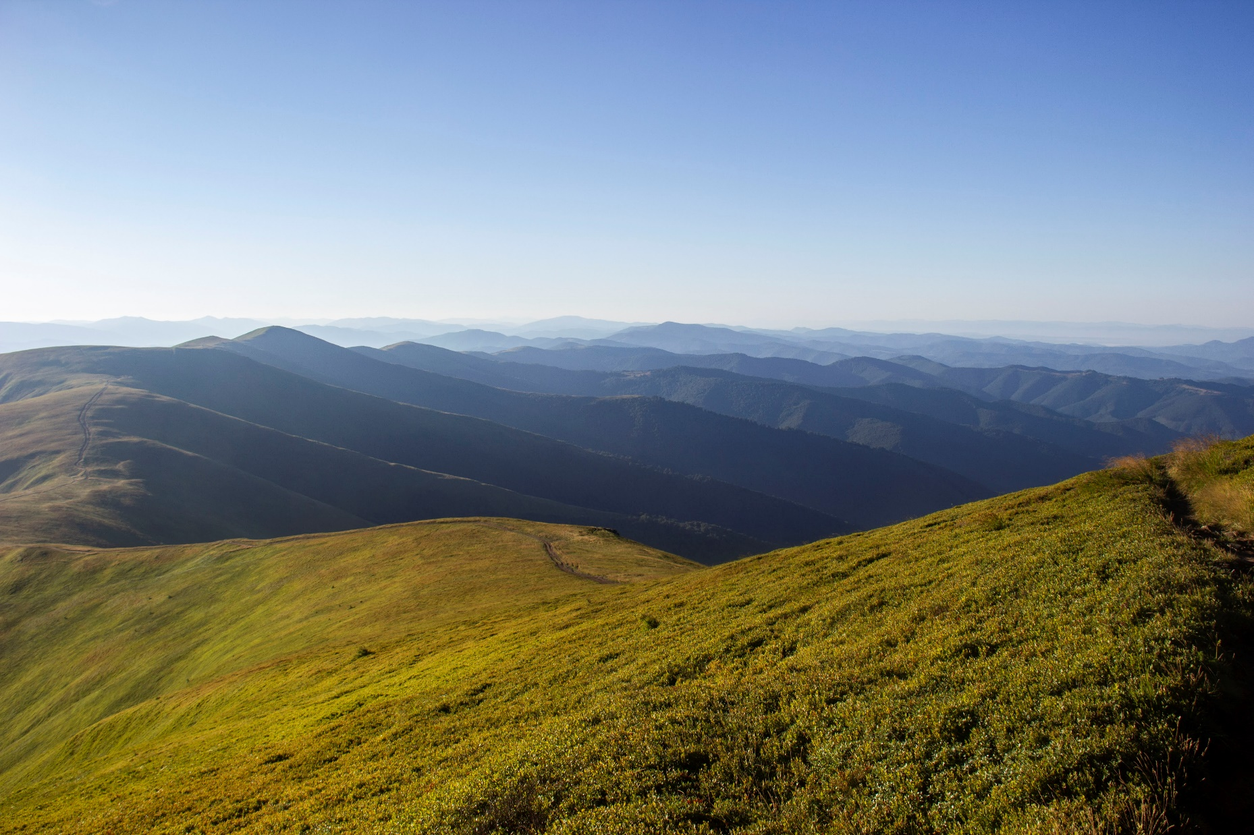

Slide 9
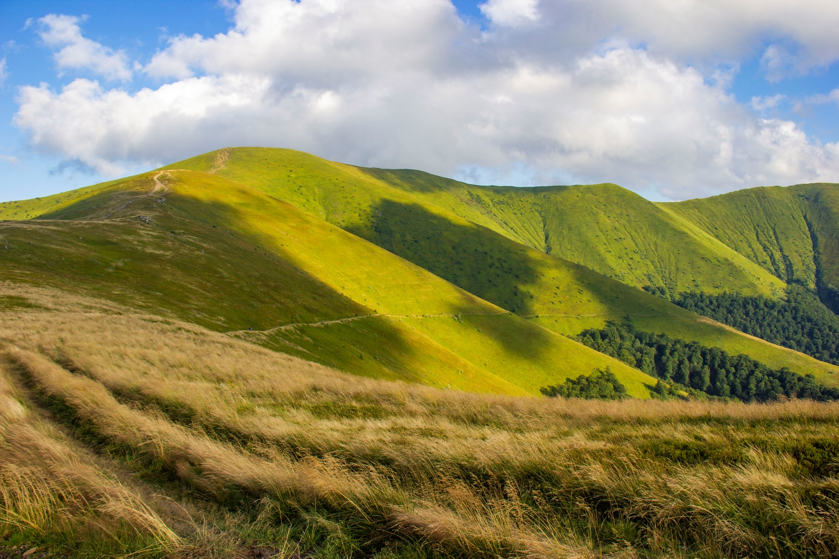

Slide 10
Thank you for attention!

