Slide 1
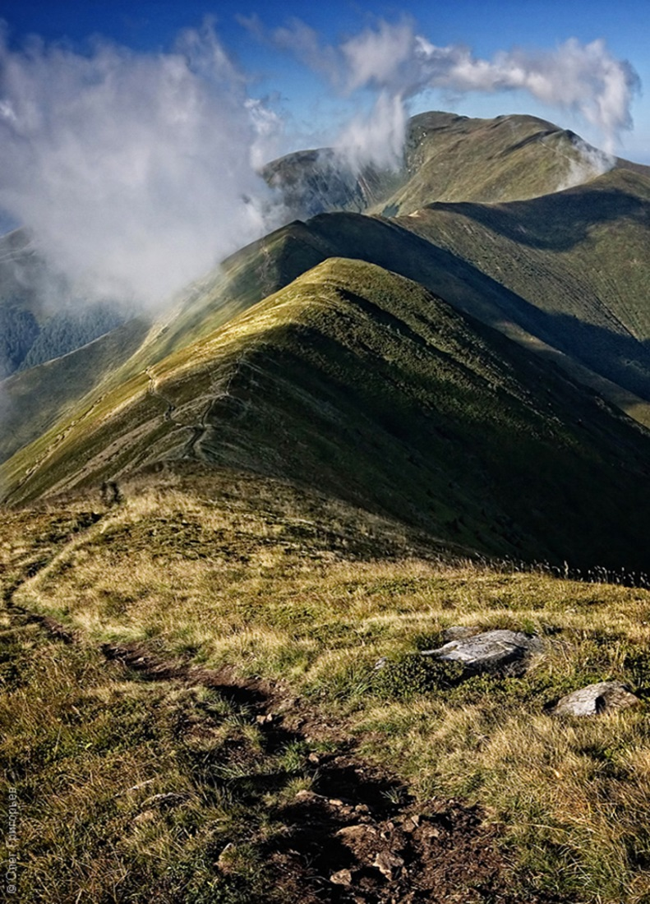
REPORT OF THE ONLINE ADVISORY MISSION (Sept 2021)
Presumed threat to Emerald Network
site “Polonina Borzhava” from
wind energy development (UA0000263)
(Ukraine)
Bernard Fleming and
Dr Lawrence Jones-Walters
Independent experts

Slide 2
Chief objectives of the mission
On the basis of the instructions by the Bureau and Standing Committee, the information provided by the authorities and the complainant, the objectives of the mission (modified based on discussion with CoE staff and development of the question list) were to:
Gain a preliminary understanding of the environmental assessment procedures (EIAs, SEAs, CIAs) grounded into the national legislation of Ukraine, and verify if they comply with international standards;
Review and assess the Environmental Impact Assessment procedure carried out for this case, and evaluate if it was undertaken according to national law and to international standards;
Review the process of creating a nature reserve within the territory of Polonina Borzhava in order to improve its conservation status.
Provide commentary in relation to the overall progress in the implementation of the Emerald Network.

Slide 3
Mission deliverables
A written report including proposed recommendations to the national authorities on:
Possible adjustments or improvements to the national legislation related to environmental assessment procedures, to prevent future problematic situations like this complaint.
Possible modification proposals to the EIA conclusion of March 2019.
The process of setting up a nature reserve within the territory of Polonina Borzhava.
(Should the project be deemed acceptable) mitigation measures to ensure before, during and post-construction.
An action plan and timeline should be appended to these recommendations.

Slide 4
Summary of Process(1)
Planning process
This online advisory mission has reviewed evidence presented by the complainant, developer, and both local and national Government regarding the proposed establishment of a wind farm within the Polonina Borzhava Emerald Network site (UA0000263).
In total 30 stakeholders representing:
Authorities of Ukraine; Civil Society; Private & Legal Sector; Scientific Community; International Organisations
Independent experts (2); Secretariat of Bern Convention (3)

Slide 5
Summary of process (2)
Comprehensive questionnaire
Completed by participating parties and returned prior to interview-workshop sessions
Two moderated, online meetings: With purpose of 1) clarifying questionnaire responses and 2) framing follow up questions.
Meeting 1: Meeting with the national and regional authorities, private and legal sector
Meeting 2: Meeting with NGO and Civil Society stakeholders
A third moderated, online meeting with all stakeholders (authorities, complainant organisation, NGOs, scientific community, local actors such as mayors, national and regional relevant agencies, etc.)

Slide 6
Comprehensive and Concise Report

Slide 7
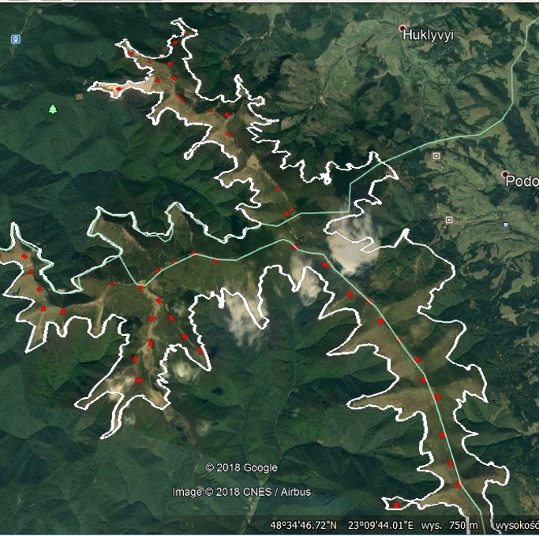
Context
Map of Polonina Borzhava Emerald Network site (white line) showing the approximate, proposed location of wind turbines (red dots) (though this may not fully reflect the latest proposals)

Slide 8
Ecological character
Extending over an area of 4250ha, Polonina Borzhava is characterised by a wide range of habitats and species listed on Resolution 4 and Resolution 6 of the Bern Convention respectively.
These ‘qualifying features’ include extensive subalpine meadows comprising good examples of mat-grass (Nardus stricta) swards, dry heath, acid grassland, subalpine moist tall-herb and fern communities and beech woodland.
Wetlands consisting of springs, streams and transition mires are also represented. Notable species include Campanula serrata and Poa granitica amongst many others. It is surrounded on all sides by extensive montane beech woodlands.
The meadow habitat (e.g. the Nardus grassland) is rare nationally and is particularly important in the context of the montane ecosystems of the Carpathians.

Slide 9
Ecological Character
Reflecting its wider setting, it supports a diverse and important bat and avifauna including Tengmalm’s owl (Aegolius funereus), golden eagle (Aquila chrysaetos), lesser spotted eagle (Aquila pomarina), short-toed eagle (Circaetus gallicus), peregrine falcon (Falco peregrinus), honey buzzard (Pernis apivorus), bluethroat (Luscinia svecica), nightjar (Caprimulgus europaeus) and four species of woodpecker; barbastelle and greater mouse-eared bats are also found (Barbastella barbastellus, Myotis myotis, respectively). All the raptors and barbastelle bats fly at a range of altitudes and their ranges can extend over great distances.

Slide 10
Ecological Character
Many of the species listed above are also listed in the Red Book of Ukraine and afforded protection under domestic law.
The territory is also an important crossing point for a number of migrant bird species that include raptors, cranes and storks and a number of other species that are protected not only under national law but also the Bonn Convention to which the Ukraine is a co-signatory.

Slide 11
Ecosystem Services
In common with many mountain massifs, Polonina Borzhava delivers a range of valuable ecosystem services. It is vital watershed for a number of major rivers and it has cultural value as a unique landscape feature. Its position and elevation (altitude) within the Carpathian Mountains also makes it a popular recreational destination for a number of activities that include hang gliding, paragliding, downhill and cross-country skiing, hiking and all-terrain vehicle use.

Slide 12
Emerald Designation
This high level of biodiversity interest allowed it to be included in the Emerald Network under the Bern Convention in November 2016. As such it is positioned to qualify as a Natura 2000 should achieve accession to the EU.

Slide 13
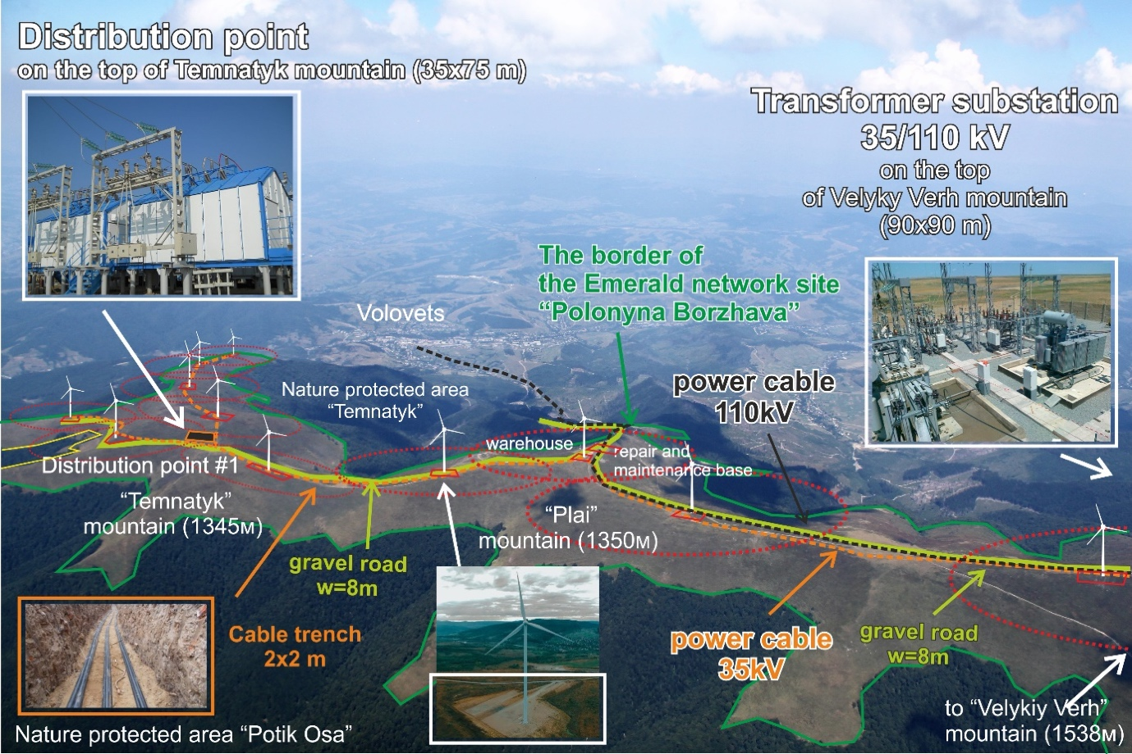
The Development
Construction has not yet started. Legal challenges have been brought by both sides to secure or remove consent. At present, construction is permitted though this is due to be challenged in the Supreme Court of Ukraine.
Should the appeal be dismissed, the turbines would be located along the main ridges that provide the ‘backbone’ of the site.
At present, the development proposes 34 turbines (a reduction from the original 48 proposed) located along two intersecting ridges, extending for approximately 14km from north to south and about 10km from east to west.
The turbines fall entirely within the boundary of the Emerald Network site.
Including roads and other infrastructure, the development would appear to extend over approximately 30km and 50ha

Slide 14
Ecological impact
Significant impacts on the qualifying features can be anticipated but shortcomings in the EIA were apparent as follows:
Lack of recognition of the Emerald Network site;
The absence of detailed assessments on Resolutions 4 and 6 features;
A lack of assessment on the avifauna of six other protected areas;
A lack of assessment of associated infrastructure such as roads, substations and both buried and overhead cables;
The absence of a trans-boundary assessment in terms of:
Bird migration (notably Grus grus);
The Ukrainian Carpathian ecological network; and
Transboundary rivers;
The lack of an assessment of credible, alternative locations for the wind farm

Slide 15
Conclusion
We believe that development of this scale and nature within an Emerald Network site allied with shortcomings in the Environmental Impact Assessment (EIA) process should not be permitted at this location.
To do so would, we believe, conflict with the requirements and spirit of the Bern Convention.
Therefore, we recommend that the Standing Committee takes the following action:

Slide 16
Main recommendations to the Standing Committee of the Bern Convention, the relevant authorities of Ukraine and other involved stakeholders:
Primary recommendation: The plans for the development should be cancelled.
It is clear that there will be significant impact on the biodiversity interest; thus alternative sites should be sought where the impact would be much less and would not impinge on an Emerald Network site, but would allow a similar contribution to be made to Ukraine's renewable energy targets.
Mindful of the ongoing court case, we have also recommended the following alternative action but only if consent is confirmed by the Supreme Court:
Alternative recommendation: If the development is to proceed, the environmental impact assessment should be repeated using current methodology that is agreed between the developer, the regulator and the complainants; in doing so this will mean that the results are less likely to be challenged and can potentially form a better basis for decision-making in relation to ‘go and no-go areas’ for development.

Slide 17
Additional Recommendations (1): Understanding and assessment of the environmental assessment procedures (and compliance with international standards).
Produce country-wide ‘opportunity maps’ with ‘go and no-go areas’ that show where windfarms could be placed without significant impact on environmental, social or cultural aspects.
Implement a programme of awareness raising of the legislation and how it should be implemented for key officials including private developers, through the provision of simple written advice and guidance and targeted training.
Develop common standards in relation to the collection of biodiversity data and information for the EIA process.
Develop an independently administered national level certification scheme for ecologists involved in commercial work such as EIA.

Slide 18
Additional Recommendations (2): Creation of a nature reserve
A multi-stakeholder process is initiated in order to: i) define a vision and high-level conservation objectives for the site; ii) identify the critical issues (opportunities, threats, conflicts, relating to the various uses, ecosystem services and other features); iii) set objectives for the resolution of those issues; and iv) agree on costed actions and the timescale for the delivery in order to achieve those objectives.
The above process be translated into an integrated management plan for the site.
The above process be used to determine the most appropriate designation for the site in order to achieve its management and protection and, in particular, to provide the basis for staffing and the provision of resources for actions to be taken.
The process be accompanied by the development of a communications plan to raise general awareness of users and the general public in relation to the correct behaviour required to maximise the enjoyment that can be achieved from recreating on the site whilst at the same time protecting its fragile and valuable natural resources.

Slide 19
Additional Recommendations (2): Overall progress in the implementation of the Emerald Network
The quantification of the contribution of the Emerald Network to carbon sequestration and storage is assessed.
The production of an ‘opportunities map’ to support the national renewable energy strategy (Repeated above).

Slide 20
Thank you for your attention

