Slide 1
Agenda Item 6.3. Follow-up of previous Complaints & Recommendations Recommendation No. 9 (1987) on the protection of Caretta caretta in Laganas Bay, Zakynthos (Greece)
Slide 1/13
39th Meeting of the Standing Committee
Bern Convention
3rd – 6th December 2019

Slide 2
Violations of National Legislation & Lack of Enforcement of National Marine Park of Zakynthos (NMPZ) Protection Measures
Slide 2/13
Zakynthos:
Hosts one of the largest Loggerhead sea turtle breeding aggregations in the Mediterranean. (Av. 1185 nests/yr1)
Nesting primarily occurs across six nesting beaches, approx. 5.5km in length
The NMPZ was established in 1999 and the Management Authority (MA) in 2000.
Sourced: https://www.monachus-guardian.org/mguard09/09perspe.htm
1. ARCHELON 1984- 2019 ‘Conservation efforts during 2019 at nesting habitat of Caretta caretta in Laganas Bay, Zakynthos, Greece’

Slide 3
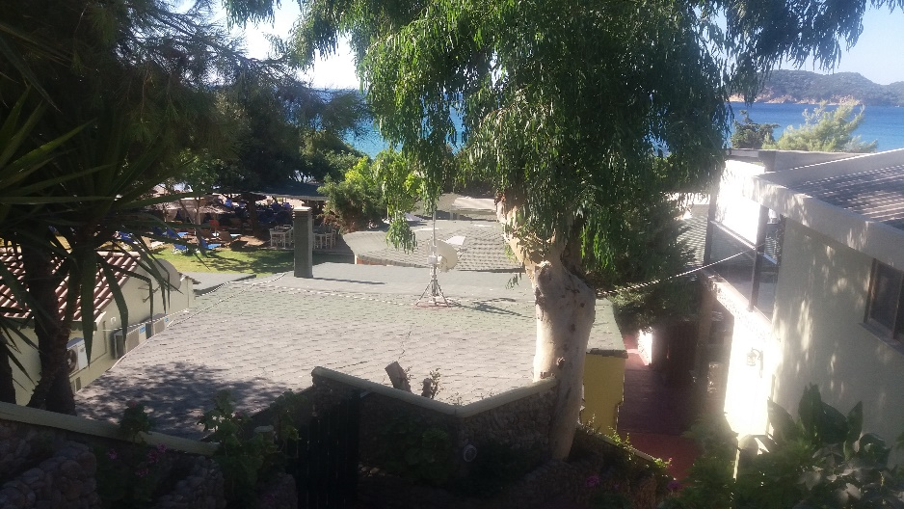
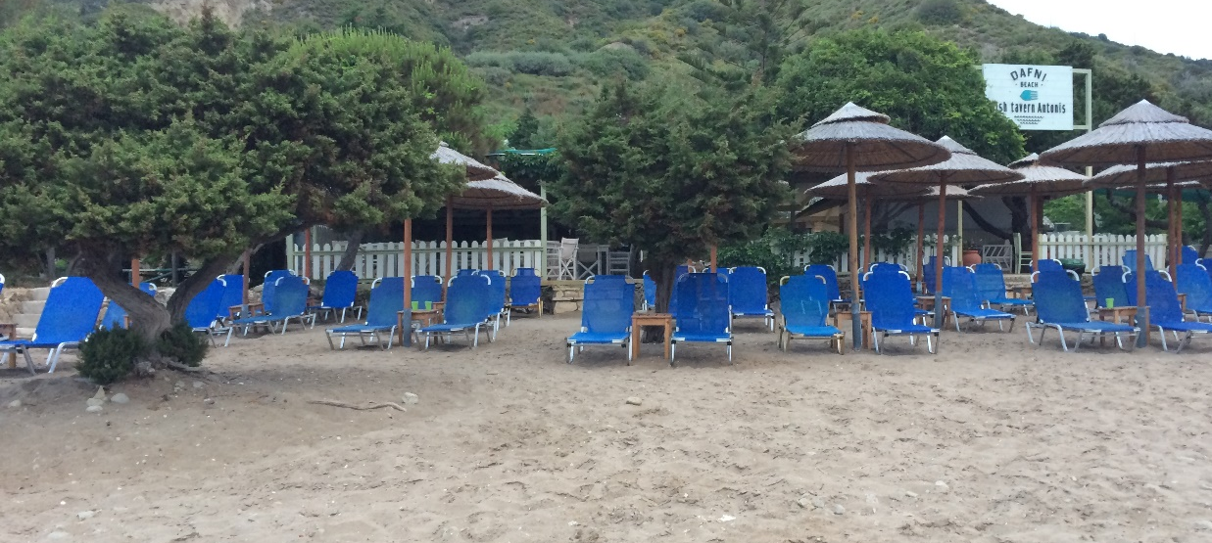
Daphni- Illegal Constructions (Measure #1)
Slide 3/13
MEDASSET Photo
taken 12th August 2019
Illegal business offer accommodation, which can be seen advertised on Booking.com
ARCHELON Photo 2109

Slide 4
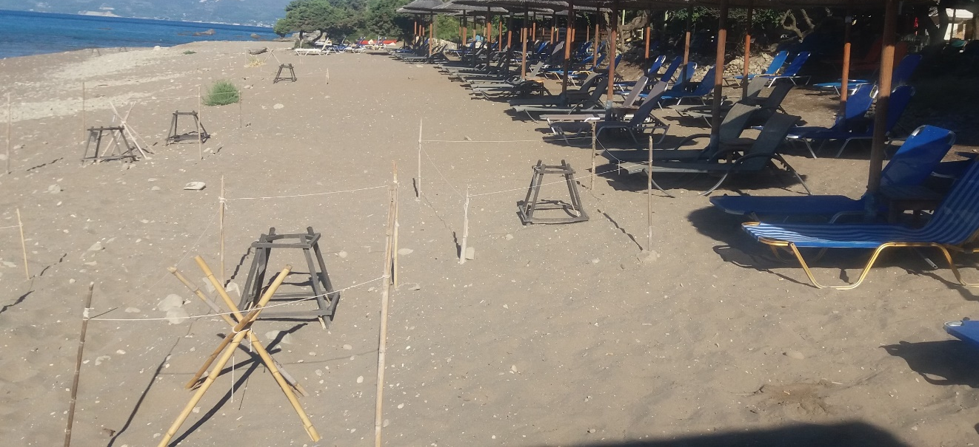
Daphni- Lack of compliance & enforcement
Slide 4/13
Lack of zone management
Destruction of natural dune system
MEDASSET Photos taken 12th August 2019
Watering of introduced grass

Slide 5
Legal limits of the public land on all beaches at Laganas Bay (Measure #4)
Slide 5/13
Numbers of beach furniture greatly exceed the Presidential Decree regulations & Management Measures of the NMPZ
Beach | Maximum permitted | 2019 Counts
Kalamaki & East laganas | 150 Umbrellas; 300 Sunbeds | 945 Sunbeds1
Daphni | 0 sunbeds, | 564 sunbeds
Gerakas | 60 Umbrellas; 120 Sunbeds | 364 Sunbeds1
Marathonissi | 0 Umbrellas | Not visited
ARCHELON 2019 counts

Slide 6
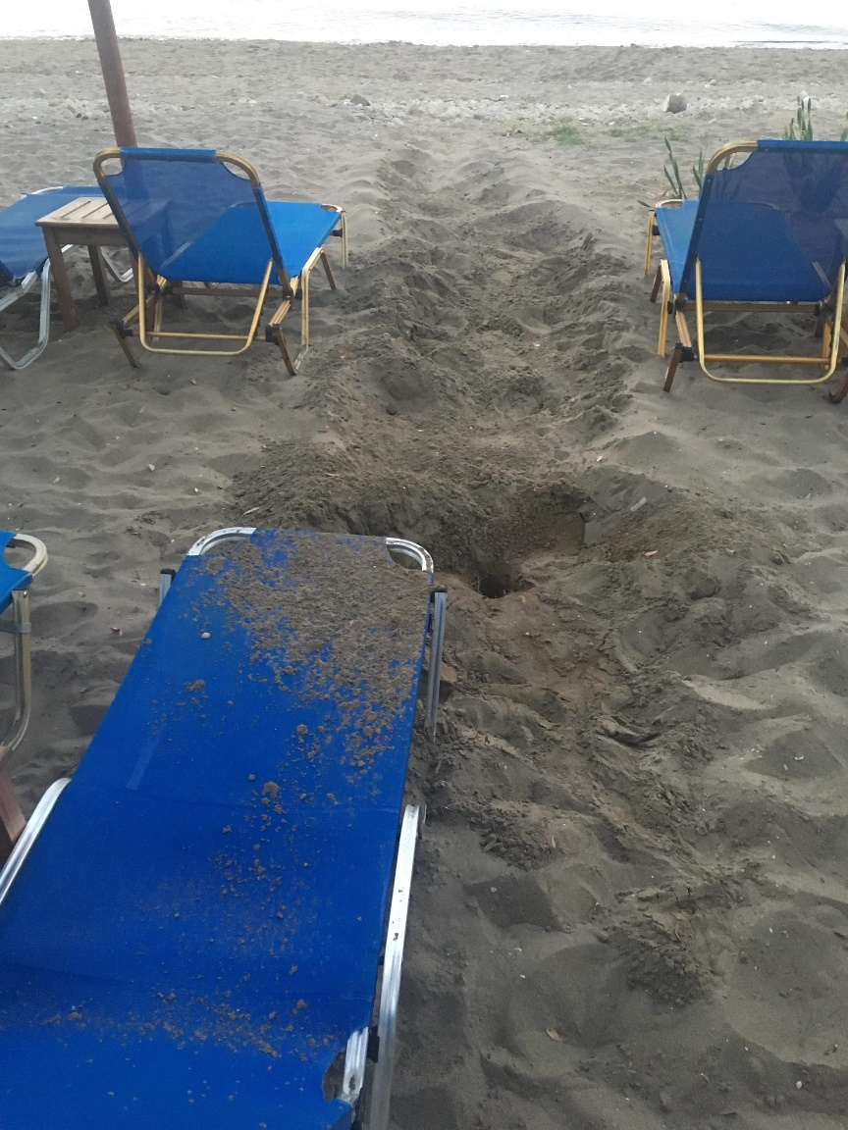
Slide 6/13
Removal of Beach Furniture at Night (Measure #5)
Kalamaki
97, 171 Violations for Sunbeds &
4, 521 for Pedaloes1
Photo
ARCHELON
Eastern Laganas
Gerakas
1. ARCHELON 2019

Slide 7
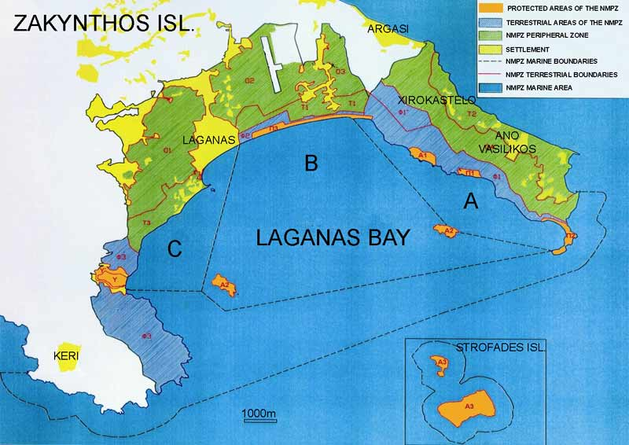
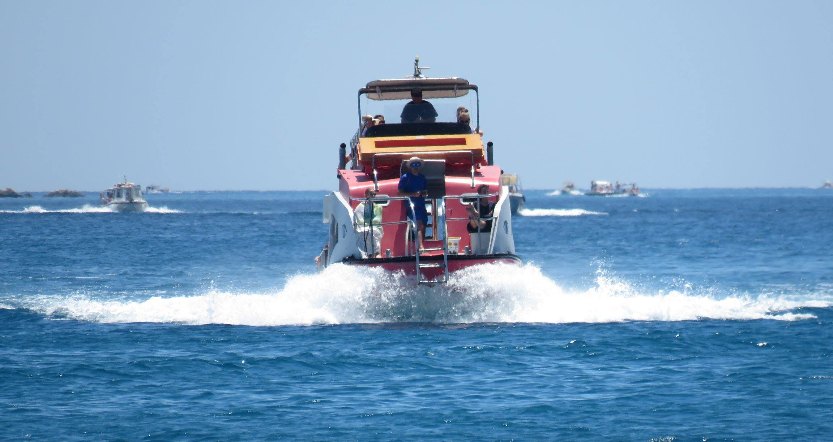
Slide 7/13
NMPZ Maritime Regulations regularly infringed
Number of Vessels entering Zone A (restricted area) in 2019: 261
Exceeding the 6 knot speed limit – 1,9911
Photo
ARCHELON
1. ARCHELON 2019

Slide 8
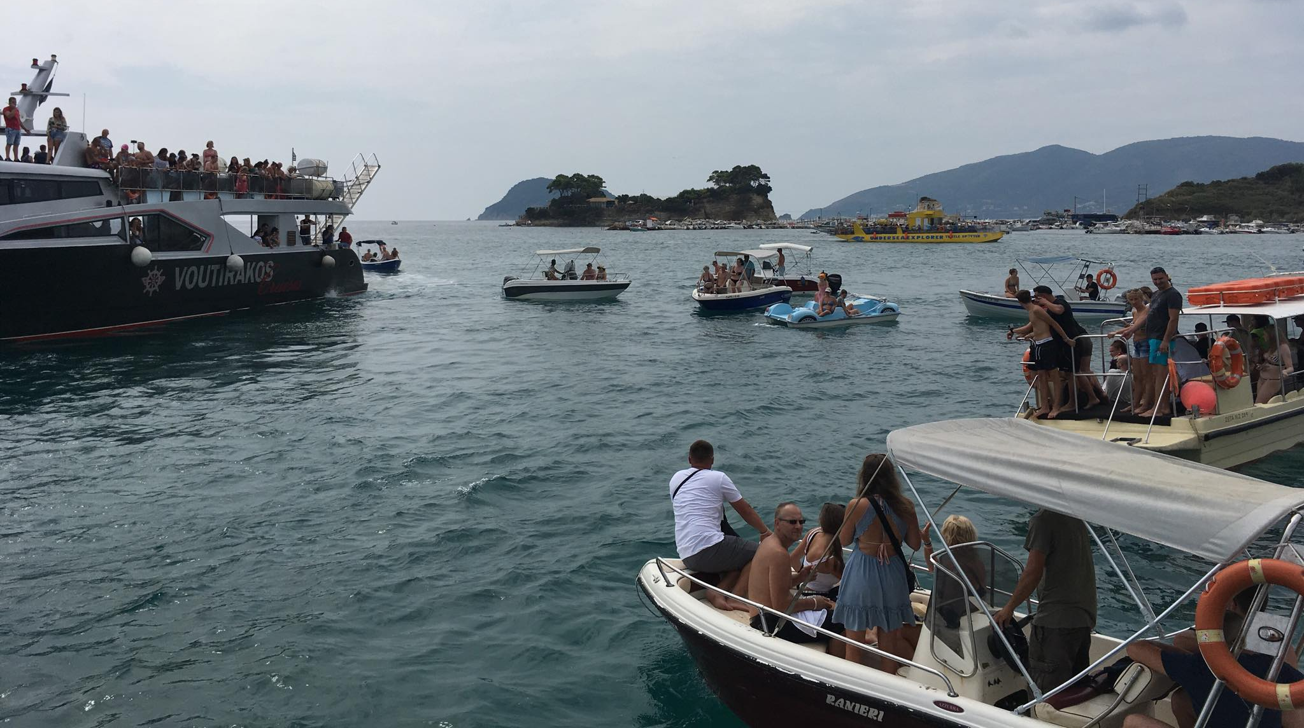
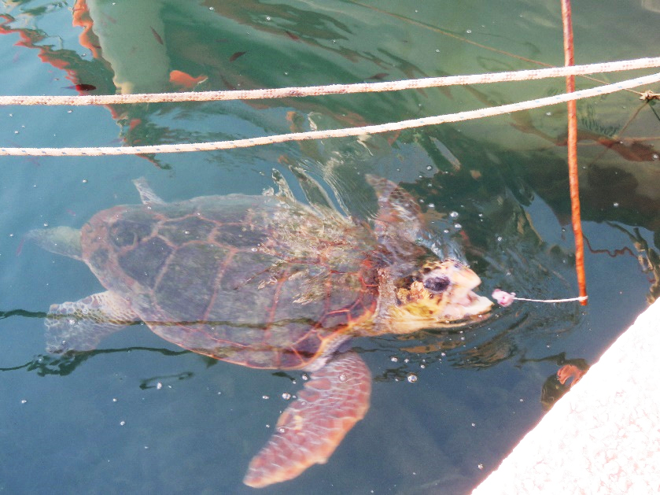
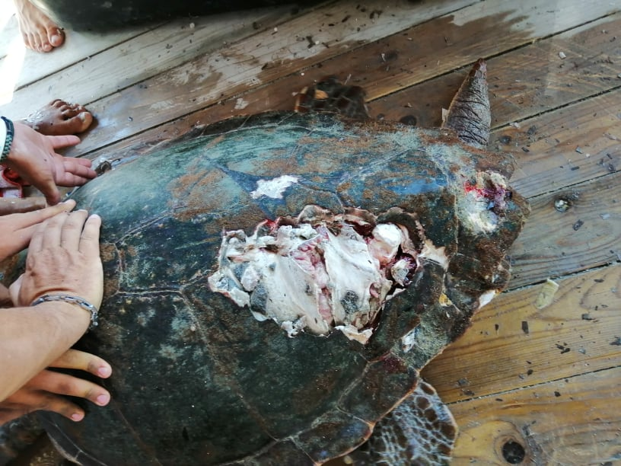
Slide 8/13
Lack of Compliance to Turtle Spotting Code of Conduct
ARCHELON Volunteers recorded 3, 673 violations to the Turtle Spotting guidelines and large vessels entering the Turtle Spotting Zone1
Sea turtle feeding to attract tourists inside the Turtle-Spotting Zone (11 violations recorded in 2019 only by 2 fishers, with many more occurring)
Injured sea turtle due to boat collision. Animal eventually died 1 month later
ARCHELON
Large vessels (>25 persons) in Turtle Spotting Zone & over 2 vessels surrounding one turtle, in violation of regulations
ARCHELON
ARCHELON
1. ARCHELON 2019

Slide 9
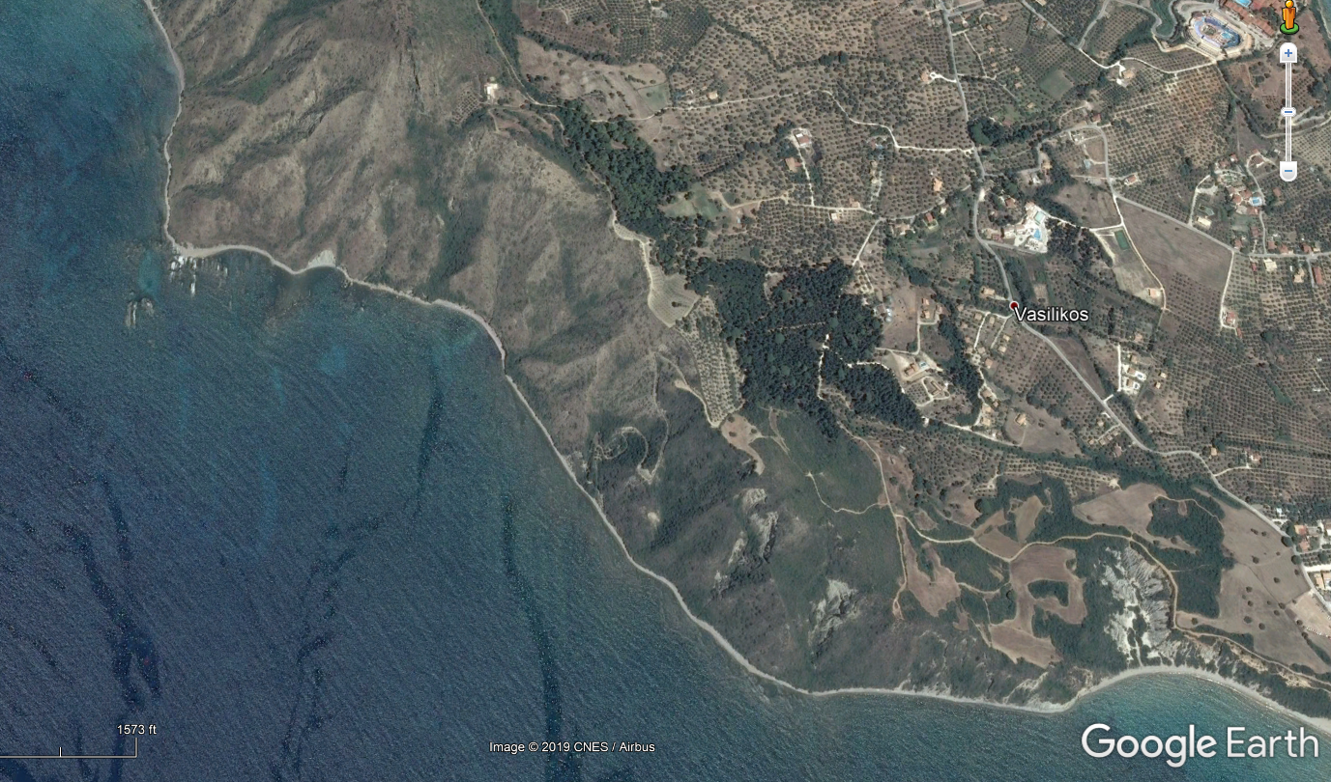
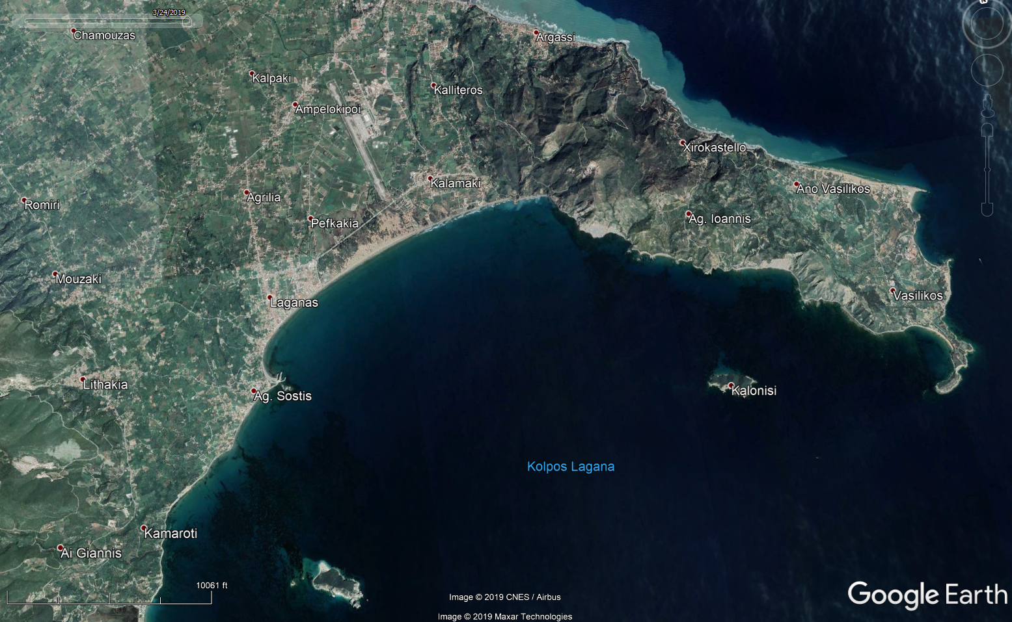
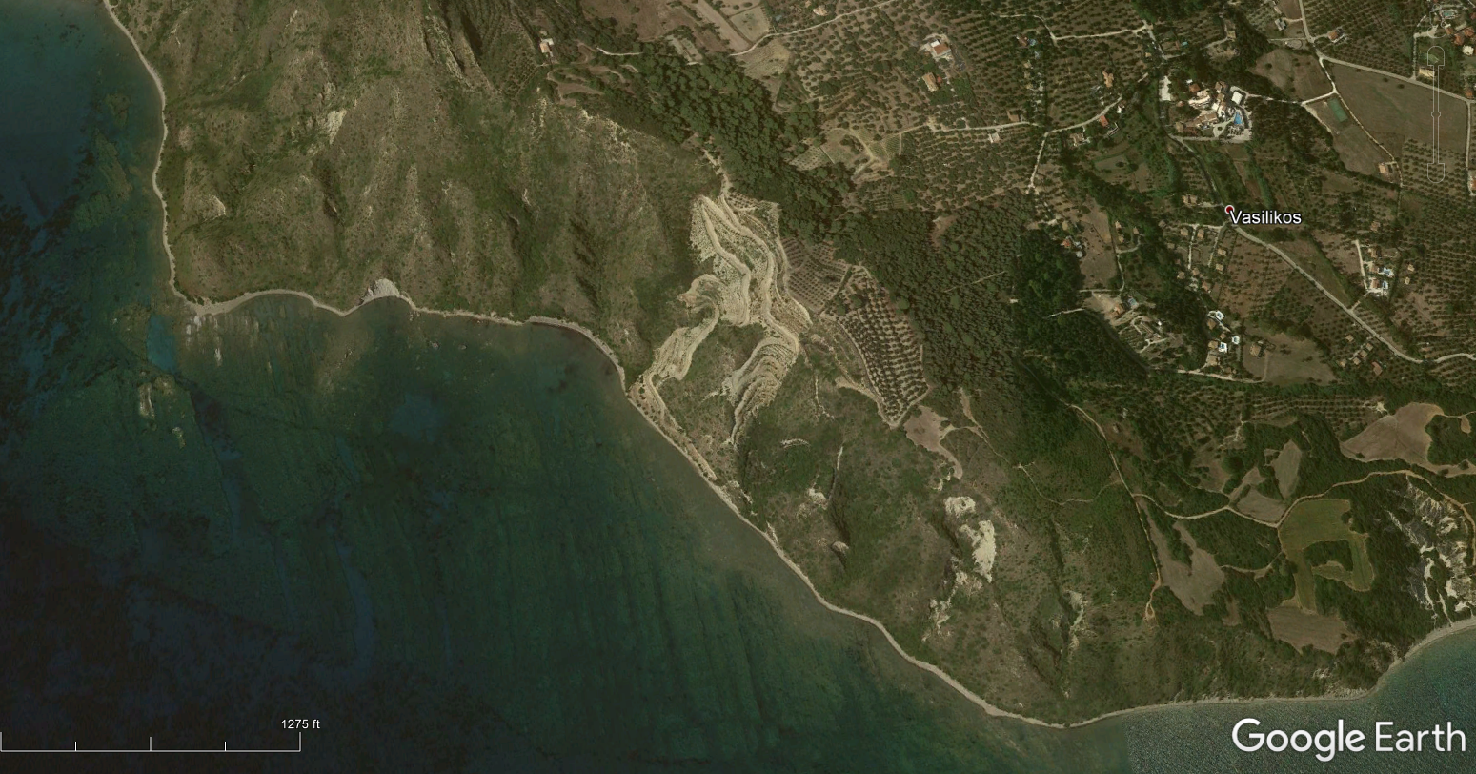
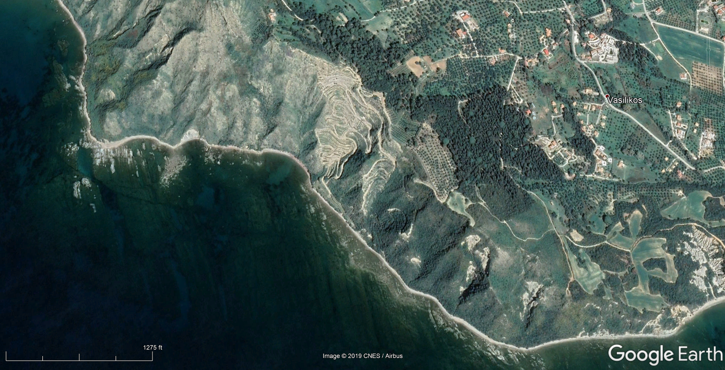
Illegal Actions I
Slide 9/13
Google Earth Image captured: 13th April 2013
Google Earth Image captured: 7th June 216
Road illegally created between Daphni and Gerakas still present. No restorative actions taken.
Google Earth Image captured: 28th June 2017
Sekania
Daphni
Google Earth Image captured: 24th March 2019
Gerakas

Slide 10
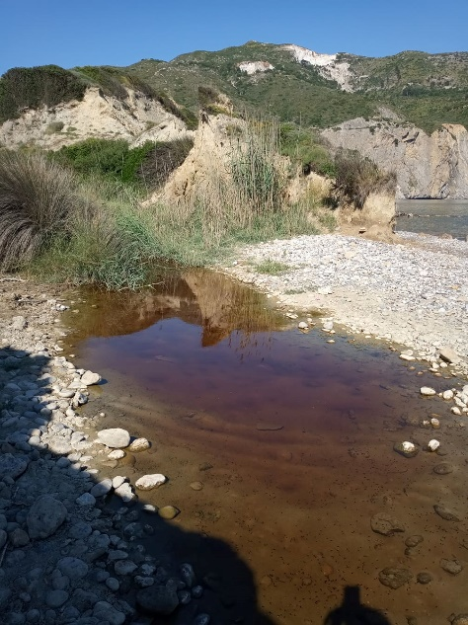
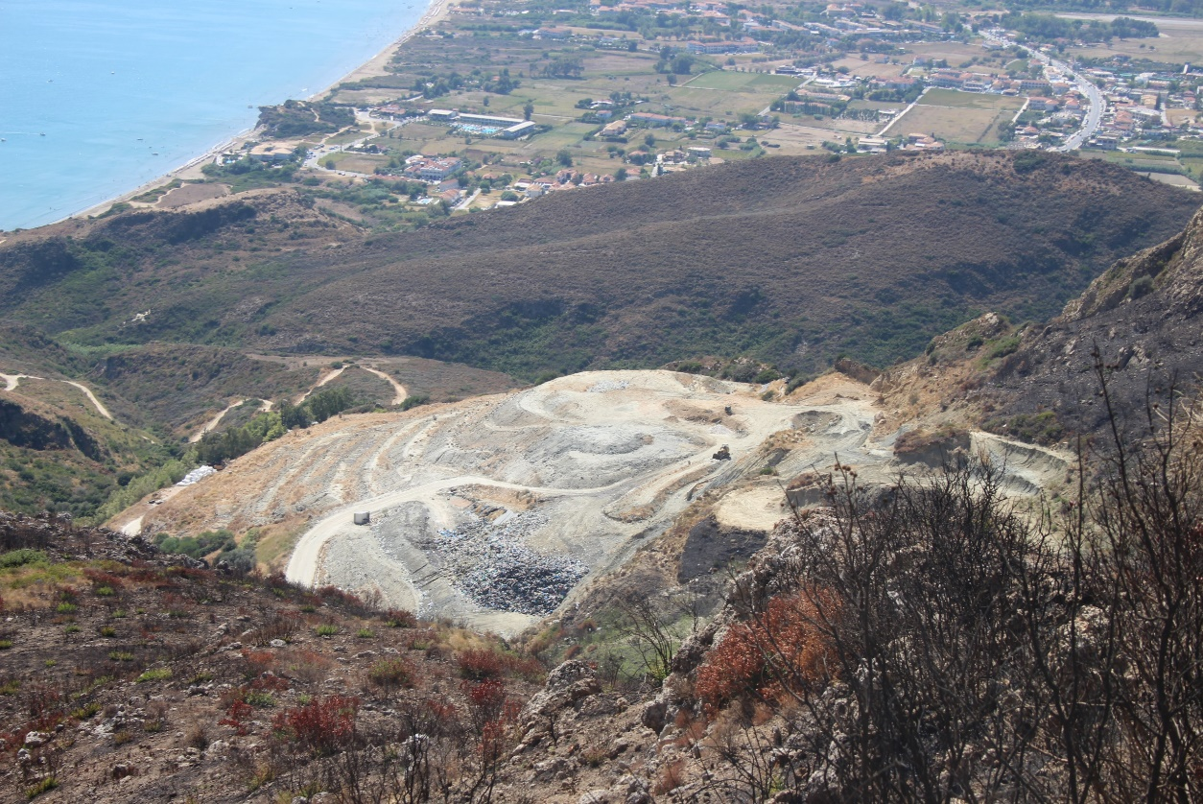
Illegal Actions II
Slide 10/13
Google Earth Image captured: 7th June 2016
Illegal landfill:
Seized operations BUT restoration not completed, causing toxic runoff into Laganas Bay
Google Earth Image captured: 28th June 2017
Kalamaki
ARCHELON
E. Laganas
Sekania
Daphni
Gerakas

Slide 11
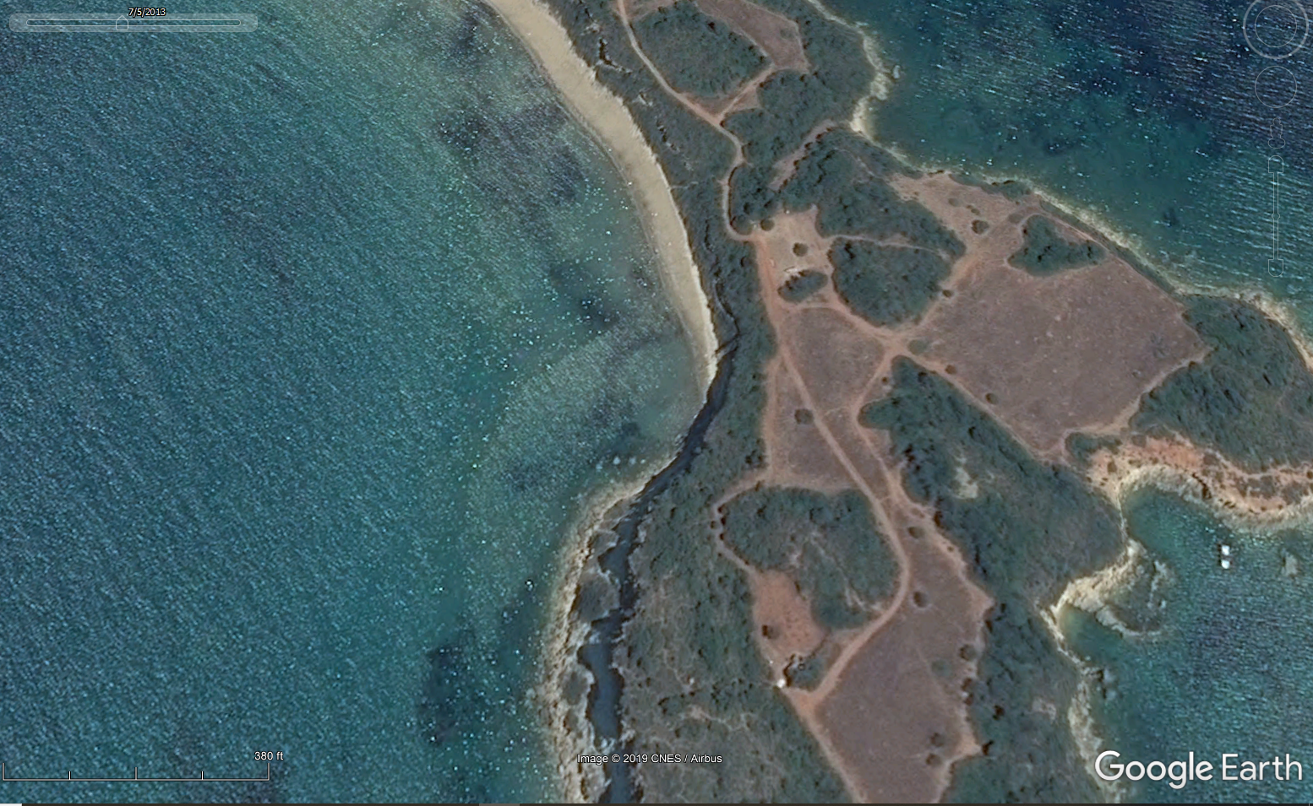
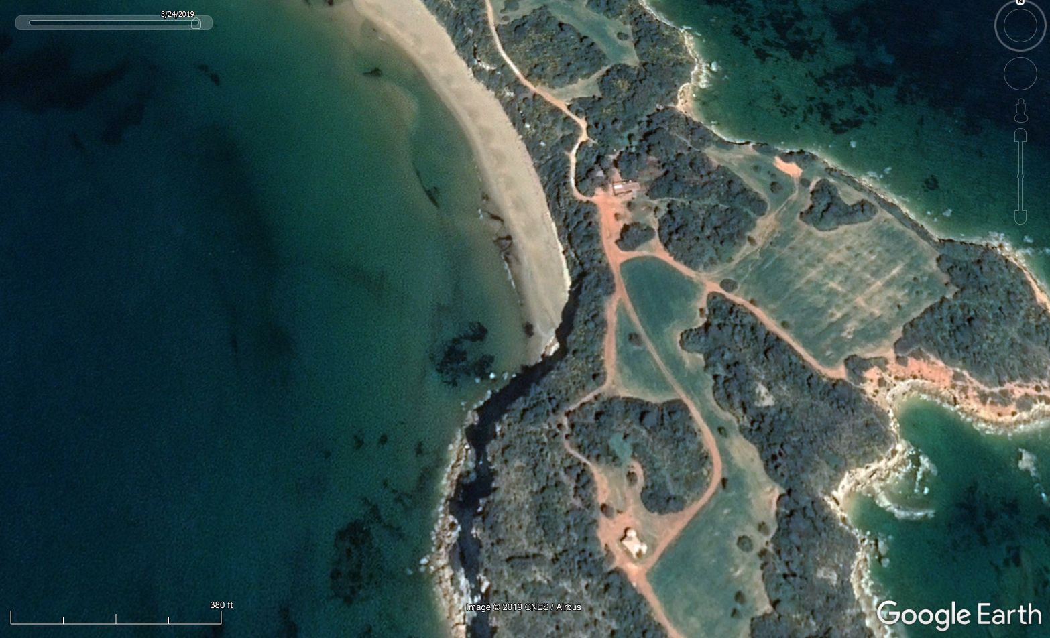
Illegal Actions III
Slide 11/13
Google Earth Image captured: 5th July 2013
Gerakas:
Two illegal buildings constructed within the NMPZ at Gerakas in 2017 remain
Kalamaki
Google Earth Image captured: 24th March 2019
E. Laganas
Sekania
Daphni
Gerakas

Slide 12
Conclusion
Slide 12/13
Extreme pressure in Laganas Bay MPA by:
Tourism
Turtle spotting rule violations
Poor enforcement of PD and NMPZ regulations
NMPZ’s lack of resources (financial and staffing)

Slide 13
MEDASSET
Slide 13/13
Calls on the Greek Government to:
Increase and secure funding to the NMPZ
Enforce the PD and NMPZ regulations
Impose fines and penalties
Take action to stop operation of illegal businesses in Daphni
Calls on the Standing Committee of the Bern Convention to:
Re-open the case file
Follow-up with the Greek Government Rec #9, and in particular measure #1 regarding Daphni
Perform an on-the- spot appraisal in order to update and amend Rec #9

