Slide 1



Slide 1/14
Agenda Item 6.3:
Follow-up
of Recommendation No. 95 (2002) on the conservation of
marine turtles in Kazanli (Turkey)
And New Complaint about Anamur (Turkey)
39th Meeting of the Standing Committee
Bern Convention
3-6 December 2019

Slide 2
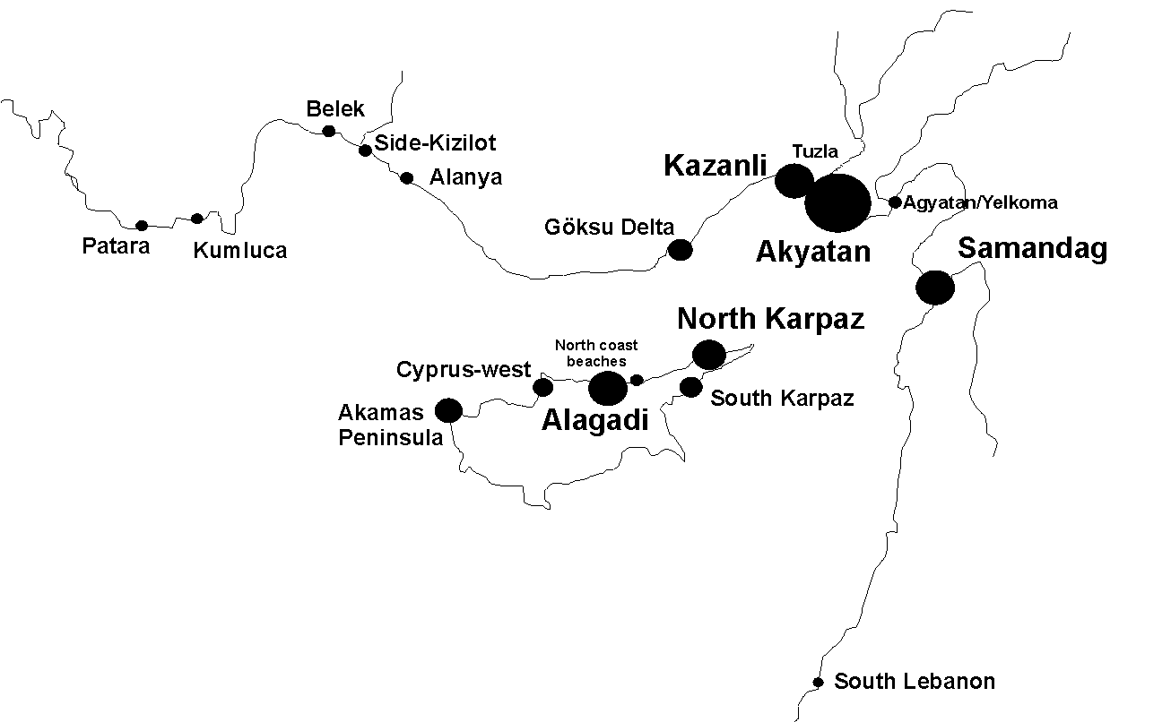
Main green turtle nesting beaches in the Mediterranean
& Location of Kazanli
Slide 2/14
Lattakia

Slide 3
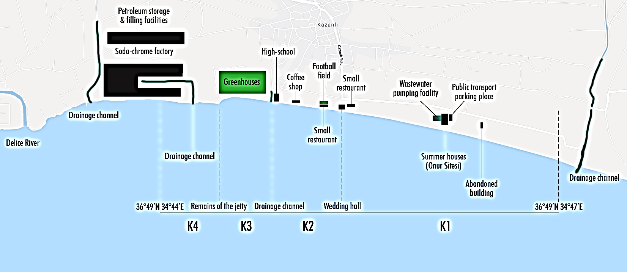

Slide 3/14
2019 updated map of Kazanlı nesting beach sections and coastal infrastructure
THREATS
Erosion
Toxic waste pollution
Litter, sewage & agriculture runoff
Light pollution
Greenhouses & buildings
Sand extraction
Coastal fishing
Low public awareness

Slide 4
Rec. No. 95 Measure Nº 1:
Removal of Greenhouses as a matter of urgency and restore that space to favour turtle nesting
Survey September 2019
Slide 4/14
Greenhouses in beach section K3 have not been removed. Greenhouses in the middle part also have large stones piled in front of them, possibly to cope with the effects of erosion. Greenhouses on the western side of the section are abandoned, but now entirely embanked with a stone wall.

Slide 5
Rec. No. 95 Measure Nº 2:
Moving the taxi parking area away from the beach as a matter of urgency
Survey September 2019
Slide 5/14
There is no designated taxi parking area close to the shore in any beach section, except for a public transport parking area next to the summer houses in K1. A number of vehicles park next to and in front of the wedding hall in section K2.
Vehicle parking near greenhouses in section K3
Vehicles parked next to and in front of the wedding hall at night, section K2

Slide 6
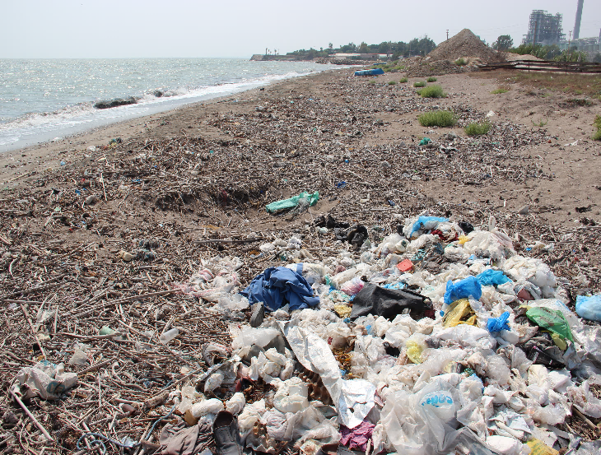
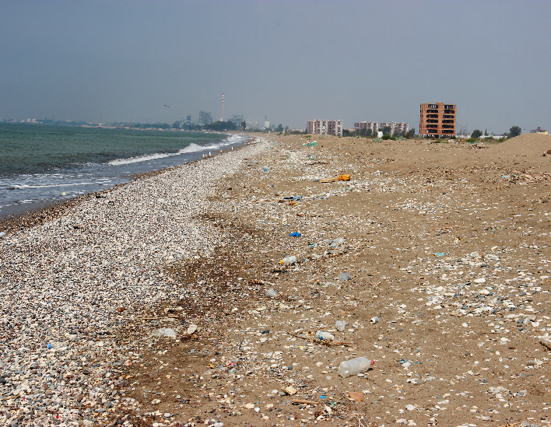
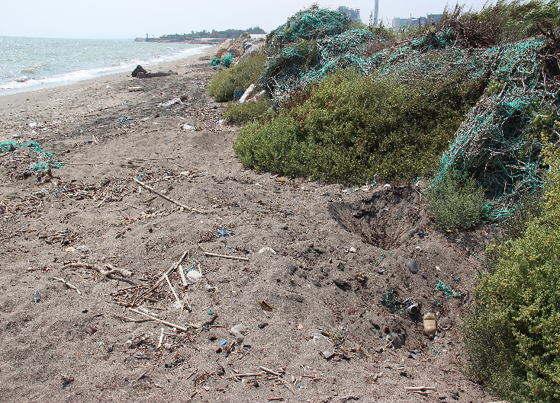
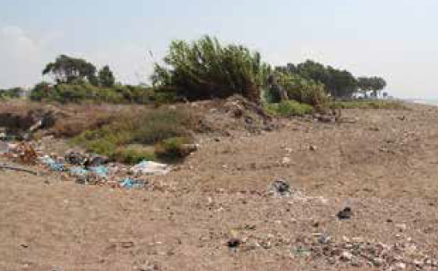
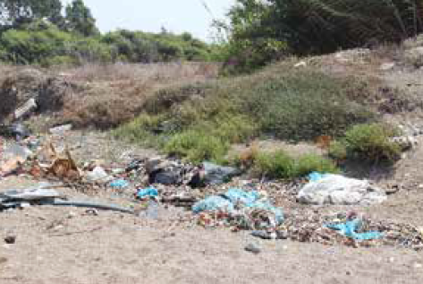
Rec. No. 95 Measure Nº 3:
Periodically remove the plastic debris from the beach
Survey September 2019
Slide 6/14
Marine debris was observed along the entire coast
Plastic bags and other debris in section K3
Plastic bottles, all along the shore in section K1
Discarded greenhouse nets and plastic debris in front of the greenhouses in section K3
Plastic debris dumped near the restaurant in section K2
Close-up of the plastic debris dumping area

Slide 7
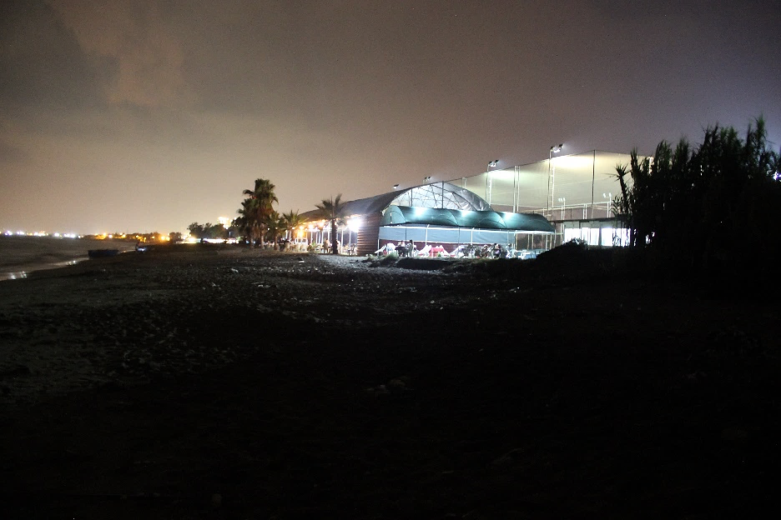
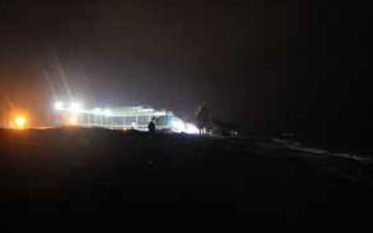
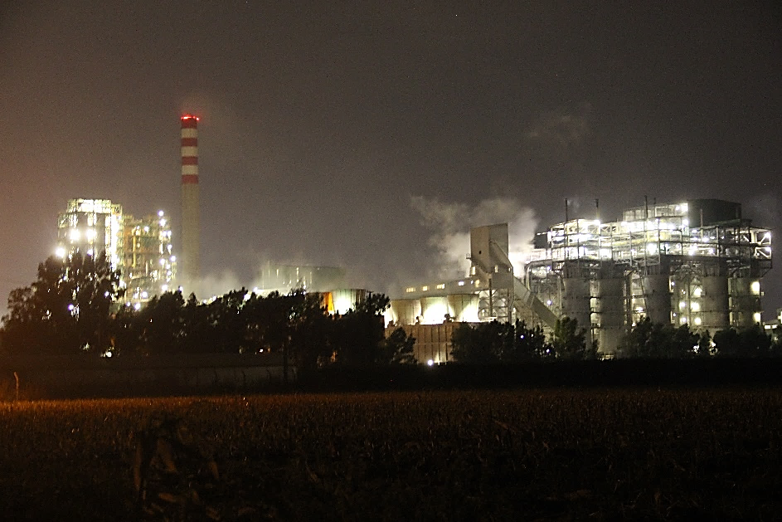
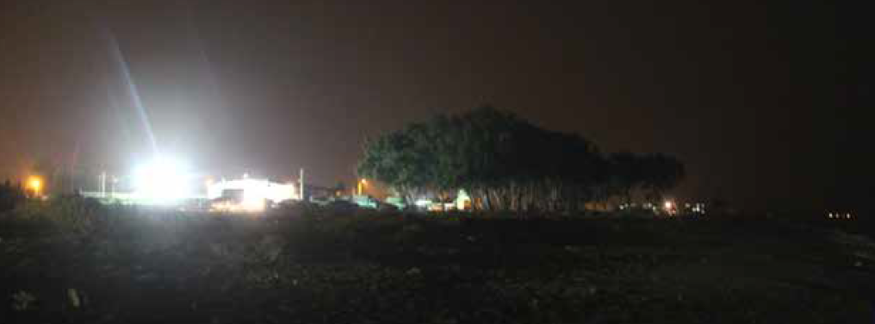
Rec. No. 95 Measure Nº 4:
Screening the lights of the municipality of Kazanli and the Soda-Chrome factory to avoid light-pollution on the beach
Survey September 2019
Slide 7/14
Light-pollution on the beach is clearly evident. No light screening has been installed
Light pollution from the football court Light pollution from restaurant
Soda-Chrome factory and orange street lights at night
Wedding hall at night, and the municipality’s orange streetlights at the back (section K2)

Slide 8
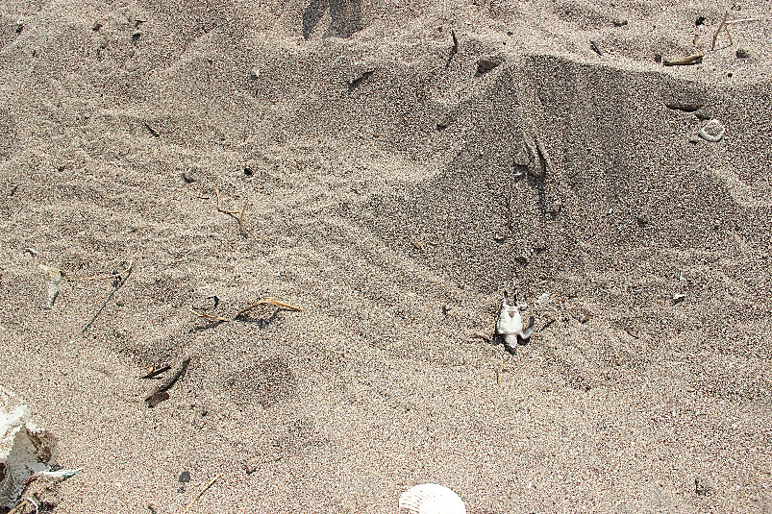
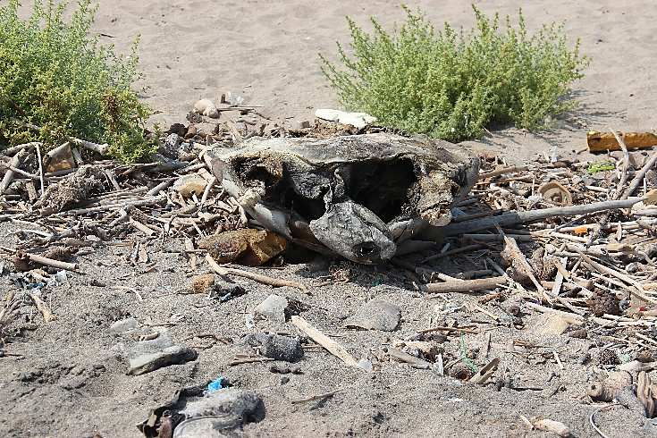
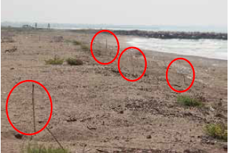
Rec. No. 95 Measure Nº 5:
Establish a reliable and permanent monitoring of nesting activities in the beach
Clear need for improved monitoring on all sections
Survey September 2019
Slide 8/14
A dead Chelonia mydas hatchling, dried under the sun, with its track (section K3)
Dead adult sea turtle, missing its front flippers (section K4)
Footprints of dogs (possible predator) in section K2
Turtle tracks marked with long sticks in section K1 (red circles)

Slide 9
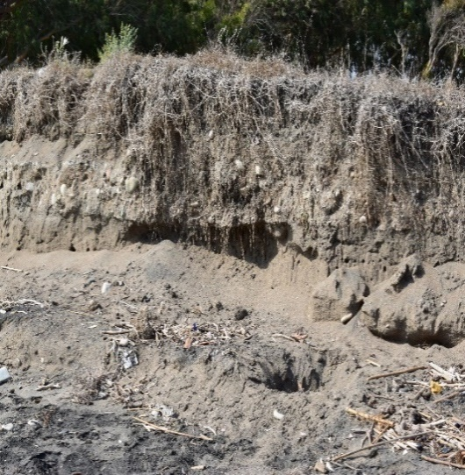
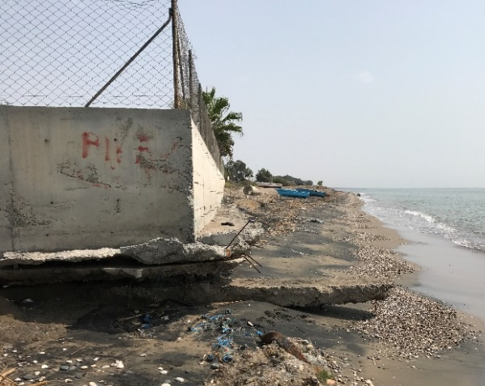
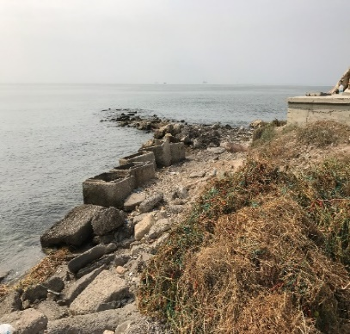
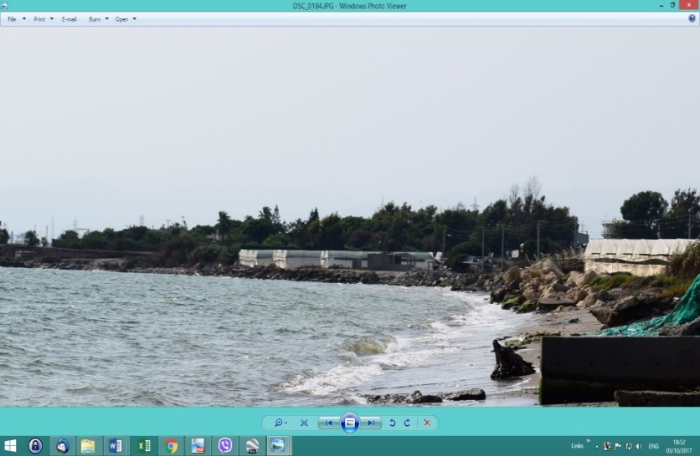
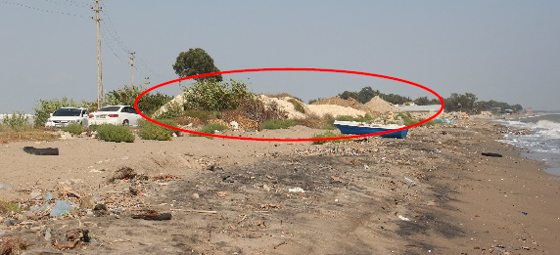
Rec. No. 95 Measure Nº 6:
Setting in place monitoring of beach erosion, in order to take remedial measures, as needed:
Survey September 2019
Slide 9a/14
Coastline erosion has progressed rapidly and disastrously over the years.
Effective remedial measures need to be applied as a matter of great urgency.
Effects due to severe coastal erosion
Erosion affecting the school yard wall
Erosion in K3 area; ineffective use of rocks and concrete blocks to try to halt and control the severe erosion
Piles of sand and soil behind the beach, near the greenhouses in section K3.

Slide 10
Rec. No. 95 Measure Nº 6:
Setting in place monitoring of beach erosion, in order to take remedial measures, as needed:
Survey September 2019
Slide 9b/14
The beach front in area K3 has decreased dramatically and can no longer sustain any turtle nests.
Coastal erosion progress in K3. Top: Satellite image 2007. Bottom: Satellite image 2018 (Source: Google Earth)

Slide 11
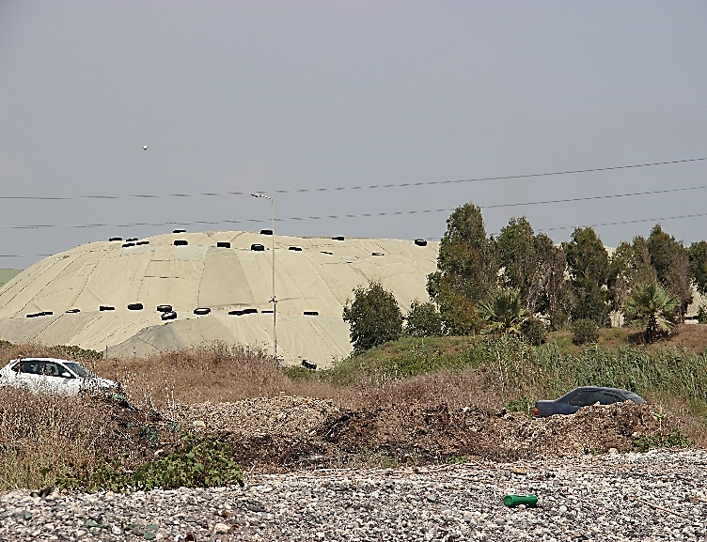
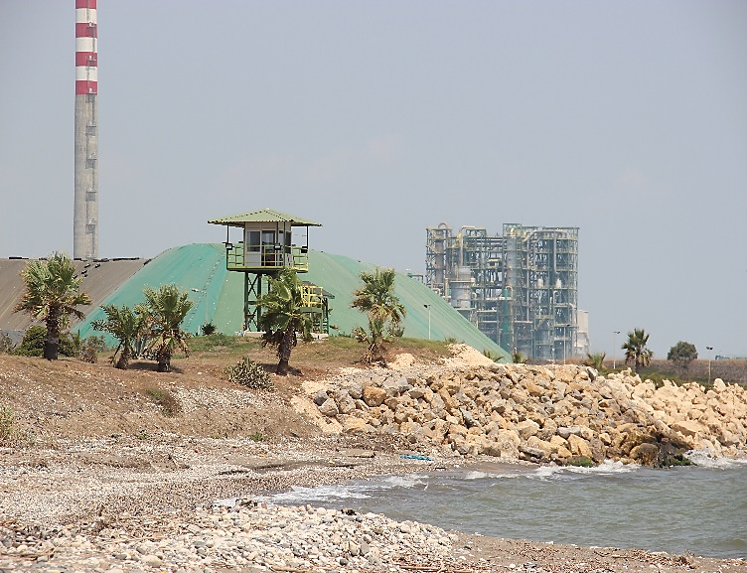
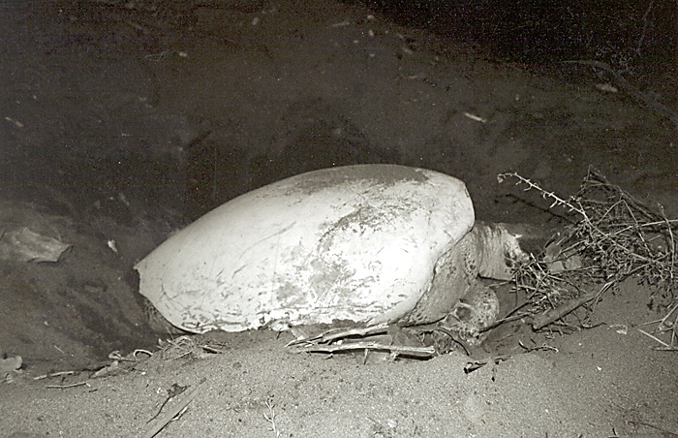
Survey September 2019
Slide 10/14
Rec. No. 95 Measure Nº 10:
Removing as appropriate the hazardous waste accumulated over the years close to the beach as a result of industrial activities
Soda chrome factory:
1.5 million tons of hazardous toxic waste covered with plastic sheeting have been deposited and remain right beside Kazanli nesting beach.
Little progress
Close-up of the waste deposits (section K4)
Close-up of the waste hills NEAREST to the sea, with the watch tower by the shore, and the stone wall (section K4)
Nesting green turtles are encrusted with calcium carbonate compounds due to the factory’s discharges into the sea

Slide 12
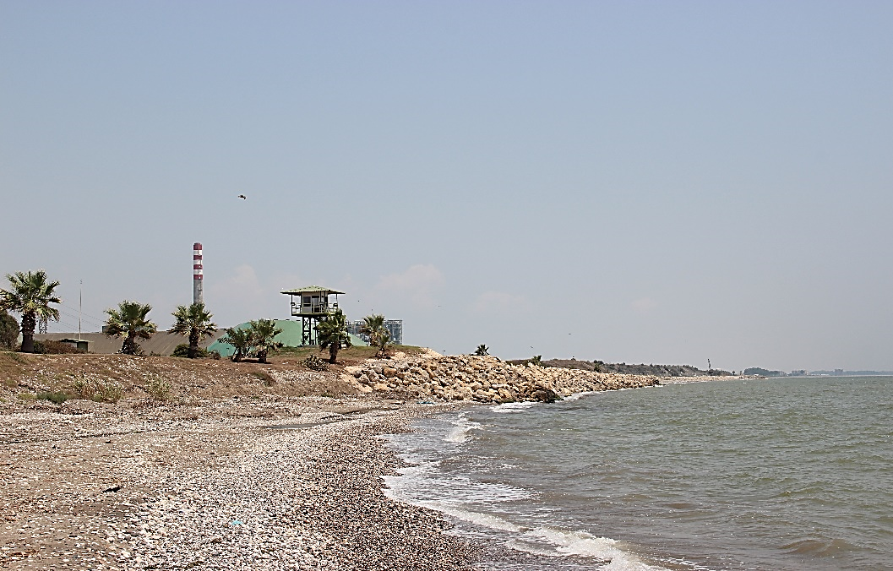
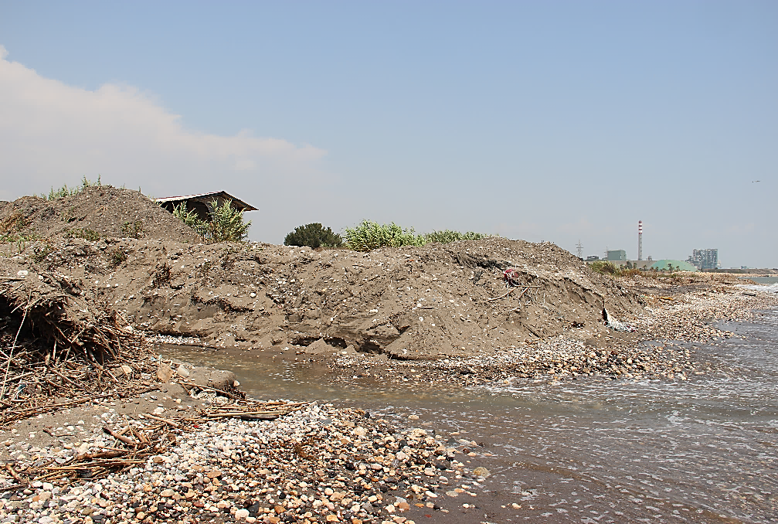

Survey September 2019
Slide 11/14
Rec. No. 95 Measure Nº 12:
Applying appropriate treatment to sewage waters from Kazanlı, in order to free the back of the beach from pollution
The local government's Kurumsal website is not functional.
Inadequate information available about effectiveness of waste treatment, and quality of discharge water draining into the sea
Small drainage channel to the west of the soda-chrome factory in section K4
Larger drainage channel in the middle of section K4

Slide 13
Recommendation No. 95 (2002)
2002-2019: little or no progress
Survey September 2019
Slide 12/14
  (Rec. No1) remove greenhouses : not implemented
  (Rec. No2) moving the taxi parking area : partially implemented
    (Rec. No3) remove plastic debris: partially implemented
    (Rec.No4) light screening : partially implemented
  (Rec.No6) monitoring beach erosion : not addressed- erosion has increased
  (Rec. No7) public awareness: partially implemented
    (Rec. No9) remove illegal building: not implemented
    (Rec. No10) remove hazardous waste: waste remains
    (Rec. No11) remove wedding hall: not implemented
    (Rec. No12) chemical analysis of discharges at sea: inadequate information
    (Rec. No13) remove houses on beach: not implemented

Slide 14
Recommendation No. 95 (2002)
Slide 13/14
MEDASSET wishes to emphasize its concern about lack of implementation of:
Measure No. 6 for erosion control which continues at an appalling speed and represents a major threat which can undermine all other conservation efforts. Significant loss of beach calls for urgent and drastic measures that have yet to be taken.
Measure No. 10 for the removal of the 1.5 million tons of highly toxic solid waste located right next to Kazanli’s green turtle nesting beach, posing a severe hazard for the habitat, the sea turtle nesting population, human health and the entire Mediterranean.
MEDASSET calls upon the Bern Convention Standing Committee to:
Follow-up Recommendation No. 95 (2002) especially regarding the implementation of erosion control and toxic waste removal
Urge Turkish authorities to fully implement Recommendation No. 95 (2002) with no further delay.
MEDASSET calls upon the Turkish authorities to:
Urgently implement all outstanding measures under Recommendation No. 95 (2002).

Slide 15

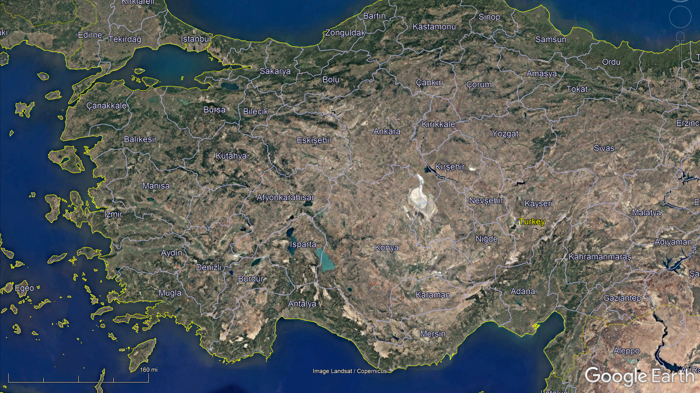
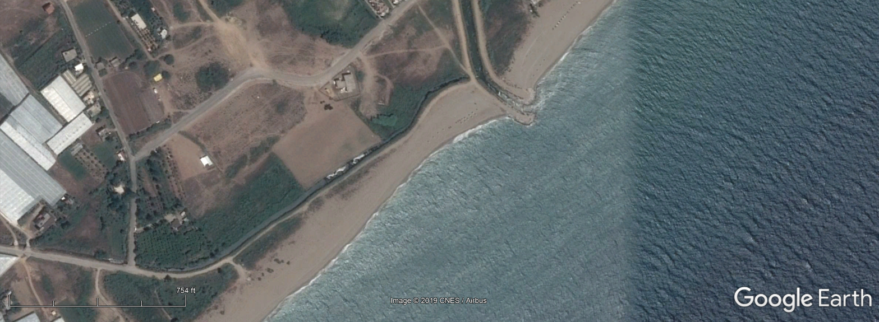
Slide 1/8
Mersin Çevre ve Doğa Derneği (MERÇED) Mersin Environment and Nature Association
Akdeniz Kaplumbağaları ve Doğa Koruma Derneği (AKKAP) Mediterranean Turtles and Nature Conservation Association
Underwater Research Association (SAD)
Illegal Activities & Habitat Destruction at Anamur Sea Turtle Nesting Beach
Illegal Activities & Habitat Destruction at Anamur Sea Turtle Nesting Beach
Karaağaç Beach
39th Meeting of the Standing Committee, Bern Convention. 3rd – 6th December 2019

Slide 16
Slide 2/8
ANAMUR SEA TURTLE NESTING SITE
12km sea turtle nesting beach
2nd Important Sea turtle nesting in Turkey & 4th Important in the Mediterranean1
  Nest/yr Average = 7332
  2018 recorded approximately 1,200 nests
Standing Committee adopted Recommendation 66 (1998) on the conservation status of some nesting beaches for marine turtles in Turkey on 4th December 1998.
  Measure 1 for site protection states that necessary Environmental Impact Assessments (EIAs) to be carried out for projects.
  Measure 5 For urgent & stringent measures to enforce legislation against illegal sand extraction.
  Species Protection on Anamur Beach: To Prohibit sand extraction from Anamur Beach & Secure remaining unbuilt beach plots against development.
1 IUCN MTSG report Sea turtles in the Mediterranean, 2010; Hochscheid et al. 2018. Sea Turtles in the Mediterranean Region: MTSG Annual Regional Report
2 Hochscheid et al. 2018. Sea Turtles in the Mediterranean Region: MTSG Annual Regional Report

Slide 17
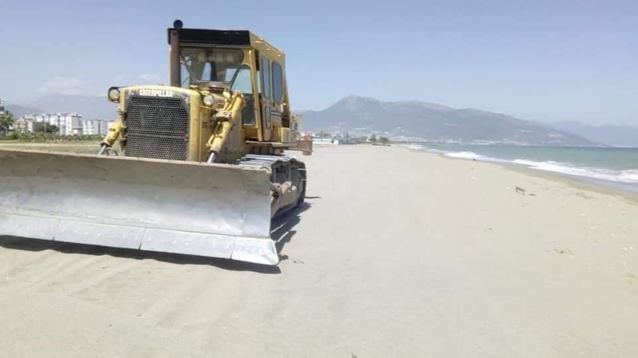
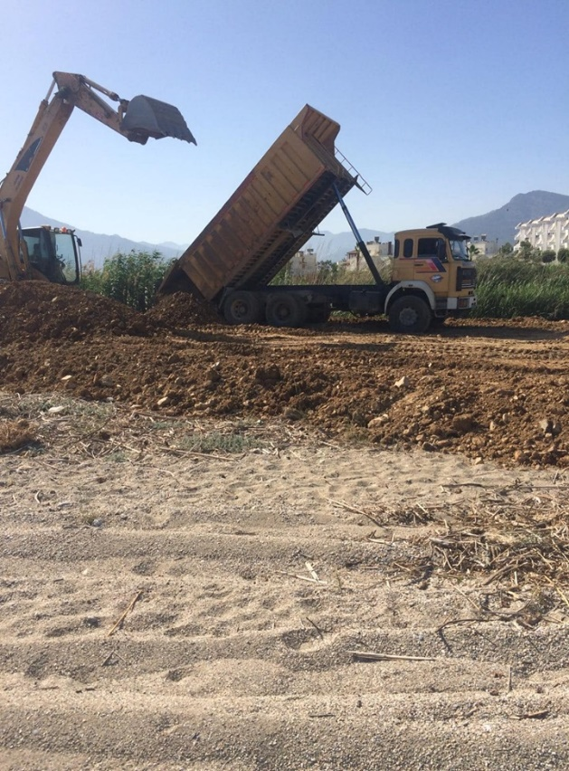
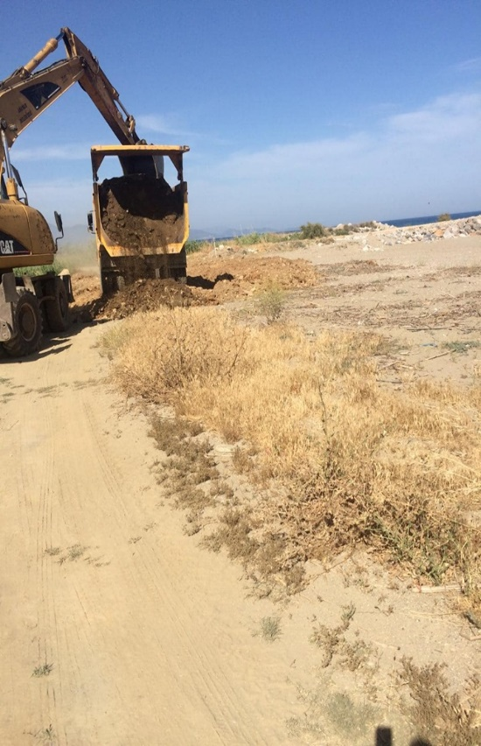
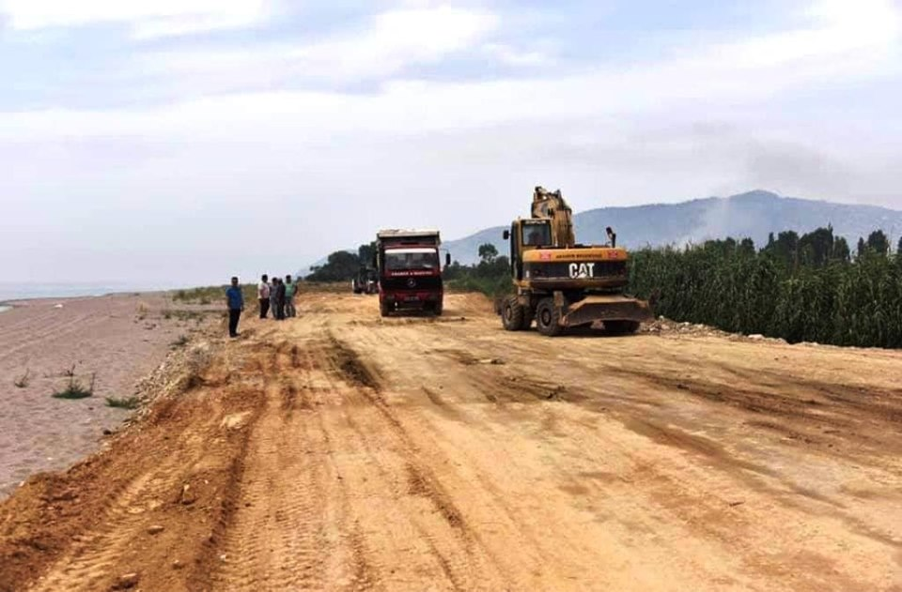
Slide 3/8
HABITAT DESTRUCTION OF NESTING BEACH AND ADJACENT SAND DUNE SYSTEM & DUMPING OF SOIL
Photos taken from Anamur Çevre Platformu Fb Posts

Slide 18
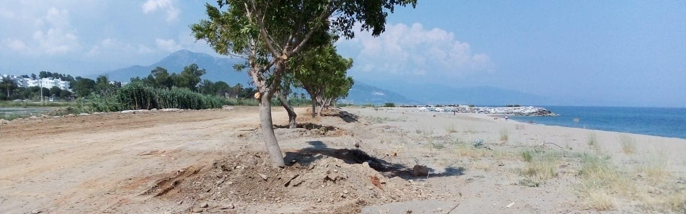
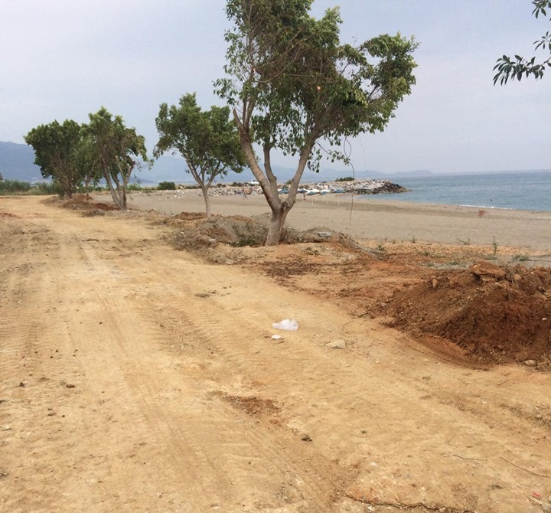
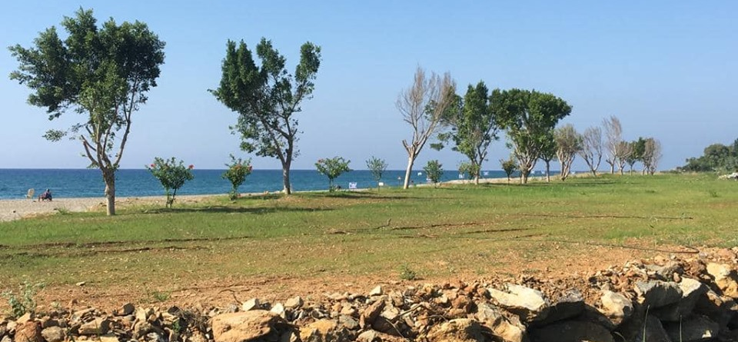
ALTERATION OF DUNE SYSTEM & INTRODUCTION OF ALIEN FLORA SPECIES TO THE SAND DUNES
Slide 4/8
Photos taken from Anamur Çevre Platformu Fb Posts

Slide 19
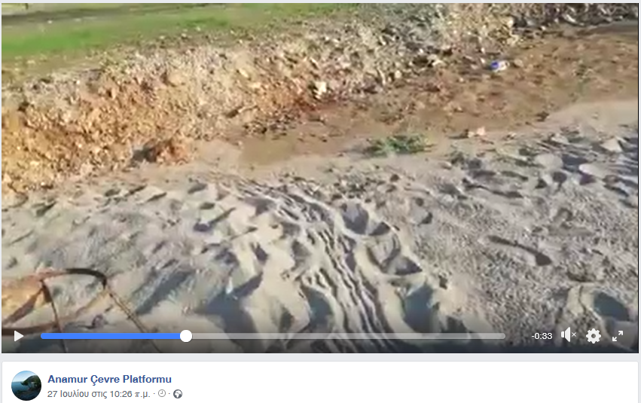
Slide 5/8
FAILED SEA TURTLE NESTING ATTEMPT

Slide 20
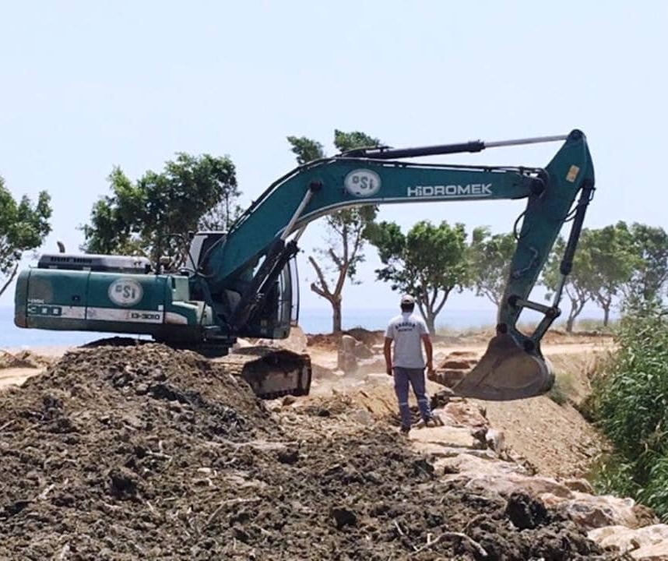
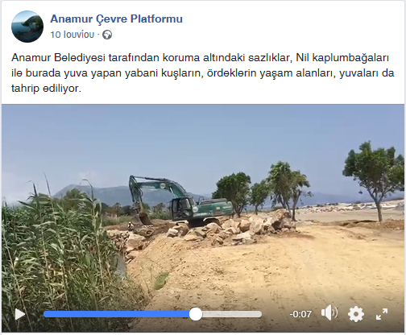
ALTERATION OF SARISU CREEK (RAMSAR WETLAND SITE)
Slide 6/8
Photos taken from Anamur Çevre Platformu Fb Posts

Slide 21
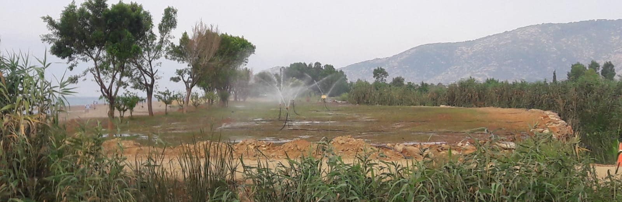
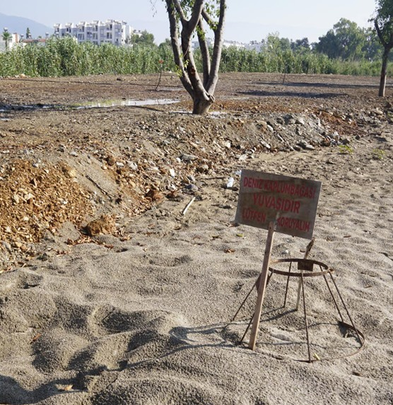
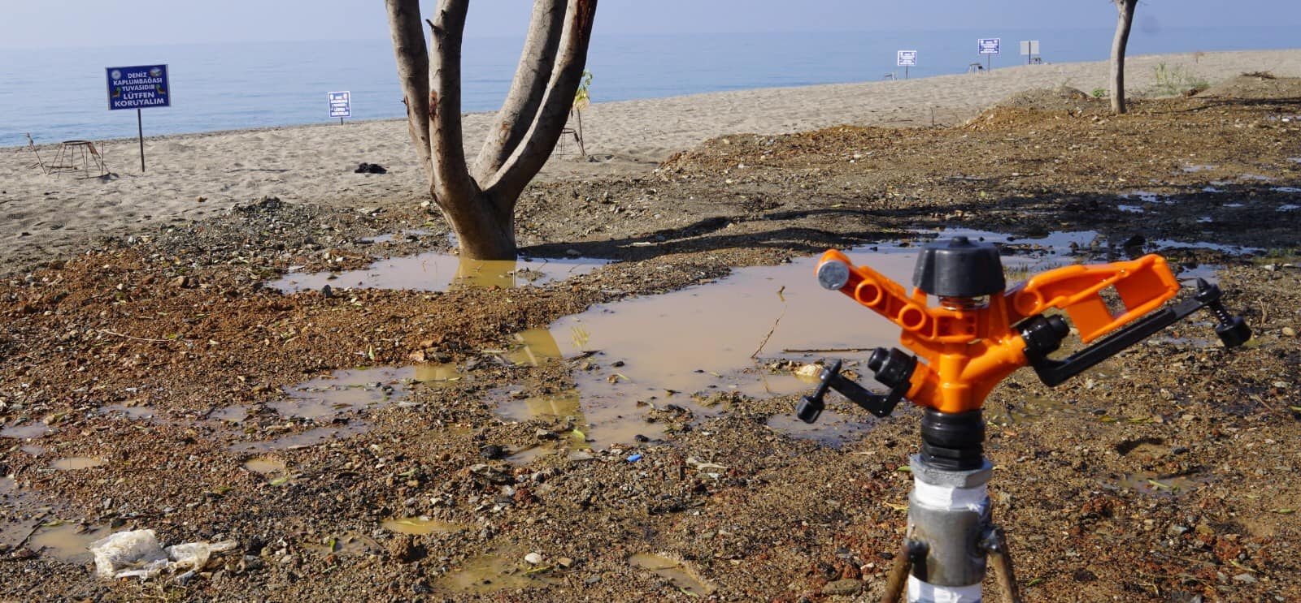
IRRIGATION OF INTRODUCED ALIEN TREES & GRASS
Slide 7/8
Photos taken from Anamur Çevre Platformu Fb Posts

Slide 22
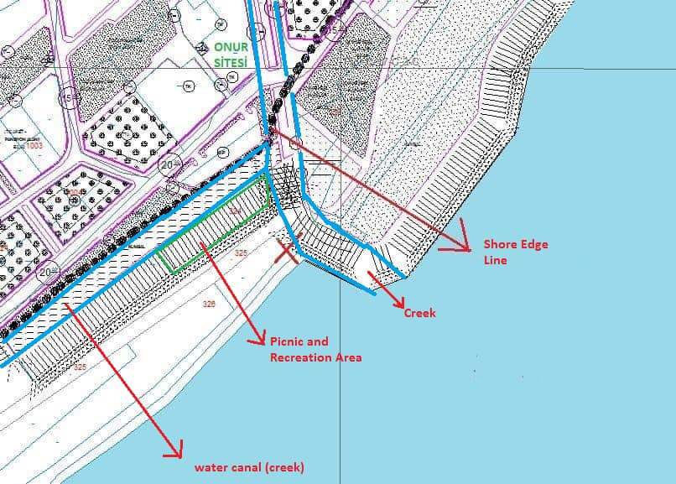
In Conclusion
Slide 8/8
MAP: Anamur Çevre Platformu
Complete disregard to National, International commitments & Recommendations
Deliberate destruction of sensitive nesting habitat
Continuation of actions placing sea turtle nesting at risk
Lack of enforcement by Local Authorities
We encourage the Turkish Government to:
  Enforce the restoration of the site
  Enforce compliance to declared fines and orders
The Standing Committee of the Bern Convention to:
  Follow-up this case with the Turkish Government

Slide 23
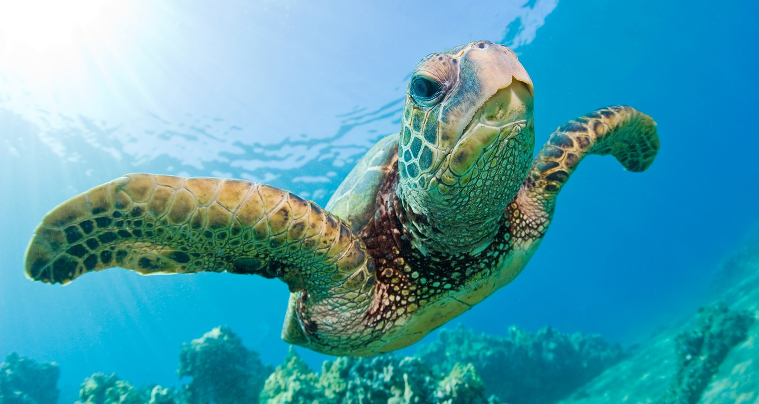
Slide 14/14
Green turtle Chelonia mydas
    Thank you for your kind attention!

