Slide 1
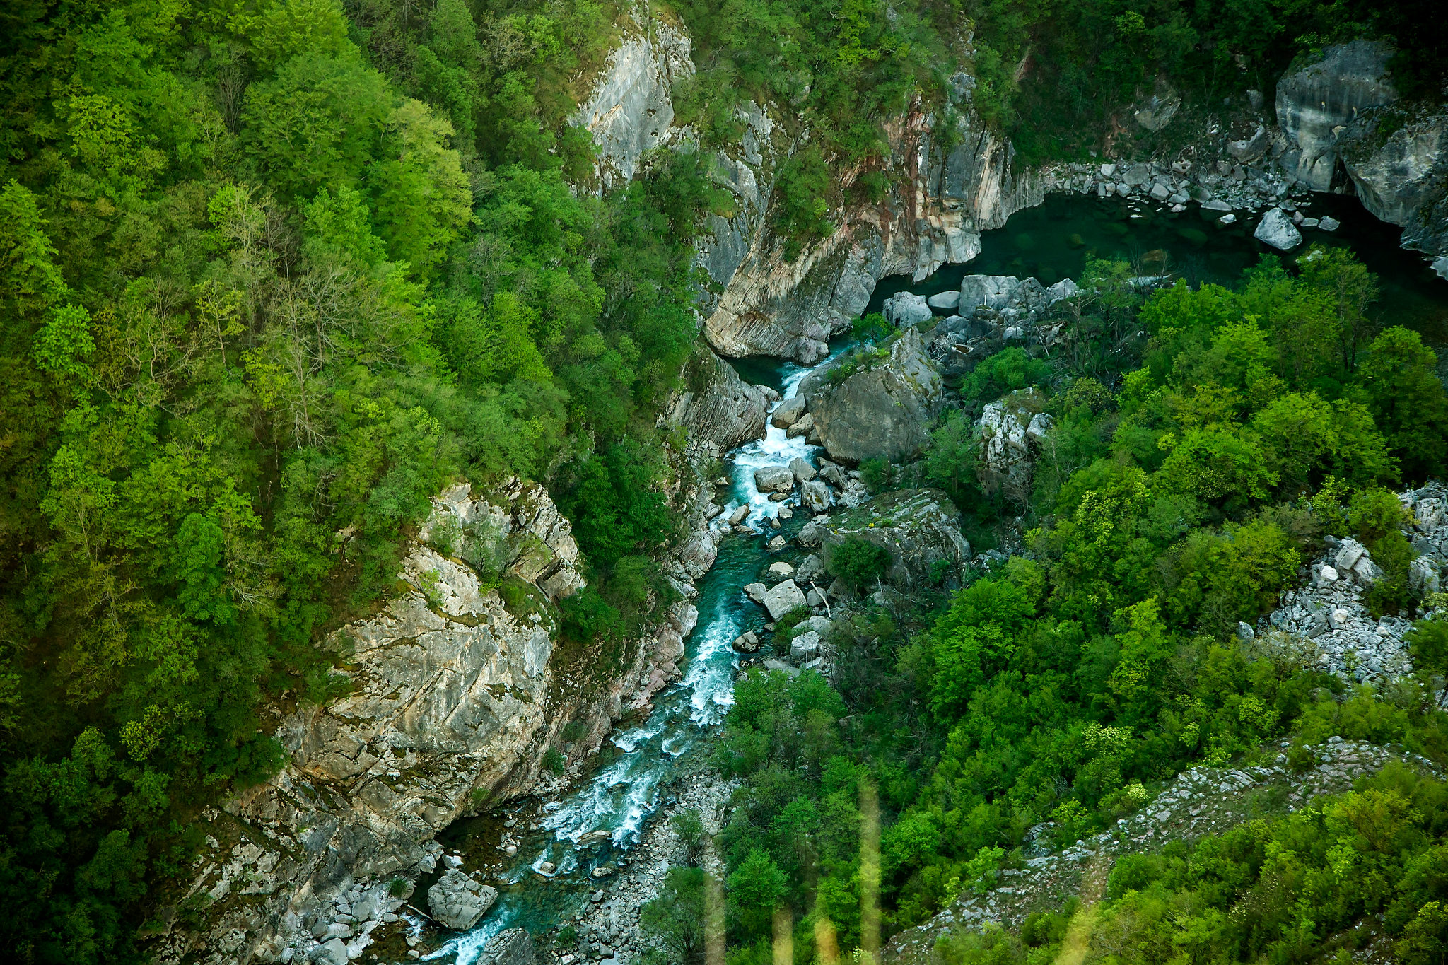
Upper Neretva case 41th meeting of the Standing Committee, December 2021, Strasbourg
On behalf of group of CSOs:
Nataša Crnković
Centar za životnu sredinu/ Friends of the Earth Bosnia and Herzegovina

Slide 2
Upper Neretva case – iconic river and dam tsunami
Possible file 2020/09: Bosnia and Herzegovina: Possible negative impact of hydro-power plant development on the Neretva river
Ulog hydropower plant (35 MW)
HES “Gornja Neretva” hydroelectric system that consists of 7 small hydropower plants (total 15 MW)
New dams planned downstream in FBiH: HPP Bjelimići, PHPP Bjelimici, and HPP Glavatićevo – capacity to be confirmed
All these plants are inside the candidate Emerald Site Gornji tok Neretve, Ulog dam is near the center of the site.

Slide 3
Current status
The construction of Ulog has continued even after the Bern Convention Bureau requested on September 2021 to “halt any works at the site until comprehensive and legally sound environmental assessments have been carried out”.
The government of Republika Srpska approved on 11 November 2021 the Electricity Transmission Company’s project to build, use and maintain the connecting transmission line to HPP Ulog.
Construction of HPP Ulog is ongoing.

Slide 4
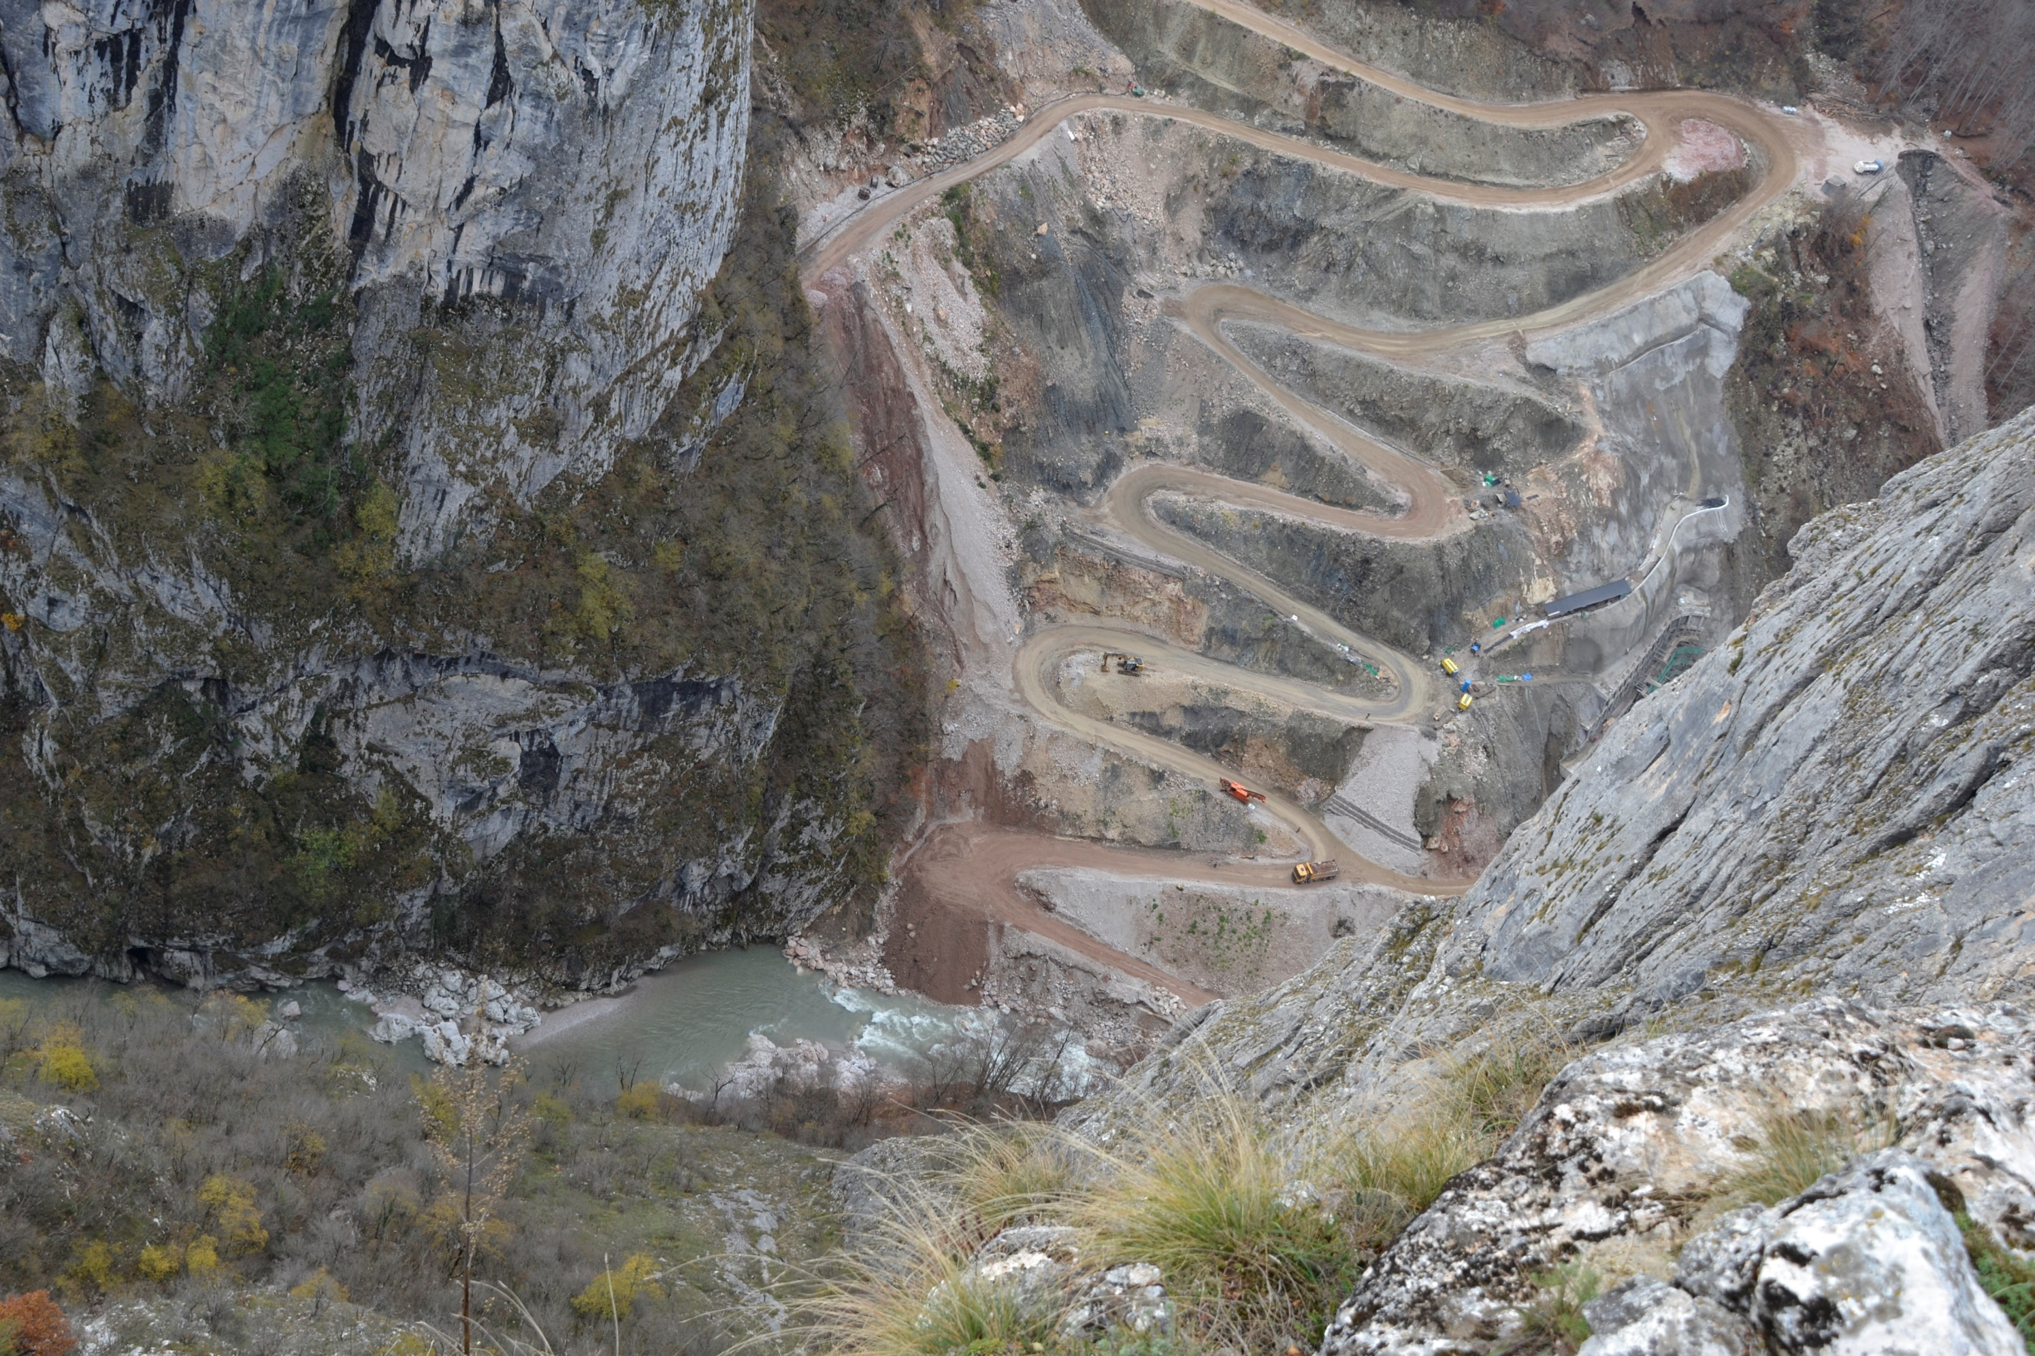
Neretva River and ongoing construction of Ulog HPP in November 2021 (Photo © Robert Oroz)

Slide 5
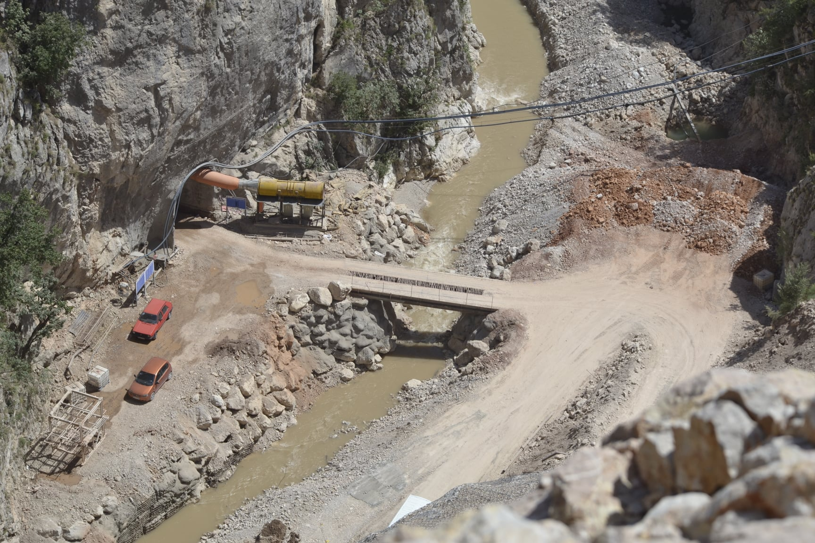

Slide 6
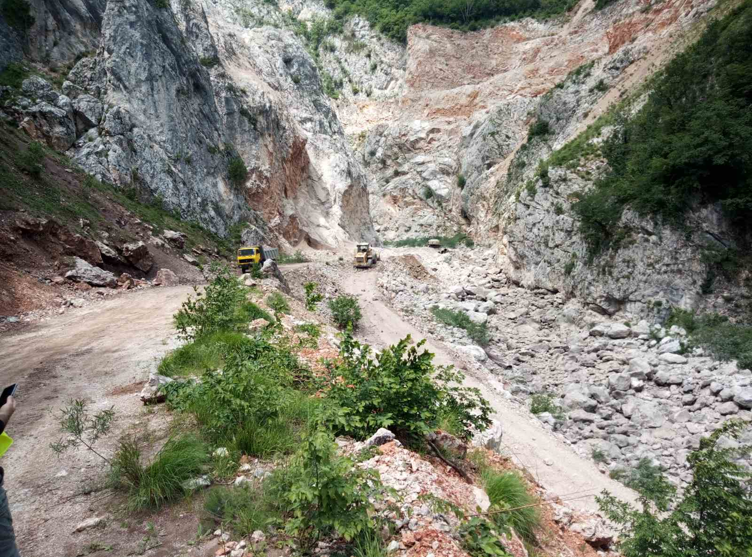

Slide 7
Particularly important is the lack of a cumulative impacts assessment in the three individual EIAs that have been done for the SHPPs on the Upper Neretva.
Based on our calculation, there would be plants stretching continuously from around 8 km from the source to 38 km from the source, in total 30 km with only one gap of 2 km.
The upper Neretva would be completely changed from a river into a series of reservoirs and pipelines, losing completely its biodiversity importance as a candidate Emerald site.
The biodiversity data in the EIAs for HPPs (Ulog and Upper Neretva) mention several species protected under the Bern Convention and the EU Habitats Directive, but do not specify where these have been found and how would the construction and operation impact them.
Golden eagle, Aquila chrysaetos

Slide 9
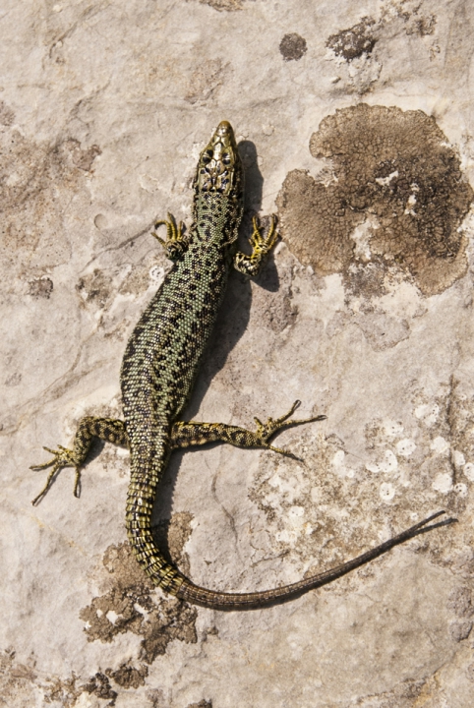
Initiative for the protection of Upper Neretva
Initiative for the protection of Upper Neretva as two protected areas (natural habitat and natural trout spawn) is submitted by Center for Environment in June 2021
Field research of nine taxonomy groups are organized in 2021 and 2022
Already preliminary results are showing the exceptional biodiversity richness such as Golden Eagle and Mosor rock lizard.
Mosor rock lizard,
Dinarolacerta mosorensis

Slide 10
Our request from the Standing Committee:
To open the file and recommend an urgent on-spot-appraisal as the construction is already impacting the unique fish species of Neretva river.
Muddy water from construction, filling of the future dam and hydropeaking during exploitation would wipe out the most important Balkan populations of:
marble trout (Salmo marmoratus, Resolution 6 species);
soft-mouth trout (Salmo obtusirostris, globally endangered);
Neretva loach (Cobitis naretana, endemic Resolution 6 species).

Slide 11
Thank you for your attention!

