Slide 1


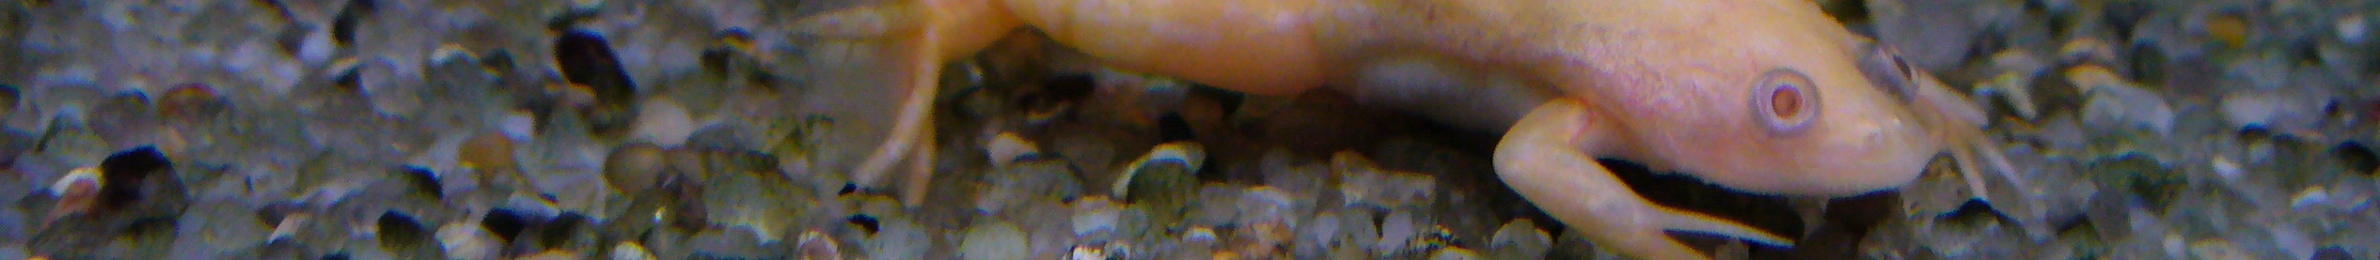
Study on alien pathogens and wildlife in Europe
Riccardo Scalera
Programme officer, IUCN/SSC Invasive Species Specialist Group
42nd meeting of the Standing Committee of the
Bern Convention
Strasbourg, 28 November - 2 December 2022

Slide 2
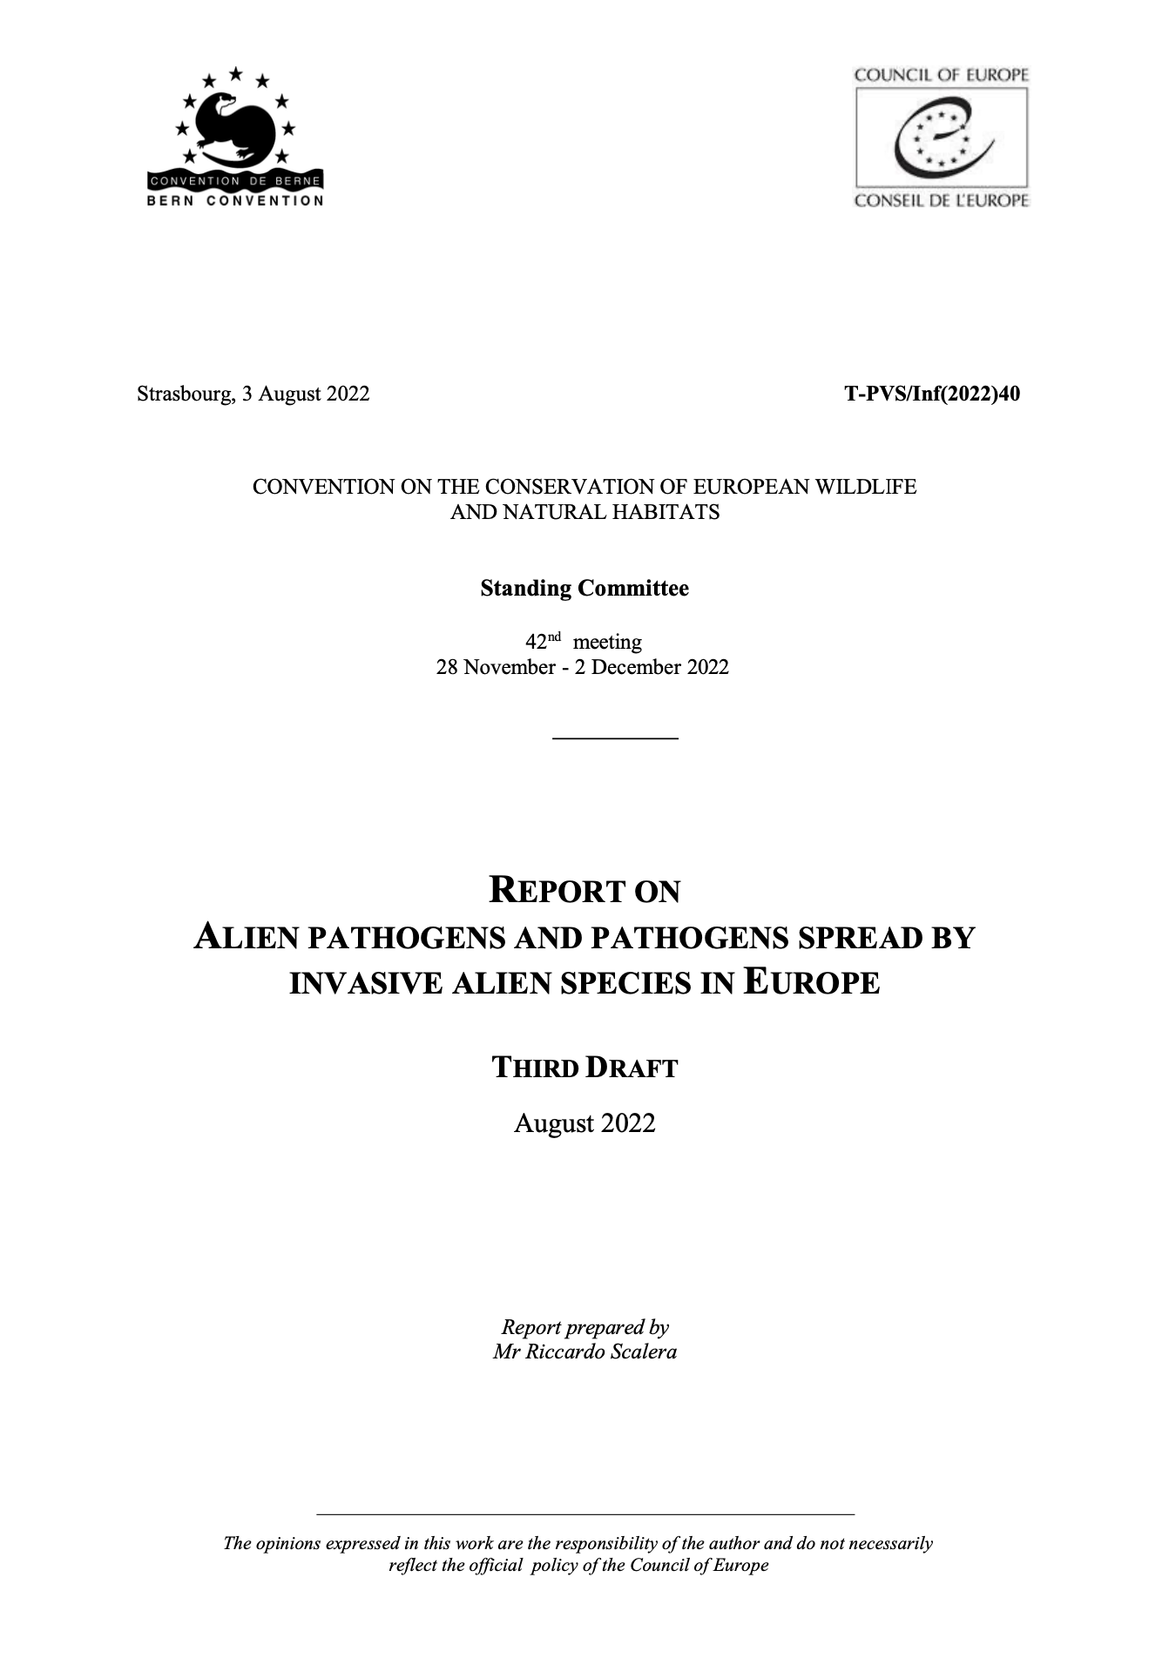
Focus of the report
Alien pathogens and
pathogens spread by invasive alien species
with a specific focus on those having an impact on wildlife

Slide 3
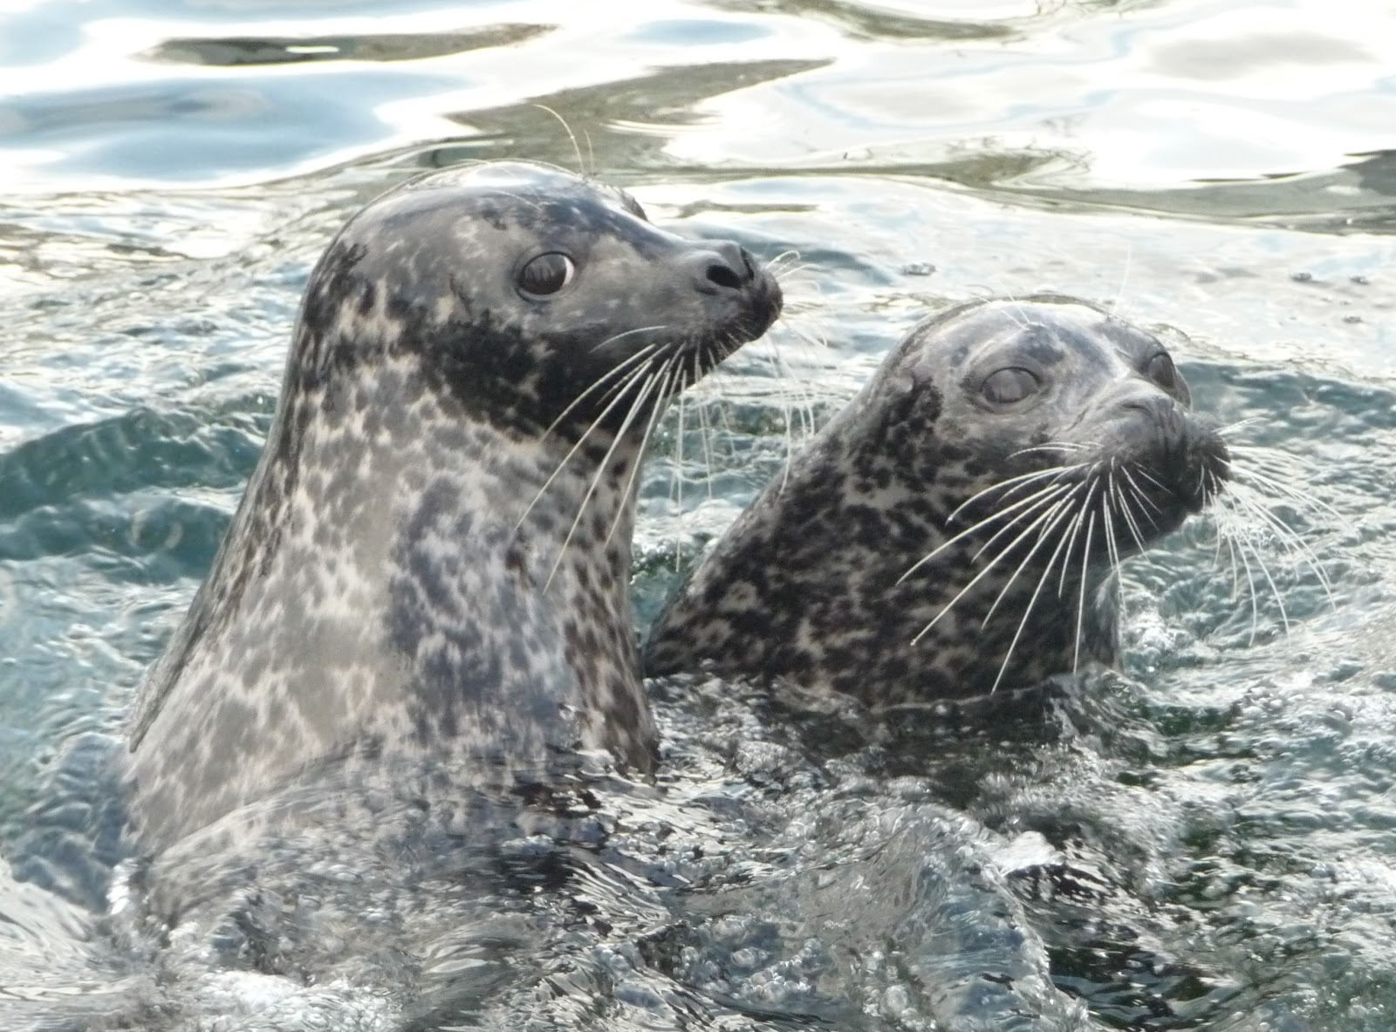
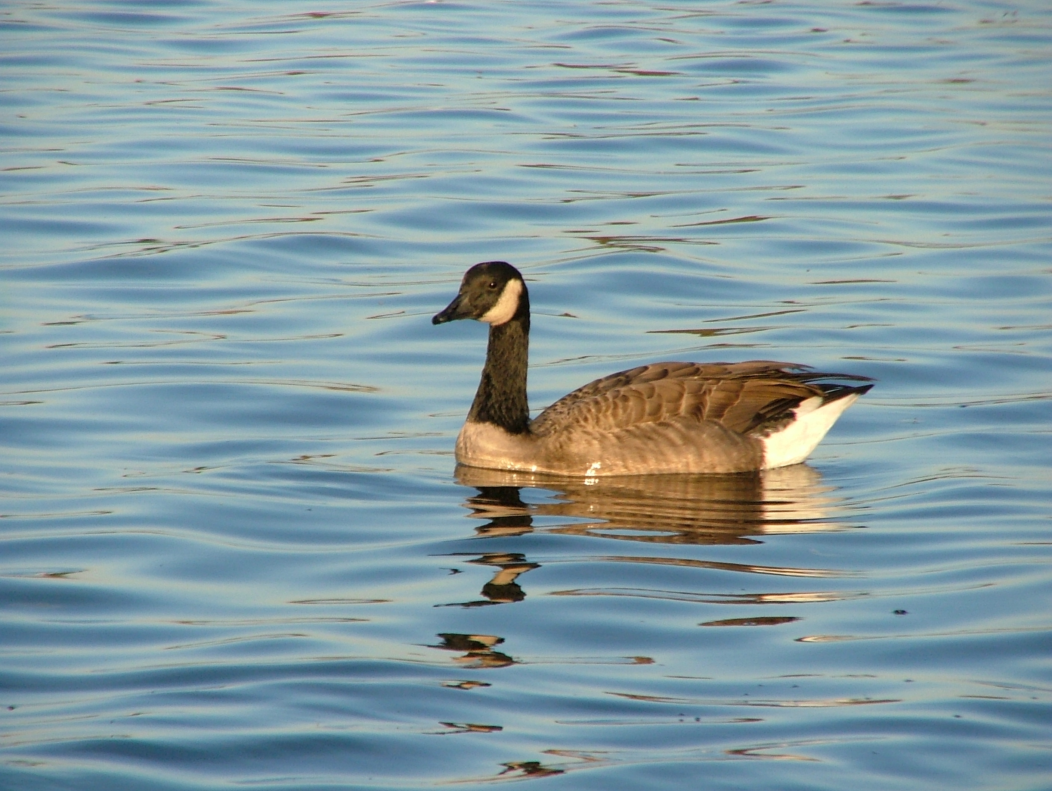
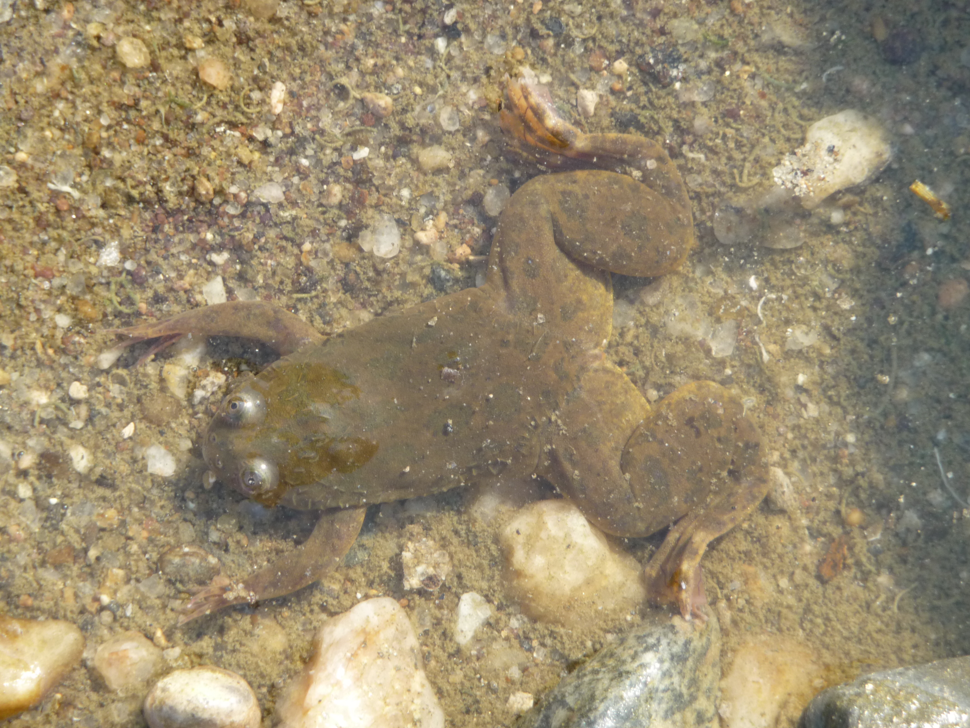
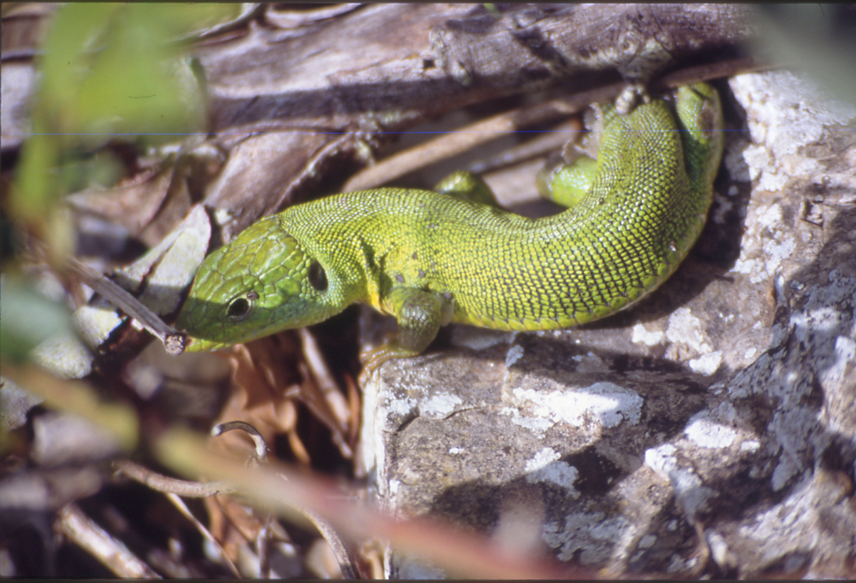
Focus of the study
Invasive
alien
species
(IAS)
Emerging infectious diseases
(EIDs)

Slide 4
Objectives
The aim is to provide Member States of the Council of Europe with an overview of the issues at stake in relation to alien pathogens and pathogens spread by IAS.
The main gaps in knowledge, science, policy and legislation (including at the EU level) which may have an impact on the conservation objectives set by the Bern Convention are highlighted.
This overview should set the basis for a larger discussion in the relevant scientific bodies of the Bern Convention, on the conservation actions (including research priorities) and possible policy and legislative recommendations that could be promoted by the Bern Convention on the issue.

Slide 5
Revisions made
Second revision cycle
A number of general revision comments aimed at improving the overall quality of the text (including minor edits and remarks suggested by the reviewers across the full document) were taken into account in the final draft of the document .

Slide 6
Revisions made
Disclaimer on information that may appear outdated
Some information present in the document may appear currently outdated, particularly in relation to relevant legislation e.g. in the EU animal and plant health legislation (not to consider any points in the literature).
Due to the very dynamic nature of the issue, and the time/resources needed to revise/update a document, it was decided to keep the document as it is, coherently with the draft date of 2019. A disclaimer was added to clarify the drafting date and acknowledging the time gap.
The rationale and the scope of the document are not affected, and all recommendations remain still valid.

Slide 7
Revisions made
Clarifications on terminology and definitions
A glossary with definitions for key terms and concepts was added.
The definitions are based on those already adopted within the main treaties and legislation. Alternatively, a basic explanation was added to show the meaning as intended in the document.
It is stressed that, as acknowledged in chapter 3 of the study, further investigations going beyond the scope of the present study are required, including on definitions.

Slide 8
Revisions made
Reference the link between wildlife, pathogens and zoonosis, but remark that the focus in on wildlife pathogens only
Zoonosis fall beyond the scope of the document, nevertheless the relevant risks for human health (which is indeed inherent to the spread of invasive alien species) will be mentioned, to acknowledge the link between wildlife, pathogens and zoonosis.

Slide 9
Revisions made
Clear reference to original sources for definitions
Official definitions and citations excerpted from the websites of treaties and organisations introduced in the document were highlighted in Italic to clarify the different usage of terminology.

Slide 10
Recommendations
Creation of a dedicated network
Organisation of one or more dedicated workshops
Identification of key actors
Circulation of questionnaires
Clear formulation of research topics
Analysis of the current policy and legislation
Development of an action plan for wildlife pathogens
Identification of key management tool
Increase awareness on the impact of wildlife pathogens

Slide 11
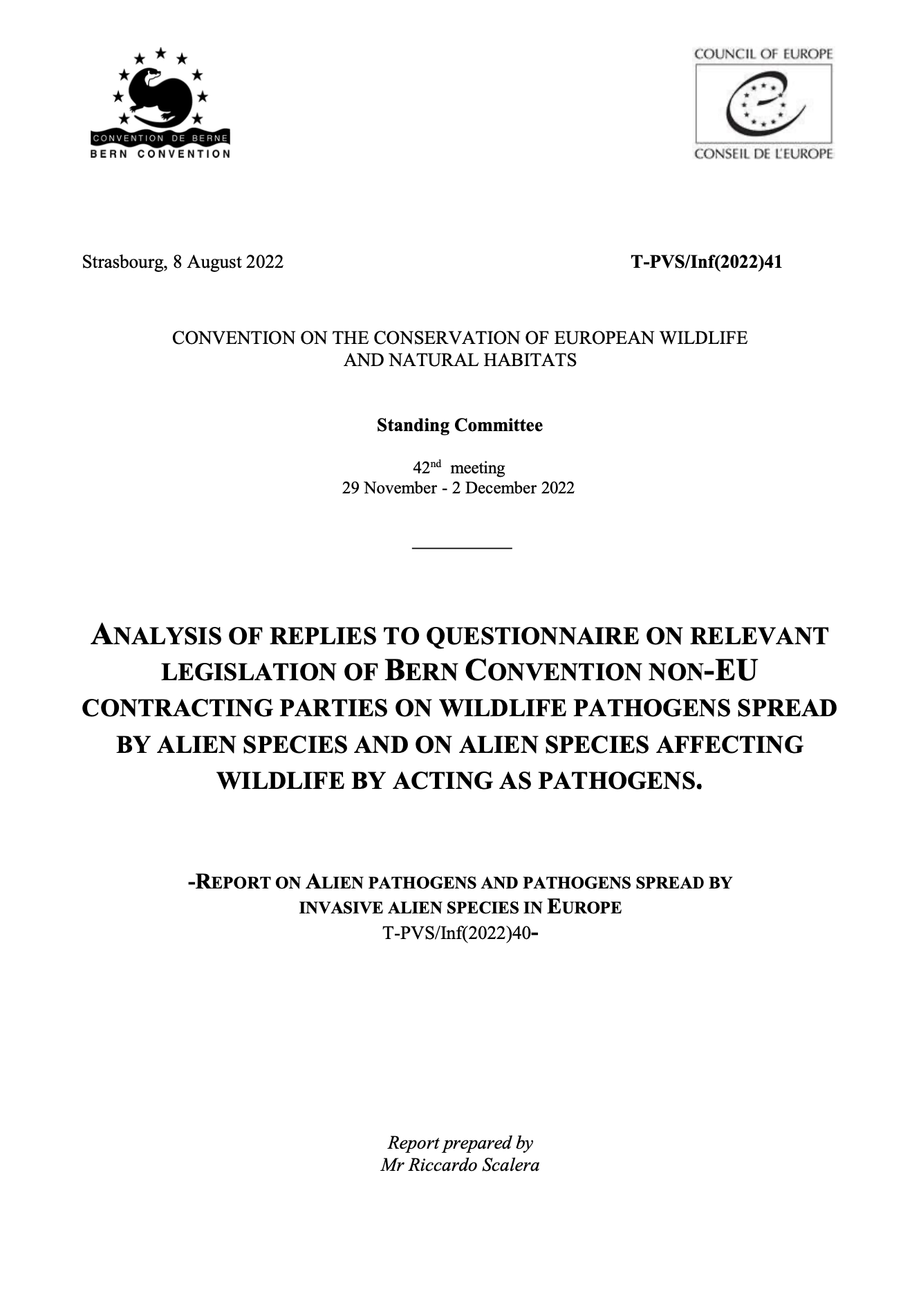
Additional information
Questionnaire on relevant legislation/policy to Bern Convention Parties which are not members of the EU
While a comprehensive legislation assessment would be beyond the initial scope of the document, it was decided to circulate a questionnaire to widen the policy and legislation analysis.

Slide 12
Additional information
Questionnaire on relevant legislation/policy to Bern Convention Parties which are not members of the EU
Eight Contracting Parties sent their replies to the questionnaire:
Armenia
Georgia
Lichtenstein
Moldova
Norway
Serbia
Switzerland
8 United Kingdom

Slide 13
Thank you for your attention!
Your comment and suggestions are welcome
scalera.riccardo@gmail.com

