Slide 1
Revision of the 1st draft made by Camilla Orlandi prof. Thomas Abeli Roma Tre University M. Carboni, M. Carosi, S Ceschin, A. Di Giulio, M. Scalici, L. Vignoli
CONVENTION ON THE CONSERVATION OF EUROPEAN WILDLIFE
AND NATURAL HABITATS
Standing Committee
42nd meeting
29 November - 2 December 2022
Guidance on communication on IAS
-second draft-

Slide 2
Aims of the document: 1) provide a guidance for communicating on IAS 2) provide basic concepts of communication 3) provide practical advises for communicating on IAS 4) provide examples of good communication strategies
Guidance on communication on IAS
-second draft-

Slide 3
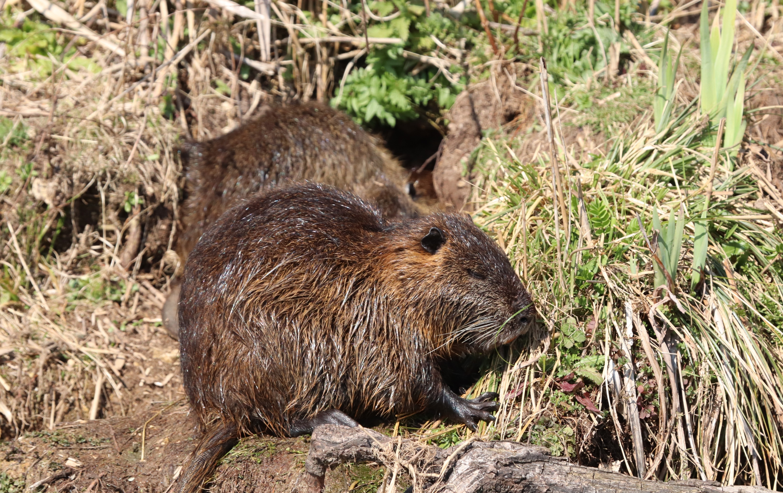
COMMUNICATION PLAN Communication on IAS requires a communication expert.

Slide 4
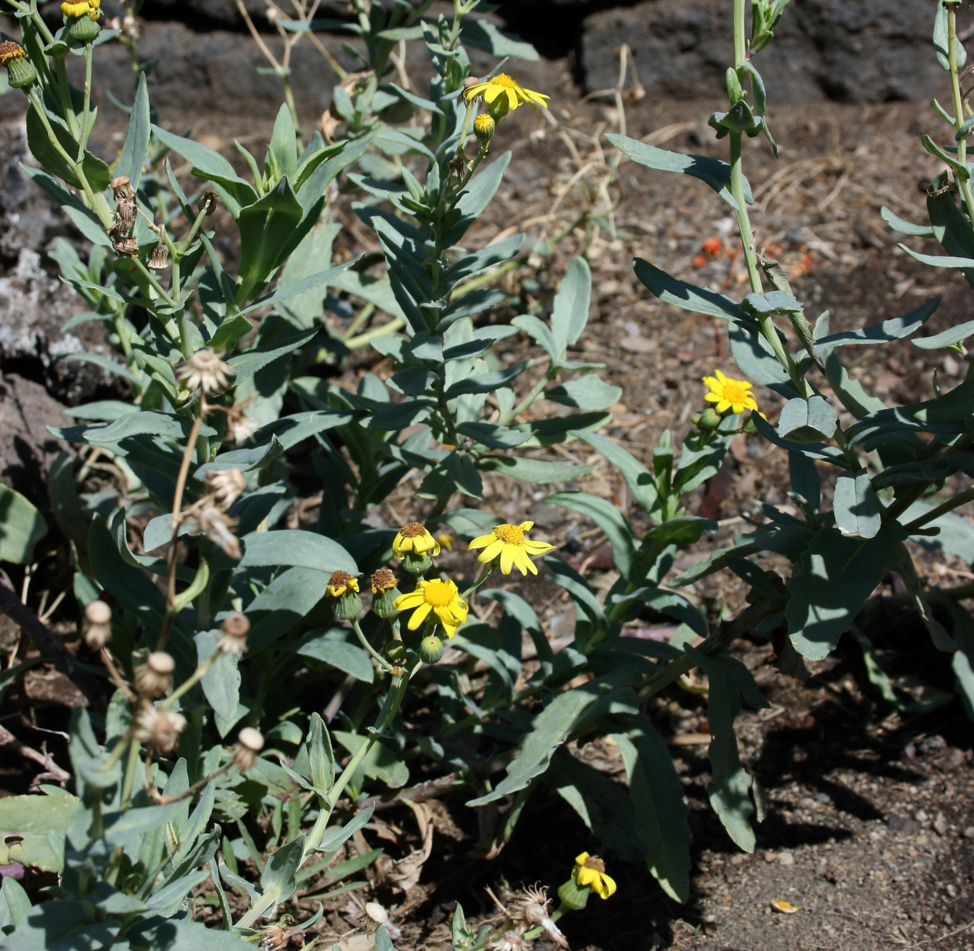
TARGET AUDIENCE The general public doesn’t exist. The general public is composed of segments, each target of a specific communication strategy.

Slide 5
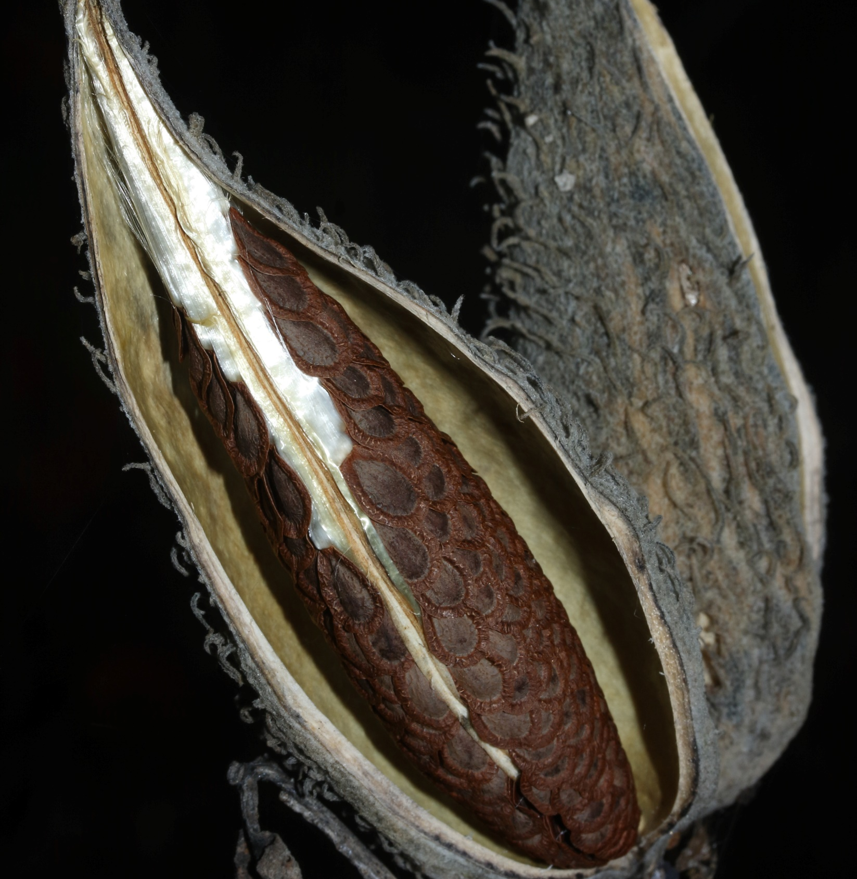
COMMUNICATION TOOLBOX Examples of messages that catch the attention of the public. Focus on key-messages with keywords (keywords detailed). A new paragraph on social media.

Slide 6
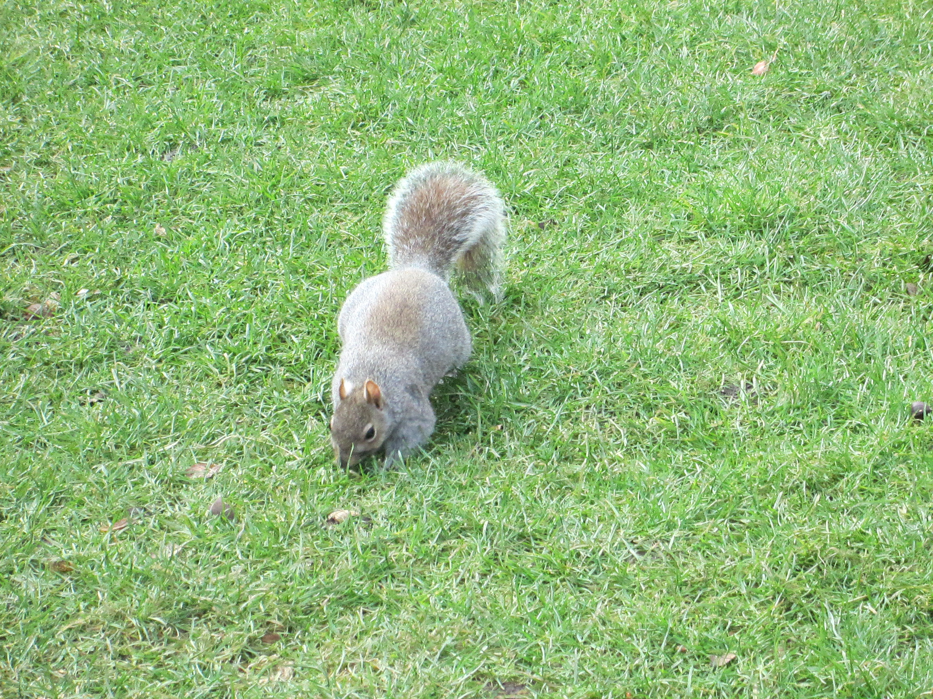
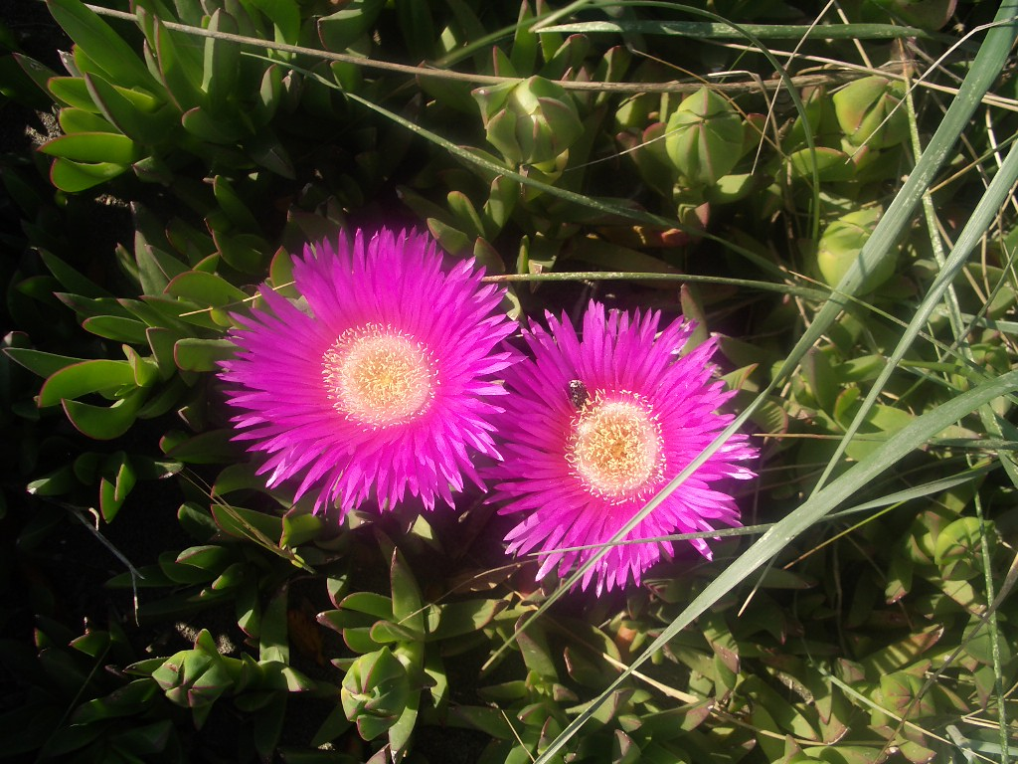
ISSUES
Why do we fight so nice creatures?
Use a positive attitude.

Slide 7
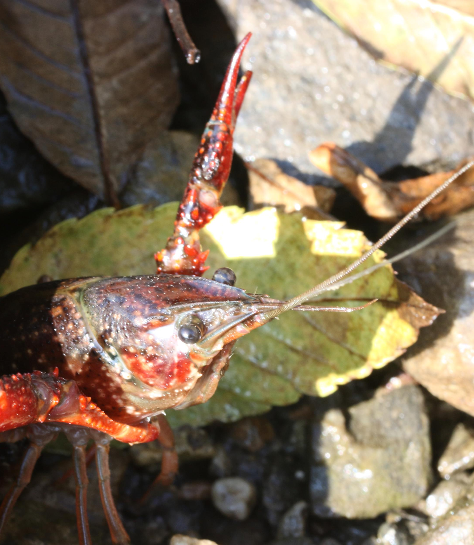
GUIDANCE PRINCIPLES Bullet points available at the end of the document.

Slide 8
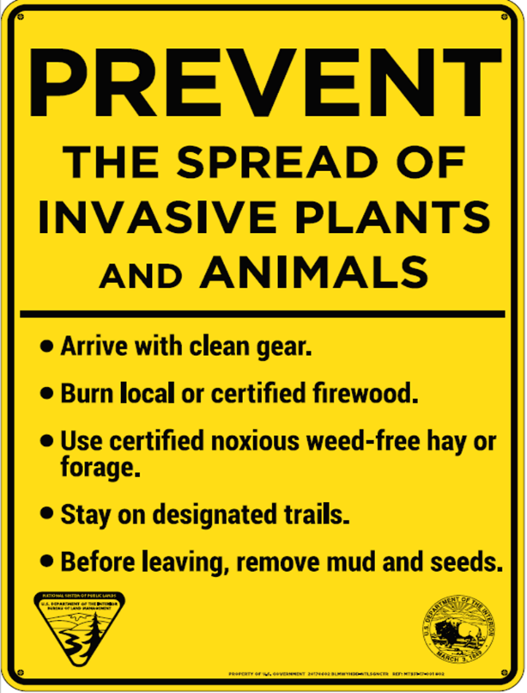
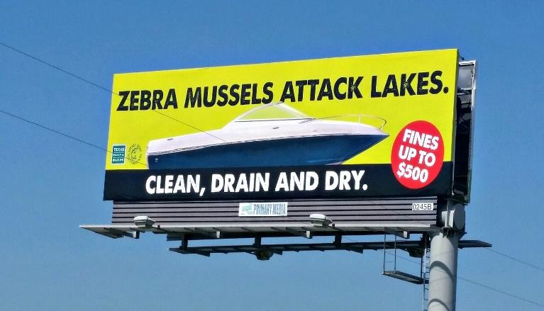
APPENDIX Examples of good communication strategies and of communication generating issues.

Slide 9
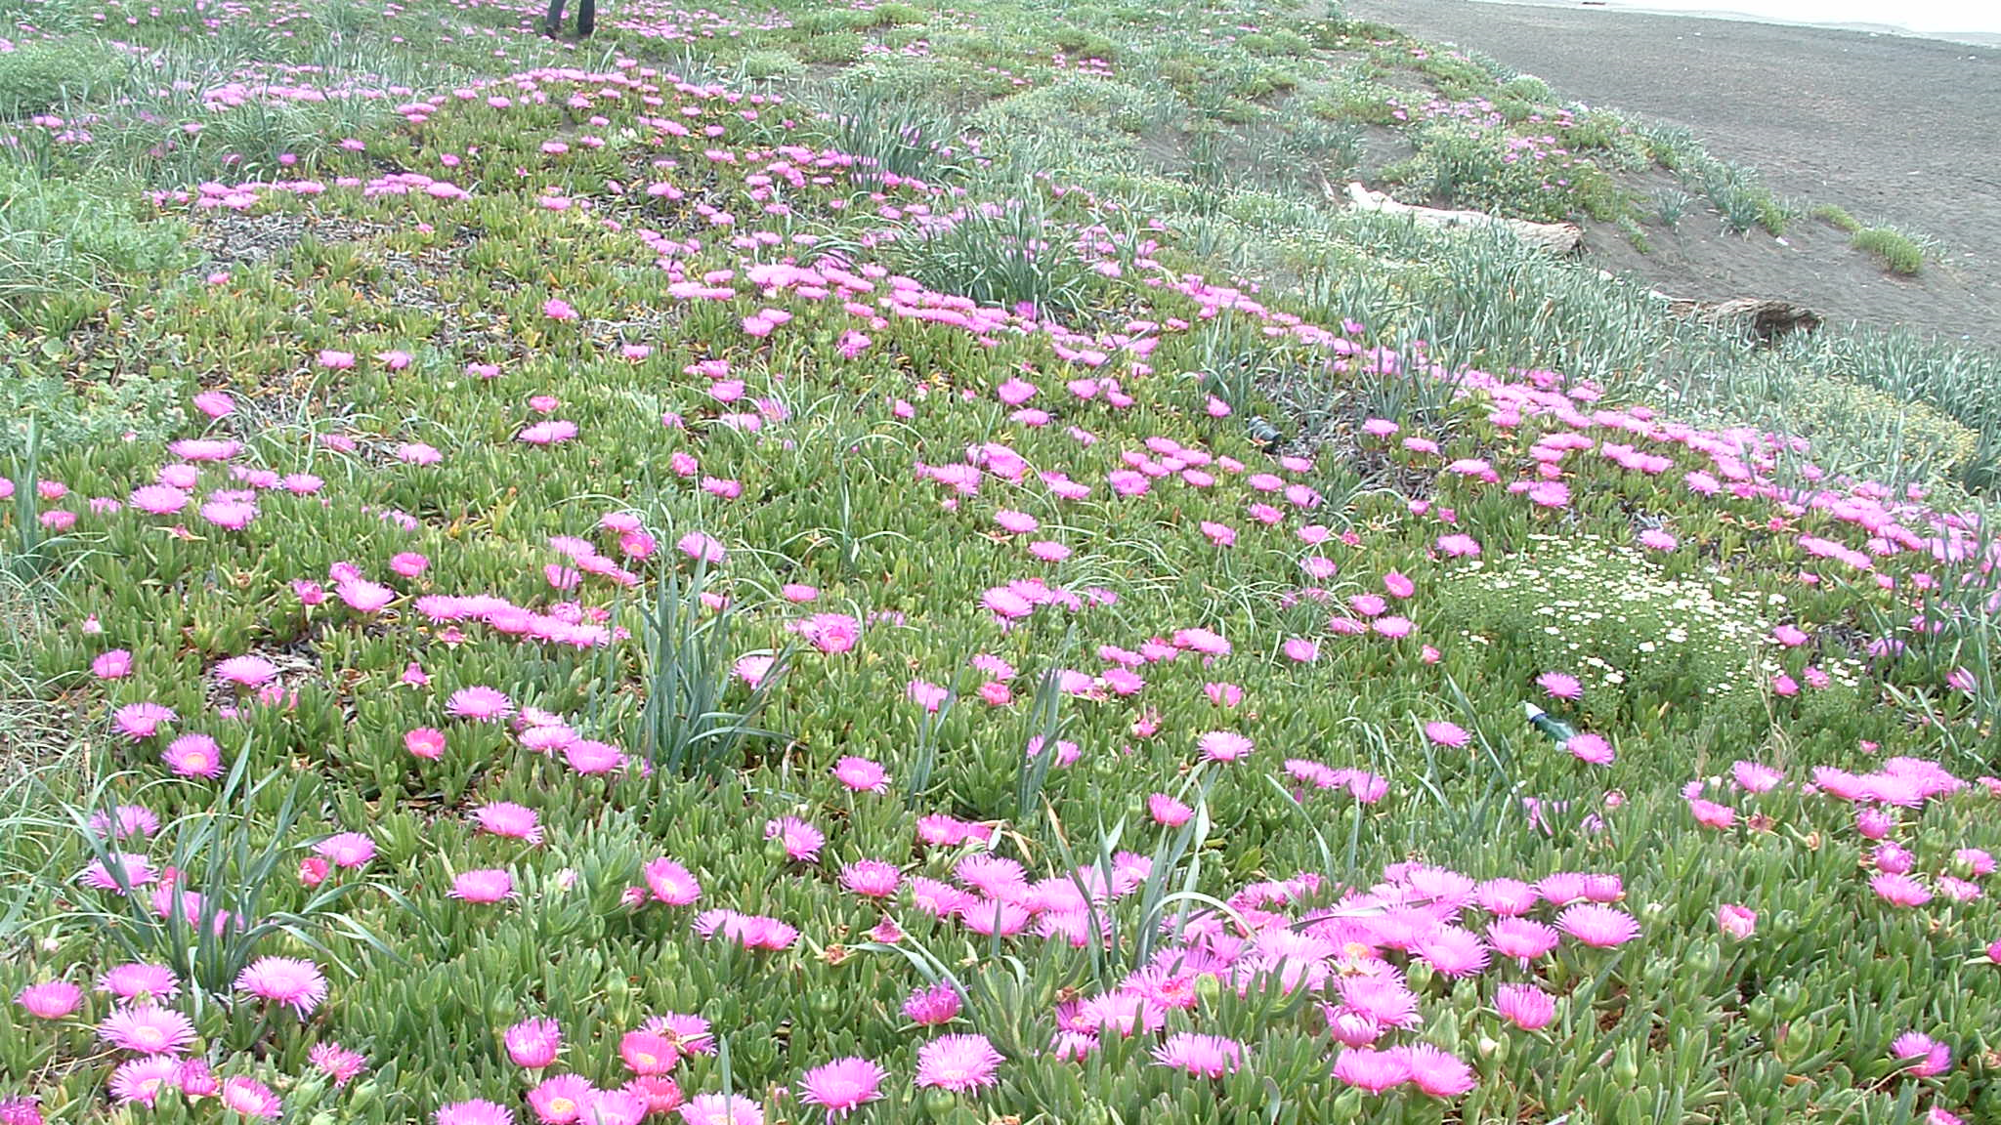
THANK YOU FOR YOUR ATTENTION
Guidance on communication on IAS
-second draft-

