Slide 1
Agenda Item 6.2: Files opened Greece: Threats to Marine Turtles in Thines Kiparissias
41th Meeting of the Standing Committee
Bern Convention
29 November – 3 December 2021

Slide 2
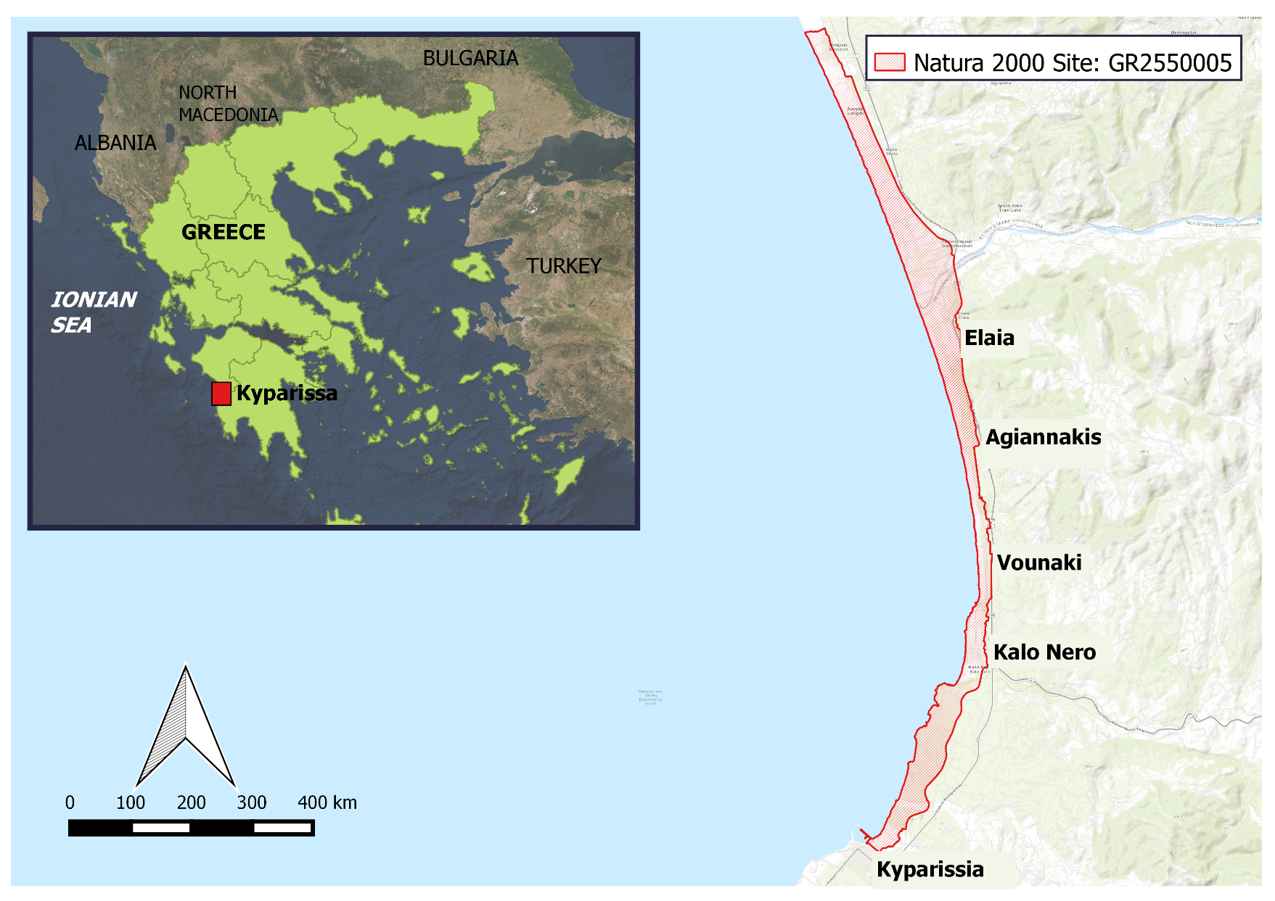
Habitat Degradation due to Uncontrolled Development in a Protected Sea Turtle Nesting Area
A NATURA 2000 site: GR2550005 “Thines Kyparissias: Neochori – Kyparissia”
Extensive sand dunes system with Juniperus spp.
The largest reproductive population across the Mediterranean for the protected loggerhead sea turtle (Caretta caretta). During 2021 nesting season over 3,200* nests were recorded in the core area (from Neda to Arkadikos River 9,5 km)

Slide 3
The issuance of the Presidential Decree
Overview
Oct 2012
EC Reasoned Opinion to Greece
Nov 2012
Greece commits to taking measures
Summer 2013
Degradation continues: protective legislation delayed
Dec 2013
Case File opened at Standing Committee Meeting
Mar 2014
EC takes Greece to European Court of Justice
Aug 2010
MEDASSET Complaint to the Bern Convention
Jul 2014
On-the-spot appraisal by Bern Convention experts
Dec 2014
CoE
Appraisal Unanimously adopted
Rec. No 174
Nov 2016
Judgment of CJEU [C-504/14]: Greece failed to fulfil obligations under Directive 92/43/EC
June 2018 Approval of the draft Presidential Decree by the Council of State
October 2018
Issuance of Presidential Decree for southern Kyparissia Bay (Government Gazette D 391/03-10-2018)
7 motions for annulment requesting the repeal of the Presidential Decree led to a Court trial at national level on the 3rd of June 2020
The Council of State (Supreme Administrative Court of Greece) decided that the Presidential Decree for the Protection of Kyparissia Bay (issued in October 2019) is in line with the Constitution and National legislation and rejected the seven motions for annulment on February 3rd 2021

Slide 4
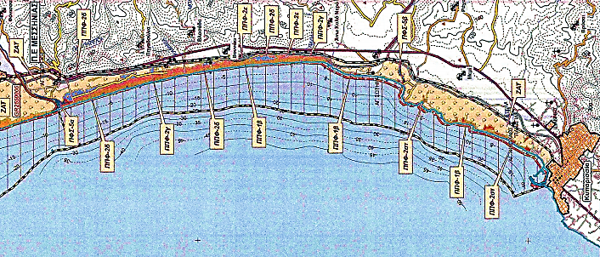
Rec. No 174. Measure No 1:
Appropriate Protection status
Presidential Decree (PD) a positive step but not ensuring adequate protection
No buffer zone between Nature Protection Area & Agricultural Landscape Zone
Presidential Decree designates Kyparissia Bay as a Nature Protected Area NOT as a National Park
Adjacent areas to the Nature Protection Areas, are designated as Agricultural Landscape Zones where construction is permitted
Part of the coastal area behind the core nesting beaches (red rectangles) is designated as Agricultural Landscape Zones, putting in extreme danger the reproduction of sea turtles and the adequate protection of the habitat

Slide 5
Rec. No 174. Measure No 2: Permanent Prohibition of Construction (buildings, roads, etc.)
Presidential Decree fails to adequately protect Kyparissia Bay from constructions
Core nesting area, Agiannakis to Elaia, July 2021. The five illegal roads are not restored yet in violation of the PD. Blockades placed by the Ministry of Environment and Energy fail to prevent vehicles accessing the beach

Slide 6
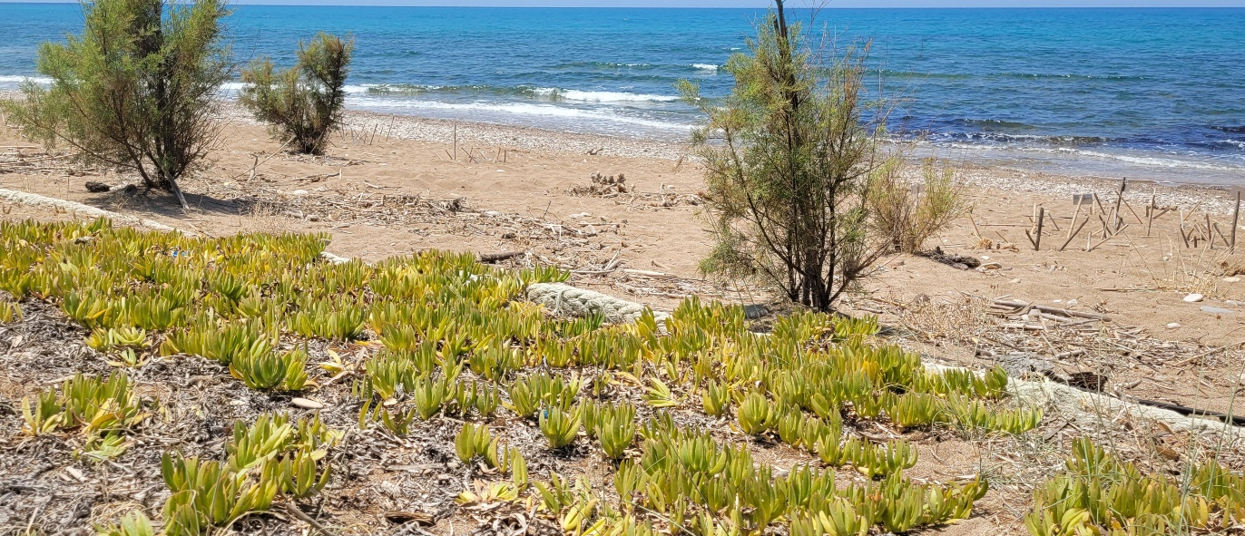
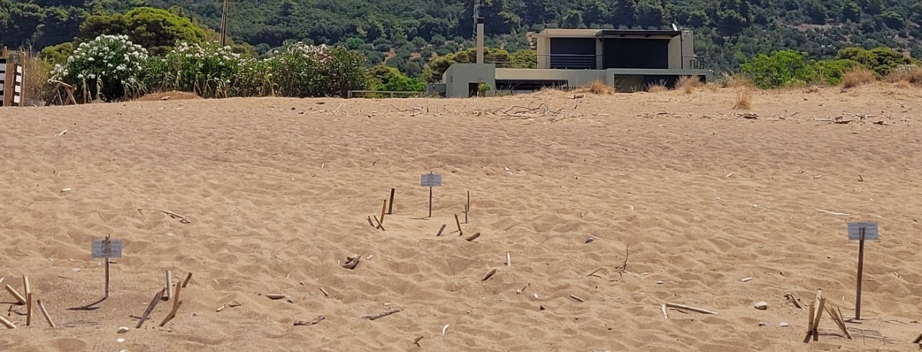
Rec. No 174. Measure No 3: Restoration of Original Dune and Forest Habitat
ARCHELON
ARCHELON
Kalo Nero, 14th July 2021. Planted young trees and cultivation of invasive species. Carpobrotus spreading behind a high density nesting area (red circles for the nests and the arrow showing the encroachment of the roots on to the nesting beach)
ARCHELON
Agiannakis core nesting area, 14th July 2021. No steps have been taken to remove the introduced alien species and to reinstate the natural dune system. Nests in front of the newly constructed house (red circles)

Slide 7
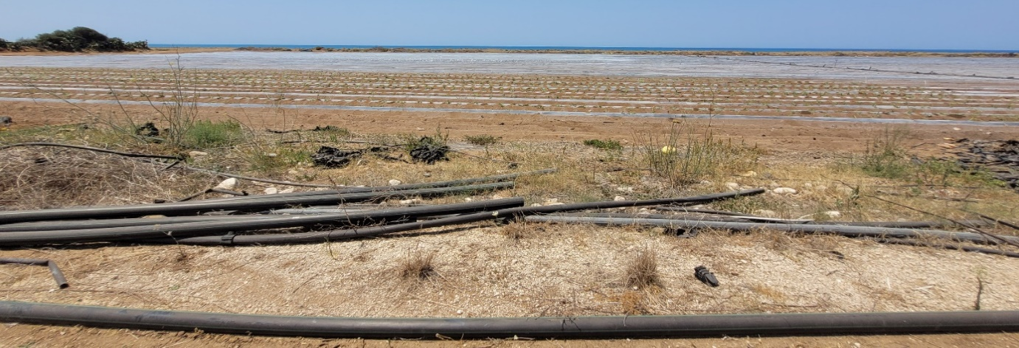
Rec. No 174. Measure No 5: No agriculture on public land & the dune area
ARCHELON
Behind the core nesting areas of Vounaki and Agiannaki, 14th July 2021. Sand dune destruction due to agricultural use; ongoing watermelon cultivation

Slide 8
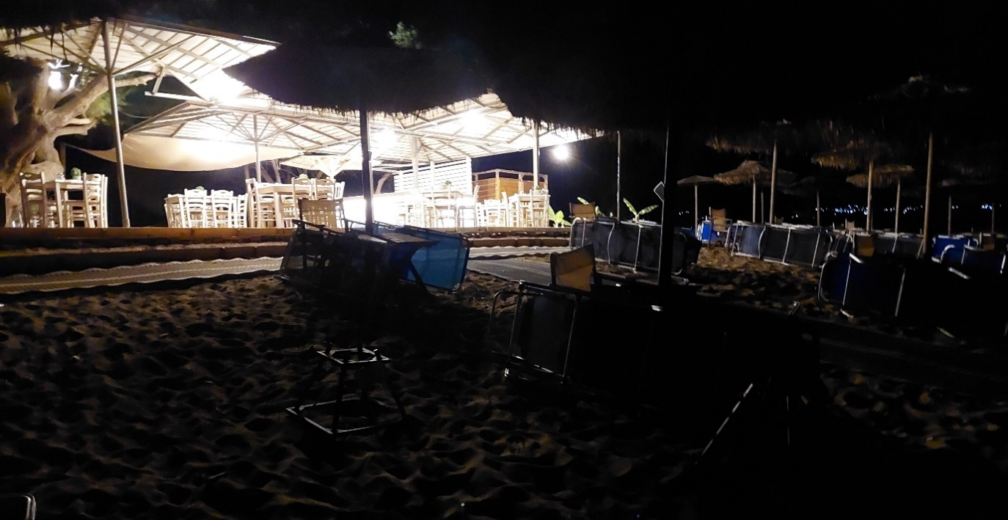
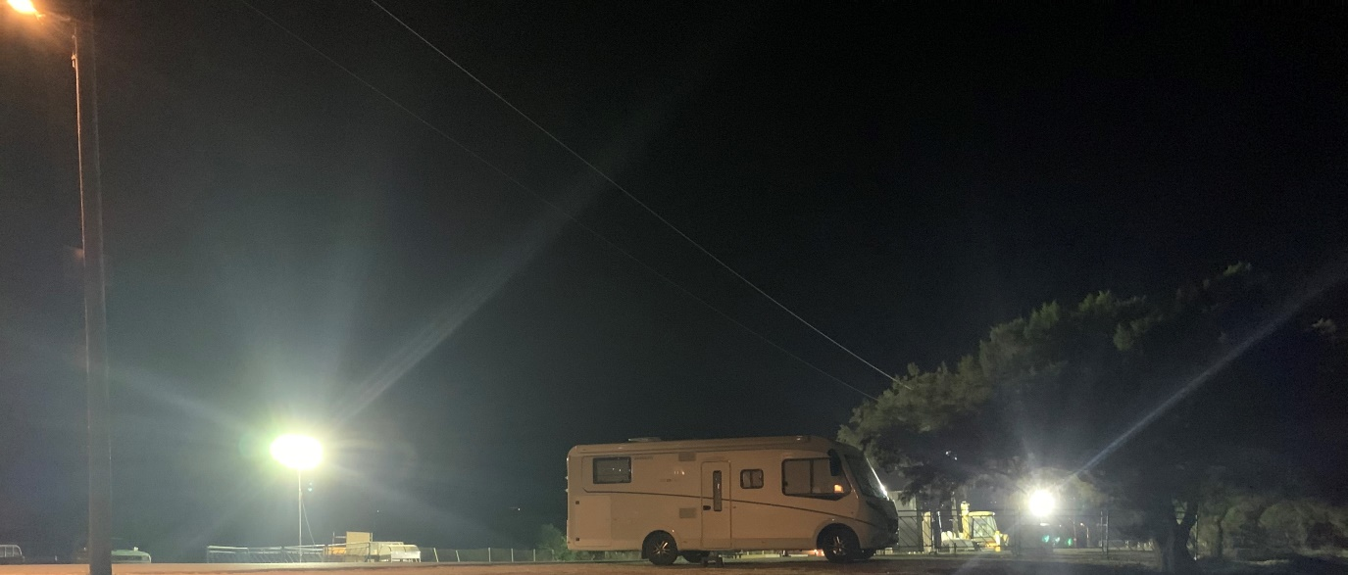
Rec. No 174. Measure No 6:
Light Pollution reduction
(a)
Caged nests
(b)
(c)
Kalo Nero, 13th & 14th July 2021. Caravans (top) and overnight camping (bottom) directly behind the core nesting area
(a)
(c)
(c)
Agiannakis, 13th July 2021. Light pollution from the beach bar on the core nesting area
@ARCHELON
Kalo Nero, 13th July 2021. Light pollution from the beach bar/ restaurant on the core nesting area and beach furniture not removed during the night

Slide 9
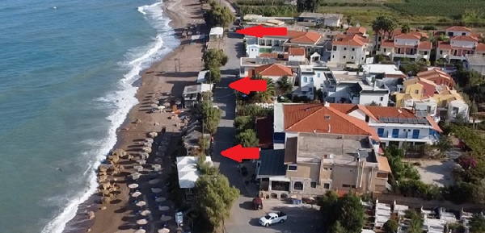
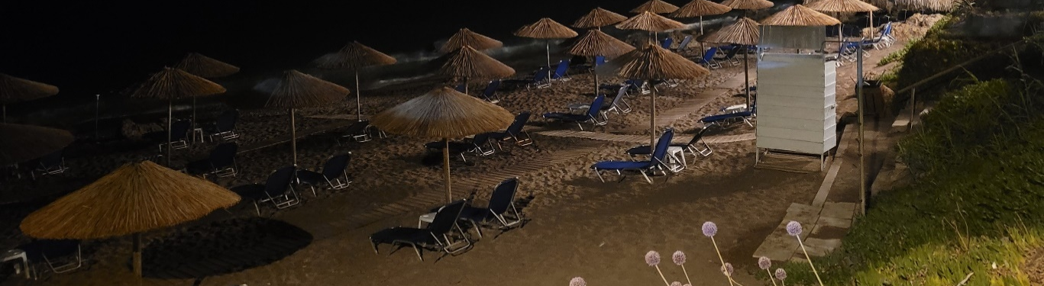
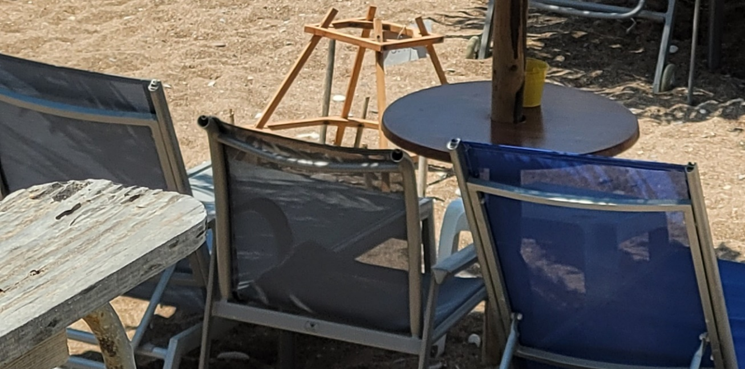
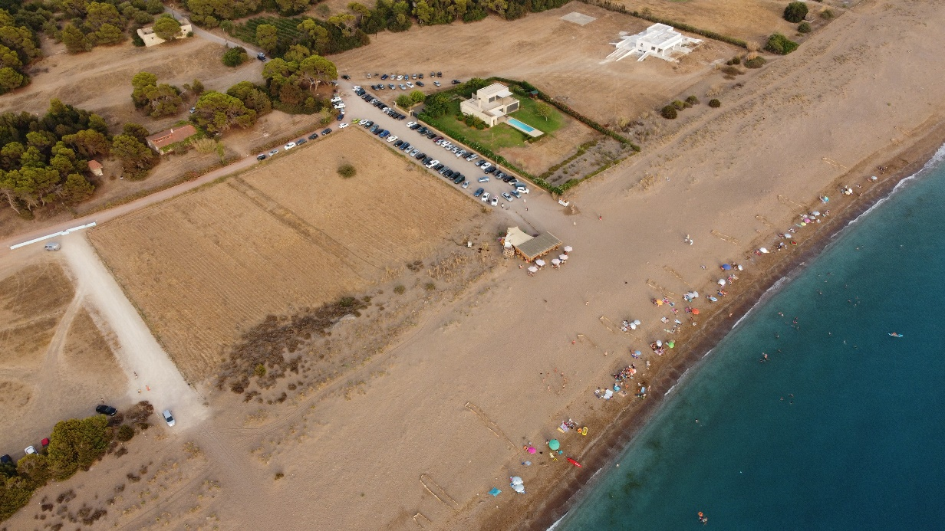
Rec. No 174. Measure No 7:
Beach Equipment management
Kalo Nero core nesting area, 13th July 2021. Lack of beach furniture management during the night, light pollution emitted from all the beach bars/restaurants directly behind the nesting area and human alteration of the nesting beach (raking to flatten the sand)
ARCHELON
Kalo Nero core nesting area, 14th July 2021. Lack of beach zonation management for tourism. Note nest in red circle
Beach bars at Elea and Agiannakis, kept operating on the sand dune zone

Slide 10
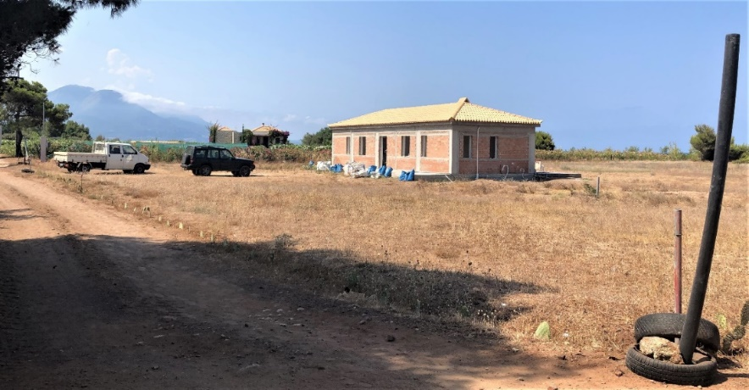
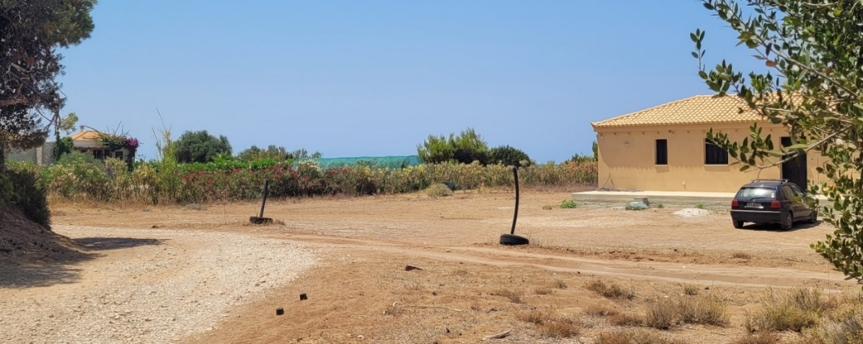
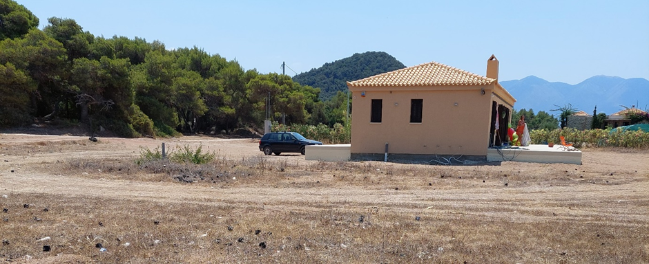
Rec. No 174. Measure No 9: Further construction outside the urban-planning areas
2021 – Construction completed
2020 – Under construction
In violation of the Presidential Decree which prohibits the expansion of settlements and buildings in the Nature Protection Areas, newly constructed house as recorded during 2021 survey
Vounaki core nesting area, 14th July 2021. Newly constructed house completed in 2021. Arrows indicate the house and its proximity to the core nesting beach, with turtle nests and shelter circled on the nesting beach

Slide 11
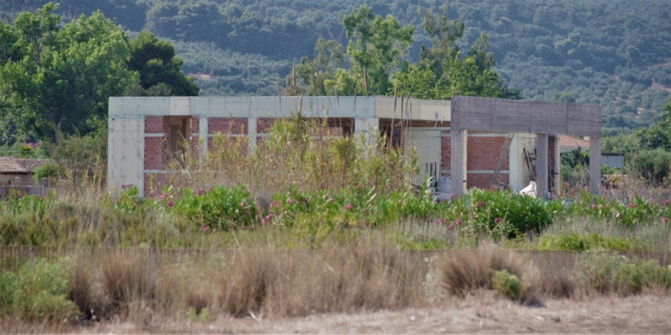
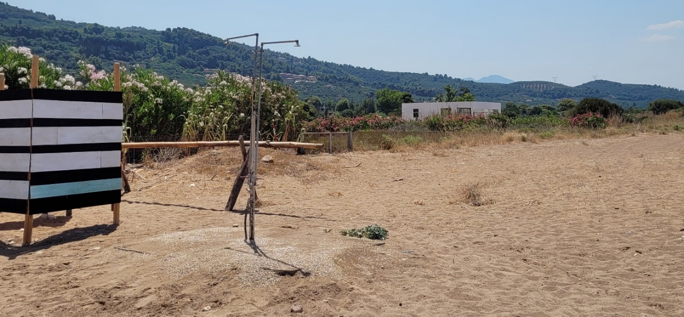
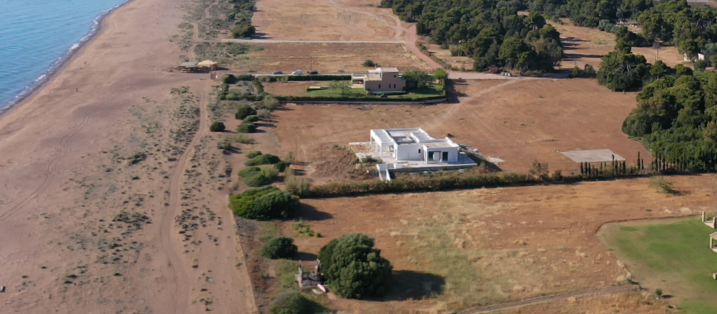
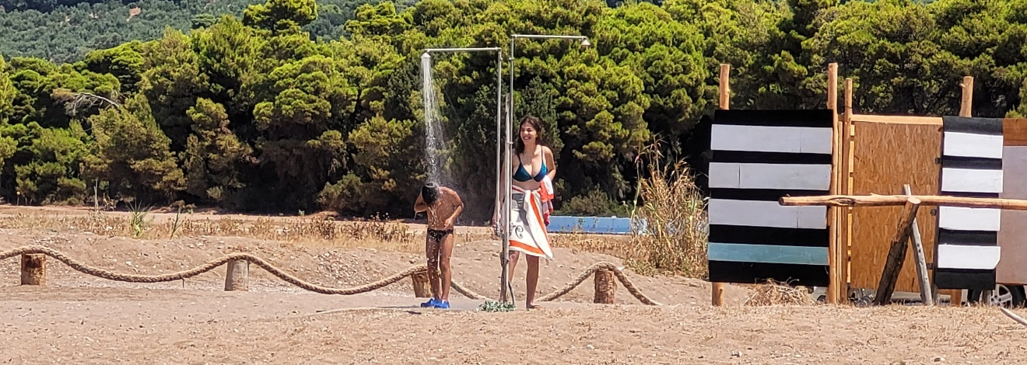
Rec. No 174. Measure No 9: Further construction outside the urban-planning areas
Disregard to the Presidential Decree's prohibition of the expansion of settlements and buildings in the Nature Protections Areas, newly constructed house as recorded during 2021 survey
2020 – Under construction
@ARCHELON
Agiannakis core nesting area, 14th July 2021. Newly constructed house complete in 2021 (red arrow). Introduced alien plant species are maintained (Red lines). No steps have been taken to remove the introduced alien species and to reinstate the natural dune system.
Shower (yellow arrow) runoff flows on the protected nesting beach right next to the beach bar

Slide 12
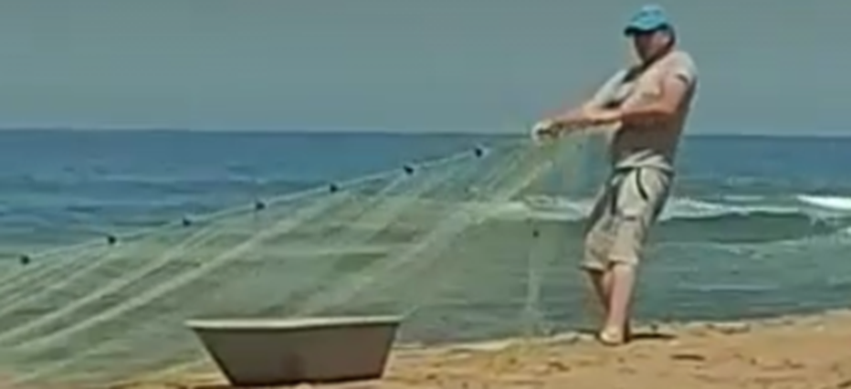
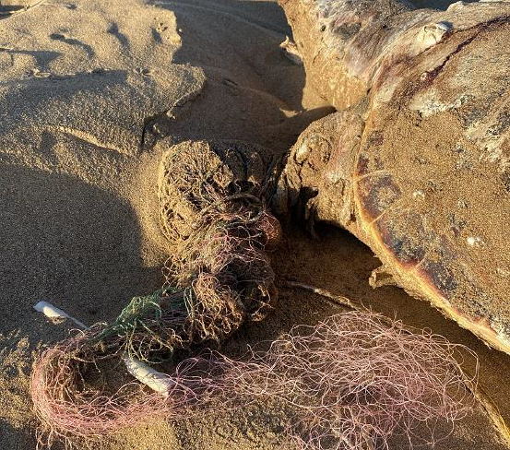
Rec. No 174. Measure No 10: Regulation of vessels navigation & fishing practices
Fisheries regulations are not addressed by the Presidential Decree – Urgent need of a Management Plan
@ARCHELON, Galini Samlidou
@ARCHELON
Neda area, July 2021. Fisher retrieving a fishing net set in the nearshore waters of the nesting beach. This presents a significant threat of entanglement to the nesting population
ARCHELON
Sea turtle stranding with evidence of entanglement in fishing gear. June 2021
The Regulation of fishing activities are not considered in the Presidential Decree- This significant threat is supposed to be addressed in the Management Plan - There is still no Management Plan in place and urgent action is needed to reduce/ eliminate this threat. In total, 36 strandings were found in Kyparissia Bay, 3 displayed injuries from interaction with fishing activities.

Slide 13
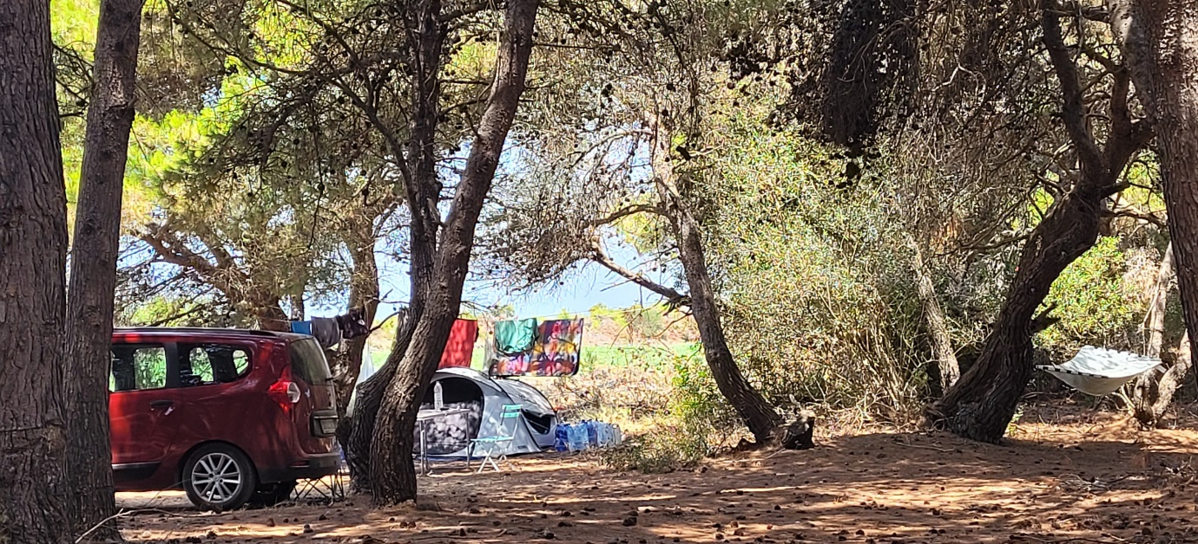
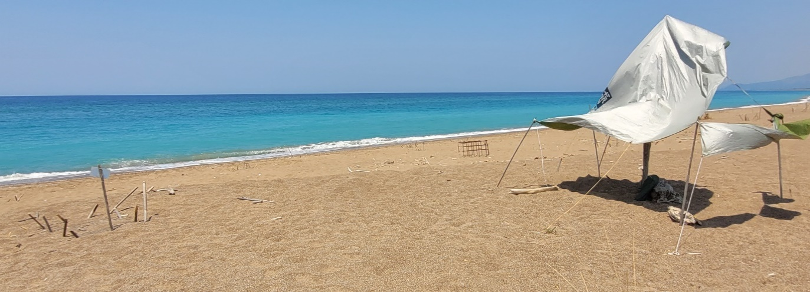
Rec. No 174. Measure No 11: Human presence on the nesting beach
Vounaki core nesting area, 14th July 2021
ARCHELON
ARCHELON
Camping directly behind the core nesting area in the protected forestry area
Vounaki core nesting area, 14th July 2021. Temporary shelters mostly used by free campers, on the nesting beach in close proximity to turtle nests. (red circles)

Slide 14
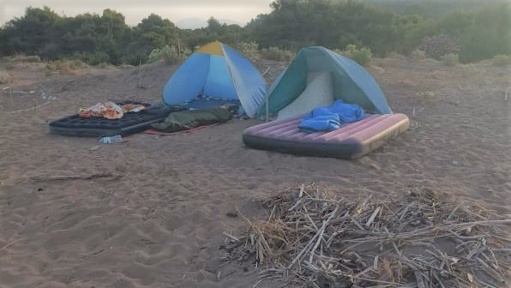
Rec. No 174. Measure No 11: Human presence on the nesting beach
ARCHELON
@ARCHELON, Galini Samlidou
@ARCHELON, Galini Samlidou
Agiannakis core nesting area, 6th August 2021. Overnight free campers on the nesting beach as observed at 7.00 am. Light pollution protection measures; nest shading placed by ARCHELON volunteers
ARCHELON
During August 2021 more than 3,000 people were camping simultaneously, while more than 805 temporary beach shelters, caravans, tents, and sleepovers on the sand dunes or on the nesting beach were recorded by ARCHELON
@ARCHELON, Galini Samlidou
Elaia nesting area, 31st July & 1st August 2021. Overnight free campers on the nesting beach as observed at 6.00 am, with collected wood to make a bonfire. Red circle shows the location of a nest next to the campers

Slide 15
Conclusions
Rec. No 174 has not been fully implemented
The issuance of the Presidential Decree for Kyparissia Bay (Government Gazette D 391/0310-2018) constitutes a positive development.
Several major conservation issues are not addressed by the Decree which can only be solved through the elaboration and adoption of a Management Plan
National governance model for the management of the protected areas has been fundamentally changed (so called OFYPEKA) with the implementation of this new model to be pending since last year. New national laws, which remove funding and responsibilities for biodiversity conservation from the newly formed OFYPEKA, are of great concern.

Slide 16
MEDASSET
Calls upon the authorities to:
Safeguard and enforce implementation of the Presidential Decree (PD) regulations
Urgently adopt and implement a Management Plan, in collaboration with all relevant stakeholders
Impose fines and penalties in order to stop illegal activities and restore the habitat
Safeguard the effective management of Kyparissia Bay, as the new Legislation poses serious threats for the adequate protection of all protected areas in Greece
Keep the Standing Committee informed about progress in the implementation of the above Recommendations
Calls upon the Bern Convention Standing Committee to:
Keep the Case file open
Urge authorities to implement Recommendation No.174 (2014)
Request from the Greek Authorities to withdraw the new law (4782/2021) as it is in direct violation of the provisions of Recommendation No. 174

