Slide 1
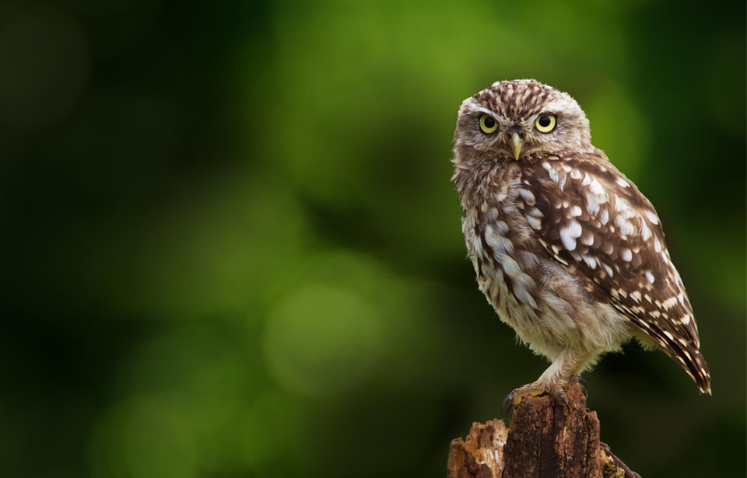
Akamas Peninsula and Chrysochous Bay in Cyprus
Threats posed to wildlife by development near or within these areas

Slide 2
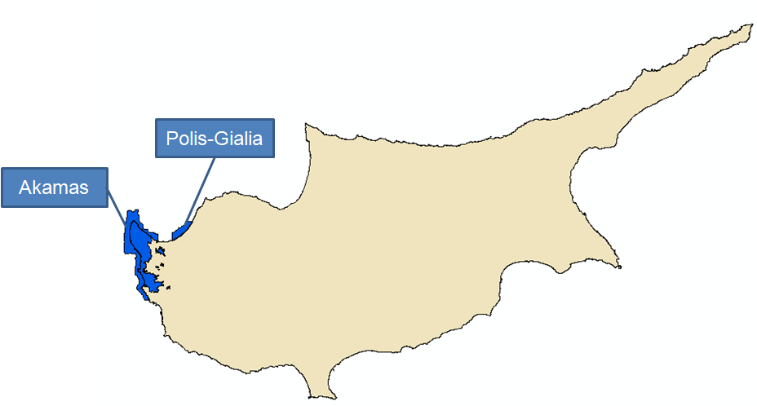
Akamas Peninsula and Polis-Gialia Natura 2000 sites

Slide 3
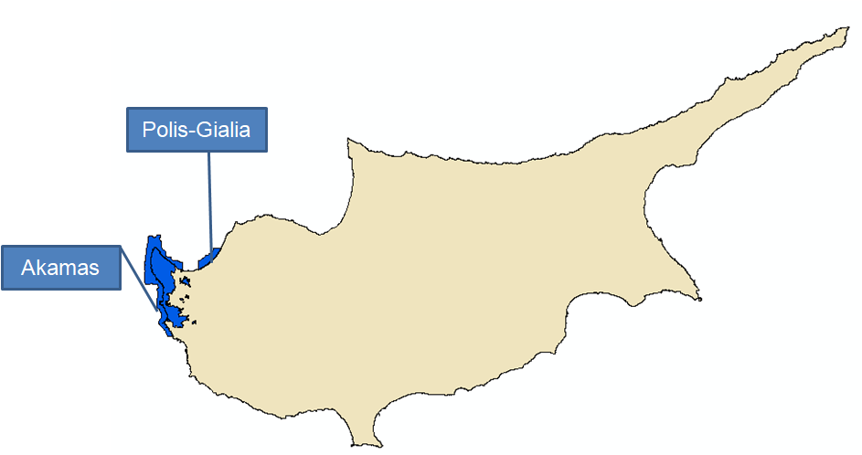
Akamas Peninsula Natura 2000 sites

Slide 4
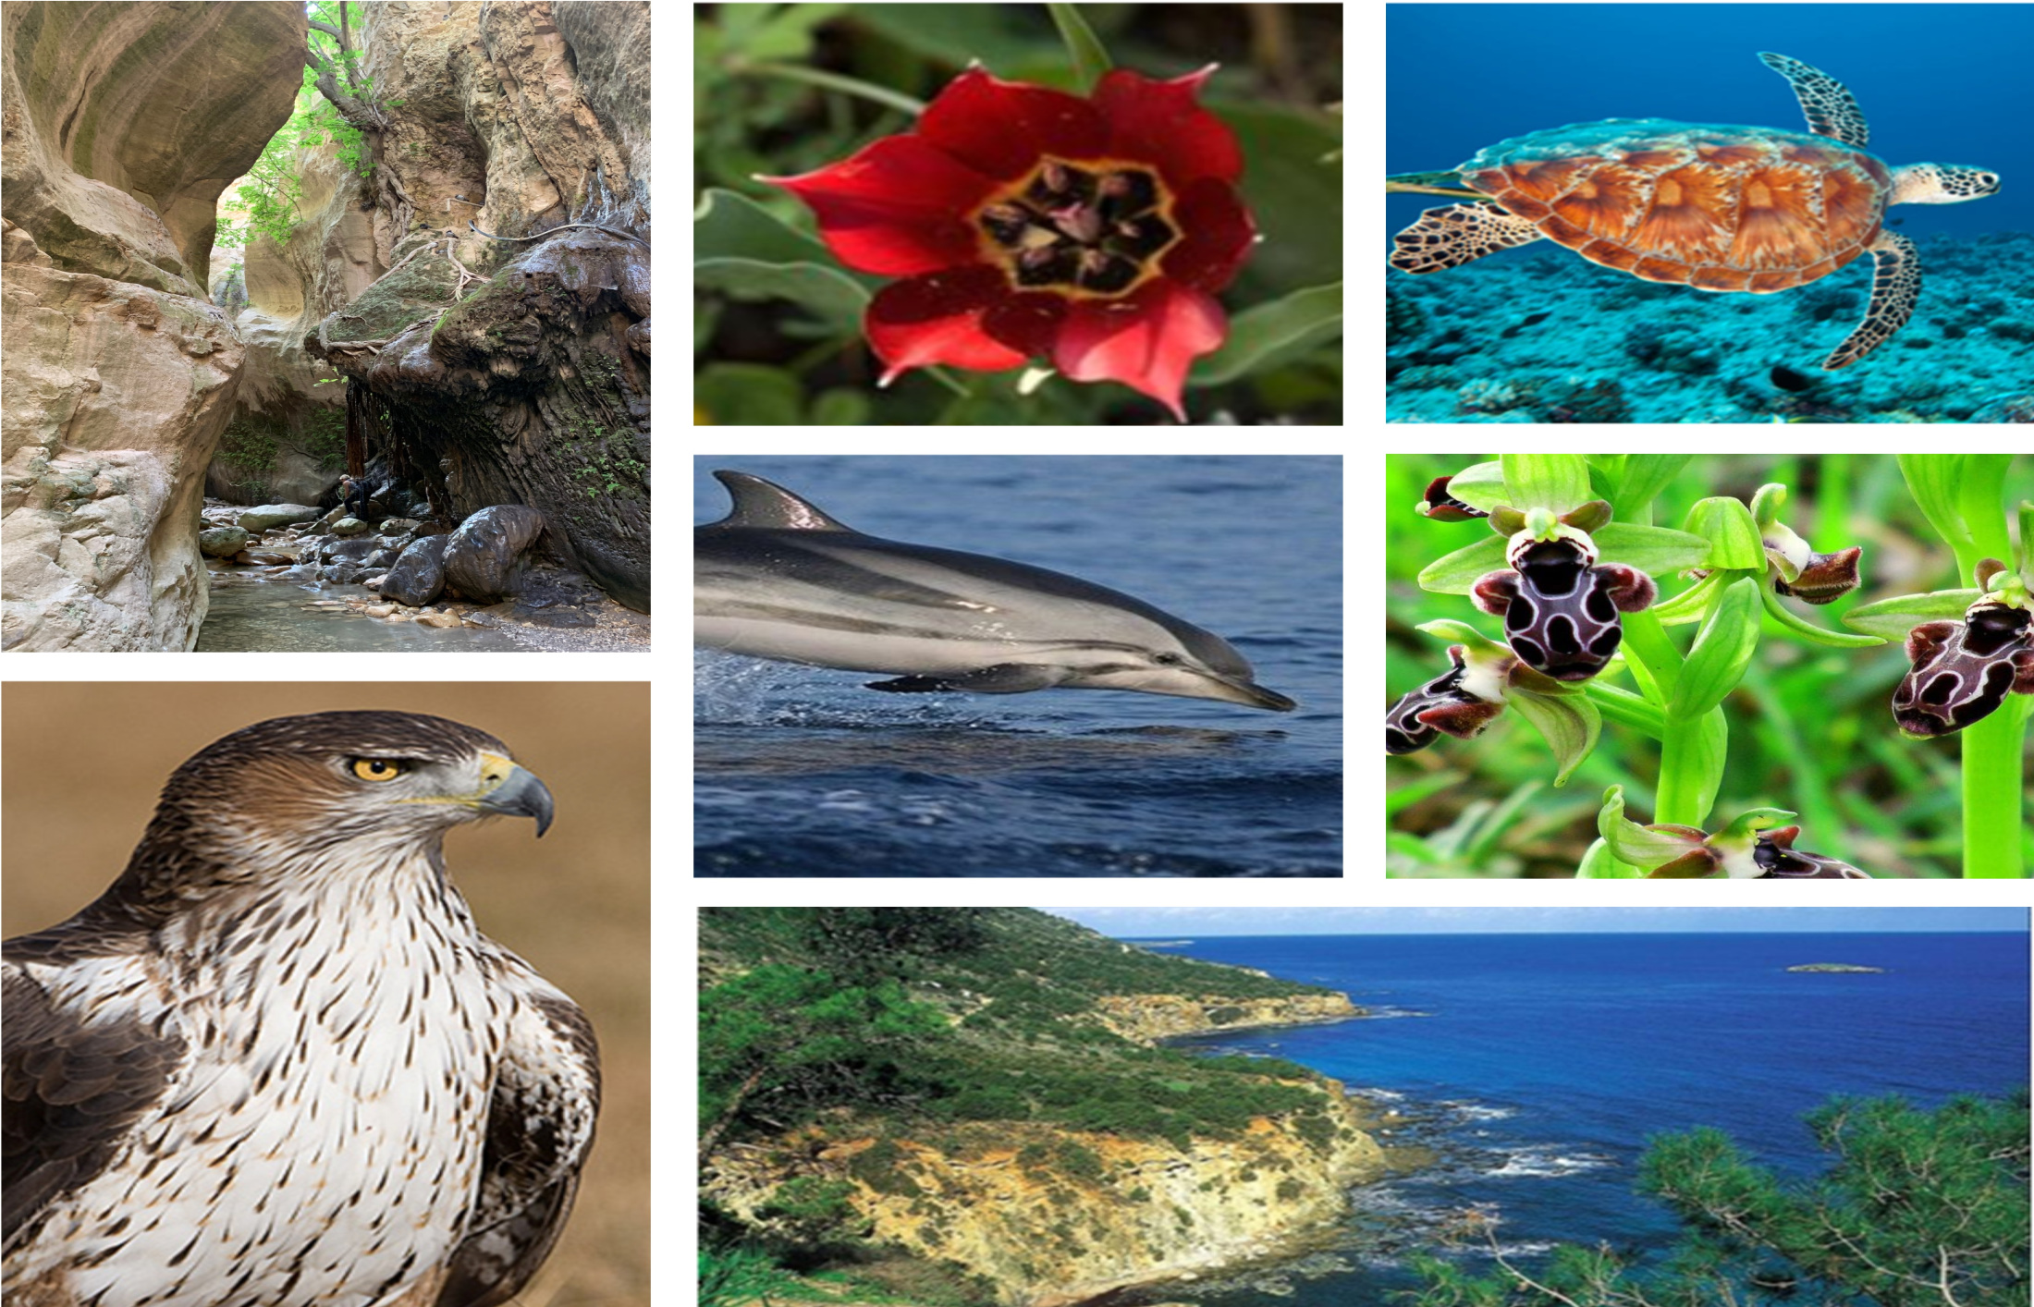

Slide 5
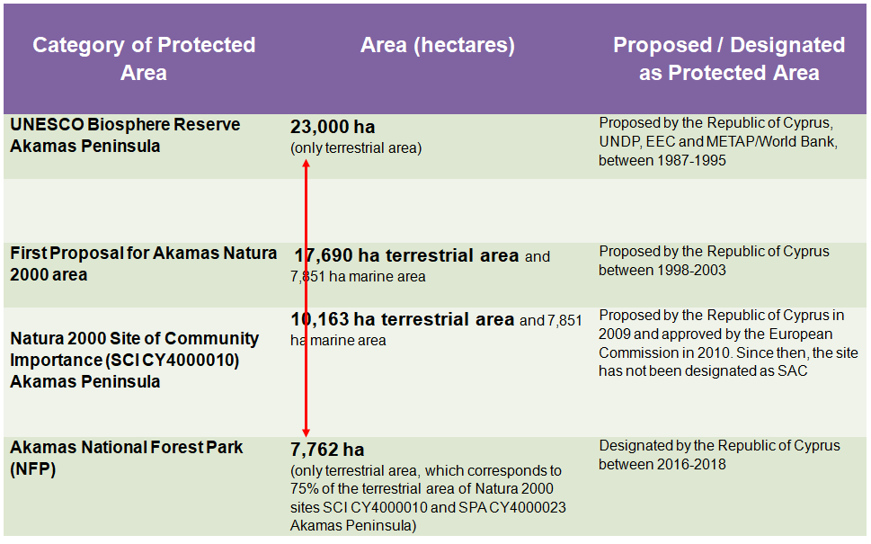

Slide 6
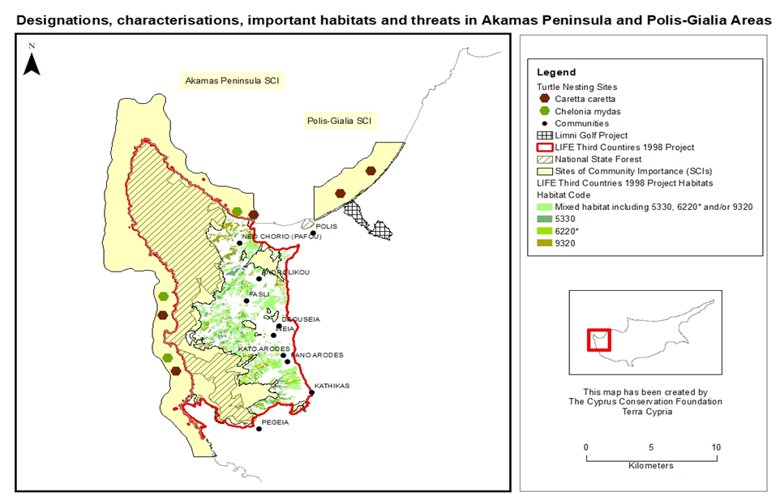

Slide 7
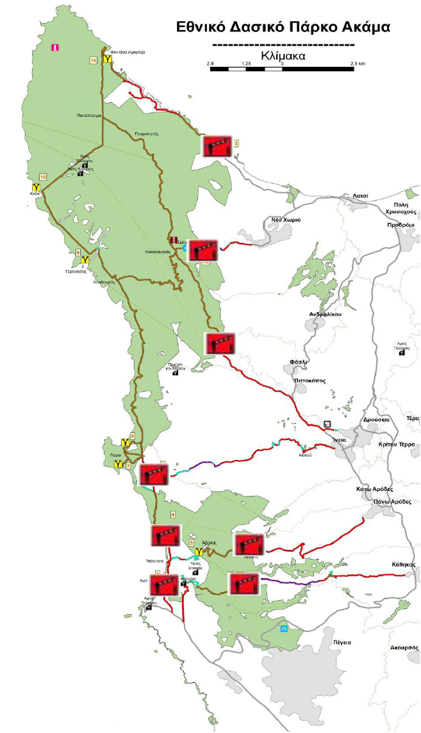
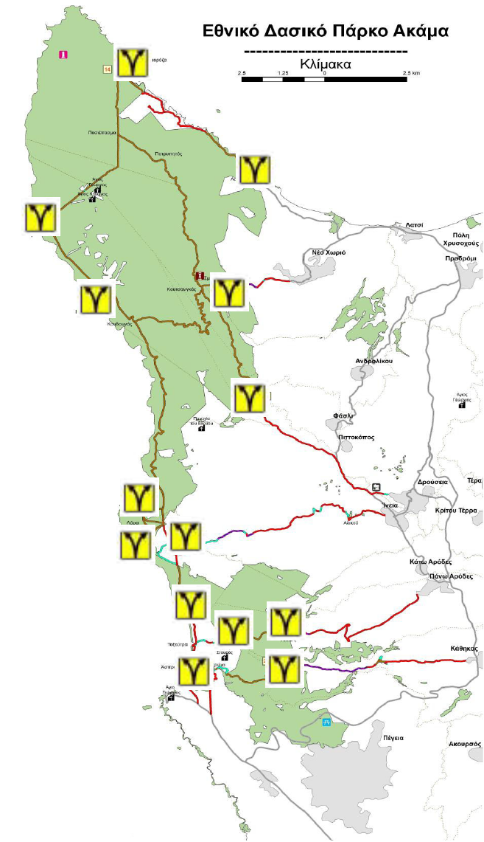
The official proposal for the Akamas National Forest Park (ANFP) entrances (red) and the 14 nodes (yellow) providing facilities such as refreshment points, toilets and souvenir stands etc.

Slide 8
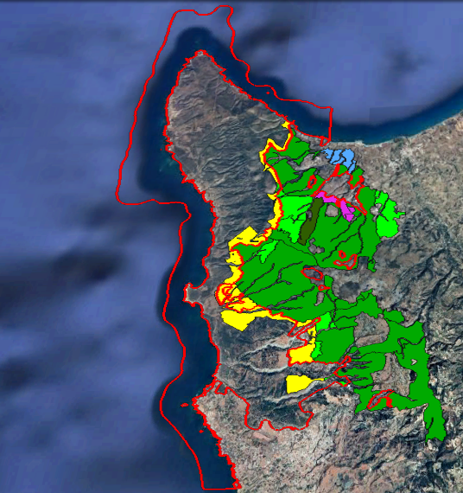
Akamas Local Plan
Visitable farms
(proposed spatial zones)
Quarry zones

Slide 9
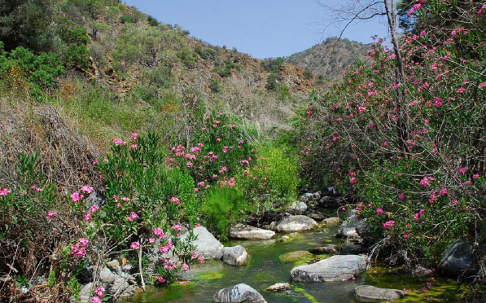
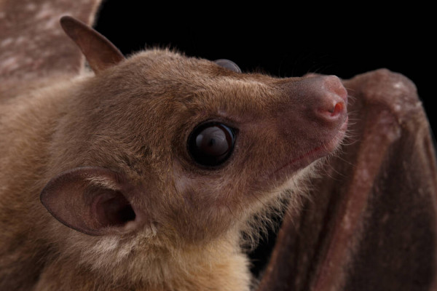
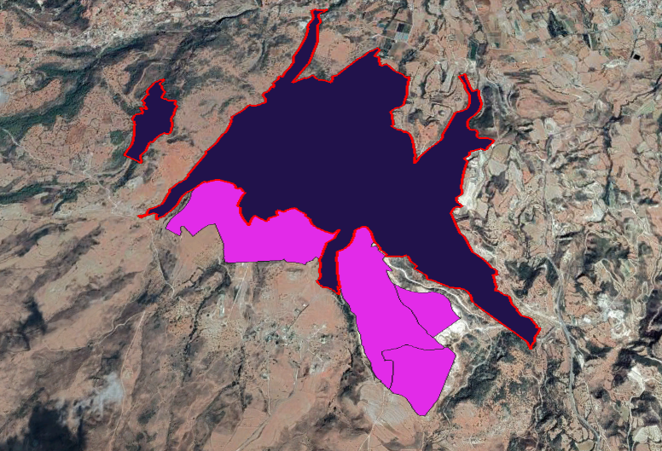
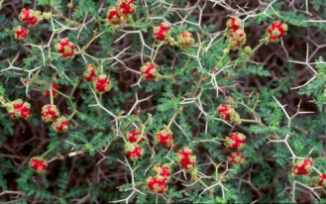
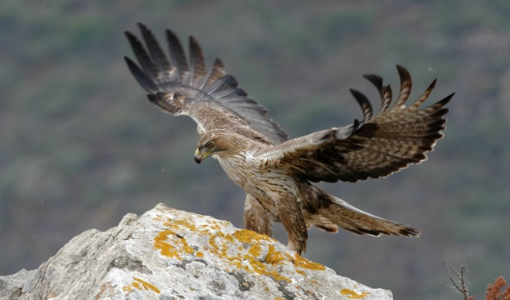
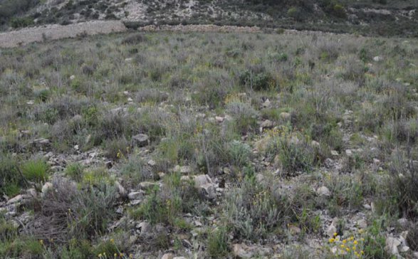
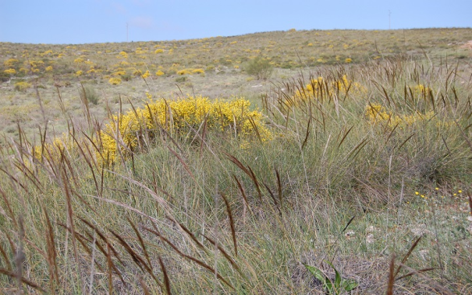
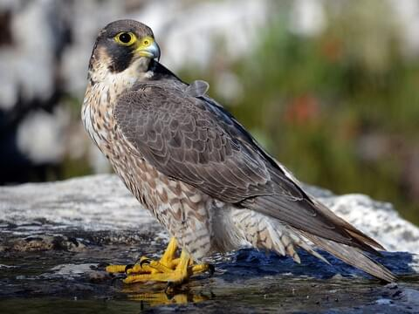
Τοπικό Σχέδιο Ακάμα
Akamas Local Plan
Quarry zones and Natura 2000
Natura 2000

Slide 10
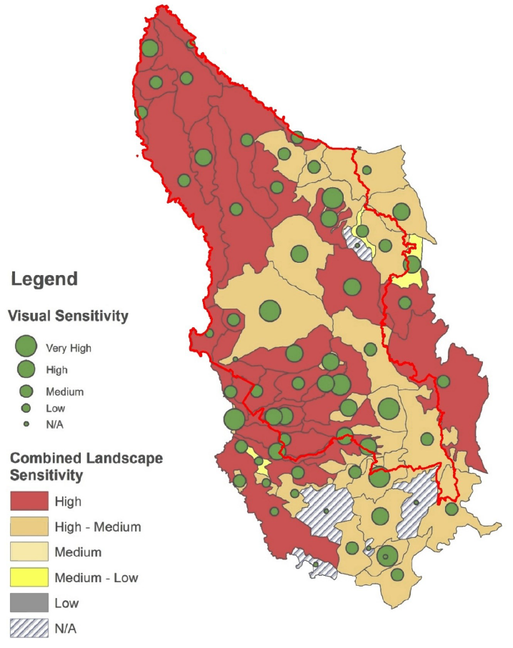
Akamas Local Plan
Visual and Landscape sensitivity

Slide 11
Akamas Natura 2000 site What are the main issues?
DESIGNATION
Insufficient Natura 2000 Site Designation
Unprotected priority habitats (e.g. 6220* and 3170*) and species (e.g. Aquila fasciata and Coracias garrulus)
Lack of political will to declare the whole area of Akamas Peninsula as a protected area with comparable international protection status (e.g. UNESCO Biosphere Reserve, EU Natura 2000 and/or IUCN National Park)
Illegalities (infrastructure, driving, earthworks)
MANAGEMENT PLANNING
Existing Management Plans (SCI, SPA, Grazing Capacity and Local Communities Sustainable Development) do not have legal standing and are not implemented
No Management Entity
New Plans are under evaluation or preparation, carrying potential new threats:
Two separate Local Development Plans by the Town Planning and Housing Department
A Sustainable Development Plan for Akamas National Forest Park by the Department of Forests

Slide 12
Akamas Natura 2000 site What are the main issues?
Akamas National Forest Park (ANFP)
Covers only the state forest land of Akamas, an area which corresponds to 75% of the Natura 2000 areas
Plans and assessment of ANFP’s Plans and in breach of the Habitats Directive (92/43/EEC): before undertaking an Appropriate Assessment
Architectural design of the infrastructures within the park,
Extensive road network and improvement of existing roads
Strategic Environmental Impact Assessment (SEA)
The SEA for the Akamas National Forest Park Sustainable Development Plan (ANFPSDP) was undertaken by the Forest Department. The ANFPSDP was prepare by the same Department.
14 development nodes (facilities) within the ANFP: Entrance Points, Parking lots, Toilets, 4x4 Shuttle Vehicle Stops, Information Centre/ Point, Refreshment Kiosk/ Souvenir Shop etc.

Slide 13
Akamas Natura 2000 site What are the main issues?
Akamas Local Plan
Several proposals allowing various developments outside the local communities’ boundaries and within Nature 2000 sites.
Visitable farms within Nature 2000 areas (it includes accommodation and overnight infrastructure, retail and catering facilities, dining facilities, information facilities, sports facilities).
Bulky Specialized Developments such as: Organized Large Scale Sports Centers, Theme Parks, Research and Development Centers and High Technology Developments.
Isolated houses located within a distance of 500m from the outer boundary of designated residential areas.
Expansion of quarry zones adjacent to Natura 2000 sites
Secondary Road Network opens the prospect for activities and development on adjacent plots of land along this network.

Slide 14
Akamas Natura 2000 site What are the main issues?
Environmental Assessments
Opinions regarding the Appropriate Assessment (AA)and Strategic Environmental Assessment (SEA) of the Akamas National Forest Park Sustainable Development Plan (Plan)
Fails to:
Assess satisfactory and cumulatively the effects on the designation species and habitats
Assess cumulatively the effects of the new road network on the designation species and habitats within the National Forest Park (NFP) and in relation to the proposed Road Network of Akamas Local Plan
Limit the infrastructures and services of the various facility nodes within the NFP
Prevent the construction of any infrastructure within sensitive and, till now, pristine areas
Reassure that the visitation traffic within the NFP will not accumulate in sensitive areas like the Lara-Toxeftra Marine Protected Area due to facility nodes
Evaluate the cumulative effects of the Plan, the Akamas Local Plan and Pegeia Local Plan, following the provisions of article 3, paragraph 2, of the Directive 2001/42/EC (SEA Directive), and article 6, paragraph 3, of the Directive 92/43/ECC (Habitats Directive).

Slide 15
Akamas Natura 2000 site What are the main issues?
MANAGEMENT ON-THE-GROUND
No effective protection measures in place
No legally binding protection measures are yet in place
Integrated management for early response system, intervention, accountability and fines not in place or issued
Fragmentation of responsibilities between 4 different competent authorities within 2 Ministries.
Some examples of the result of such lack of integrated management

Slide 16
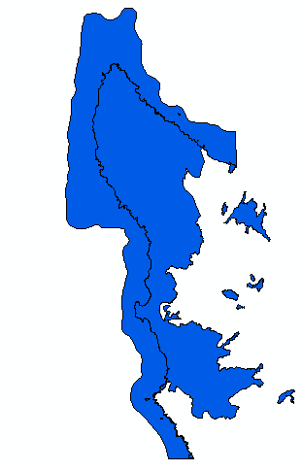
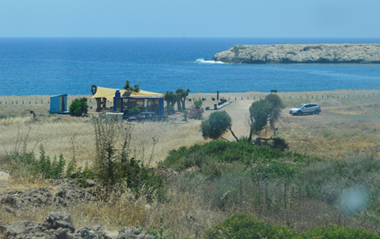
North and South Lara Beaches - Green Turtle and Loggerhead Nesting Areas
Illegal snack bar in South Lara Bay

Slide 17
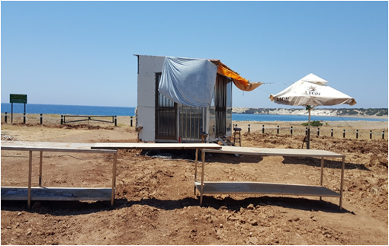
North and South Lara Beaches - Green Turtle and Loggerhead Nesting Areas
Illegal kiosk in South Lara Bay (summer 2021)

Slide 18
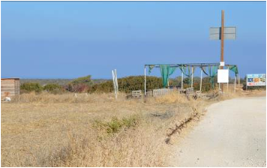
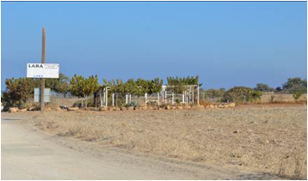
North and South Lara Beaches - Green Turtle and Loggerhead Nesting Areas
Abandoned illegal kiosks and snack bars

Slide 19
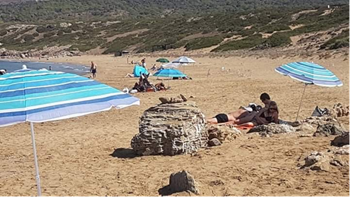
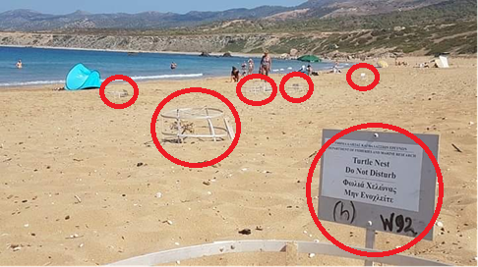
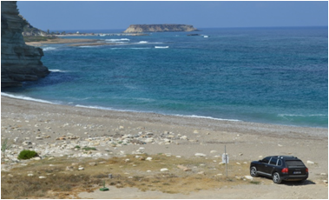
North and South Lara Beaches - Green Turtle and Loggerhead Nesting Areas
Illegal umbrellas, sunbeds and vehicle entrance at North Lara MPA

Slide 20
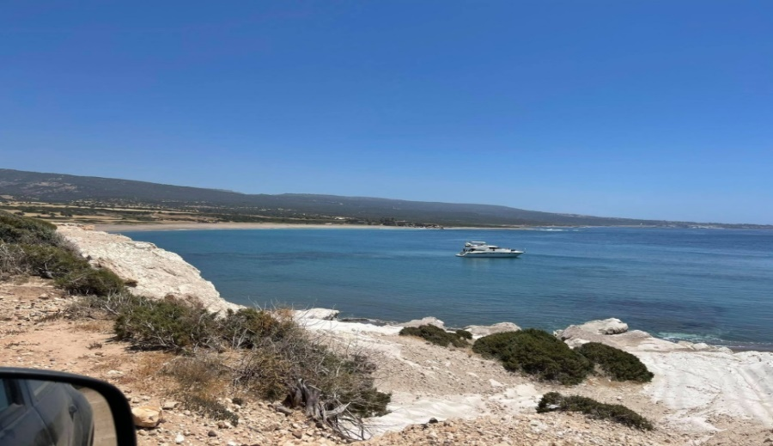
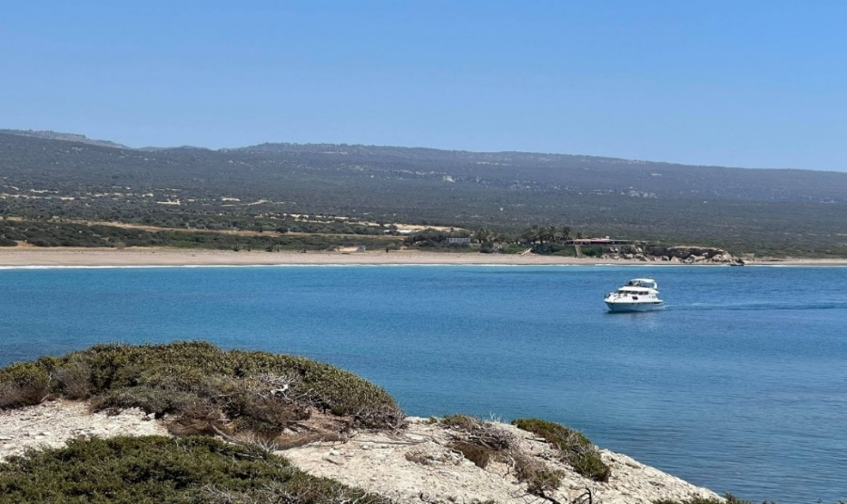
North Lara Beaches - Green Turtle and Loggerhead Nesting Areas
Illegal boat traffic and anchoring (summer 2021)

Slide 21
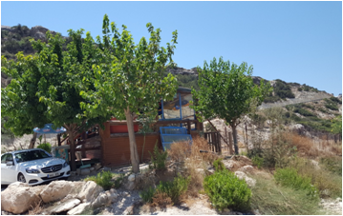
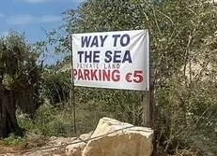
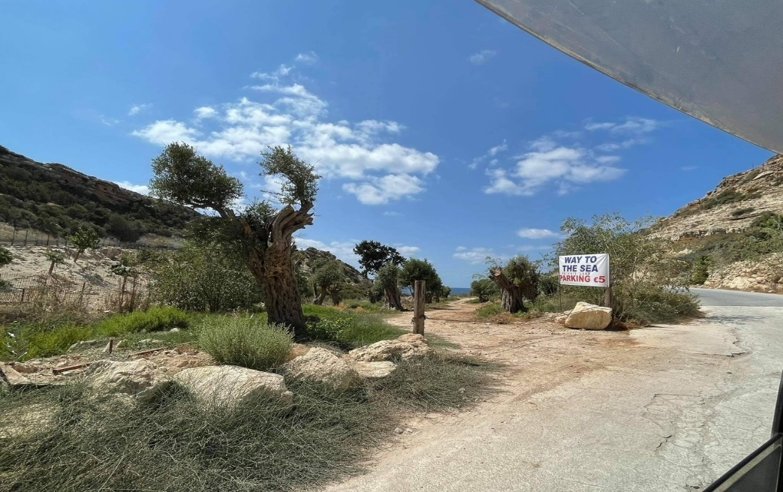
Aspros River Estuary, Toxeftra MPA - Green Turtle and Loggerhead Nesting Areas
Illegal restaurant and snack bar (summer 2021)

Slide 22
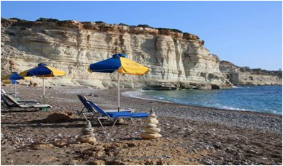
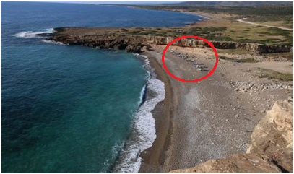
Aspros River Estuary - Green Turtle and Loggerhead Nesting Areas
Illegal umbrellas and sunbeds

Slide 23
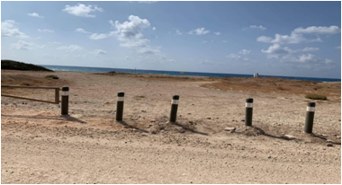
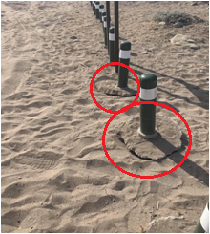
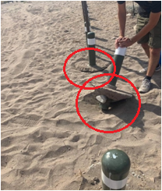
Lara and Toxeftra Beaches - Green Turtle and Loggerhead Nesting Areas
Iron fence posts to prevent vehicle access on the beach at Lara-Toxeftra MPA

Slide 24
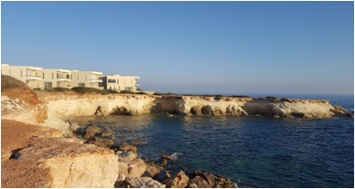
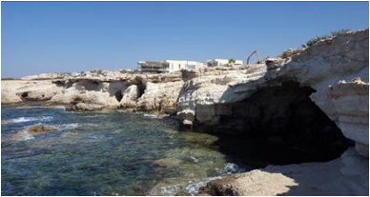
Sea Caves in Pegeia – Mediterranean Monk Seal Breeding and Resting Area
Rampant residential development (summer 2020)

Slide 25
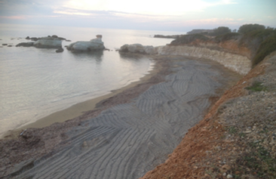
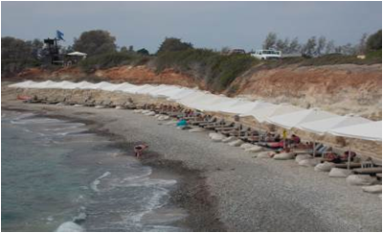
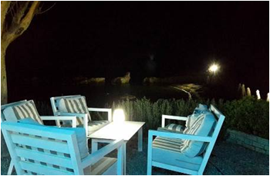
Sea Caves in Pegeia – Mediterranean Monk Seal Breeding and Resting Area
Illegal earthworks & creation of an artificial beach. Direct lighting
and sunbeds with umbrellas in Kafizis area

Slide 26
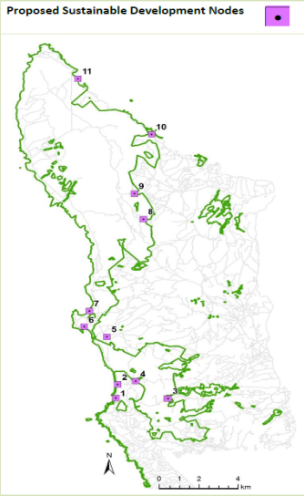
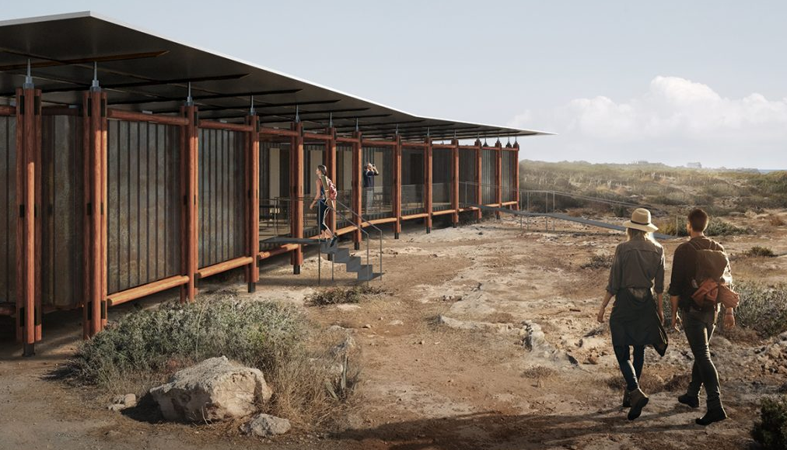
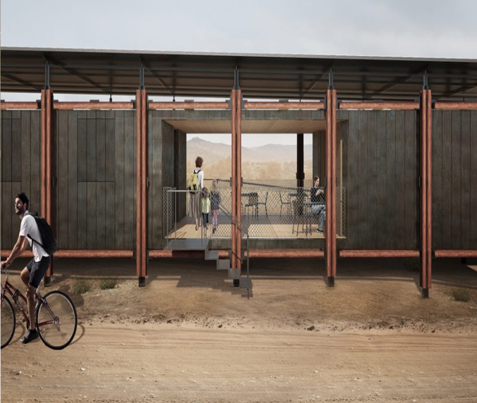
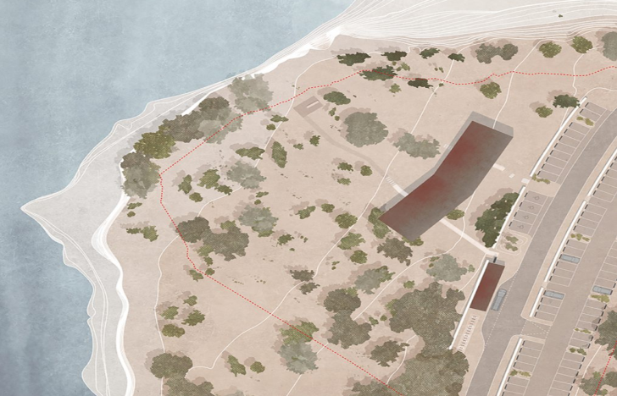
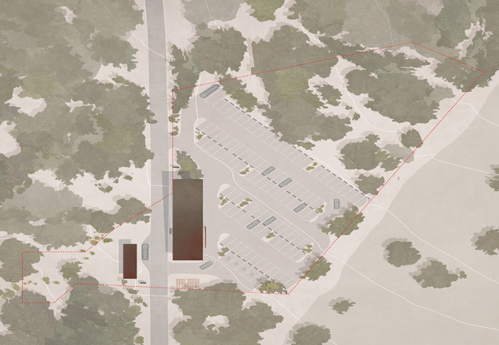
14 Nodes within the Akamas National Forest Park
Refreshment kiosks and souvenir shops within the ANFP will compete the local communities of Akamas.

Slide 27
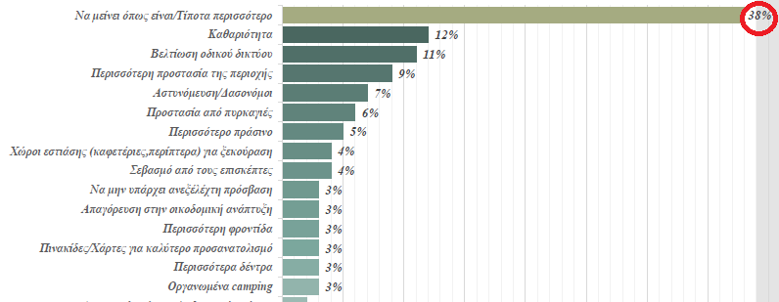
Official visitation survey of Akamas National Forest Park
A very high percentage (92%) considers the protection of the Akamas National Park area very important.
Q: What visitors would like to see more of in the Akamas National Park: Most of visitors asked (38%) responded that “they do not want to see anything more and to keep Akamas as is”, that is, natural and authentic.

Slide 28
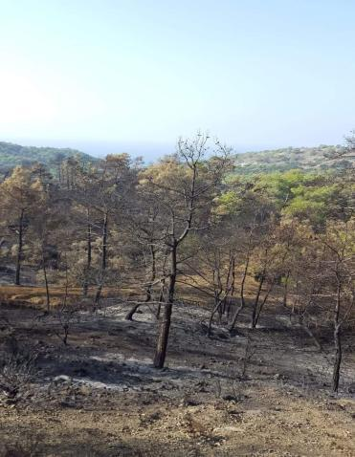
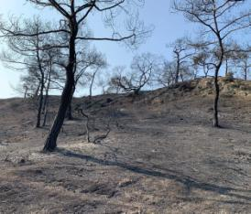
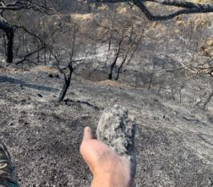
Akamas Peninsula
Numerous malicious fires as a form of political pressure for land-use change

Slide 29
Akamas Natura 2000 site What do we want to see?
Expansion of Natura 2000 boundaries
Establish and enforce an integrated Management Plan and legally binding Conservation Decrees
Allocation of funding for the implementation of Management Plans and effective patrolling
Declare the whole of the Akamas Peninsula a national park, a biosphere reserve or a protected area with comparable international protected status.
Enforce the existing legislation for the protection of marine turtles according to the Fisheries Law (Chapter 135) and Regulations 1990 (Reg. No. 273/90) in force since 1989
Prohibition of infrastructure and overnight and dining accommodation outside the existing boundaries of the designated Development Areas of Akamas villages. For this, the Akamas Local Plan needs a complete revision.

Slide 30
Polis-Gialia Natura 2000 sites

Slide 31
Polis-Gialia Natura 2000 site An imminent threat to a major nesting site for Loggerhead Turtles

Slide 32
Polis-Gialia Natura 2000 site What is its importance?
Total Mediterranean nests 6000 p.a.
Total Cyprus nests 1000 p.a.
Total Polis-Gialia nests 550 p.a.
Total nests directly impacted by the proposed golf complex 200-250 p.a.
25% of Total Cyprus Nests
4.2% of Total Mediterranean Nests

Slide 33
The Limni Bay Resort
2 golf courses (18 holes each)
2 club houses (with bars and restaurants)
792 villas
2-storey hotel (with 160 rooms)
Road network
Sport facilities

Slide 34
Limni Bay Resort
The development complex is situated in an area bordering 145-200m from the sea, extending for up to 4 km inland and consisting of more than 3 million sq. m.

Slide 35
Limni Bay Resort What are the issues?
Taking into consideration the maximum capacity of the 792 villas, which equals to 3,123 individuals (excluding the maximum capacity of the hotel complex, which equals 160 rooms / 320 individuals, as well as employees and visitors), the proposed project is expected to:
Increase the population (4,061 individuals) of the municipalities and communities, which fall under the administrative area of the Natura 2000 SCI/SAC Polis – Gialia (CY4000001), by 77%.
Increase the population (2,348 individuals) of the municipalities and communities, which fall under the administrative area of the Chrysochou Bay Local Plan, by 133%.
These figures are based on the latest Population Census of 2011 and demonstrate the significant increase of human presence and pressure caused by the project.

Slide 36
Limni Bay Resort What are the issues?
The substantial term of a 475m No-building Zone between the proposed golf complex and the sea (suggested by the European Commission, the Standing Committee of the Bern Convention and originally by the Environment Department of the Republic of Cyprus) has not been respected in the updated master plan, which received a green light by the competent authorities
The precautionary principle has not been followed
The cumulative effects of the project have not been properly assessed
The proposed mitigation measures are not sufficient
E.g. Out of the 28 lighting conditions imposed by the
Environment Department, 17 are based solely or partly
on residents’ compliance within their private properties

Slide 37
Why a 475-meter No-building Zone?

Slide 38
Area that needs to remain free of buildings (41 villas, a club house and a two-storey hotel)

Slide 39
Limni Bay Resort – What do we want to see?
At least a 475m No-building Zone between the golf complex and the sea
Reduction of residential capacity of the project
Establish and enforce an integrated Management Plan and legally binding Conservation Decrees
Funding to be allocated for the implementation of conservation and management measures, as well as careful monitoring and patrolling of the area

Slide 40
Polis-Gialia - Green Turtle and Loggerhead Nesting Areas
Insufficient road light-barrier adjacent to the sea turtles nesting beach in Polis-Gialia area, Chrysochou Bay (summer 2021)

Slide 41
Polis-Gialia - Green Turtle and Loggerhead Nesting Areas
Light pollution adjacent to the sea turtles nesting beach in Polis-Gialia area, Chrysochou Bay (summer 2021)

Slide 42
Thank you

