Slide 1
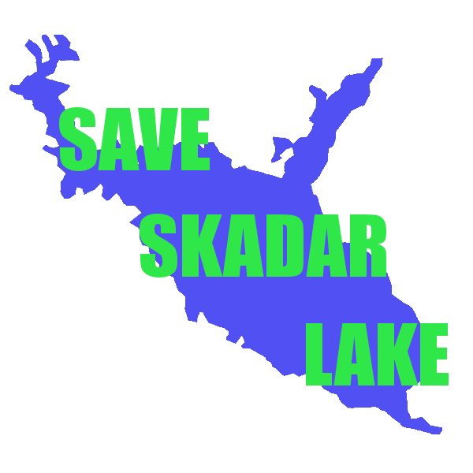
SCADAR LAKE NATIONAL PARK
MSc. Azra Vuković
NGO Green Home
Citizens Group of Virpazar
01.12.2021.

Slide 2
Importance of Scadar Lake
The biggest lake in South East Europe covering the area of 370km²;
1983. it was proclaimed as national park in Montenegro, IUCN category II
The territory of the lake is dominated by freshwater and wetland ecosystems. The trademark of the lake is Dalmatian pelican (Pelicanus crispus)
From 1989 it has IBA status
From 1995. it is Ramsar site

Slide 3
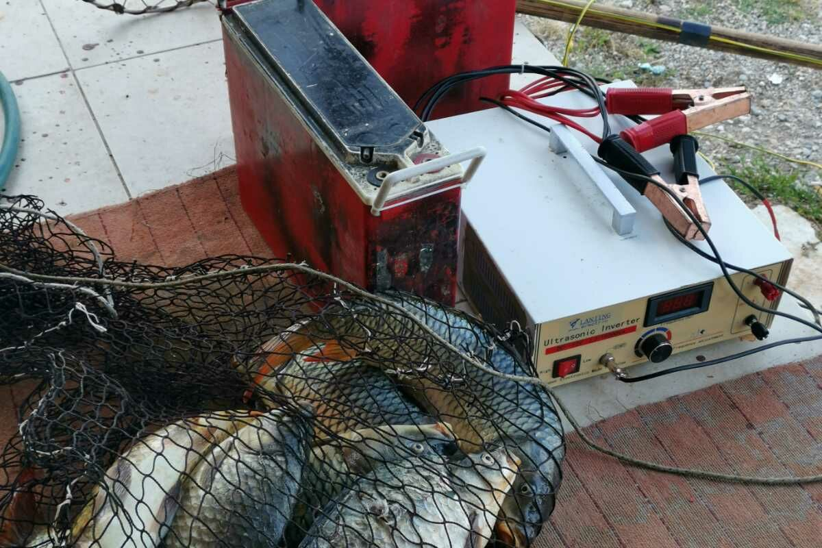
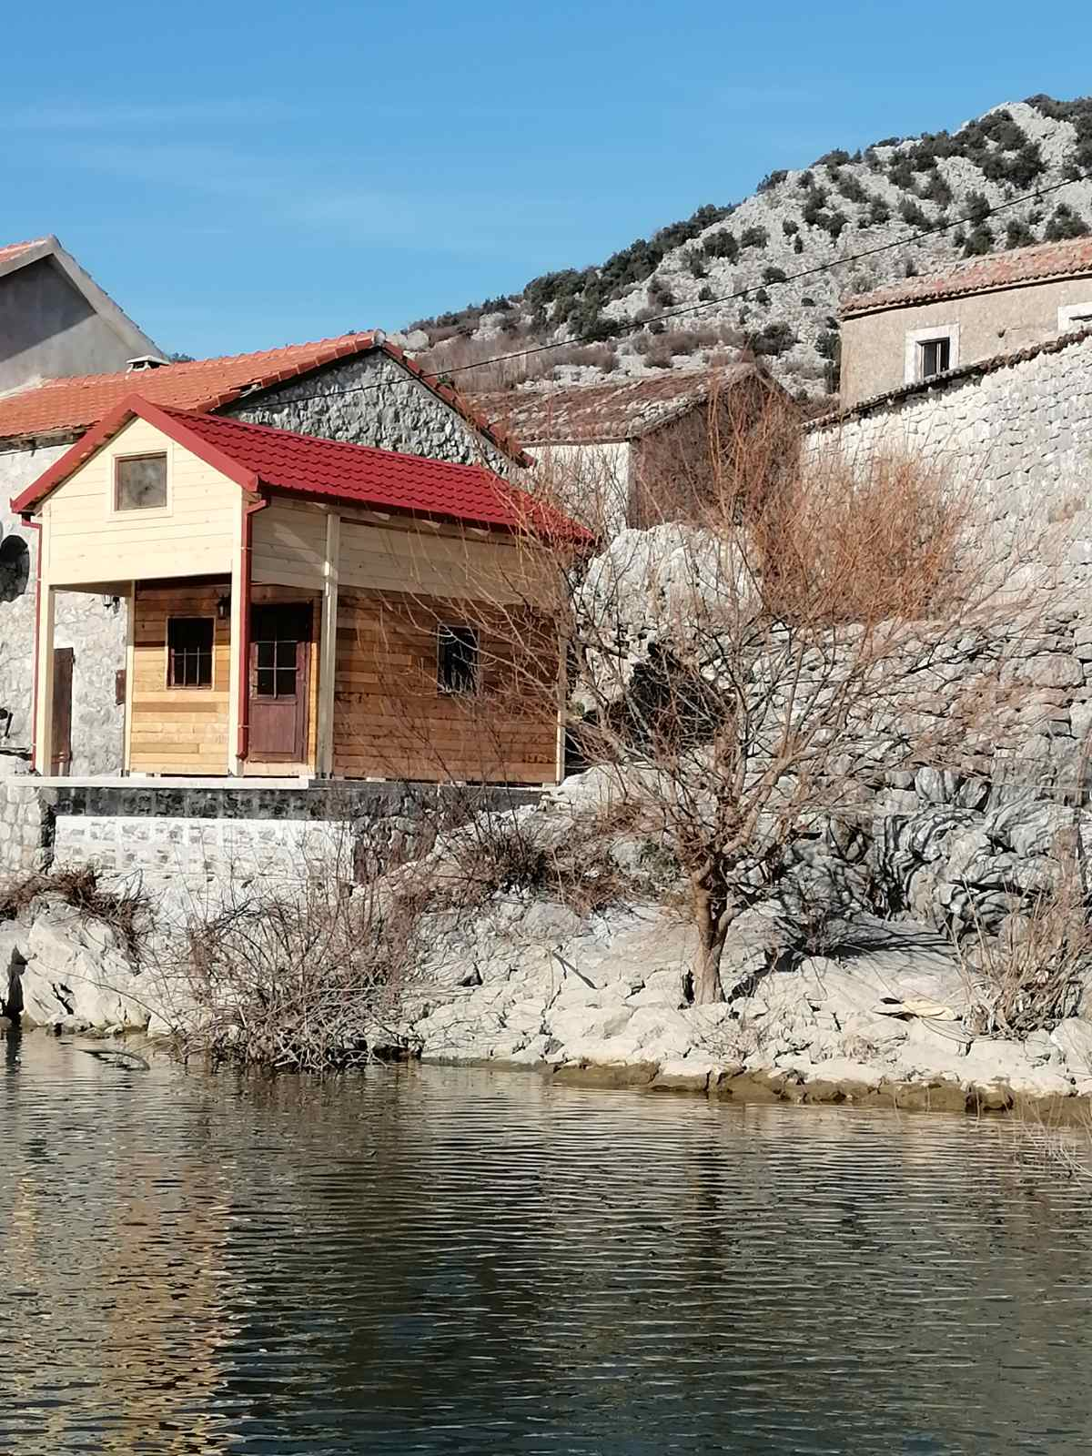
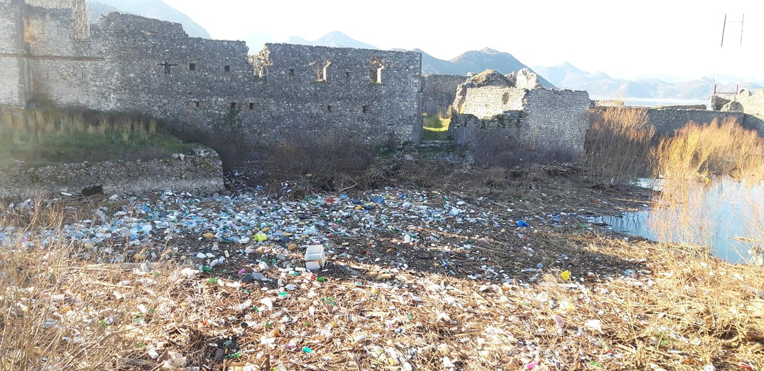
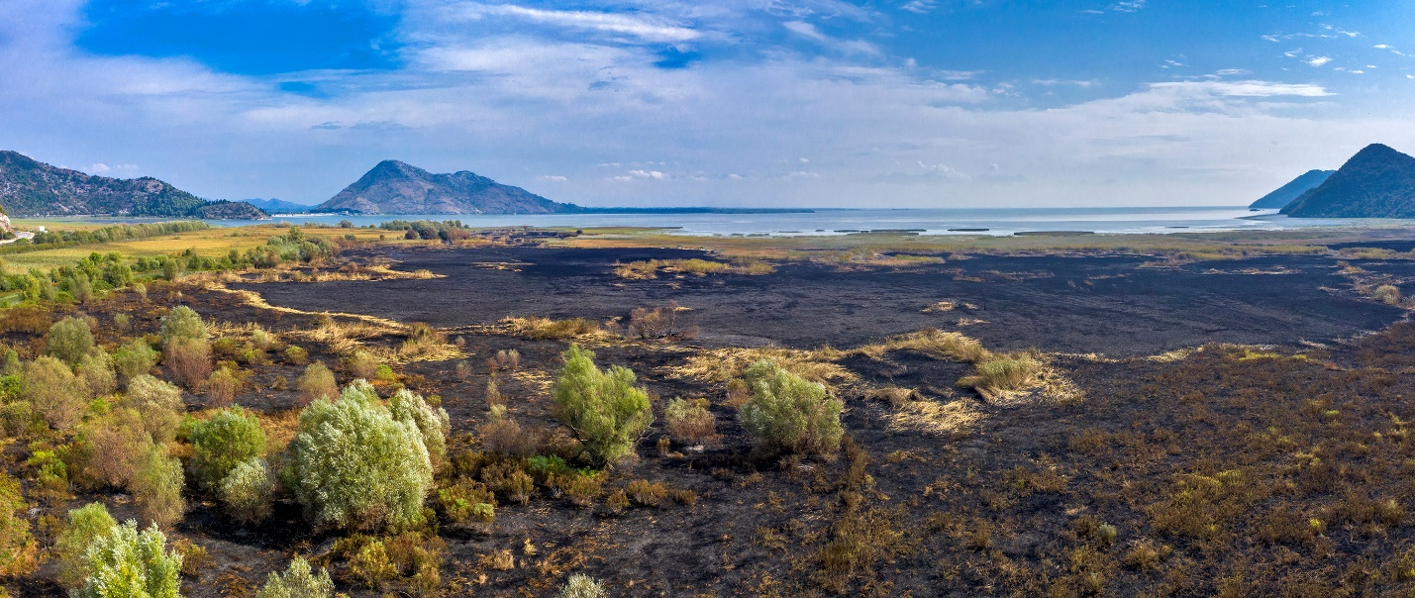
Threats
Illegal construction of buildings
Poaching
Illegal gravel extraction
Invasive species
Not effective waste management
Fires

Slide 4
Open File No. 2016/4: Montenegro: Development of a commercial project in Skadar Lake National Park and candidate Emerald site
A formal Case File was opened in 2016
Bern Convention On-the-Spot Appraisal Mission and Ramsar Advisory Mission were implemented jointly in 11-14 June 2018

Slide 5
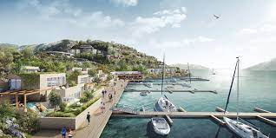
KEY FINDINGS
No meaningful progress from Montenegrin government on recommendations 201.
Case of hotel “Vir” in Virpazar – a negative example of building practices and lack of rule of law.

Slide 6
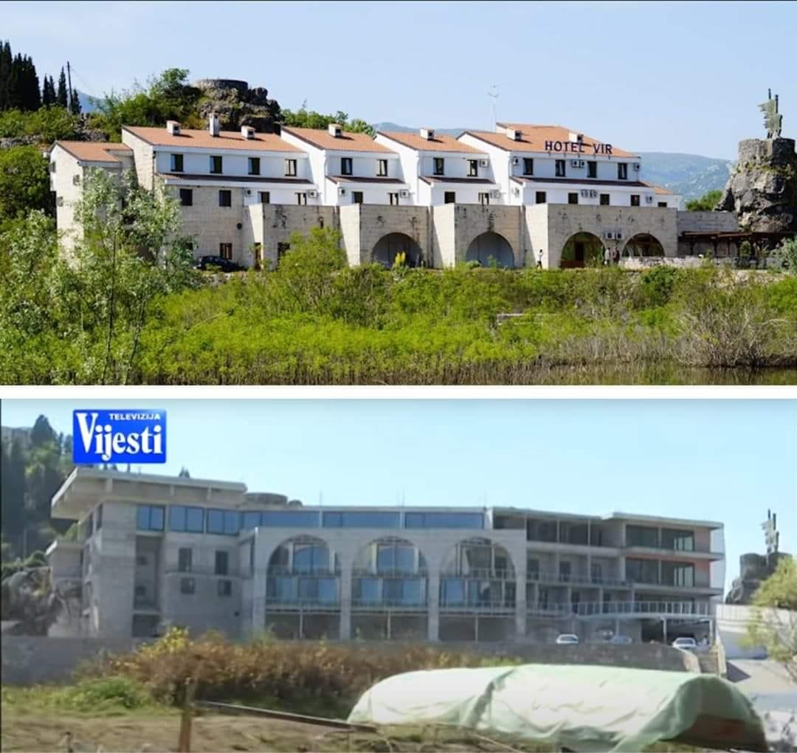
Case of hotel “Vir” in Virpazar – a negative example of building practices and lack of rule of law
Hotel Vir (previously “13 Jul”) was built in 1981, architecturally inspired by traditional house building in the region of Crmnica.
The proposal for its reconstruction has been twice rejected by the main Architect of Montenegro, only to be approved in February this year directly by Mr Ratko Mitrovic, Minister of Ecology, Spatial Planning and Urbanism.
Note that this is a Minister who has been known to be involved in illegal building practices himself.

Slide 7
Highway Bar-Boljare
Part of the planed highway goes 50 km through NP Skadar Lake, as defined with the Spatial Plan.
Detailed Spatial Plan Bar-Boljare recognizes that the Skadar Lake will be endangered having in mind that it goes directly through the lake in the length of 9km.
Another corridor was proposed, though Rijeka Crnojevića that goes as well across the National park.

Slide 8
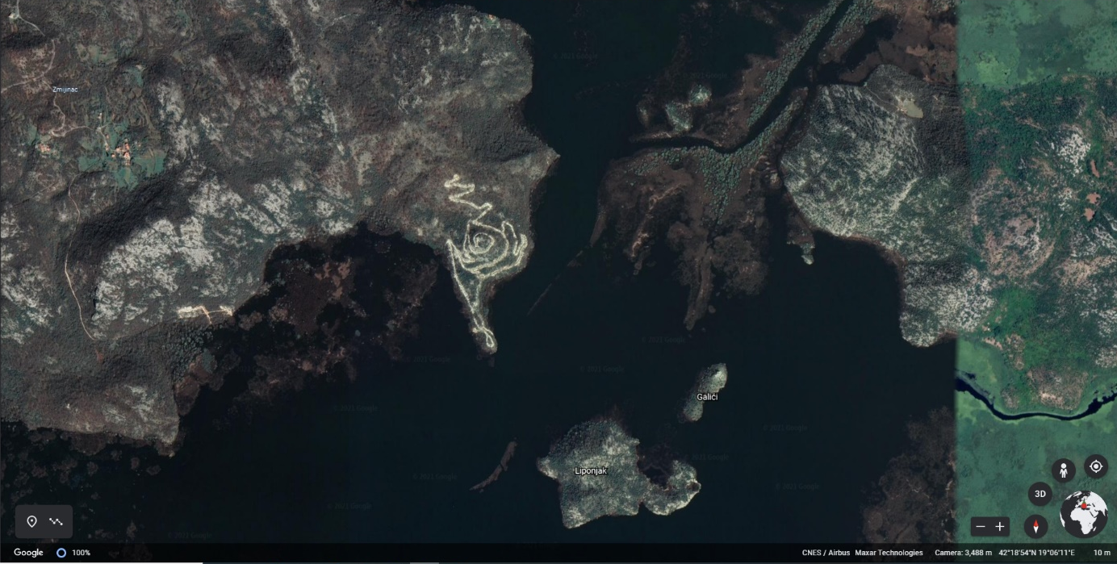
Reiterating our key positions:
1. Abandoning SLS Mihalovici entirely (validity expired in 2020) and, in the light of current evidence, revoking all building permits for Porto Skadar Lake and White Village. This will ensure that most of the Recommendations 201 are respected. It will send a strong message that sustainable development and conservation takes priority over private sector profit.
Building permits for both project are still in force.

Slide 9
2. As the highest priority, the development and delivery of a new spatial plan for the National Park, as previously committed to by the Montenegrin authorities. Ensuring that the new Spatial Plan is rezoned according to Recommendations 201, the Shore Functionality Index study and recent biodiversity mapping.
Zone I and II with their buffer zones are treated as nature reserves and fully protected from ANY AND ALL developments.
any further new tourist developments be sustainable, based in areas that are already currently occupied, be of small scale, and be eco and village tourism based. This as per 3.4.2 Recommendations for Montenegro (page 66 of SFI Study).
existing road infrastructure is maintained and not upgraded. We maintain that the new motorway route (Bar-Boljare) over Rijeka Crnojevica should be abandoned, and a more sustainable/less damaging alternative is found.
waterways follow Recommendations 201. Exceptions to the recent law limiting boat engine sizes to be abandoned and law to be enforced.
No management plan for NP Skadar lake

Slide 10
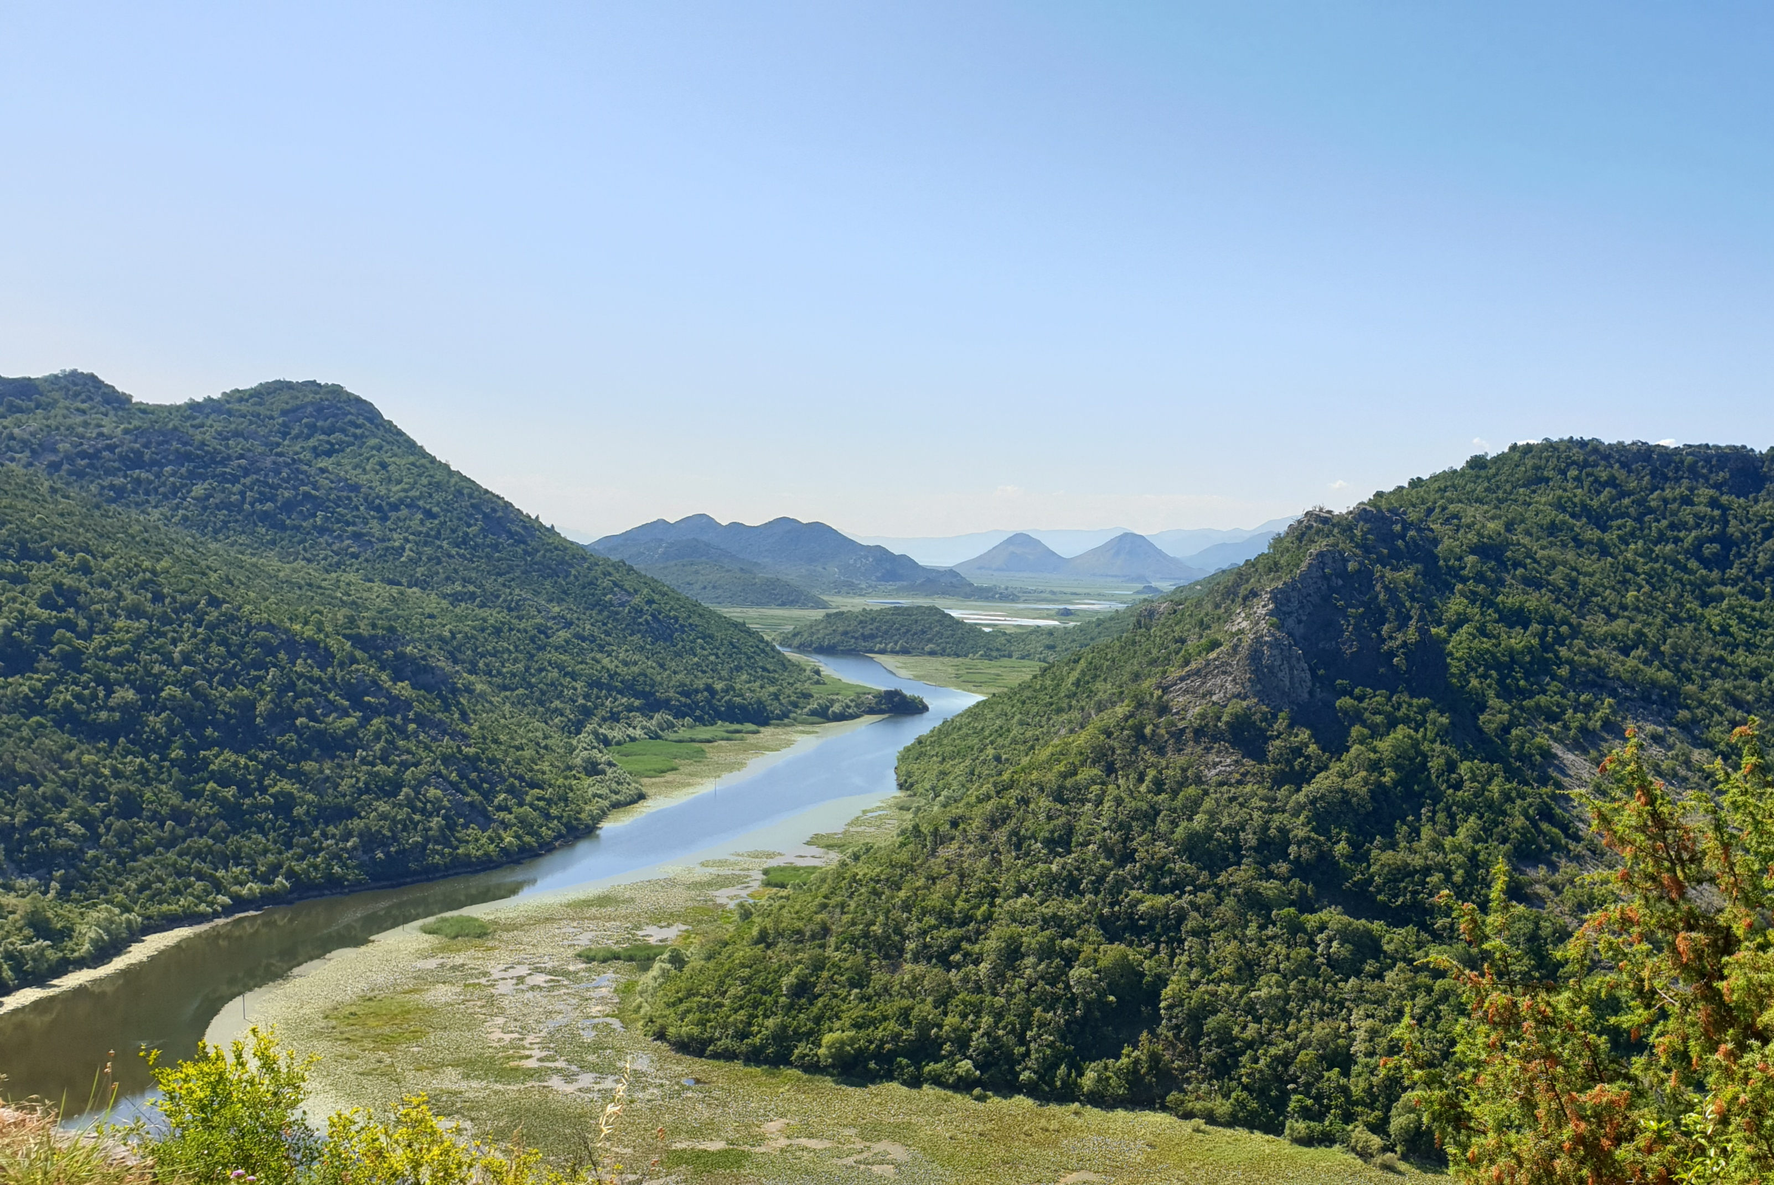
3. Protection as a priority. Finally, initiate and establish efficient and effective methods of monitoring implementation of existing laws, executed in a manner that is visible on the lake.

Slide 11
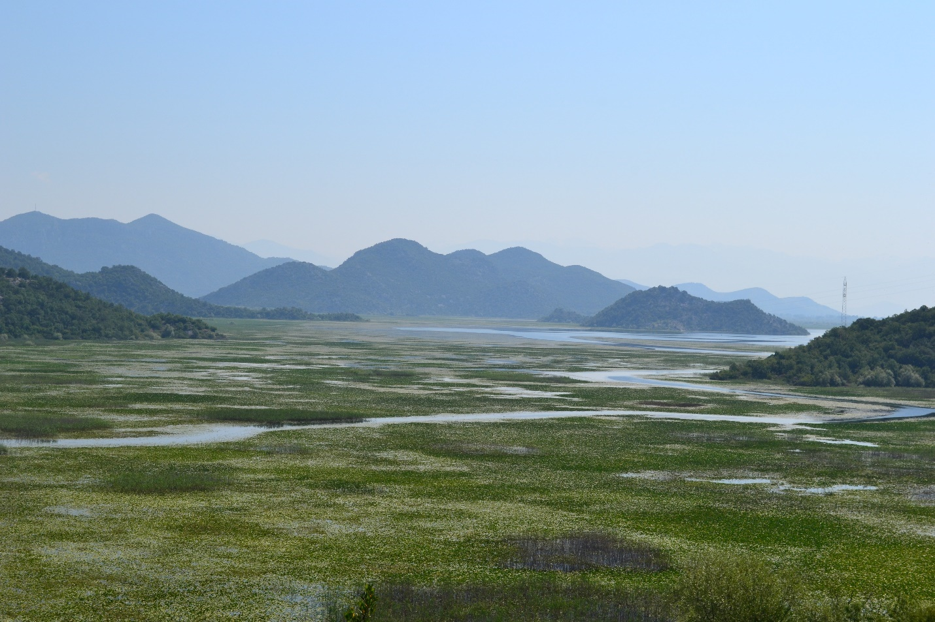
Thank you!
Azra Vuković
NGO Green Home, Citizen’s Group Virpazar
+38268526061
azra.vukovic@greenhome.co.me

