Slide 1
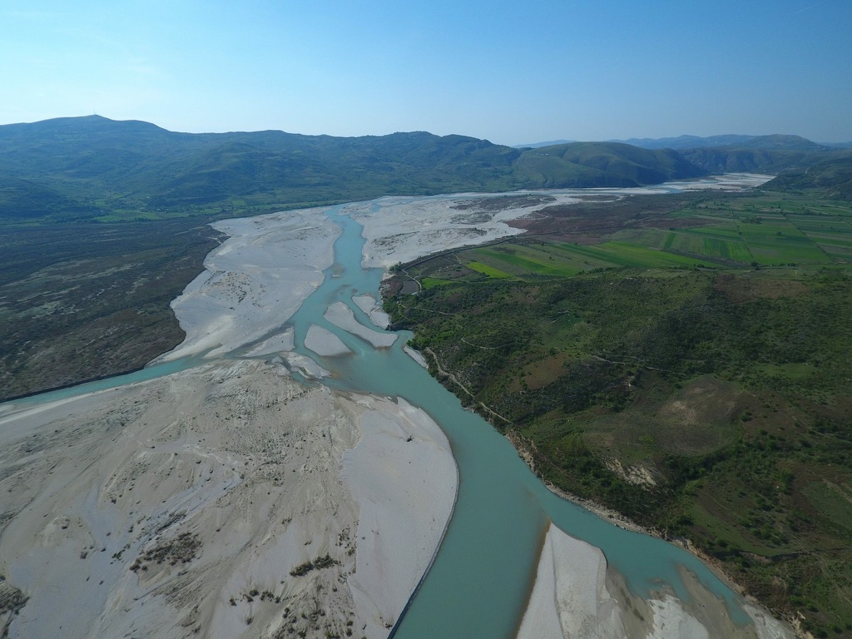
Update Report
On Vjosa River case
Olsi Nika – EcoAlbania, 2021
o.nika@ecoalbania.org
41st Standing Committee Meeting
of the Bern Convention

Slide 2
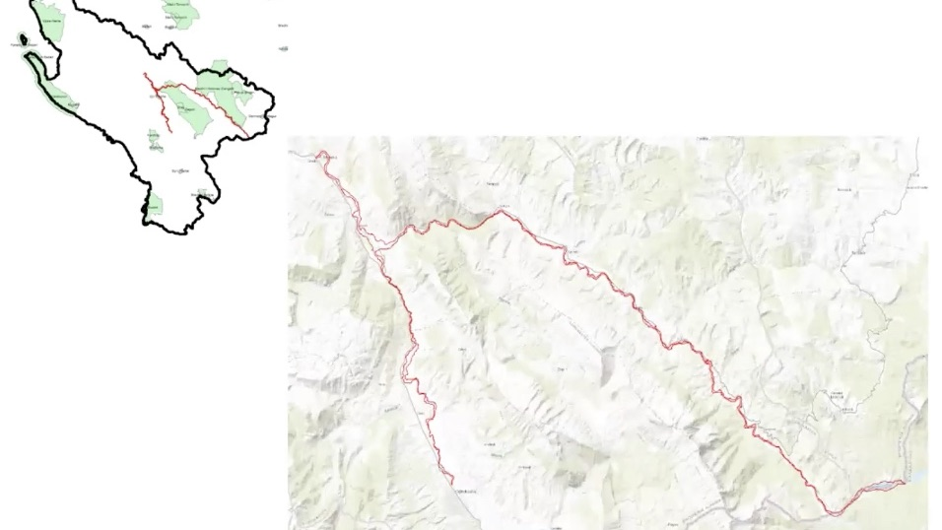

Slide 3
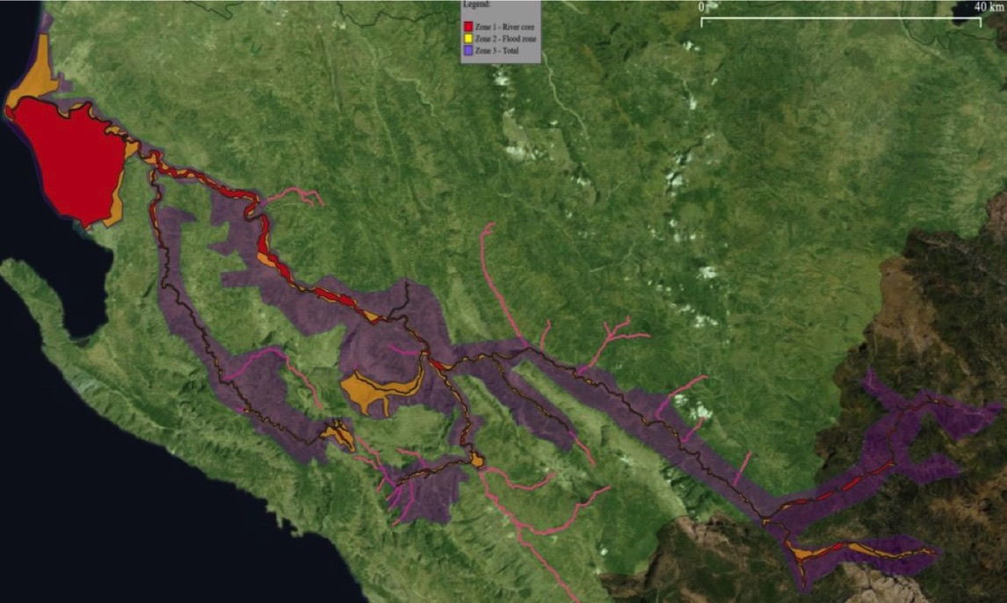
Notes:
https://www.ecoalbania.org/wp-content/uploads/2021/05/IUCN-Protection-study-of-the-Vjosa.pdf

Slide 5
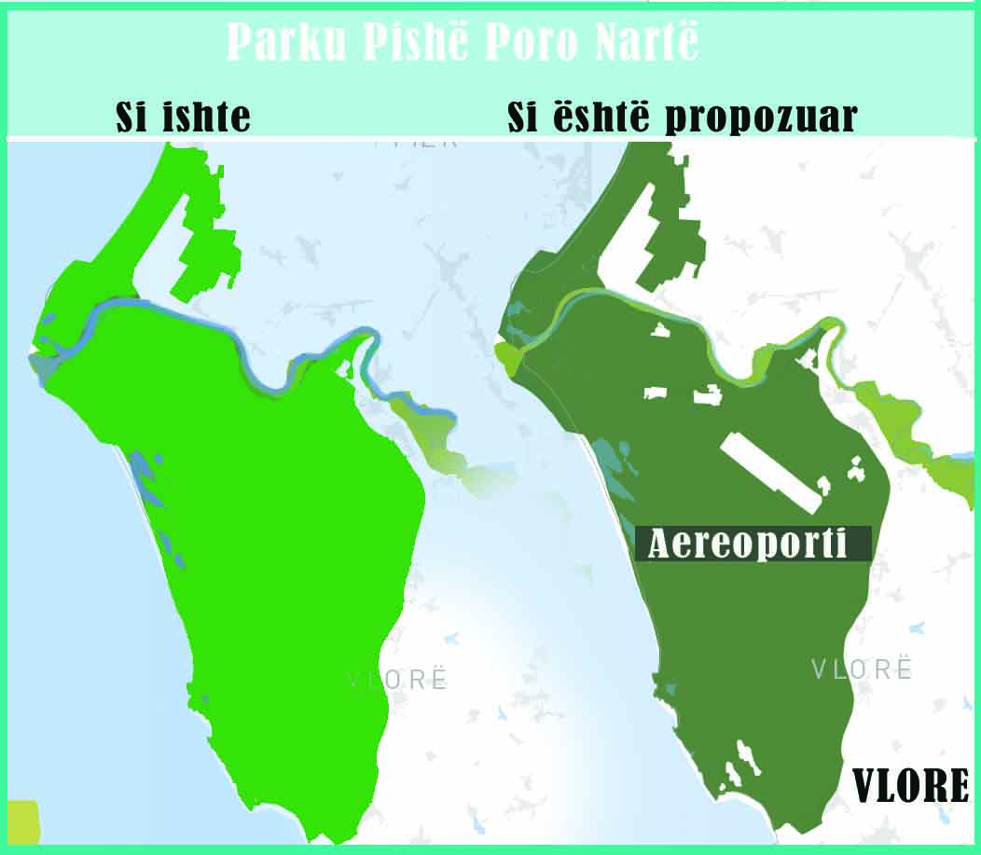
Notes:
Raised the concers of the unified ECSOs community in Albania and abroad

Slide 6
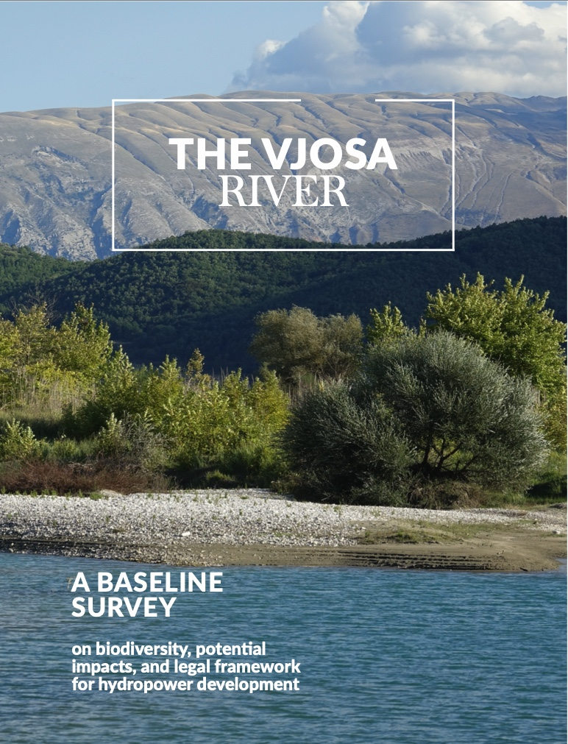

Slide 7
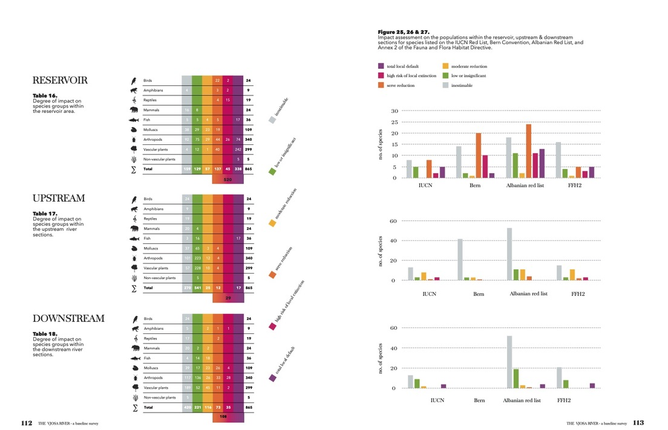
1100 species described and registered
45 species registered for the first time in Albania
Dozens of Priority Hbitats
650 species dam-sensitive

Slide 8
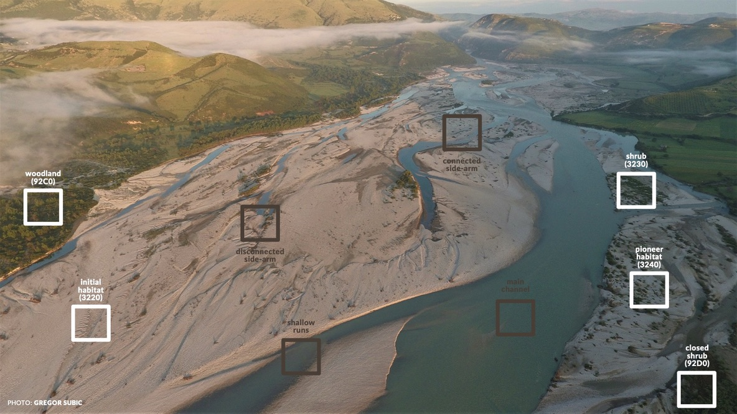

Slide 9
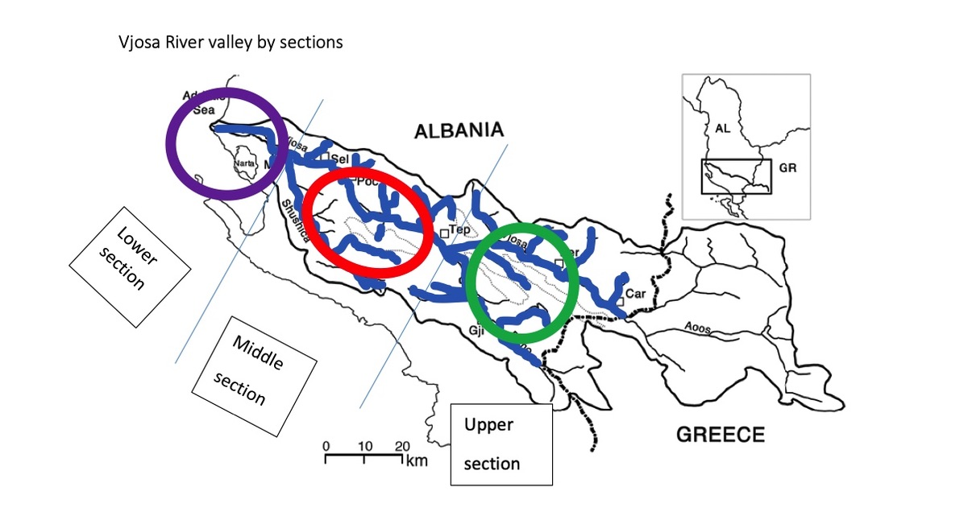

Slide 10
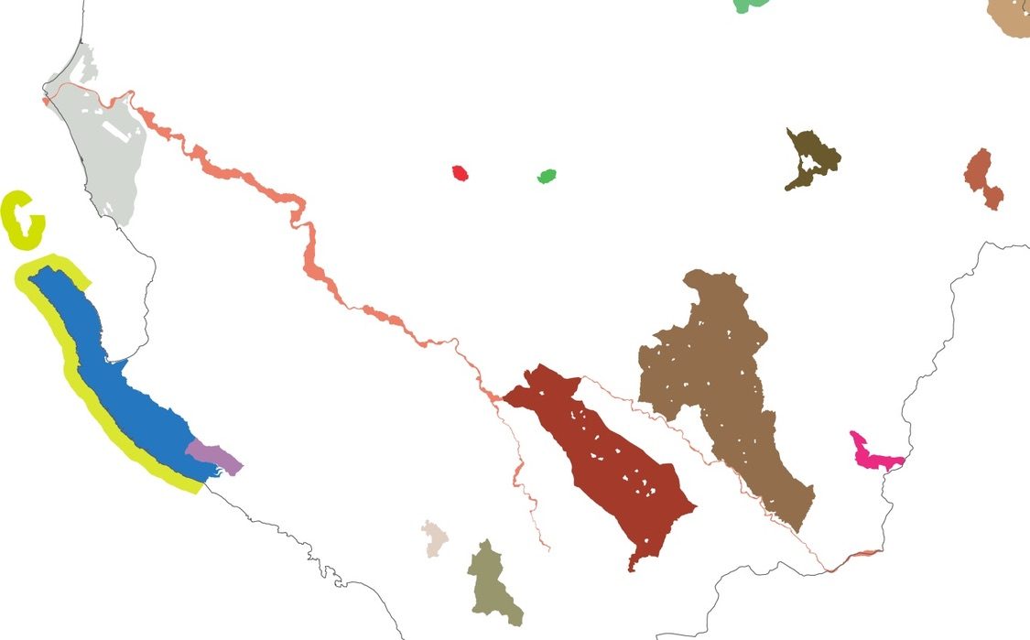

Slide 11
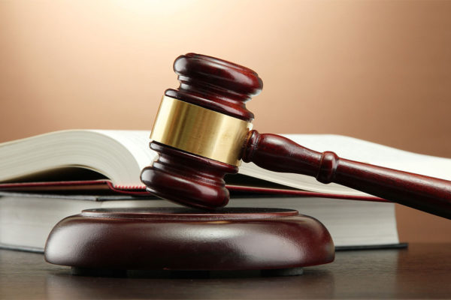
Administrative Court of Tirana has rejected the Company’s claim
The MoTE and NEA accepted the support of NGOs
Notes:
Tirana, 28 May 2021. Today, the Administrative Court of Tirana has rejected as “fundamentally unfounded” the lawsuit for the development of HPP Kalivaç against the “Negative Environmental Statement” issued by the Ministry of Environment for the “Environmental Impact Assessment” served from the company. The Ministry and the National Environment Agency were joined and supported by the environmental organizations like EuroNatur, Riverwatch and EcoAlbania as well as 39 members of the local community affected by the Kalivaçi project.

Slide 12
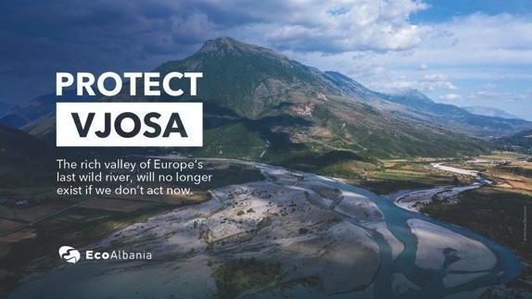
Notes:
Tepelena/Brataj Albania, Vienna, Radolfzell, June 3, 2021. From May 29 to June 6, a group of scientists from Austria, Albania, Italy and Germany, collected multidisciplinary data from the two major Vjosa tributaries Shushica and Bence. This research week is a follow-up of a comparable undertaking at the Vjosa in 2017 (HYPERLINK), which contributed substantially to our success in establishing the ecological value of the Vjosa, fending off the hydropower projects (HPP) and the designation as a protected area.

Slide 14
“The Bureau also reiterated its deep concern regarding the urbanisation plans for the Vjosë- Nartë Protected Area, including construction of an airport, and urged the government to rethink these plans. The natural values of this area are evident, and a strong protection regime needs to be implemented”.

Slide 15
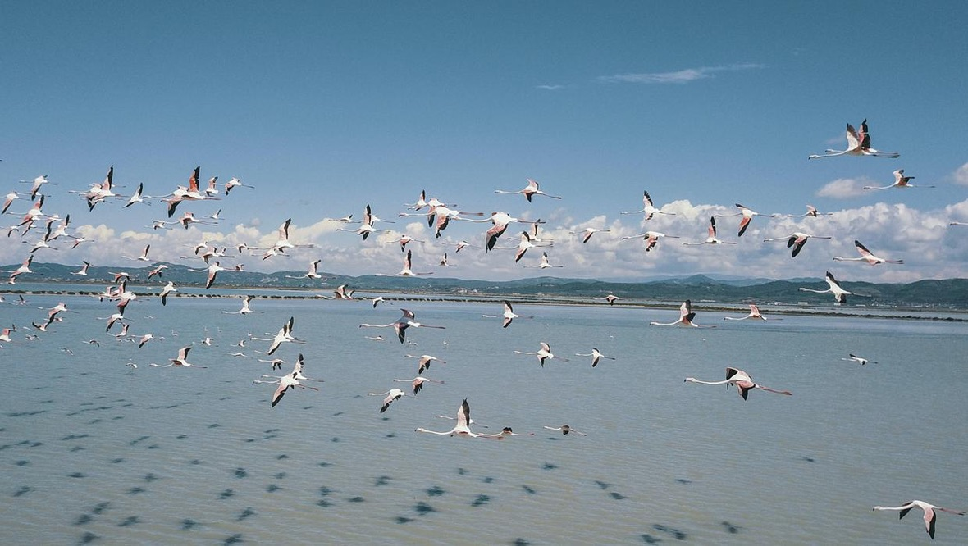
Keep the case-file Open
Ask the Albanian Government to Proclaim the Vjosa WRNP
Follow closely the Planning phase of the Vjosa WRNP
Initiate an on-the-spot-appraisal for the Vjosa Delta-Narta Lagoon PA

