Slide 1
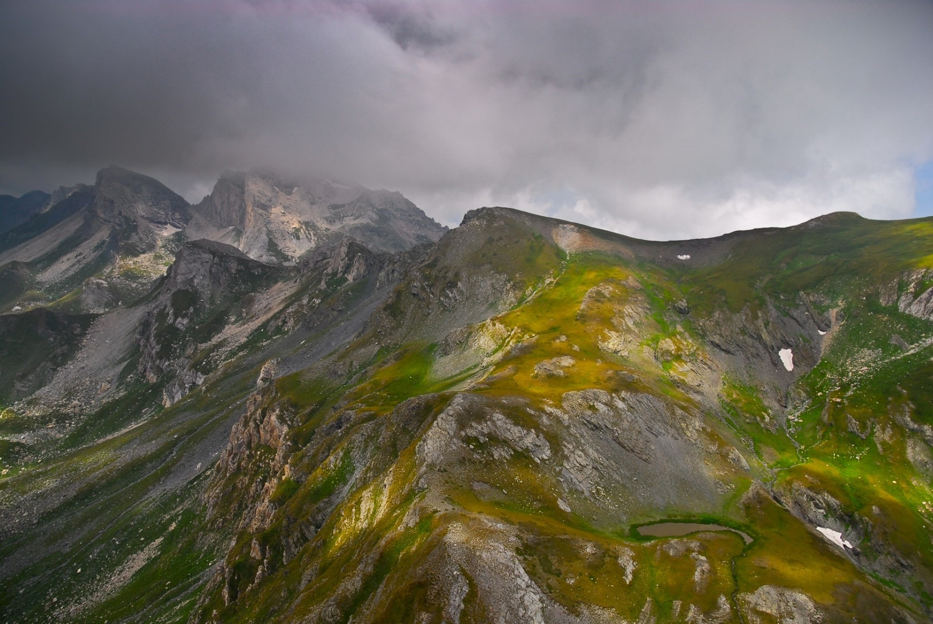
Mavrovo national park and planned hydropower projects on it’s territory
Аna Colovic Lesoska
Eko-svest
Bern Convention Standing Committee meeting,
29.11-.3.12.2021

Slide 2
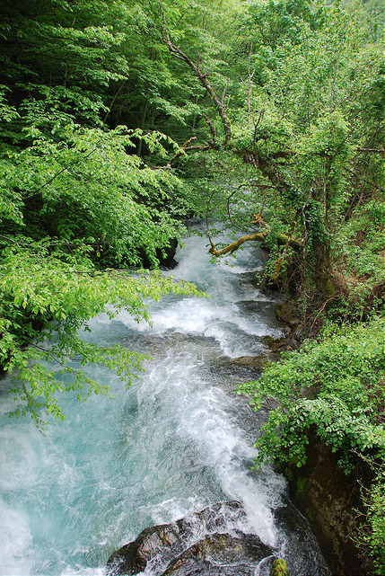
About the case
Complaint submitted in 2013
Case file opened in 2014
On the spot appraisal 2015
Recommendation 184 (35th Standing Committee meeting)
On the spot appraisal May 2021

Slide 3
Update on the case
There has been no progress regarding the development of an SEA study that would incorporate a cumulative impact assessment of planned infrastructure in the Park.
The two large hydropower projects have been removed from the Energy Strategy and are not considered.
Although new construction of small hydro power plants has not been registered, there are ongoing processes for development of large touristic zones and residential complexes. The cumulative impact assessment is more than needed and should be carried out in the upcoming process of re-proclamation of the protected area.

Slide 4
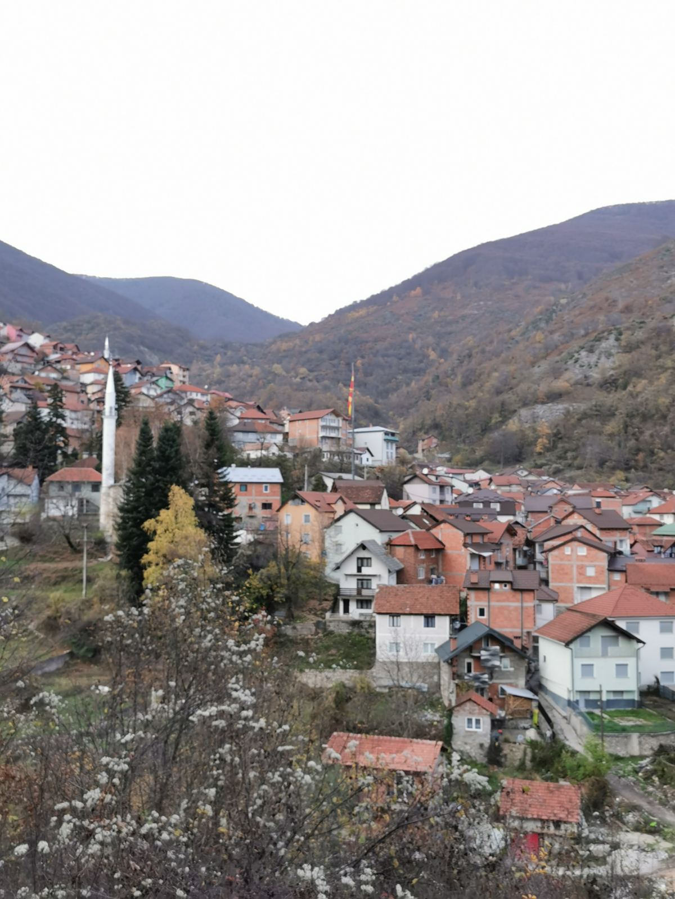
Update on the case
Even though the Government’s new 4 year programme sets a goal to abolish small hydro power plants in protected areas, already issued concessions are again being extended.
There is still local opposition from the Mavrovo communities to the construction of hydropower.

Slide 5
Proposal to the Standing Committee
The on the spot appraisal resulted in a report with excellent recommendations.
The new recommendations are proposed as a replacement of Recommendation 184 adopted in 2015.
However, the new set of recommendations do not mention the needed cumulative impact assessment and the strategic impact assessment of all planned projects in Mavrovo NP as in the 2015 recommendation. They do not refer to in any way to the recommendation towards the international financial institutions, one of the key points in the Recommendation 184.

Slide 6
Proposal to the Standing Committee
We ask the Standing Committee to adopt all proposed recommendations with a minor change to the text on page 2, instead of:
Agreeing that the current Recommendation supersedes and replaces Recommendation No. 184 (2015) The text should read:
Agreeing that the current Recommendation complements Recommendation No. 184 (2015).

Slide 7
Thank you for your attention

