Slide 1
Update on Case 2016/5: Presumed negative impact of hydro-power plant development on the Vjosa river
39th Standing Committee of the Bern Convention
Strasbourg, 3-6 December 2019
Olsi Nika / EcoAlbania 2019
o.nika@ecoalbania.org

Slide 2
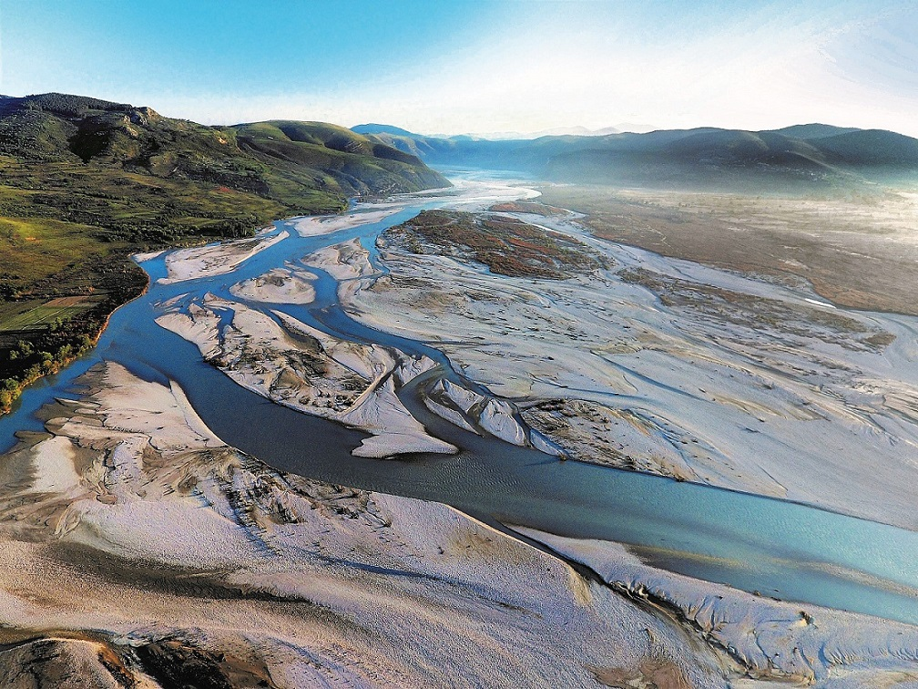

Slide 3
39th Standing Committee of the Bern Convention
Strasbourg, 3-6 December 2019
Content
Efforts taken by the Complainant
Efforts taken by the Albanian Authorities
The Albanian EPAN Revision Process - the main focus on the Emerald Candidate Site “Vjosa-Narta”

Slide 4
Complaint to Energy Community Treaty
Complaint to the construction of 2 HPPs in Kalivaç and Poçem
Substantial breaches in the Environment Impact Assessment, feasibility study and public consultation procedures

Slide 5
Following the procedures taken by the company on the Kalivaç HPP
An almost fake meeting without providing with any relevant information
No sign of public authorities (MIE and MTE)
Unanimity amongst all the NGO community in Albania
Tirana, April 8th, 2019

Slide 6
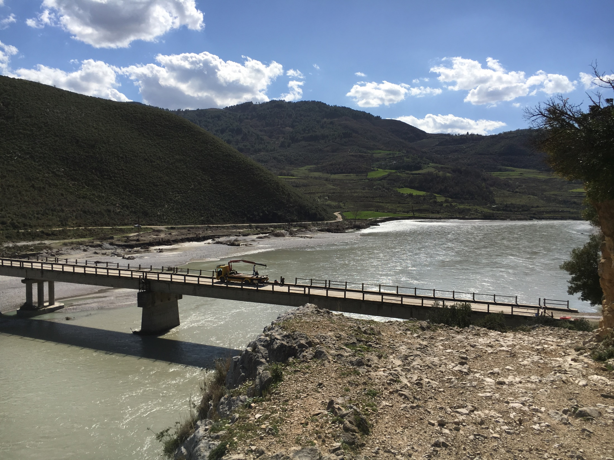
Measuring of sediment transport and morphodynamics at the Vjosa river / Albania
Research project:
April 2017 – March 2019

Slide 7
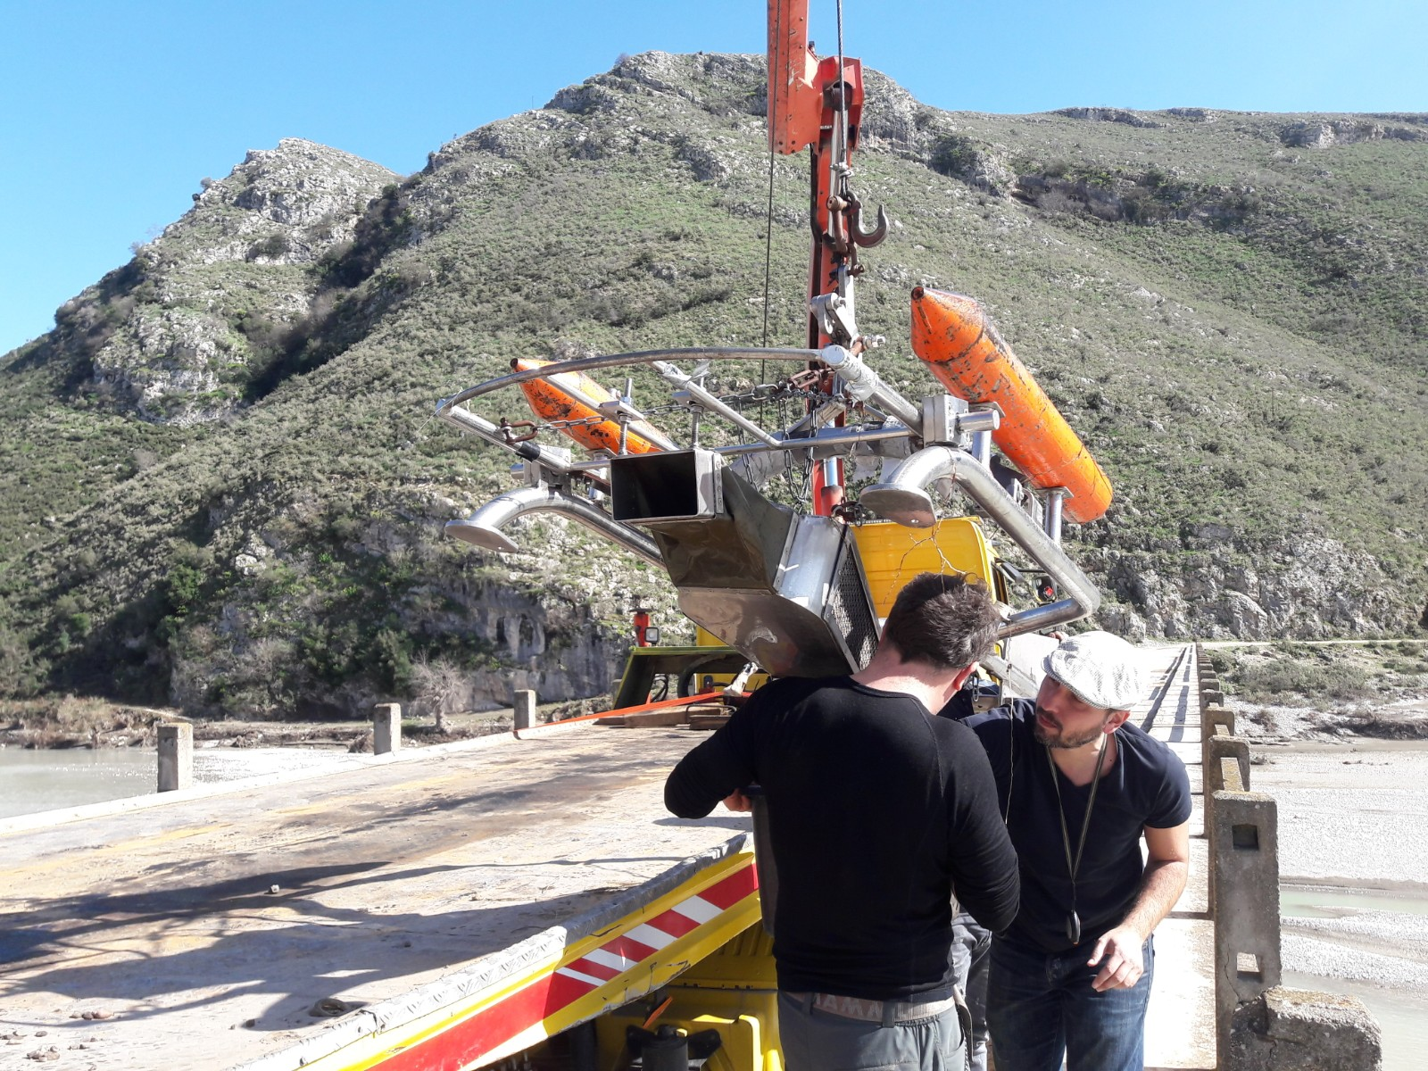

Slide 8
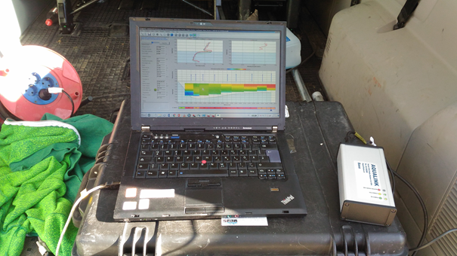
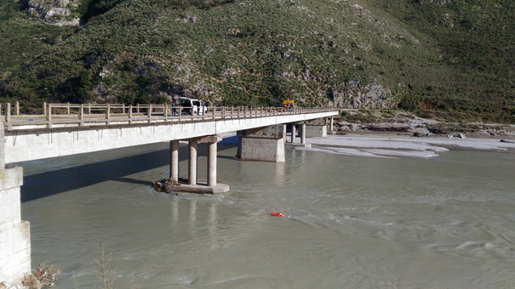

Slide 9
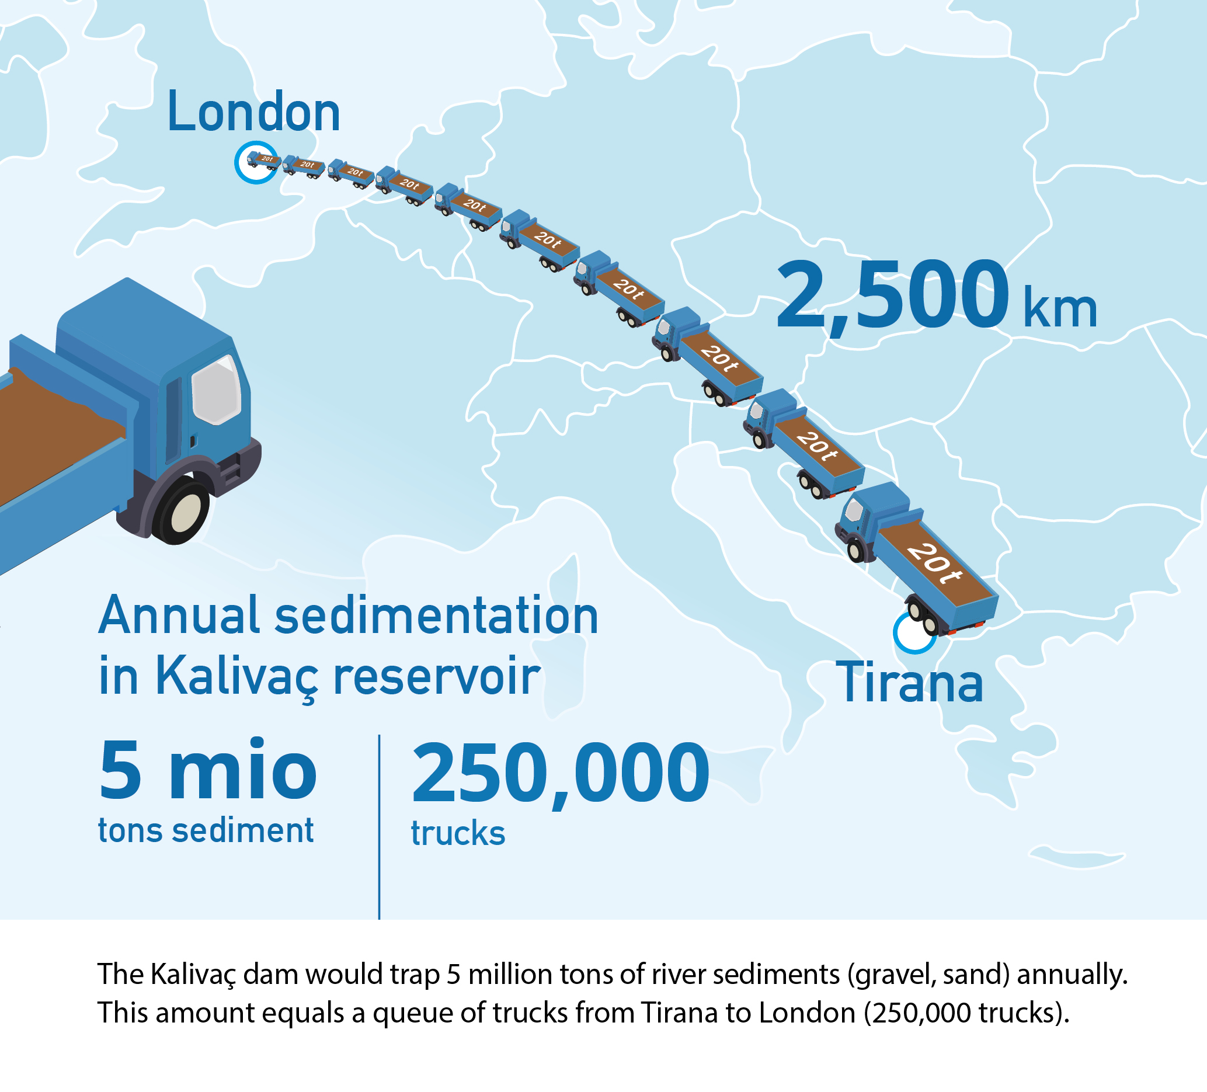

Slide 12
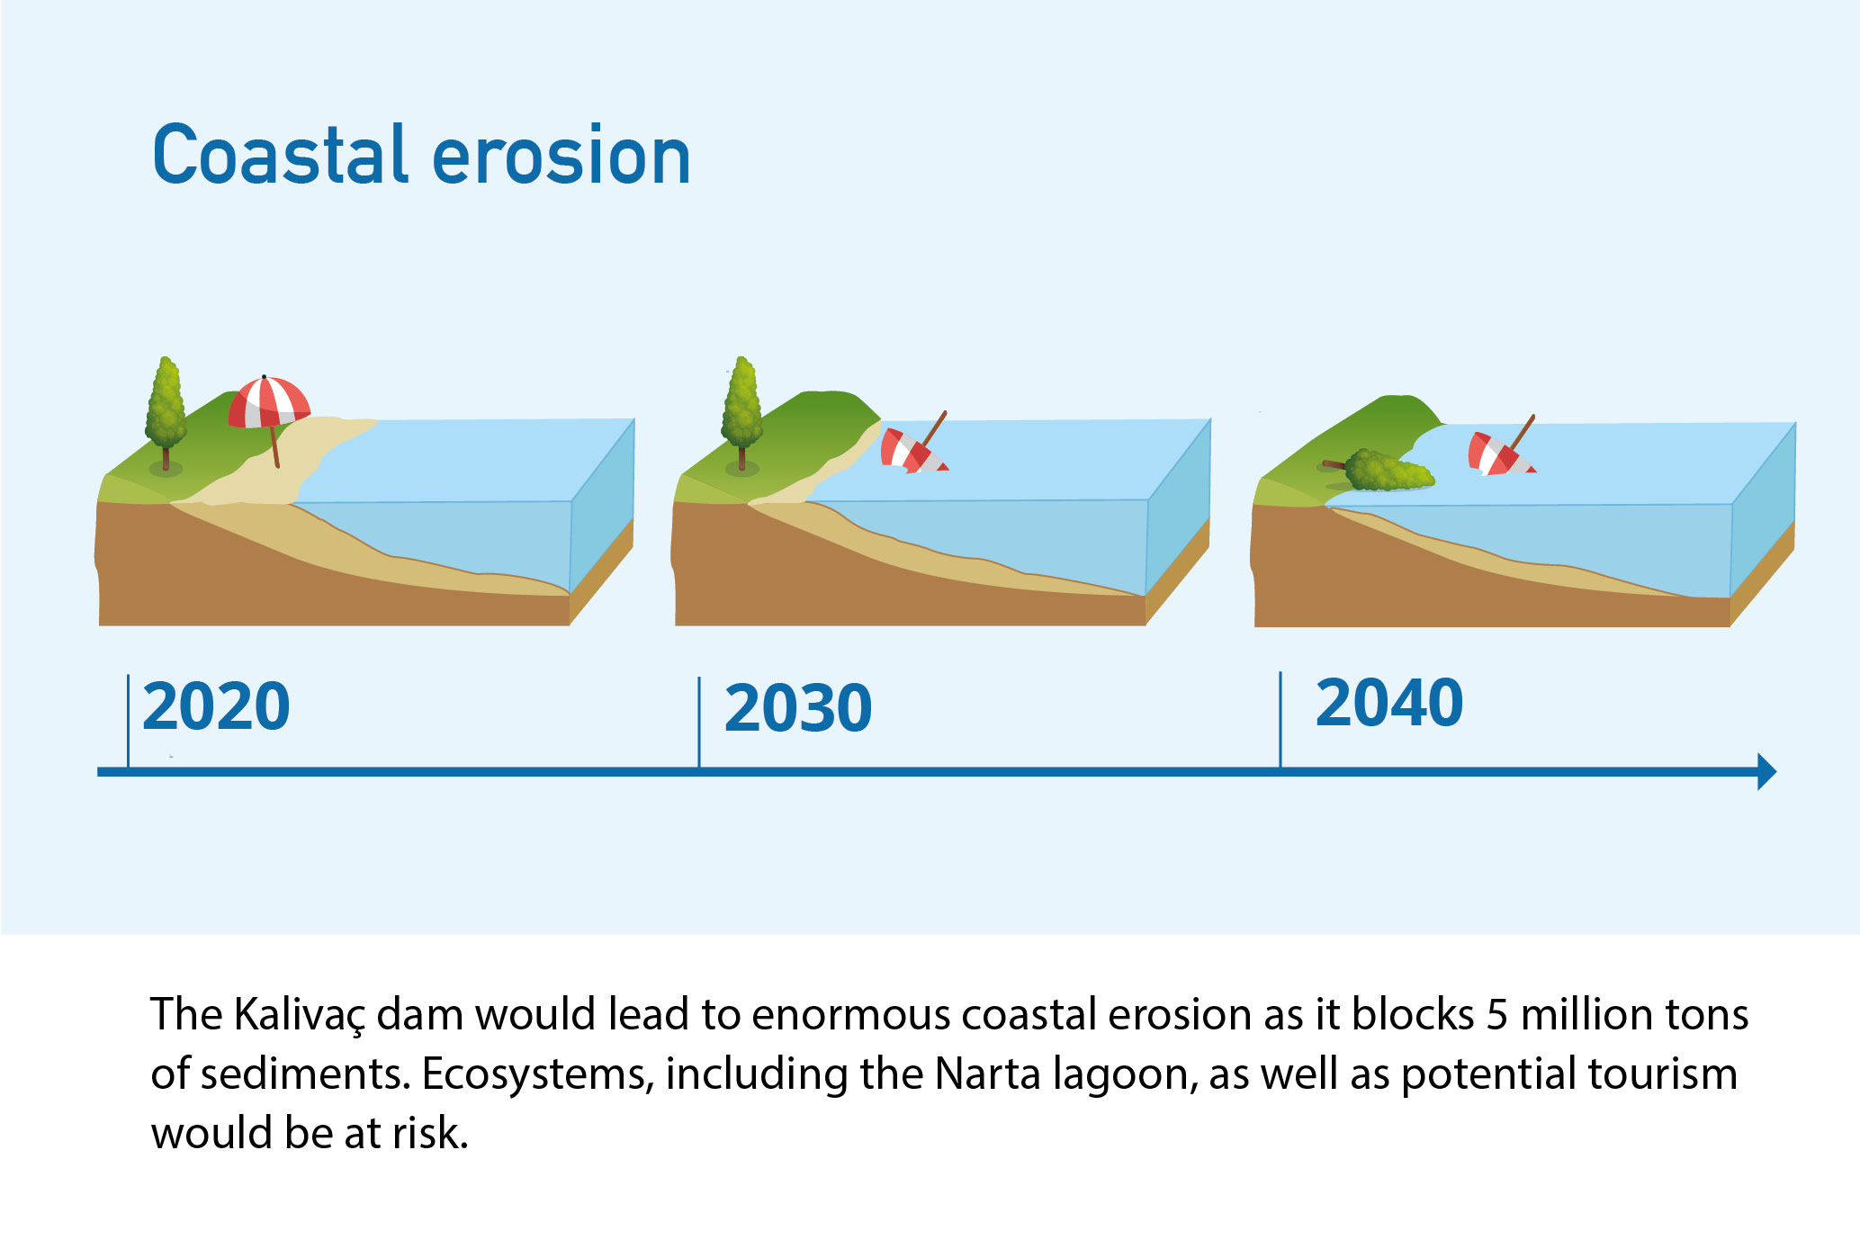

Slide 13
Eco Masterplan
Over a total river network of 80,523 km, 61,033 km (76%) of rivers meet our criteria for establishing No-go river stretches for hydropower
2,497 of a total of 2,790 (89%) hydropower plants are projected to be built within No-go river stretches.
91% of all projects are small hydropower plants with a capacity < 10MW and 59% are even below 1MW
The independent energy assessment has shown that projected hydropower expansion can be substituted by other renewable energy sources

Slide 15
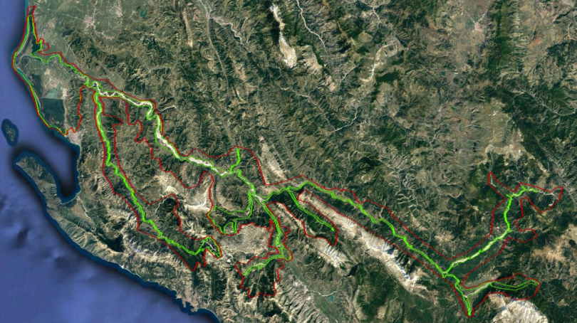

Slide 17
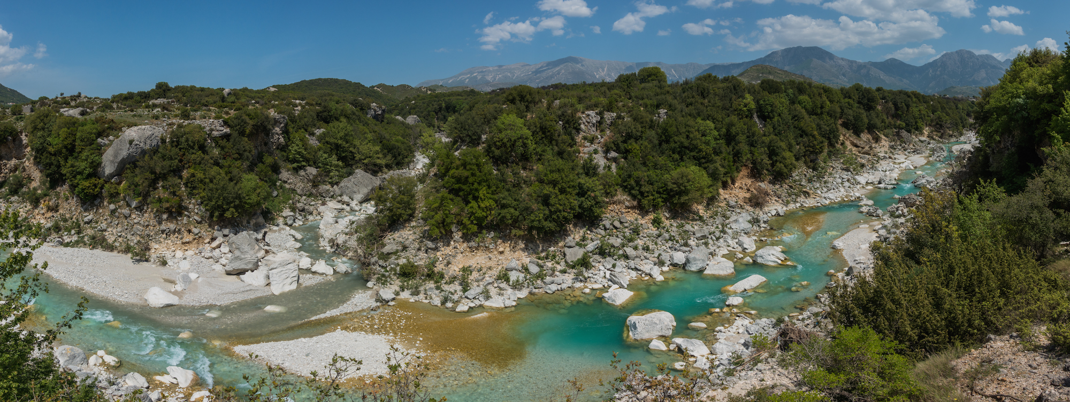

Slide 18
Around 150 NGOs call on Prime Minister Edi Rama to immediately suspend all ongoing hydropower developments in the Vjosa catchment until a Strategic Environmental Impact Assessment and an integrated River Basin Management plan, which takes into account social aspects, particularly the potential of ecotourism, has been elaborated

Slide 19
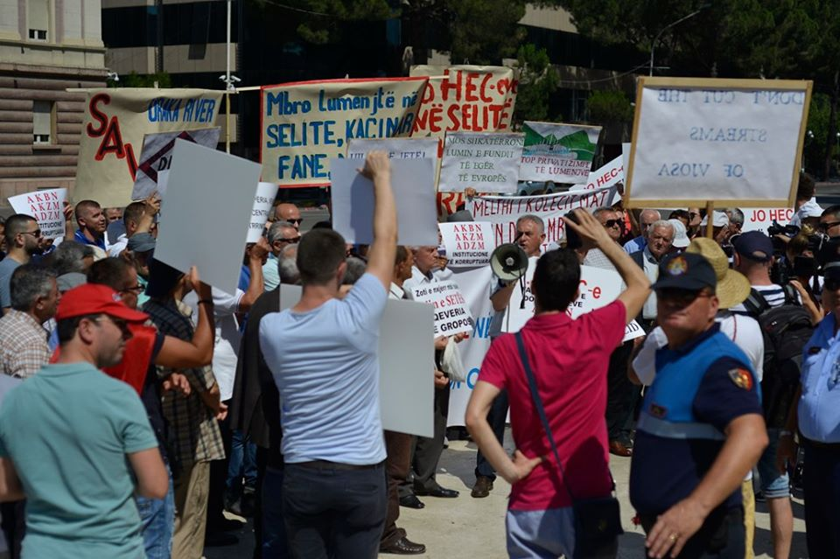

Slide 20
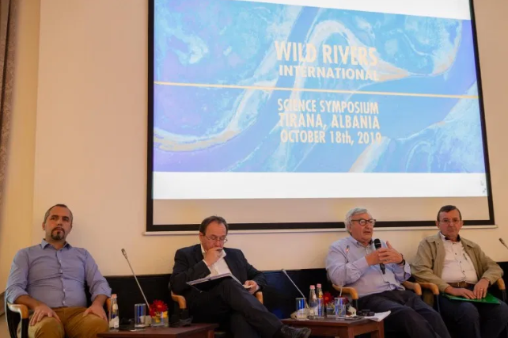

Slide 21
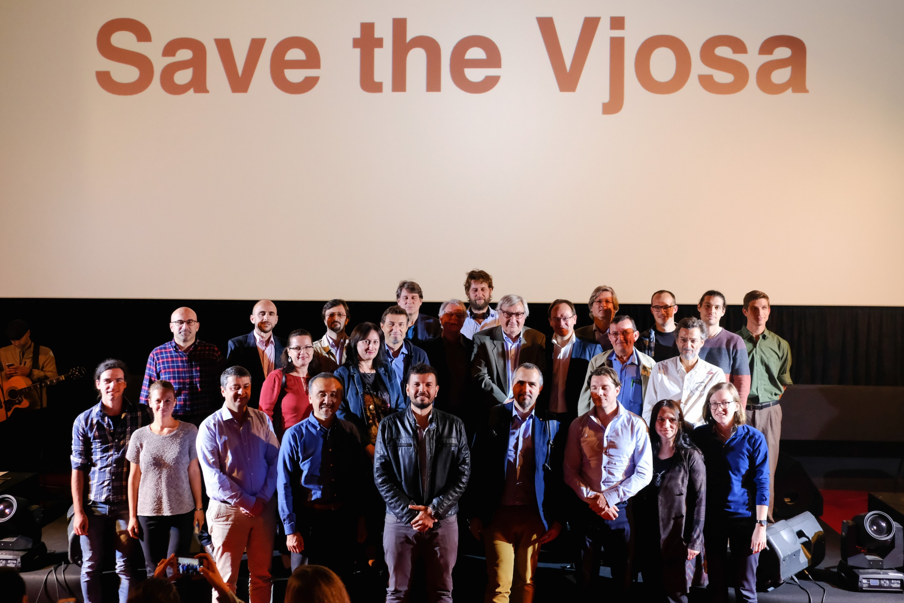

Slide 22
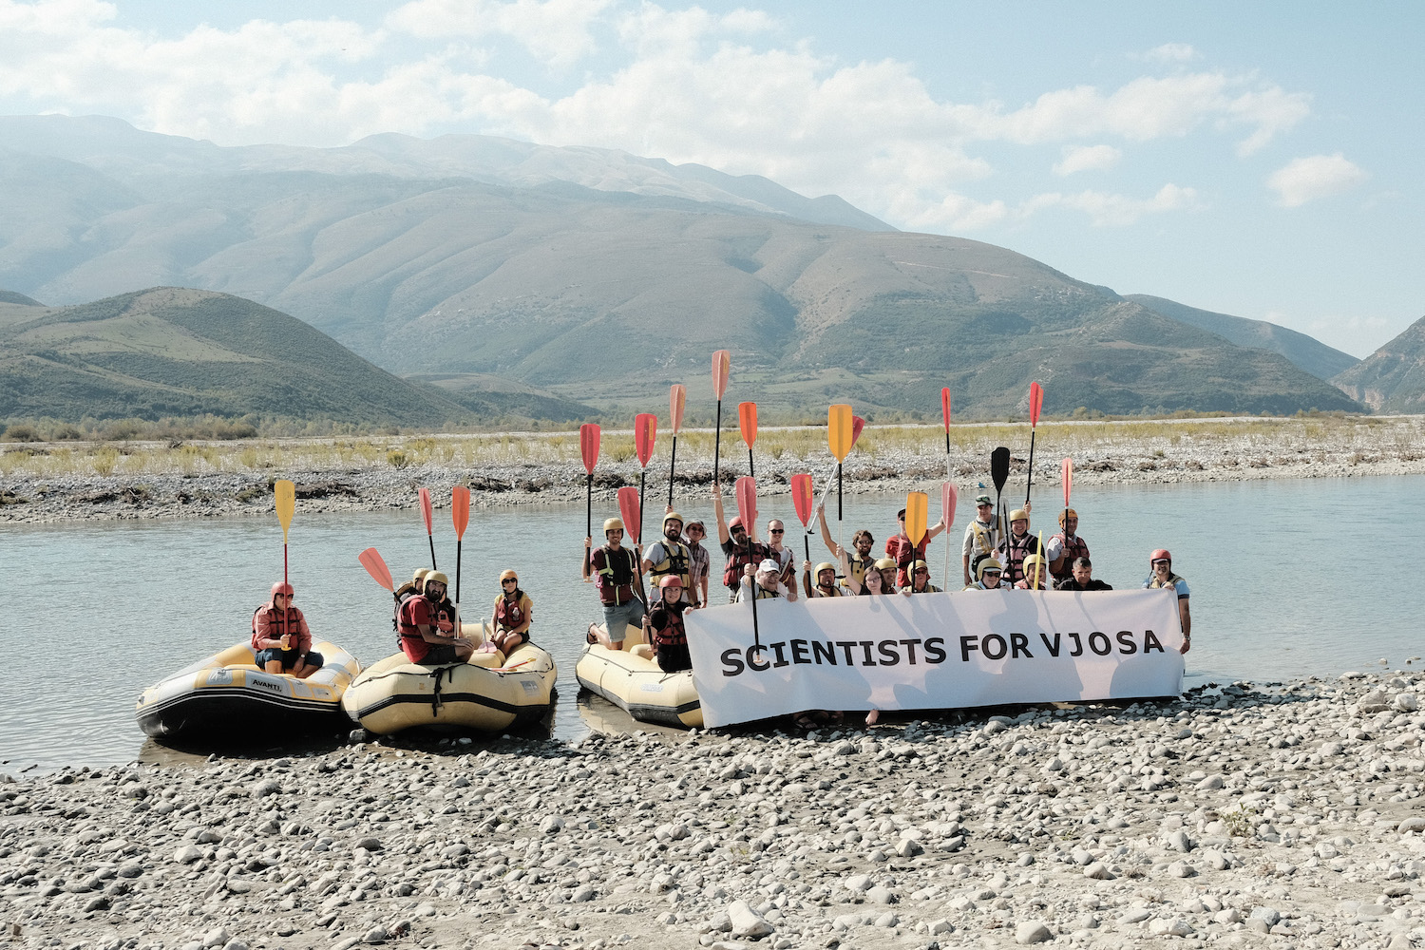

Slide 23
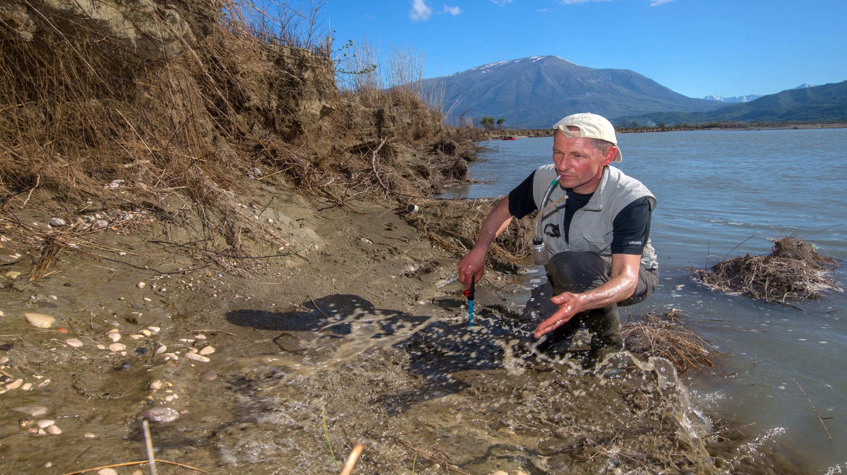

Slide 25
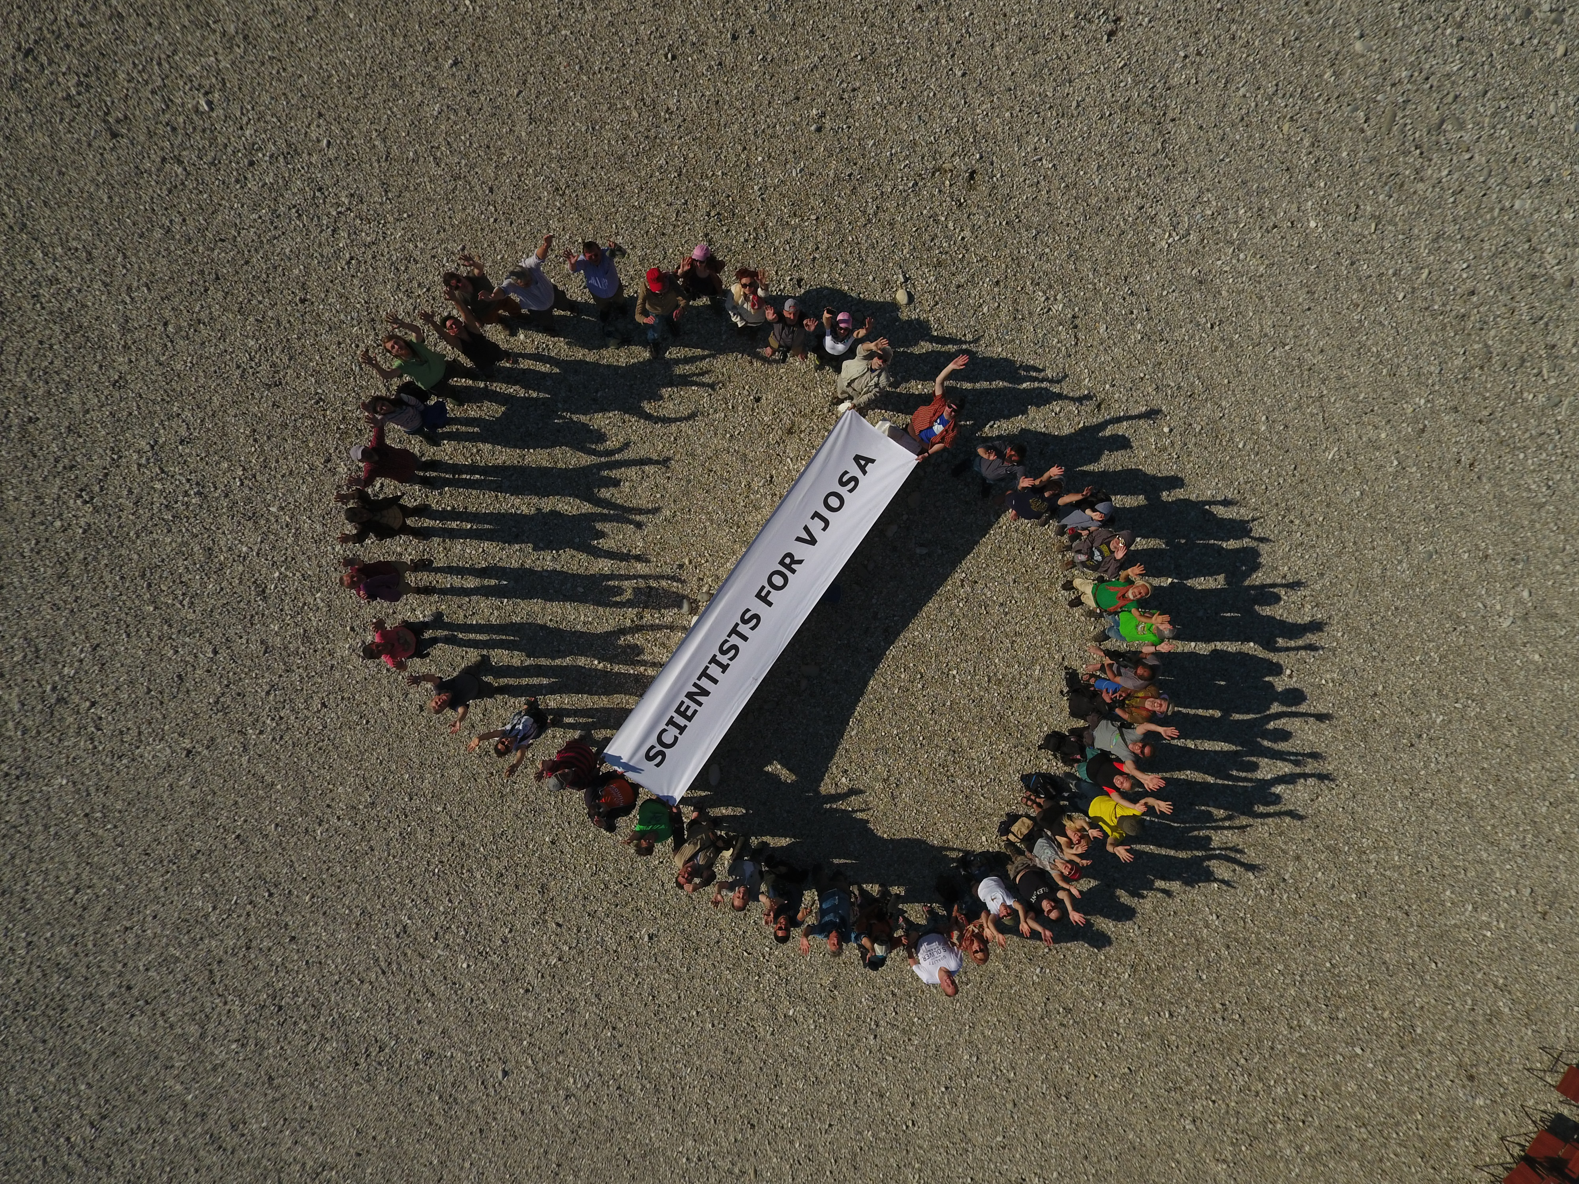

Slide 26
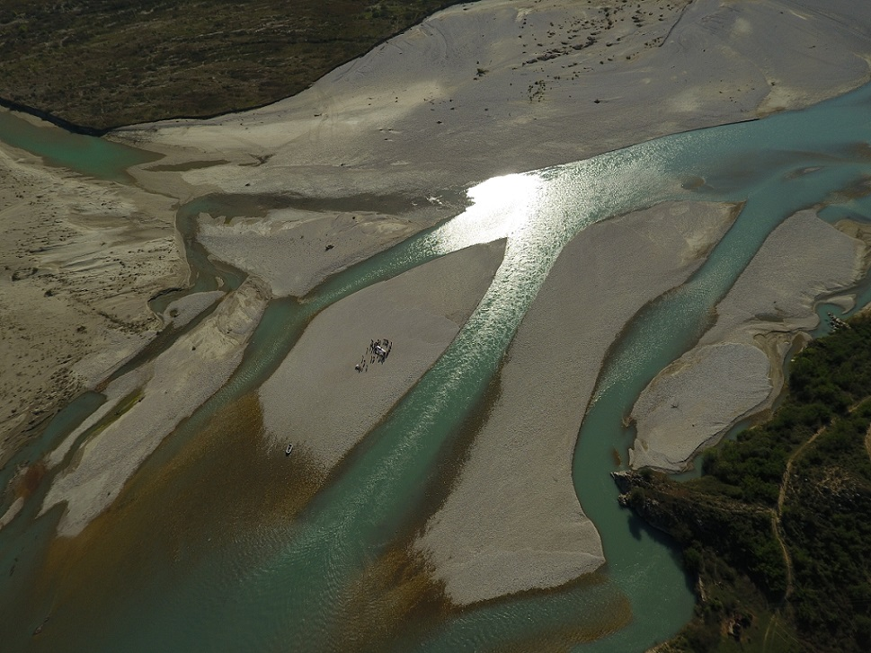

Slide 27
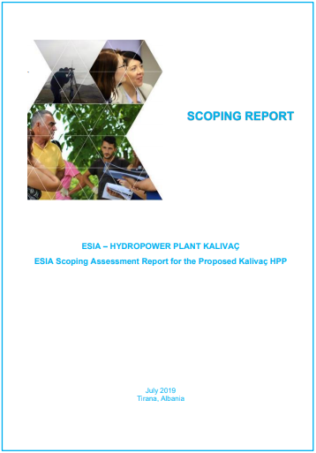
Abkons presents the ESIA for Kalivaç HPP
No proper notification for the people
The language used very technical
No relevant information shared
No relevant audience
Again no sign of public authorities

Slide 28
The revision of EPAN in Albania - Overview
The exclusion of several PAs of EPAN in Albania
The reduction of several actual PAs of EPAN in Albania
The proposals for proclamation of new PAs in Albania

Slide 29
The revision of EPAN in Albania – The coastal PAs
The reduction of the coastal PAs within the range of 15-30 %
The exclusion of the buffer zones
The risk for a bigger pressure on the core zones
The Possible increase of the Albanian EPAN in total

Slide 30
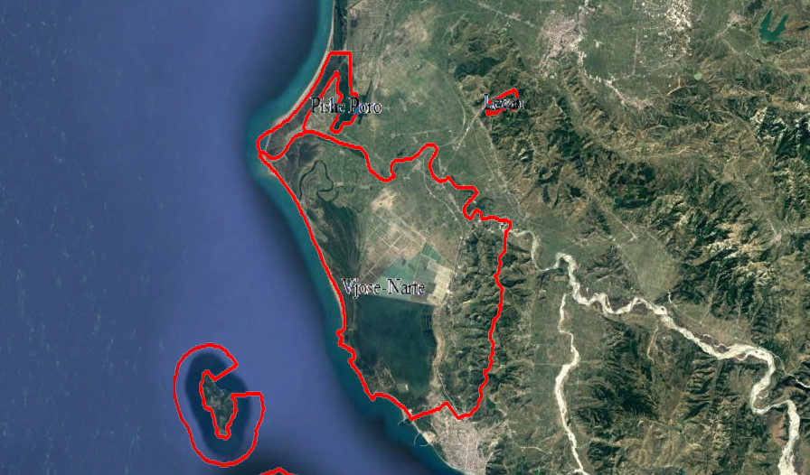
The revision of EPAN in Albania
The Vjosa-Narta PA

Slide 31
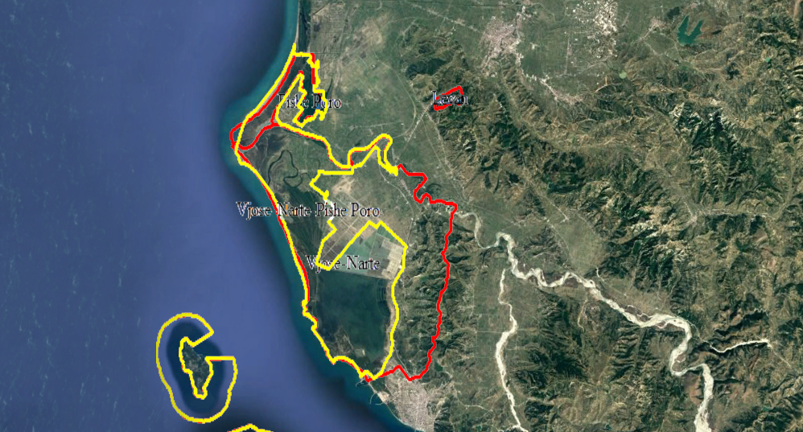
The revision of EPAN in Albania
The Vjosa-Narta PA

Slide 32
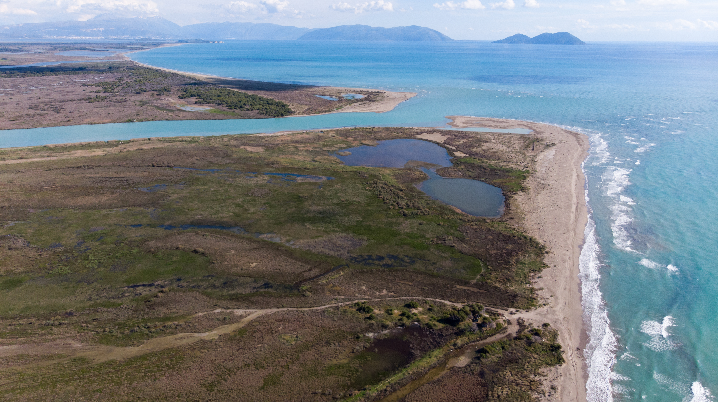

Slide 33
The revision of EPAN in Albania
NGOs position
The process is considered not transparent and pre-determined
The process has not included the stakeholders
The process is not based on studies
The NGOs have raised their concerns

Slide 34
What we ask from the Convention
To keep the Vjosa case file open
To urge the Albanian Government for taking concrete steps on fulfilling the Recommendations of the Decision 202/2018c
To call on Albanian Government to withdraw from the decision to shrink the EPAN without being based in scientific data
To call on Albanian Government to abandon the development project along the Vjosa valley including the Candidate Emerald site “Vjosa-Narta”

Slide 35
Eco Masterplan
To asses the Natural values of the Balkan Rivers
To consider environmental implications and to avoid biodiversity loss
To consider social conflicts
To increase investor security and reduce risk of breaching the law

Slide 37
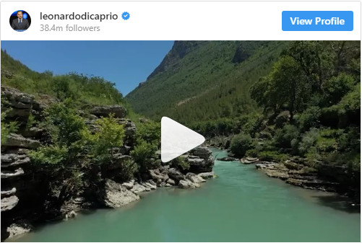
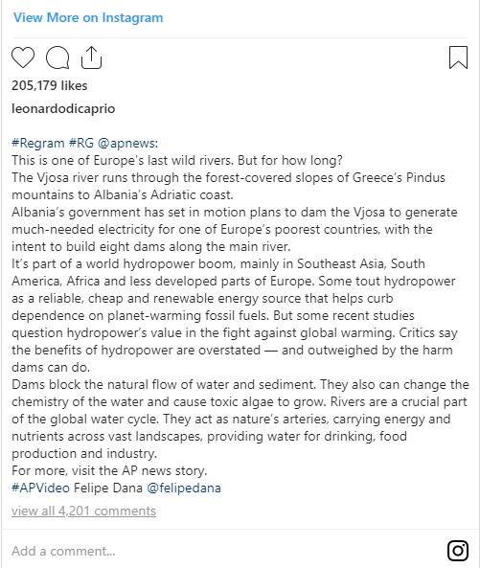

Slide 38
I’m Watching You

