Slide 1


Slide 1/29
Agenda Item 6.1: Files opened
Turkey: Degradation of nesting beaches in Fethiye & Patara Specially Protected Areas
39th Meeting of the Standing Committee
of the Bern Convention
3-6 December 2019

Slide 2
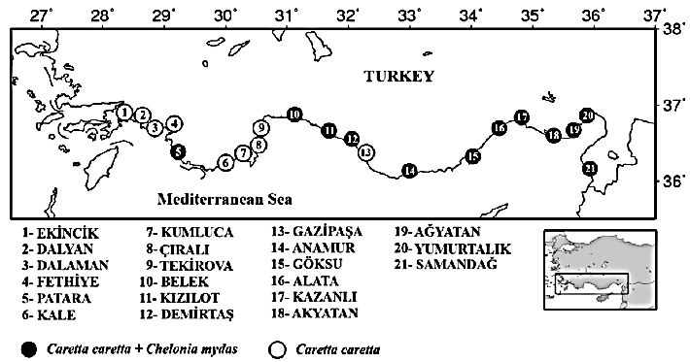
Slide 2/29
Fethiye & Patara are among most important
sea turtle nesting beaches in Turkey
4

Slide 3
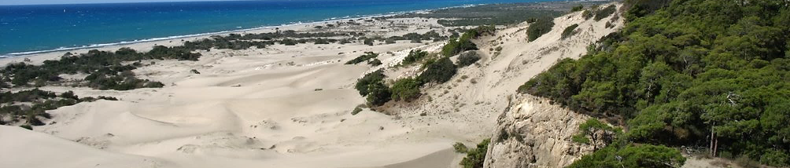
Slide 3/29
Recommendation No. 182 (2015)
Measure No. 1: Urgently ensure that Patara nesting beach receives appropriate legal protection & management →No improvement
Measure No. 2: Define fines for non-compliance to strict regulations defined in Measure No. 2 → No Action
Measure No. 3: Ensure adequate financial & human resources for control, management & enforcement of regulations
→ No management personnel observed on site during visit, to enforce regulations. Measures not enforced
Measure No. 8. Set up long-term conservation & research programme with permanent team & adequate manpower for entire beach & season → One-season contract, inadequate manpower
Photo: Panoramio.com User: 1409857

Slide 4
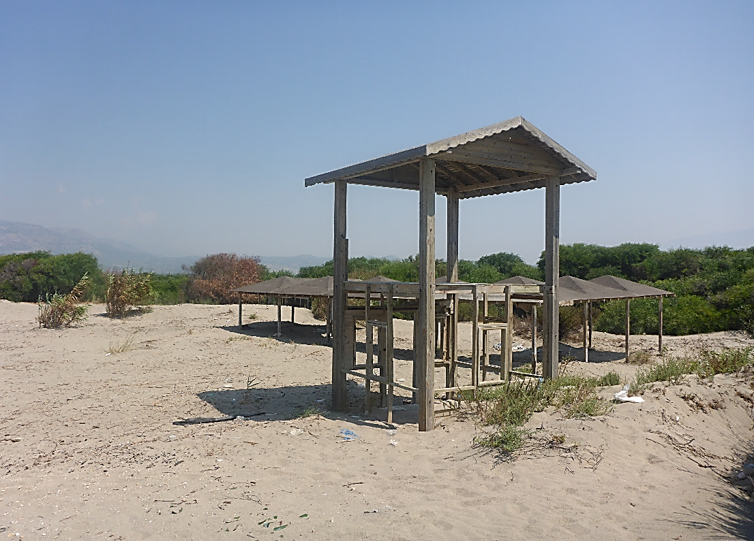
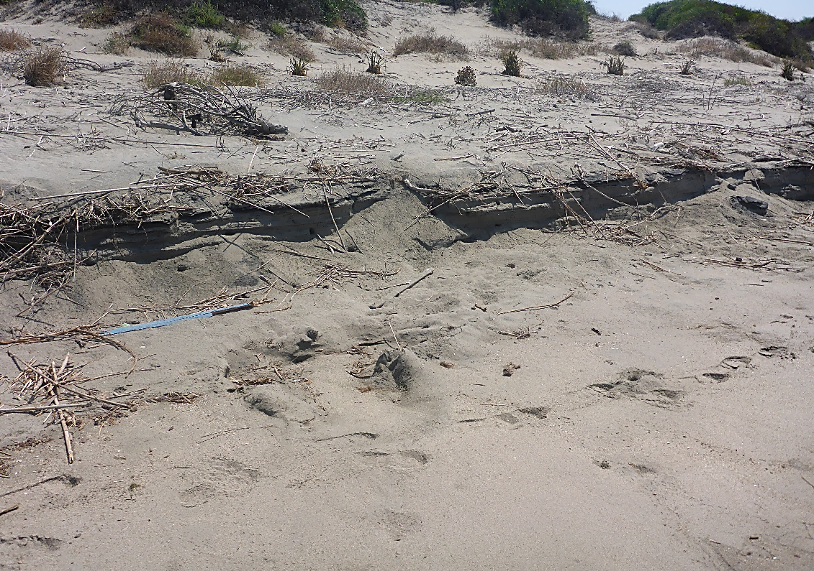

Patara Rec. NO.182.2(i): Prohibit development on beach, remove abandoned illegal facilities & restore dunes
Slide 4/29
Patara SPA. Letoon beach. SPA facilities have been abandoned and have not been removed from the dunes
Letoon beach. An old fence line with posts and old wire between dunes and beach

Slide 5
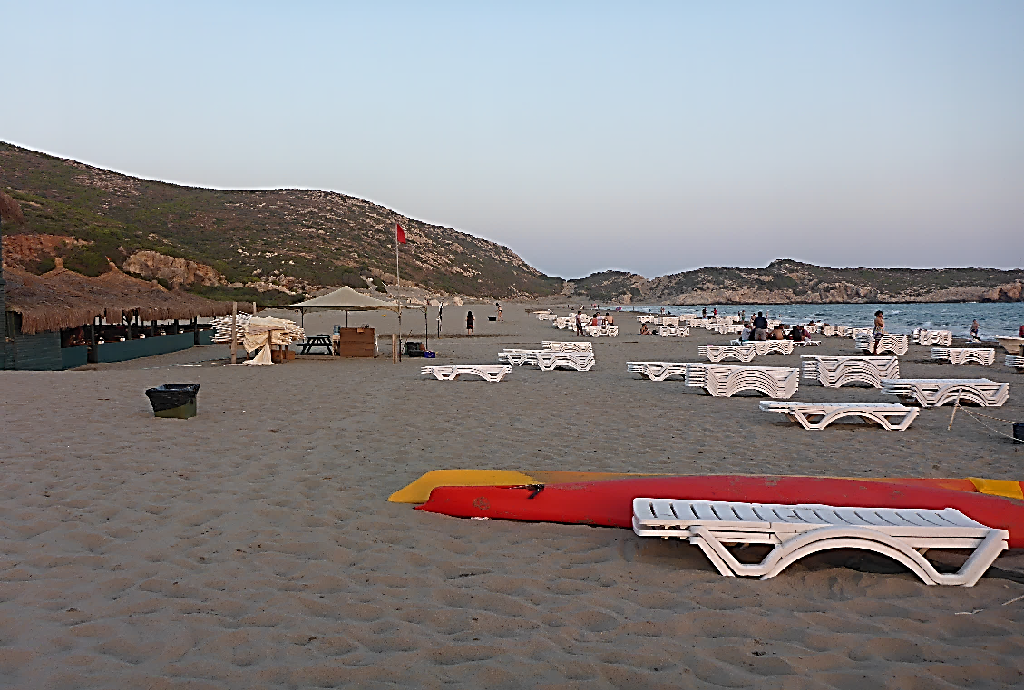
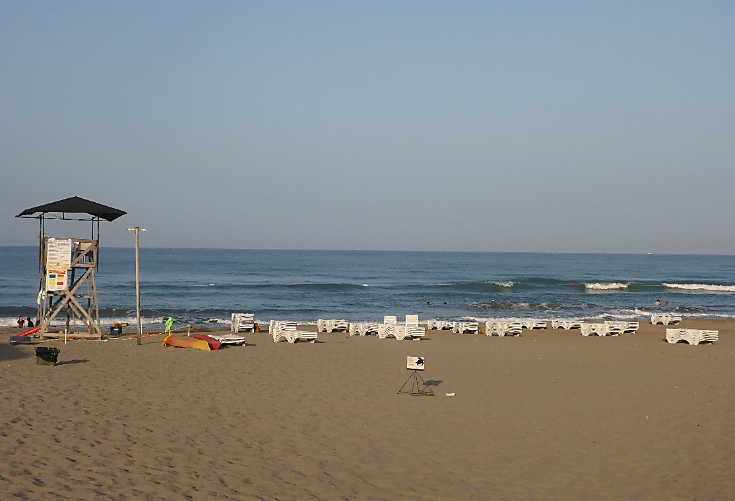
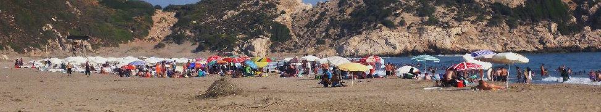
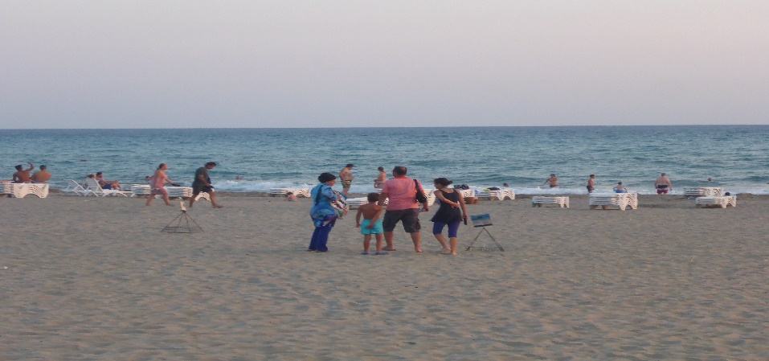
Patara Rec. NO.182.2(ii): Regulate extent & use of beach furniture, ensure removal from nesting zone at night
Slide 5/29
No zoning in 90% of Patara SPA nesting beach
nest
Stacked sunbeds in the evening (left) and morning (right), although too close to the waterline. Note kayaks (left) that remain on the beach at night
Patara SPA. Patara main beach. View of beach furniture area
Visitors on the beach after permitted time (8pm)

Slide 6
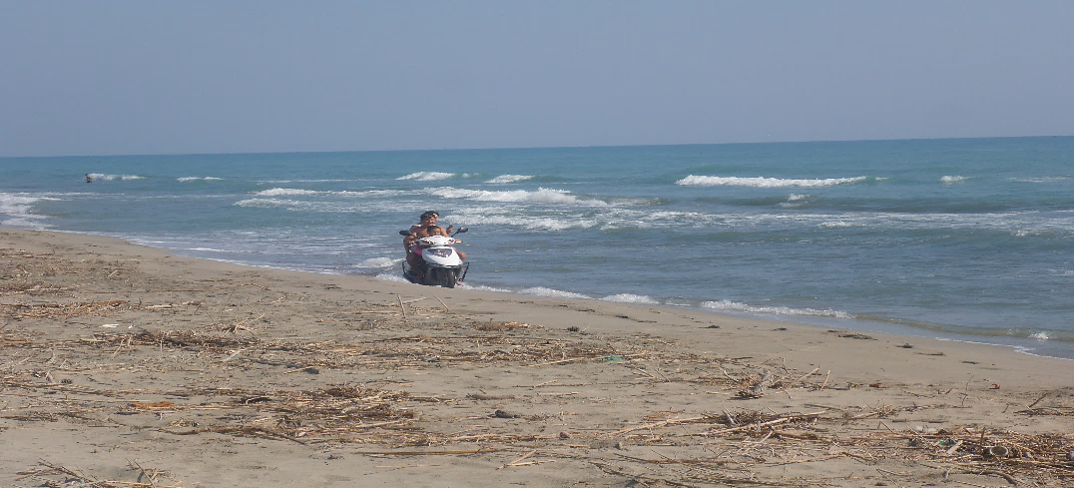
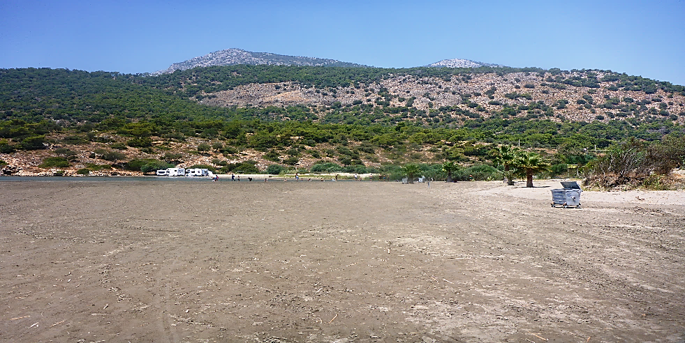
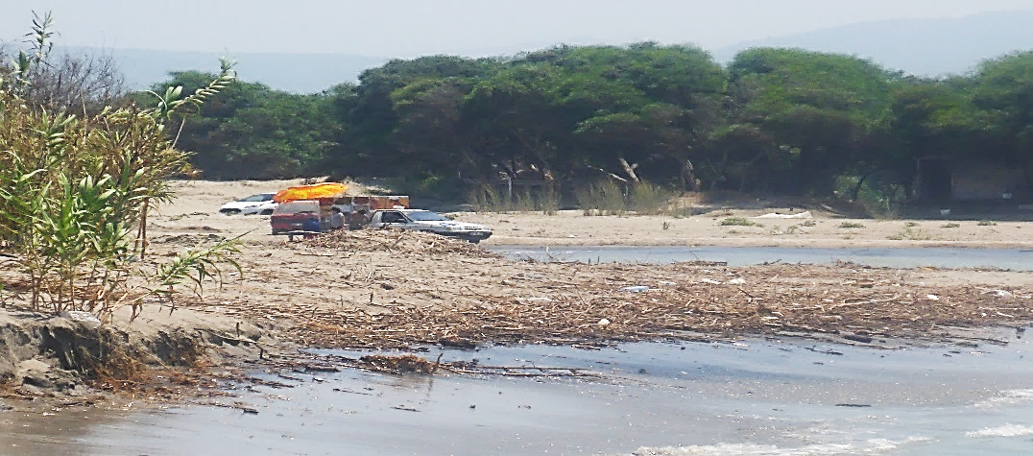
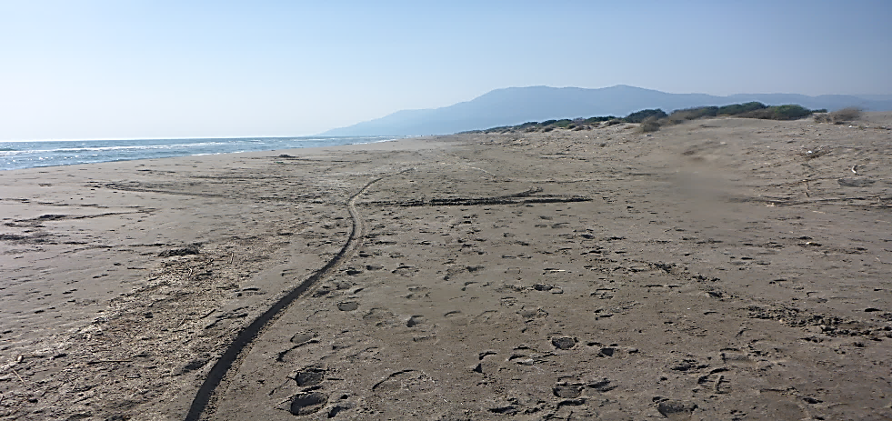
Patara Rec. NO.182.2(III): Prohibit access of vehicles by placing barriers at beach entrances
Slide 6/29
Uncontrolled vehicle access. No guards, no barriers.
Quads, motorbikes, tractors and 4x4 vehicles on entire nesting beach.
Vehicle tracks and beach flattening on Ozden beach.
Vehicle tracks and beach flattening on Ozden beach - note caravans at the end of the beach
Vehicles around Esen river mouth.
Vehicle track on Patara Beach.

Slide 7
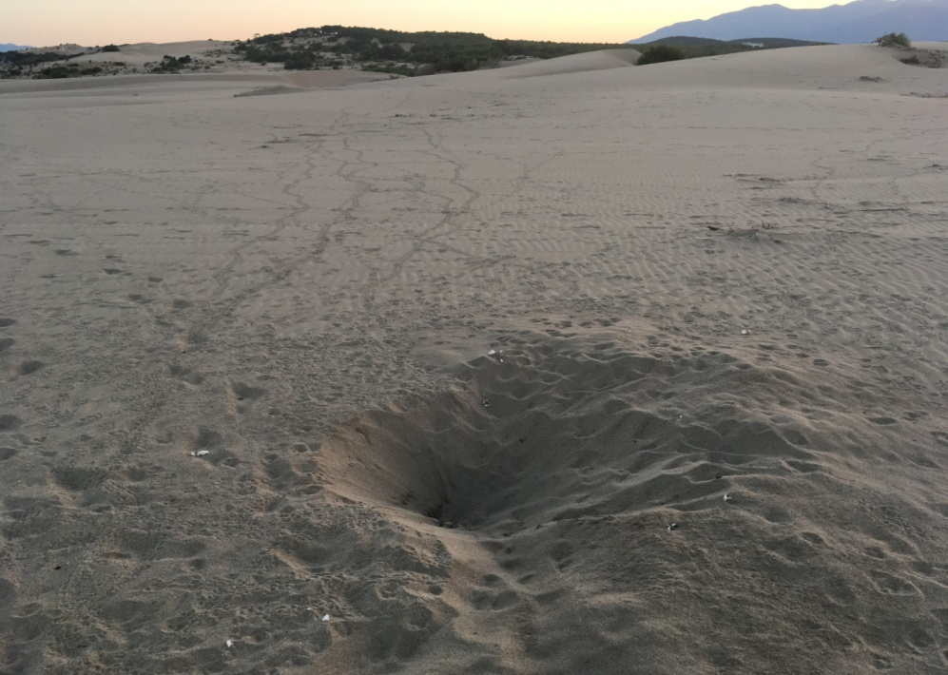
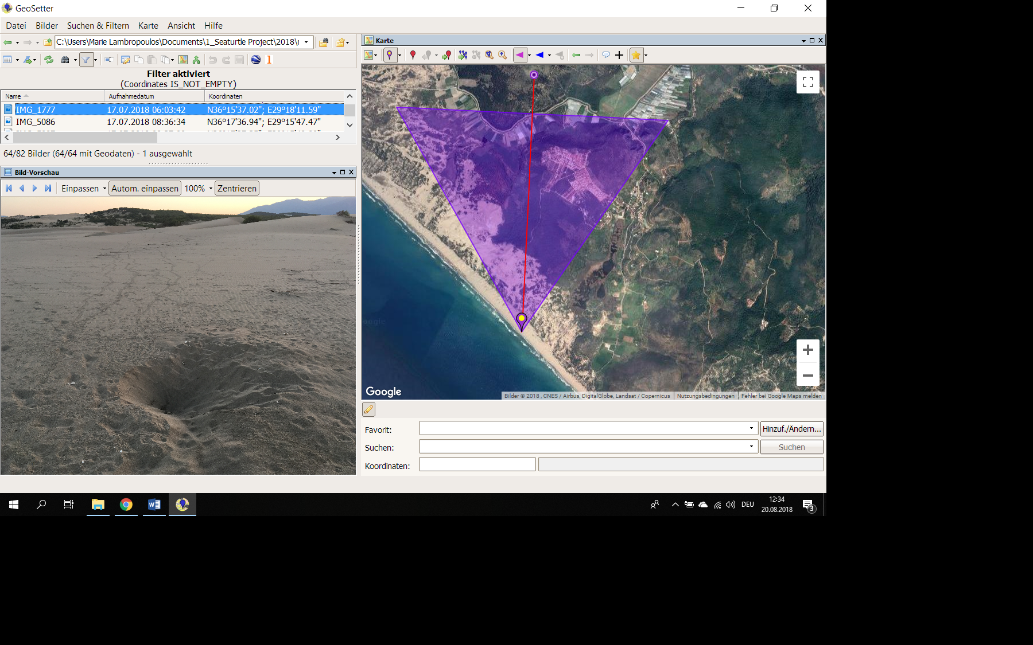
Patara Rec. NO. 182.2(IV): Prohibit illumination of THE beach
Slide 7/29
Summer house village
Hatchling tracks
Nest
The sea
On Patara main beach, one street lamp in the parking area was visible from top of the nesting beach
Once the summer house village construction is completed, light pollution will increase unless specific measures are taken

Slide 8
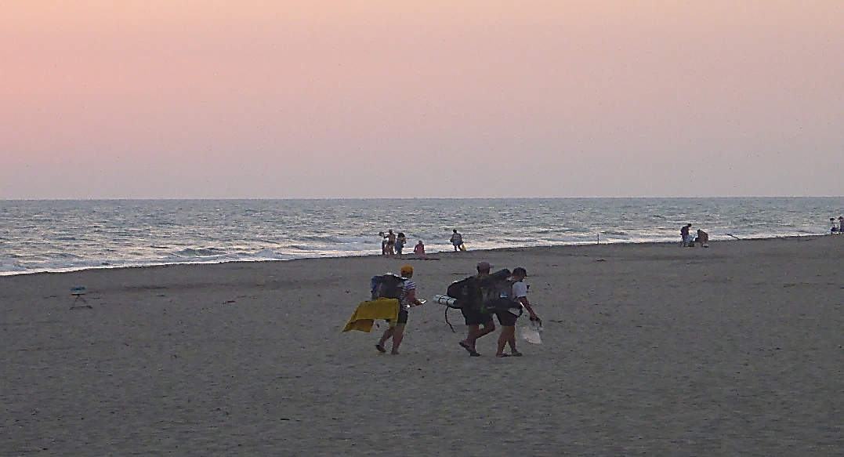
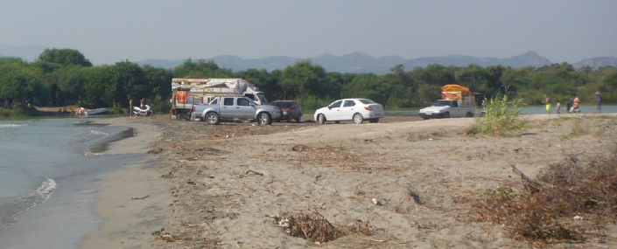
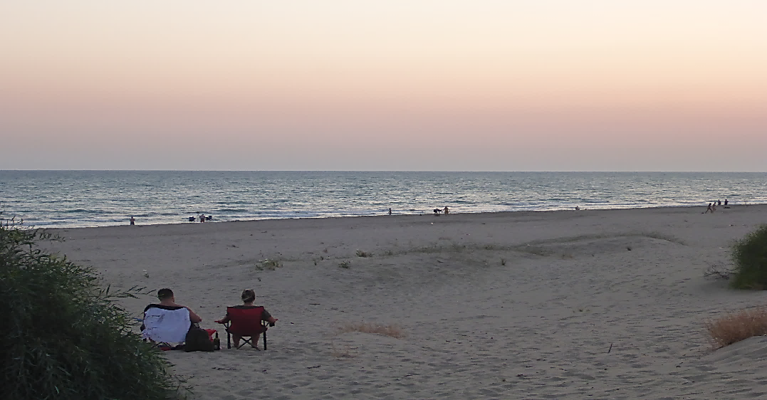
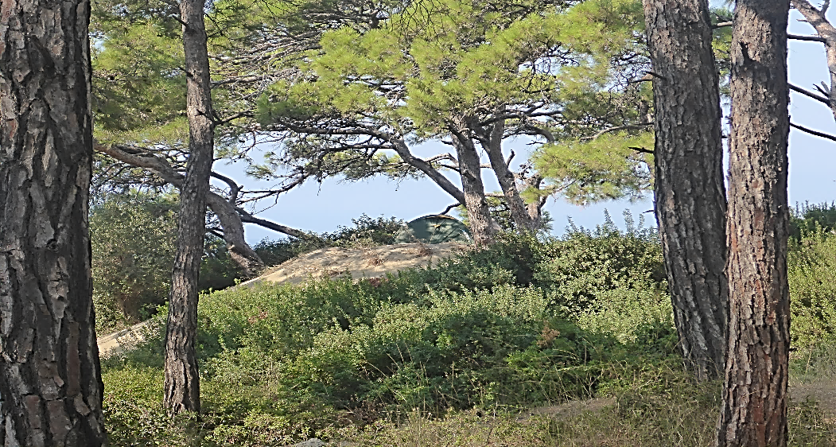
Patara Rec. NO. 182.2(vi): Prohibit camping on THE beach & riversides in view of THE beach
Slide 8/29
People with camping gear heading towards the dunes after spending the night camping
Vehicle access and preparation for evening barbecue and camping
Sunset picnics and human presence on the beach after permitted hours
Camping at the top of the dunes

Slide 9
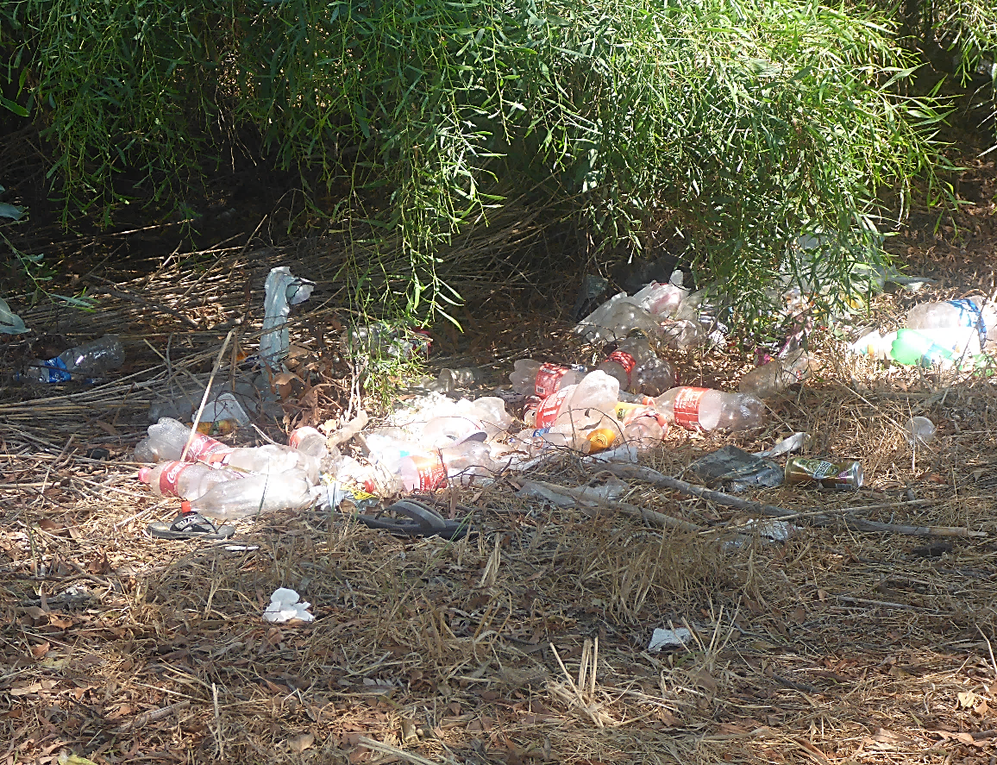
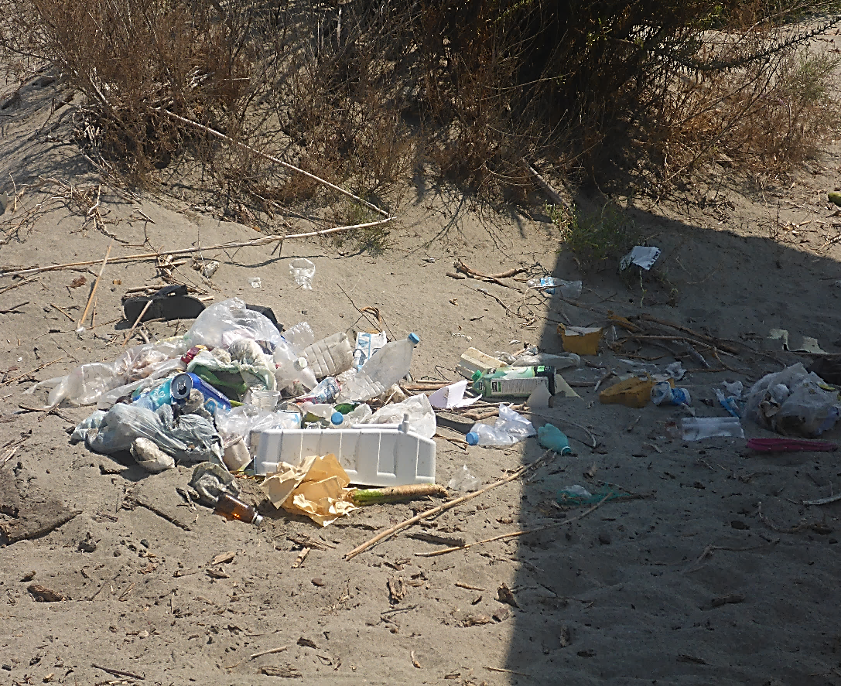
Patara Rec. 182 No. 5: Ensure litter is periodically removed from THE beach & dunes
Slide 9/29
Letoon beach: Litter spread on the beach and dunes due to a lack of waste disposal bins and collection

Slide 10
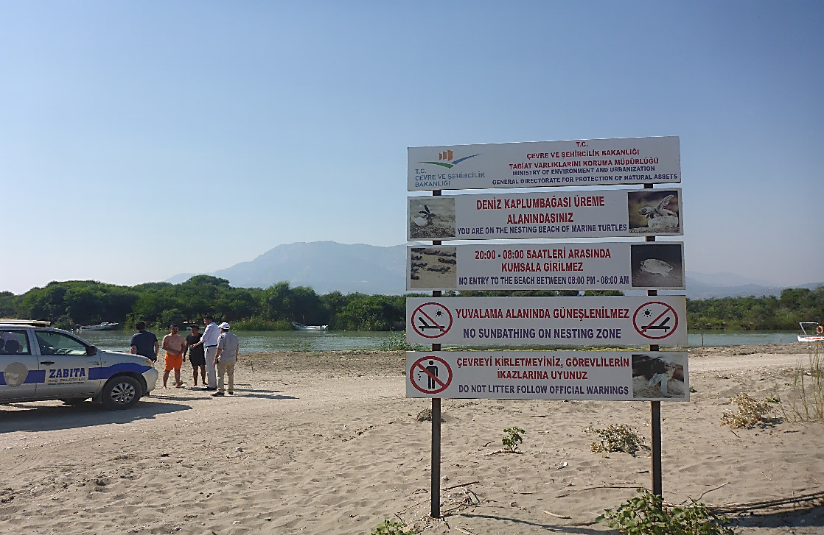
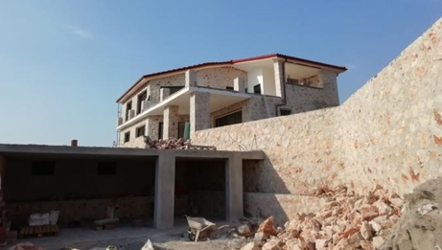
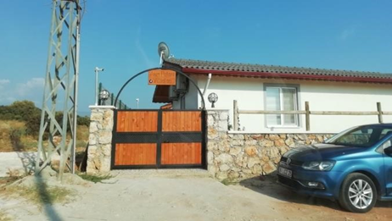
Patara Rec. 182
Slide 10/29
Measure 9: Tourists: Improve information to & awareness → Improvements occurred by installing new signs, but more needs to be done
Measure 10: Local community: Improve information to & education, involve in conservation & management → We do not have sufficient information to report on this measure, but several human activities observed, such as construction, have a negative impact
Patara SPA: New sign in the foreground
Construction of 20 additional summer houses that do not seem to have permission

Slide 11
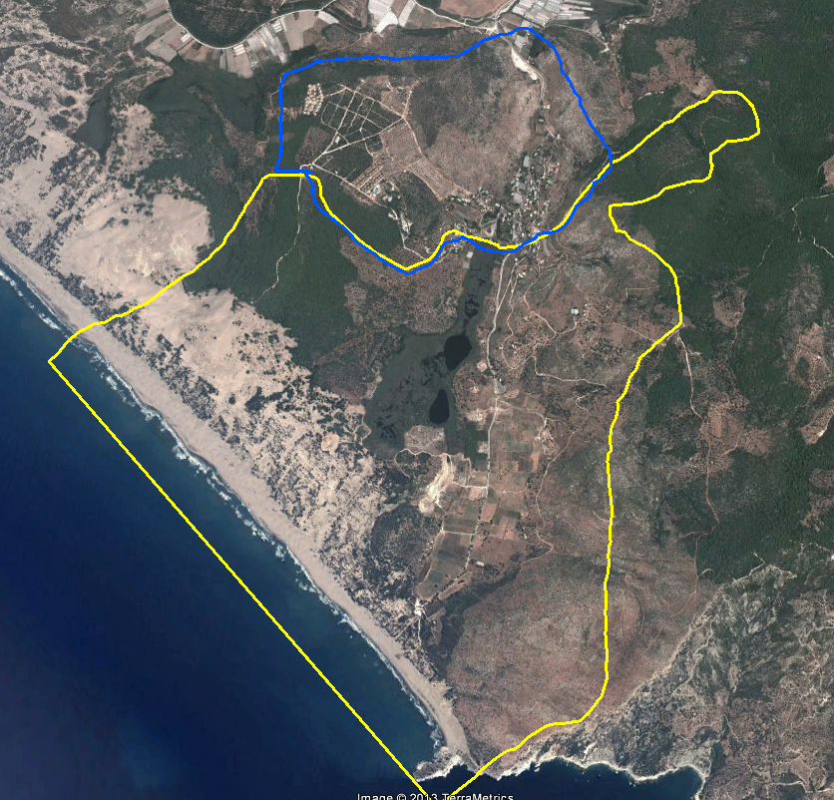
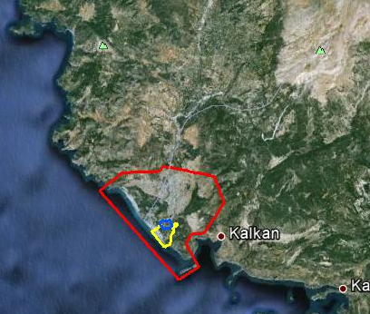
Patara Rec. 182 No. 4: Continue to prevent uncontrolled human settlement behind the beach
Slide 11/29
300-312 summer houses
120% population increase
Inside the SPA in a 3rd Degree Archaeological Site
800 m from the sand dunes
1500 m from the beach
Blue line: 3rd Degree Archaeological Site.
Yellow line: 1st Degree Archaeological Site

Slide 12
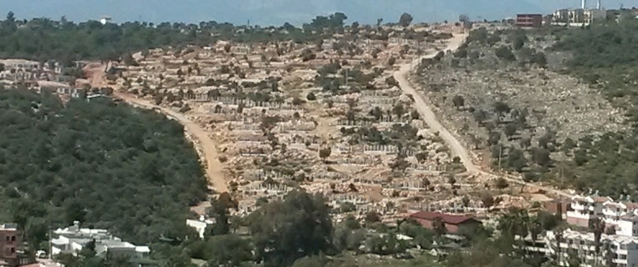
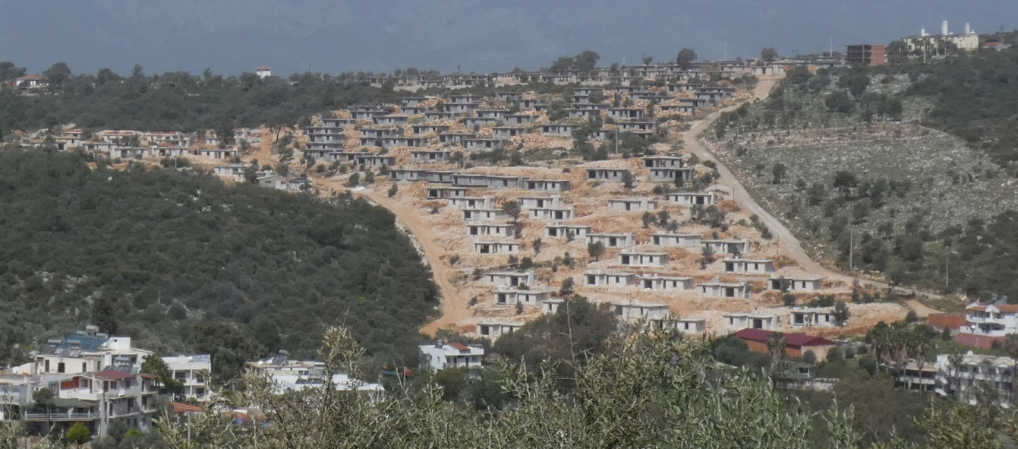
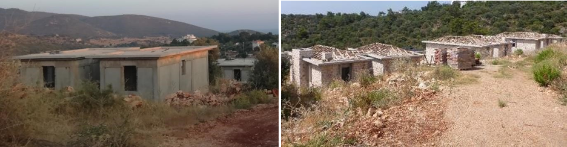
Patara Rec. NO. 182.4: Continue to prevent uncontrolled human settlement behind the beach
Slide 12/29
April 2018
June 2016
Patara SPA. 3rd Degree Archaeological Site. Construction work continues for approx. 310 buildings in different stages of construction

Slide 13
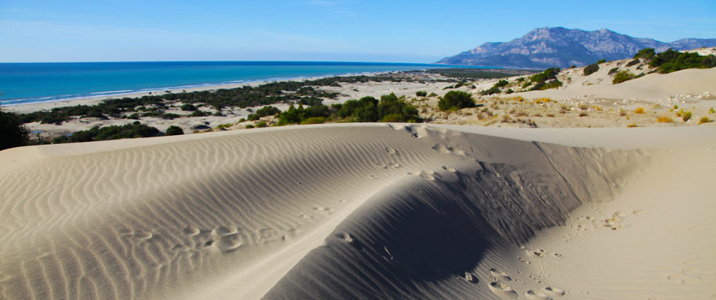
Patara Recommendation No. 182
Measure 2 V: Prohibit fishing with nets in front of beach -> Status unknown, not observed
Measure 2 VII: Prohibit horse riding, 4x4 safaris on beach -> not effectively addressed, no improvement
Measure 6: Address the problem of predation -> not effectively addressed, no improvement (most nests not protected)
Measure 7: Ensure proper fencing of nests in areas with high human presence -> not effectively addressed. Some nests were protected from predation but it was not systematic
Slide 13/29
Recommendation NOT fully implemented

Slide 14
Slide 14/29
Agenda Item 6.1: Files opened
Turkey: Degradation of nesting beaches in Fethiye & Patara Specially Protected Areas
39th Meeting of the Standing Committee
of the Bern Convention
3-6 December 2019

Slide 15
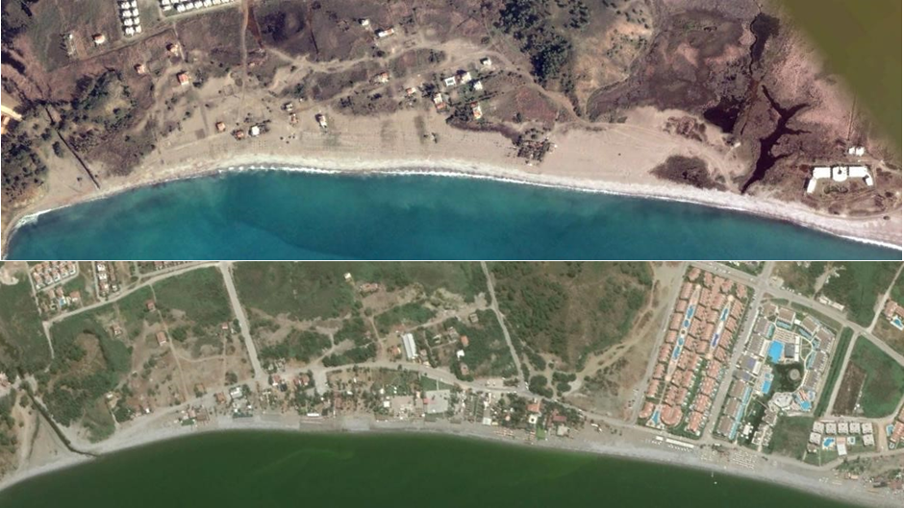
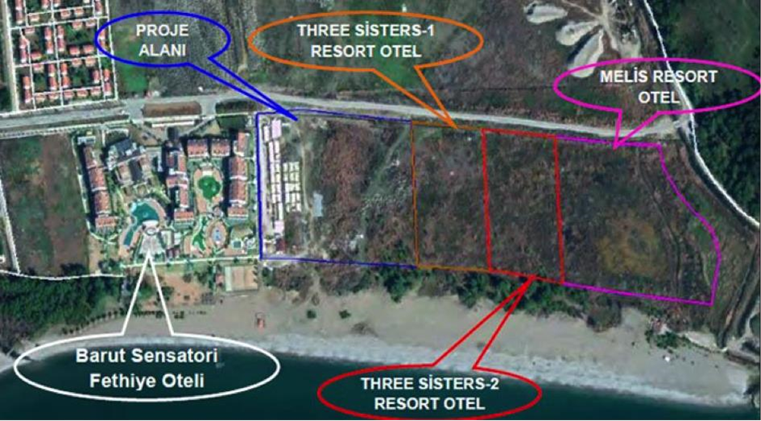
Fethiye Rec. NO. 183.1: Stop further development of permanent structures (buildings, shipyard, jetties, etc.)
Slide 15/29
New business on severely degraded nesting beach & disturbances increased
2003
2019
Fethiye SPA. Çalış Section B. Google Earth 2003 – 2019 satellite imagery comparison shows the continual coastal build-up, planting of sandy area and occupation of nesting beach, in conflict with Recommendations. Note that the sandy area (nesting zone) has been occupied
Fethiye SPA. Karatas. Building plans for four new hotels. Thousands of new rooms and visitors degrading the previously pristine beach

Slide 16
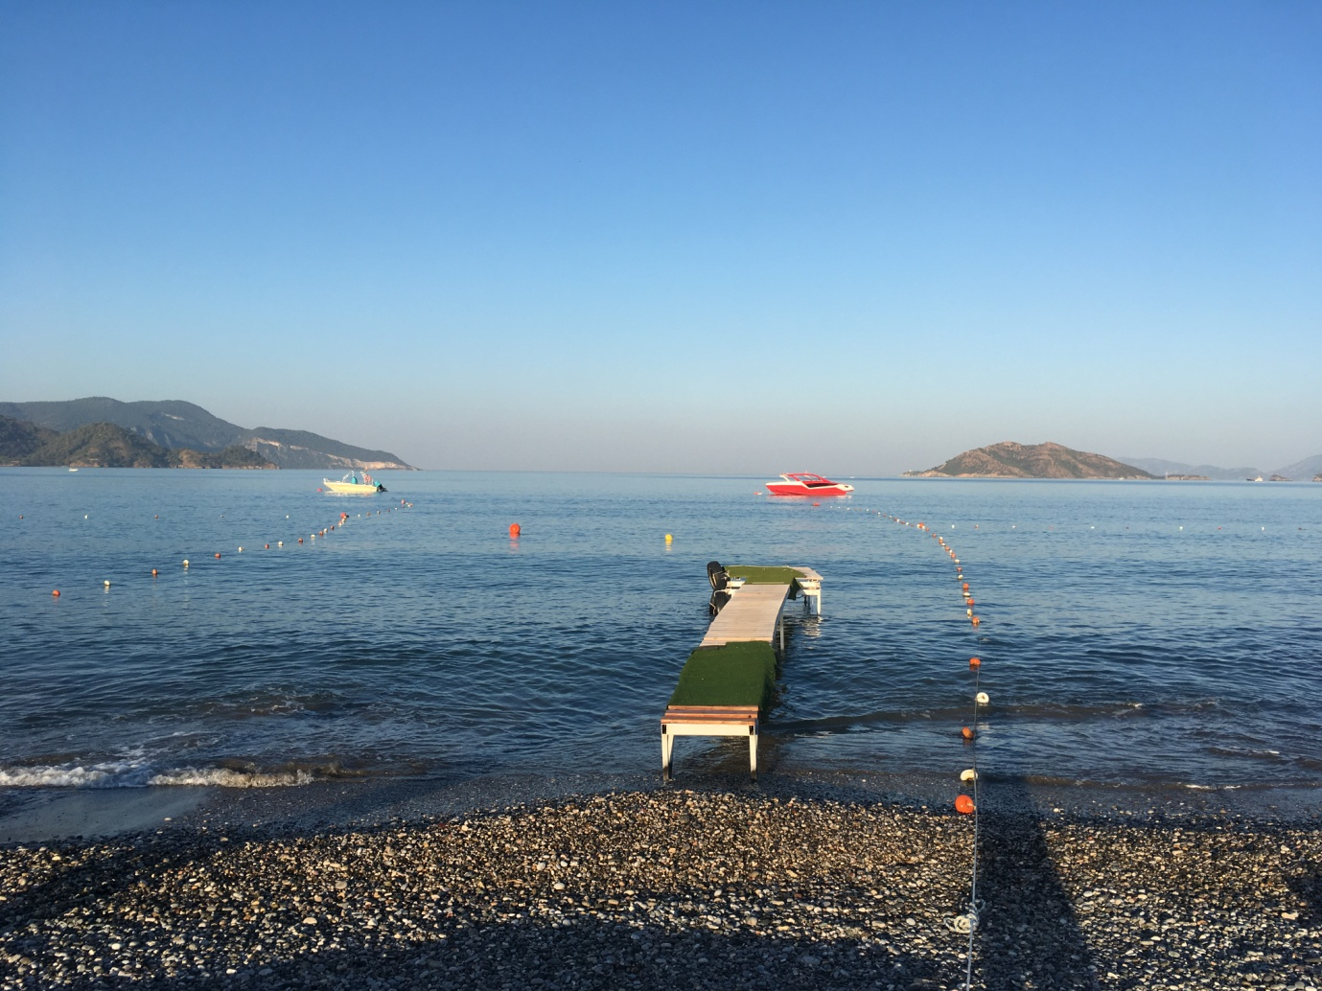
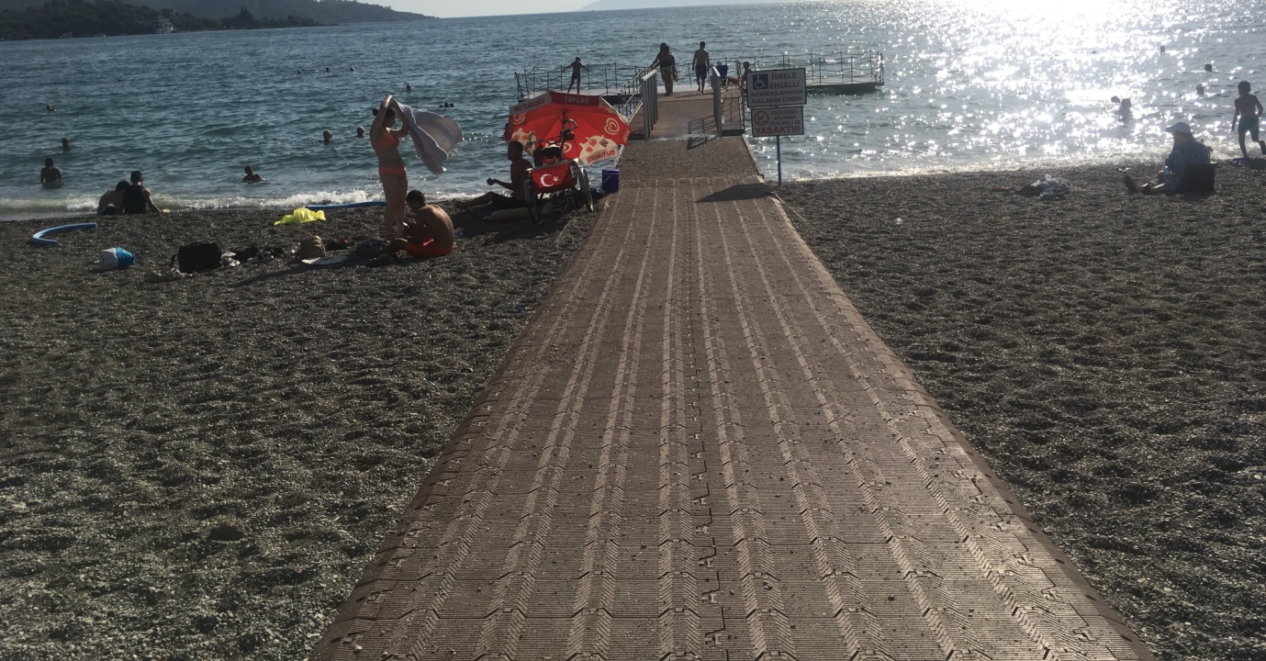
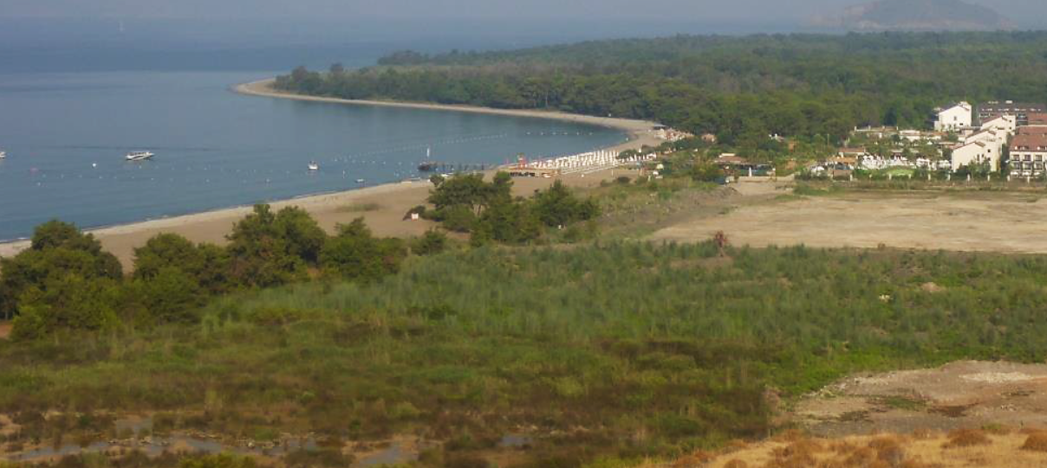
Fethiye Rec. No. 183. 1: Stop further development of permanent structures (buildings, shipyard, jetties, etc.)
Slide 16/29
Fethiye SPA. Çalış Section. Examples of jetties and cordoned water sport areas
Fethiye SPA. Çalış Section B. Abandoned Concrete platform on nesting beach
Fethiye SPA. Karatas. Flattened wetland in order to be developed. The Hotel established in 2015 and expanded in 2019, is seen in the background

Slide 17
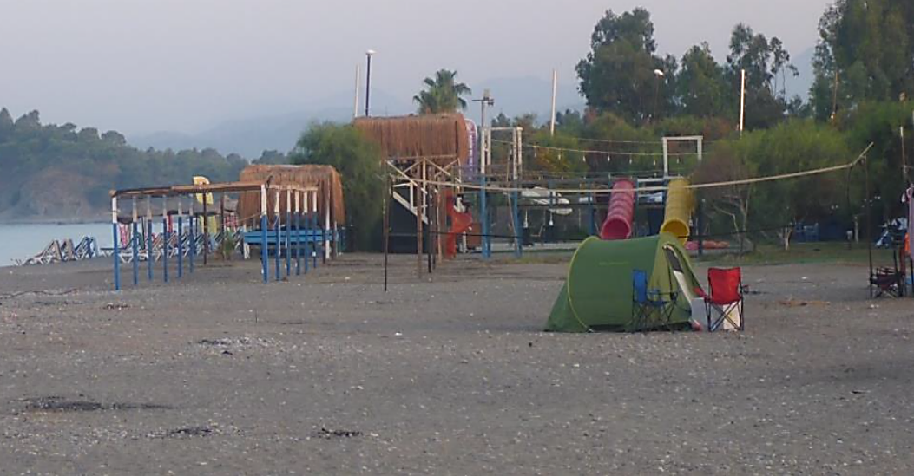
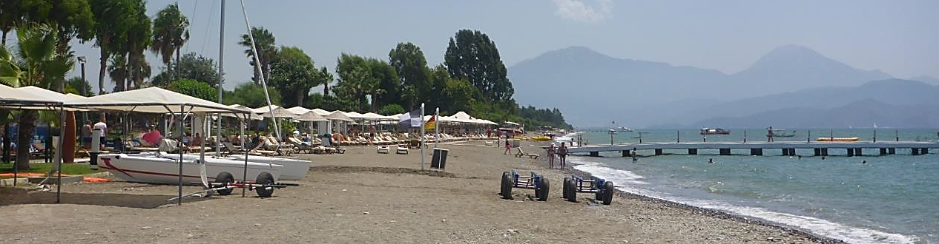
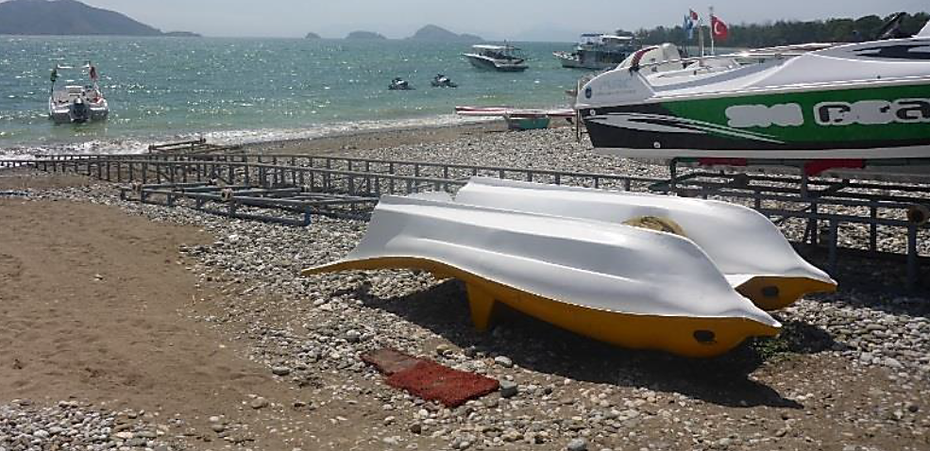
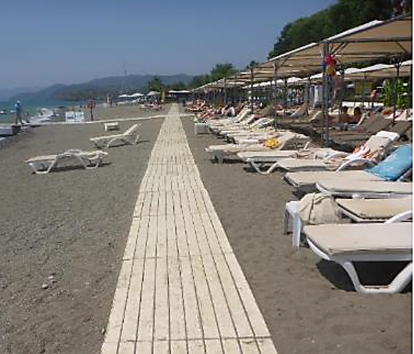

Fethiye Rec. 183. 2: Remove structures & restore sandy areas
Slide 17/29
Fethiye SPA. Çalış Section B. Playground, volleyball court, and permanent shades have occupied nesting beach. Note camping tent in foreground
Fethiye SPA. Karatas beach. Barut TUI Sensatori Hotel boats and watersport equipment on the nesting beach are not removed at night.

Slide 18
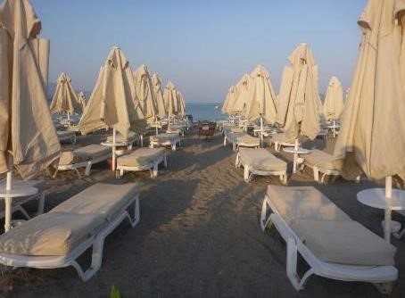
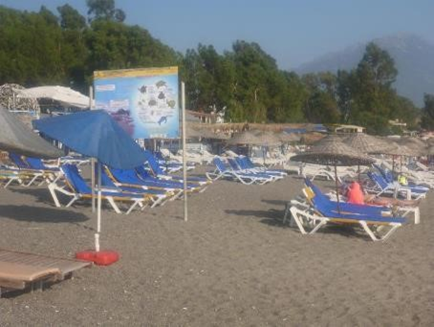
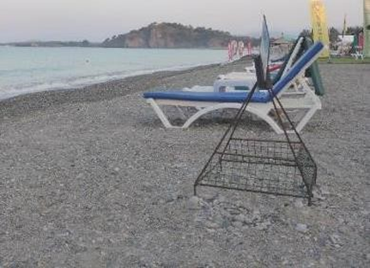
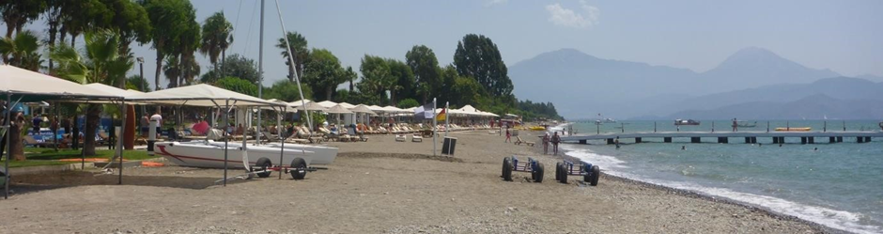
Fethiye Rec. No.183.5: Map & zone the ENTIRE Fethiye coast. Enforce furniture night removal /stacking
Slide 18/29
Businesses completely occupy nesting zone with dense rows of sunbeds that are not removed at night
Fethiye SPA. Çalış Section B. Sunbeds occupy the nesting beach and are not removed at night
Note nest with cage among sunbeds

Slide 19
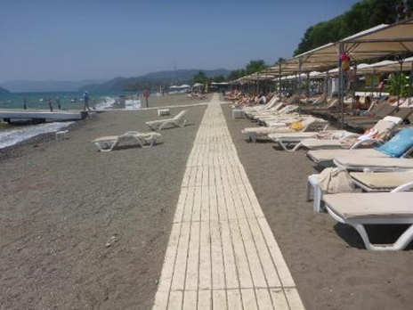
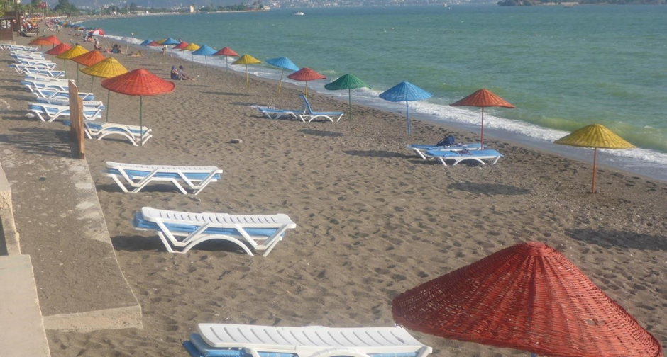
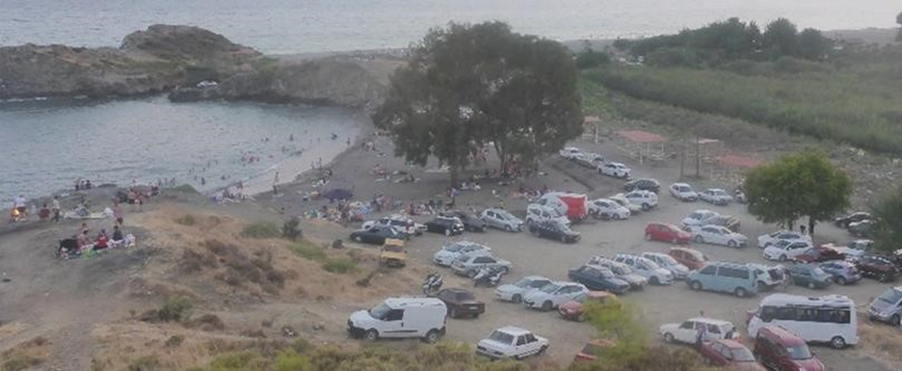

Fethiye Rec. No.183.5: Map & zone the ENTIRE Fethiye coast. Enforce furniture night removal/stacking
Slide 19/29
There was an increase in walkways & beach furniture and no zoning exists

Slide 20
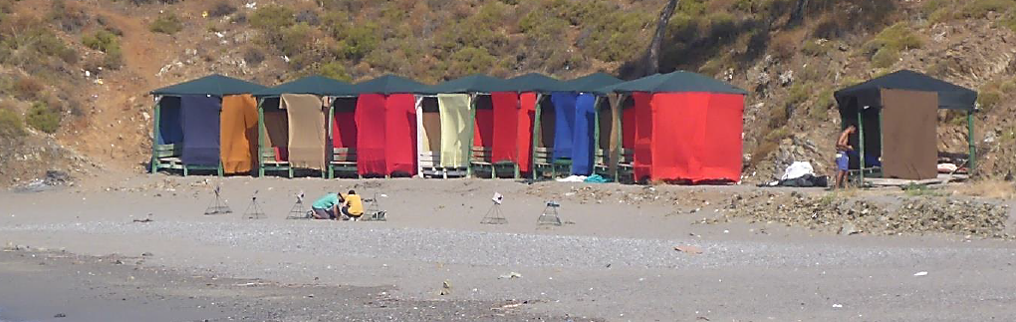
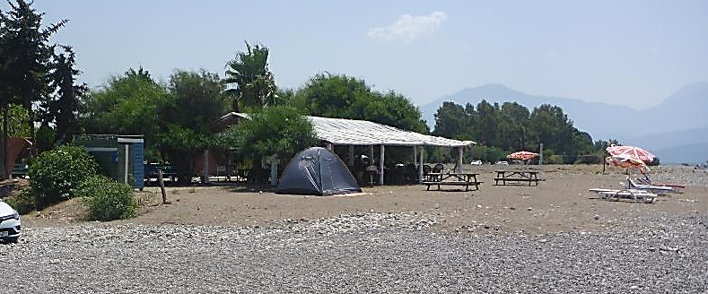
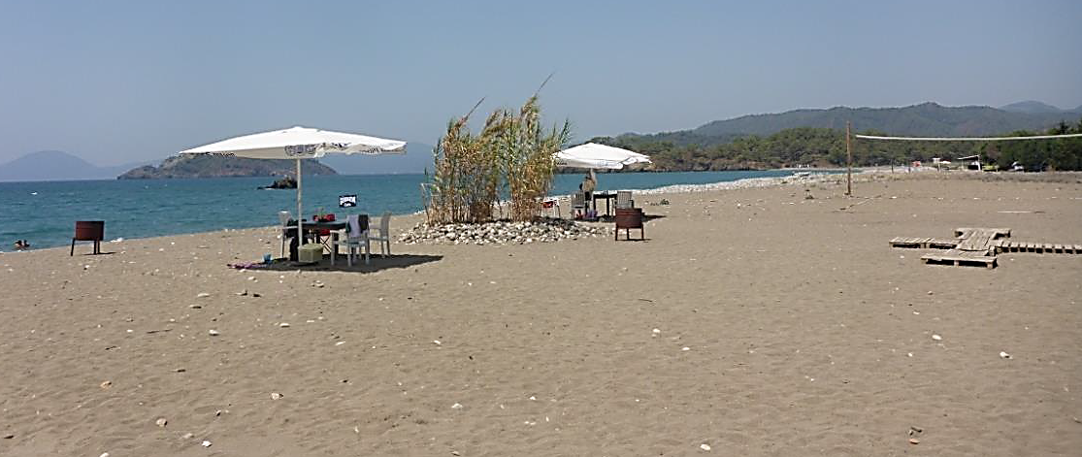
Fethiye Rec. No. 183.6: Prohibit furniture, structures or facilities on the sandy zones of Akgöl beach
Slide 20/29
Pavilions remain on nesting hotspot increased since 2015
nests
Fethiye SPA. Akgöl (early a.m. before beach users arrive). Nesting hotspot occupied by a row of wooden pavilions. Note the numerous marked nests and the research team on the beach
Fethiye SPA. Akgöl. Bathroom facilities, tents, sunbeds and parasols, picnic tables and a boat on the nesting beach
Akgöl.Volleyball court, boardwalks, permanent shades, tables, and plantations on the nesting beach by new business

Slide 21
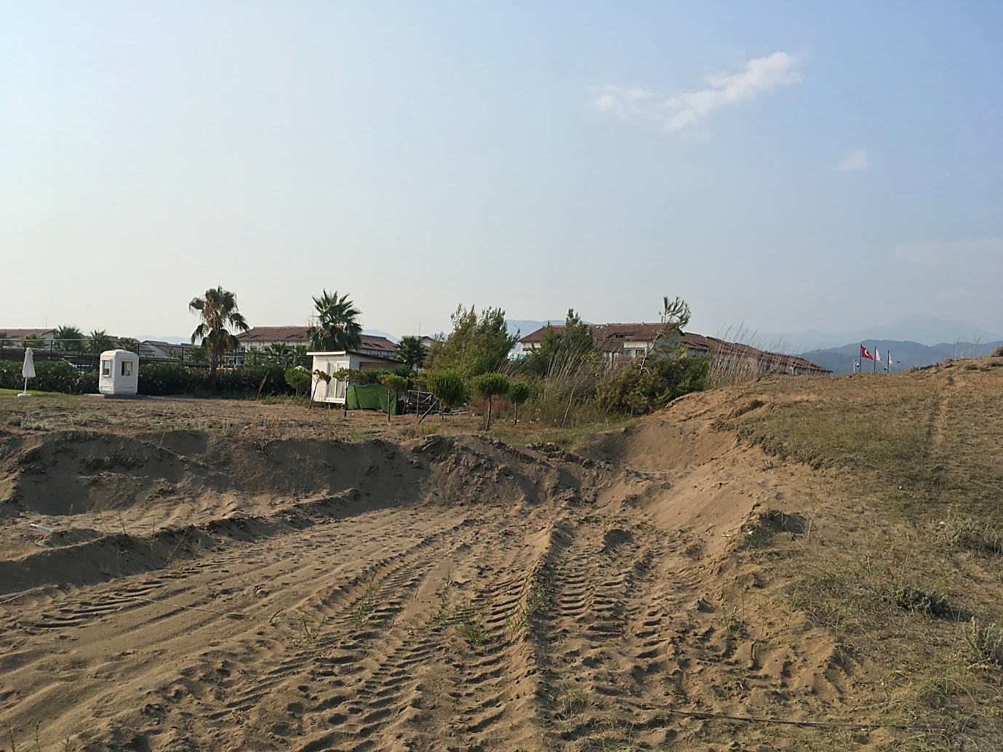
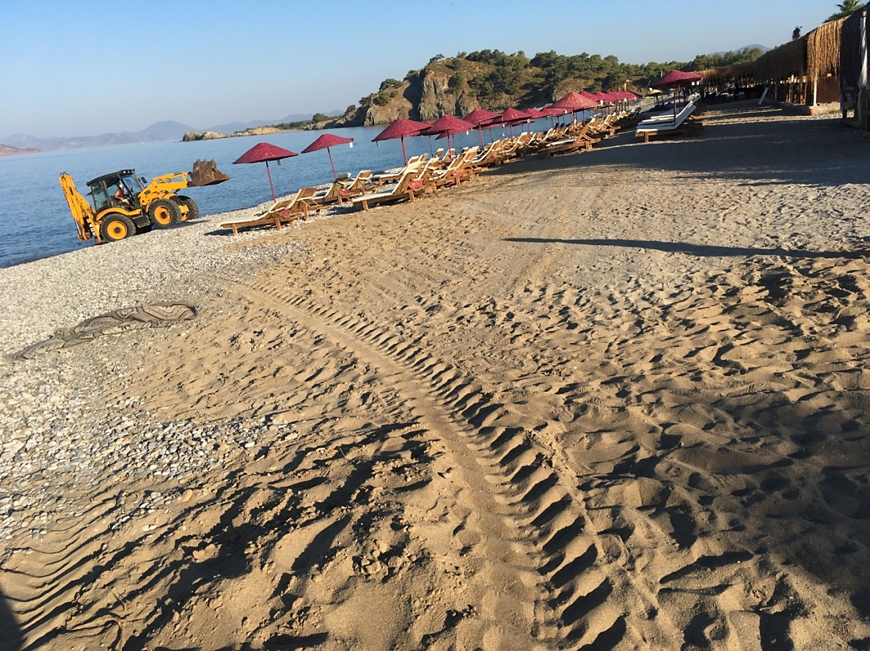
Fethiye Rec. No. 183.3: Stop sand extraction
Slide 21/29
Evidence of digging and sand/gravel removal around the river mouth, between Yanıklar and Akgöl
Evidence of sand removal between Barut and the cleared wetland

Slide 22


Fethiye Rec. 183. 4: Remove planted vegetation
Slide 22/29
Fethiye SPA. Karatas. Barut hotel pavilions, boardwalks, sunbeds and lawn planted on sand inside nesting zone
Çalış Section B. Palm tree on nesting beach continues to be irrigated

Slide 23





Fethiye Rec. 183. 7: Reduce light pollution
Slide 23/29
Fethiye SPA. Yaniklar. Jetty (left) and hotel (right) lights
Fethiye SPA. Çalış. Section B. Beach bar lights on the nesting beach
Fethiye SPA. Çalış. Section A. Light pollution on the nesting beach. Note nest sign on cage (red circle)

Slide 24



Fethiye Rec. NO. 183. 8: Build permanent road barriers, designate parking & picnic areas away from beach
Slide 24/29
Due to lack of barriers, vehicles drive on most of the nesting beaches
Vehicle tracks
Vehicle tracks
Fethiye SPA. Vehicle tracks on Akgöl (left) and Karatas (right) nesting beach
Fethiye SPA. Çalış Section B. Vehicle access point

Slide 25



Fethiye Rec. NO. 183.11: Prohibit camping & bonfires, set appropriate time limits for beach bars’ operation at night
Slide 25/29
Camping, picnics & bonfires observed on all nesting beaches
No night time restrictions for operation of beach businesses
Fethiye SPA. Camping on the nesting beach in Agkol (left) and Calis B (right)

Slide 26



Fethiye Rec. NO. 183.15: Improve information to local community and tourists about sea turtle nesting and sustainable use of the beach.
Slide 26/29
Fethiye SPA. Çalış Section A. Signage remains mainly unchanged compared to 2015 and is insufficient, unclear and poorly displayed. More signs are required at each entry point and more information needs to be presented to visitors.
Fethiye SPA. Information board in Çalış Section B
Yanıklar. Turtle ecology information board

Slide 27
Fethiye Recommendation No.183
Measure 9: Regulate maritime traffic, prohibit at appropriate distances, set speed limits & mark corridors → No Action
Measure 10: Set up long-term research & conservation programs, with adequate manpower. Assess: (i) photo-pollution effects (ii) disturbance of nesting females (iii)predation → No Action, one-season project
Measure 12: Clean beach & ensure sewage is not discharged into the sea → Although bins are available, rubbish seems to be piled up in specific areas on the beach
Measure 13: Set up & enforce adequate regulations and fines → No Action
Measure 14: Ensure adequate financial & human resources for control & management → No Action
Measure 16: Protect all nests with cages → Improvement, Nests are caged in areas with dense touristic activities, and have predation cages (protective grills) in more remote places
Slide 27/29

Slide 28
Slide 28/29
URGENT ACTION NEEDED
to protect Fethiye & Patara’s natural & cultural heritage
Majority of measures under Recommendations 182 & 183 (2015)
NOT implemented
We call upon the Standing Committee to:
Follow-up and keep the case files open at the 39th Meeting of the Standing Committee.
To Urge the Turkish authorities to implement all measures under Recommendations 182 and 183 with no further delay.
To Reiterate to the Turkish authorities the urgent need to implement a comprehensive action plan before May 2020.

Slide 29

Slide 29/29
Thank You
for your attention
MEDASSET
Mediterranean Association to Save the Sea Turtles
E-mail: medasset@medasset.org
Websites:
www.medasset.org |www.euroturtle.org
Photo ©2012 K. Olgun, E. Bozkurt

