Slide 1
Agenda Item 6.1: Files opened Greece: Threats to Marine Turtles in Thines Kiparissias
Slide 1/19
39th Meeting of the Standing Committee
Bern Convention
3-6 December 2019

Slide 2
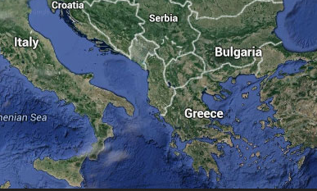
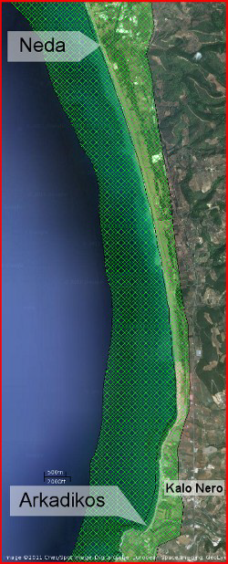
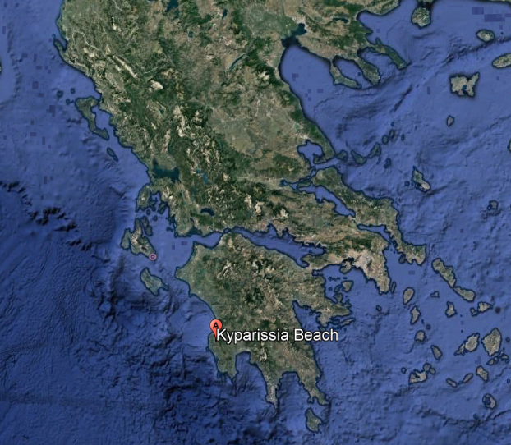
Habitat Degradation due to Uncontrolled Development in a Protected Sea Turtle Nesting Area
Slide 2/19
A NATURA 2000 site: THINES KYPARISSIAS
The largest reproductive population across the Mediterranean for the protected loggerhead turtle Caretta caretta. During 2019 nesting season over 2,850 nests were recorded in the core area ( from Neda to Arkadikos River).
Extensive sand dunes system with Juniperus spp
Survey 2019
Notes:
note for dir. in case of a question. data given for the core nesting area.

Slide 3
The issuance of the Presidential Decree
Slide 3/19
Overview
Oct 2012
EC Reasoned Opinion to Greece
Nov 2012
Greece commits to taking measures
Summer 2013
Degradation continues: protective legislation delayed
Dec 2013
Case File opened at Standing Committee Meeting
Mar 2014
EC takes Greece to European Court of Justice
Aug 2010
MEDASSET Complaint to the Bern Convention
Dec 2014 CoE
Appraisal Unanimously adopted
Rec. No 174
Nov 2016
Judgment of CJEU [C-504/14]: Greece failed to fulfil obligations under Directive 92/43/EC
Jul 2017
Judgement of Council of State on Presidential Decree postponed till Ministry of Environment proves follow-up of correct procedure
Jul 2014
On-the-spot appraisal by Bern Convention experts
June 2018 Approval of the draft Presidential Decree by the Council of State
October 2018 Adoption of the Presidential Decree for the three Natura 2000 sites
Issue in October 2018 of Presidential Decree for southern Kyparissia Bay (Government Gazette D 391/03-10-2018)
Court pending for the 20th of February 2020, after 7 writs of annulment of the Presidential Decree
Survey 2019

Slide 4
Issuance of Presidential Decree a positive step but still does not ensure adequate protection
Slide 4/19
The Presidential Decree does not address some important issues for the adequate protection of southern Kyparissia Bay & for marine turtles, including the permissions of offshore oil activities in the marine area adjacent to the newly protected area
Very low enforcement & implementation of the Presidential Decree regulations (management and protection measures) during the 2019 nesting season
If writs of annulment of the Presidential Decree get approved, Kyparissia Bay will be totally unprotected again
Urgent Adoption & Implementation of a Management Plan for Kyparissia Bay is essential for its protection
Survey 2019

Slide 5
Rec. No 174. Measure No 1: Appropriate Protection status
Slide 5/19
Presidential Decree designates Kyparissia Bay as a Nature Protected Area
NOT as a National Park
Adjacent areas to the Nature Protected Areas, are designated as Agricultural Landscape Zones where construction is permitted.
Part of the coastal area behind the core nesting beaches (red rectangles) is designated as Agricultural Landscape Zones, putting in extreme danger the reproduction of sea turtles and the adequate protection of the habitat.
Survey 2019

Slide 6
Rec. No 174. Measure No 2: Permanent Prohibition of Construction (buildings, roads, etc.)
Slide 6/19
Presidential Decree fails to adequately protect Kyparissia Bay from constructions:
No buffer zone between Nature Protected Area & Agricultural Landscape Zone
The Presidential Decree addresses the existing illegal road network, but no action has been taken for its removal and restoration of the area
Existing illegal constructions have not been demolished (eg. Platforms at Kalo Nero) and in addition 2 newly constructed houses are being built with no intervention from the Authorities
Survey 2019

Slide 7
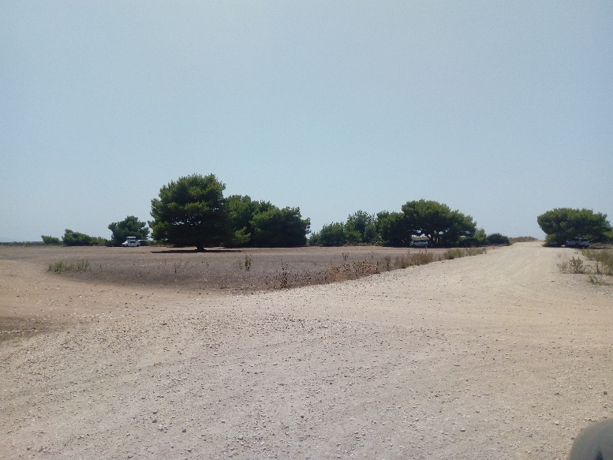
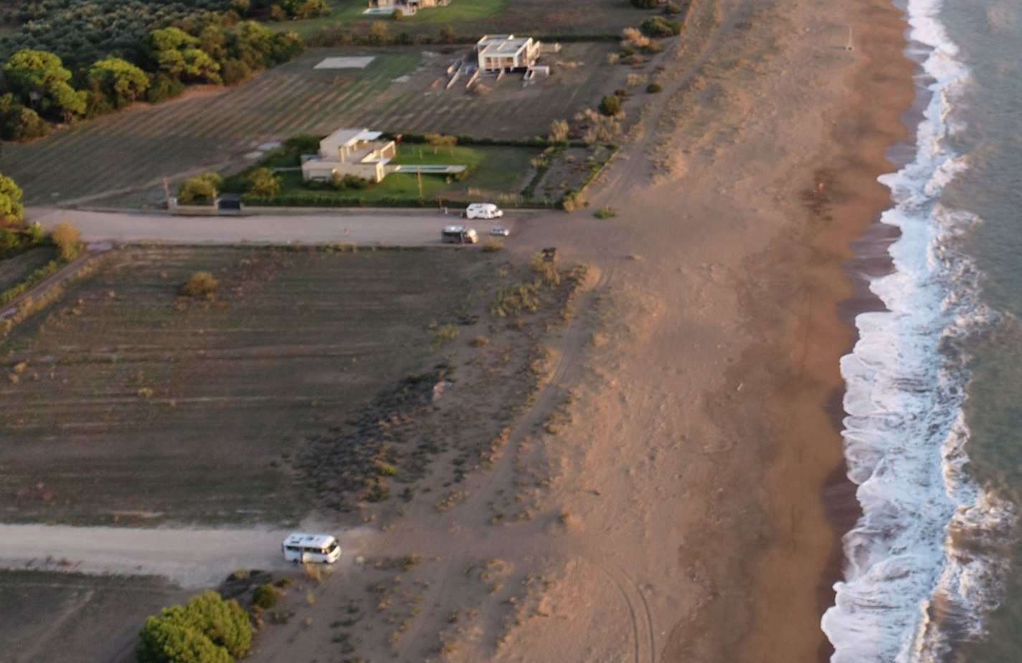
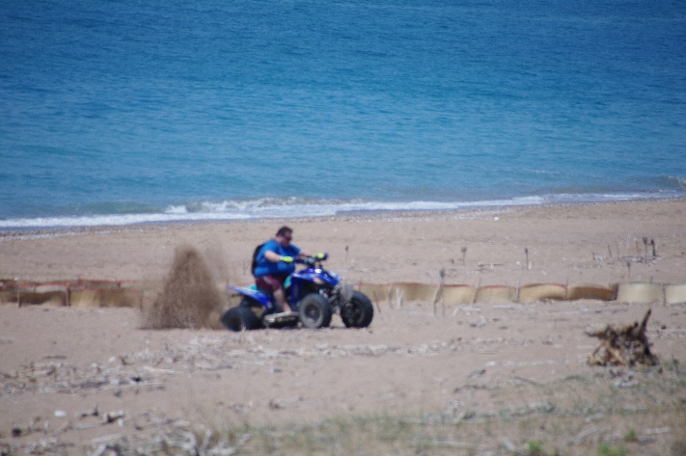
Rec. No 174. Measure No 3: Restoration of Original Dune and Forest Habitat
Survey 2019
Slide 7/19
Illegal road system with no signs of any restoration
action
ARCHELON
Illegal roads accessing the sand dunes remain and no barriers have been set up.
Quad bike rider at Agiannakis beach, stuck in the soft sand within close proximity of nests
Tractor parked on sand dunes at Agiannakis beach

Slide 8
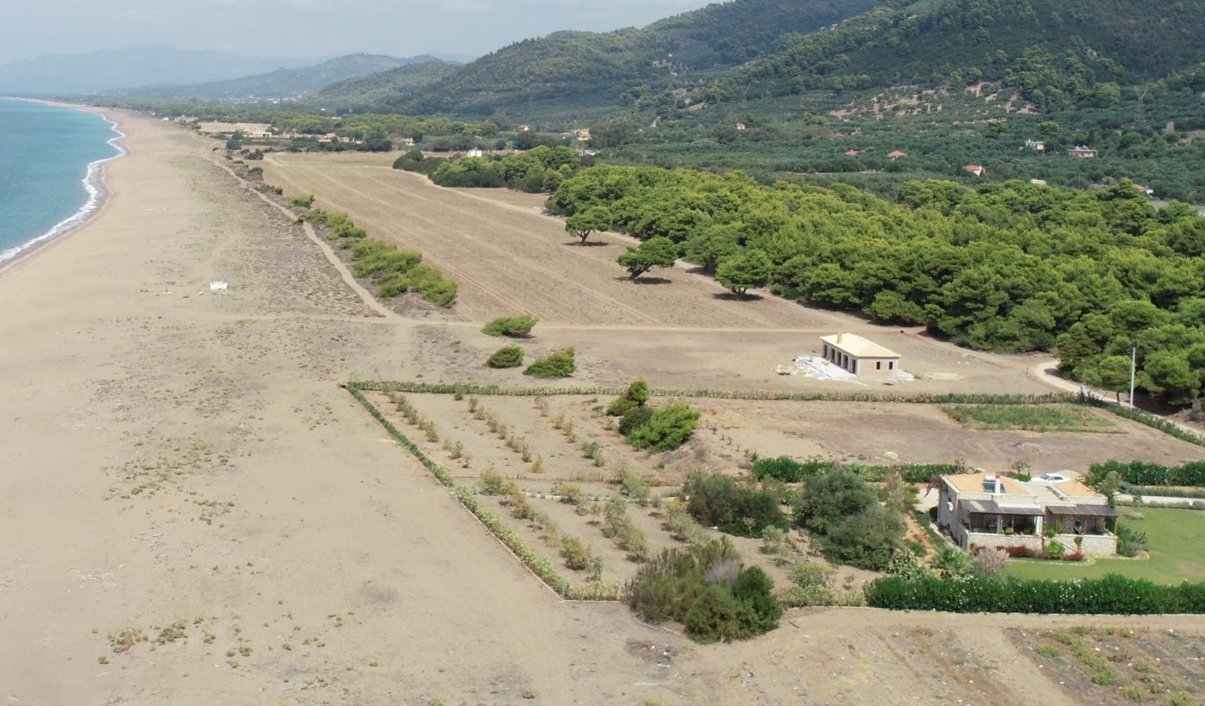
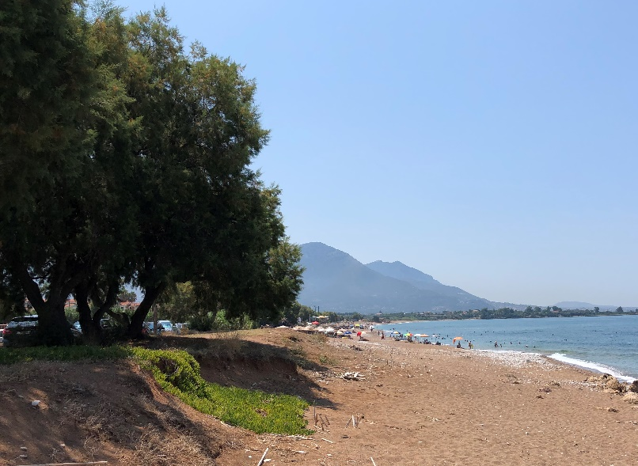
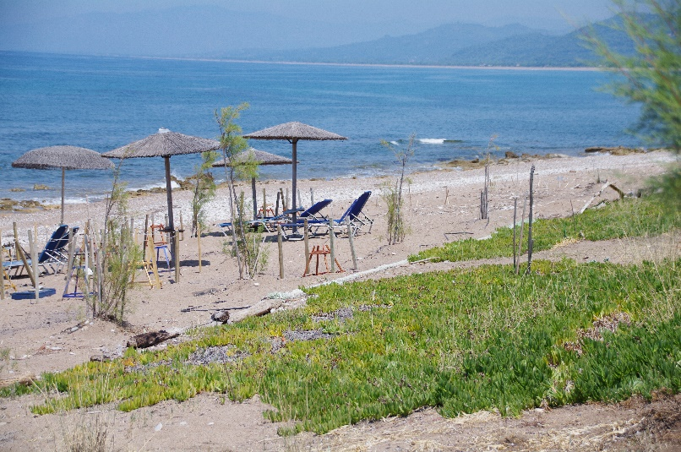
Rec. No 174. Measure No 4: Adjustments to existing buildings
Slide 8/19
ARCHELON
Houses at Vounaki. Note the introduced alien plant species. No steps have been taken for their removal in order to reinstate the natural dune system.
(a)
(b)
Invasive species along the beach not removed. (a) & (b) Planted young trees and cultivation of the invasive species Carpobrotus spreading onto the nesting area.
Survey 2019

Slide 9
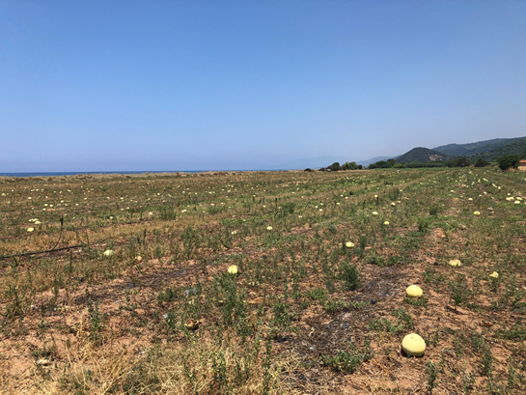
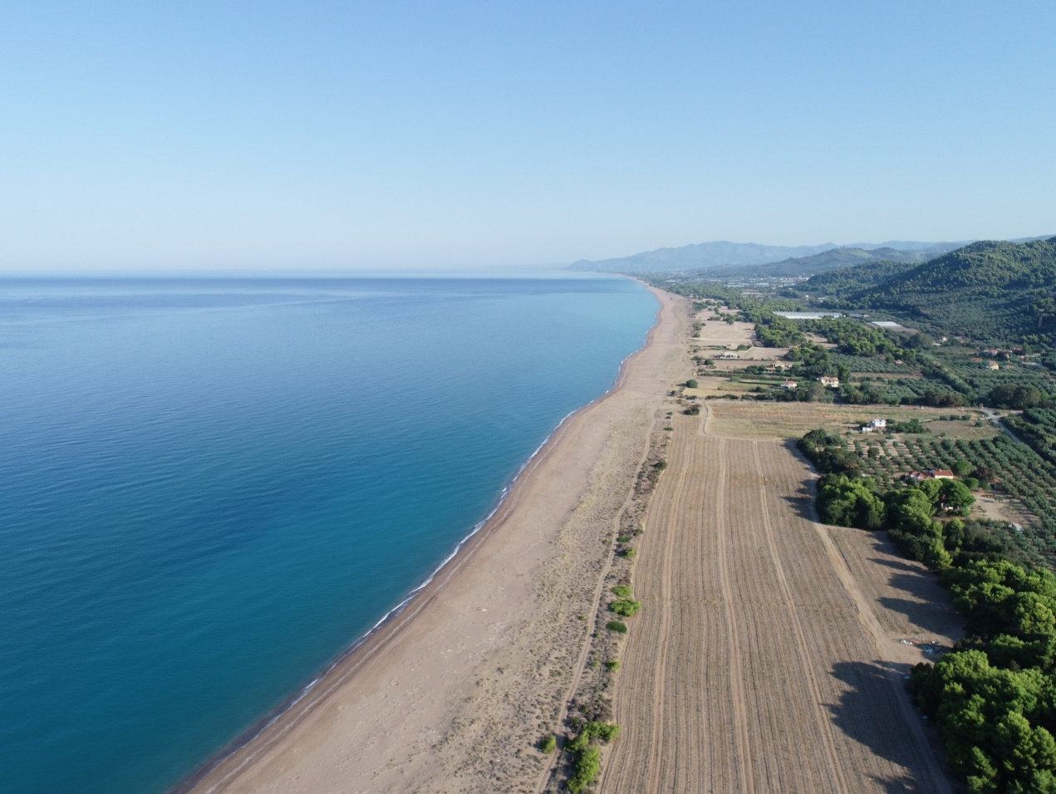
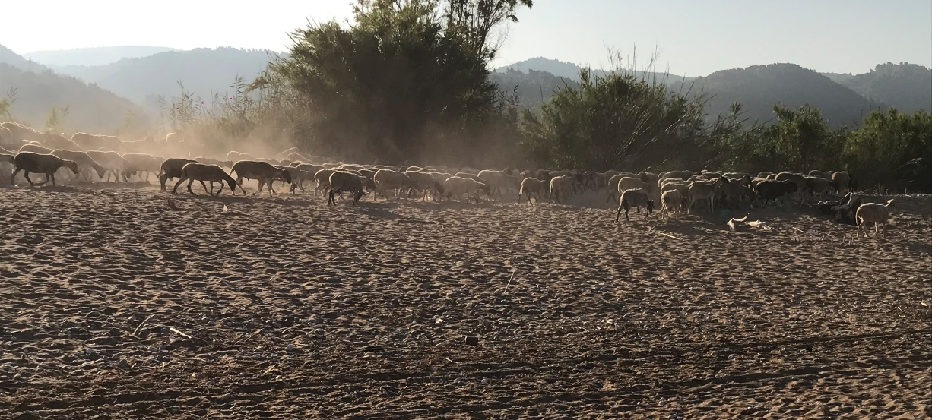
Rec. No 174. Measure No 5: No agriculture on public land & the dune area
Slide 9/19
(a)
(b)
ARCHELON
Photo of the alteration of the sand dune system with ongoing watermelon cultivation and of the dirt track with regular vehicle use (a), (b)
ARCHELON
Animal grazing & cultivation of watermelons/vegetables
continues on the dune area
Survey 2019

Slide 10
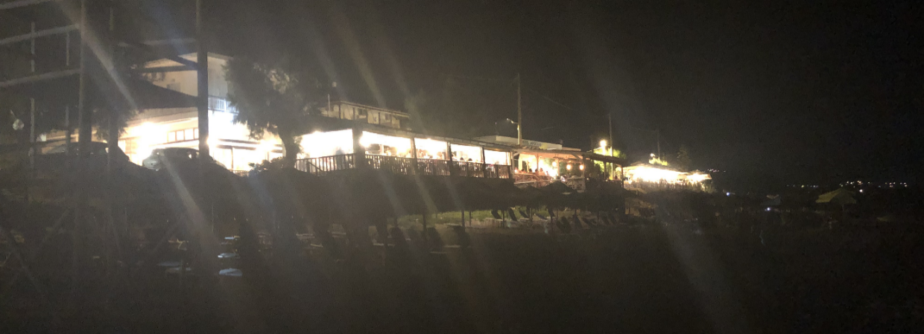
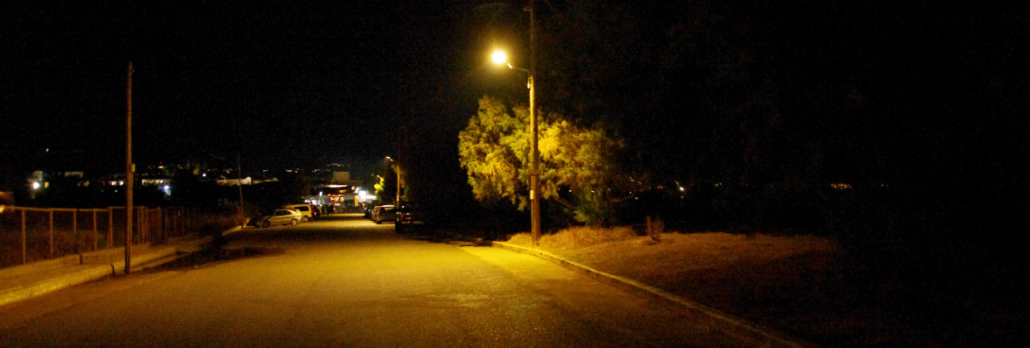
Rec. No 174. Measure No 6:
Light Pollution reduction
Slide 10/19
Despite the provisions of the Presidential Decree the situation has not improved. At Kalo Nero 65% of the nests were exposed to light pollution during the 2019 nesting season
Intensive light pollution caused by public & private lights (hotel platforms, restaurants & bars next to the beach)
Survey 2019

Slide 11
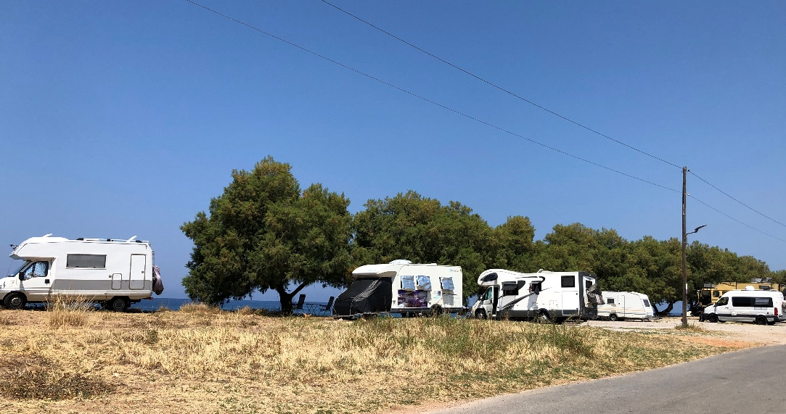
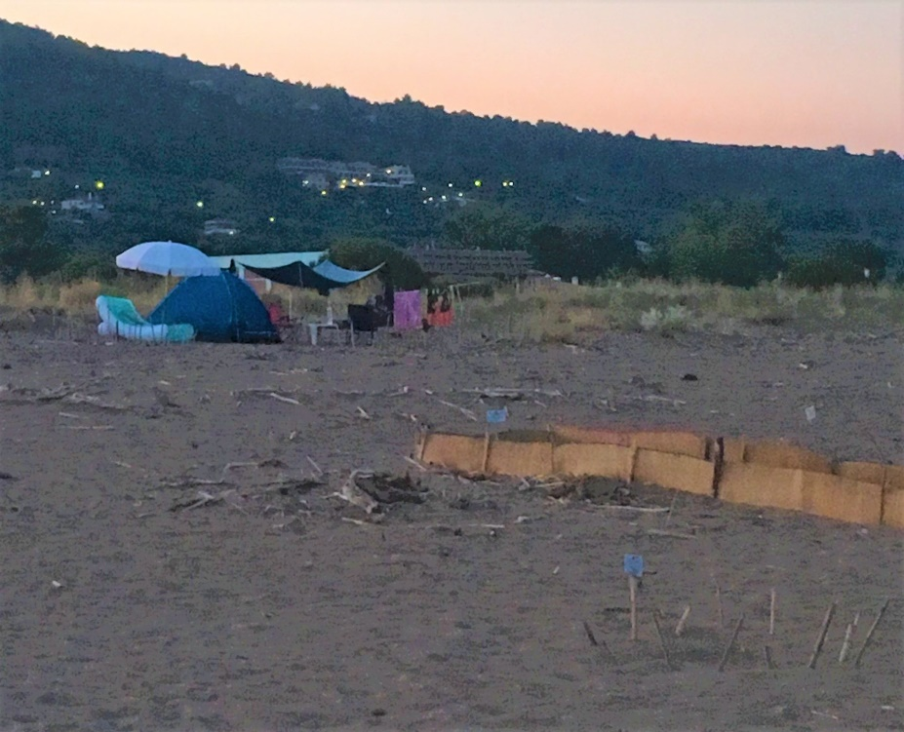
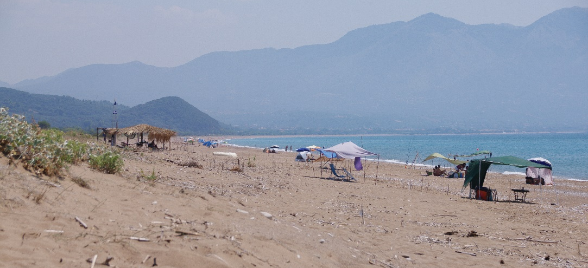
Rec. No 174. Measure No 6:
Further evidence of illegal actions
Slide 11/19
Extensive presence of caravans & shelters at Kalo Nero nesting beach
Overnight camping along the beachfront and on the beach
ARCHELON
Survey 2019

Slide 12
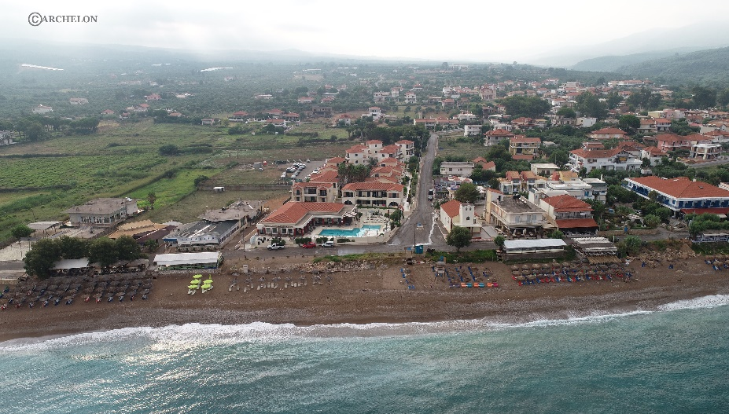
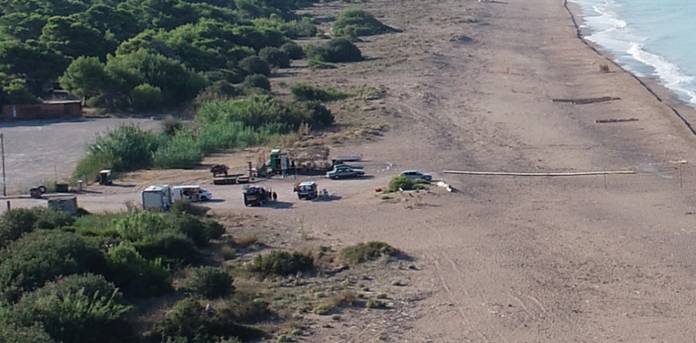
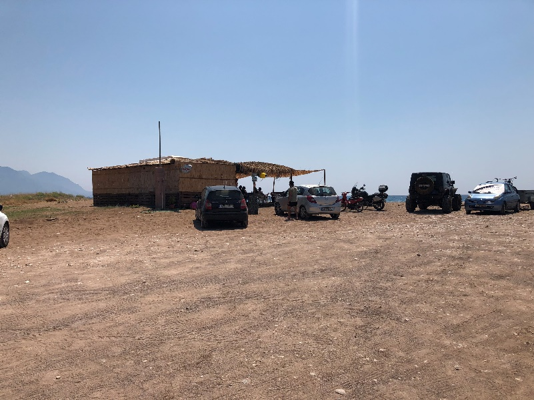
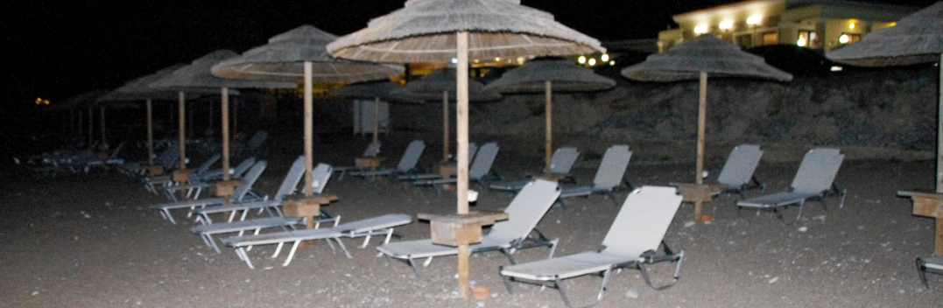
Rec. No 174. Measure No 7:
Beach Equipment management
Slide 12/19
ARCHELON
Illegal platforms & beach furniture completely cover nesting areas in Kalo Nero
Beach furniture not removed at night. ARCHELON recorded more than 41,000 cases of sunbeds not being removed in summer 2019
Canteens on the nesting beach and cars
Survey 2019

Slide 13
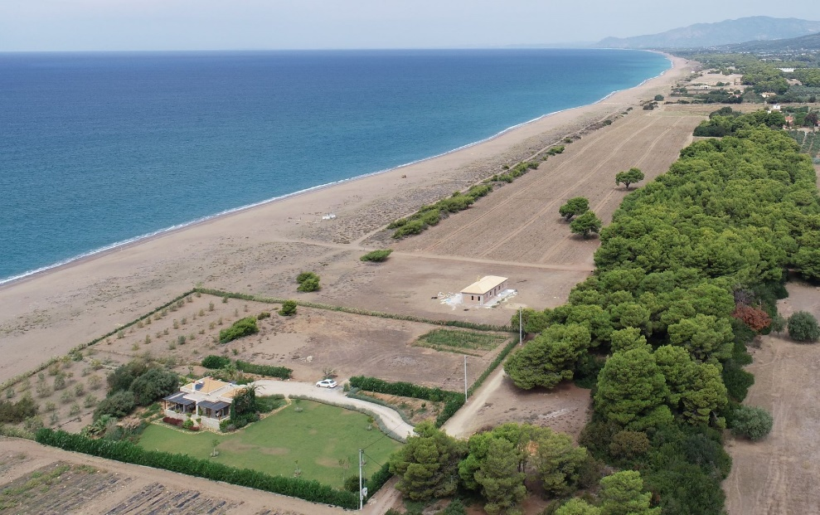
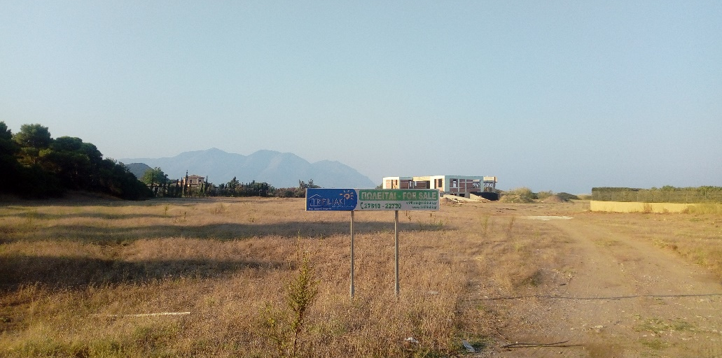
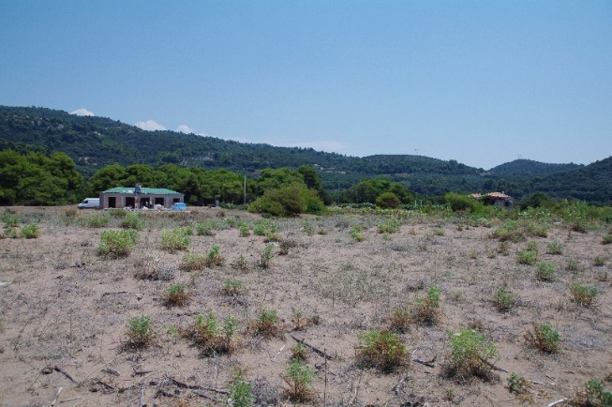
Rec. No 174. Measure No 9: Further construction outside the urban-planning areas
Slide 13/19
Although the Presidential Decree does not allow the expansion of settlements into Nature Protection Areas, during 2019 two new constructions were observed at Vounaki and Agiannakis Beach
ARCHELON
Survey 2019

Slide 14
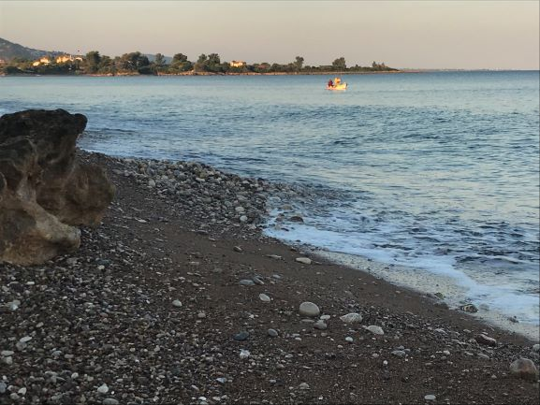
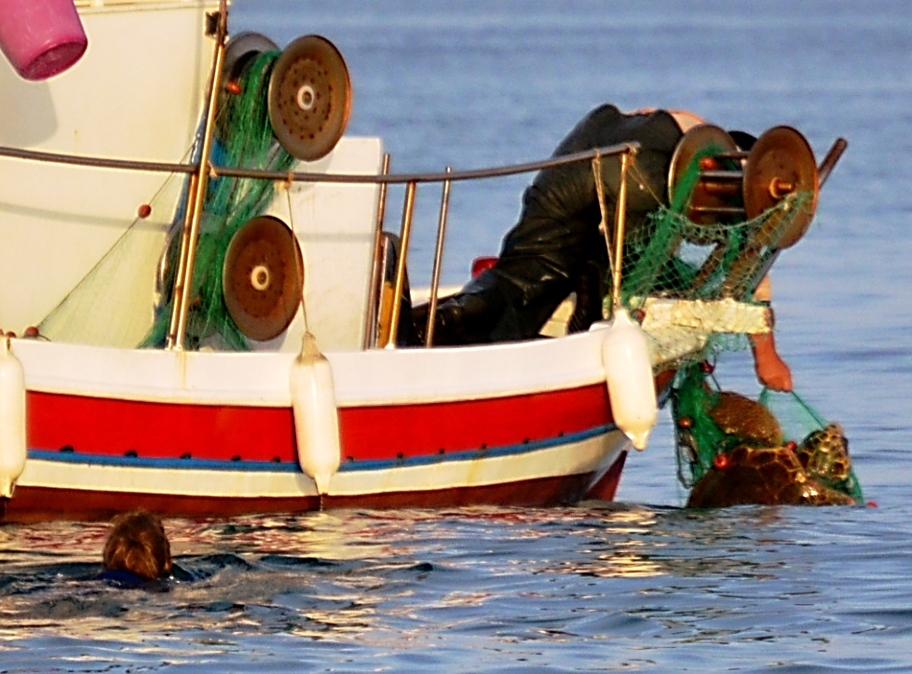
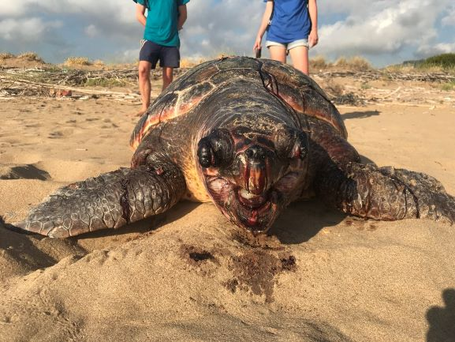
Rec. No 174. Measure No 10: Regulation of vessels navigation of vessels & fishing practices
Slide 14/19
11 dead turtles found during nesting season in the core area and 13 more in the rest of Kyparissia Bay
ARCHELON
ARCHELON
Fishing boat laying nets too close to the shore on sector O
By-caught sea turtle
Fishing with nets close to the nesting beach is currently permitted, resulting in captures of sea turtles during the reproductive season
ARCHELON
Dead turtle with signs of injuries caused by dynamite fishing
Survey 2019

Slide 15
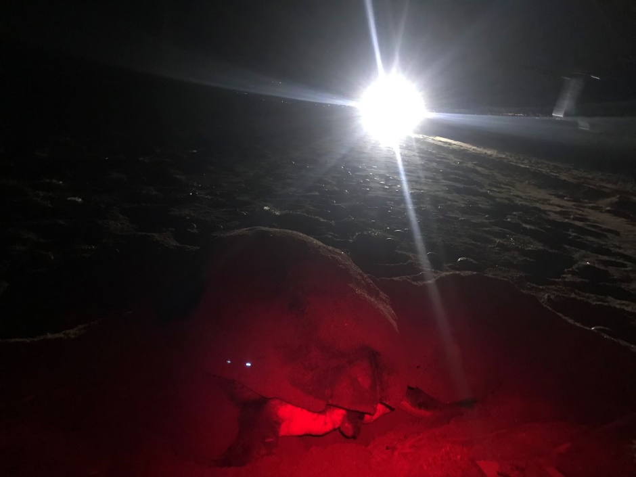
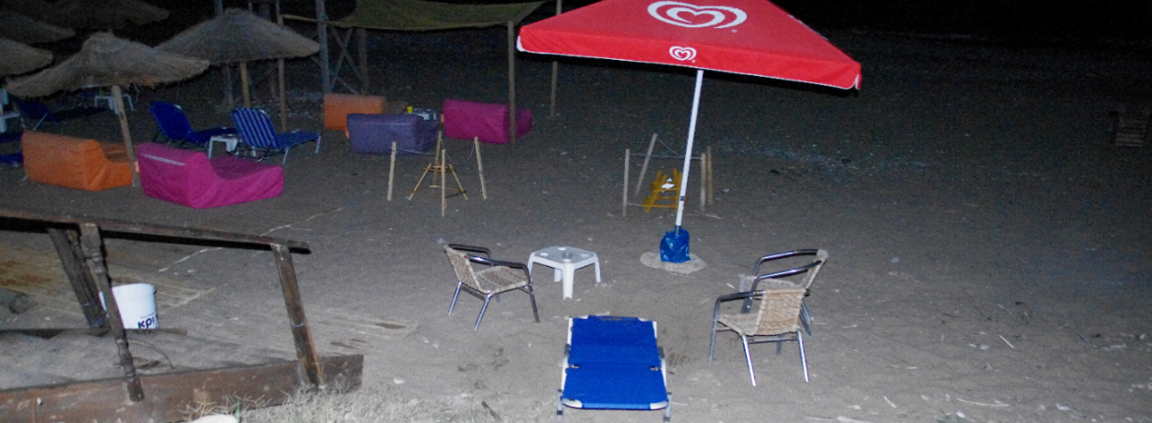
Rec. No 174. Measure No 11: Human presence on the nesting beach at night
Slide 15/19
ARCHELON
ARCHELON
Incident of a 4x4 vehicle crossing the beach during night time, while a sea turtle was nesting. In total 57 incidents of vehicles on the beach were recorded by ARCHELON volunteers.
NESTS
Beach furniture was not removed at night. No access control after sunset. More than 90 incidents of visitors at night were recorded.
Survey 2019

Slide 16
Slide 16/19
Rec. No 174. Measure No 12: Control of feral or stray dogs
No attacks by feral dogs have been recorded during 2019
Rec. No 174. Measure No 8:
Sand & Gravel Extraction
Sand and gravel extraction was not a significant issue during the 2019 season
Survey 2019

Slide 17
Conclusion
Slide 17/19
Rec. No 174 was not fully implemented
The issue of Presidential Decree for Kyparissia Bay (Government Gazette D 391/0310-2018) constitutes a positive development
Several major conservation issues are not addressed by the Decree which can only be solved through the elaboration and adoption of a Management Plan
Threats identified lead to habitat degradation & direct or indirect damage to sea turtle nesting areas
Seven writs of annulment are pending in front of the Council of State, requesting the repeal of the Presidential Decree

Slide 18
Slide 18/19
MEDASSET:
Calls on the Greek Government to:
Enforce the implementation of the Presidential Decree regulations
Urgently adopt & implement a Management Plan, with the active engagement of the competent Management Agency of Kotychi, Strofilia Lagoon & Kyparissia Bay
Keep the Standing Committee informed about progress in the implementation of the above Recommendations
Calls on the Standing Committee of the Bern Convention to:
Keep the Case file open
Continue following up with the Greek Government regarding progress made on the implementation of Rec. No 174

Slide 19
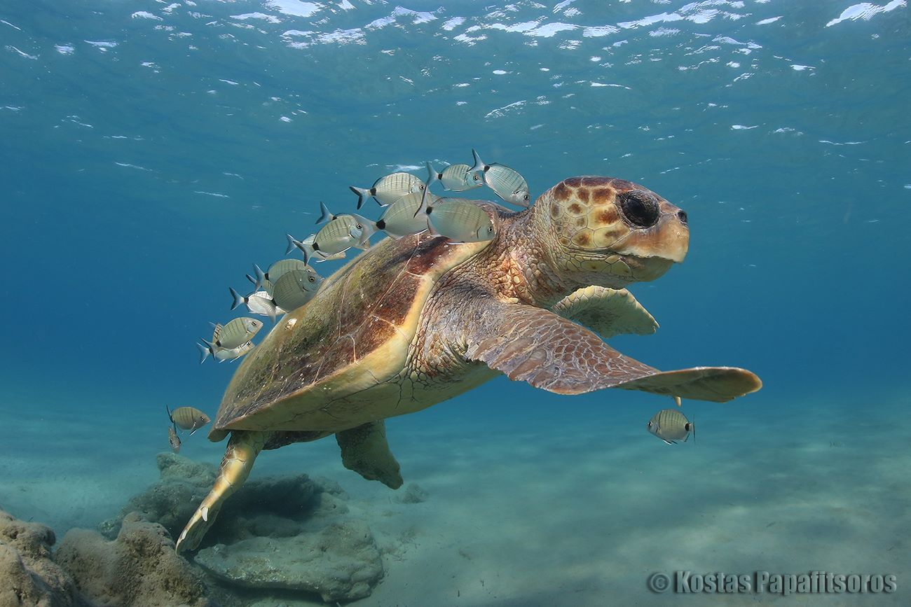
Agenda Item: 6.1: Files opened Greece: Threats to Marine Turtles in Thines Kiparissias
Slide 19/19
39th Meeting of the Standing Committee
Bern Convention
3-6 December 2019

