Slide 1
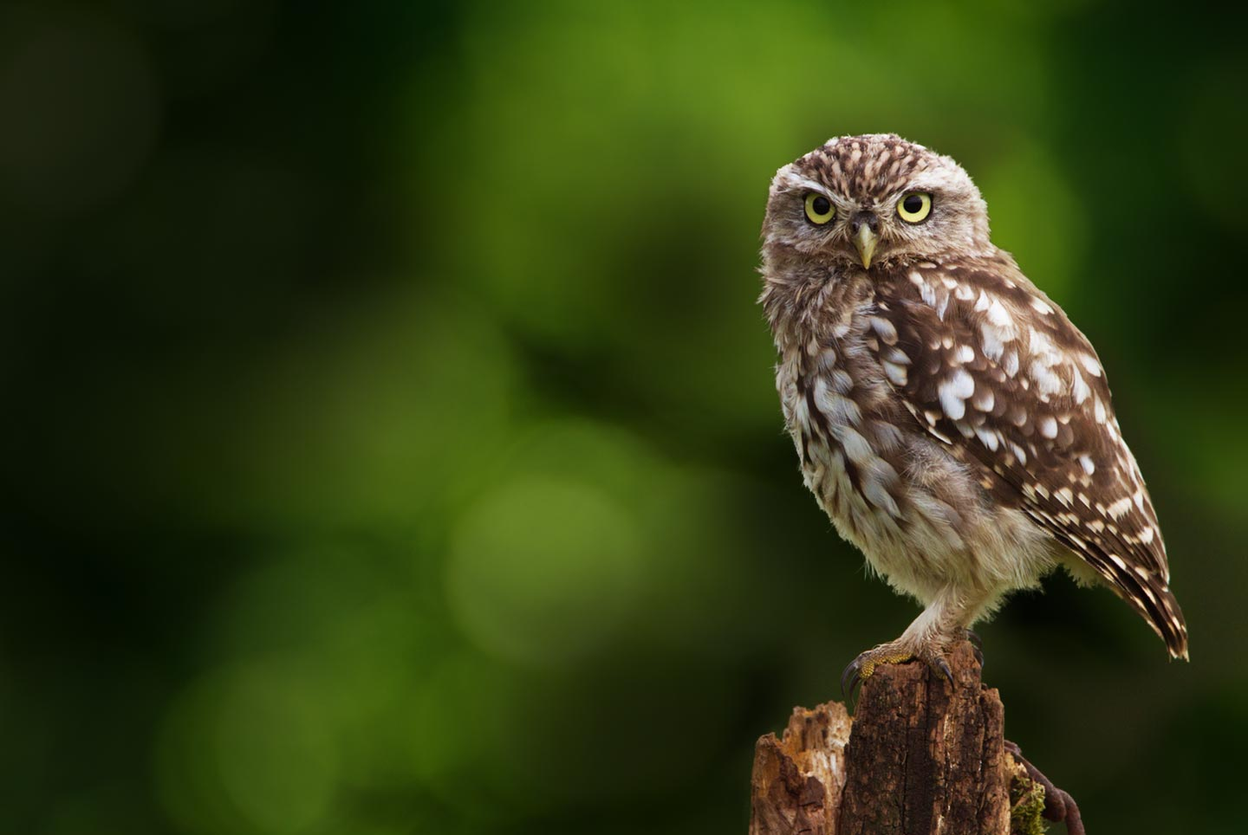

Conservation of the Akamas Peninsula
and Chrysochous Bay in
Western Cyprus:
Τhreats posed to wildlife
by development near or
within these areas

Slide 2
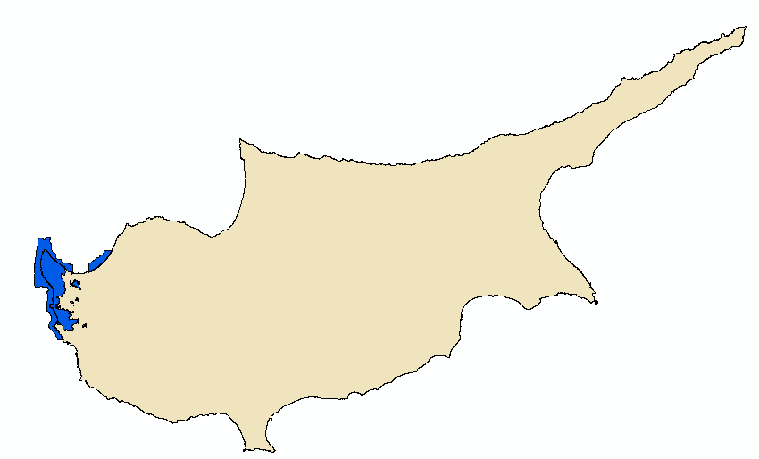
Akamas Peninsula and Polis-Gialia
Natura 2000 sites
Polis-Gialia
Akamas

Slide 3
Akamas Peninsula Natura 2000 site
Polis-Gialia
Akamas

Slide 4
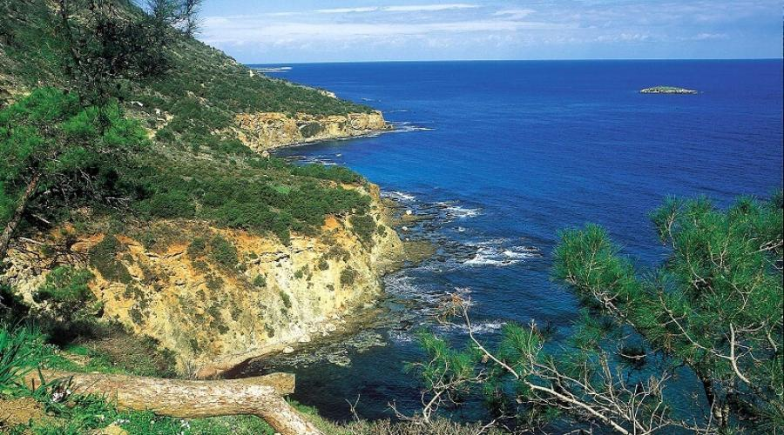
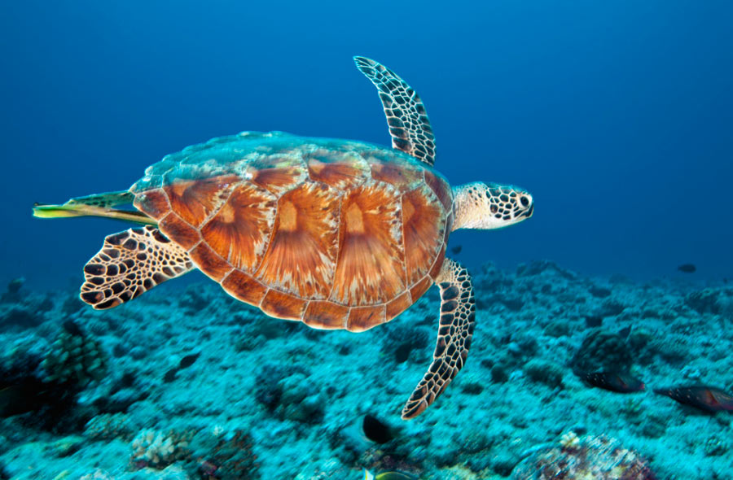
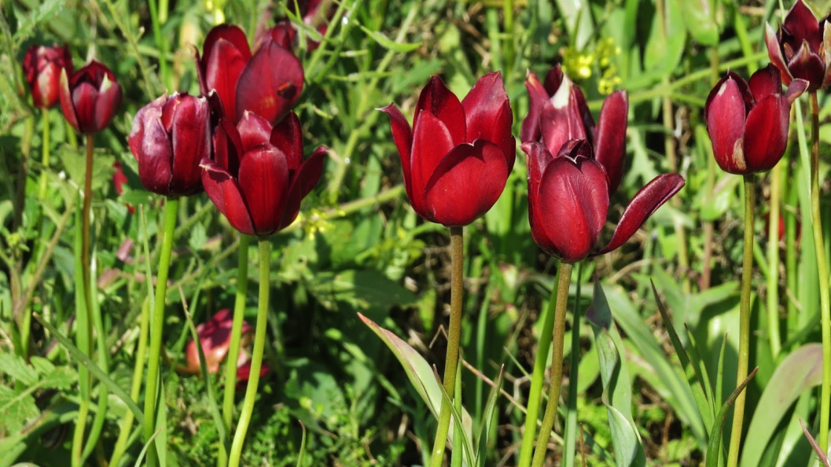
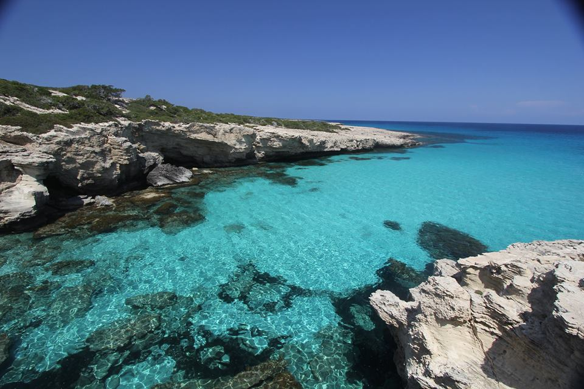

Slide 5
Category of Protected Area | Area (hectares) | Proposed / Designated as Protected Area
UNESCO Biosphere Reserve Akamas Peninsula | 23,000 ha (only terrestrial area) | Proposed by the Republic of Cyprus, UNDP, EEC and METAP/World Bank, between 1987-1995
First Proposal for Akamas Natura 2000 area | 17,690 ha terrestrial area and 7,851 ha marine area | Proposed by the Republic of Cyprus between 1998-2003
Natura 2000 Site of Community Importance (SCI CY4000010) Akamas Peninsula | 10,163 ha terrestrial area and 7,851 ha marine area | Proposed by the Republic of Cyprus in 2009 and approved by the European Commission in 2010. Since then, the site has not been designated as SAC
Akamas National Forest Park (NFP) | 7,762 ha (only terrestrial area, which corresponds to 75% of the terrestrial area of Natura 2000 sites SCI CY4000010 and SPA CY4000023 Akamas Peninsula) | Designated by the Republic of Cyprus between 2016-2018

Slide 6
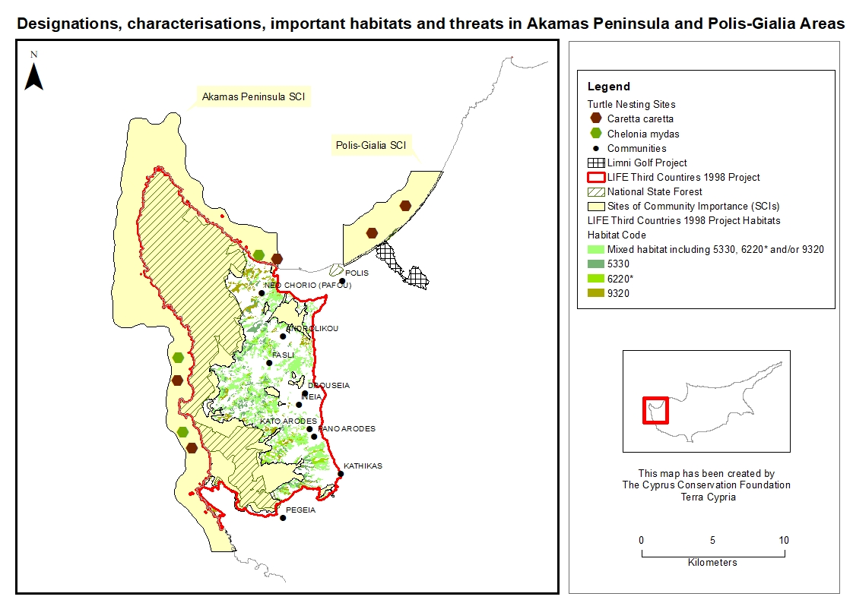

Slide 7
Akamas Natura 2000 site
What are the main issues?
DESIGNATION
Insufficient Natura 2000 Site Designation
Unprotected priority habitats (e.g. 6220* and 3170*) and species (e.g. Aquila fasciata and Coracias garrulus)
Lack of political will to declare the whole area of Akamas Peninsula as a protected area with comparable international protection status (e.g. UNESCO Biosphere Reserve, EU Natura 2000 and/or IUCN National Park)
MANAGEMENT PLANNING
Existing Management Plans (SCI, SPA, Grazing Capacity and Local Communities Sustainable Development) do not have legal standing and are not implemented
No Management Entity
New Plans are under preparation, carrying potential threats:
  Two separate Local Development Plans by the Town Planning and Housing Department
  A Sustainable Development Plan for Akamas National Forest Park by the Department of Forests

Slide 8
Akamas Natura 2000 site
What are the main issues?
MANAGEMENT ON-THE-GROUND
No effective protection measures in place
Integrated management for early response system, intervention, accountability and fines not in place
Some examples of the result of such lack of integrated management

Slide 9
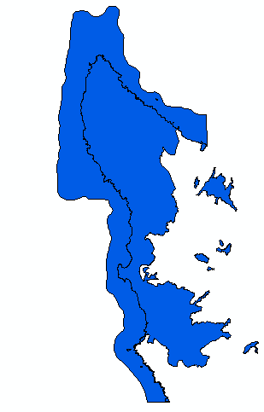
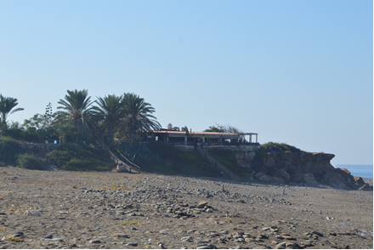
North and South Lara Beaches - Green Turtle and Loggerhead Nesting Areas
Illegal restaurant in South Lara Bay

Slide 10
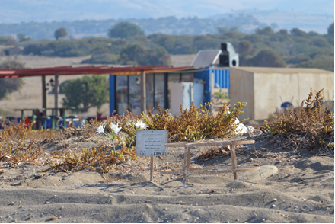
North and South Lara Beaches - Green Turtle and Loggerhead Nesting Areas
Illegal beach bar in South Lara Bay

Slide 11
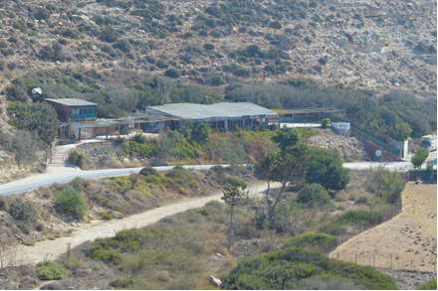
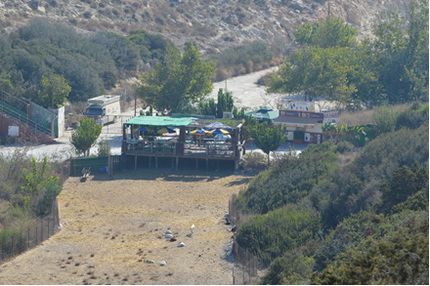
Aspros River Estuary - Green Turtle and Loggerhead Nesting Areas
Illegal restaurant and snack bar in Aspros River Estuary

Slide 12
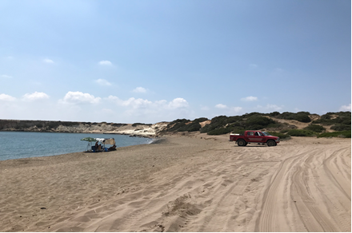
North and South Lara Beaches - Green Turtle and Loggerhead Nesting Areas
Unregulated human activities

Slide 13
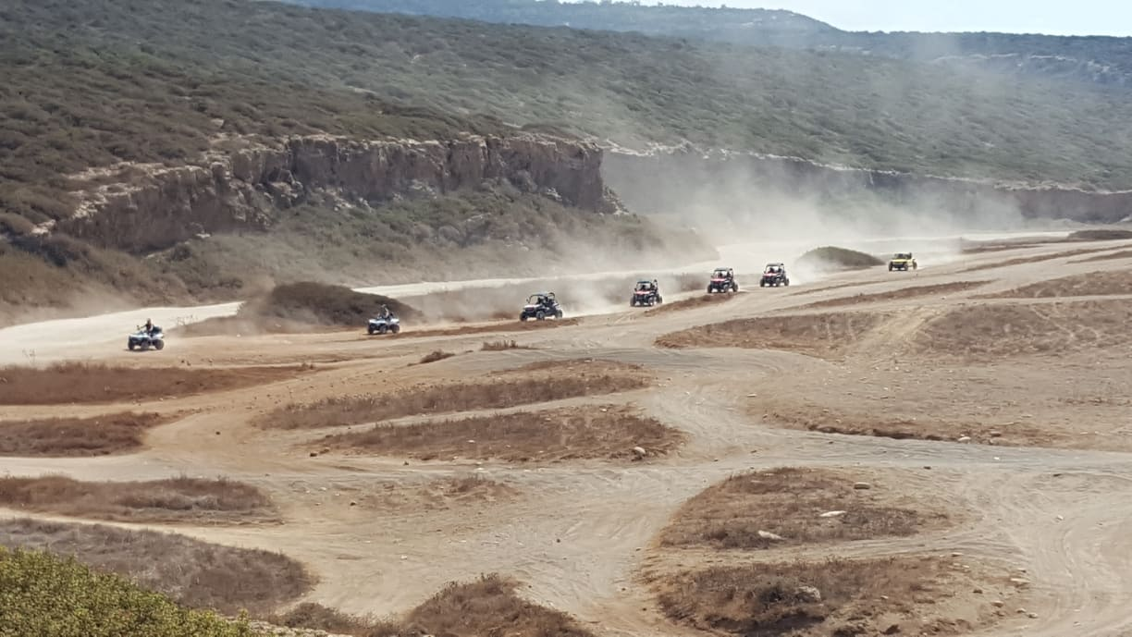
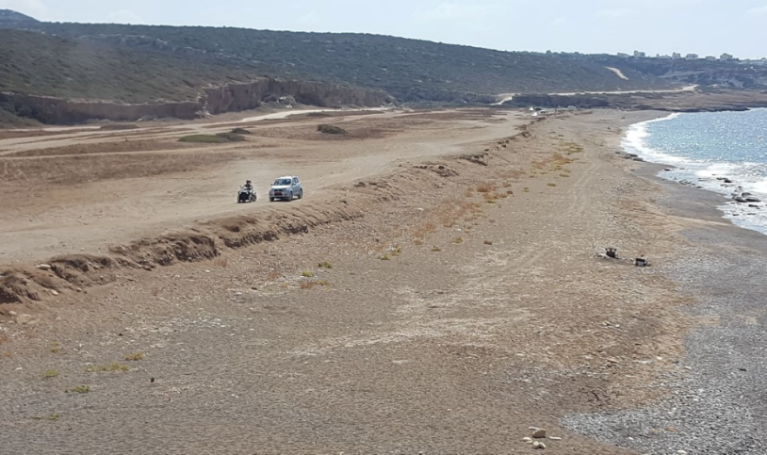
South Lara Beach - Green Turtle and Loggerhead Nesting Areas
Illegal uncontrolled quad bikes and other vehicles adjacent to the turtle nesting sand dunes in Toxeftra

Slide 14
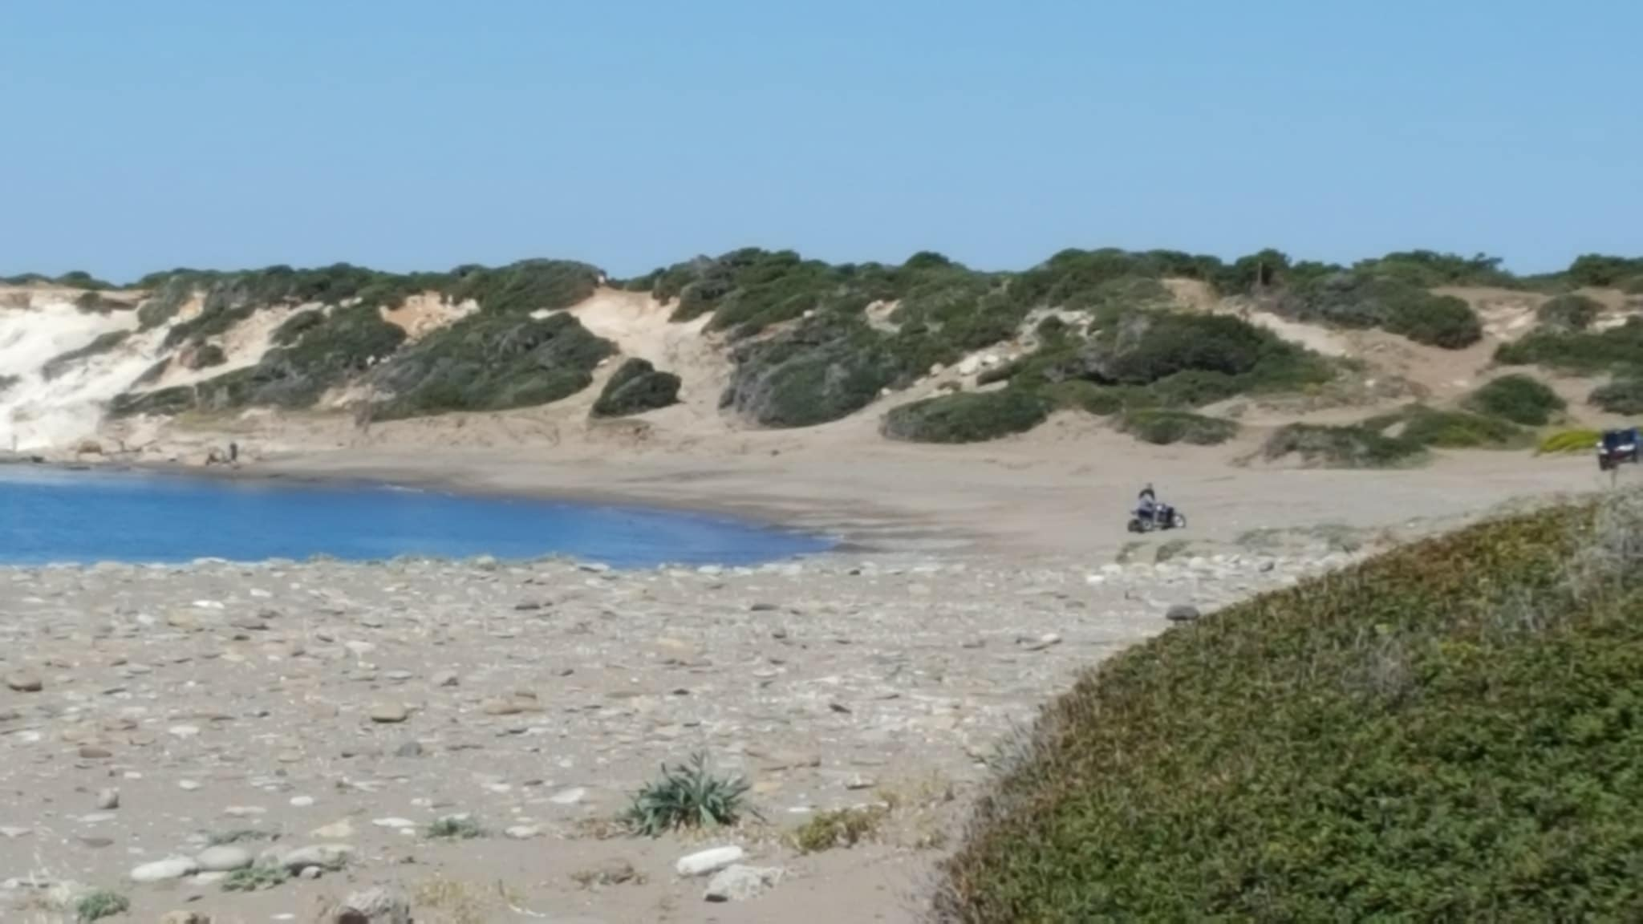
North- South Lara Beach - Green Turtle and Loggerhead Nesting Areas
Illegal uncontrolled quad bike driving

Slide 15
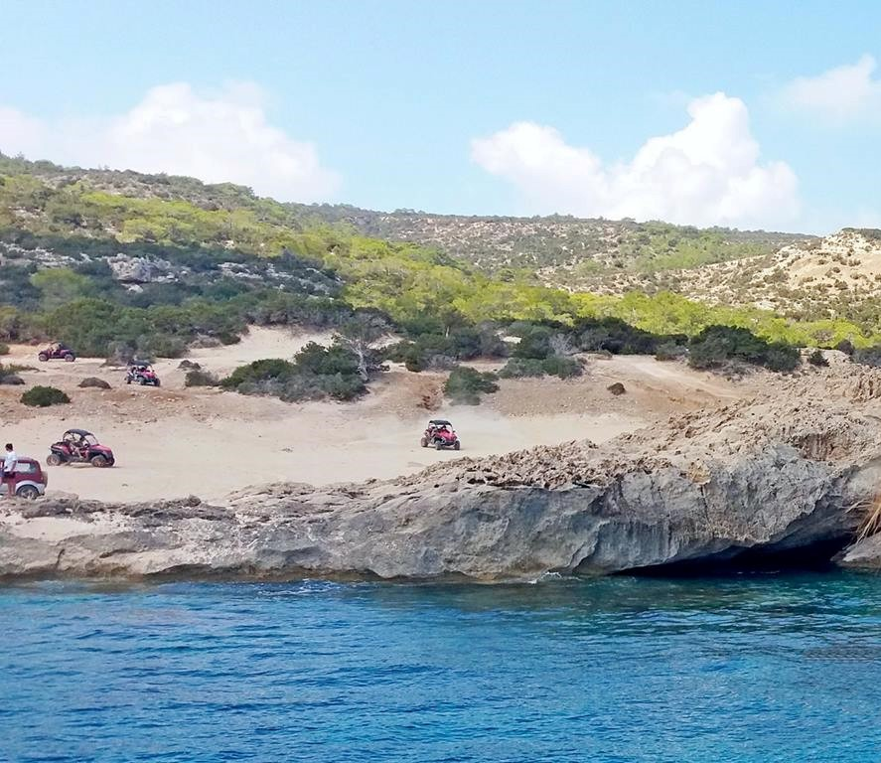
North and South Lara Beaches - Green Turtle and Loggerhead Nesting Areas
Unregulated human activities –
Illegal quad driving in Akamas

Slide 16
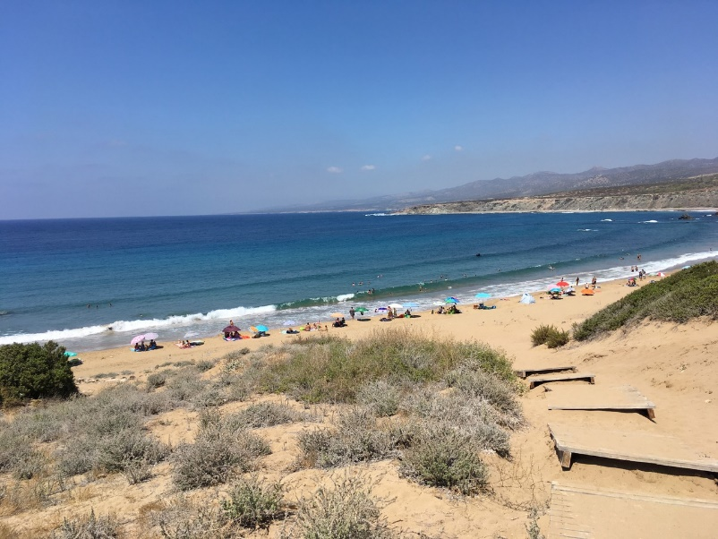
North and South Lara Beaches - Green Turtle and Loggerhead Nesting Areas
Unregulated human activities – Uncontrolled human presence in North Lara Bay (e.g. beach towels, umbrellas, chairs and sun beds)

Slide 17
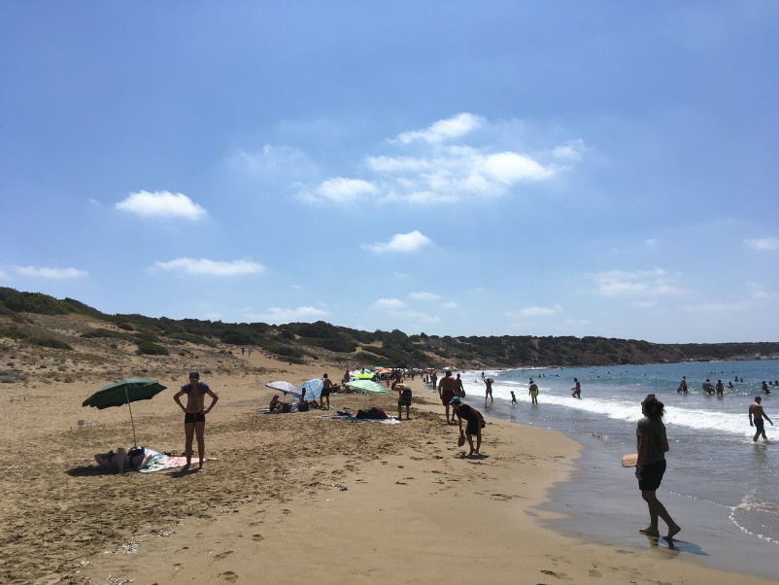
North and South Lara Beaches - Green Turtle and Loggerhead Nesting Areas
Unregulated human activities – Uncontrolled human presence in North Lara Bay (e.g. beach towels, umbrellas, chairs and sun beds)

Slide 18
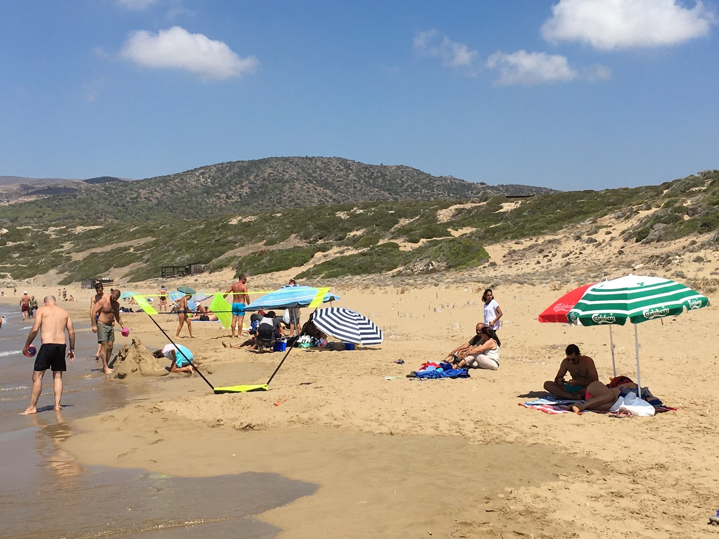
North and South Lara Beaches - Green Turtle and Loggerhead Nesting Areas
Unregulated human activities – Uncontrolled human presence in North Lara Bay (e.g. beach towels, umbrellas, chairs and sun beds)

Slide 19
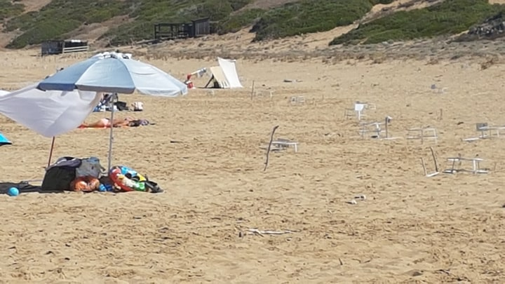
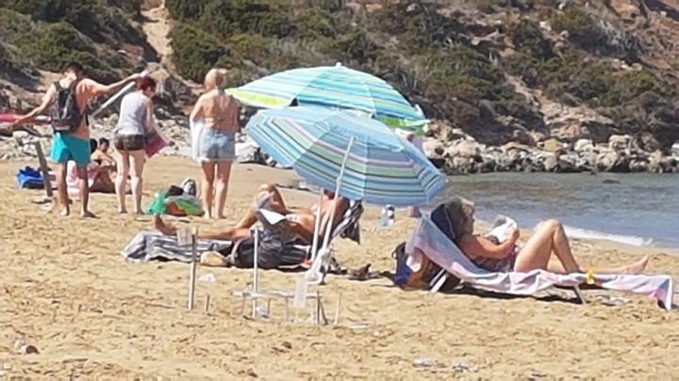
North and South Lara Beaches - Green Turtle and Loggerhead Nesting Areas
Illegal umbrellas and sunbeds in Lara-Toxeftra Beach

Slide 20
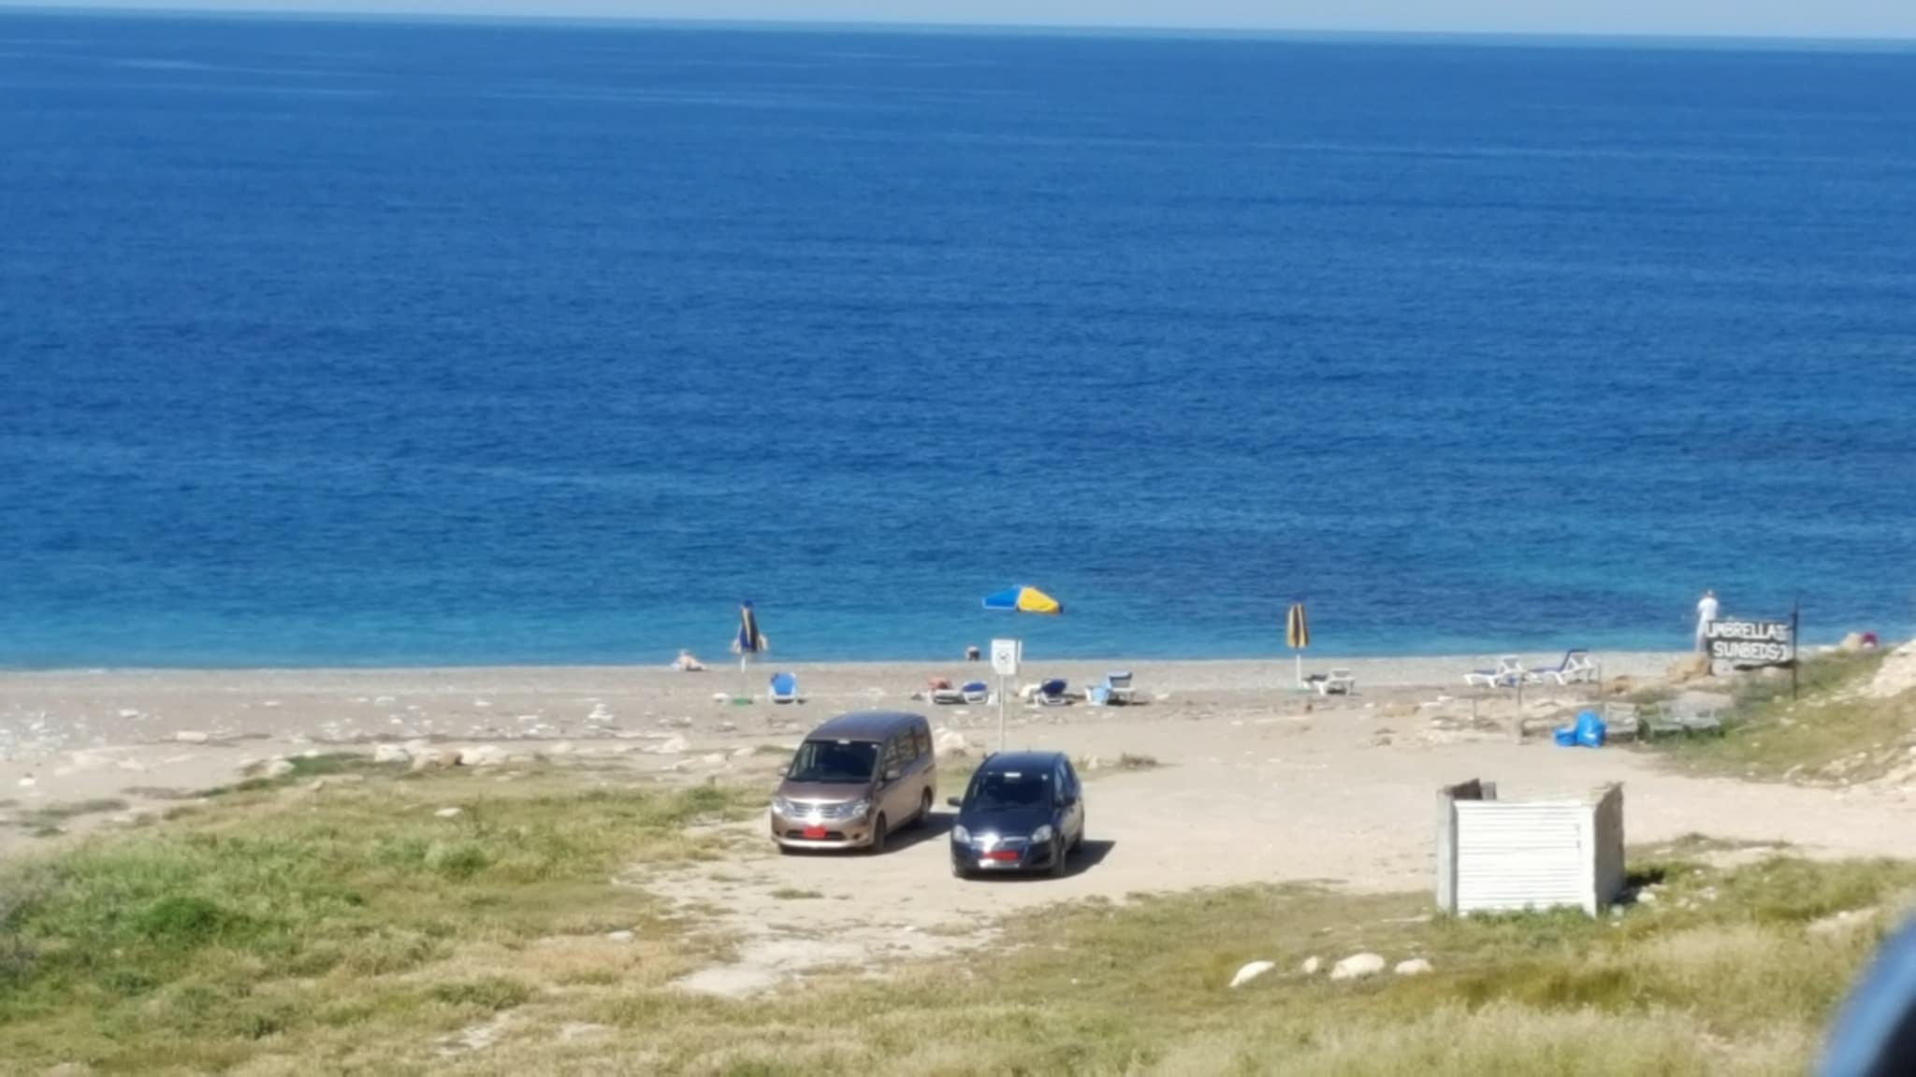
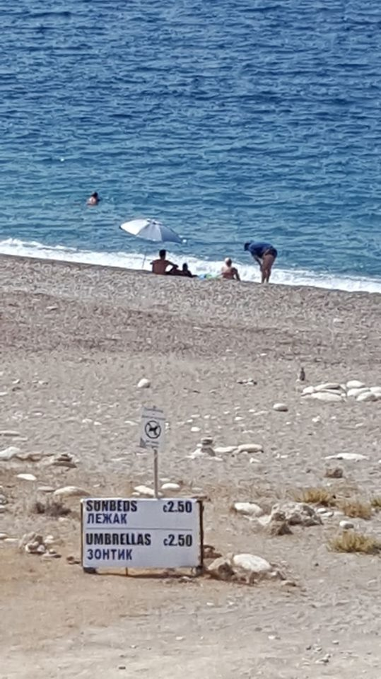
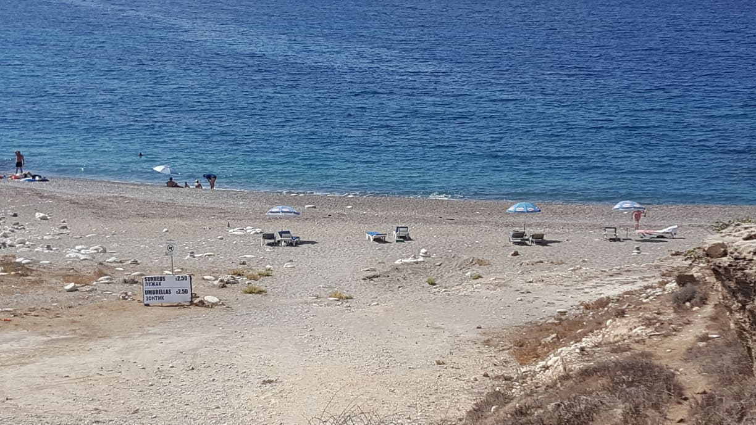
North Lara Beaches - Green Turtle and Loggerhead Nesting Areas
Illegal sunbeds, within Lara-Toxeftra Marine Protected Area

Slide 21
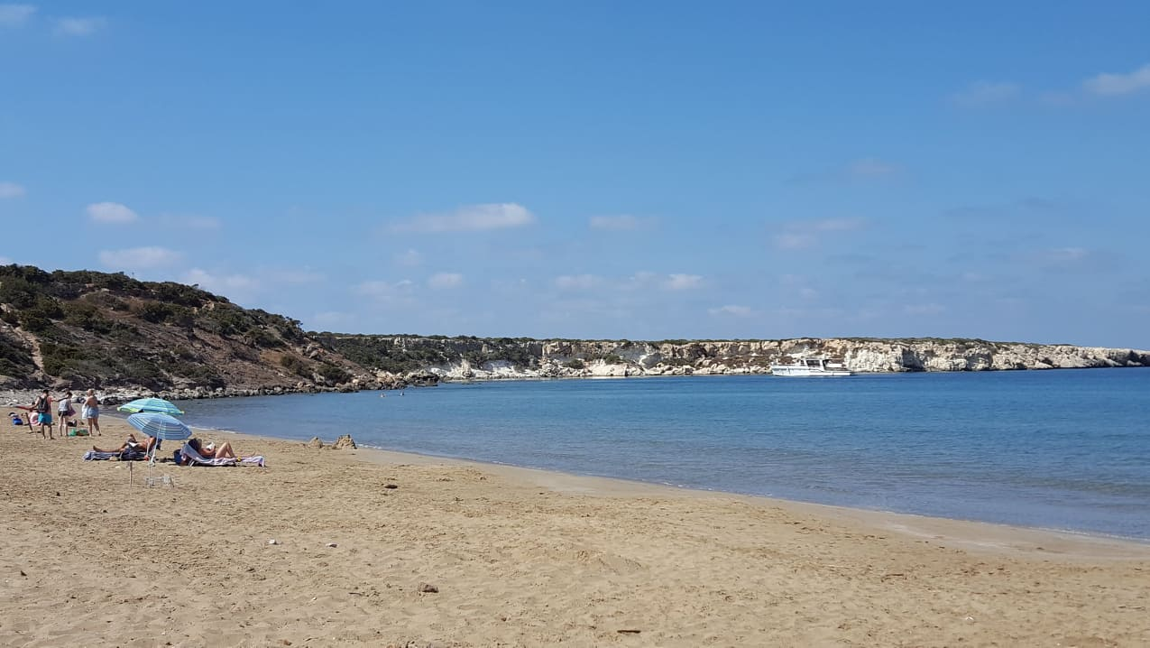
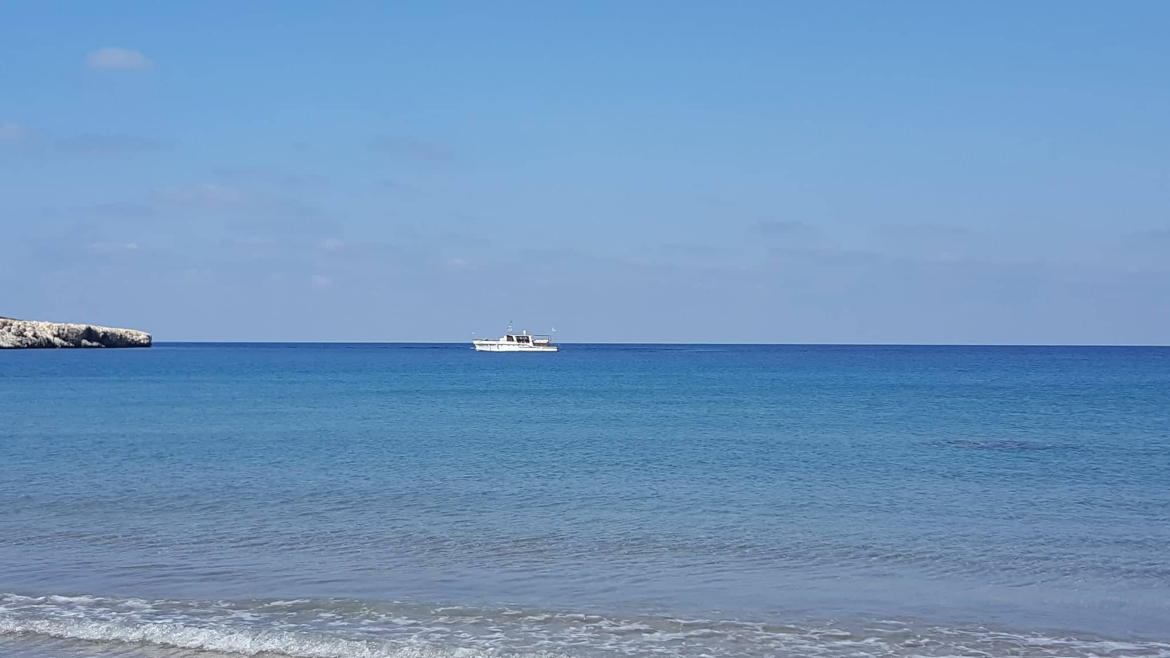
North Lara Beaches - Green Turtle and Loggerhead Nesting Areas
Illegal boat traffic and anchoring in north Lara Marine Protected Area

Slide 22
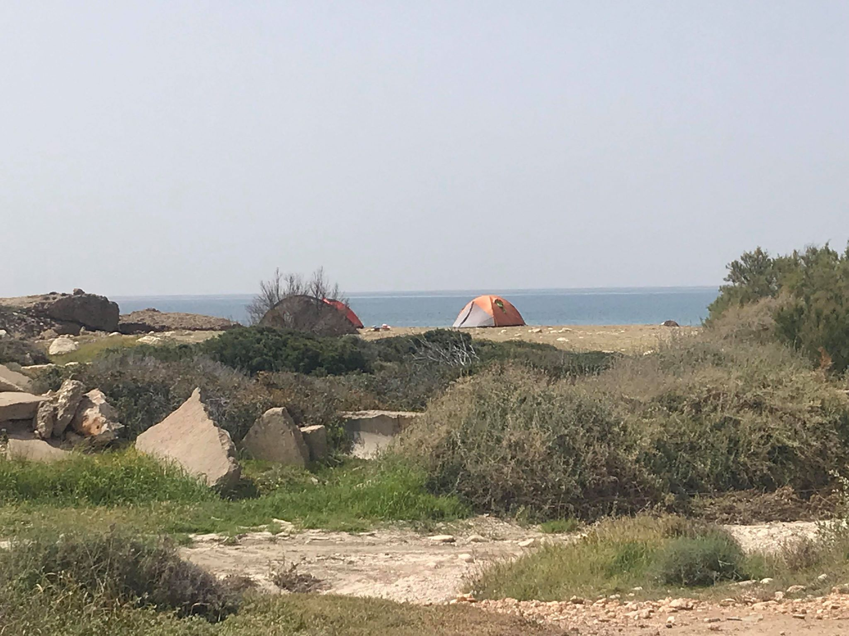
Lara-Toxeftra Beach - Green Turtle and Loggerhead Nesting Areas
Unregulated human activities – Illegal camping in Toxeftra Beach

Slide 23
North and South Lara Beaches - Green Turtle and Loggerhead Nesting Areas
Protests at Lara-Toxefta beach and placement of umbrellas
by residents of Innia joined by an MP

Slide 24
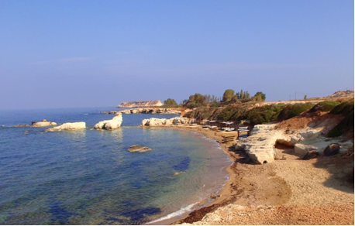
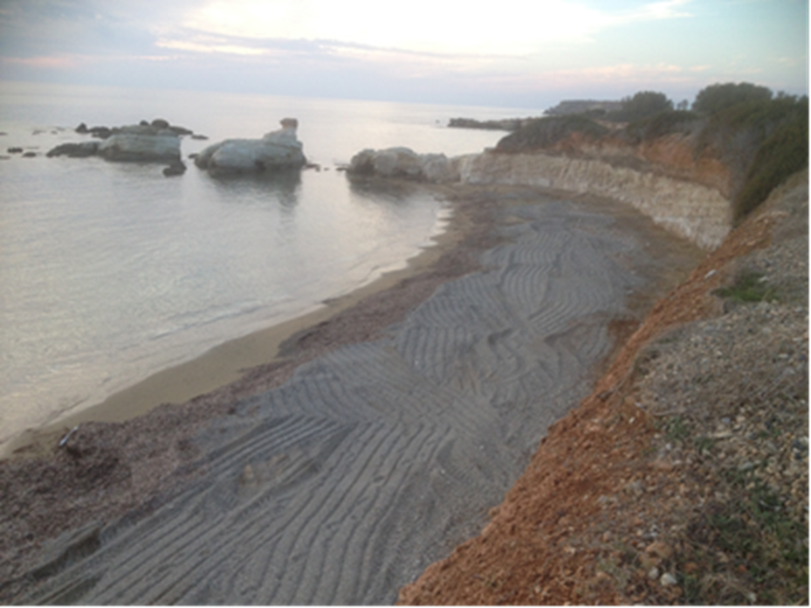
Sea Caves in Pegeia – Mediterranean Monk Seal Breeding and Resting Area
Illegal earthworks & creation of an artificial beach

Slide 25
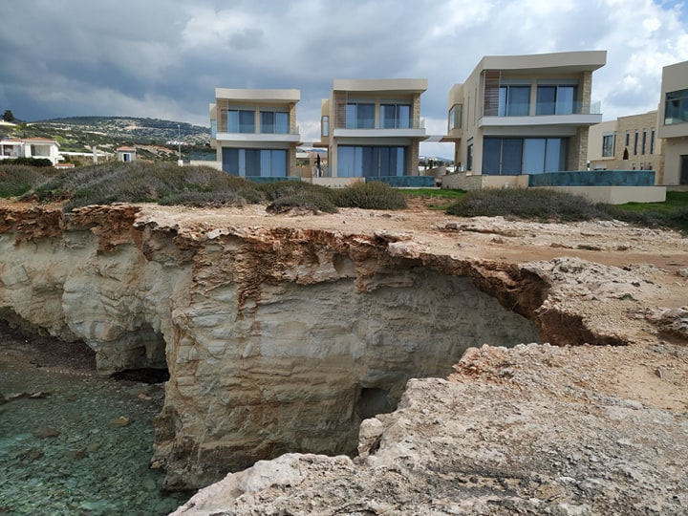
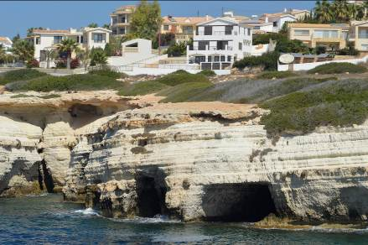
Sea Caves in Pegeia – Mediterranean Monk Seal Breeding and Resting Area
Residential development above Monk Seal caves

Slide 26
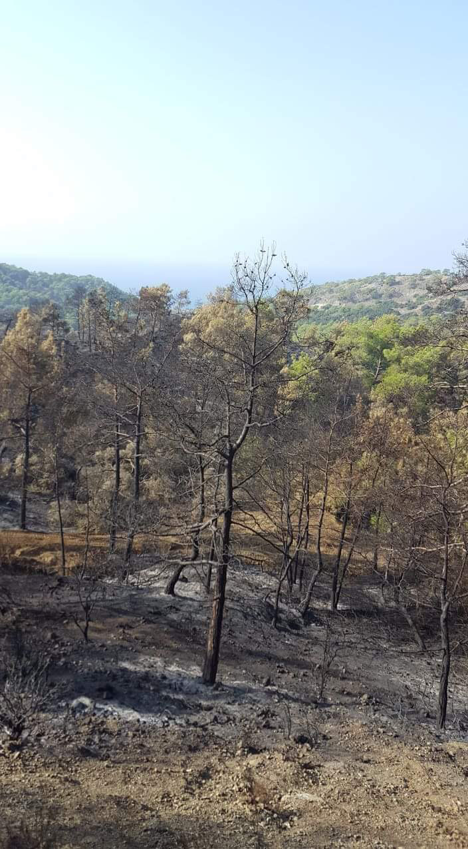
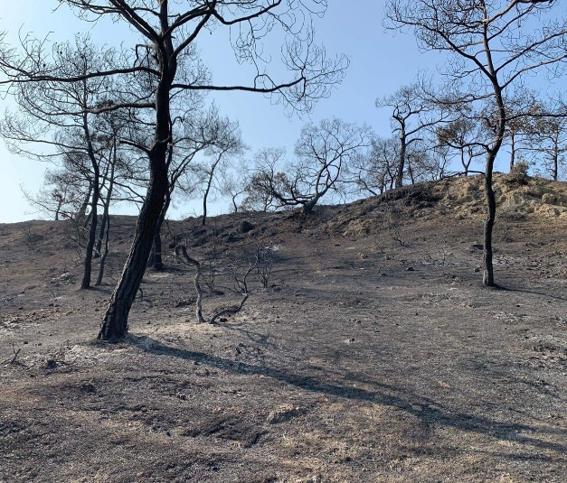
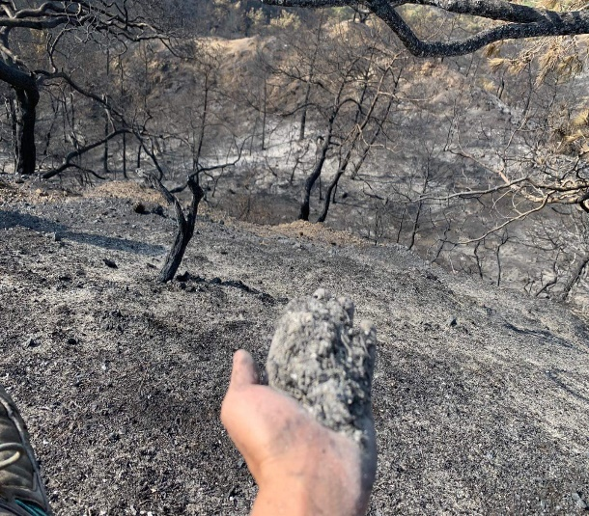
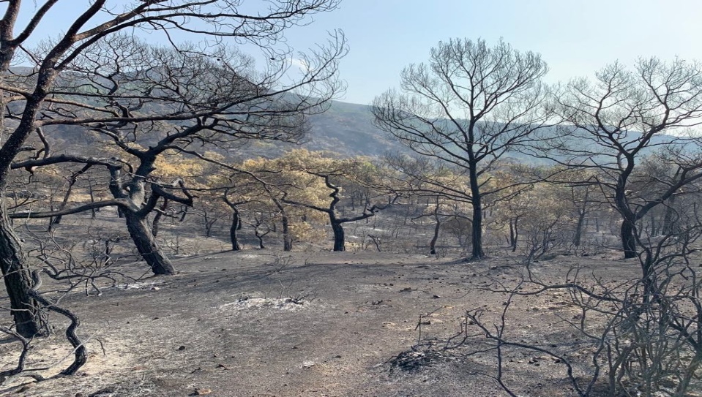
Akamas Peninsula
Numerus malicious fires as a form of political pressure for land-use change

Slide 27
Akamas Natura 2000 site
What do we want to see?
Expansion of Natura 2000 boundaries
Establishment of legally binding measures, based on the Management Plans
Allocation of funding for the implementation of Management Plans and effective patrolling
Prohibition of infrastructure (overnight stay and dining) outside of the existing designated development limits of Akamas villages in any future plans

Slide 28
Polis-Gialia Natura 2000 site
Polis-Gialia
Akamas

Slide 29

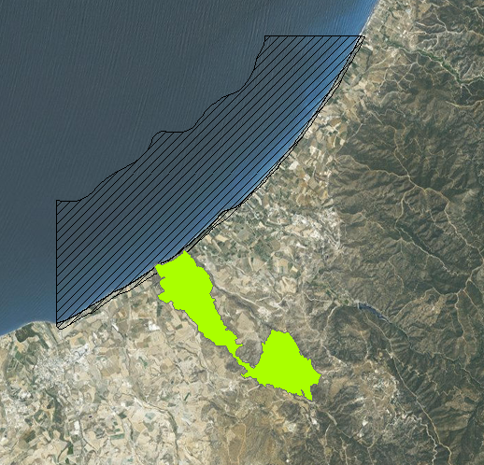
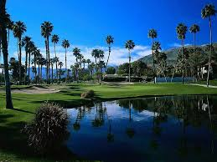

Polis-Gialia Natura 2000 site
An imminent threat to a major nesting site for Loggerhead Turtles
Limni Bay Resort: Licensed Golf Complex

Slide 30
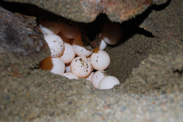
Polis-Gialia Natura 2000 site
What is its importance?
Total Mediterranean nests 6000 p.a.
Total Cyprus nests 1000 p.a.
Total Polis-Gialia nests 550 p.a.
Total nests directly impacted by the proposed golf complex 200-250 p.a.
25% of Total Cyprus Nests
4.2% of Total Mediterranean Nests

Slide 31
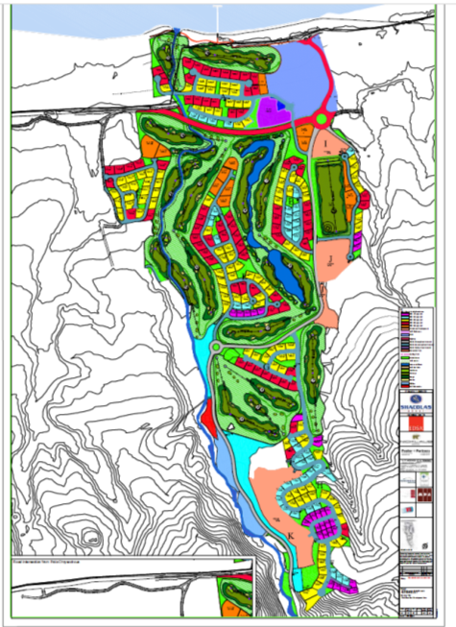
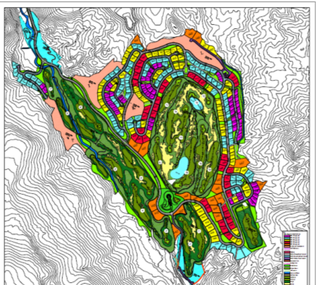

The Limni Bay Resort
2 golf courses (18 holes each)
2 club houses (with bars and restaurants)
792 villas
2-storey hotel (with 160 rooms)
Road network
Sport facilities

Slide 32
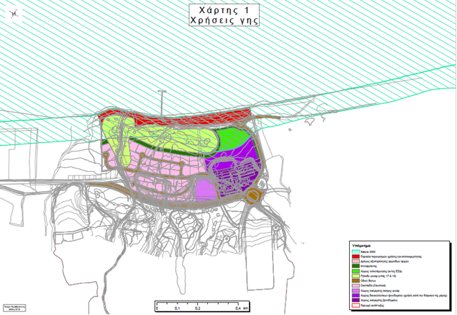
Limni Bay Resort
The development complex is situated in an area bordering 145-200m from the sea, extending for up to 4 km inland and consisting of more than 3 million sq. m.

Slide 33
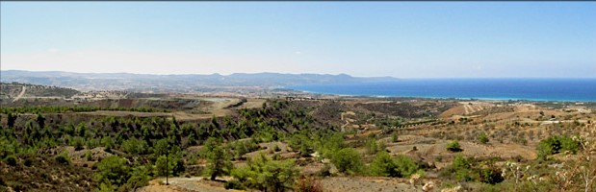
Limni Bay Resort
What are the issues?
Taking into consideration the maximum capacity of the 792 villas, which equals to 3,123 individuals (excluding the maximum capacity of the hotel complex, which equals 160 rooms / 320 individuals, as well as employees and visitors), the proposed project is expected to:
Increase the population (4,061 individuals) of the municipalities and communities, which fall under the administrative area of the Natura 2000 SCI/SAC Polis – Gialia (CY4000001), by 77%.
These figures are based on the latest Population Census of 2011 and demonstrate the significant increase of human presence and pressure caused by the project.

Slide 34
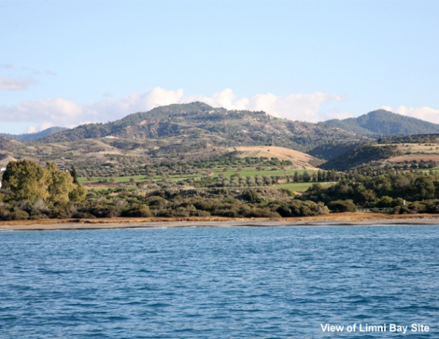
Limni Bay Resort
What are the issues?
The substantial term of a 475m No-building Zone between the proposed golf complex and the sea (suggested by the European Commission, the Standing Committee of the Bern Convention and originally by the Environment Department of the Republic of Cyprus) has not been respected in the updated master plan, which received a green light by the competent authorities
The precautionary principle has not been followed
The cumulative effects of the project have not been properly assessed
The proposed mitigation measures are not sufficient
  E.g. Out of the 28 lighting conditions imposed by the Environment Department, 17 are based solely or partly on residents’ compliance within their private properties

Slide 35
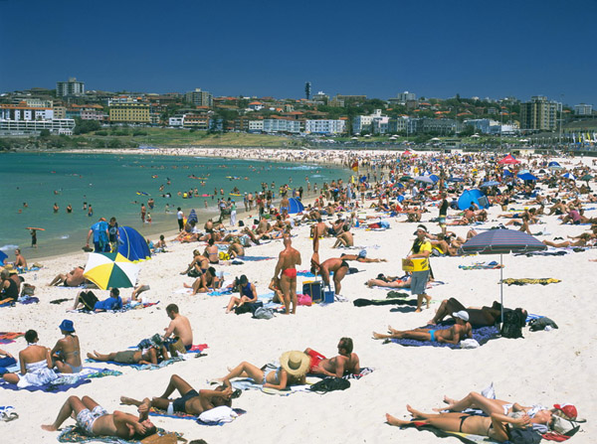

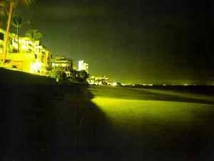
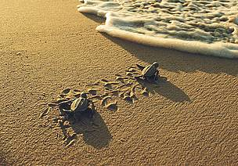
Why a 475-meter No-building Zone?
?

Slide 36
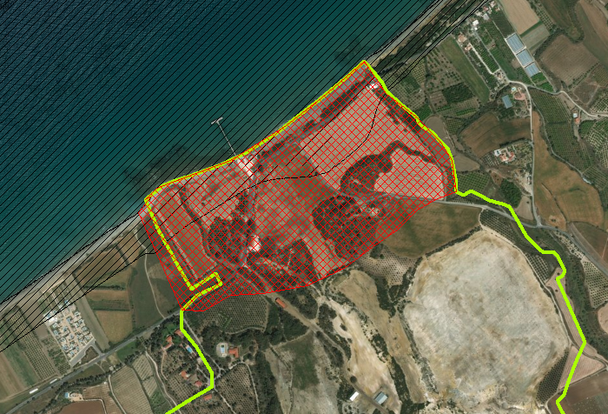
Area that needs to remain free of buildings
(41 villas, a club house and a two-storey hotel)
Boundaries of the proposed Limni Bay Resort
Boundaries of the Natura 2000 site Polis-Gialia
475m No-building Zone

Slide 37
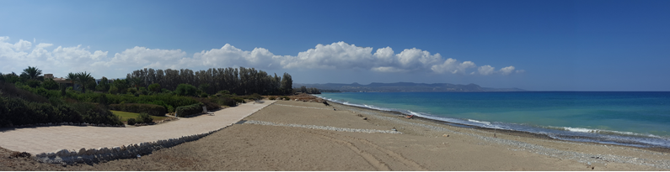
Limni Bay Resort –
What do we want to see?
At least a 475m No-building Zone between the golf complex and the sea
Reduction of residential capacity of the project
Establishment and enforcement of a Management Plan and Conservation Decree for the site
Funding to be allocated for the implementation of conservation and management measures, as well as careful monitoring and patrolling of the area

Slide 38
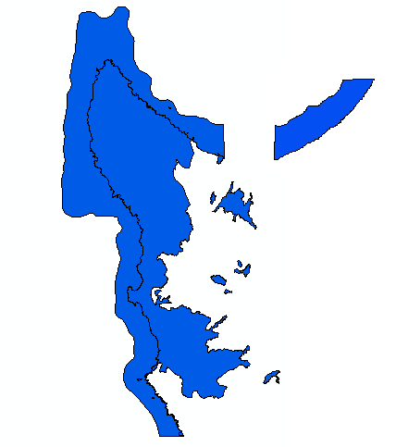
Polis-Gialia - Green Turtle and Loggerhead Nesting Areas
Obstruction of the Turtle Conservation Programme by local authorities of Argaka at Polis-Gialia

Slide 39


Polis-Gialia - Green Turtle and Loggerhead Nesting Areas
Acacia trees removed on-site at Limni and Argaka sea turtle nesting beach at Polis-Gialia

Slide 40

Thank you

