Slide 1
Group of Experts on Protected Areas and Ecological Network Emerald Network biogeographical evaluation in Georgia Marc Roekaerts
Notes:
A few words on the Council of Europe and why the Convention was negotiated there.

Slide 2
Emerald Network sufficiency evaluation cycle Georgia
2010 First database transmission on the CDR
2015 First Biogeographical Evaluation Seminar
.....
2021 Most recent database transmission
December 2021 3th Biogeographical Seminar

Slide 3
Emerald Network Evaluation Cycle in Georgia
Seminar sequence | Seminar year | subject | Biogeo regions | city
1 | 2015 | all (except Birds) | ALP-Cau, ANA, STE, BLS | Tbilisi
1 | 2016 | Birds | n/a | Tbilisi
2 | 2017 | all (except Birds) | ALP-Cau, ANA, STE, BLS | Tbilisi
2 | 2019 | Birds | n/a (AM-AZ-GE) | Budapest
3 | 2021 | all | ALP-Cau, STE, BLS | Virtual - online

Slide 4
1 The countries databases
1 The countries databases
concl-fin | Habitats | Plants | Animals | Birds | Total
CD |  |  | 2 | 3 | 5
EXCL REF | 17 | 3 | 18 |  | 38
EXCL REF/CD | 2 |  | 11 | 6 | 19
IN MAJ | 2 |  |  |  | 2
IN MIN | 23 | 2 | 5 | 31 | 61
IN MIN/CD | 7 |  | 1 |  | 8
IN MIN/MR |  |  | 2 |  | 2
IN MOD | 4 | 1 | 11 | 9 | 25
IN MOD/CD | 2 |  |  |  | 2
IN MOD/IN MIN | 59 | 1 |  | 15 | 75
IN MOD/IN MIN/CD | 5 |  |  | 3 | 8
IN MOD/IN MIN/MR | 1 |  |  |  | 1
IN MOD/MR | 1 |  | 3 |  | 4
IN MOD/SR |  |  |  | 1 | 1
MR |  |  |  | 1 | 1
SR | 32 |  | 1 | 1 | 34
SR/CD | 1 |  |  |  | 1
SR REF/CD |  |  | 1 |  | 1
SUF | 13 | 18 | 59 | 49 | 139
SUF/CD | 7 |  | 10 | 6 | 23
Total: | 176 | 25 | 124 | 125 | 450
Total without Excl: | 157 | 22 | 95 | 119 | 393
subtotal SUF: | 20 | 18 | 69 | 55 | 162
sufficiency index: | 12,7 | 81,8 | 72,6 | 46,2 | 41,2

Slide 5
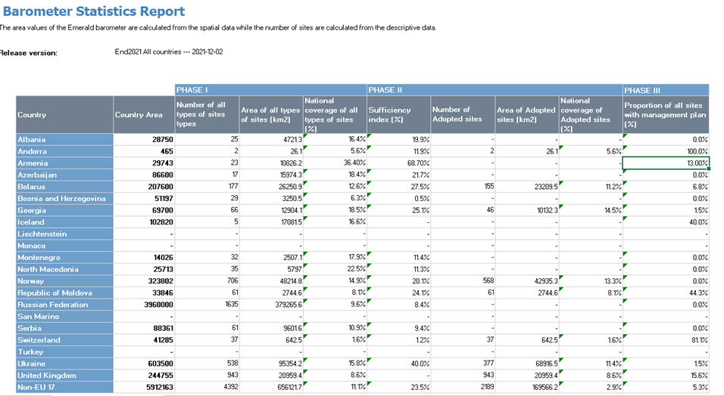
Barometer Release 2021
The name of Türkyie could not be changed in the Emerald Network Barometer at the time of the presentation

Slide 6
Concluding remarks
The example of Georgia clearly illustrates the cyclic aspects of reaching sufficiency (3 cycles performed)
Countries should understand the various steps in the Emerald Network Dataflow to interpret the results and plan the next steps
The Emerald Network Barometer should be a stimulating instrument to do so
....

Slide 7
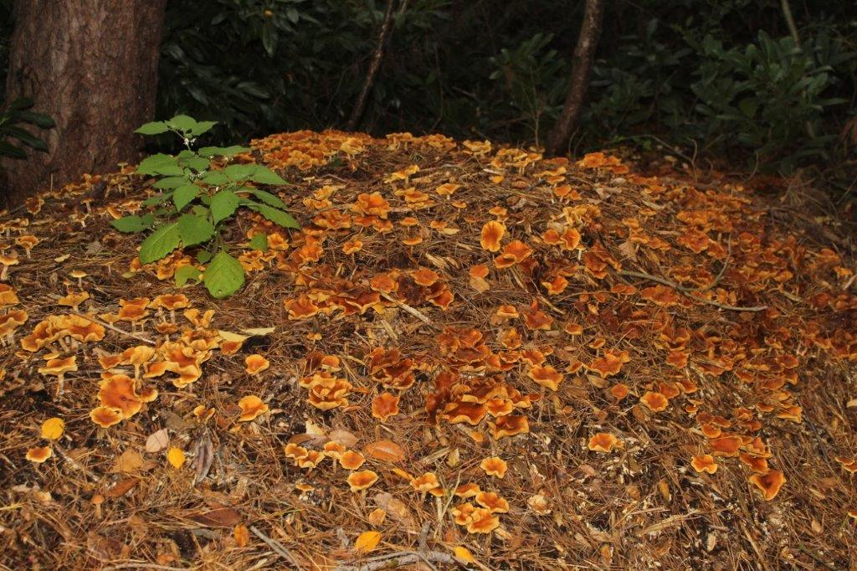
Thank you for your attention

