Slide 1
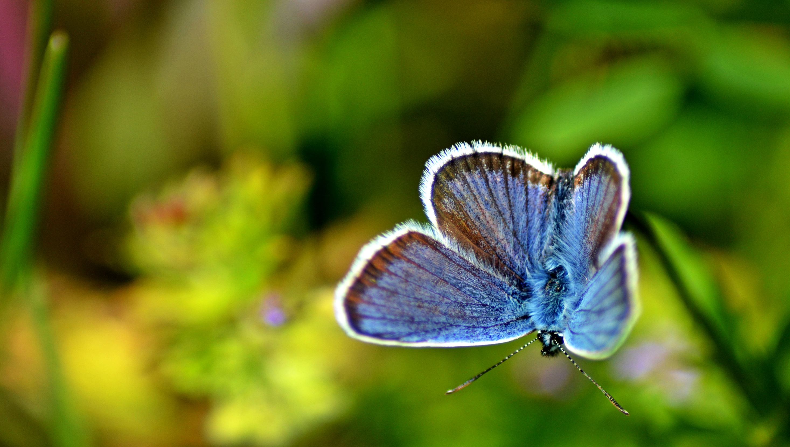
Emerald Network data mobilisation in
the Western Balkans
© Dominika Hrašková, REDISCOVER Nature/EEA
Mette Lund / Group of Experts on Protected Areas and Ecological Networks 13th meeting / 15 June 2022
Notes:
OPENING SLIDE – dark background and white logo

Slide 2
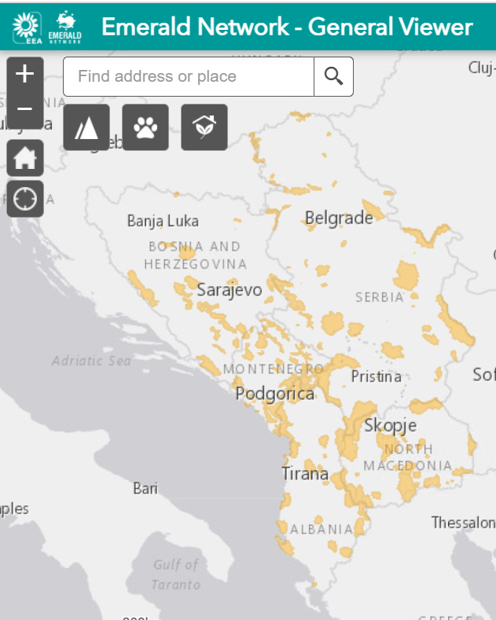
Background for the data mobilisation project
Joint call from Council of Europe and European Commission recommending and outlining a process from Emerald to Natura 2000 in the Western Balkans:
The EU accession process for WB re-opened in February 2020
Funding available through the Instrument for Pre-accession Assistance (IPA) II
Support Emerald networks to go through another round of biogeographical and birds’ evaluation seminars
Record and encourage Natura 2000 initiatives to go through the evaluation process under the Bern Convention/Emerald
Emerald candidate sites in Western Balkans anno 2011

Slide 3
Mandate of the project
Mobilization of Emerald databases through bi-lateral workshops
Improve consistency in interpretation of habitat types in the Resolution No. 4 (1996) of the Bern Convention and the Habitats Directive Annex I: development of crosswalk both ways
Ensure taxonomic consistency in reporting between the Resolution No. 6 (1998) of the Bern Convention and the annexes of the nature directives
Evaluation of amendment proposals of the Annexes and biogeographical regions
Helpdesk support in using the SDF manager tool
Contract issued in July 2021 to consortium (Environment Agency Austria and Slovak Academy of Science - Institute for Landscape Ecology)
Time frame: December 2021- June 2022 (time reduced due to Corona)

Slide 4
Outcome of the project
Bi-lateral workshops with four countries
Serbia provided new data to the project and could submit a database to the Bern Convention for evaluation in the near future (using Annex I habitats)
Clarification on biogeographical regions needed
Two countries are in survey phase
One country is starting up
Two countries could not respond during the project
Funding of Natura 2000 projects in five of the six countries
Two Reference List seminars
Draft final Reference Lists for all countries (three based on new survey data, three based on Reference Lists from 2011) – sent by email 14/06
Other material
improved crosswalks Resolution 4 <-> Annex I and
Annex I <-> Resolution 4
Evaluation of amendment proposal from Serbia
Country databases (2011) in the new Emerald SDF format available
© Laura Rosch, REDISCOVER Nature/EEA

Slide 5
The project is closing but you may still submit an Emerald database and we will support you through the regular channels
Thank you
© Dominika Hrašková, REDISCOVER Nature/EEA
In case of questions -> mette.lund@eea.europa.eu .
Notes:
Closing slide: you may want to use the same image as in the opening slide and thank your listeners.

