Slide 1
AD-HOC WORKING GROUP ON REPORTING Reference list of species and habitats and option for the creation of the Checklists under Resolution No. 8 (2012) Marc Roekaerts / Otars Opermanis
Notes:
A few words on the Council of Europe and why the Convention was negotiated there.

Slide 2
Emerald Network Reference Lists
list which species (Resolution No. 6 (1998)) and habitats (Resolution No. 4 (1996)) occur in which country and biogeographical region, and are subject for site-based conservation measures
Reporting under Resolution No. 8 (2012) Checklists
include also all features of potential conservation concern in a territory (such as vagrants, irregular visitors, etc.)

Slide 3
1 The countries databases
1 The countries databases
Emerald Network Reference Lists
Until today, they are part of and result from the sufficiency evaluations in the biogeographical seminars
Published after the first seminar
Kept up to date following each seminar
Only available for countries with an Emerald Network
Never separately discussed or published in a consolidated way

Slide 4
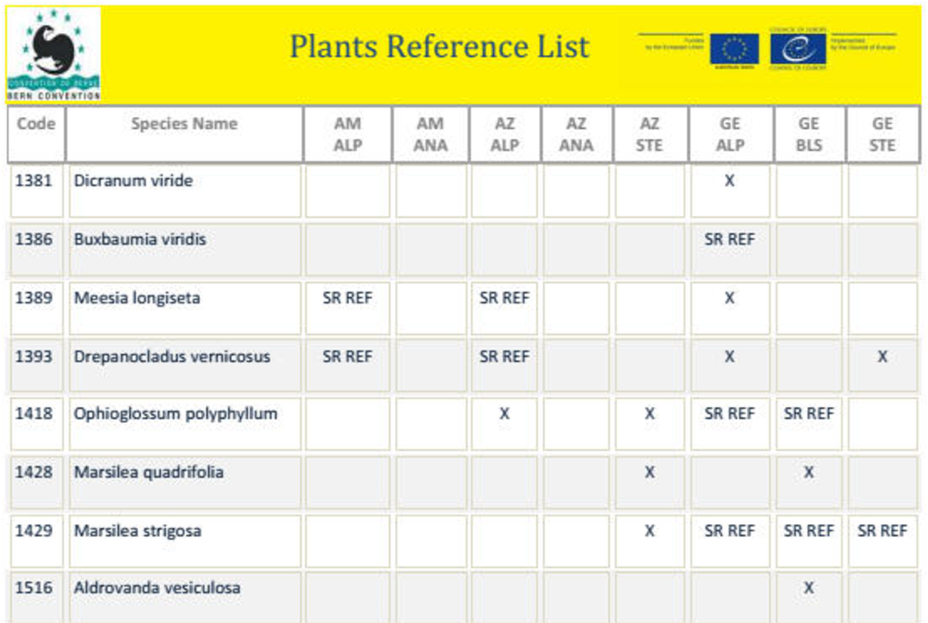
Example Reference List for plants in the Caucasus

Slide 5
Emerald Network Reference Lists
Resolution No. 6 (1998) species names and taxonomy need for a Standard Code List
Latest version available at:
https://eunis.eea.europa.eu/references/2443/species
Final up-to-date list will soon be available (etc/bd)
Countries will be stimulated to follow this revised species list when transmitting new Emerald Network Databases

Slide 6
Standard Code List for the Reference Lists
Reference List Code | Interpretation
X | The feature is present, and there should be Emerald Network sites identified
SR REF | During the biogeographical evaluation, the presence was identified as doubtful and additional research is necessary
SR | The biogeographical evaluation could not define a final conclusion for various reasons such as taxonomy, habitat definition or sufficient geographical coverage in certain regions. The comment field in the database explains the reason.
Ex | The species is considered extinct and should actually be deleted from the Reference List unless reintroduction or natural regeneration is possible
R | The species is marked with the “#”-sign in Resolution No. 6 (2012) and the country requested the exclusion of the species for the development of the Emerald Network
BCR | Bern Convention Reservation: the country made a reservation for the species at the moment of accession to the Convention. The species is excluded for the development of the Emerald Network

Slide 7
Initiative for the creation and/or further development of the Reference Lists e.g. West-Balkan Countries (IPA II project)
Reference Lists seminar for Serbia
Reference Lists seminar for Albania, Bosnia-Herzegovina, Montenegro, North Macedonia and Kosovo*
Draft Final Reference Lists available for Animals, Plants, Birds and Habitats (for Montenegro and Serbia using HD Annex I codes, but reference should be made to the crosswalks between Annex I and Resolution No. 4 (1996))
*All references to Kosovo, whether to the territory, institutions or population, in this text shall be understood in full compliance with United Nations Security Council Resolution 1244 and without prejudice to the status of Kosovo

Slide 8
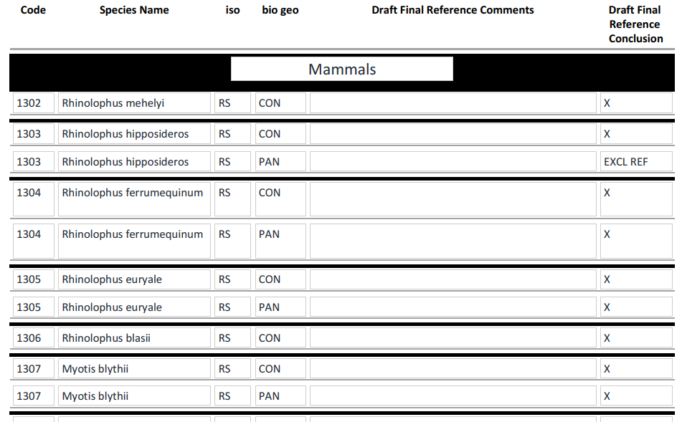

Slide 9
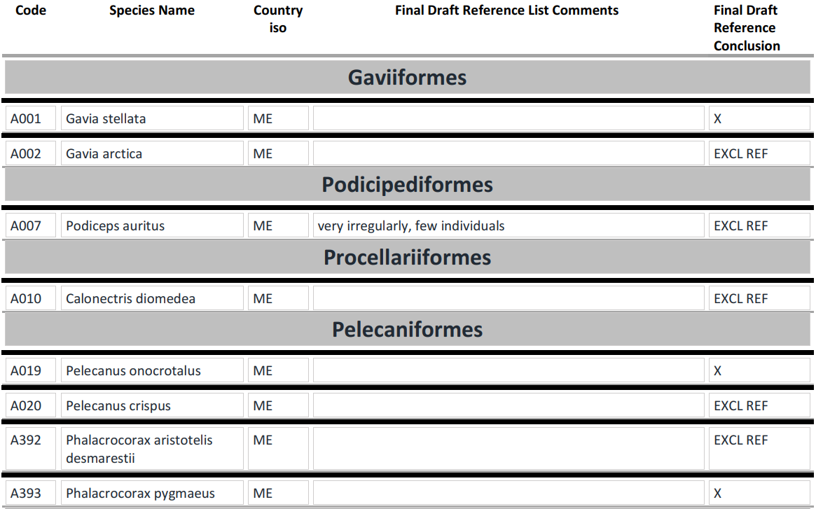

Slide 10
Concluding remarks: Draft Reference Lists for the Emerald Network
The Emerald Network is in need to consolidate the existing conclusions and to create a compilation of agreed Reference Lists to clearly identify the features from Resolution No. 4 (1996) and Resolution No. 6 (1998) for which sites are to be selected in the network.
Draft Reference Lists based on the existing Emerald Network sufficiency conclusions now exist for 15 countries. After the biogeographical evaluations in Iceland and Liechtenstein the number will grow to 17.
For Contracting Parties to the Bern Convention not having an Emerald Network, alternative ways for creating Reference Lists are to be identified. Those countries should identify the features from Resolution No. 4 (1996) and Resolution No. 6 (1998) present in their country and transmit a draft Reference List to the Secretariat in a compatible format with the Consolidated Reference List for the Emerald Network
The Emerald Network data for UK originate from the Natura 2000 database before Brexit. The sufficiency evaluation process took place under the Natura 2000 Network and the evaluation reports have not been (yet) translated to the Emerald “standards”. The Reference List for UK will be based on the Natura 2000 evaluation process.

Slide 11
Concluding remarks: Checklist for species and habitats under Resolution No. 8 (2012)
The consolidated Reference Lists for the Emerald Network are a good basis for the creation of the Checklists for Reporting under Resolution No. 8 (2012)
Depending on the decisions of the Ad Hoc Working Group on Reporting, various options should be considered to continue the work related to Reference Lists and the possible extension to the Checklists for reporting. The following steps could be considered:

Slide 12
For 17 countries the consolidated Reference Lists are created from the Emerald sufficiency conclusions.
These Reference Lists could be considered as “the draft Checklists for the reporting under Resolution No. 8 (2012)”. The 17 countries should verify these lists by recognising the difference between Reference Lists and Reporting Checklists (see above) and suggest possible amendments.
Countries without Emerald Network databases should be asked to create such checklists for the reporting from scratch in the required format (database – see above).
For the UK, the Checklist for the reporting under Resolution No. 8 (2012) is built on checklists for Art. 17 and Art 12
The result – the Checklist for the reporting under Resolution No. 8 (2012) - can be used as a basis for every possible decision regarding the reduction of the reporting volume in the next reporting round

Slide 13
A timeframe should be agreed when decisions are made on the procedure to follow

Slide 14
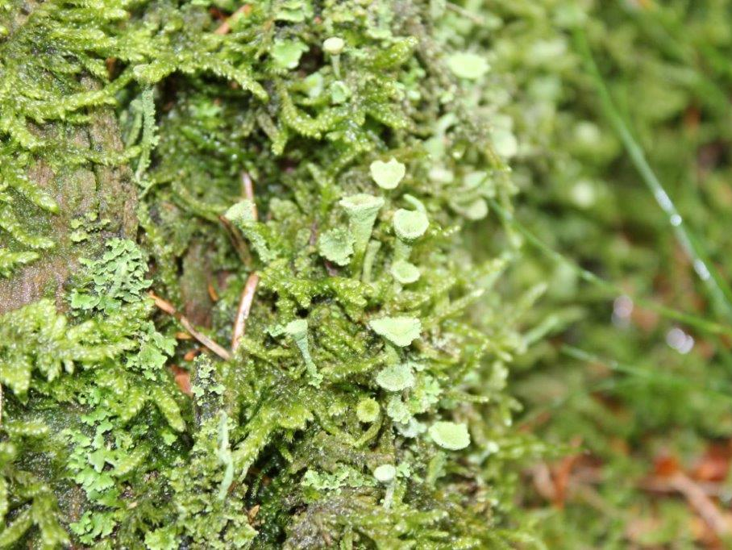
Thank you for your attention

