Slide 1

Ad hoc Working Group on Reporting
Commonly observed data issues from the previous (2018-2019) test reporting under Res. 8 of the Bern Convention
Notes:
A few words on the Council of Europe and why the Convention was negotiated there.

Slide 2
Data issues in test Res.8 reporting
“Before you start”…
Consolidate the existing knowledge
Even it is a kind of “archaeology”, it is worth doing it…
… but a lot will depend from what data collection (inventories, monitoring schemes) have been implemented in past 6 years
Involve all key data holders; negotiate access to information; each country is different: difficult to suggest a universal solution
Be positive but critical to the existing information; use the most recent and trustworthy one if there is a choice
Summarise the best you have and make best use of it even if information is scarce: reporting anything is not productive for Bern Convention targets.

Slide 3
Data issues in test Res.8 reporting
General approach to filling database
Be responsible for each record, each entry character matters!
Enter data according to the requirements of reporting format and guidelines
Two options to fill in the database: interface and backdoor
Double care if using backdoor: mistyping more possible as drop-down lists not working; take care to record data in appropriate sections!
Internal double-check highly advisable

Slide 4
Data issues in test Res.8 reporting
Specific issues that makes data assessment problematic
Learned from previous Res. 8 reporting exercise 2018-2019…
… but from also HD Article 17 and BD Article 12 reporting in EU (more experience)
Issues that are not covered by blockers…
… and problematic from analysts’ point of view
Database content is a responsibility of countries
Obvious errors can be exceptionally corrected by analysts, but often they are not obvious! But in principle, no one else than countries can do changes in the database!
Only most commonly observed problems that can have an effect on conservation status assessment are mentioned in the presentation! Everything cannot be anticipated!
Speaking about Bern Convention Contracting Parties in general without lifting up some

Slide 5
Data issues in test Res.8 reporting
Specific issues
Literature/reference not filled in. Important to know on what the general knowledge is based. If expert knowledge/unpublished information, please record (some countries have done so).
In case of scarce information better to record feature (have a record line in the database) than miss it at all (previous reporting included only 71% of total number of features that should have been reported according to check-list).
Have no value reported (but use “Unknown”) and have “absent data” under “method”. That helps prioritizing research needs for the next reporting round
Avoid leaving “blanks” (empty record) in the database, because it is not straightforward to interpret it! Not present? No data? Record forgotten to fill in?
Do not use “0” either to report “unknown data”.

Slide 6
Data issues in test Res.8 reporting
Specific issues
Use only “.” for decimal separator. Please do not use commas. Do not use comma for 000 separator either, i.e. 25643.98, not 25,643.98.
Population units: use the recommended population units. Same units for population size and FRP. Also recall what population units you have been using in Emerald SDFs – try to use the same.
Keep the range between min-max of population size and habitat coverage to a minimum (to be able to compare it with FRP which is only one value).
Trends largely unknown (especially for species) in test reporting 2019, and less so quantified (magnitude): this is a message that future monitoring should be foreseen!
Trends are important for conservation status assessment. If no direct trend measurement is available, it could be be judged from the trends in typical habitat? but in poor data situation there is a tendency to use “stable” more often than appropriate.

Slide 7
Data issues in test Res.8 reporting
Favourable Reference Values
Favourable Reference Values – values indicating the feature’s ability to persist over a long time period – an exercise for itself!
In the EU: one of heaviest part in Article 17 reporting exercise! Discussions still continue…
Way of FRV expression: figures vs operators (or distance to target classes)
  FRR species: 30% numeric; 28% operator
  habitat: 13% numeric; 50% operator
  FRP species: 26% numeric; 31% operator
  FRA habitat: 23% numeric; 27% operator
Figures (numbers) whenever possible. Advantage is to use mathematical operations
Two main methods: reference-based and model-based. But FRVs should NOT necessarily match with the current species/habitat parameters, especially if the feature has unfavorable conservation status (in test reporting 72% of FRAs were higher than current values, or at least as maximum from the range)!
If nothing possible of the above, start with possible expert opinion, but foresee a review of FRVs if better scientific knowledge becomes available in the future

Slide 8
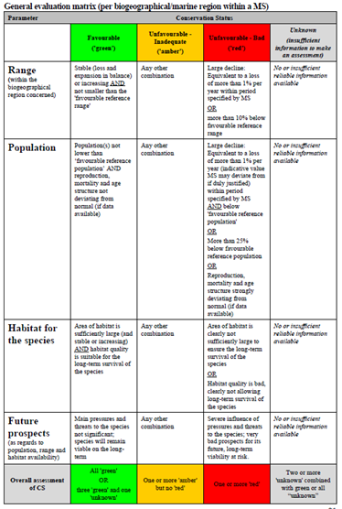
Data issues in test Res.8 reporting
Application of Conservation Status Assessment Matrix
Obey rules (!)
Examples of wrong CS assessment:
HABITAT
SPECIES
Conclusions without FRVs?
  In 13 of 38 cases when FRA not available, there is area conclusion, 5 cases final FV status
  In 51 of 103 cases when FRP not available, there is population conclusion, 16 cases final FV status
I.e. the rules are not perfect… It is possible to have conservation status assessment even if range or population is unknown! Try to avoid using such an option.
range | area | structure | future | conclusion
FV | FV | U1 | FV | FV
range | population | habitat | future | conclusion
XX | XX | FV | XX | FV
XX | XX | FV | XX | FV
U1 | FV | FV | FV | FV
U1 | FV | FV | FV | FV

Slide 9
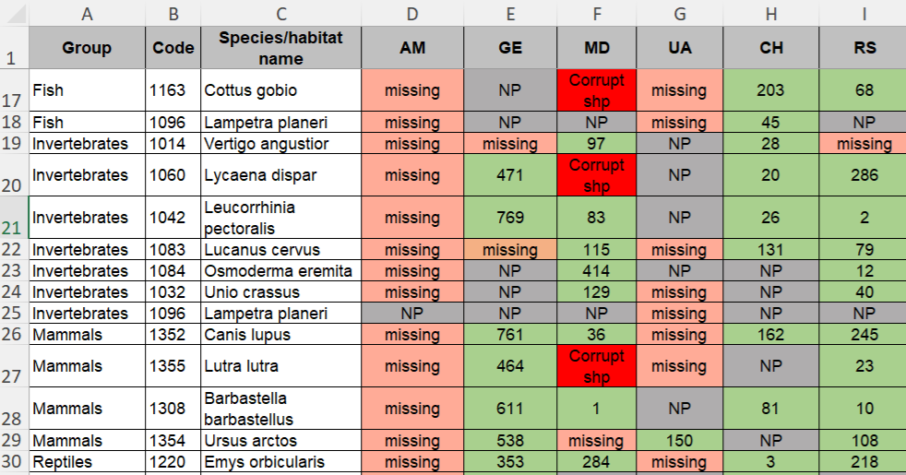
Data issues in test Res.8 reporting
Specific issues related to spatial dataset

Slide 10
Data issues in test Res.8 reporting
Other factors affecting data analysis
The more countries participate, the more thorough representation of all features, - better analysis
Previous test reporting produced only 207 species and 77 habitat records/country/bio-geographical region – very limited chances to make meaningful assessments at any higher level than features themselves (e.g. country, biogeographical region, pan-European)! 46 features reported.
Advertise results to scientific community, because Convention cannot perform all possible analyses. If possible, involve the scientific community in data collection, recording and verification.
Res. 8 data useful for Emerald database and vice versa. Using both datasets together offers additional data analyses possibilities

Slide 11
Data issues in test Res.8 reporting
Good luck in the data jungle…
but
We are here to help!

