Slide 1

Bern Convention Standing Committee
OPINIONS ABOUT THE REPORTING UNDER THE RESOLUTION NO. 8 (2012): ASSESSMENT OF THE PAST REPORTING EXERCISE AND POINTERS FOR THE FUTURE
Otars Opermanis & Marc Roekaerts

Slide 2
Enquiry
What is behind reporting databases?
A questionnaire in combination with an interview
Targeted to countries which submitted and also to those which did not submit the Resolution 8 reports in 2019
Focusing both on experiences from the past reporting exercise in 2018-2019 and on expectations from the upcoming reporting round

Slide 3
Enquiry: structure
Part I topics: examples | Part II topics: examples
Reasons for action or inaction Role of preparatory seminars Difficulties Benefits from reporting exercise | Alignment to the EU reporting How to reduce reporting burden? Existing capacity Assistance from the Secretariat

Slide 4
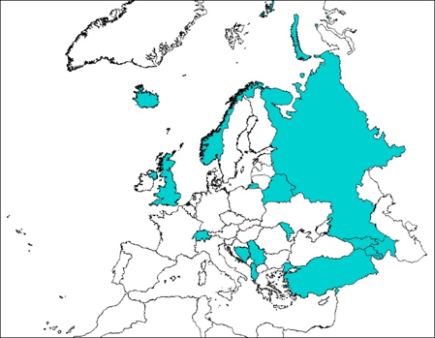
Summary of responding countries
Questionnaires filled for 17 countries
Interviews held with 15 countries, two countries submitted filled questionnaire by e-mail
Eight countries represented those which submitted reports in 2019, and another 8 did not submit reports in 2019 (UK not counted here)
Simple analysis based on response frequencies
Minimal interpretation
Priority to identify geeral trends rather than analyse individual countries

Slide 5
Key findings Part I A
Before 2019 exercise, no similar reporting schemes were in place, either in participating and non-participating countries.
The Bern Convention aim to assess the state of biodiversity internationally was the main reason for participation
Understanding the reporting process and technical advice were most important benefits from the preparatory training workshops.
On average 17 experts were involved per country (5-25) but all not at the same level. Most countries considered that 20 months were sufficient for the task.
Most important sources of information were existing databases and literature data
Most challenging information to gather were trends and area for habitats.
Most difficult parts of the work were data collection, data transfer from stakeholders to the required format and preparation of the spatial dataset
Most important benefits from the reporting exercise were that it helped to assess existing data and identify gaps and to understand the necessary capacity requirements.

Slide 6
Key findings Part I B
The main reasons for not-participating were lack of scientific expertise and budget
Turnover in the staff and lack of coordinating person affected awareness about the reporting and participation in preparatory workshops
A half of countries did not discuss internally their participation in the reporting 2019, the other half started the exercise but stopped in the process
Five countries have studied the 2020 results assessment. Three countries seemed to be convinced to take part in the next reporting round, but other 2 saw more problems than benefits and their participation is doubtful
Various factors could stimulate country participation in future (for example: amount of information requested, visibility of results, other countries, budget, external assistance), but apparently they are country-specific

Slide 7
Key findings Part II
In general, fourteen countries supported the harmonisation of the reporting with the EU in principle, but eleven with some reservations
A vast majority (16) of countries supported the use of the same reporting period as in the EU, but 11 countries also suggested that the data delivery could be later
Regarding the possible approaches to reduce the amount of information to be reported on, countries demonstrated a large disparity of views and proposed various solutions
For the format, several countries suggested to carefully assess the usefulness of each data field
A majority of countries have assessed the capacity needs for future reporting and have concluded that the current capacity is not sufficient; yet it could also depend on the scope of the information required
Countries have indicated various needs for the Secretariat’s assistance. Among other, there is a need to establish a technical working group dealing with reporting issues
In the future the results of the reporting should be presented at all levels, from the national to pan-European, and sufficient visibility should be ensured as well

Slide 8
Other important issues
Urgent need to update Resolution 8 check-lists
Understanding the link between the «reporting amount» and possibilities to use data for different analyses
Correct understanding the objectives of Resolution 8 reporting. Recognising difference between Resolution 8 reporting and building the Emerald network
How to avoid «competition» between the Resolution 8 and Emerald for resources? How to prioritise?
Benefitting from the EU’s experience on reporting

Slide 9
Thank you for attention!

